Slide 1

Multi-Criteria Sustainability Optimisation
of Floor Slabs
Beyond Structural Performance in Early-Stage Design
Jonathan Bieg
Master Thesis - Final Presentation
29 June 2026

Slide 2
Table of content
Introduction
Objective and contribution
Methodology
Results and discussion
Conclusion
Outlook
Institute of Structural Engineering
Multi-criteria sustainability optimisation of floor slabs
2

Slide 3
Introduction - Challenge for the construction industry
Why floor systems matter
Goal
- Buildings are a major source of material demand and emissions.
- Floor slabs repeat over many storeys and strongly influence mass, height and construction process.
- Early design decisions lock in much of the later sustainability performance.
Make floor-system selection comparable beyond structural performance alone.
Sustainability is assessed through GWP, cost, construction time, height and mass while all required structural and functional criteria are fulfilled.
Institute of Structural Engineering
Introduction
3

Slide 4
Objective and research questions
Objective
Assess the sustainability impact of choosing a floor system for residential and office buildings in early-stage design.
1
2
3
Which assessment criteria are relevant for early-stage floor-system comparison?
Which systems perform favourably when structural and functional requirements are respected?
How do Global Warming Potential and construction cost align or conflict?
Institute of Structural Engineering
Objective
4

Slide 5
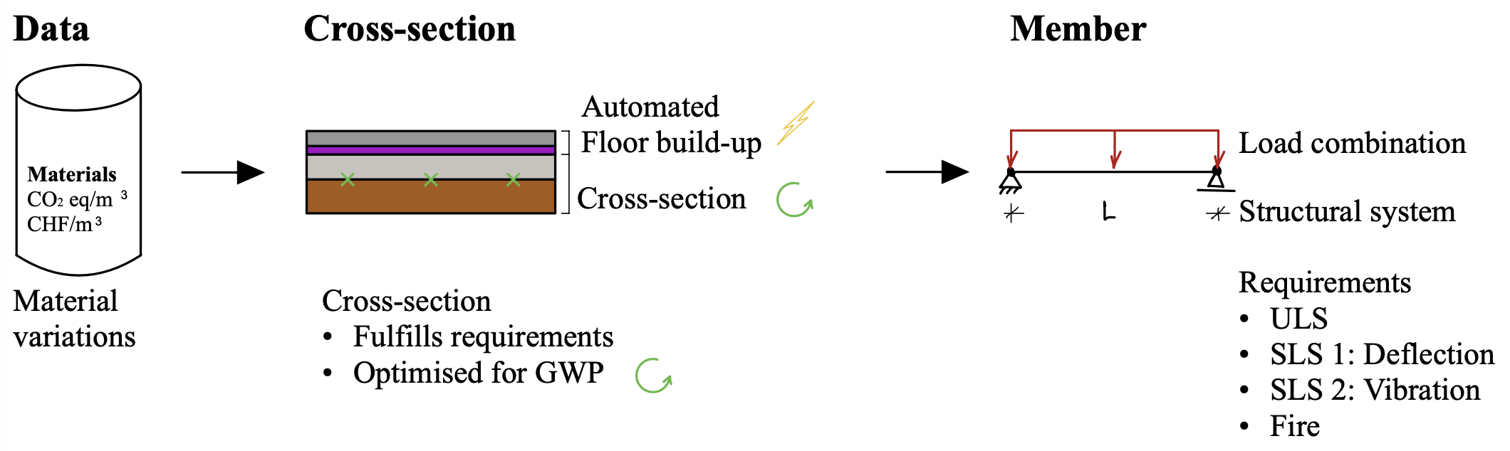
Methodology - Slab configurator workflow
Contribution
- Existing Python framework extended for consistent comparison.
- New floor systems: timber-concrete composite and post-tensioned concrete.
- Automated acoustic floor build-up handling added.
- Pairwise comparison ranks systems while accounting for data variation.
Institute of Structural Engineering
Methodology
5

Slide 6
Methodology - Compared systems and requirements
Residential
Office
Requirements
Concrete
Timber
Timber-concrete composite
Concrete systems
Post-tensioned layouts
Ribbed concrete
ULS
Deflection
Vibration
Fire
Acoustics
Comparison is performed for complete floor systems, not only the bare structural cross-section.
Institute of Structural Engineering
Methodology
6

Slide 7
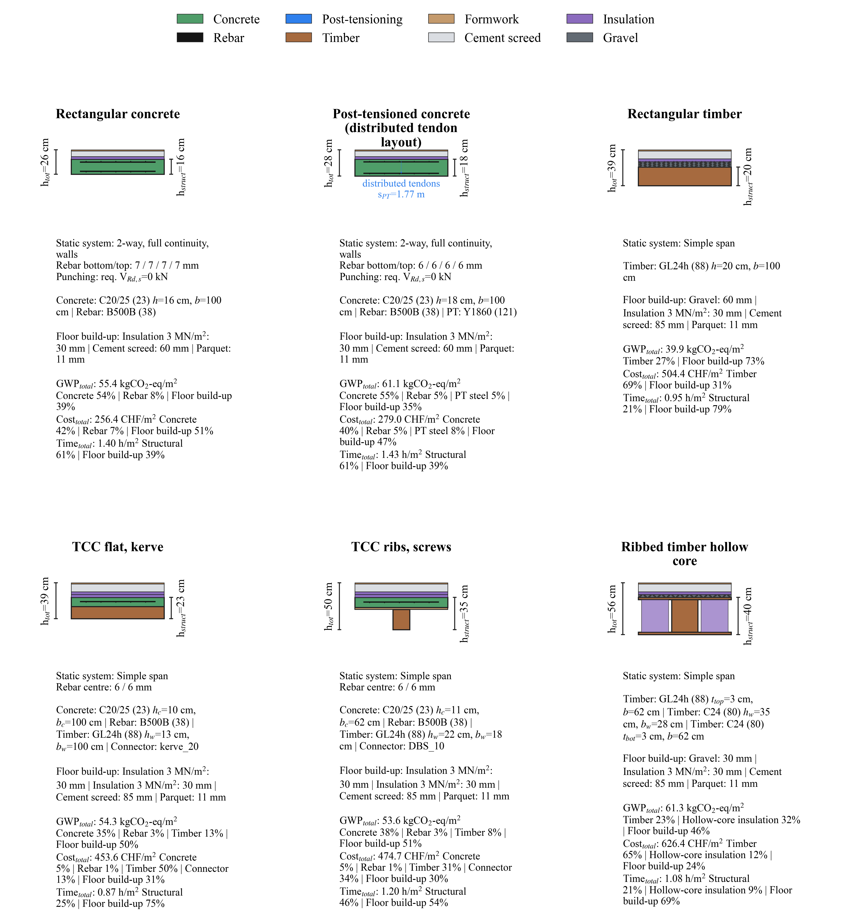
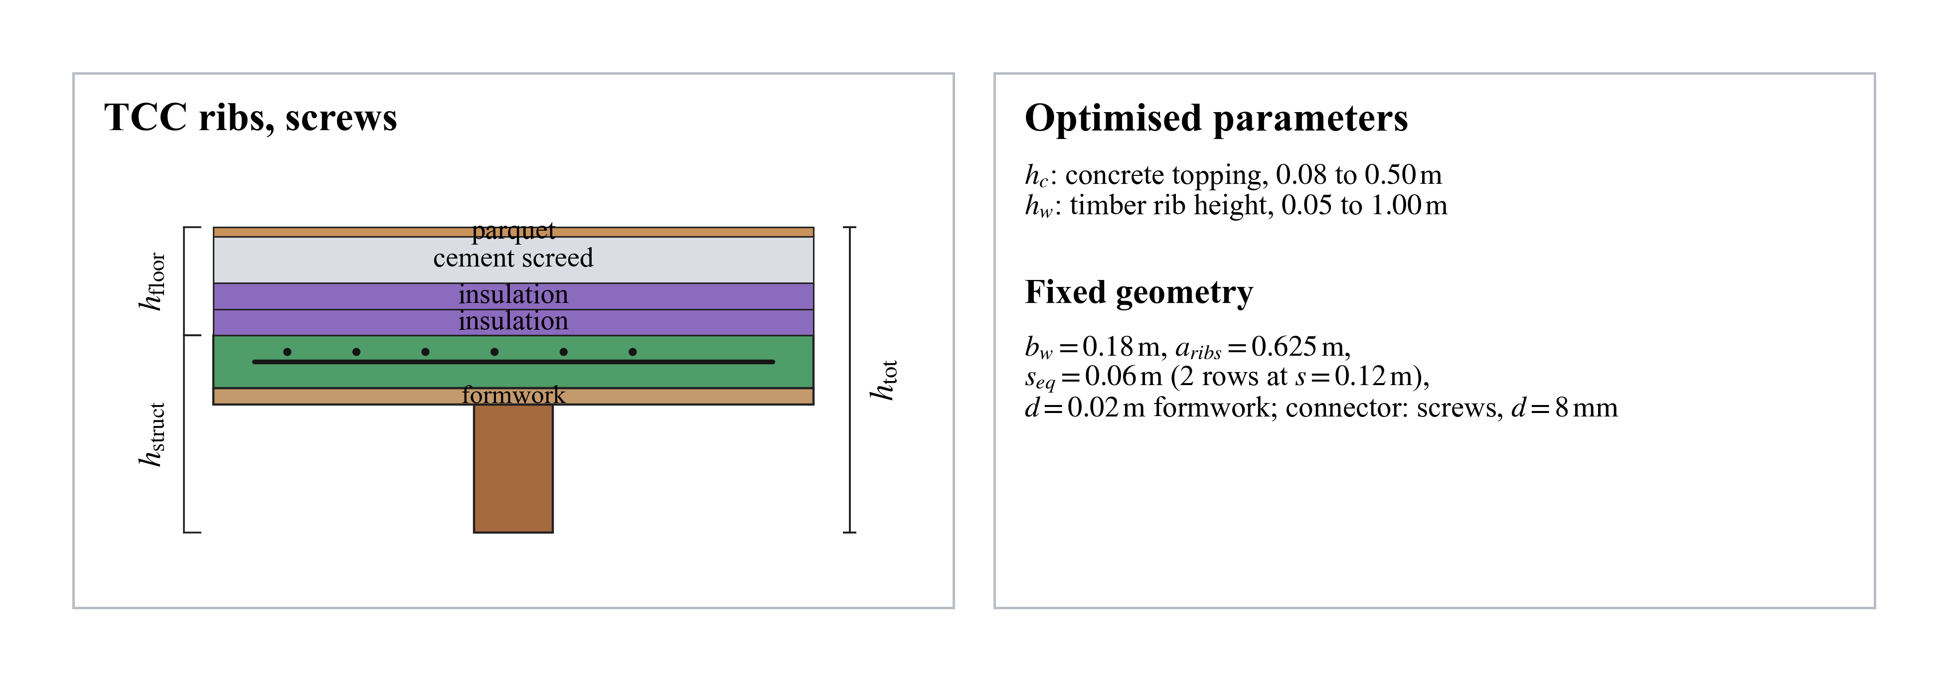
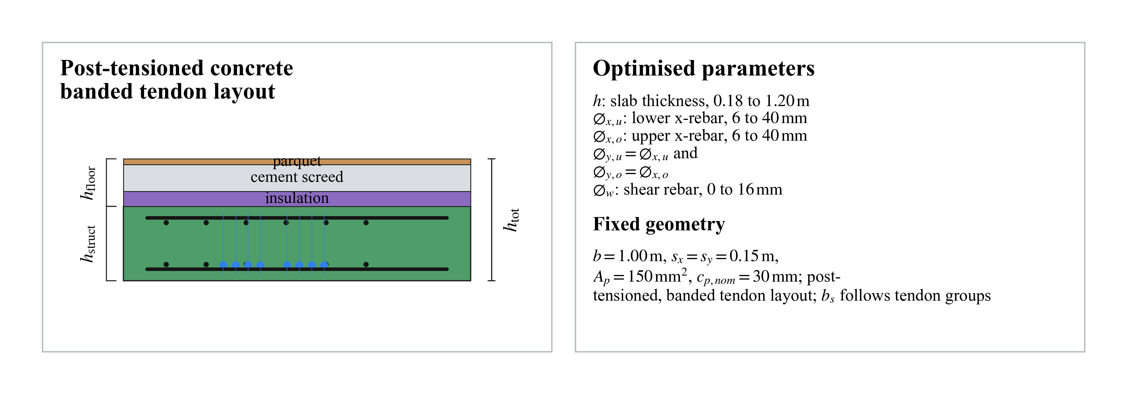
Methodology - New model components
TCC
Post-tensioning
Floor build-up
- Semi-rigid composite action
- Flat and ribbed alternatives
- Distributed and banded tendons
- Secondary moments and punching
- Acoustic requirements
- Mass, height, cost and GWP added
Institute of Structural Engineering
Methodology
7

Slide 8
Verification and comparison setup
Validation before comparison
Final comparison
- Timber-concrete composite stiffness checked against reference calculations.
- Post-tensioned concrete class validated for bending resistance and deflection.
- Acoustic build-up generator checked against Lignum reference constructions.
- Optimise each system with respect to GWP while fulfilling all requirements.
- Evaluate GWP, cost, time, height and mass over relevant span ranges.
- Use envelopes and pairwise scores to handle variation in product data.
Core principle: compare feasible alternatives, not idealised material stereotypes.
Institute of Structural Engineering
Methodology
8

Slide 9
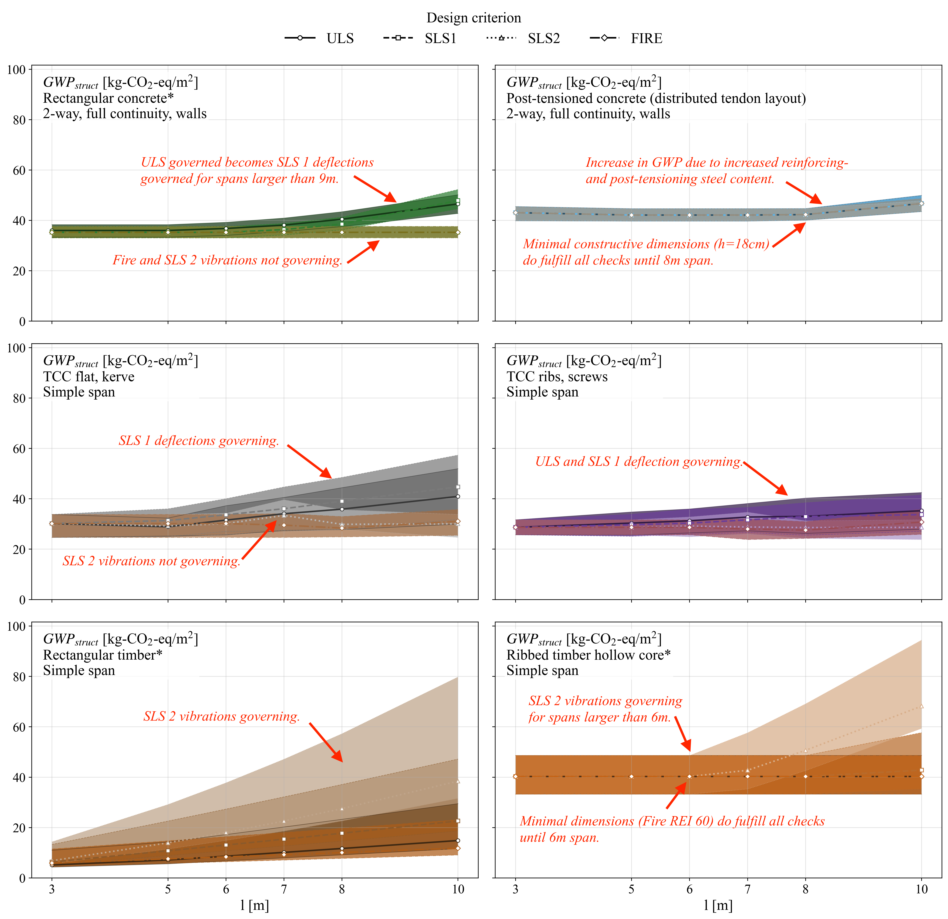
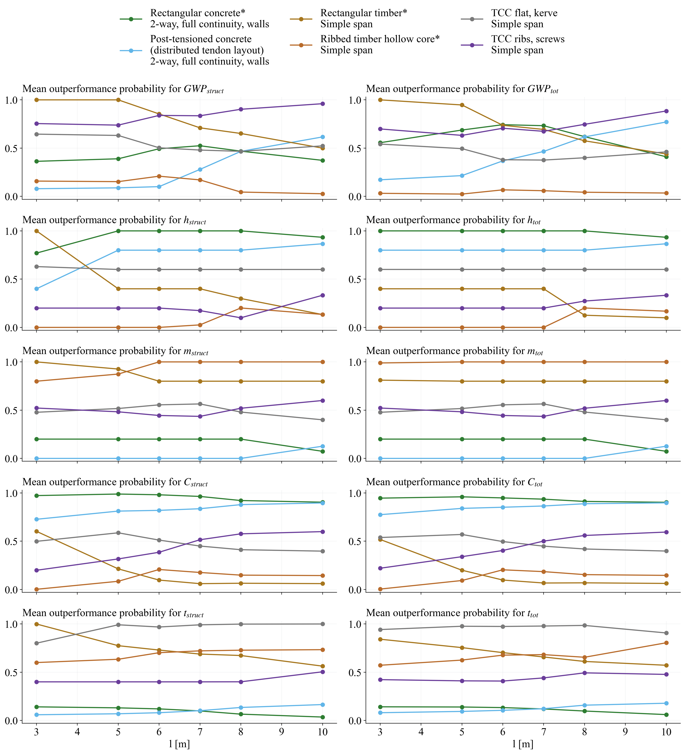
Results - Residential floor systems
- Timber performs favourably at short spans but becomes sensitive to vibration and height.
- Rectangular concrete is balanced at intermediate spans.
- TCC and post-tensioned concrete become competitive at longer spans.
Institute of Structural Engineering
Results
9

Slide 10
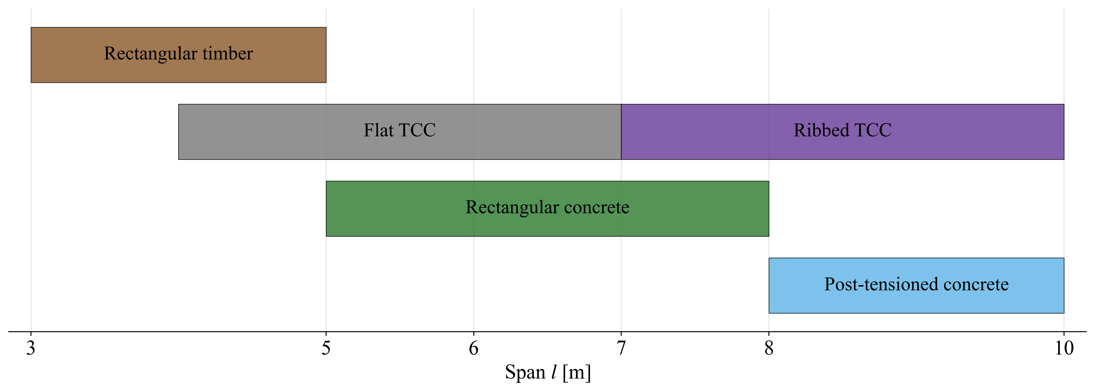
Results - Residential application ranges
Interpretation
- No single system dominates all spans and criteria.
- Use rectangular timber only where short spans keep height and cost controlled.
- Use concrete or post-tensioned concrete as span increases.
- Flat TCC is a robust compromise across residential spans.
Institute of Structural Engineering
Results
10

Slide 11
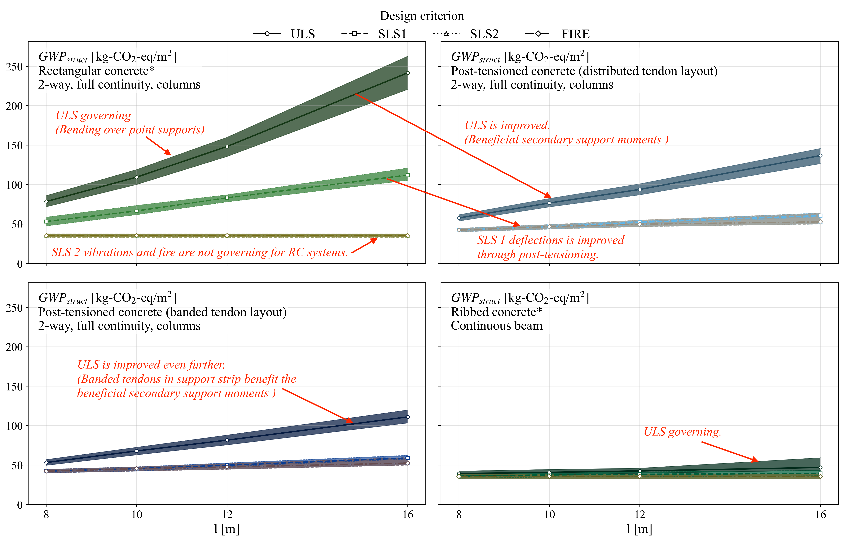
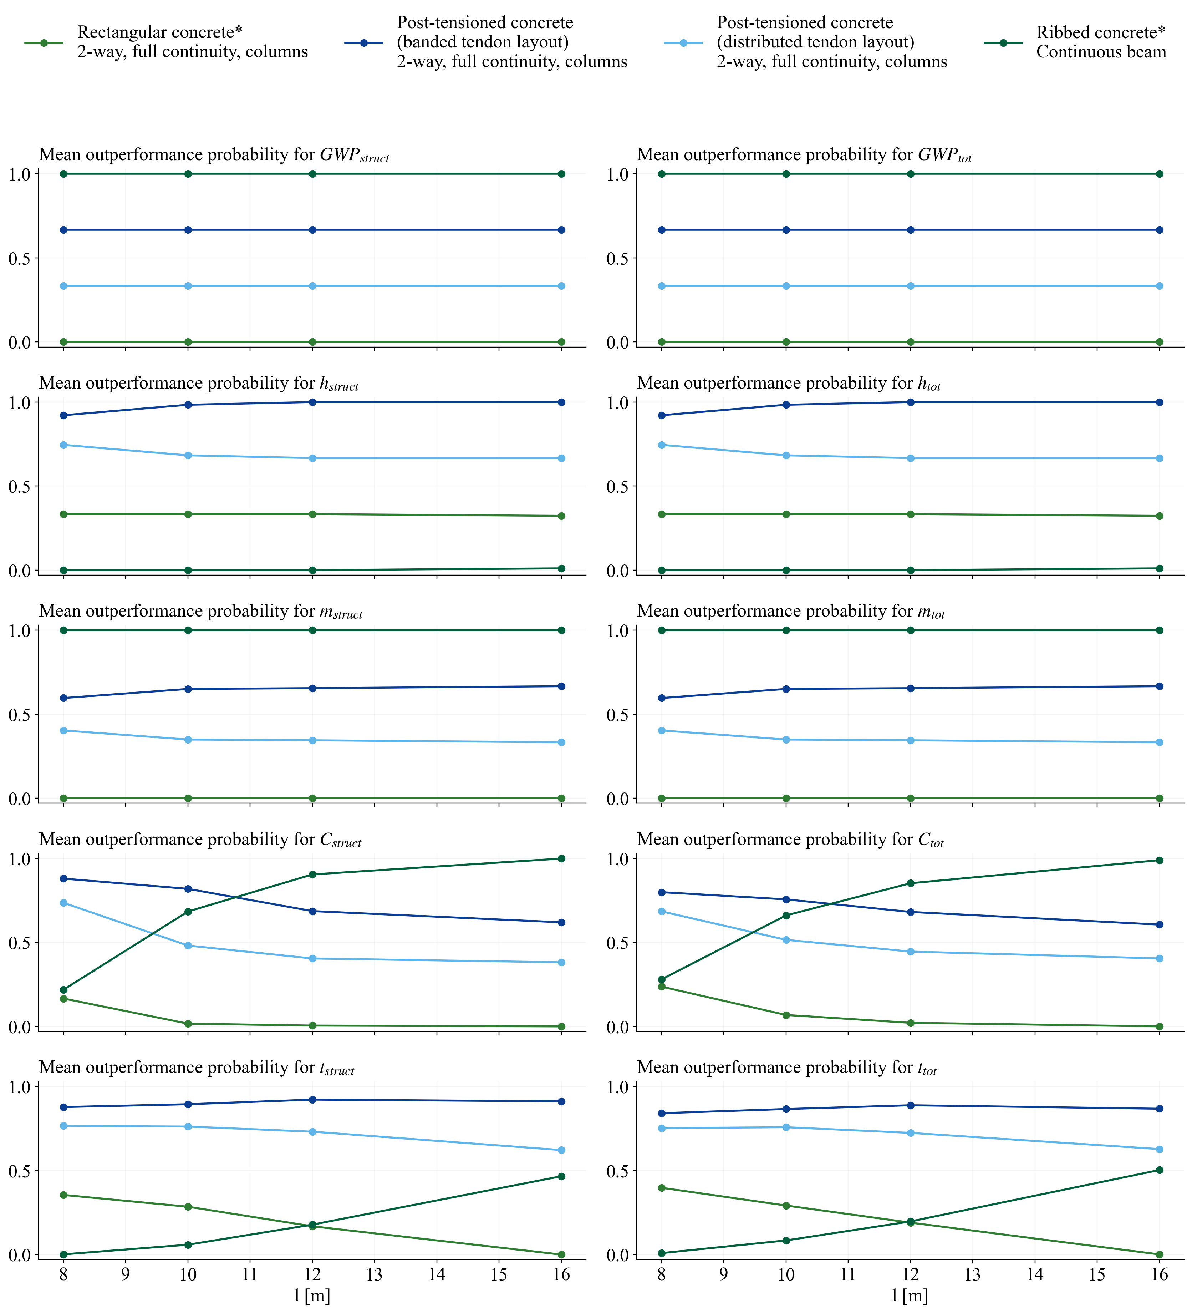
Results - Office floor systems
- Post-tensioning improves deflection, punching and material demand at larger spans.
- Banded tendons perform best in the current model because tendons align with support strips.
- Ribbed concrete has low GWP and mass, but requires more construction height.
Institute of Structural Engineering
Results
11

Slide 12
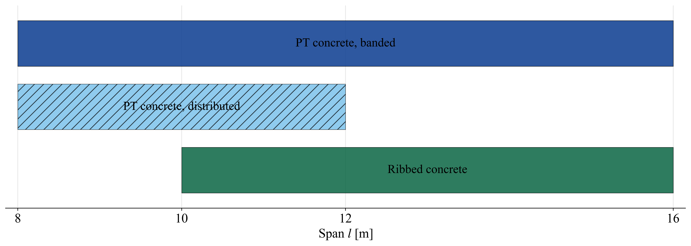
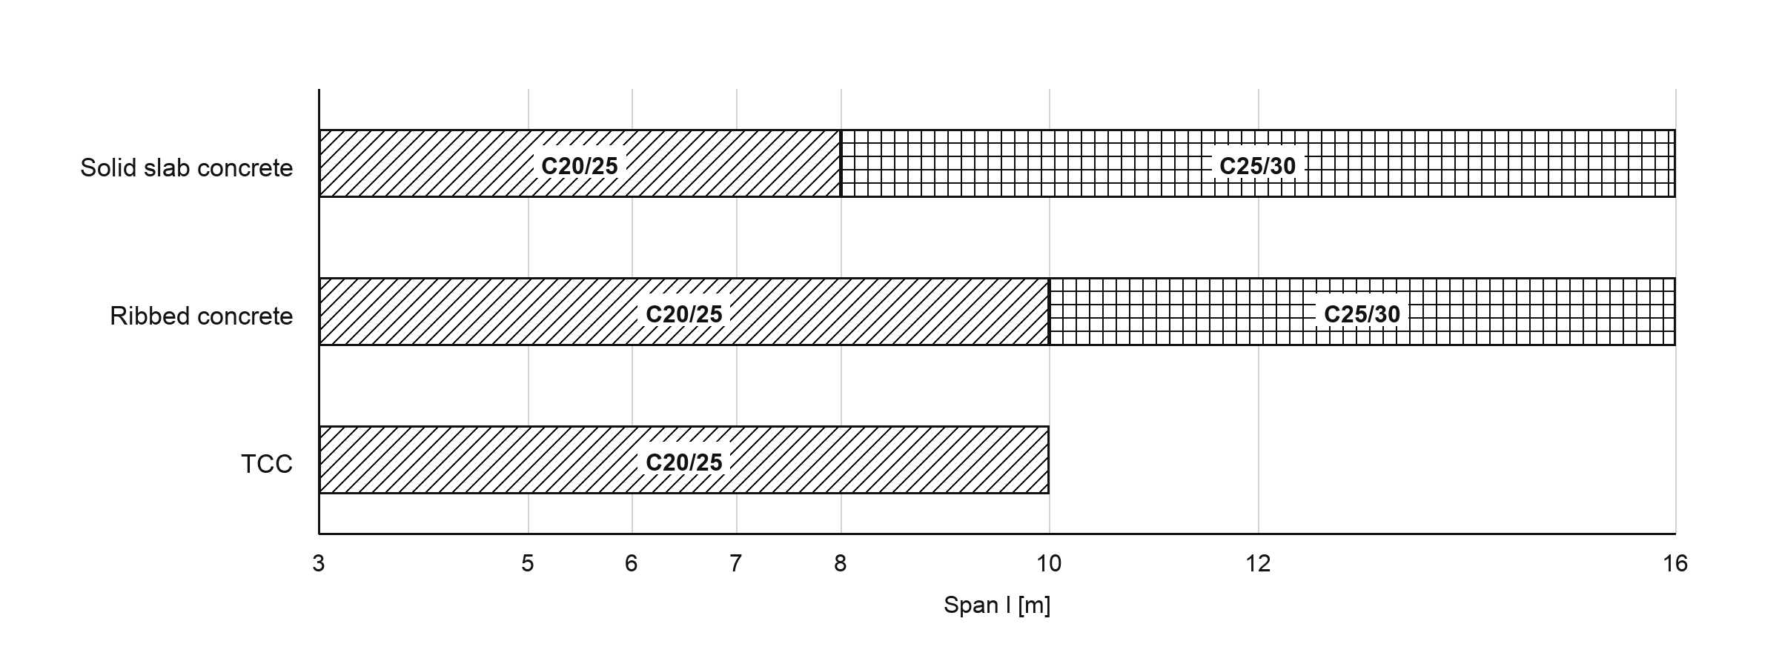
Results - Office application ranges
Recommendation
- Rectangular reinforced concrete is not recommended for the investigated span range.
- Banded post-tensioned concrete provides the best overall balance.
- Ribbed concrete is attractive from approximately 10 m, unless height governs.
Institute of Structural Engineering
Results
12

Slide 13
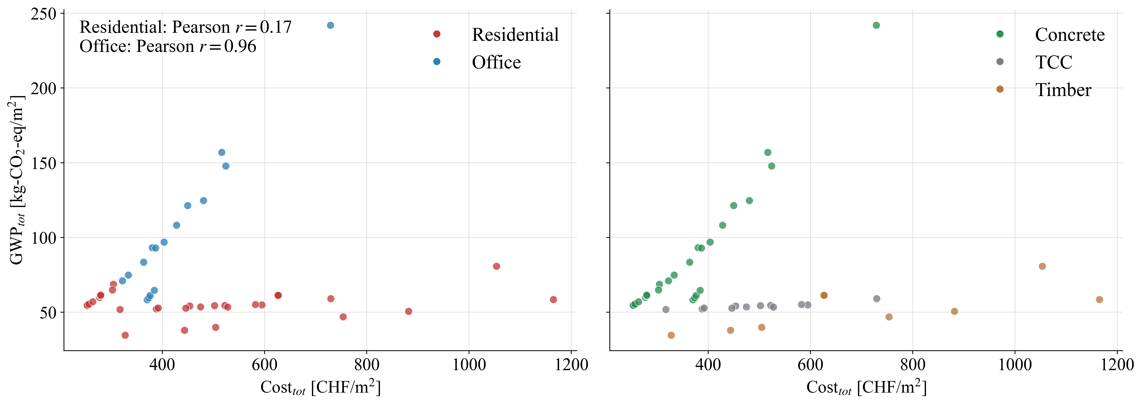
Discussion - GWP and construction cost
Residential
Weak correlation: r = 0.17
- Low-GWP timber is modelled as higher cost.
- Concrete tends to be cheaper but has higher GWP.
- TCC systems become compromise solutions.
Office
Strong correlation: r = 0.96
- All systems are concrete-based.
- Material efficiency reduces both GWP and cost.
- Height remains the key counter-criterion.
Institute of Structural Engineering
Discussion
13

Slide 14
Discussion - Relevant sustainability criteria
Primary
Boundary / project-specific
Context-dependent
GWP
Construction cost
Height
Construction time
Mass
Material variation
The complete floor system matters: acoustic build-ups can change rankings, especially for timber and TCC residential systems.
Institute of Structural Engineering
Discussion
14

Slide 15
Limitations
- Results are early-stage comparison results, not final project-specific design recommendations.
- Application ranges depend on loads, span ranges, acoustic requirements, height constraints and construction processes.
- Cost and time models simplify fabrication, logistics and connection effort.
- Ribbed timber hollow-core results are sensitive to fire verification and insulation assumptions.
Main value of the configurator: a consistent, transparent decision basis for comparing feasible floor systems early.
Institute of Structural Engineering
Conclusion
15

Slide 16
Conclusion and outlook
Conclusion
Outlook
- GWP and cost should be treated as primary criteria.
- Residential design contains a real ecological-economic trade-off.
- Office long-span design benefits from structural efficiency: post-tensioned and ribbed systems align cost and GWP.
- Floor height can decide whether a low-GWP system is actually usable.
- Improve fire verification and insulation data for timber hollow-core systems.
- Separate material, fabrication and installation in cost and time databases.
- Test sensitivity to changed loads, acoustic requirements and height limits.
- Develop a web interface for criterion weighting in practice.
Thank you
Institute of Structural Engineering
Conclusion
16

