Slide 1
Guide to Computer Forensics and Investigations
Fourth Edition
Chapter 4
Data Acquisition

Slide 2
Objectives
List digital evidence storage formats
Explain ways to determine the best acquisition method
Describe contingency planning for data acquisitions
Explain how to use acquisition tools
Guide to Computer Forensics and Investigations

Slide 3
Objectives (continued)
Explain how to validate data acquisitions
Describe RAID acquisition methods
Explain how to use remote network acquisition tools
List other forensic tools available for data acquisitions
Guide to Computer Forensics and Investigations

Slide 4
Understanding Storage Formats for Digital Evidence
Three formats
  Raw format
  Proprietary formats
  Advanced Forensics Format (AFF)
Guide to Computer Forensics and Investigations

Slide 5
Raw Format
Makes it possible to write bit-stream data to files
Advantages
  Fast data transfers
  Can ignore minor data read errors on source drive
  Most computer forensics tools can read raw format
Disadvantages
  Requires as much storage as original disk or data
  Tools might not collect marginal (bad) sectors
Guide to Computer Forensics and Investigations

Slide 6
Proprietary Formats
Features offered
  Option to compress or not compress image files
  Can split an image into smaller segmented files
  Can integrate metadata into the image file
Disadvantages
  Inability to share an image between different tools
  File size limitation for each segmented volume
Guide to Computer Forensics and Investigations

Slide 7
Advanced Forensics Format
Developed by Dr. Simson L. Garfinkel of Basis Technology Corporation
Design goals
  Provide compressed or uncompressed image files
  No size restriction for disk-to-image files
  Provide space in the image file or segmented files for metadata
  Simple design with extensibility
  Open source for multiple platforms and OSs
Guide to Computer Forensics and Investigations

Slide 8
Advanced Forensics Format (continued)
Design goals (continued)
  Internal consistency checks for self-authentication
File extensions include .afd for segmented image files and .afm for AFF metadata
AFF is open source
Guide to Computer Forensics and Investigations

Slide 9
Determining the Best Acquisition Method
Types of acquisitions
  Static acquisitions and live acquisitions
Four methods
  Bit-stream disk-to-image file
  Bit-stream disk-to-disk
  Logical disk-to-disk or disk-to-disk data
  Sparse data copy of a file or folder
Guide to Computer Forensics and Investigations

Slide 10
Determining the Best Acquisition Method (continued)
Bit-stream disk-to-image file
  Most common method
  Can make more than one copy
  Copies are bit-for-bit replications of the original drive
  ProDiscover, EnCase, FTK, SMART, Sleuth Kit, X-Ways, iLook
Bit-stream disk-to-disk
  When disk-to-image copy is not possible
  Consider disk’s geometry configuration
  EnCase, SafeBack, SnapCopy
Guide to Computer Forensics and Investigations

Slide 11
Determining the Best Acquisition Method (continued)
Logical acquisition or sparse acquisition
  When your time is limited
  Logical acquisition captures only specific files of interest to the case
  Sparse acquisition also collects fragments of unallocated (deleted) data
  For large disks
  PST or OST mail files, RAID servers
Guide to Computer Forensics and Investigations

Slide 12
Determining the Best Acquisition Method (continued)
When making a copy, consider:
  Size of the source disk
    Lossless compression might be useful
    Use digital signatures for verification
  When working with large drives, an alternative is using tape backup systems
  Whether you can retain the disk
Guide to Computer Forensics and Investigations

Slide 13
Contingency Planning for Image Acquisitions
Create a duplicate copy of your evidence image file
Make at least two images of digital evidence
  Use different tools or techniques
Copy host protected area of a disk drive as well
  Consider using a hardware acquisition tool that can access the drive at the BIOS level
Be prepared to deal with encrypted drives
  Whole disk encryption feature in Windows Vista Ultimate and Enterprise editions
Guide to Computer Forensics and Investigations

Slide 14
Using Acquisition Tools
Acquisition tools for Windows
  Advantages
    Make acquiring evidence from a suspect drive more convenient
      Especially when used with hot-swappable devices
  Disadvantages
    Must protect acquired data with a well-tested write-blocking hardware device
    Tools can’t acquire data from a disk’s host protected area
Guide to Computer Forensics and Investigations

Slide 15
Windows XP Write-Protection with USB Devices
USB write-protection feature
  Blocks any writing to USB devices
Target drive needs to be connected to an internal PATA (IDE), SATA, or SCSI controller
Steps to update the Registry for Windows XP SP2
  Back up the Registry
  Modify the Registry with the write-protection feature
  Create two desktop icons to automate switching between enabling and disabling writes to USB device
Guide to Computer Forensics and Investigations

Slide 16
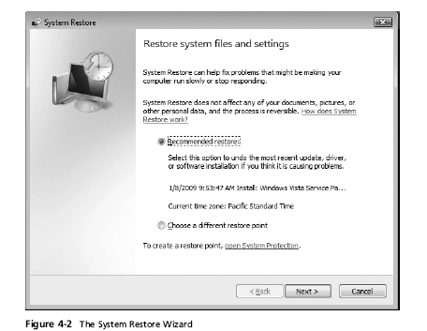
Windows XP Write-Protection with USB Devices (continued)
Guide to Computer Forensics and Investigations

Slide 17
Acquiring Data with a Linux Boot CD
Linux can access a drive that isn’t mounted
Windows OSs and newer Linux automatically mount and access a drive
Forensic Linux Live CDs don’t access media automatically
  Which eliminates the need for a write-blocker
Using Linux Live CD Distributions
  Forensic Linux Live CDs
    Contain additionally utilities
Guide to Computer Forensics and Investigations

Slide 18
Acquiring Data with a Linux Boot CD (continued)
Using Linux Live CD Distributions (continued)
  Forensic Linux Live CDs (continued)
    Configured not to mount, or to mount as read-only, any connected storage media
    Well-designed Linux Live CDs for computer forensics
      Helix
      Penguin Sleuth
      FCCU
Preparing a target drive for acquisition in Linux
  Linux distributions can create Microsoft FAT and NTFS partition tables
Guide to Computer Forensics and Investigations

Slide 19
Acquiring Data with a Linux Boot CD (continued)
Preparing a target drive for acquisition in Linux (continued)
  fdisk command lists, creates, deletes, and verifies partitions in Linux
  mkfs.msdos command formats a FAT file system from Linux
Acquiring data with dd in Linux
  dd (“data dump”) command
    Can read and write from media device and data file
    Creates raw format file that most computer forensics analysis tools can read
Guide to Computer Forensics and Investigations

Slide 20
Acquiring Data with a Linux Boot CD (continued)
Acquiring data with dd in Linux (continued)
  Shortcomings of dd command
    Requires more advanced skills than average user
    Does not compress data
  dd command combined with the split command
    Segments output into separate volumes
Acquiring data with dcfldd in Linux
  dd command is intended as a data management tool
    Not designed for forensics acquisitions
Guide to Computer Forensics and Investigations

Slide 21
Acquiring Data with a Linux Boot CD (continued)
Acquiring data with dcfldd in Linux (continued)
  dcfldd additional functions
    Specify hex patterns or text for clearing disk space
    Log errors to an output file for analysis and review
    Use several hashing options
    Refer to a status display indicating the progress of the acquisition in bytes
    Split data acquisitions into segmented volumes with numeric extensions
    Verify acquired data with original disk or media data
Guide to Computer Forensics and Investigations

Slide 22
Capturing an Image with ProDiscover Basic
Connecting the suspect’s drive to your workstation
  Document the chain of evidence for the drive
  Remove the drive from the suspect’s computer
  Configure the suspect drive’s jumpers as needed
  Connect the suspect drive
  Create a storage folder on the target drive
Using ProDiscover’s Proprietary Acquisition Format
  Image file will be split into segments of 650MB
  Creates image files with an .eve extension, a log file (.log extension), and a special inventory file (.pds extension)
Guide to Computer Forensics and Investigations

Slide 23
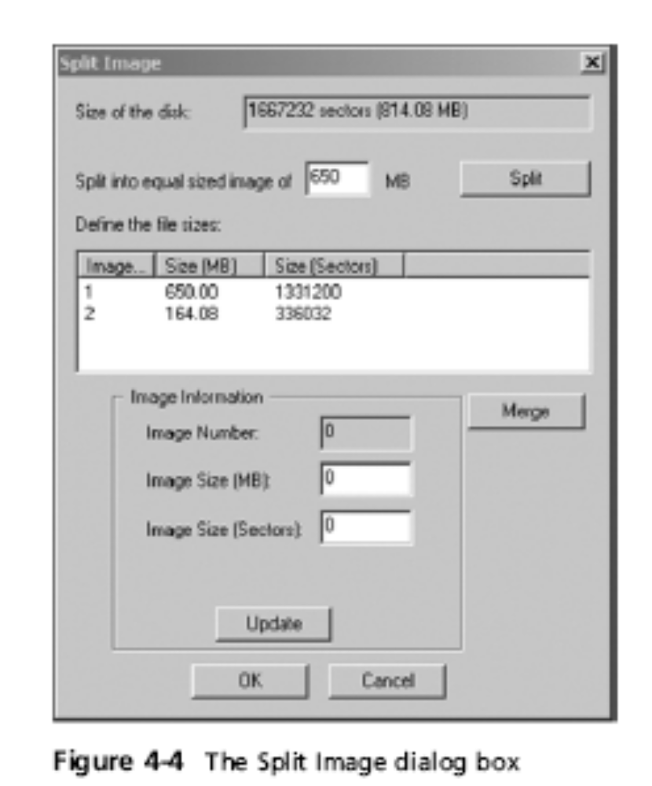
Capturing an Image with ProDiscover Basic (continued)
Guide to Computer Forensics and Investigations

Slide 24
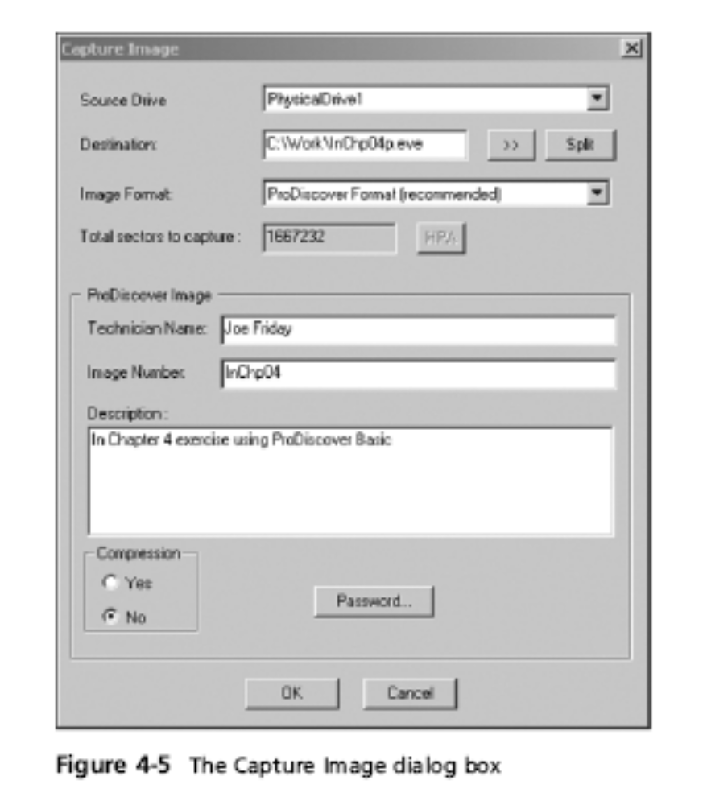
Guide to Computer Forensics and Investigations

Slide 25
Capturing an Image with ProDiscover Basic (continued)
Using ProDiscover’s Raw Acquisition Format
  Select the UNIX style dd format in the Image Format list box
  Raw acquisition saves only the image data and hash value
Guide to Computer Forensics and Investigations

Slide 26
Capturing an Image with AccessData FTK Imager
Included on AccessData Forensic Toolkit
View evidence disks and disk-to-image files
Makes disk-to-image copies of evidence drives
  At logical partition and physical drive level
  Can segment the image file
Evidence drive must have a hardware write-blocking device
  Or the USB write-protection Registry feature enabled
FTK Imager can’t acquire drive’s host protected area
Guide to Computer Forensics and Investigations

Slide 27
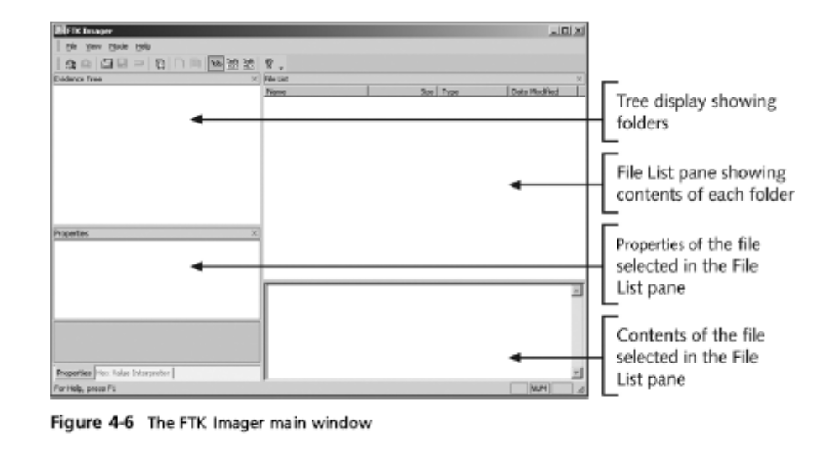
Capturing an Image with AccessData FTK Imager (continued)
Guide to Computer Forensics and Investigations

Slide 28
Capturing an Image with AccessData FTK Imager (continued)
Steps
  Boot to Windows
  Connect evidence disk to a write-blocker
  Connect target disk to write-blocker
  Start FTK Imager
  Create Disk Image
    Use Physical Drive option
Guide to Computer Forensics and Investigations

Slide 29
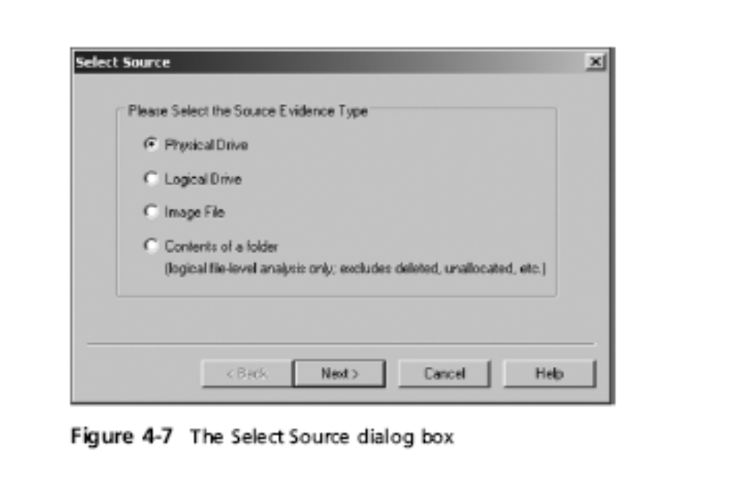
Capturing an Image with AccessData FTK Imager (continued)
Guide to Computer Forensics and Investigations

Slide 30
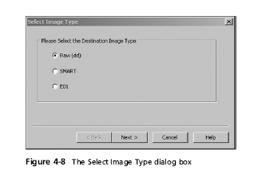
Capturing an Image with AccessData FTK Imager (continued)
Guide to Computer Forensics and Investigations

Slide 31
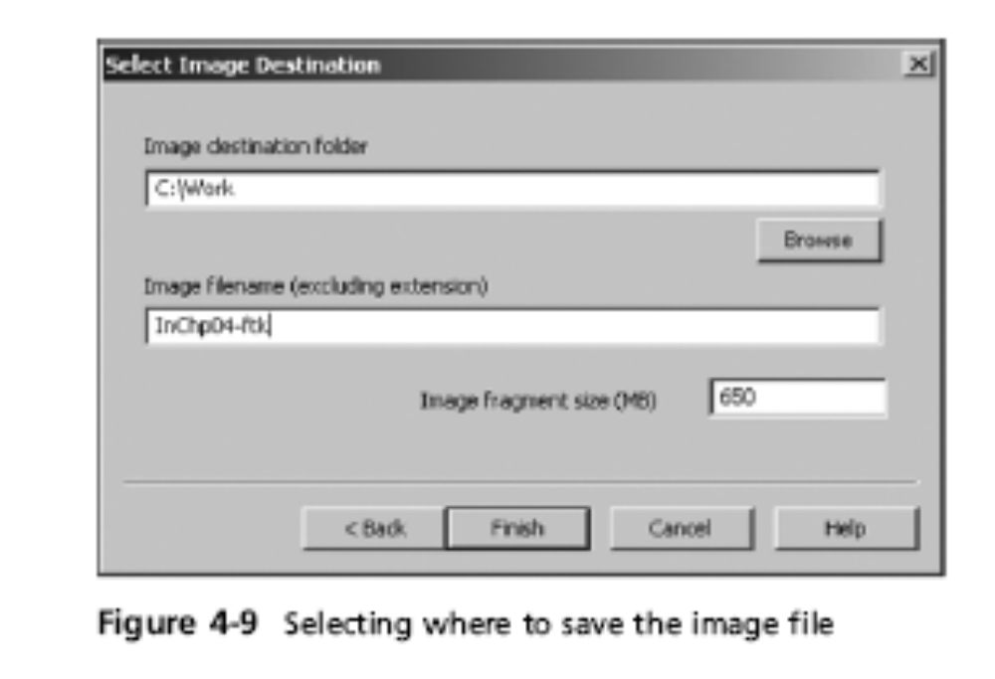
Capturing an Image with AccessData FTK Imager (continued)
Guide to Computer Forensics and Investigations

Slide 32
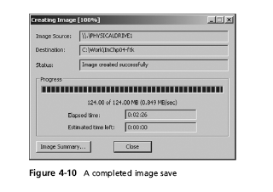
Capturing an Image with AccessData FTK Imager (continued)
Guide to Computer Forensics and Investigations

Slide 33
Validating Data Acquisitions
Most critical aspect of computer forensics
Requires using a hashing algorithm utility
Validation techniques
  CRC-32, MD5, and SHA-1 to SHA-512
Guide to Computer Forensics and Investigations

Slide 34
Linux Validation Methods
Validating dd acquired data
  You can use md5sum or sha1sum utilities
  md5sum or sha1sum utilities should be run on all suspect disks and volumes or segmented volumes
Validating dcfldd acquired data
  Use the hash option to designate a hashing algorithm of md5, sha1, sha256, sha384, or sha512
  hashlog option outputs hash results to a text file that can be stored with the image files
  vf (verify file) option compares the image file to the original medium
Guide to Computer Forensics and Investigations

Slide 35
Windows Validation Methods
Windows has no built-in hashing algorithm tools for computer forensics
  Third-party utilities can be used
Commercial computer forensics programs also have built-in validation features
  Each program has its own validation technique
Raw format image files don’t contain metadata
  Separate manual validation is recommended for all raw acquisitions
Guide to Computer Forensics and Investigations

Slide 36
Performing RAID Data Acquisitions
Size is the biggest concern
  Many RAID systems now have terabytes of data
Guide to Computer Forensics and Investigations

Slide 37
Understanding RAID
Redundant array of independent (formerly “inexpensive”) disks (RAID)
  Computer configuration involving two or more disks
  Originally developed as a data-redundancy measure
RAID 0
  Provides rapid access and increased storage
  Lack of redundancy
RAID 1
  Designed for data recovery
  More expensive than RAID 0
Guide to Computer Forensics and Investigations

Slide 38
Understanding RAID (continued)
RAID 2
  Similar to RAID 1
  Data is written to a disk on a bit level
  Has better data integrity checking than RAID 0
  Slower than RAID 0
RAID 3
  Uses data stripping and dedicated parity
RAID 4
  Data is written in blocks
Guide to Computer Forensics and Investigations

Slide 39
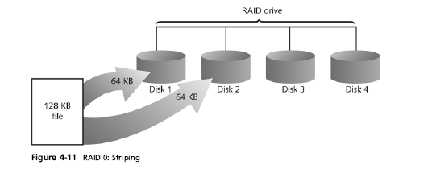
Understanding RAID (continued)
Guide to Computer Forensics and Investigations

Slide 40
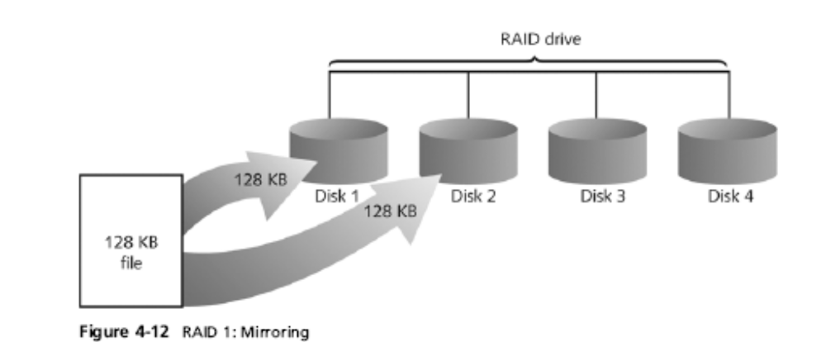
Understanding RAID (continued)
Guide to Computer Forensics and Investigations

Slide 41
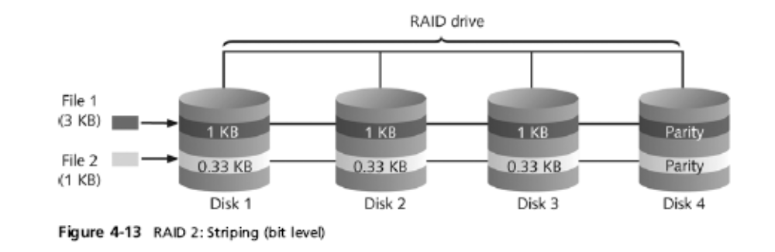
Understanding RAID (continued)
Guide to Computer Forensics and Investigations

Slide 42
Understanding RAID (continued)
RAID 5
  Similar to RAIDs 0 and 3
  Places parity recovery data on each disk
RAID 6
  Redundant parity on each disk
RAID 10, or mirrored striping
  Also known as RAID 1+0
  Combination of RAID 1 and RAID 0
Guide to Computer Forensics and Investigations

Slide 43
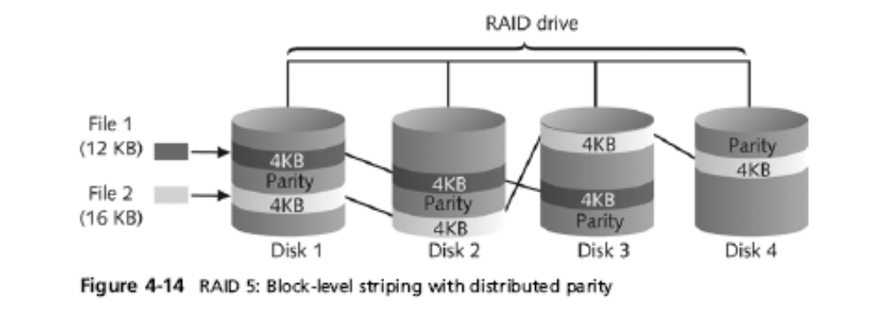
Understanding RAID (continued)
Guide to Computer Forensics and Investigations

Slide 44
Acquiring RAID Disks
Concerns
  How much data storage is needed?
  What type of RAID is used?
  Do you have the right acquisition tool?
  Can the tool read a forensically copied RAID image?
  Can the tool read split data saves of each RAID disk?
Older hardware-firmware RAID systems can be a challenge when you’re making an image
Guide to Computer Forensics and Investigations

Slide 45
Acquiring RAID Disks (continued)
Vendors offering RAID acquisition functions
  Technologies Pathways ProDiscover
  Guidance Software EnCase
  X-Ways Forensics
  Runtime Software
  R-Tools Technologies
Occasionally, a RAID system is too large for a static acquisition
  Retrieve only the data relevant to the investigation with the sparse or logical acquisition method
Guide to Computer Forensics and Investigations

Slide 46
Using Remote Network Acquisition Tools
You can remotely connect to a suspect computer via a network connection and copy data from it
Remote acquisition tools vary in configurations and capabilities
Drawbacks
  LAN’s data transfer speeds and routing table conflicts could cause problems
  Gaining the permissions needed to access more secure subnets
  Heavy traffic could cause delays and errors
Guide to Computer Forensics and Investigations

Slide 47
Remote Acquisition with ProDiscover
With ProDiscover Investigator you can:
  Preview a suspect’s drive remotely while it’s in use
  Perform a live acquisition
  Encrypt the connection
  Copy the suspect computer’s RAM
  Use the optional stealth mode
ProDiscover Incident Response additional functions
  Capture volatile system state information
  Analyze current running processes
Guide to Computer Forensics and Investigations

Slide 48
Remote Acquisition with ProDiscover (continued)
ProDiscover Incident Response additional functions (continued)
  Locate unseen files and processes
  Remotely view and listen to IP ports
  Run hash comparisons
  Create a hash inventory of all files remotely
PDServer remote agent
  ProDiscover utility for remote access
  Needs to be loaded on the suspect
Guide to Computer Forensics and Investigations

Slide 49
Remote Acquisition with ProDiscover (continued)
PDServer installation modes
  Trusted CD
  Preinstallation
  Pushing out and running remotely
PDServer can run in a stealth mode
  Can change process name to appear as OS function
Guide to Computer Forensics and Investigations

Slide 50
Remote Acquisition with ProDiscover (continued)
Remote connection security features
  Password Protection
  Encryption
  Secure Communication Protocol
  Write Protected Trusted Binaries
  Digital Signatures
Guide to Computer Forensics and Investigations

Slide 51
Remote Acquisition with EnCase Enterprise
Remote acquisition features
  Remote data acquisition of a computer’s media and RAM data
  Integration with intrusion detection system (IDS) tools
  Options to create an image of data from one or more systems
  Preview of systems
  A wide range of file system formats
  RAID support for both hardware and software
Guide to Computer Forensics and Investigations

Slide 52
Remote Acquisition with R-Tools R-Studio
R-Tools suite of software is designed for data recovery
Remote connection uses Triple Data Encryption Standard (3DES) encryption
Creates raw format acquisitions
Supports various file systems
Guide to Computer Forensics and Investigations

Slide 53
Remote Acquisition with Runtime Software
Utilities
  DiskExplorer for FAT
  DiskExplorer for NTFS
  HDHOST
Features for acquisition
  Create a raw format image file
  Segment the raw format or compressed image
  Access network computers’ drives
Guide to Computer Forensics and Investigations

Slide 54
Using Other Forensics-Acquisition Tools
Tools
  SnapBack DatArrest
  SafeBack
  DIBS USA RAID
  ILook Investigator IXimager
  Vogon International SDi32
  ASRData SMART
  Australian Department of Defence PyFlag
Guide to Computer Forensics and Investigations

Slide 55
SnapBack DatArrest
Columbia Data Products
Old MS-DOS tool
Can make an image on three ways
  Disk to SCSI drive
  Disk to network drive
  Disk to disk
Fits on a forensic boot floppy
SnapCopy adjusts disk geometry
Guide to Computer Forensics and Investigations

Slide 56
NTI SafeBack
Reliable MS-DOS tool
Small enough to fit on a forensic boot floppy
Performs an SHA-256 calculation per sector copied
Creates a log file
Guide to Computer Forensics and Investigations

Slide 57
NTI SafeBack (continued)
Functions
  Disk-to-image copy (image can be on tape)
  Disk-to-disk copy (adjusts target geometry)
    Parallel port laplink can be used
  Copies a partition to an image file
  Compresses image files
Guide to Computer Forensics and Investigations

Slide 58
DIBS USA RAID
Rapid Action Imaging Device (RAID)
  Makes forensically sound disk copies
  Portable computer system designed to make disk-to-disk images
  Copied disk can then be attached to a write-blocker device
Guide to Computer Forensics and Investigations

Slide 59
ILook Investigator IXimager
Iximager
  Runs from a bootable floppy or CD
  Designed to work only with ILook Investigator
  Can acquire single drives and RAID drives
Guide to Computer Forensics and Investigations

Slide 60
Vogon International SDi32
Creates a raw format image of a drive
Write-blocker is needed when using this tool
Password Cracker POD
  Device that removes the password on a drive’s firmware card
Guide to Computer Forensics and Investigations

Slide 61
ASRData SMART
Linux forensics analysis tool that can make image files of a suspect drive
Capabilities
  Robust data reading of bad sectors on drives
  Mounting suspect drives in write-protected mode
  Mounting target drives in read/write mode
  Optional compression schemes
Guide to Computer Forensics and Investigations

Slide 62
Australian Department of Defence PyFlag
PyFlag tool
  Intended as a network forensics analysis tool
  Can create proprietary format Expert Witness image files
  Uses sgzip and gzip in Linux
Guide to Computer Forensics and Investigations

Slide 63
Summary
Data acquisition methods
  Disk-to-image file
  Disk-to-disk copy
  Logical disk-to-disk or disk-to-data file
  Sparse data copy
Several tools available
  Lossless compression is acceptable
Plan your digital evidence contingencies
Write-blocking devices or utilities must be used with GUI acquisition tools
Guide to Computer Forensics and Investigations

Slide 64
Summary (continued)
Always validate acquisition
A Linux Live CD, such as Helix, provides many useful tools for computer forensics acquisitions
Preferred Linux acquisition tool is dcfldd (not dd)
Use a physical write-blocker device for acquisitions
To acquire RAID disks, determine the type of RAID
  And then which acquisition tool to use
Guide to Computer Forensics and Investigations

