Slide 1
Guide to Computer Forensics and Investigations
Fourth Edition
Chapter 14
Report Writing for High-Tech Investigations

Slide 2
Forensic Report
A forensic report presents evidence that might support further investigation and, in some situations, be admissible in court, at an administrative hearing, or as an affidavit to support issuing an arrest or a search warrant.
A report can also provide justification for collecting more evidence and be used at a probable cause hearing, as evidence in a grand jury hearing, or at a motion hearing.

Slide 3
Understanding the Importance of Reports
You should look at your report as your first testimony in a case. You must expect to be examined and cross-examined about it.
Opposing counsel will look for an opportunity to attack the facts you present, whether you determined them yourself or extracted them from other reports or the expected testimony of other witnesses.

Slide 4
Understanding the Importance of Reports
In addition to opinions and exhibits, the written report must specify fees paid for the expert’s services and list all other civil or criminal cases in which the expert has testified (in trials and depositions) for the preceding 4 years.
Deposition banks
  Examples of expert witness’ previous testimonies

Slide 5
Deposition & Testimony
Deposition
A formal examination in which you’re questioned under oath with only the opposing parties, your attorney, and a court reporter present. There’s no judge or jury. The purpose of a deposition is to give the opposing counsel a chance to preview your testimony before trial.
Testimony
testimony is a form of evidence that is obtained from a witness who makes a solemn statement or declaration of fact
as an expert witness, you have opinions about what you have found or observed. You form these opinions from experience and deductive reasoning based on facts found during an investigation.

Slide 6
Desposition
As an expert witness, you should be aware that lawyers use services called deposition banks (libraries), which store examples of expert witnesses’ previous testimony.
Some of these services have hundreds of thousands of depositions on file and might have several depositions for expert witnesses who testify regularly.
After a case is resolved, a lawyer sends copies of the opposing expert witnesses’ depositions to the bank to be stored.

Slide 7
Limiting a Report to Specifics
All reports to clients should start with the job mission or goal
  Find information on a specific subject
  Recover certain significant documents
  Recover certain types of files
Before you begin writing, identify your audience and the purpose of the report
Guide to Computer Forensics and Investigations

Slide 8
Types of Reports
Computer forensics examiners are required to create different types of reports
such as a formal report consisting of facts from your findings,
a preliminary written or verbal report to your attorney,
an examination plan for the attorney who has retained you.

Slide 9
Written Report
A written report is frequently an affidavit or a declaration.
Because this type of report is sworn to under oath (and penalty of perjury or comparable false swearing statute), it demands attention to detail, carefully limiting what you write, and thorough documentation and support of what you write.
Guide to Computer Forensics and Investigations

Slide 10
Examination plan
  What questions to expect when testifying
  Attorney uses the examination plan to guide you in your testimony
  You can propose changes to clarify or define information
  Helps your attorney learn the terms and functions used in computer forensics
Guide to Computer Forensics and Investigations

Slide 11
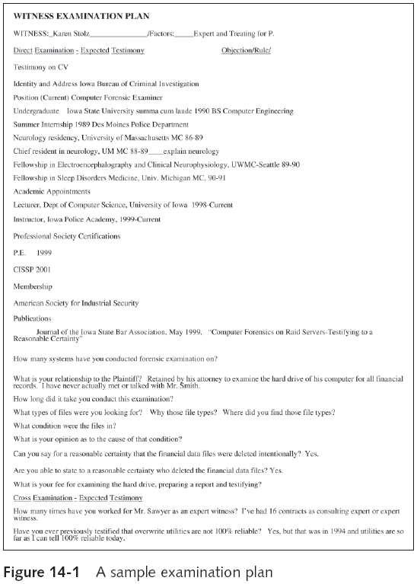
Guide to Computer Forensics and Investigations

Slide 12
Verbal report
A verbal report is less structured than a written report.
Typically, it takes place in an attorney’s office, where the attorney requests your consultant’s report.
As an expert hired as a trial consultant, you’ll use verbal reports often. Keep in mind that others can’t force your attorney to repeat what you’ve told him or her in a verbal report.
  A verbal report is usually a preliminary report and addresses areas of investigation yet to be completed
Tests that have not been concluded
    Interrogatories
    Document production
    Depositions
mention to your client that your factual statement and opinion are still tentative and subject to change

Slide 13
Guidelines for Writing Reports
Hypothetical questions based on factual evidence
  Less favored today
  Guide and support your opinion
  Can be abused and overly complex
Opinions based on knowledge and experience
Exclude from hypothetical questions
  Facts that can change, cannot be used, or are not relevant to your opinion
Guide to Computer Forensics and Investigations

Slide 14
Guidelines for Writing Reports (continued)
As an expert witness, you may testify to an opinion, or conclusion, if four basic conditions are met:
  Opinion, inferences, or conclusions depend on special knowledge or skills
  Expert should qualify as a true expert
  Expert must testify to a certain degree of certainty
  Experts must describe facts on which their opinions are based, or they must testify to a hypothetical question
Guide to Computer Forensics and Investigations

Slide 15
What to Include in Written Preliminary Reports
Anything you write down as part of your examination for a report is Subject to discovery from the opposing attorney
Considered high-risk documents because opposing counsel can demand discovery of it
If the written preliminary report states a contrary or more equivocal position than you take in your final report or testimony, you should expect opposing counsel to try to discredit your testimony by using the written report.
Spoliation
Destroying the report could be considered destroying or concealing evidence; among lawyers, this action is called spoliation,
it could subject your client to monetary or evidentiary sanctions

Slide 16
What to Include in Written Preliminary Reports (continued)
Additional items to include in your report:
  Summarize your billing to date and estimate costs to complete the effort
  Identify the tentative conclusion (rather than the preliminary conclusion)
  Identify areas for further investigation and obtain confirmation from the attorney on the scope of your examination
Guide to Computer Forensics and Investigations

Slide 17
Report Structure
Structure
  Abstract
  Table of contents
  Body of report
  Conclusion
  References
  Glossary
  Acknowledgements
  Appendixes
Guide to Computer Forensics and Investigations

Slide 18
Report Structure
Abstract: An abstract simply condenses the report to concentrate on the essential information. It should describe the examination or investigation and present the report’s main ideas in a summarized form
Body:The body consists of the introduction and discussion sections. The introduction should state the report’s purpose and show that you’re aware of its terms of reference
Organize discussion sections logically under headings to reflect how you classify information and to ensure that your information remains relevant to the investigation.
Two other main sections are the conclusion and supporting materials (references and appendixes).

Slide 19
Writing Reports Clearly
Consider
  Communicative quality
  Ideas and organization
  Grammar and vocabulary
  Punctuation and spelling
Lay out ideas in logical order
Build arguments piece by piece
Group related ideas and sentences into paragraphs
  Group paragraphs into sections
Guide to Computer Forensics and Investigations

Slide 20
Writing Reports Clearly (continued)
Avoid jargon, slang, and colloquial terms
Define technical terms
  Consider your audience
1. Consider writing style
  Use a natural language style
  Avoid repetition and vague language
  Be precise and specific
  Use active rather than passive voice
  Avoid presenting too many details and personal observations
Guide to Computer Forensics and Investigations

Slide 21
Writing Reports Clearly (continued)
2. Include signposts
Signposts assist readers in scanning the text quickly by highlighting the main points and logical development of information
3. Designing the Layout and Presentation of Reports
Decimal numbering structure
  Divides material into sections
  Readers can scan heading
  Readers see how parts relate to each other
Legal-sequential numbering
  Used in pleadings
  Roman numerals represent major aspects
  Arabic numbers are supporting information

Slide 22
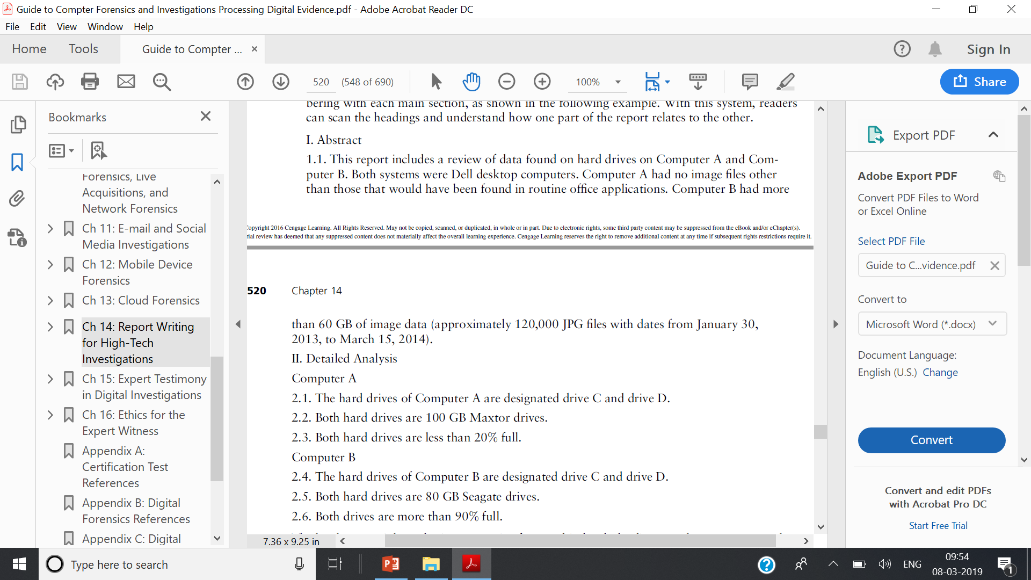
Designing the Layout and Presentation of Reports
Decimal numbering structure

Slide 23
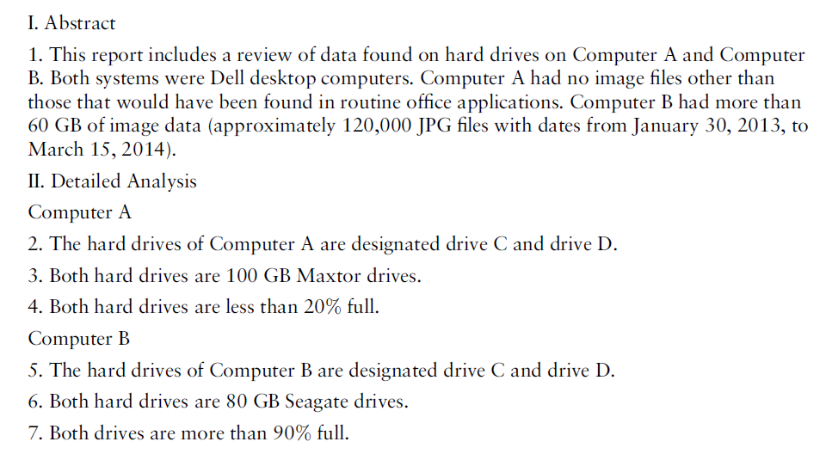
Designing the Layout and Presentation of Reports
Legal-sequential numbering

Slide 24
4. Providing supporting material
  Use material such as figures, tables, data, and equations to help tell the story as it unfolds
5. Formatting consistently
  How you format text is less important than being consistent in applying formatting
6. Explaining examination and data collection methods
  Explain how you studied the problem, which should follow logically from the purpose of the report
  Data collection is a critical portion of the report
7. Including calculations
  If you use any hashing algorithms, be sure to give the common name

Slide 25
8. Providing for uncertainty and error analysis
  a statement of limitations of knowledge and uncertainty is necessary to protect your credibility
9. Explaining results and conclusions
  Explain your findings, using subheadings to divide the discussion into logical parts
  Save broader generalizations and summaries for the report’s conclusion
10.Providing references
  Cite references by author’s last name and year of publication
  Follow a standard format
11. Including appendixes
  You can include appendixes containing material such as raw data, figures not used in the body of the report, and anticipated exhibits
  Arrange them in the order referred to in the report

Slide 26
Generating Report Findings with Forensics Software Tools
Forensics tools generate reports when performing analysis
Although forensics software reports what was found and where, remember that it’s your responsibility to explain the significance of the evidence you recover and, if necessary, define any limitations or uncertainty that applies to your findings.
Report formats
  Plaintext
  Word processor
  HTML format

Slide 27
Using ProDiscover Basic to Generate Reports
Create a new project
Add an image file to the project
Search for file extensions

Slide 28
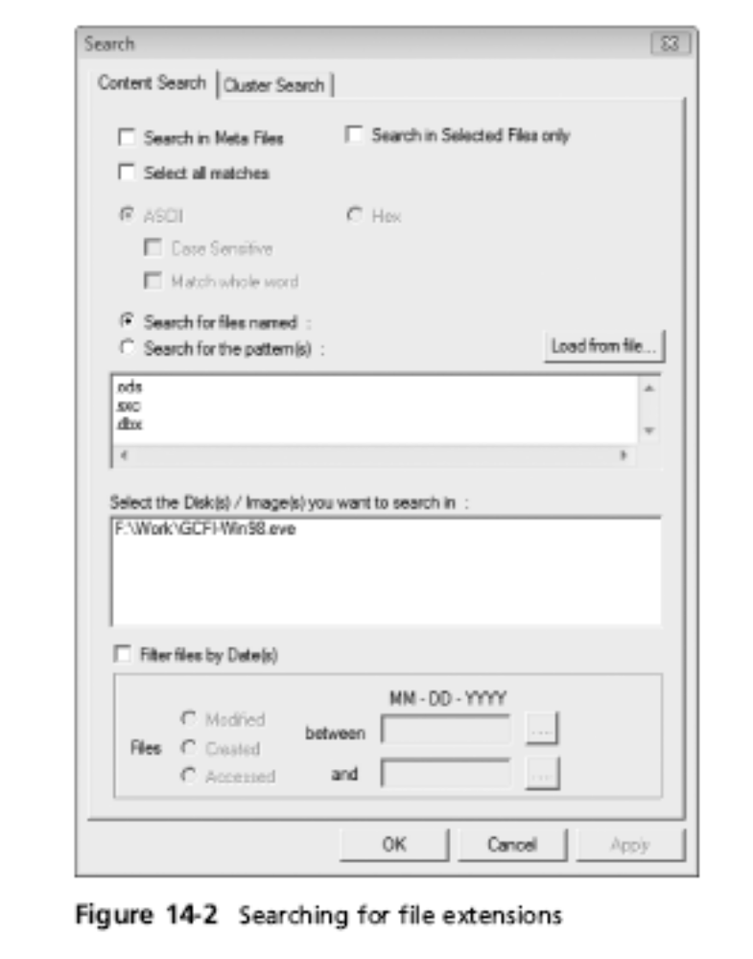

Slide 29
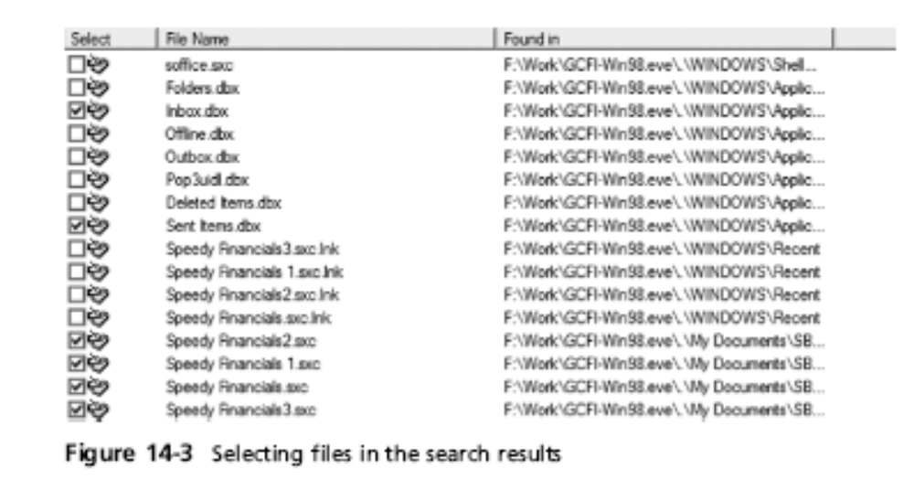
Using ProDiscover Basic to Generate Reports (continued)
Guide to Computer Forensics and Investigations

Slide 30
Using FTK Demo to Generate Reports
Create a new case
Add evidence to the case
Analyze evidence with FTK
  Look for image files
  Locate encrypted files
  Search for specific keywords
    Indexed search
    Live search
Guide to Computer Forensics and Investigations

Slide 31
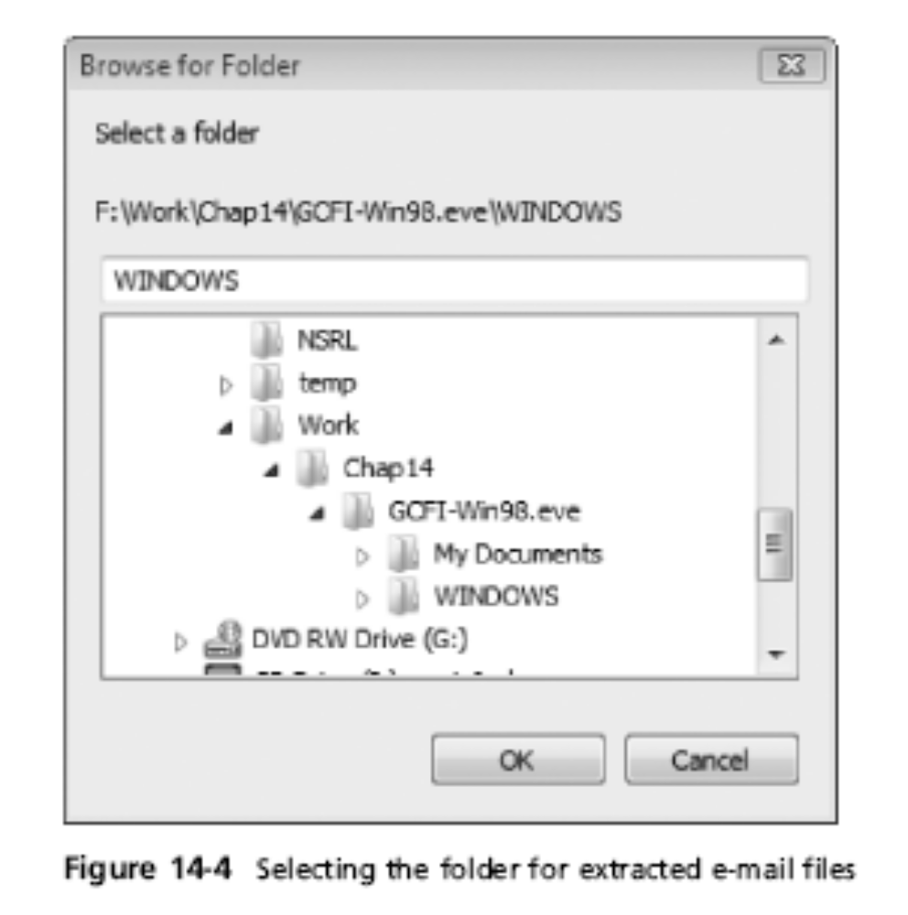
Using FTK Demo to Generate Reports (continued)

Slide 32
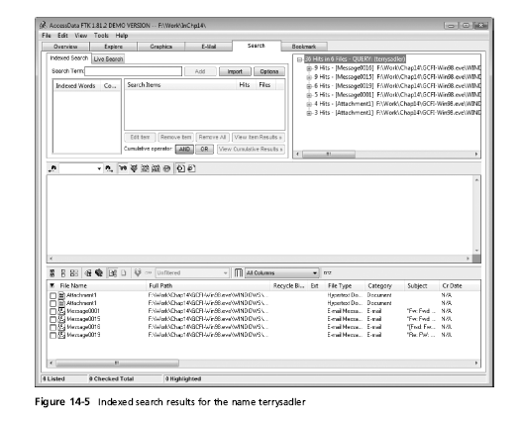
Guide to Computer Forensics and Investigations

Slide 33
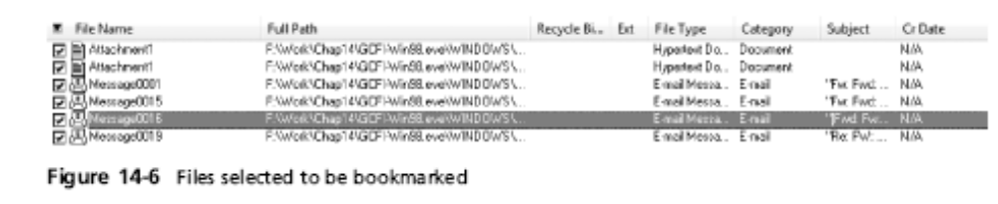
Using FTK Demo to Generate Reports (continued)
Create bookmarks
Generate a report from your bookmarks

Slide 34
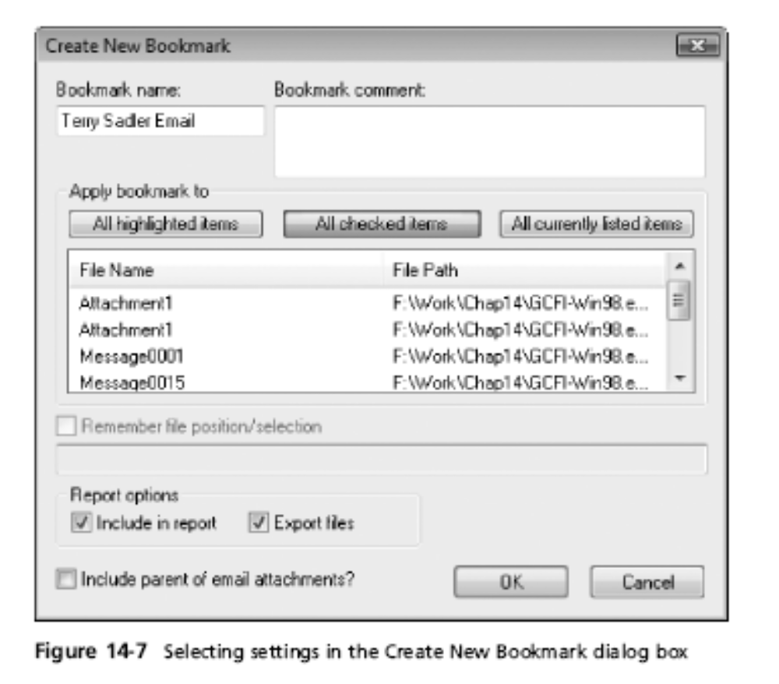
Using FTK Demo to Generate Reports (continued)
Guide to Computer Forensics and Investigations

Slide 35
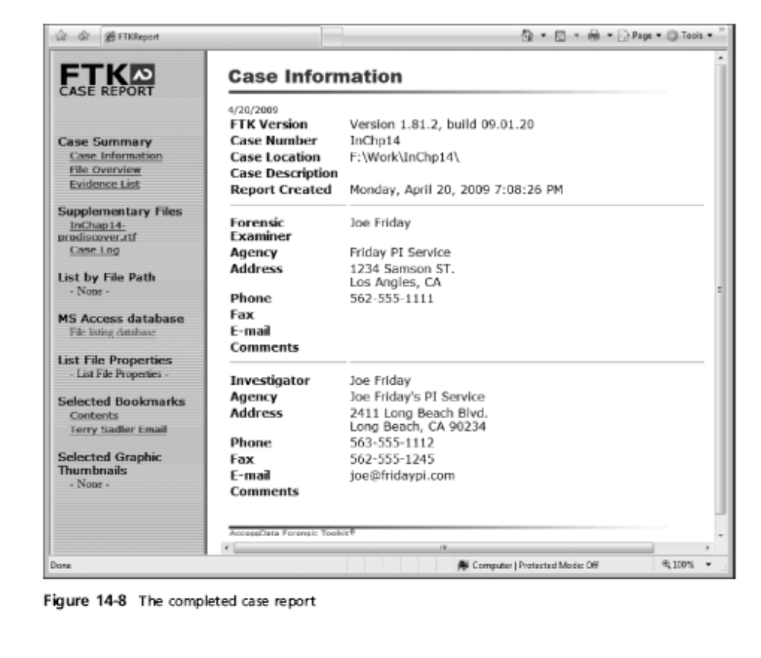
Using FTK Demo to Generate Reports (continued)

