Slide 1
Guide to Computer Forensics and Investigations
Fourth Edition
Chapter 15
Expert Testimony in High-Tech Investigations

Slide 2
Preparing for Testimony

Slide 3
Preparing for Testimony
Technical or scientific witness
  Provides facts found in investigation
  Does not offer conclusions
  Prepares testimony
Expert witness
  Has opinions based on observations
  Opinions make the witness an expert
  Works for the attorney

Slide 4
Preparing for Testimony (continued)
Confirm your findings with documentation
  Corroborate them with other peers
  Social networking and professional organizations will help to locate peers
Check opposing experts
  Internet
  Deposition banks
  Curriculum vitae, strengths, and weaknesses

Slide 5
Preparing for Testimony (continued)
When preparing your testimony consider the following questions:
  What is my story of the case?
  What can I say with confidence?
  What is the client’s overall theory of the case?
  How does my opinion support the case?
  What is the scope of the case? Have I gone too far?
  Have I identified the client’s needs for how my testimony fits into the overall theory of the case?

Slide 6
Documenting and Preparing Evidence
Document your steps
  To prove them repeatable
Preserve evidence and document it
Do not use formal checklist
  Do not include checklist in final report
  Opposing attorneys can challenge them
Collect evidence and document employed tools
Maintain chain of custody

Slide 7
Documenting and Preparing Evidence (continued)
Collect the right amount of information
  Collect only what was asked for
Note the date and time of your forensic workstation when starting your analysis
  Check your clock with time.gov
Keep only successful output
  Do not keep previous runs
Search for keywords using well-defined parameters

Slide 8
Documenting and Preparing Evidence (continued)
Keep your notes simple
List only relevant evidence on your report
Define any procedures you use to conduct your analysis as scientific
  And conforming to your profession’s standards
Monitor, preserve, and validate your work
Validate your evidence using hash algorithms

Slide 9
Consulting Expert:
Depending on your attorney’s needs, you might give him or her just your opinion and technical expertise instead of testifying in court; this role is called a “consulting expert.”

Slide 10
Reviewing Your Role as a Consulting Expert or an Expert Witness
Do not record conversations or telephone calls
Federal information requirements
  Four years of experience
  Ten years of any published writings
  Previous compensations
Learn about all other people involved and basic points in dispute
Brief your attorney on your findings and opinion of the court’s expert
Find out if you are the first expert asked

Slide 11
Creating and Maintaining Your CV
Curriculum vitae (CV)
  Lists your professional experience and education
  Supports your role as an expert
Show you continuously enhance your skills
Detail specific accomplishments
List basic and advanced skills
Include a testimony log
  Do not include books you have read, because you may not agree with everything in those books

Slide 12
Preparing Technical Definitions
Prepare definitions of technical concepts
Use your own words and language
Some terms
  Computer forensics
  Hash algorithms
  Image and bit-stream backups
  File slack and unallocated space
  File timestamps
  Computer log files

Slide 13
Preparing Technical Definitions (continued)
Some terms (continued)
  Folder or directory
  Hardware
  Software
  Operating system

Slide 14
Preparing to Deal with the News Media
Some legal actions generate interest from the news media
Reasons to avoid contact with news media
  Your comments could harm the case and create a record that can be used against you
  You have no control over the context of the information a journalist publishes
  You can’t rely on a journalist’s promises of confidentiality

Slide 15
Testifying in Court

Slide 16
Testifying in Court
Procedures during a trial
  Your attorney presents you as a competent expert
  Opposing attorney might attempt to discredit you
  Your attorney leads you through the evidence
  Opposing attorney cross-examines you

Slide 17
Understanding the Trial Process
Typical order of trial
  Motion in limine (pretrial motion to exclude evidence)
  Empaneling the jury
  Opening statements
  Plaintiff
  Defendant
  Rebuttal
  Closing arguments
  Jury instructions

Slide 18
Providing Qualifications for Your Testimony
Demonstrates you are an expert witness
  This qualification is called voir dire
Attorney asks the court to accept you as an expert on computer forensics
Opposing attorney might try to disqualify you
  Depends on your CV and experience

Slide 19
Example Voir Dire
See page 547

Slide 20
General Guidelines on Testifying

Slide 21
Delivery and Presentation
Be conscious of the jury, judge, and attorneys
If asked something you cannot answer, say:
  That is beyond the scope of my expertise
  I was not requested to investigate that
Be professional and polite
Avoid overstating opinions
Guidelines on delivery and presentation:
  Always acknowledge the jury and direct your testimony to them

Slide 22
Delivery and Presentation
Movement
  Turn towards the questioner when asked
  Turn back to the jury when answering
Place microphone six to eight inches from you
Use simple, direct language to help the jury understand you
Avoid humor
Build repetition into your explanations

Slide 23
Delivery and Presentation
Use chronological order to describe events
If you’re using technical terms, identify and define these terms for the jury
Cite the source of the evidence the opinion is based on
Make sure the chair’s height is comfortable, and turn the chair so that it faces the jury

Slide 24
Delivery and Presentation
Dress in a manner that conforms to the community’s dress code
Don’t memorize your testimony
For direct examination
  State your opinions
  Identify evidence to support your opinions
  Relate the method used to arrive to that opinion
  Restate your opinion

Slide 25
Preparing Testimony
Prepare your testimony with the attorney who hired you
  How is data (or evidence) stored on a hard drive?
  What is an image or a bit-stream copy of a drive?
  How is deleted data recovered from a drive?
  What are Windows temporary files and how do they relate to data or evidence?
  What are system or network log files?

Slide 26
Using Graphics
Graphical exhibits illustrate and clarify your findings
Your exhibits must be clear and easy to understand
Graphics should be big, bold, and simple
The goal of using graphics is to provide information the jury needs to know
Review all graphics with your attorney before trial
Make sure the jury can see your graphics, and face the jury during your presentation

Slide 27
Avoiding Testimony Problems
Recognize when conflict-of-interest issues apply to your case
Avoid agreeing to review a case unless you’re under contract with that person
Avoid conversations with opposing attorneys
You should receive payment before testifying
Don’t talk to anyone during court recess
Make sure you conduct any conferences with your attorney in a private setting

Slide 28
Understanding Prosecutorial Misconduct
If you have found exculpatory evidence, you have an obligation to ensure that the evidence isn’t concealed
Initially, you should report the evidence to the prosecutor handling the case
  Be sure you document the communication
If this information isn’t disclosed to the defense attorney in a reasonable time
  You can report it to the prosecutor’s supervisor or the judge

Slide 29
Testifying During Direct Examination
Techniques
  Work with your attorney to get the right language
  Be wary of your inclination to be helpful
  Review the examination plan your attorney has prepared
  Provide a clear overview of your findings
  Use a systematic easy-to-follow plan for describing your methods
  Practice testifying
  Use your own words when answering questions

Slide 30
Testifying During Direct Examination (continued)
Techniques (continued)
  Present your background and qualifications
  Avoid vagueness
  When you’re using graphics in a presentation, keep in mind that you’re instructing the jury in what you did to collect evidence

Slide 31
Testifying During Cross-examination
Use your own words
Keep in mind that certain words have additional meanings
Opposing attorneys sometimes use the trick of interrupting you
Be aware of leading questions
Never guess when you do not have an answer

Slide 32
Testifying During Cross-examination (continued)
Be prepared for challenging, pre-constructed questions
  Did you use more than one tool?
Rapid-fire questions
Sometimes opposing attorneys declare that you aren’t answering the questions
Keep eye contact with the jury
Sometimes opposing attorneys ask several questions inside one question

Slide 33
Testifying During Cross-examination (continued)
Attorneys make speeches and phrase them as questions
Attorneys might put words in your mouth
Be patient
Most jurisdictions now allow the judge and jurors to ask questions
Avoid feeling stressed and losing control
Never have unrealistically high self-expectations when testifying; everyone makes mistakes

Slide 34
Preparing for a Deposition

Slide 35
Preparing for a Deposition
Deposition differs from trial testimony
  There is no jury or judge
Opposing attorney previews your testimony at trial
Discovery deposition
  Part of the discovery process for a trial
  Conducts an equivalent of cross examination & direct examination
Testimony preservation deposition
  Requested by your client
  Preserve your testimony in case of schedule conflicts or health problems

Slide 36
Guidelines for Testifying at Depositions
Some recommendations
  Stay calm, relaxed, and confident
  Maintain a professional demeanor
  Use name of attorneys when answering
  Keep eye contact with attorneys
  Try to keep your hands on top of the table
  Be professional and polite
  Use facts when describing your opinion
  Being deposed in a discovery deposition is an unnatural process

Slide 37
Guidelines for Testifying at Depositions (continued)
If you prepared a written report, the opposing attorney might attempt to use it against you
If your attorney objects to a question from the opposing attorney
  Pause and think of what direction your attorney might want you to go in your answer
Be prepared at the end of a deposition to spell any specialized or technical words you used

Slide 38
Recognizing Deposition Problems
Discuss any problem before the deposition
  Identify any negative aspect
Be prepared to defend yourself
Avoid
  Omitting information
  Having the attorney box you into a corner
  Contradictions
Be professional and polite when giving opinions about opposite experts

Slide 39
Recognizing Deposition Problems
To respond to difficult questions that could jeopardize your client’s case
  Pause before answering
Keep in mind that you can correct any minor errors you make during your examination
Discovery deposition testimony often doesn’t make it to the jury
  It might be presented to the jury, usually as part of an attempt to discredit the witness

Slide 40
Guidelines for Testifying at Hearings
Testifying at a hearing is generally comparable to testifying at a trial
A hearing can be before an administrative agency or a legislative body or in a court
Often administrative or legislative hearings are related to events that resulted in litigation
A judicial hearing is held in court to determine the admissibility of certain evidence before trial
  No jury is present

Slide 41
Preparing Forensics Evidence for Testimony

Slide 42
Preparing Forensics Evidence for Testimony
Use ProDiscover Basic to extract e-mail folders
  And FTK Demo to extract and analyze e-mail metadata and messages
  See Figures 15-1 and 15-2

Slide 43
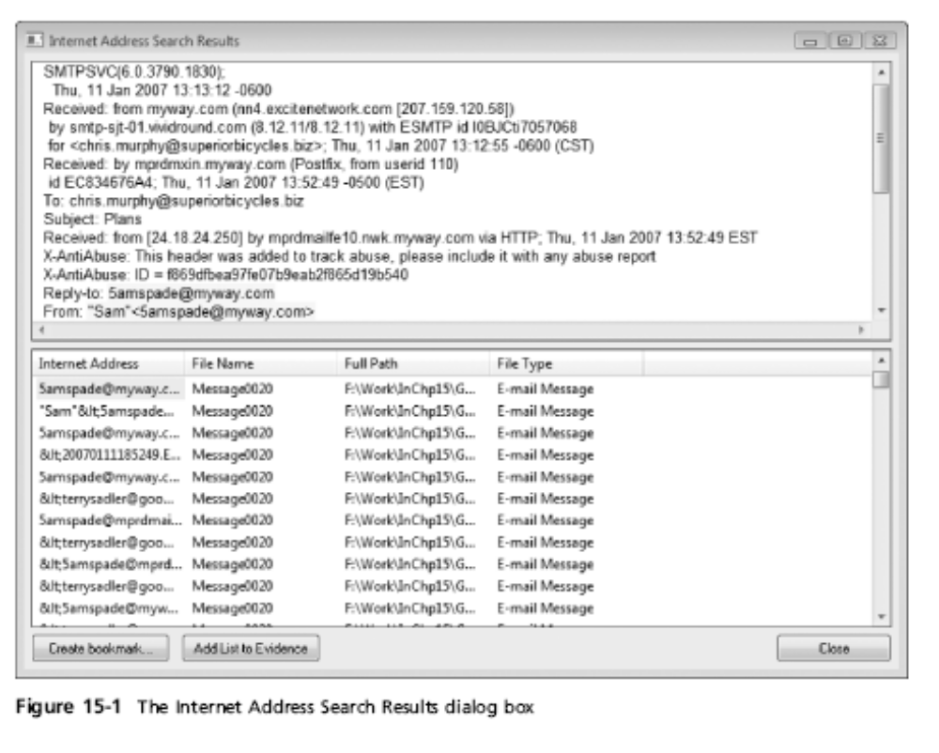
Preparing Forensics Evidence for Testimony (continued)

Slide 44

Preparing Forensics Evidence for Testimony (continued)

Slide 45
Preparing Explanations of Your Evidence-Collection Methods
To prepare for court testimony
  You should prepare answers for questions on what steps you took to extract e-mail metadata and messages
You might also be asked to explain specific features of the computer, OS, and applications (such as Outlook)
  And explain how these applications and computer forensics tools work

