Slide 1


Building a Discord Bot
Ganesh Tiwari

Slide 2




Ganesh Umesh Tiwari
Mentor and Member at Tesseract Coding
Gold Microsoft Learn Student Ambassador
Currently Studying MSC in CS at RD National College
University of Mumbai
And a lot of other interesting things….
gats.dev
igat786
gat786

Slide 3
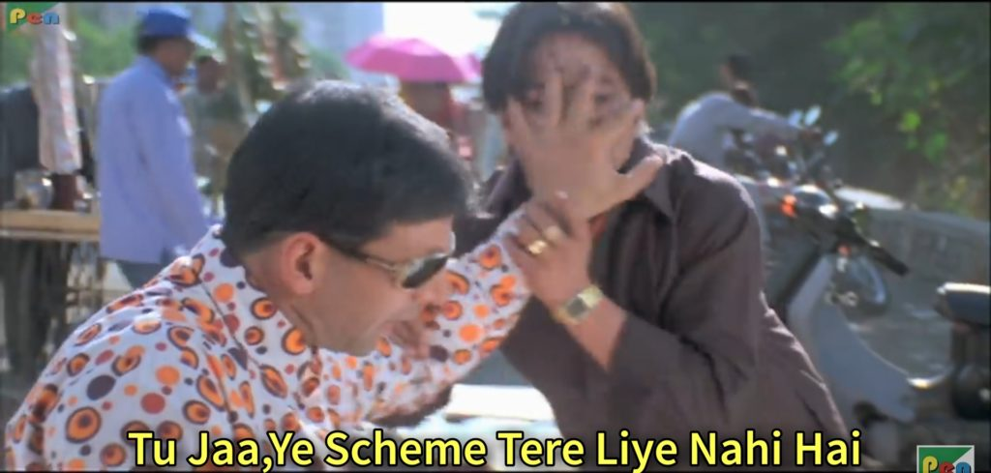
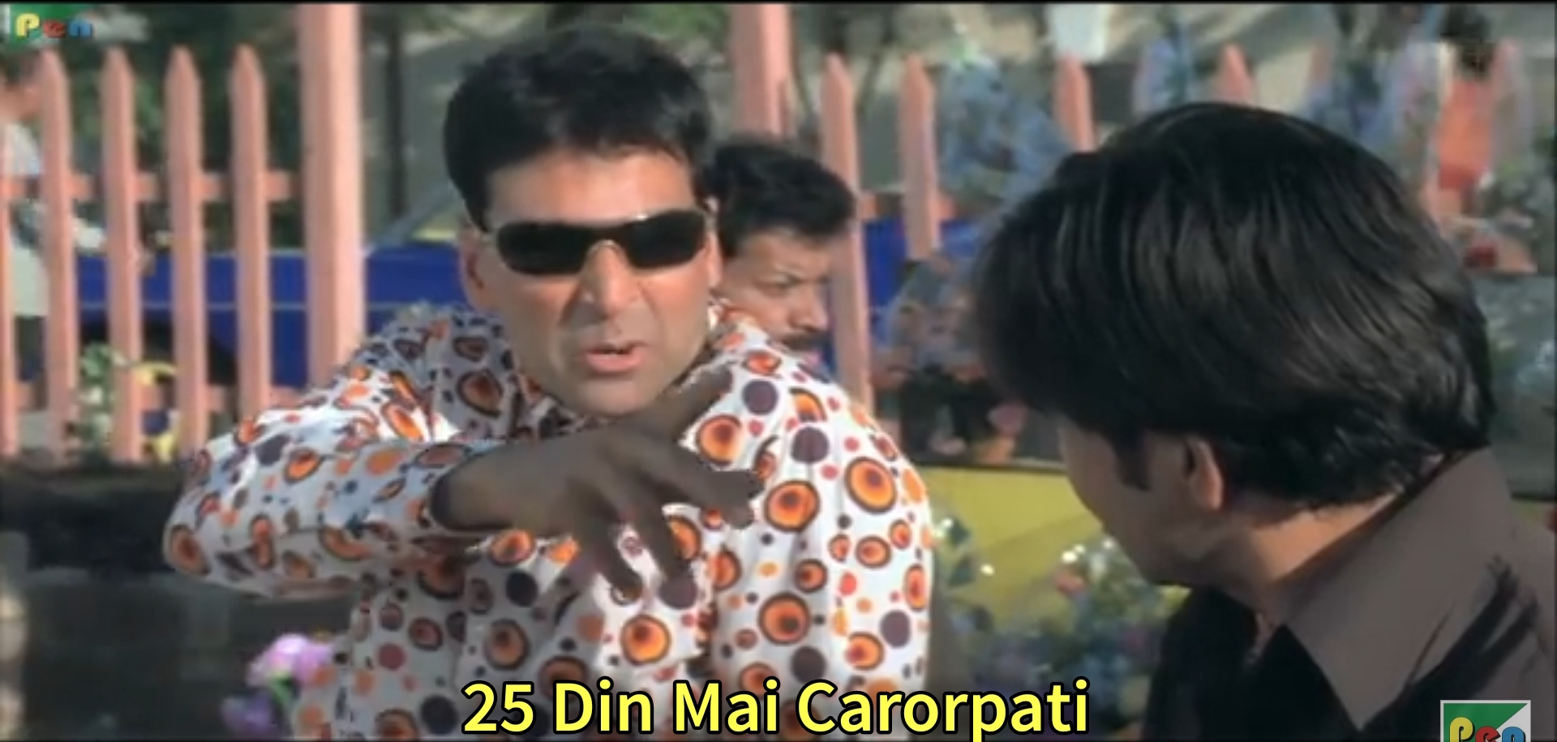
Now if you will ask me what is Discord or what is a bot I will say only one thing.
And the reason why you need to know to build a discord bot

Slide 4
How to make one?
The process is simple and consists of following steps
Go to Discord Developers Portal
Create your discord app
Create a bot within that app
Now go and write code for that app.

Slide 5
Now starts the interesting bits
While discord has its own API with which you can start building your bot. It can quickly get pretty tough and confusing to maintain the codebase as you would be handling a lot of things to do just a small task.
It is often easier to build apps with SDK’s which is nothing but these REST API’s wrapped inside language specific codebase making it easier to handle REST requests.

Slide 6

What ways are we going to use?
We will use discord.py
It is a community built and maintained Python SDK for Discord API’s and make the process of building Discord bots a lot easier than it would have been without it.
Logo of discord.py

Slide 7
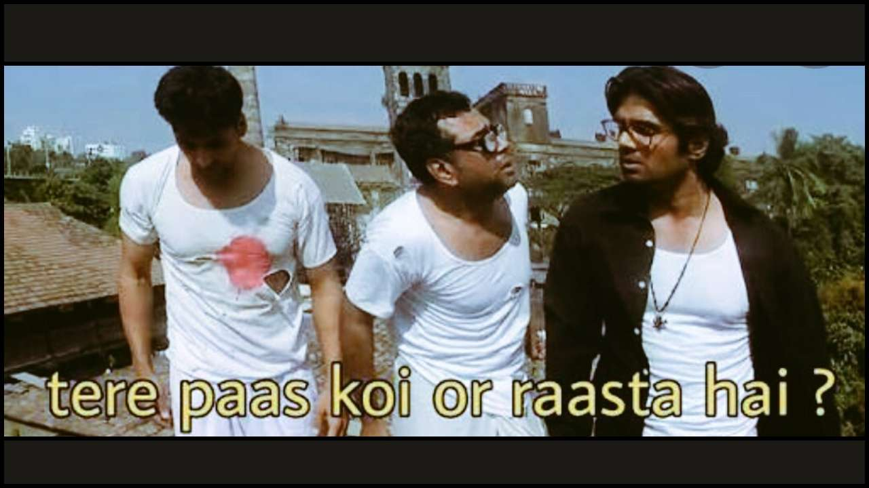
To that if you ask me why discord.py then I would say

Slide 8
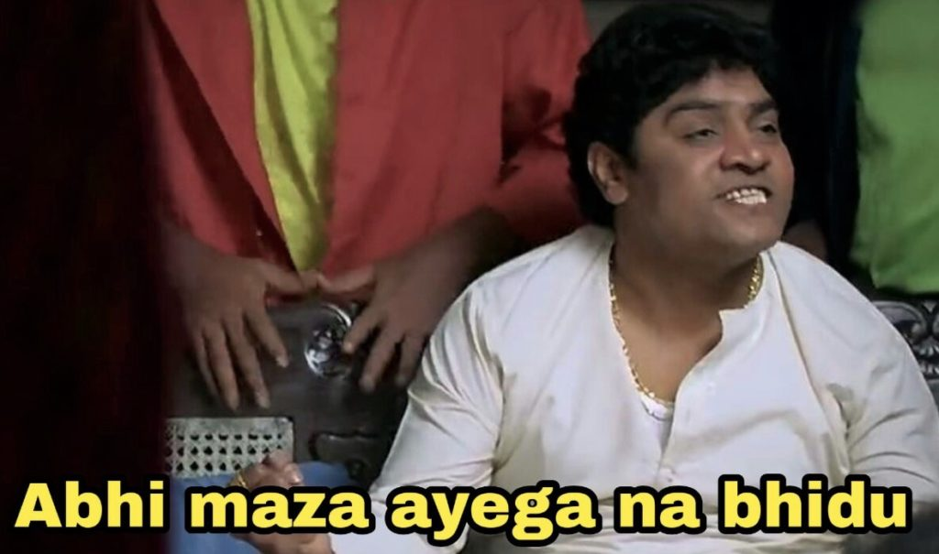
Lets begin with Coding….

Slide 9
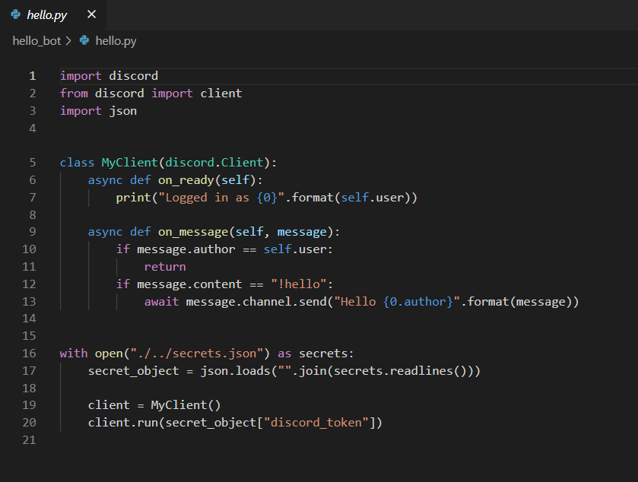
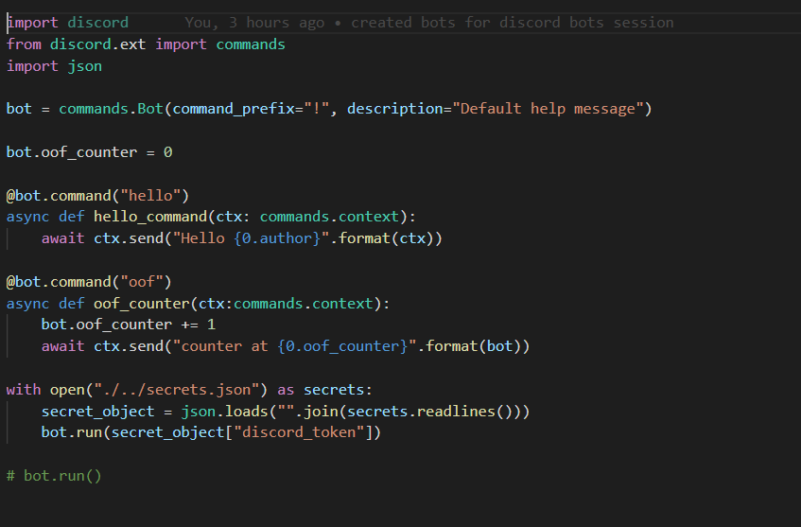
There are two ways with which you can structure your bots code with Discord.py
Standard way of defining callbacks inside a client
Using named functions with commands extension of discord.py

Slide 10
All of the resource and codes used in this session including this presentation are available at
https://github.com/gat786/discord-bot-session
You can also find me at Tesseract Codings Discord Server as Bill Gats (Best Mentor)
You all are most welcome to come and contribute to our Ric-Bot which is available at
https://github.com/TesseractCoding/Ric-Bot
We already have a few issues open and will be waiting for your contributions eagerly

Slide 11
Thank you for giving your precious time and attention
Yours truly,
gat786

