Slide 1
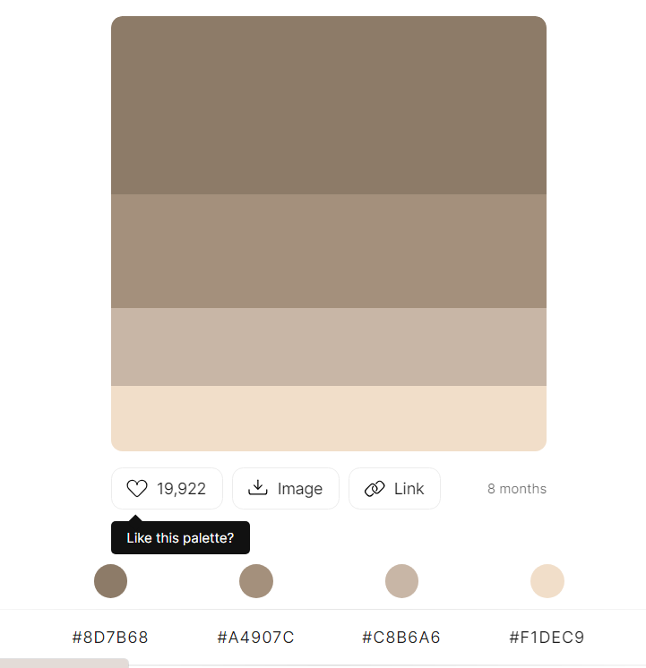

Beanmaster
Home buy now
Hi fellas!
Welcome to
Your personal coffee bean maker

Slide 2
Home buy now
About
Bean Maker was created in 2000 to facilitate every person who want to have a coffee bean
Image coffee

Slide 3
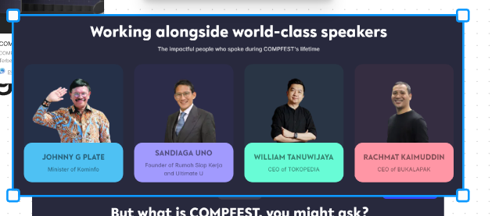
Home buy now
Core values
image
image
Image
Image
Sustainability
Hygiene
Organic
Fairness

