Slide 1
ACE Team
(Algae Count Estimator)
Samuel Dunlap, Matt Ralphs, Josh Minor, Andrew Young

Slide 2
How ACE Works

Slide 3
Architecture

Slide 4
Interface
Algae Slides
Contains randomly generated colonies and a known cell count
Trainer
Contains algae slide generated by slide's gen_colony() function
Result put into text box and saved into data repository
Editor
User generated slides are saved into data repository
Statistics
Gets resultset from data repository, put into table
Graphs will be generated from data

Slide 5
GUI – Framework and Tools
QT
UI Framework targeted for C++
Using PyQT for python code
QTDesigner
Tool to make GUI from QT components - widgets
Generates .UI file - XML
User Interface Compiler (pyuic4)
Generates python code from .UI file
Generated file imported into main code

Slide 6
Prototype Demonstration

Slide 7
Design Artifacts
Aside from initial UI design, prototype, and architecture the SDD outlines:
Naming Conventions
Programming Standards (formatting and documentation)
Component Design (UML Class Diagrams)
Change Request Procedure

Slide 8
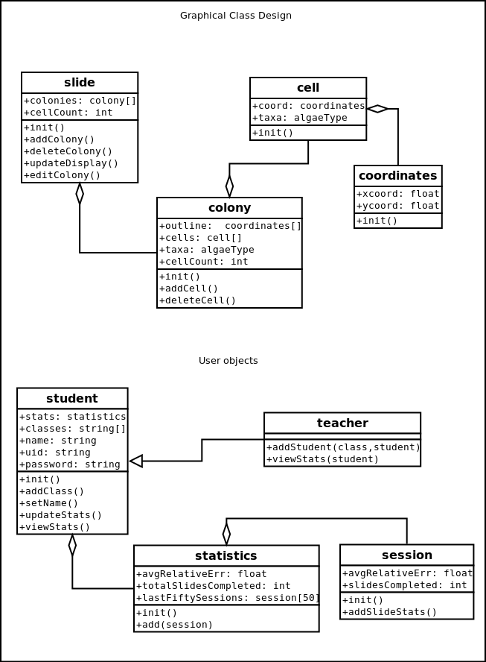
Example of Class Structure

Slide 9
View of Scrum/Agile
The good
Abandoned projects produce usable code
Tasks are nicely segmented
Dragging items around is incredibly satisfactory
Backlog provides easy way to show status and present problems for the SCRUM master
The bad
Development and Design seem mushed together
Hard to focus on specifically one or the other
Steady progress doesn’t work well with multiple projects on each student’s mind
Time to learn set us back a bit
Hard to compare to waterfall, as we have no experience with this either

Slide 10
Current Sprint

Slide 11
Roadblocks

