Slide 1
ACE Team
(Algae Count Estimator)

Slide 2
Team Members
Andrew Young – OO Methodologies, Web Applications, Java, .NET, SQL
Sam Dunlap – Numerical Methods, Efficiency Analysis
Josh Minor – C/C++, Lisp, Graphics experience
Matt Ralphs – C, Python, SQL, some GUI experience

Slide 3
Customers
Institute for Watershed Studies (IWS)
Director: Robin Matthews
Affiliated with Huxley College of the Enviornment
Geoffrey Matthews
CS Professor
Robin’s husband
Implementation guide

Slide 4
Problem
Phosphorous runoff in recent years has caused greater algae blooms
The surge in algae causes decreased oxygen levels in Lake Whatcom, and an increase in “slime” for our drinking water
In 2009, summer algal blooms caused water filtration to slow so dramatically that the city imposed mandatory limits on water use
We need accurate counts to treat the water

Slide 5
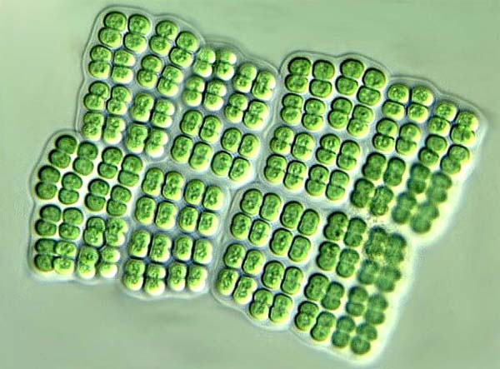
Some are easy to count
Merismopedia

Slide 6
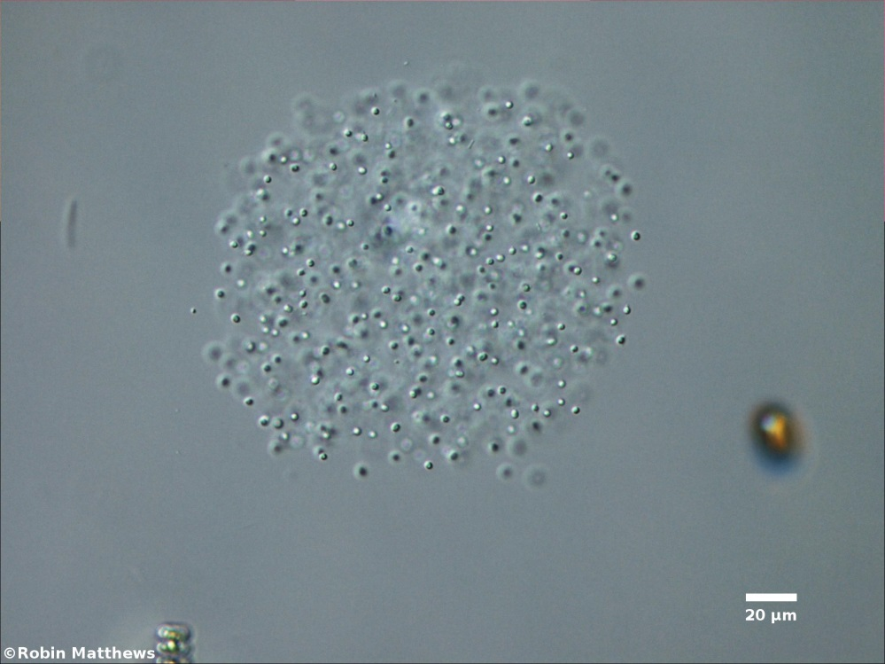
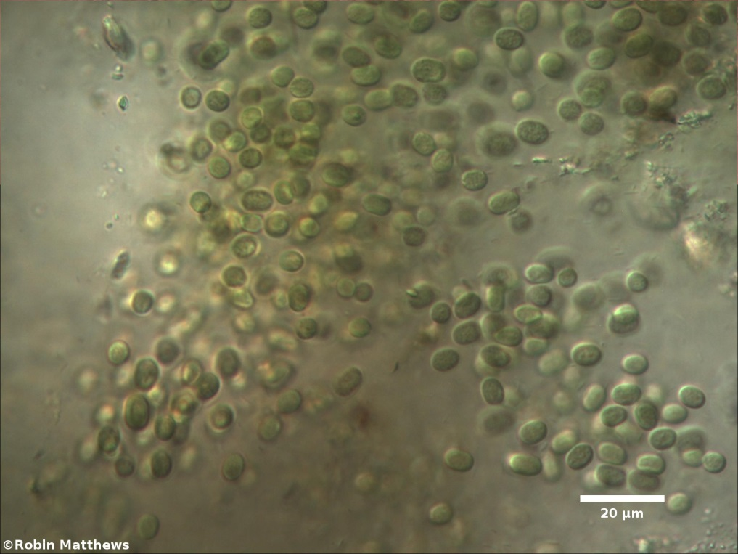
Some are not
Aphanocapsa
Aphanothece

Slide 7
Our Task
To generate algae slides with known counts to aid scientists in their estimations
Consists of two main parts:
A trainer tool that quizzes the participant given a range of slides
Will provide feedback stats to aid in future improvement
A user-generation mode that allows the user to create a slide resembling their current sample
Thus, the program’s count should aid in the estimation of the sample in question

Slide 8
FR-1
The system shall be able to generate algae colony images with known counts.
Associated Use Cases:
UC-10 Select Algae Taxa
UC-11 Toggle Debris
UC-12 Algae Generator

Slide 9
FR-2
The system shall guide the user through a training process of estimating algae counts.
Associated Use Cases:
UC-5 Start Estimation Trainer Session
UC-6 Estimate Size of Algae Colony
UC-11 Toggle Debris
UC-20 Load Slide
UC-21 Add Slide to Trainer

Slide 10
FR-3
The system shall provide controls that a microscope would have.
Associated Use Cases:
UC-7 Adjust Magnification
UC-8 Pan Slide
UC-9 Adjust Lighting

Slide 11
FR-4
The system shall provide an editor that allows the user to create their own algae images.
Associated Use Cases:
UC-10 Select Algae Taxa
UC-11 Toggle Debris
UC-12 Algae Generator
UC-13 Draw Shape of Colony
UC-14 Select a Colony Shape
UC-15 Adjust Density inside Colony Shape
UC-16 Delete Colony Shape
UC-17 Undo Previous Action
UC-18 Create New Slide
UC-19 Save Slide
UC-20 Load Slide
UC-21 Add Slide to Trainer

Slide 12
FR-5
The system shall record and display statistics on a user's algae estimation performance.
Associated Use Cases:
UC-2 Create User Account
UC-3 Log In
UC-4 Log Out
UC-22 View Personal Statistics
UC-23 View Class Statistics
UC-24 View a Student’s Statistics

Slide 13
FR-6
The system shall provide an intuitive user interface.
Associated Use Cases:
UC-1 Select Mode
UC-12 Algae Generator
UC-13 Draw Shape of Colony
UC-15 Adjust Density inside Colony Shape

