Slide 1
ACE Team
(Algae Count Estimator)
Samuel Dunlap, Matt Ralphs, Josh Minor, Andrew Young

Slide 2
How ACE Works
Qt application framework, renders and displays UI Widgets.
User input is captures though mouse clicks and interaction with UI Widgets
The view of the virtual microscope is represented as “slides”.
Slides are built and maintained using the slide manager controller

Slide 3
Architecture
Qt Framework
ACE Backend
Data Repository
User Manager
User Accounts
Views
Slide Manager
Slides
Navigation View
Statistics View
Trainer View
User Management View
Trainer Manager
Statistics
Editor View

Slide 4
Interface
Algae Slides
Contains randomly generated colonies and a known cell count
Trainer
Contains algae slide generated by slide's gen_colony() function
Result put into text box and saved into data repository
Editor
User generated slides are saved into data repository
Statistics
Gets resultset from data repository, put into table
Graphs will be generated from data

Slide 5
GUI – Framework and Tools
QT
UI Framework targeted for C++
Using PyQT for python code
QTDesigner
Tool to make GUI from QT components - widgets
Generates .UI file - XML
User Interface Compiler (pyuic4)
Generates python code from .UI file
Generated file imported into main code

Slide 6
Prototype Demonstration

Slide 7
Design Artifacts
Aside from initial UI design, prototype, and architecture the SDD outlines:
Naming Conventions
Programming Standards (formatting and documentation)
Component Design (UML Class Diagrams)
Change Request Procedure

Slide 8
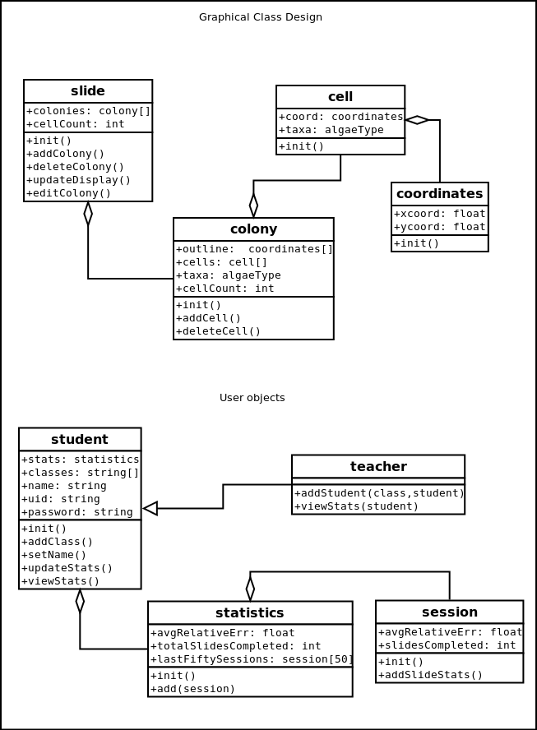
Example of Class Structure

Slide 9
View of Scrum/Agile
The good
Abandoned projects produce usable code
Tasks are nicely segmented
Dragging items around is incredibly satisfactory
Backlog provides easy way to show status and present problems for the SCRUM master
The bad
Development and Design seem mushed together
Hard to focus on specifically one or the other
Steady progress doesn’t work well with multiple projects on each student’s mind
Time to learn set us back a bit
Hard to compare to waterfall, as we have no experience with this either

Slide 10
Sprint 0
Outline UI Designs
Research options for GUI
Qt, PyQt
Research options for graphics display
SMFL, PyQt

Slide 11
Sprint 1
Create UI forms for Title Menu, Trainer, Editor
Generate PyQt code from the XML files
Implement transitions between different modes

Slide 12
Sprint 2
Create UI form for Statistics page
Add information to status bar
Draw slides to screen using PyQt

Slide 13
Sprint 3 (Current)
Implement basic functionality for Trainer mode
Generating new random slides
Receiving user input
Recording the displaying session stats

Slide 14
Roadblocks
Settling on a framework
Learning Qt
Choosing PyQt
Schedule Issues
Work in other classes delayed sprints

