Slide 1
Zeming Zhang Paper Reanalysis

Slide 2
CD8 2017 Cell Liver Cancer?
CD8 LEF1 naïve marker
CD8 CCR7 naïve marker
CD8 CX3CR1 CD8 effector
CD8 LAYN exhausted T cells
CD8 SLC4A10, ZBTB16, RORC MAIT mucosal-associated invariant T cells
CD8 GZMK effector memory?

Slide 3
CD4 2017 Cell Liver Cancer
CD4 CCR7 TCF7 SELL naïve marker genes
CD4 FOXP3 Tregs
CD4 CTLA4 exhausted marker
CD4 CCL5 and GZMA Helper

Slide 4
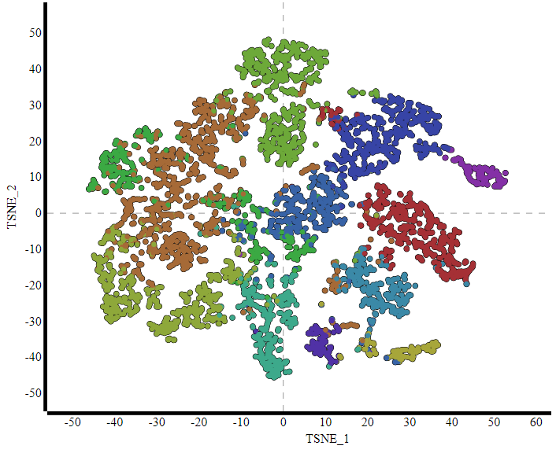
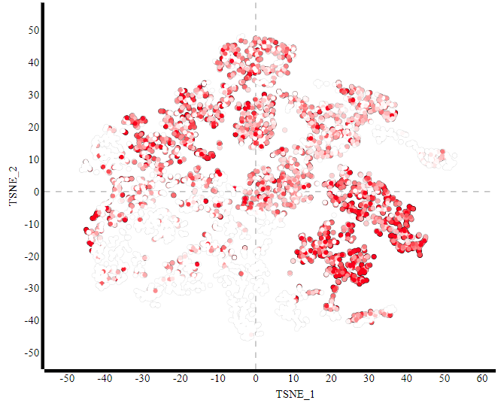
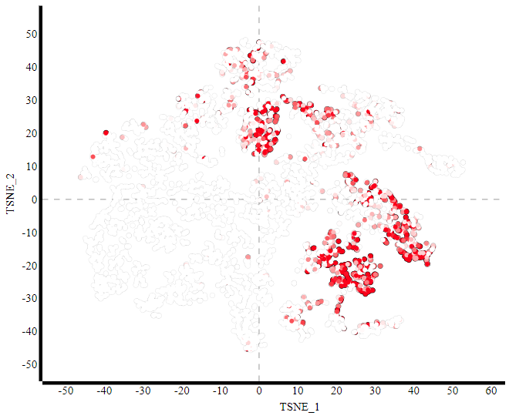
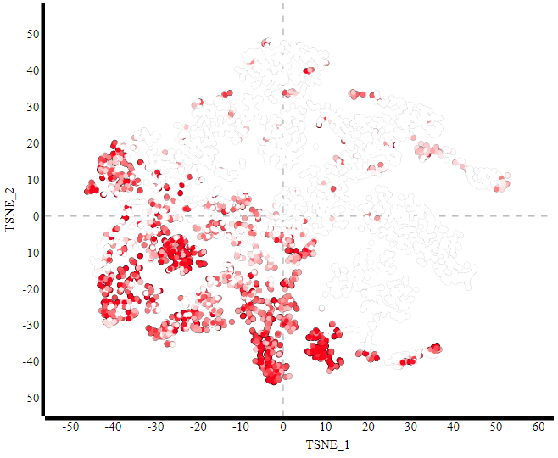
CD4 and CD8 cells
CD4
CD25 (IL2RA)
CD8A

Slide 5
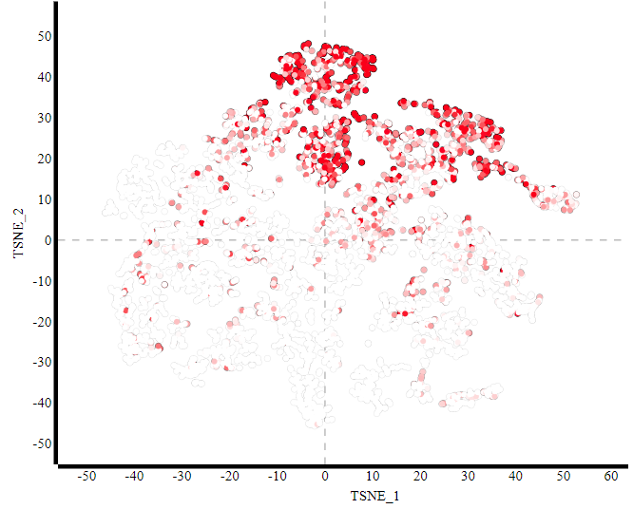
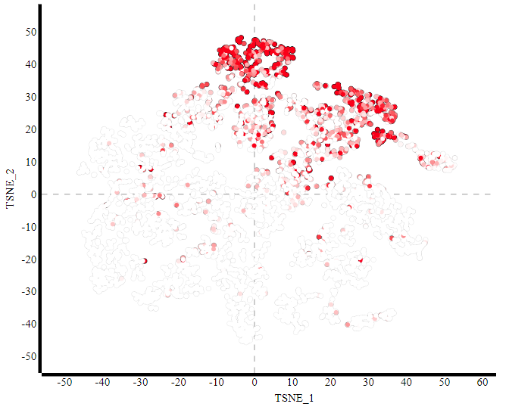
CD8 Naïve T cells
CD8A
LEF1
CCR7

Slide 6
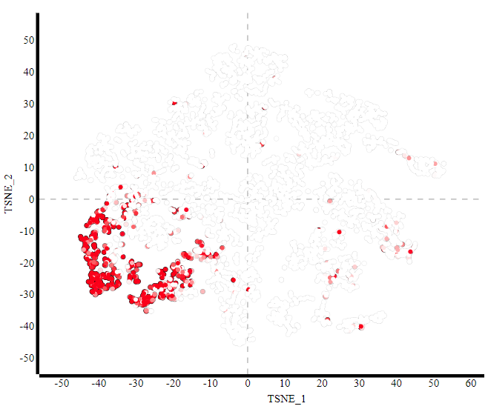
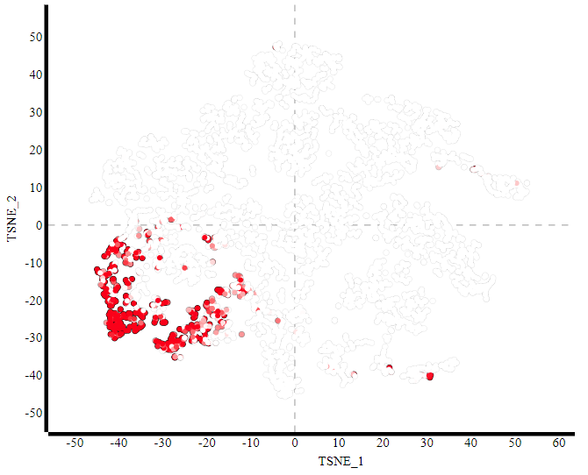
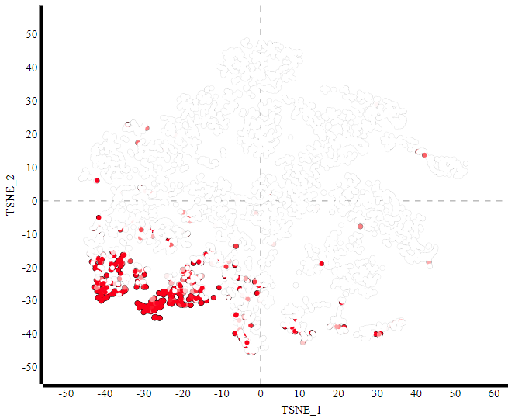
CD8 Effector T cells
CD8A
CX3CR1
FGFBP2
FCGR3A

Slide 7
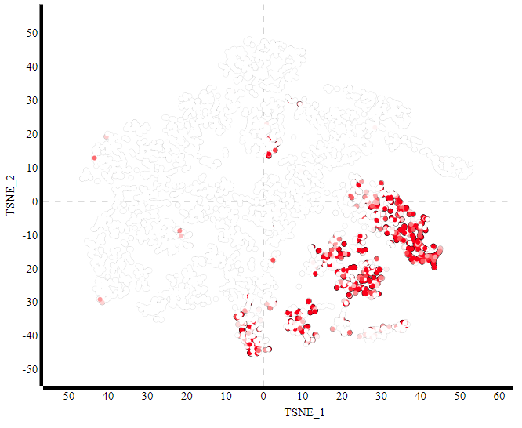
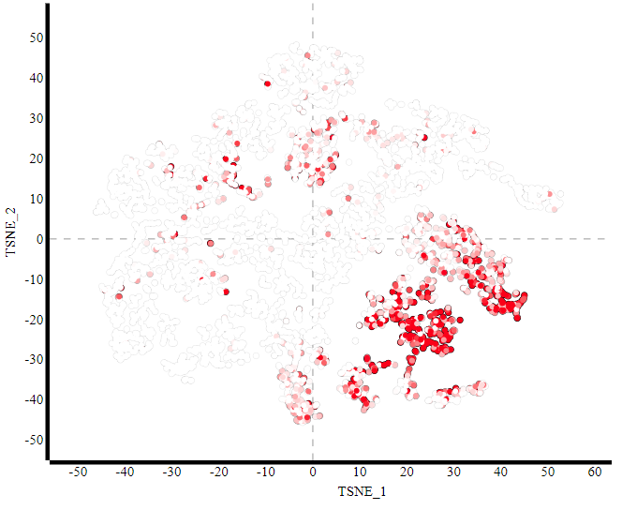
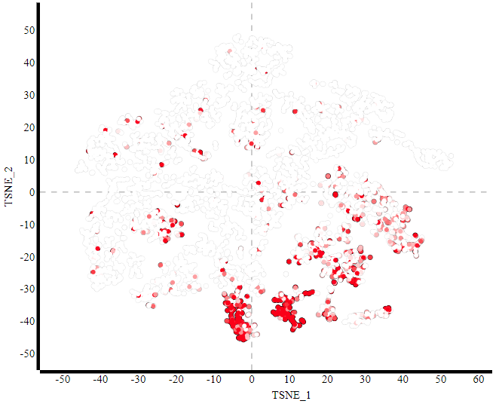
CD8 Exhausted T cells
CD8A
LAYN
CTLA4
HAVCR2

Slide 8
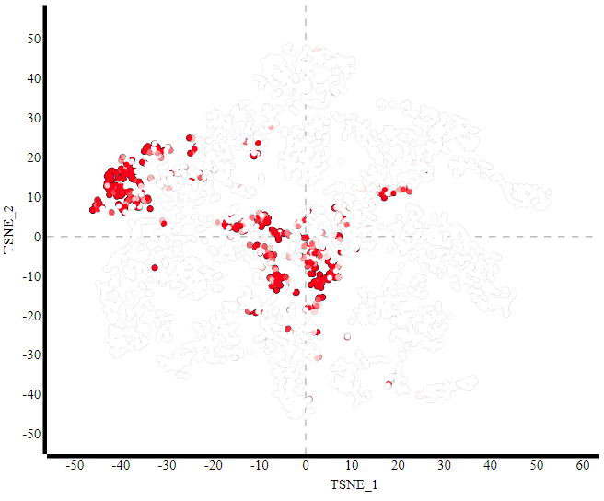
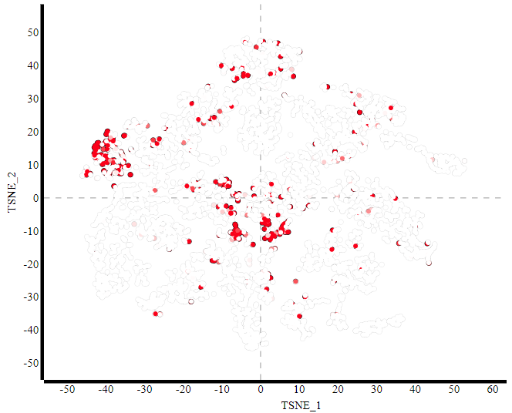
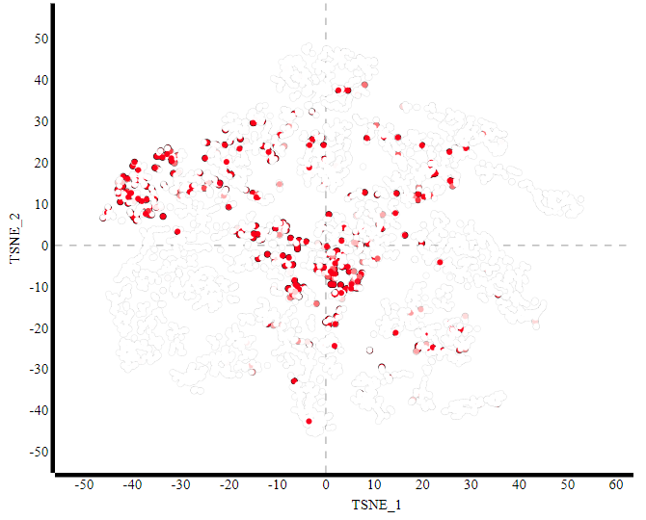
CD8 MAIT mucosal-associated invariant T cells
CD8A
SLC4A10
ZBTB16
RORC

Slide 9
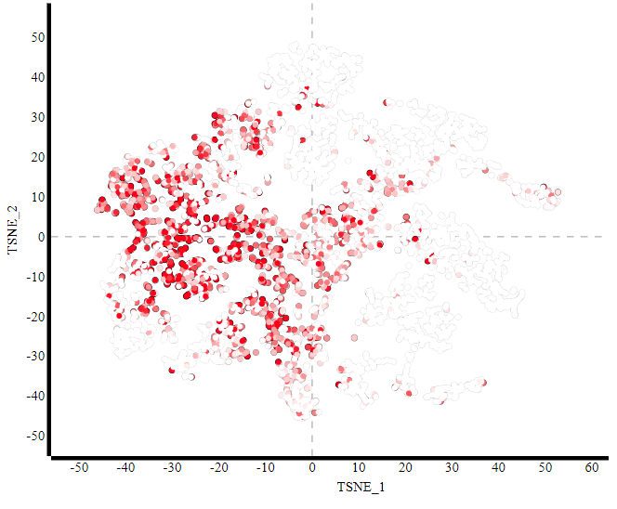
CD8 GMZK Intermediate between Effector and Exhausted T cells
CD8A
GMZK

Slide 10
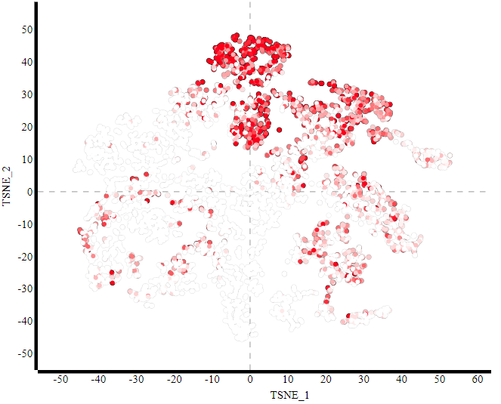
CD4 Naïve T cells
CD4
LEF1
CCR7
SELL

Slide 11
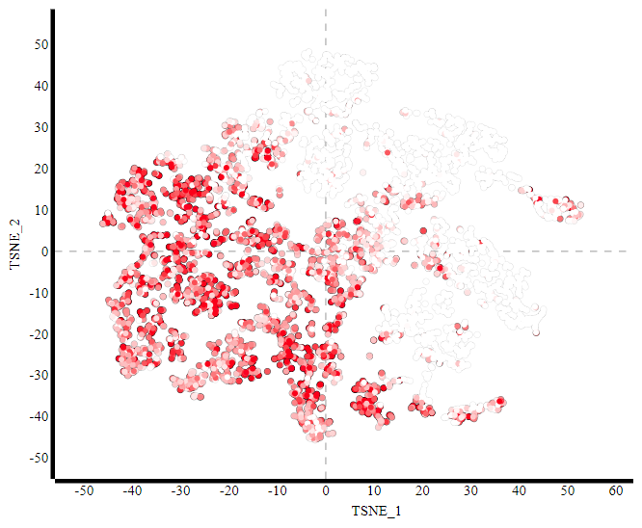
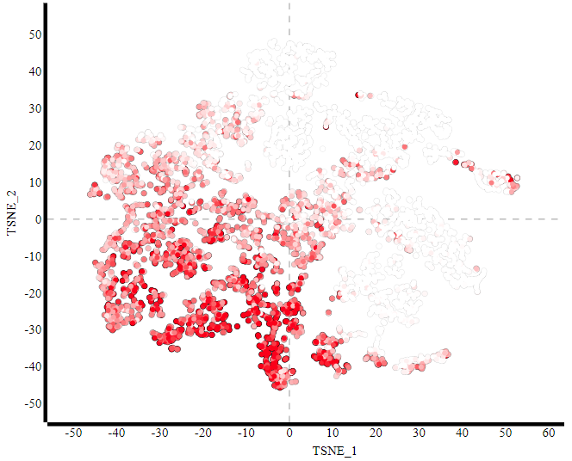
CD4 Helper
CD4
GZMA
CCL5

Slide 12
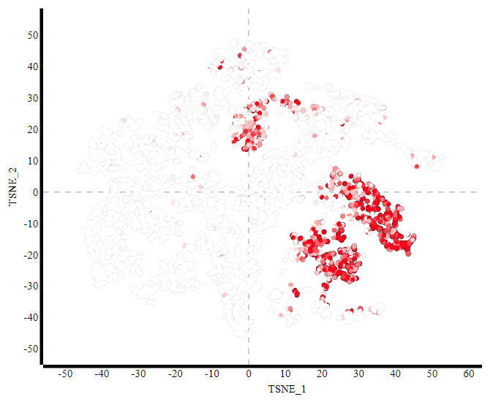
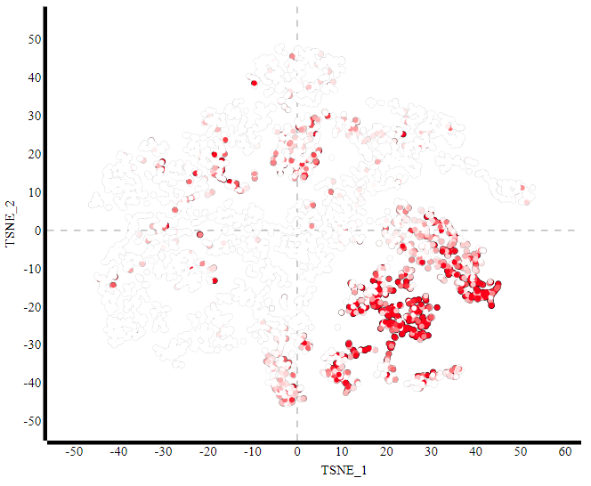
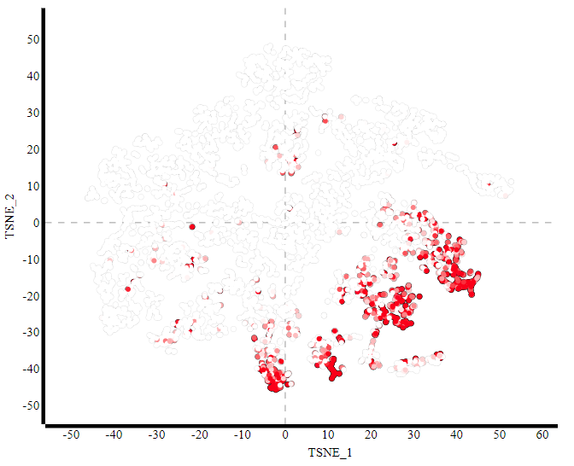
CD4 Tregs
CD4
FOXP3
CTLA4
TNFRSF9

Slide 13
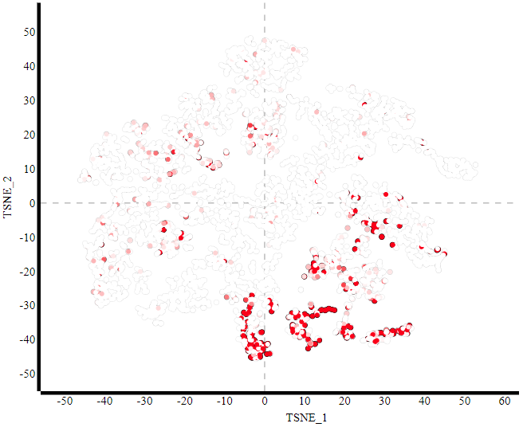
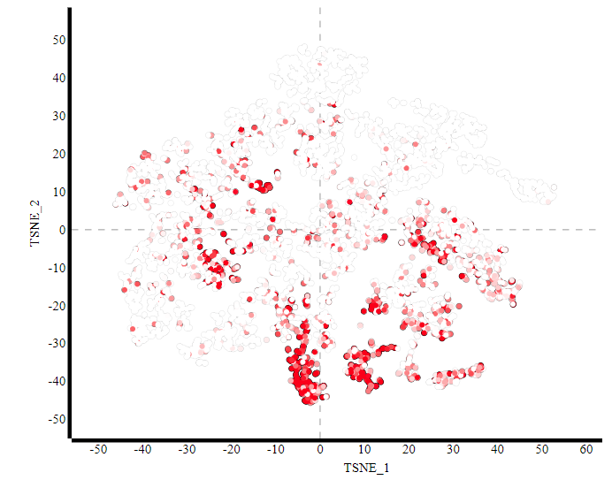
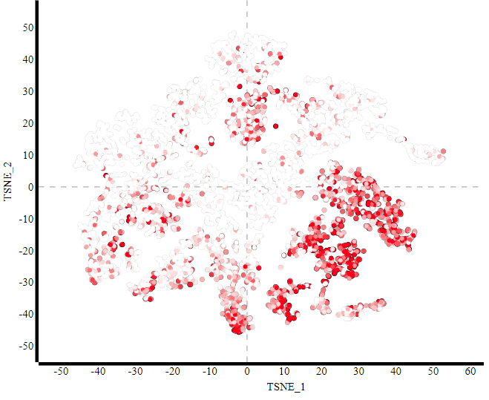
CD4 Exhausted CD4
CD4
CXCL13
PDCD1
TIGIT

Slide 14
Summary
T cells can be broadly characterized as
Naïve, Effector, Helper, Exhausted, Cytotoxic
Only a select few markers can distinguish the different state of CD4 and CD8

