Slide 1
histo_GUI.py guide
Phil Wilmarth
[Script written by Billy Rathje, summer 2014] Jan. 14, 2019
Notes:
This script does the threshold setting to control PSM false discovery rates. It is a graphical approach where the analyst interactively inspects and adjusts threshold choices.

Slide 2
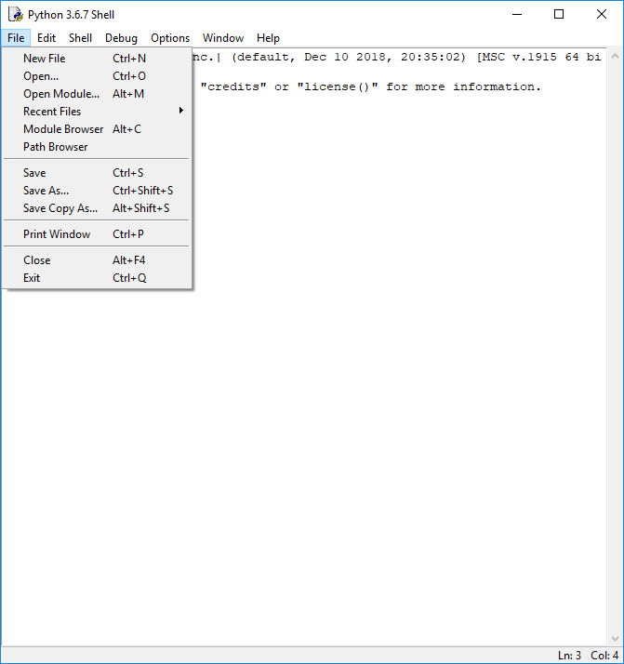
Notes:
Open the histo_GUI.py script from IDLE (“File” menu, “Open…” command, from the console “Shell” window).

Slide 3
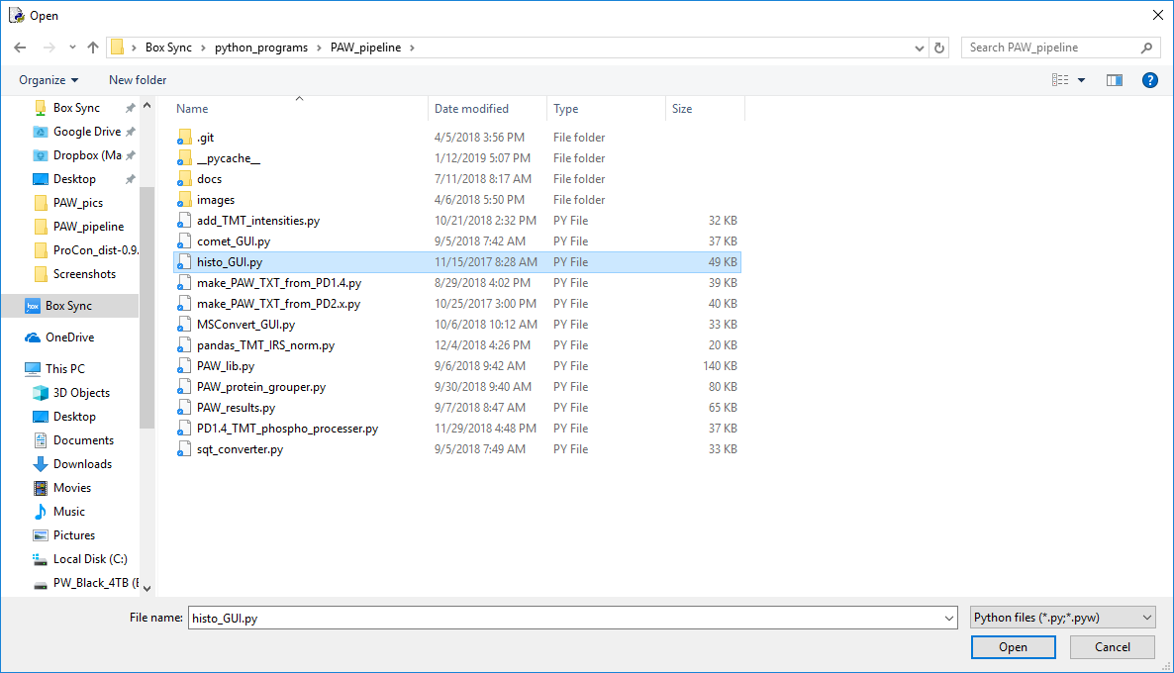
1
2
Notes:
Select the “histo_GUI.py” script in the file dialog box and click “Open”. You may need to browse to the location where the scripts are saved on your system.

Slide 4
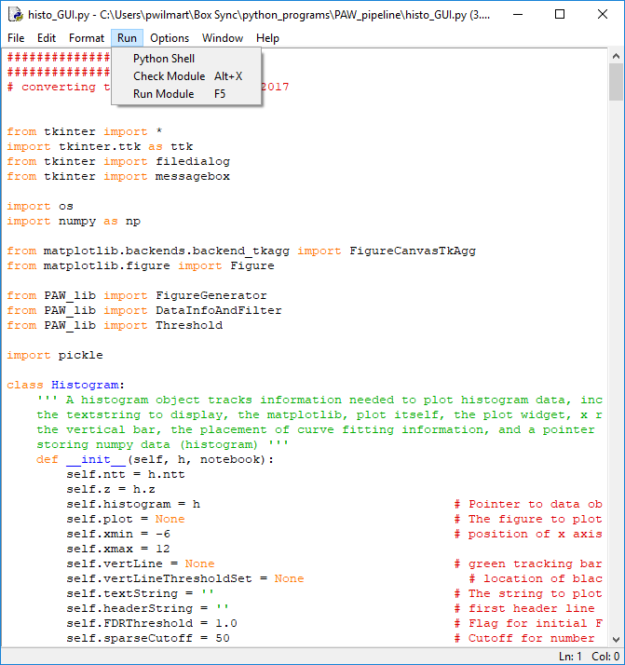
Notes:
From the code editor window, select the “Run Module” command from the “Run” menu (or press the F5 key).

Slide 5
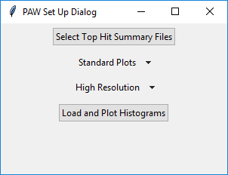
Notes:
A Tkinter GUI application will launch. The first window is a setup dialog box. Click on the first button (“Select Top Hit Summary Files”).

Slide 6
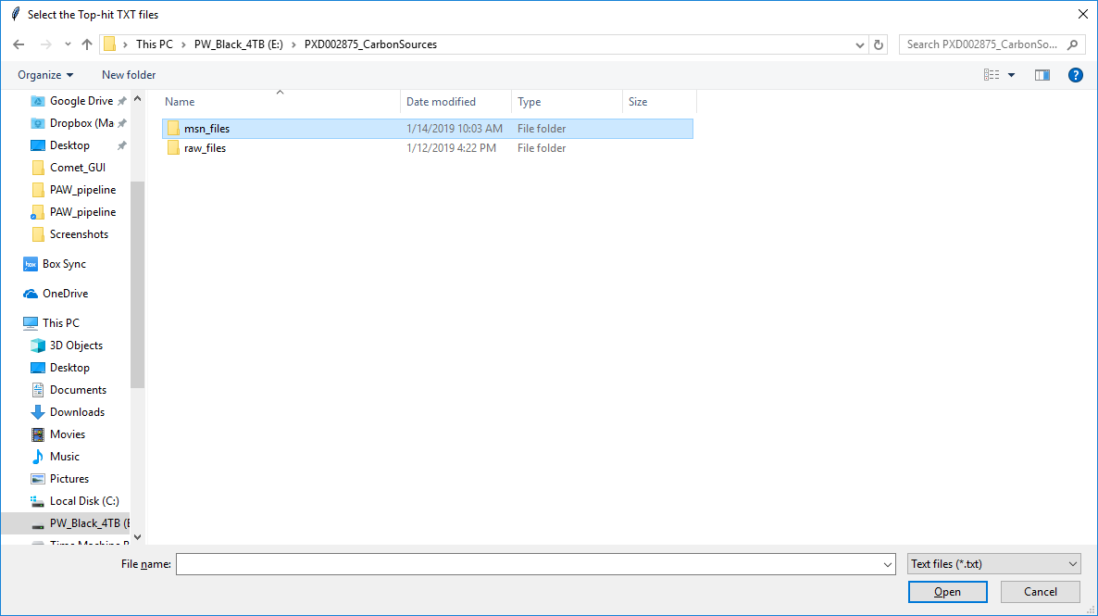
Notes:
This brings up a file browser dialog box. Browse to the location of the Comet search results. This is where the MS2 format files were located. After Comet runs, there will be SQT files that have the Comet results. The “sqt_converter.py” script converts the SQT files (with several matches per spectrum) into a “top hit” summary file. These TXT files have the top hit sequences and scoring information. They may also have reporter ion intensities. Double click the “msn_files” folder (or select then press the Open button).

Slide 7
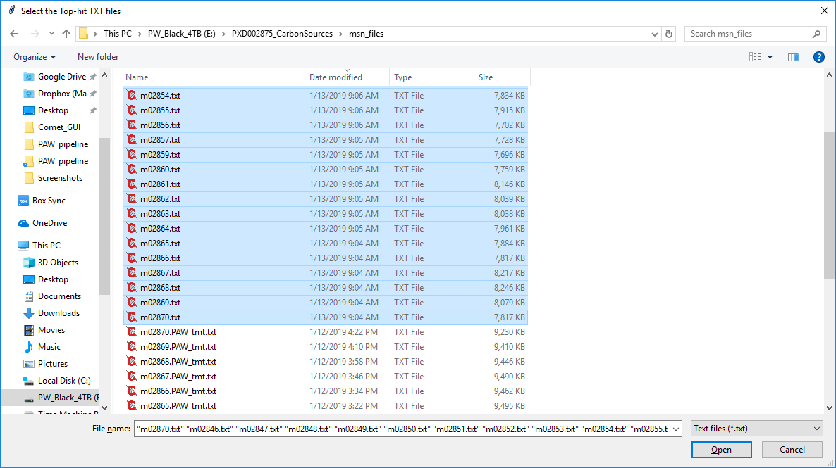
Select all of the top hit summary files
Then click
Notes:
Select all of the top hit summary text files (“txt” extension). This is a basic multiple file selection operation for your operating system. Then click the “Open” button. NOTE: the “PAW_tmt.txt” extension files are NOT top hit summary files. They are files with reporter ion intensities.

Slide 8
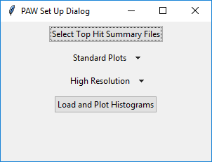
Standard or smoothed histogram plots
High resolution/accurate mass or low resolution ion traps
Notes:
The defaults are “Standard” histogram plots (or smoothed) and “High Resolution” (Orbitrap) instrument (or “Low Resolution” for ion traps). Change the defaults if need be, then press the bottom “Load and Plot Histograms” button.

Slide 9
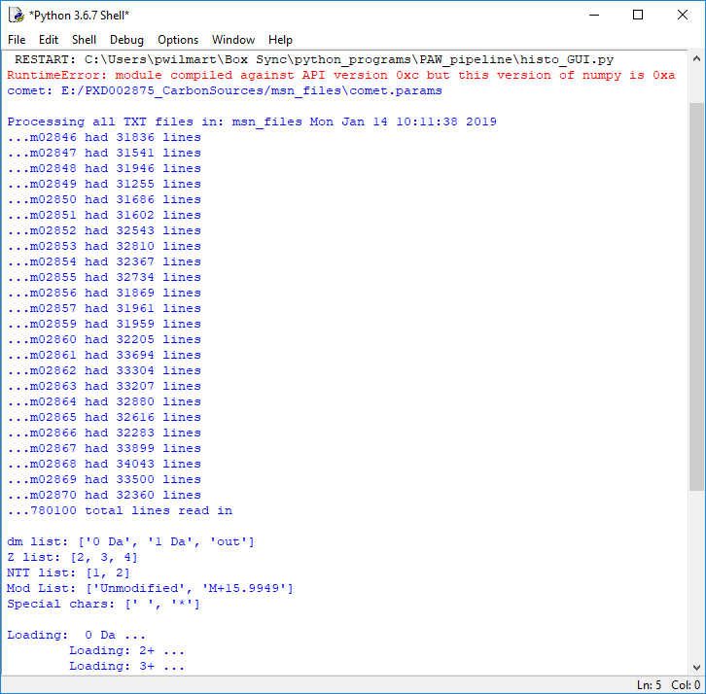
File reading progress
Selected search parameters
Notes:
The GUI application is not self-contained. Useful output still gets printed to the standard shell console window. Here we see that the 24 selected TXT files were read in. We see some of the search parameters that affect what histograms will be created. After the top hit files are read and the histograms have been constructed, the GUI window will have the delta mass histograms. When using high mass accuracy instruments, correct matches will have accurate masses and most incorrect masses with not have an accurate mass. We use a wider tolerance so that incorrect matches will not be coerced into having an accurate mass (essentially invalidating accurate mass as a discriminant).

Slide 10
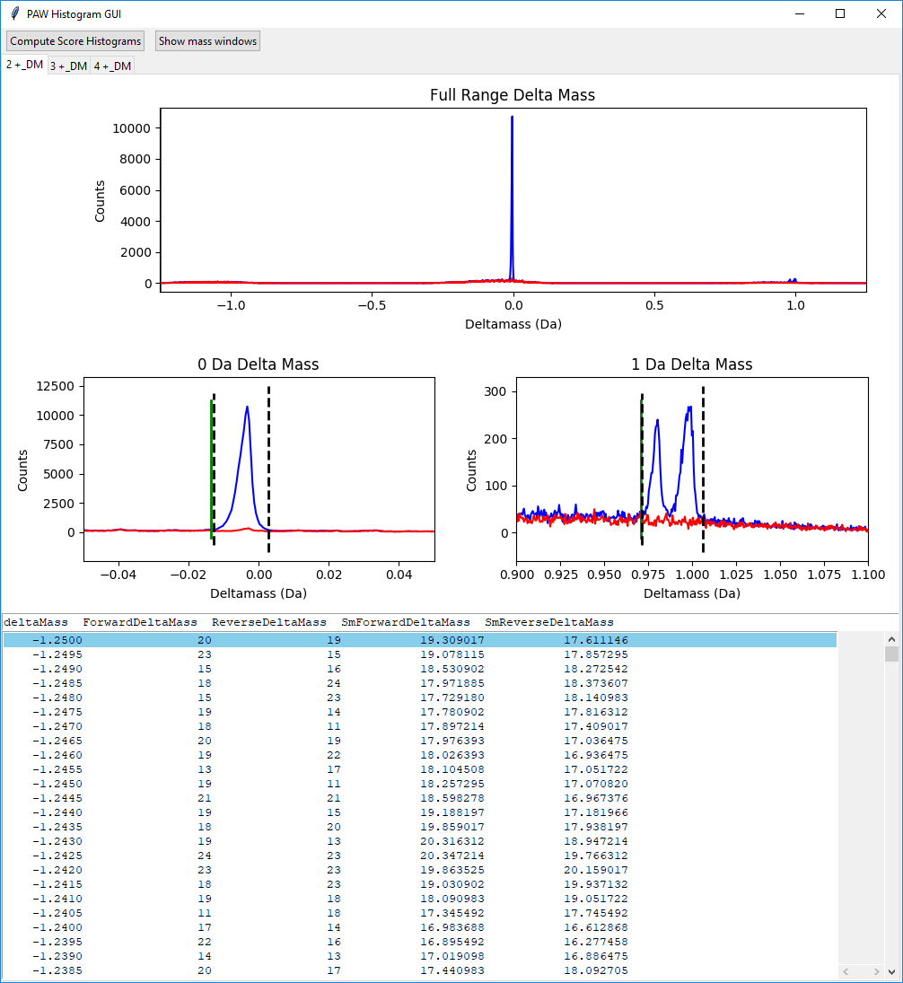
Notes:
The first step is to look at the accurate mass histograms. These are target/decoy histograms of the mass differences between the measured peptide masses and the theoretical masses of the matched sequences. There are a couple of control buttons at the top of the multi-tabbed window. There are tabs for the different charge states (2+, 3+, and 4+). For Orbitrap (high resolution) instruments, 1+ ions are not considered. We have some delta mass plots in the top half of the windows and a delta mass table in the bottom half. The table shows the target (blue histograms) and decoy (red histograms) counts as a function of the delta mass value. There are three plots and just one table. The table changes depending on which plot has been clicked (selected).
The plots and table are in Da units because those have some actual physical meaning. A delta mass near zero Da is desirable. There are two less common (but not negligible) situations that result in delta masses near 1-Da. Deamidation of asparagine (particularly –NG- motifs) is a common sample processing artifact (+0.984 Da mass shift). There can also be cases where the first isotopic peak is mis-assigned as the monoisotopic peak, a +1.003 Da shift. We get better results by not burdening the search engine to try and sort these cases out. We use a wider tolerance parent ion window and track them in the delta mass windows.

Slide 11
<- Control buttons
<- Tabs
Full range plot
0-Da
region
1-Da
region
Target and decoy counts by delta mass table
Notes:
There is no support for PPM units. Delta mass histograms are in Da units. Mass values for matches to the target half of the protein database are in blue color. Matches to the decoy half are in red. The top plot is the full precursor tolerance window (I recommend 1.25 Da in Comet searches). The bottom two plots are expanded scale plots for the 0-Da region (left) and the 1-Da region (right). We should have a strong peak at 0-Da for most of the correct matches. It should be pretty symmetric and be narrow. There are dotted lines automatically set for the left and right bounds of the peak. The right plot typically has two peaks. The left one is from deamidation of asparagine residues (+0.984 Da) and the right one is the first isotopic peak when the precursor was not triggered on the monoisotopic peak (+1.003 Da). The dotted lines encompass both peaks. Below the plots is a table of delta mass information (its contents depend on which plot has been selected).
The next couple of slides show how to change the locations of the dotted lines when they are not quite right. There are some control button (“Compute Score Histograms” and “Show mass windows”) at the top of the window. Below those are three tabs, one for each of the supported charge states (2+, 3+, and 4+). This slide is for the 2+ peptides.

Slide 12
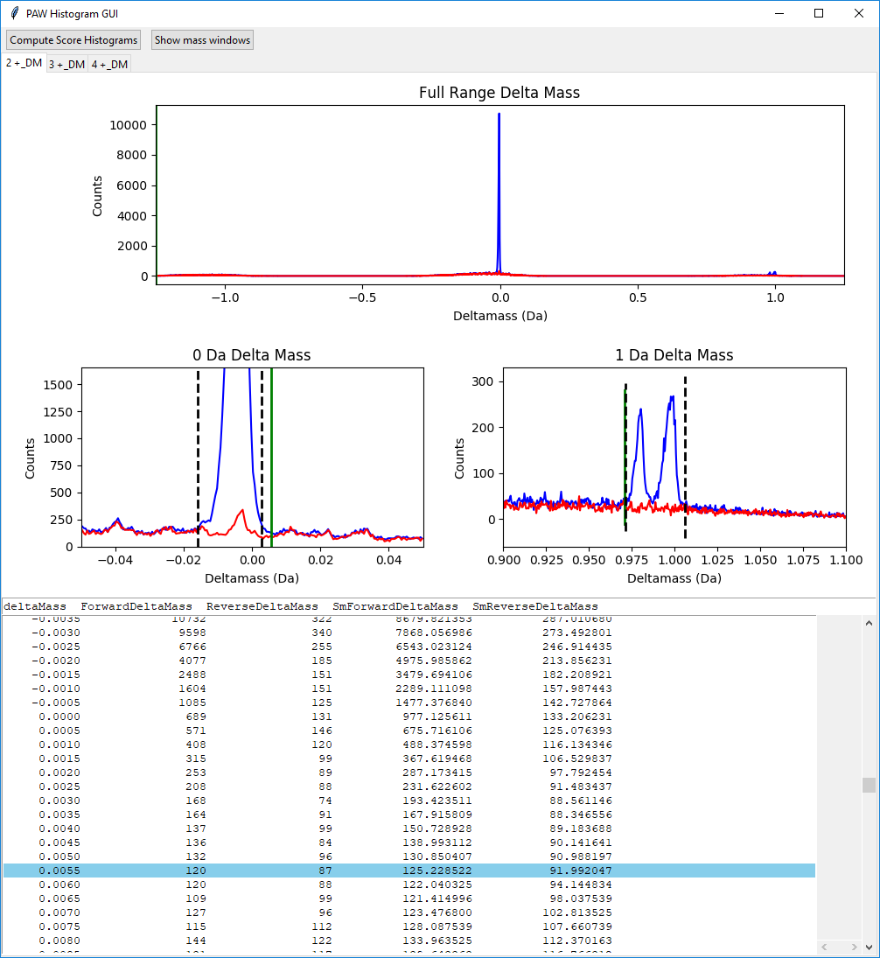
Double left click – expands y-scale
Double right click – reduces y-scale
1– click plot to update table
2- click inside table to set focus
3- press left or right arrow key to select threshold
4- move highlighted row up or down to move green line
5- press return key to update threshold position
Notes:
The general idea is to have the two dotted lines encompass the delta mass peak(s), but not include much of the region where the blue histogram is at the red baseline (noise) level. The y-scale can be expanded by double left-clicking in the plot of interest. The scale can be changed in the other direction by double right-clicking of the mouse. There are 5 steps to adjust threshold positions (where the dotted lines are located). First, left mouse click in the plot where you want to change the thresholds. This will set the table contents to the values for that plot. Second, click in the table to get the application to set focus on the keyboard. Third, the left and right cursor arrow keys are used to pick which threshold you want to adjust. Fourth, the up and down cursor arrow keys are used to move the highlighted table row up or down. As the row changes, a green line will appear and move in the plot. It shows you where the table row is located in the plot. You can also click on rows using the mouse. Fifth, when the green line is where you want the new threshold to be positioned, press the return key to update the position of the threshold. You will see the dotted line move to lie on top of the green line. Use the appropriate other left/right arrow key to adjust the other side of the window if it needs adjustment. When you are satisfied with the window positions, click on the next charge-state tab.

Slide 13
Notes:
The 2+ 0-Da plot has been expanded. The left threshold has been moved to the left to capture the leading edge of the peak. We are in the process of moving the right threshold to capture more of the trailing edge.

Slide 14
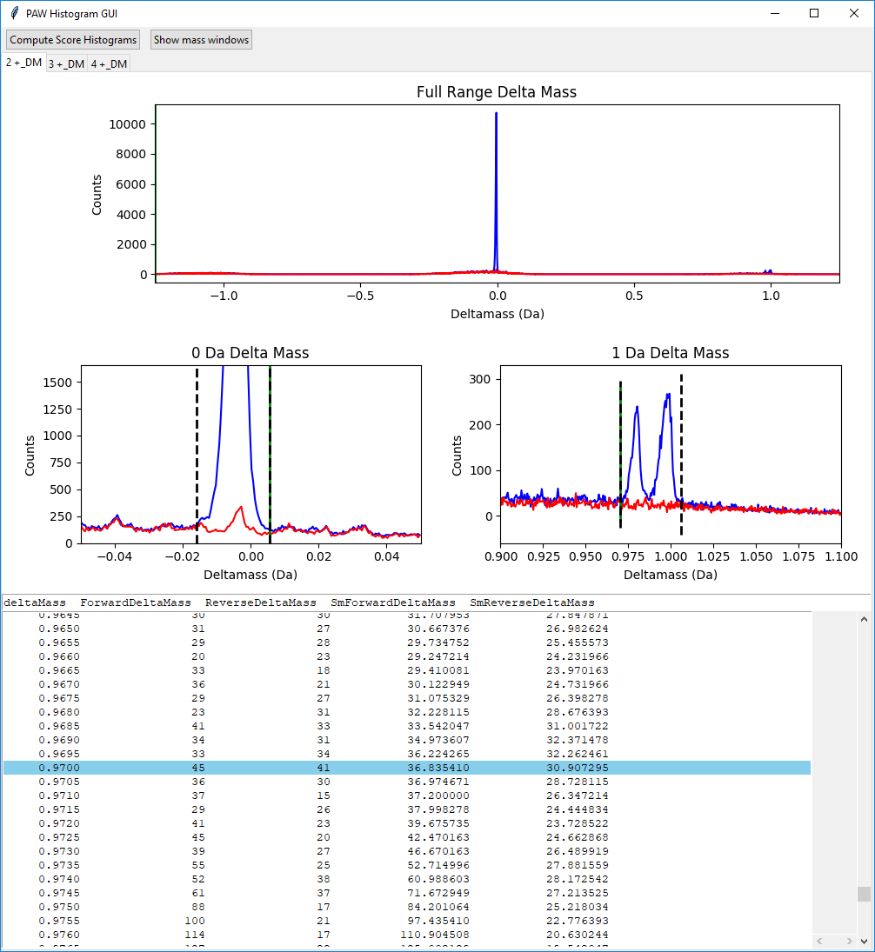
Notes:
We have expanded the scale for the 2+ 0-Da plot and widened the window. The window now captures all of the peak. The 1-Da region looks pretty good. On Orbitraps at standard settings, these peaks are typically just baseline resolved. The software is designed to capture BOTH peaks in one window.

Slide 15
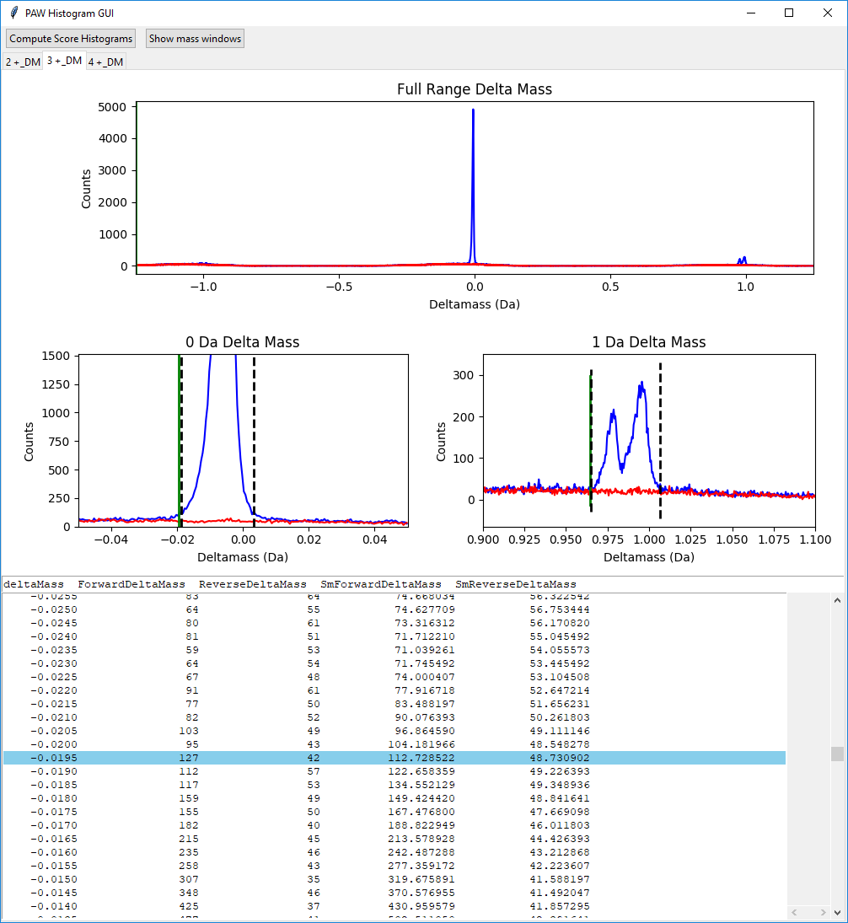
Notes:
This is the 3+ peptide tab. We have somewhat broader peaks that we did for 2+ peptides. We need to widen the 0-Da window. We have expanded the y-scale to see the base of the peak better.

Slide 16
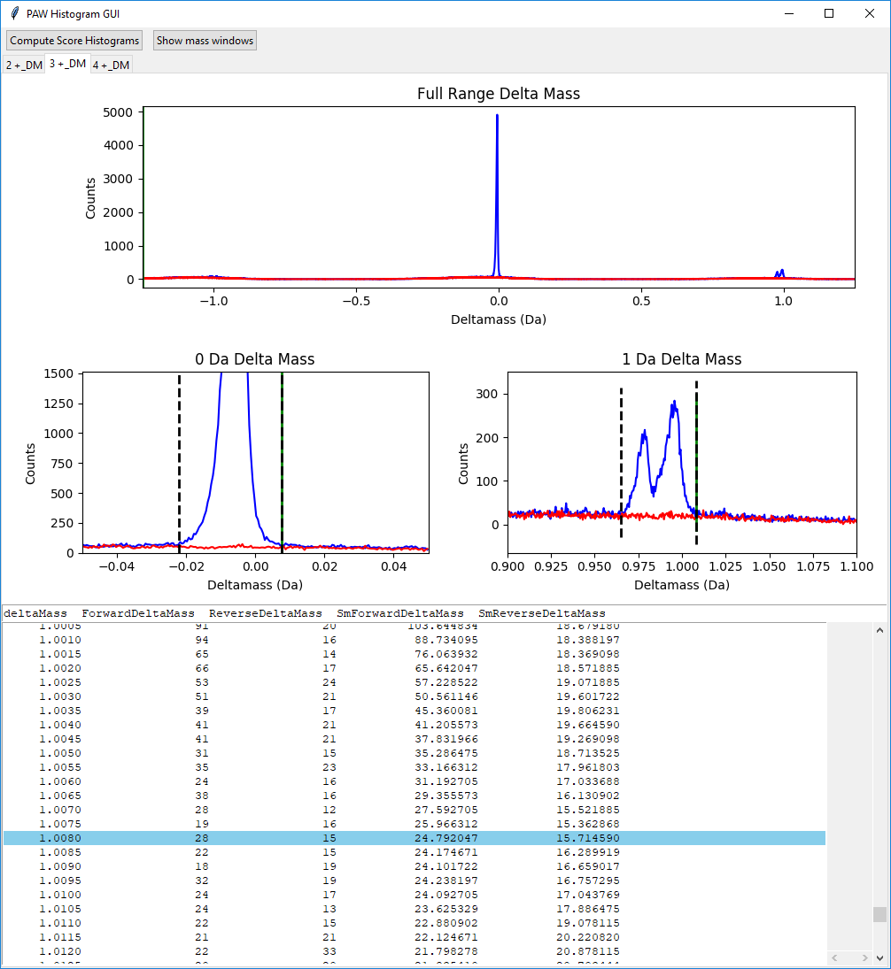
Notes:
We have set the new thresholds to just capture the full peak. Remember the steps: click the plot, click the table, pick a left or right threshold, move the table row up or down, and hit return to update the threshold.

Slide 17
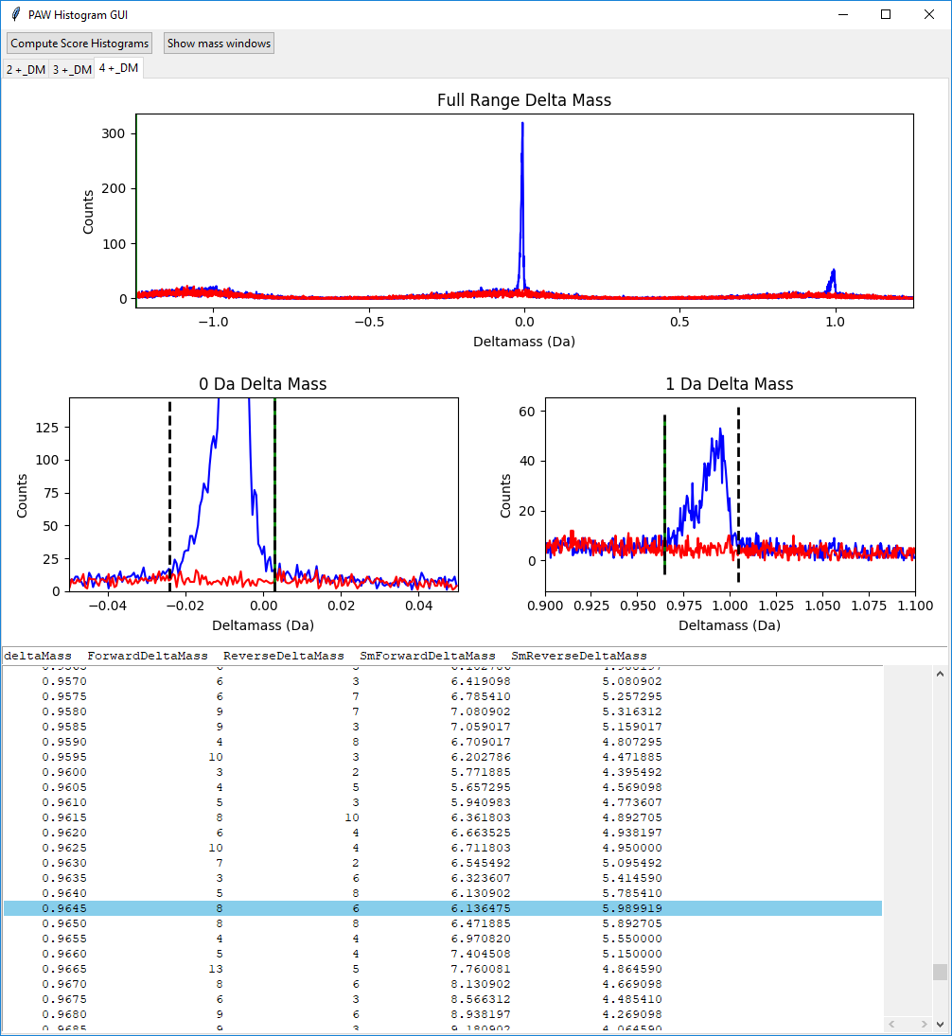
Notes:
This is the 4+ peptide tab. We have far fewer 4+ peptides than 2+ (usually about 2/3 of the data) or 3+ (usually about 1/3 of the data), so the plots have more fluctuations. We have widened the 0-Da window and adjusted the left side of the 1-Da region window. We have worked through all of the tabs from left-to-right.

Slide 18
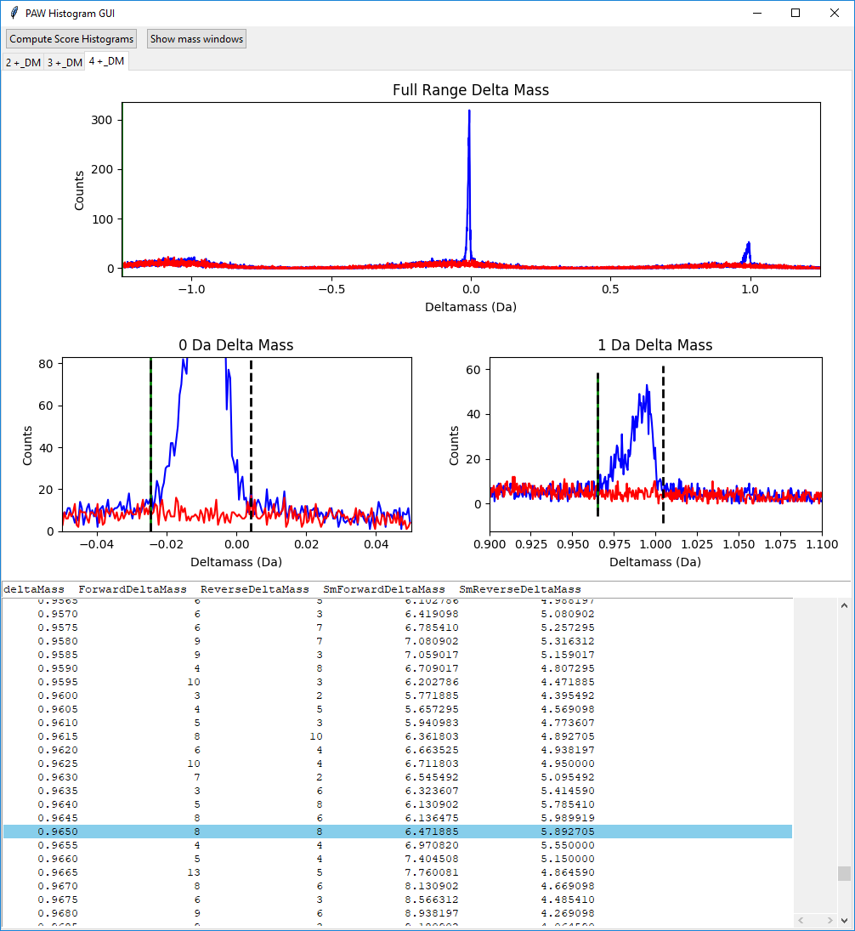
Click to compute conditional score histograms
Notes:
Once we have the delta mass windows all checked and adjusted (if needed), we can compute conditional score histograms. Accurate mass can be used (or is that misused?) in several ways. It can be used after the PSM FDR analysis to validate results. That will hurt sensitivity. It can be used as one or more terms in a classifier function determined by an expert or by a computer algorithm. This can be tricky because delta mass is more discrete (sharp features) than search scores. This can work in theory, but the implementation details are pretty critical (one of those “your mileage may vary situations”).
Another poor way to use accurate mass is by setting a very narrow parent ion search tolerance window in the search engine. The incorrect assumption is that by doing that, you will be rejecting the noise (the failed assumption is that all noise does not have an accurate mass). There are red data points inside the narrow windows above. There are not many of them because we used a 1.25 Da search setting. The noise is distributed over the whole plus/minus 1.25 region. When we do a narrower setting, the noise does not go away, it gets replaced by different noise that has narrower delta mass differences to match the search setting. We end up piling much more noise under the blue peaks and decreasing our signal to noise. Narrow parent ion mass tolerances select (rather than reject) noise. In essence, narrow tolerance searches invalidate accurate mass as something that distinguishes correct from incorrect.
The accurate mass measurement and the search engine score are completely independent. We can set an accurate mass condition up front, and then make conditional score histograms. This will reduce the noise matches and allow lower score thresholds (which improves sensitivity).

Slide 19
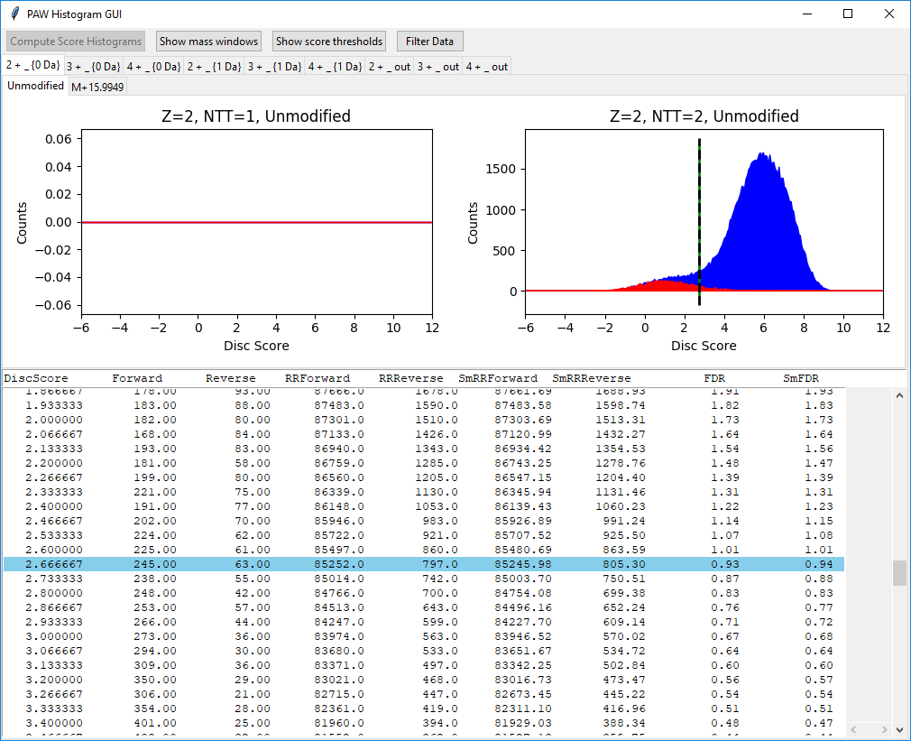
<- Control buttons
<- Outer tabs
<- Inner tabs
Semi-tryptic peptides (empty)
Fully-tryptic peptides
Targets
Decoys
Running remainders are the integrals of all counts to the right of the score value
Notes:
It has been know for many years that search scores can vary depending on peptide charge. We will make different score histograms for each of the three change states. Other factors can also complicate score distribution, such as, number of tryptic termini and modification state. Those affect FDR analysis differently than charge state. For these factors, the issue is that the noise (decoys) partitions differently than the signal (target matches) across these classes. The separation between the red and blue distributions is important. However, so it the relative magnitudes of the two distributions. FDR analysis is mostly the right hand tail integration of the red distribution divided by the area of the blue distribution (excluding its left hand tail). If the red distribution is large and the blue distribution is small, the threshold has to be moved to the right to get the same FDR.
We have some control buttons at the top of the window. We again have tabbed windows, but we have two rows of tabs. The outer tabs (the top row) are the different delta mass windows for each charge state (9 total tabs). The inner tabs are for the different variable modification states. We have just unmodified peptides and peptides with oxidized met for this data. We have two score histogram plots. Matches in Comet have been restricted to fully tryptic peptides. We only determine the C-terminal tryptic terminus directly. The N-terminal status depends on the protein sequence and is inferred. Peptides that match multiple proteins can be fully tryptic in some and semi-tryptic in others.
Here, we have the 2+ peptides associated with the 0-Da delta mass window. We remember that that was a very large blue peak on top of a very small red background. We see a large blue (target) distribution well separated from a small red (decoy) distribution. The default threshold is set to 1% FDR is shown as the dotted line. The default is fine.

Slide 20
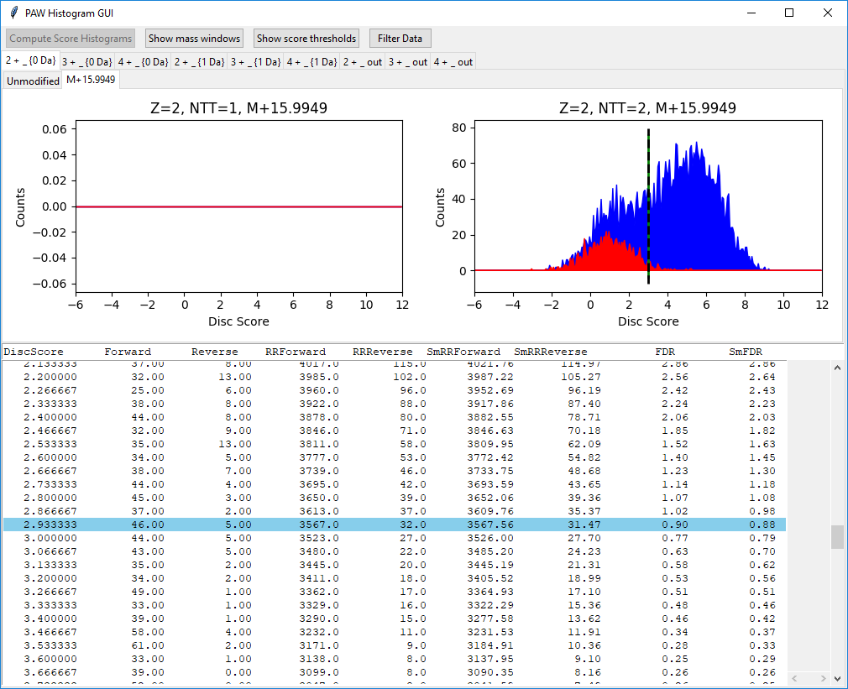
Notes:
These are the 2+ peptides with an oxidized Met. We have fewer matches. The relative fraction of the red distribution to the blue distribution is different. The 1% cutoff is a little higher (2.9 versus 2.7). The default threshold position looks fine.

Slide 21
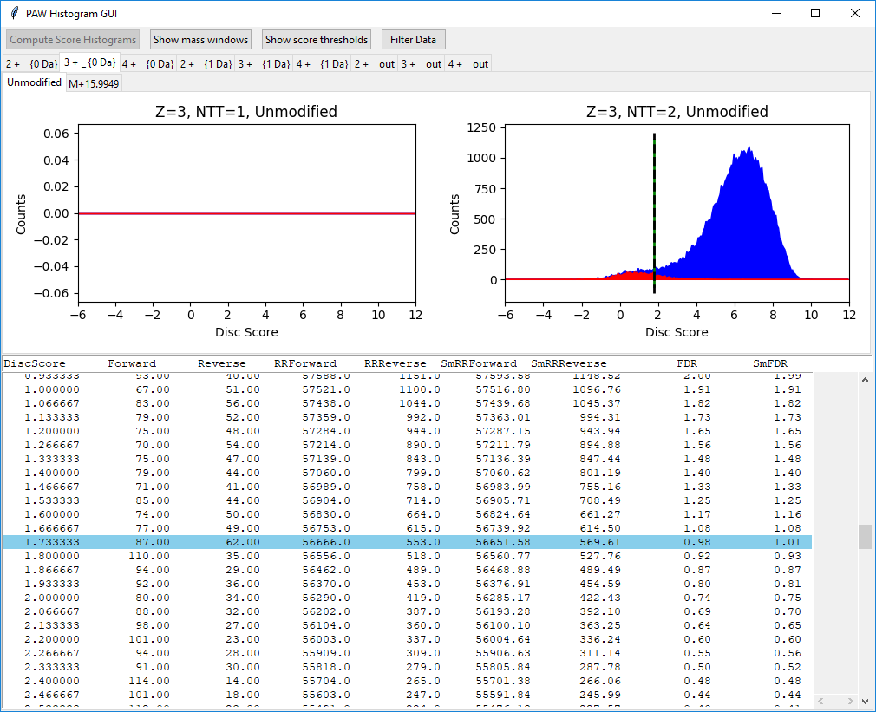
Notes:
These are the 0-Da delta mass, unmodified 3+ peptides. Like the 2+ peptides, we have a large blue distribution and very small red bump. The threshold location is fine.

Slide 22

Notes:
These are the 0-Da, 3+ oxidized Met peptides. We have a greater chance of having a Met residue in the longer 3+ peptides, so the magnitude of the score distribution is larger. The default threshold is fine.

Slide 23

Notes:
These are the last of the 0-Da delta-mass peptides. These are unmodified 4+ peptides. We have far fewer of these. The threshold position is fine.

Slide 24
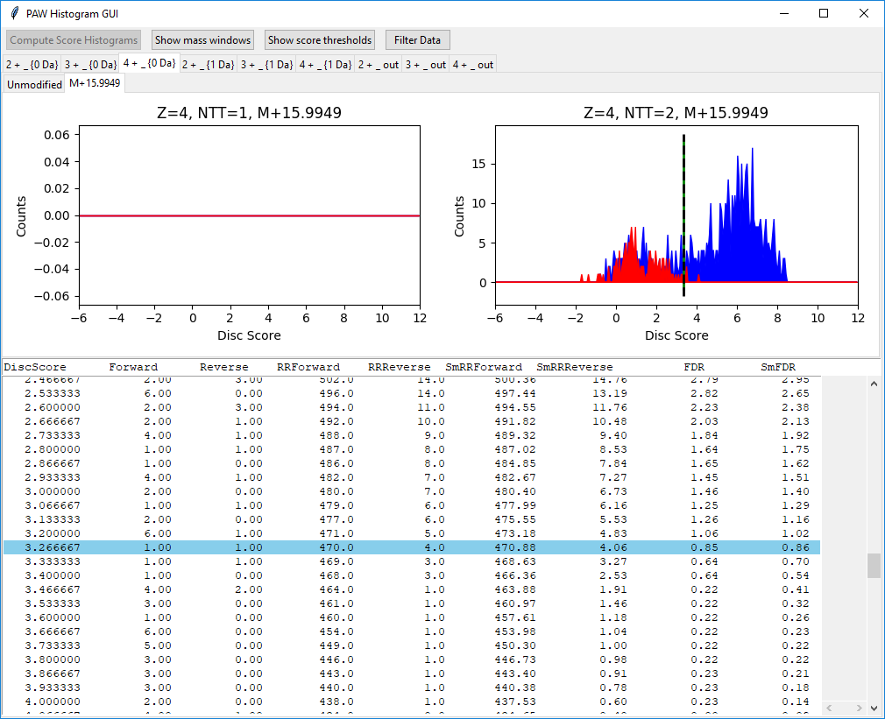
Notes:
The oxidized Met, 4+, 0-Da peptides are pretty sparse. The 1% FDR cutoff location looks fine. If we have fewer that 50 counts in the blue distribution above the threshold, the software will exclude that data by default. That shows as a plot without any dotted line. You can always add thresholds to sparse data classes if you want to squeeze all of the PSMs out of the data.

Slide 25
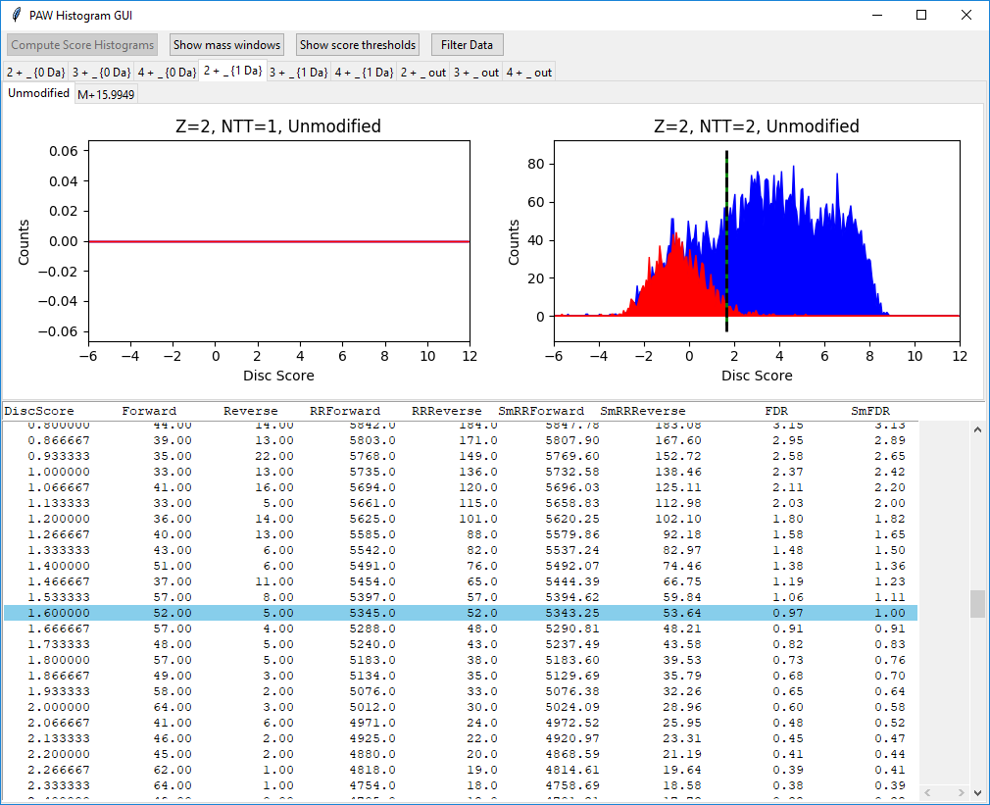
Notes:
The next three tabs will be the 1-Da regions. These are 2+ unmodified peptides. We see that the relative sizes of the red and blue distributions are more comparable. The dotted line looks fine.

Slide 26
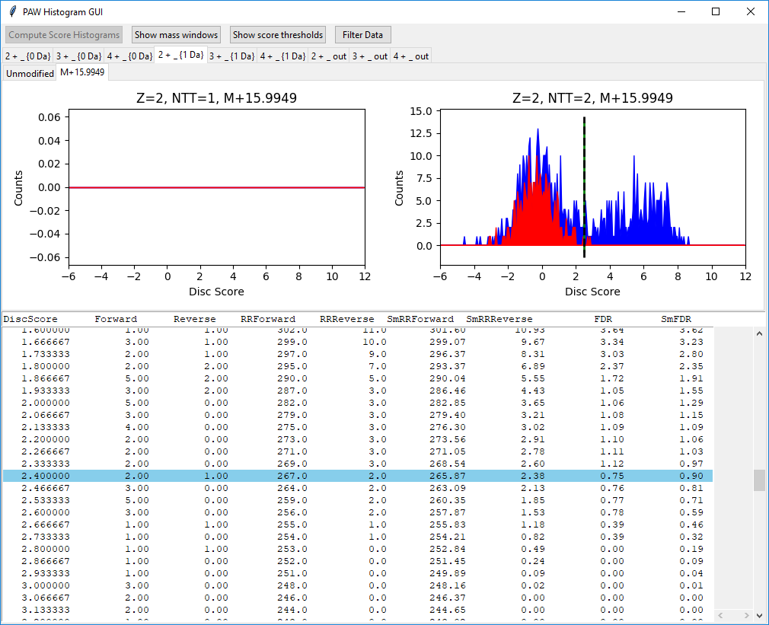
Notes:
The modified 2+ peptides are more sparse and the default threshold is okay.

Slide 27

Notes:
1-Da region, 3+ unmodified peptides also have a good default threshold location.

Slide 28
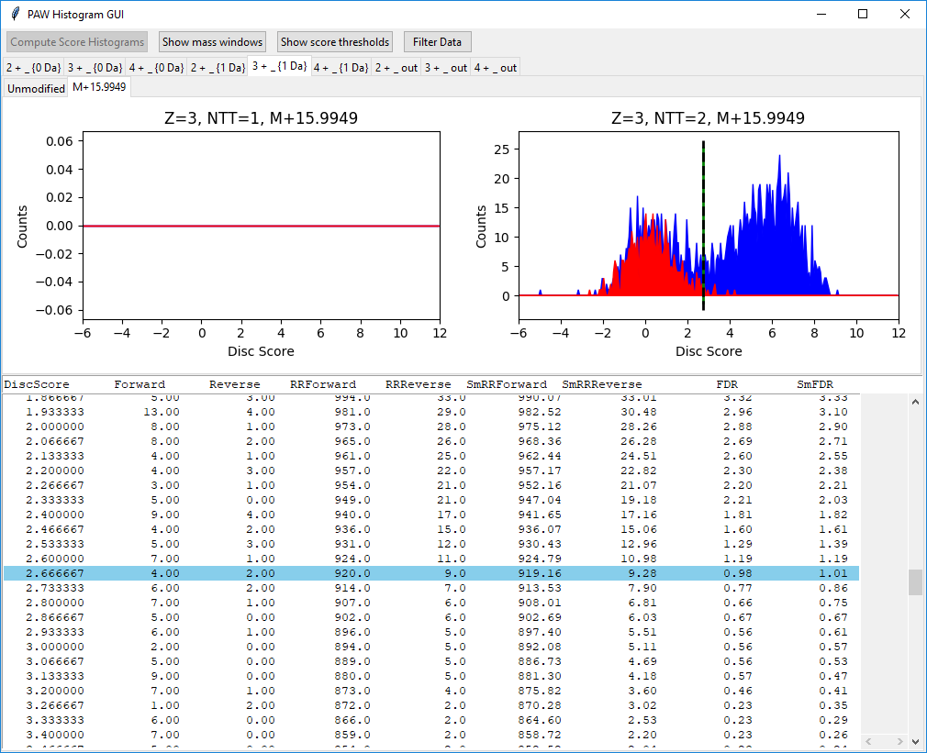
Notes:
The modified, 3+, 1-Da peptides also look fine.

Slide 29
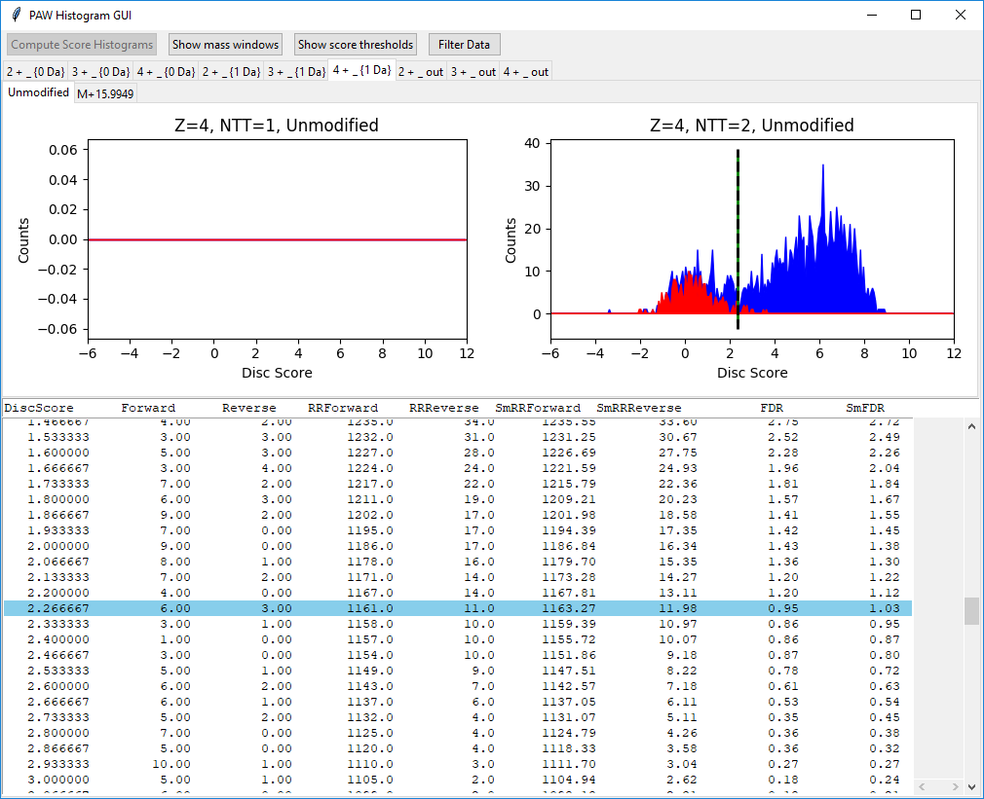
Notes:
The 1-Da delta-mass window, 4+, unmodified peptide scores are shown here. The histograms and threshold look good.

Slide 30
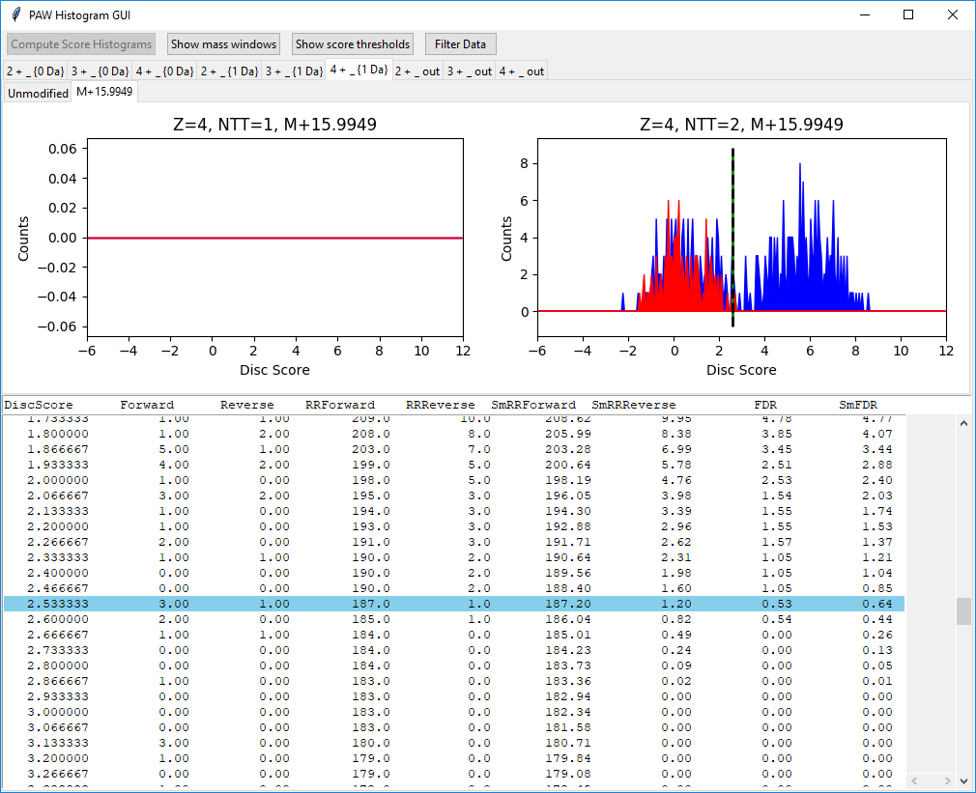
Notes:
The threshold for the oxidized met peptides (1-Da delta-mass window, 4+ change state) does not need any tweaking.

Slide 31
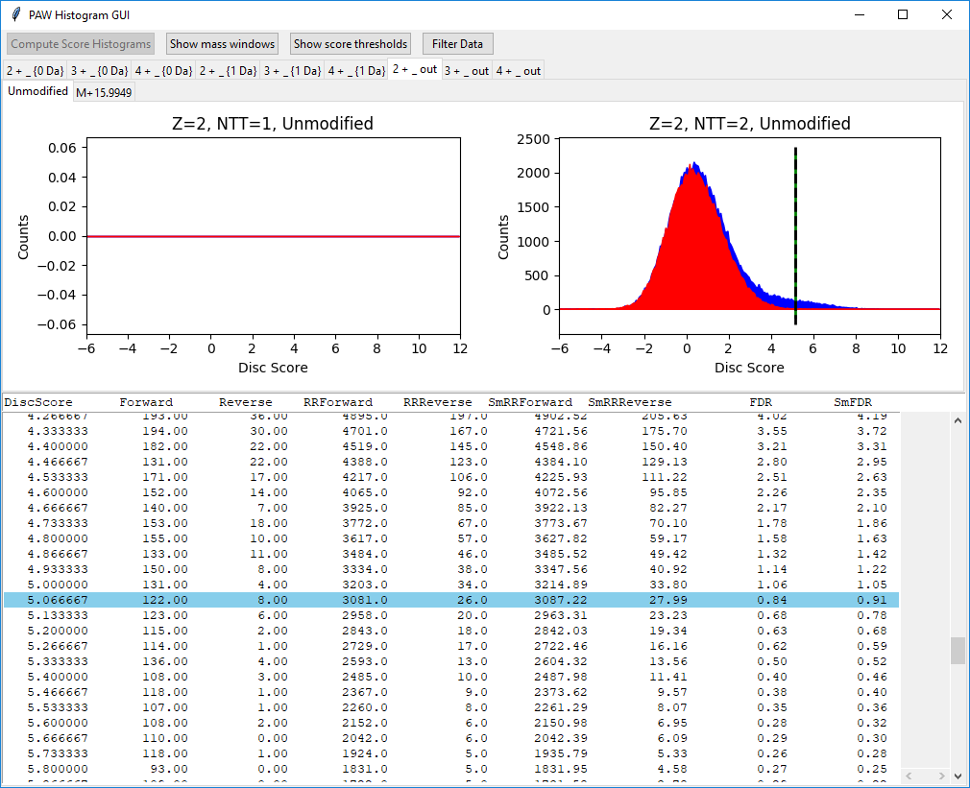
Notes:
The last set of three outer tabs are something you might not have expected. These are the score histograms for peptides that did not have an accurate mass (all delta masses not inside either the 0-Da or 1-Da windows). Not all peptides are abundant and the instruments are not perfect. Dynamic exclusion can impact the instrument in unexpected ways. Acquisition modes have options that can create mixed mode data. Some scans that may not have an accurate mass or defined charge state are to be expected.
This is the score distribution of 2+, unmodified peptides without an accurate mass. The PSMs are mostly incorrect (nearly identical red and blue distributions centered at 0), but there are some net blue counts at higher scores. We have to set correspondingly higher score thresholds to control FDR. Here, we can get 3000 more IDs.

Slide 32
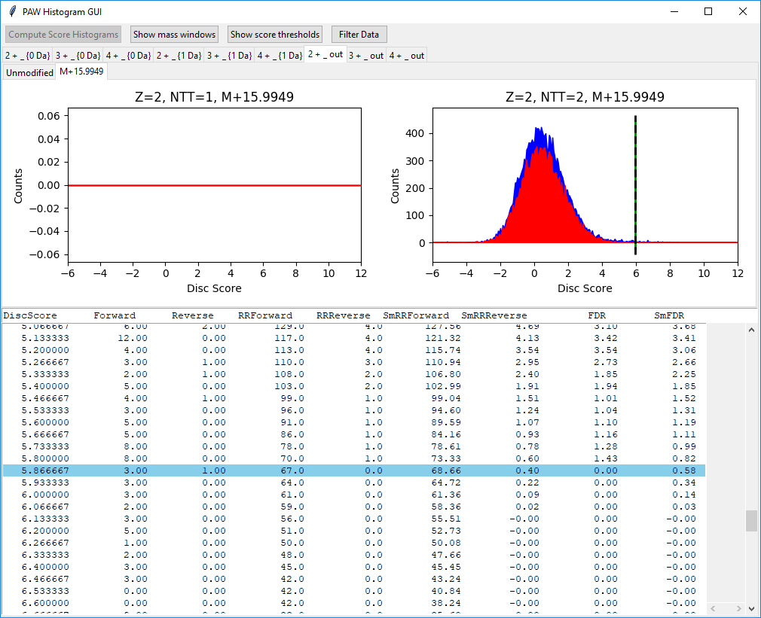
Default
Notes:
The modified 2+ peptides in this delta-mass class that are beyond the decoys are getting pretty sparse. The default threshold location is just past the last decoy count. If we lowered the threshold to 5.467, we could gain 32 target matches at the expense of only a single decoy match. That might be reasonable. You can always over-ride the default threshold positions; however, please look at the table and the plot to see if it is justified.

Slide 33
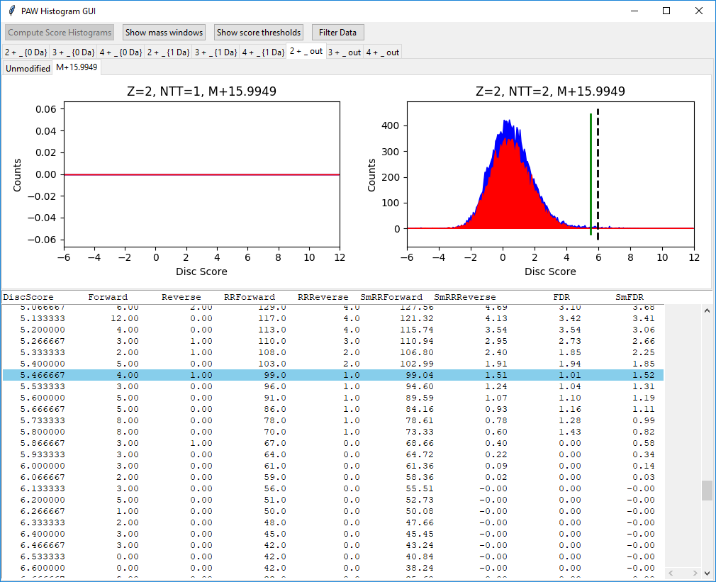
Notes:
We are in the middle of changing the threshold. We need to press the return key to update the threshold to the green line location.

Slide 34

Notes:
We have successfully changed the threshold.

Slide 35
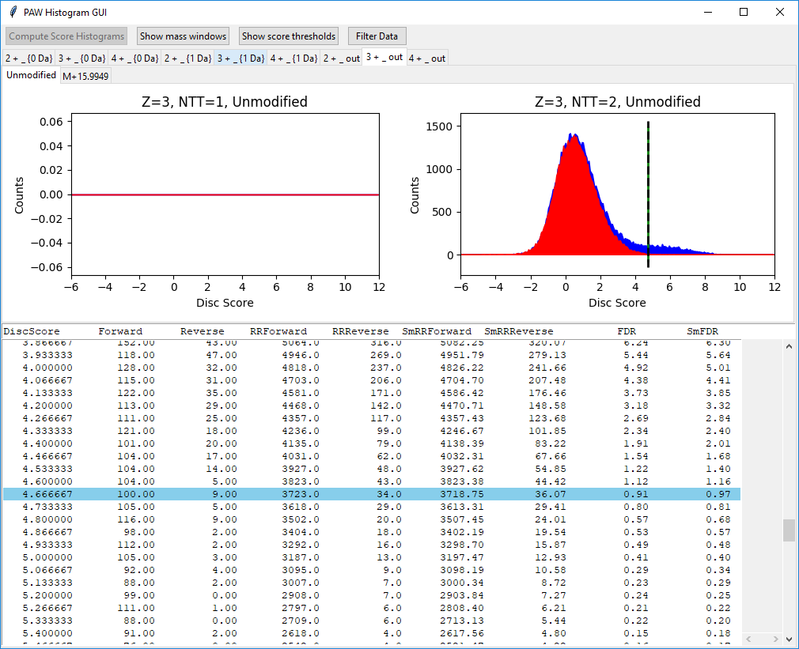
Notes:
These are the 3+ peptides (unmodified) without an accurate mass. Threshold is fine.

Slide 36
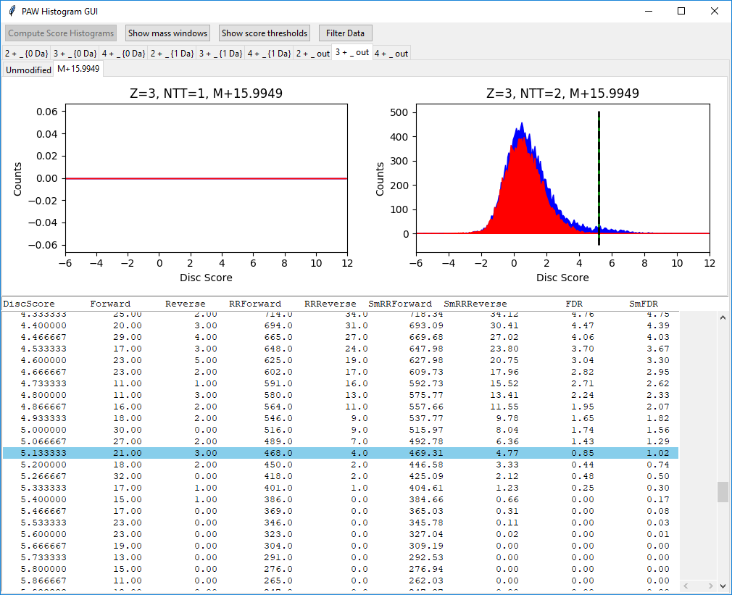
Notes:
These are the modified 3+ peptides (no accurate mass) and the default looks fine.

Slide 37
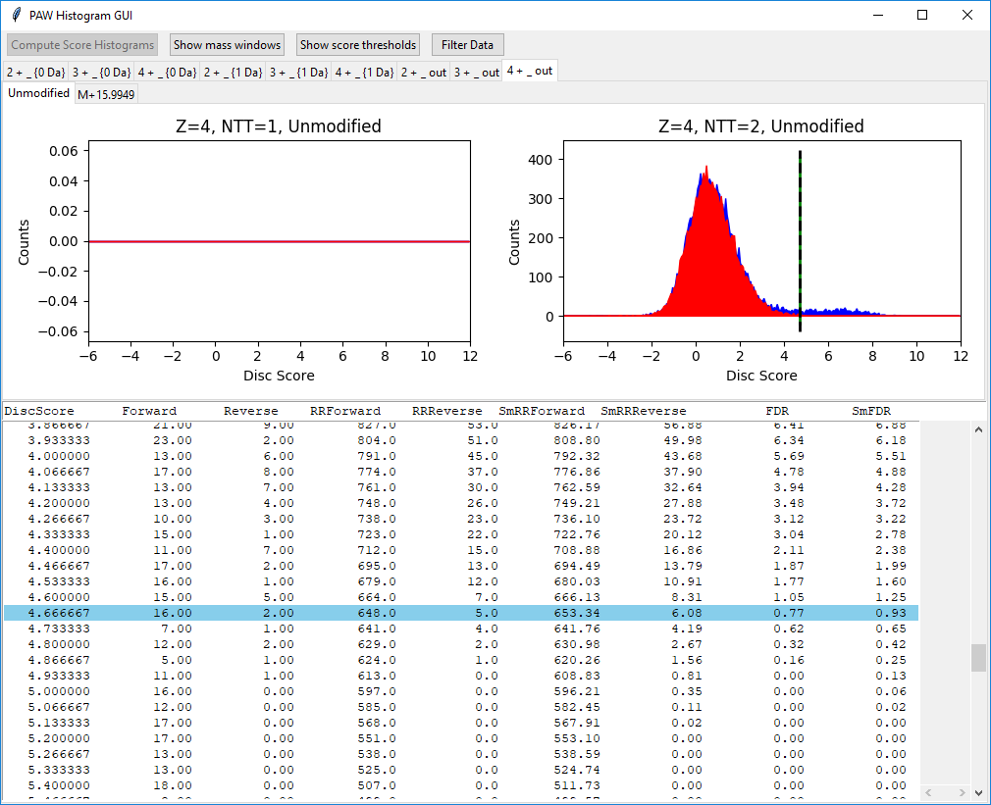
Notes:
Here are the 4+ peptides (no accurate mass, unmodified). No changes are needed.

Slide 38
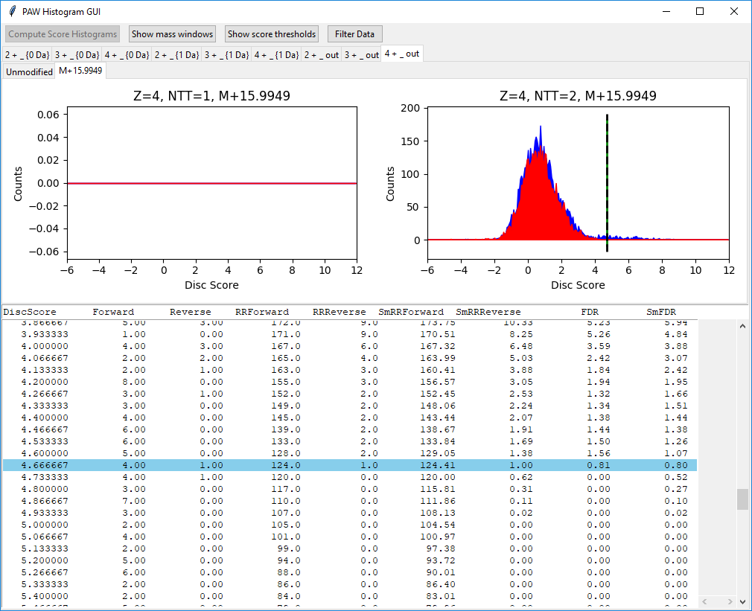
Notes:
Finally, we have the modified (oxidized Met), 4+ peptides that have no accurate mass. We could tweak the threshold a little here if we want.

Slide 39
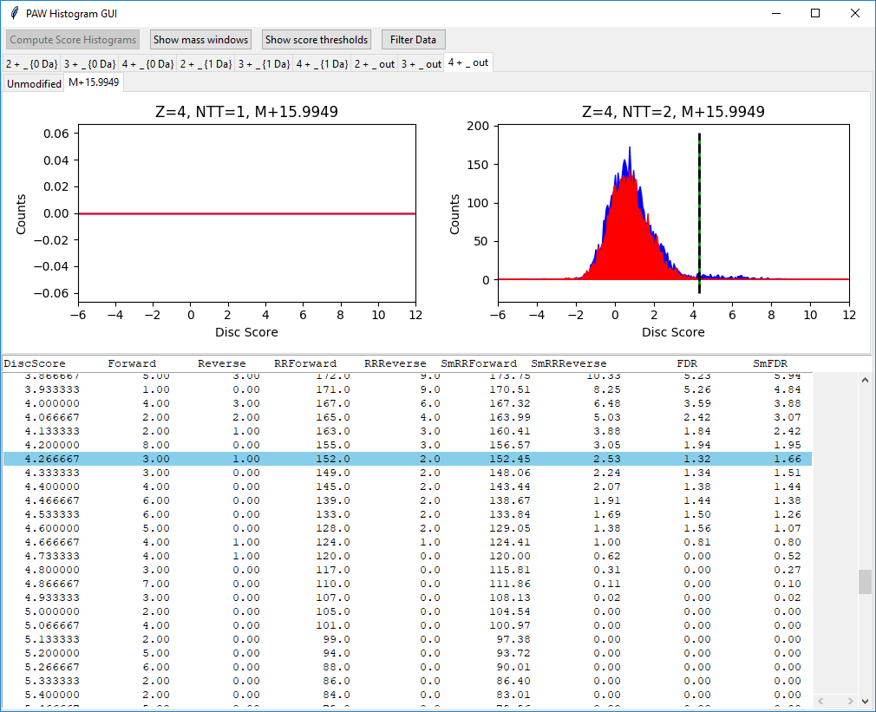
Notes:
We have lowered the threshold following the basic steps: click in the score plot first, then click in the table, then click on the new row (or use the up/down arrow keys), then press return.

Slide 40
Notes:
Once we have worked left-to-right across all of the outer tabs and all of the inner tabs and inspected/set the score thresholds, we can filter the data (press the “Filter Data” button). The data where the scores exceed the score thresholds in each of the peptide classes will get written to new peak lists (MS2 format), new Comet result files (SQT format), and new top hit summaries (tab delimited text files).

Slide 41
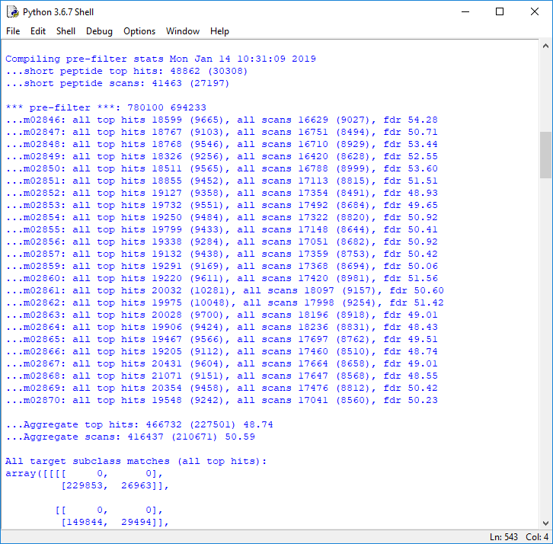
Notes:
The console (and log file) will have useful information. We see that there were 466,732 total top hits to start with (subject to a minimum peptide length). 49% of those matches were to the decoy database.

Slide 42
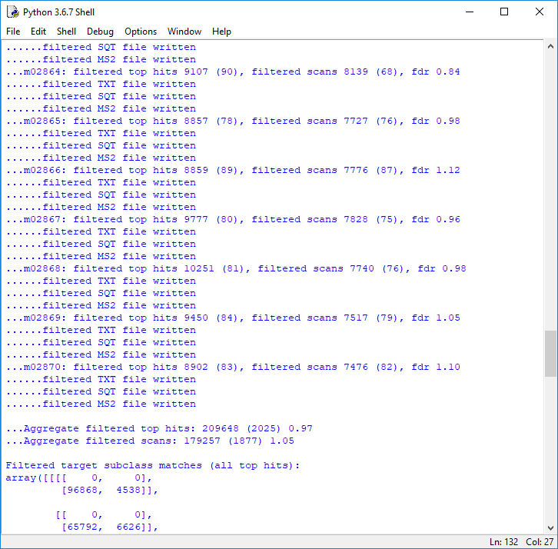
Notes:
After filtering, there were 209,648 matches passing the thresholds. There were about 2000 decoy matches for a 1% FDR.

Slide 43
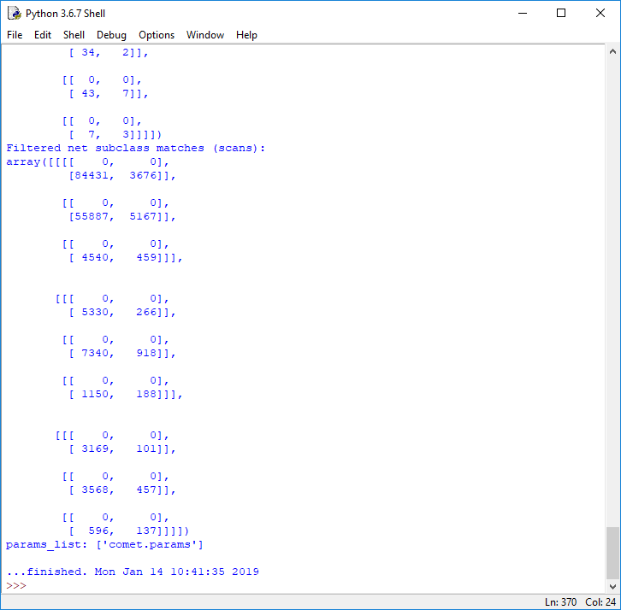
Notes:
You will get a “…finished” line when the filtering has completed. Click on the close window button on the GUI window (it does not have a quit button).

Slide 44
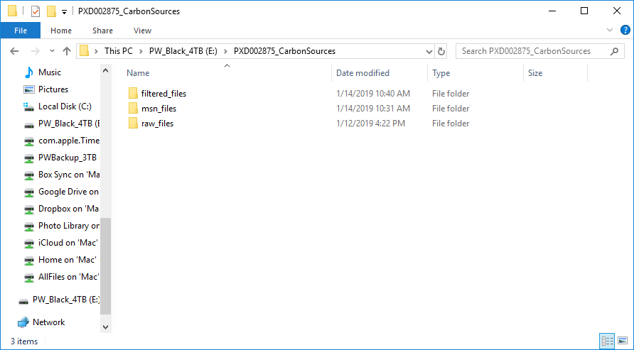
Notes:
We have a new folder called “filtered_files”.

Slide 45
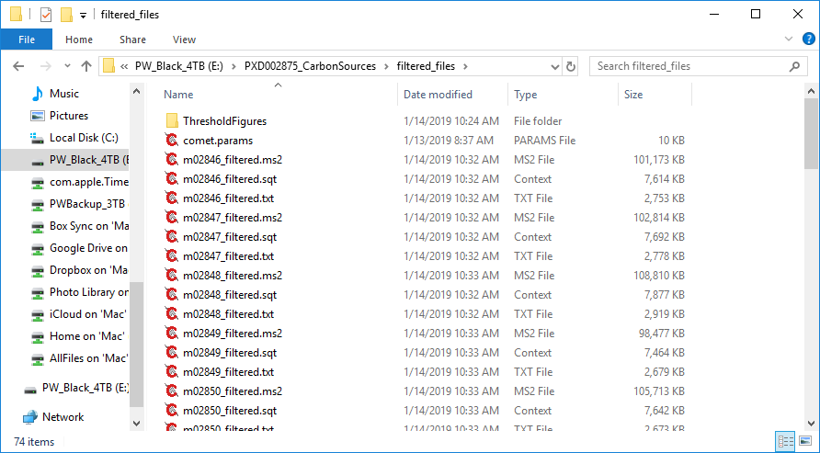
<- histograms
<- Filtered peak lists
<- Filtered Comet results
<- Filtered top hits
Notes:
There are new (smaller) MS2, SQT, and TXT files for just the PSMs that passed the thresholds. There are also PDF pictures of the score histograms and the threshold locations in the “ThresholdFigures” folder.

