Slide 1
PAW_results.py Guide
Phil Wilmarth January 18, 2019
Notes:
Part of the PAW pipeline (https://github.com/pwilmart/PAW_pipeline.git).
Protein inference and protein grouping steps.

Slide 2
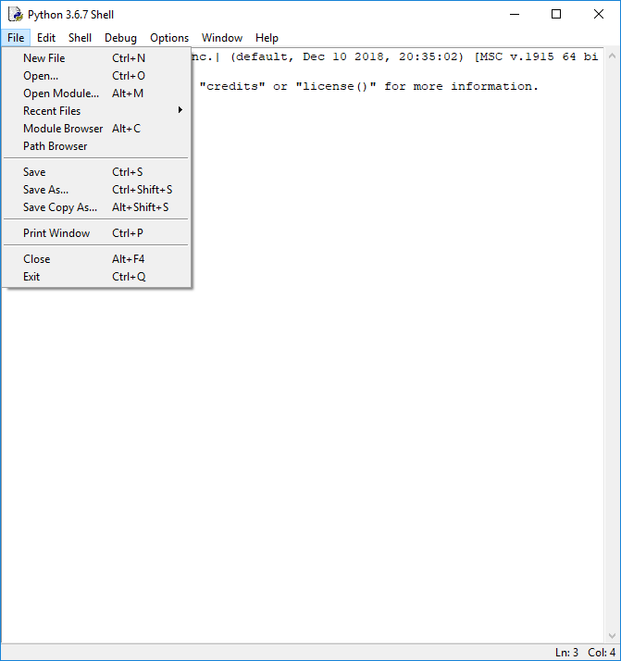
Notes:
From IDLE, open the “PAW_results.py” script.

Slide 3
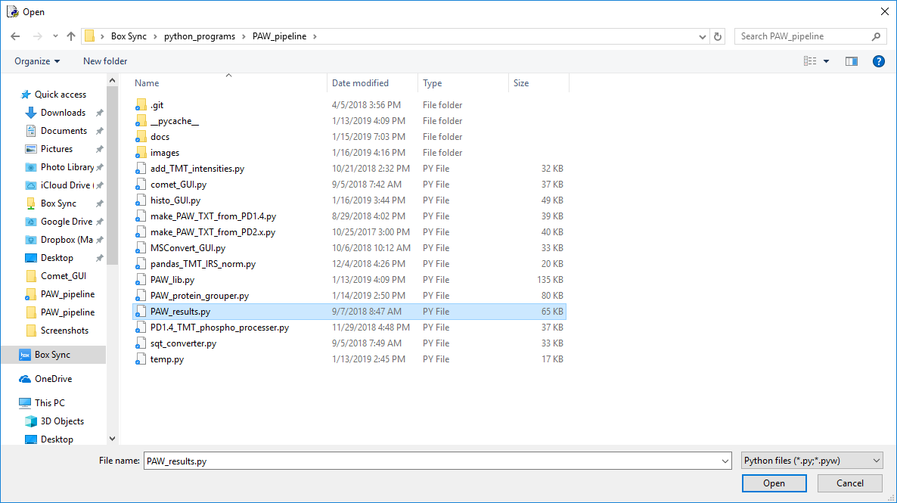
1
2
Notes:
Select the script and click Open.

Slide 4
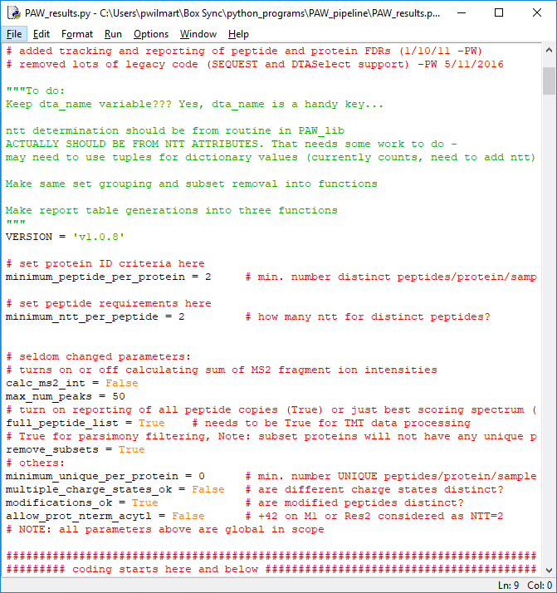
Notes:
There are a couple of parameters that you might want to occasionally change. Two peptides per protein is a HIGHLY recommended setting. Sometimes you may need single peptide per protein IDs. The PAW pipeline does not have any explicit protein FDR algorithms. There is a one-to-one relationship between incorrect PSMs and incorrect proteins when using a one peptide per protein setting. Sometimes semi-tryptic or non-tryptic peptides are important. The “minimum_ntt_per_peptide” parameter would need adjustment in those cases.

Slide 5
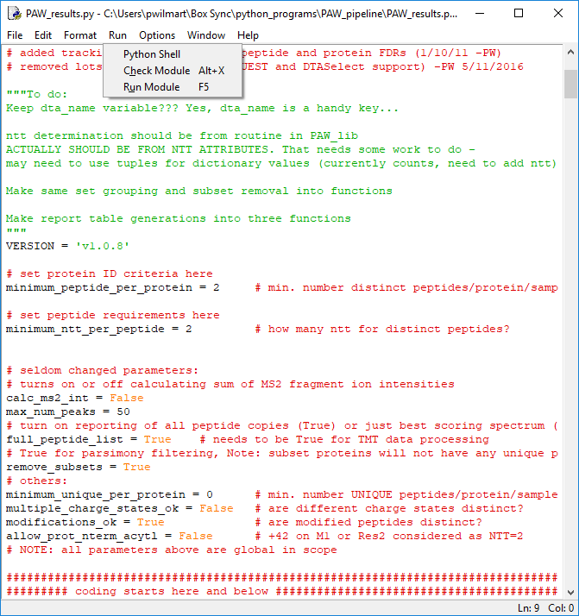
Notes:
Run the script (Run Module command from the Run menu).

Slide 6
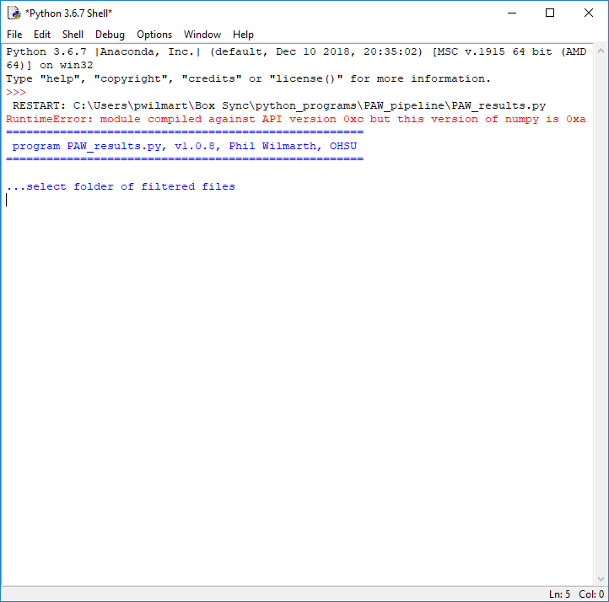
Notes:
The IDLE console windows indicates that a folder dialog box has been popped up for “filtered_files” folder selection.

Slide 7
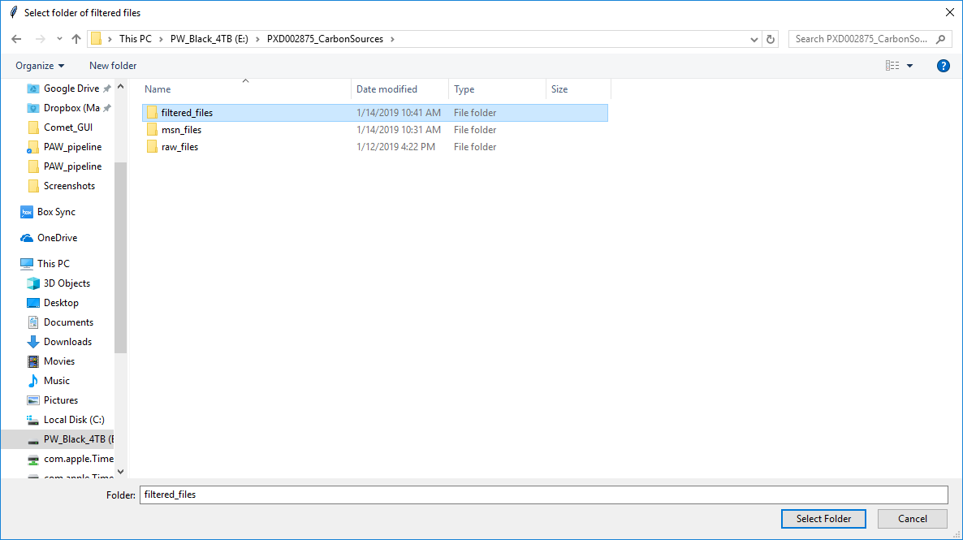
1
2
Notes:
Browse to the “filtered_files” folder inside your project folder. Select the folder and then click the “Select Folder” button.

Slide 8
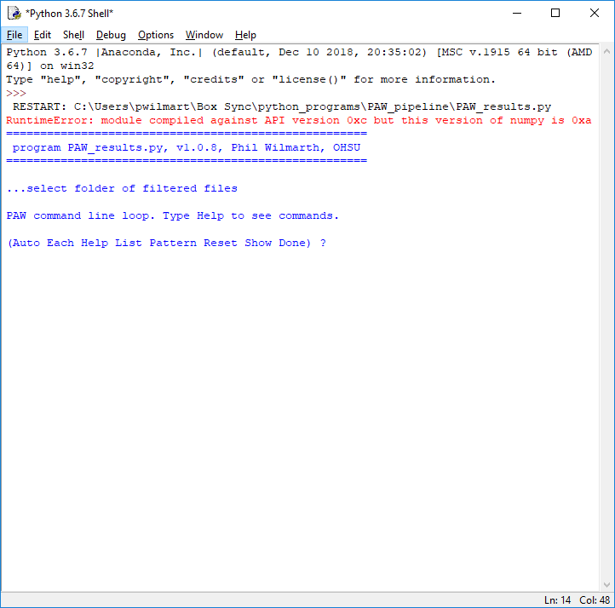
(commands are not case sensitive and first letter is sufficient.)
...Auto: automatically parse the sample names from the filenames,
...Each: treat each filename as a separate sample,
...Help: prints this message,
...List: lists all of the (remaining) filename(s),
...Pattern pattern: glob-style search pattern to get a subset of filenames
("*" or "*.*" is all files,
"*.txt" is all files that have a "txt" extension,
"a*" is all files that start with the letter "a",
"*string*" is all files that contain "string", etc.),
...Reset: start over,
...Show: print the current samples and associated files [verbose],
...Done: exit from the command loop and return to processing.
Notes:
All of the filtered top hit summary files are parsed and a simple command interpreter is started. This allows assigning the RAW files to the biological samples. Many experiment have multiple biological samples. Shotgun analysis of biological samples often requires multiple dimensions of separation, so several RAW files might correspond to single biological samples. We have the “Help” information on this slide. The pattern matching is like most file system pattern matching (known as Glob patterns, see https://en.wikipedia.org/wiki/Glob_(programming)).

Slide 9
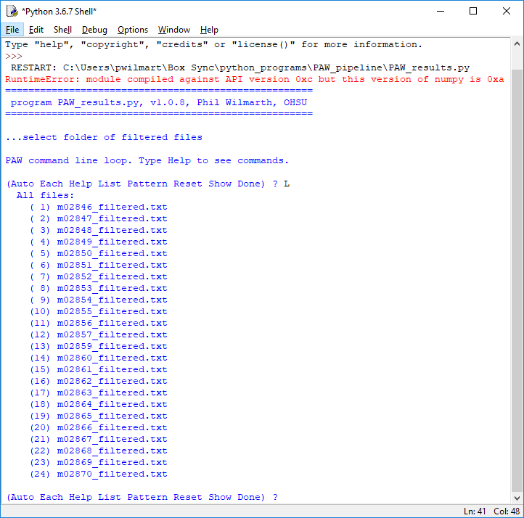
The 24 filtered file names (files have not been read yet)
Notes:
A good command to do first is to “List” the files. We have the 24 fractions for this sample. Since this is a 9-plex TMT experiment, the 9 biological samples are hidden. The 24 fractions are really just one effective biological sample.

Slide 10
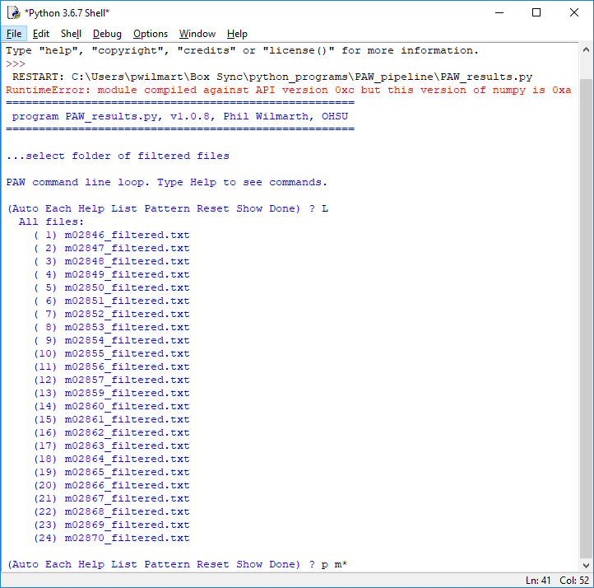
We want to select all 24 fractions: Glob pattern – anything that starts with “m”
Notes:
We will use the “Pattern” command to select all of the files so we can give them a nice name. “p m*” will select all files starting with an “m” character.

Slide 11
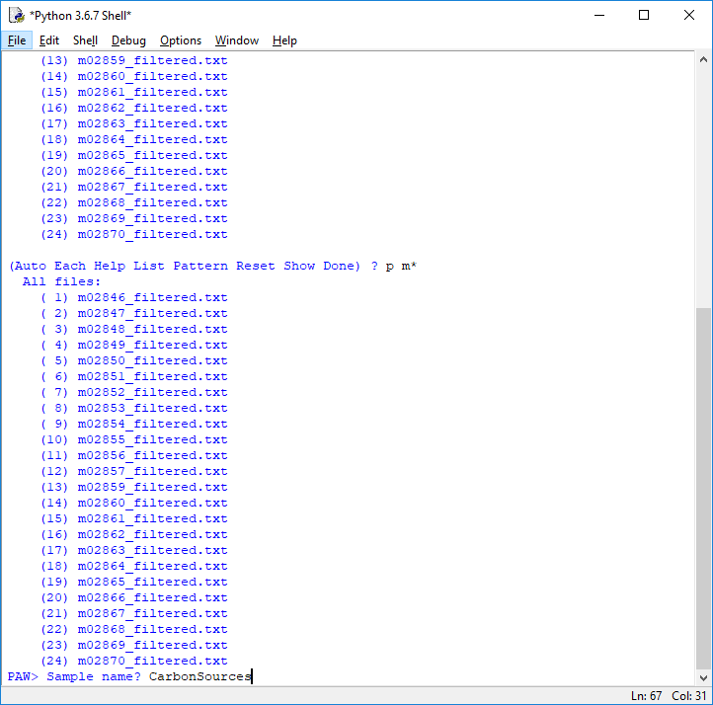
All 24 fractions are one biological sample for protein inference
TMT dimension is hidden
Sample name
Notes:
The 24 matching files are echoed and a sample name is asked for. We will use “CarbonSources” for the effective sample name.

Slide 12
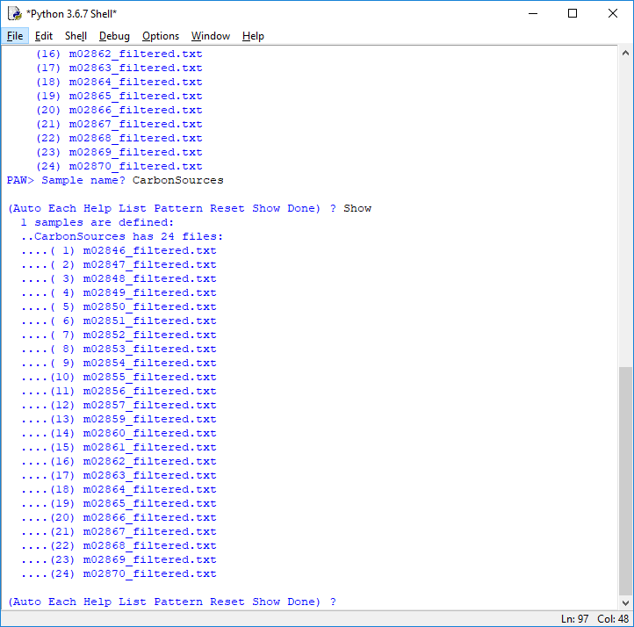
Notes:
If we want to double check what has been assigned to samples so far, we can type the “Show” command. It tells us that we have one sample with 24 files. Collecting files to assign to samples is usually an iterative process.

Slide 13
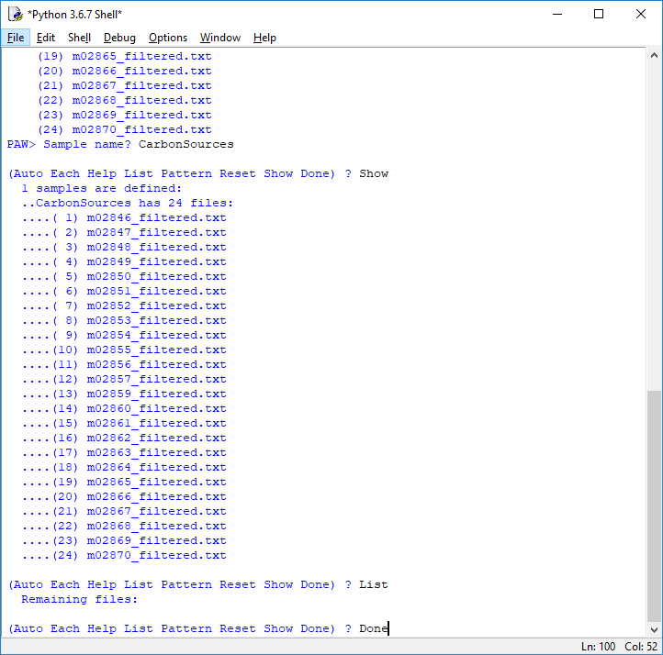
No files left
Notes:
We can make sure that we have no leftover files (files not yet assigned to samples) by typing the “list” command again. It shows that we do not have any remaining files. We type the “Done” command to exit the command processor and get back to the protein inference algorithm.

Slide 14
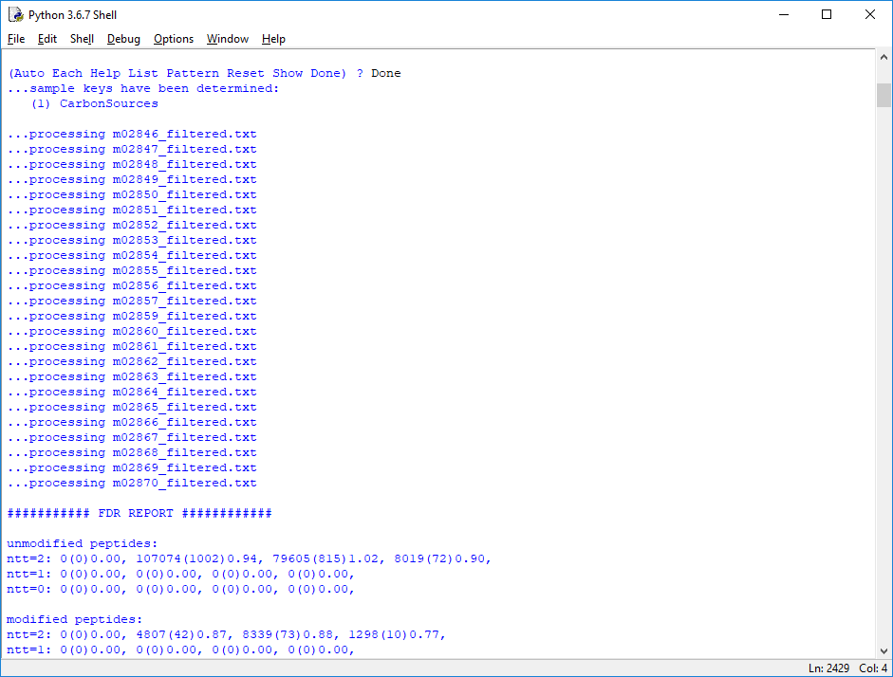
Data loading progress
2+
3+
4+
Notes:
The files to samples mapping(s) have been defined, so we can read in the filtered results files. After the files have been read in, we get a PSM FDR report. It is broken down by charge state and by modification state.

Slide 15
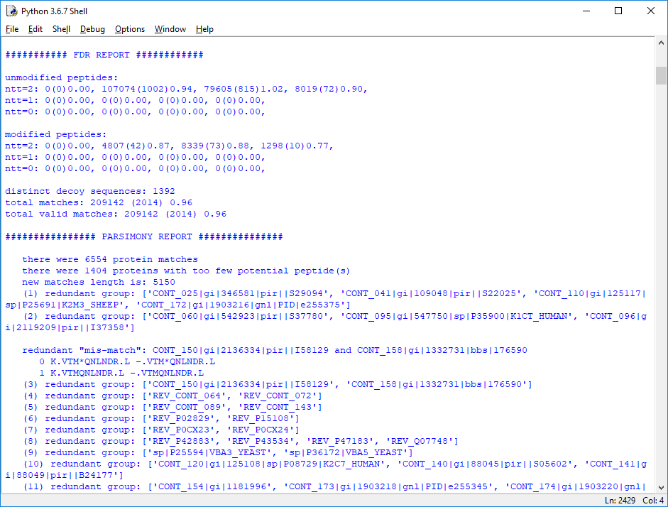
Redundant peptide set grouping first
Notes:
After the FDR report, the protein inference starts by making peptide sets for each protein that had any PSMs that passed the thresholds. Any proteins having peptide sets with fewer distinct peptides than the minimum cutoff (2 here) are removed. The next step is to group proteins having indistinguishable peptide sets (also called redundant proteins).

Slide 16
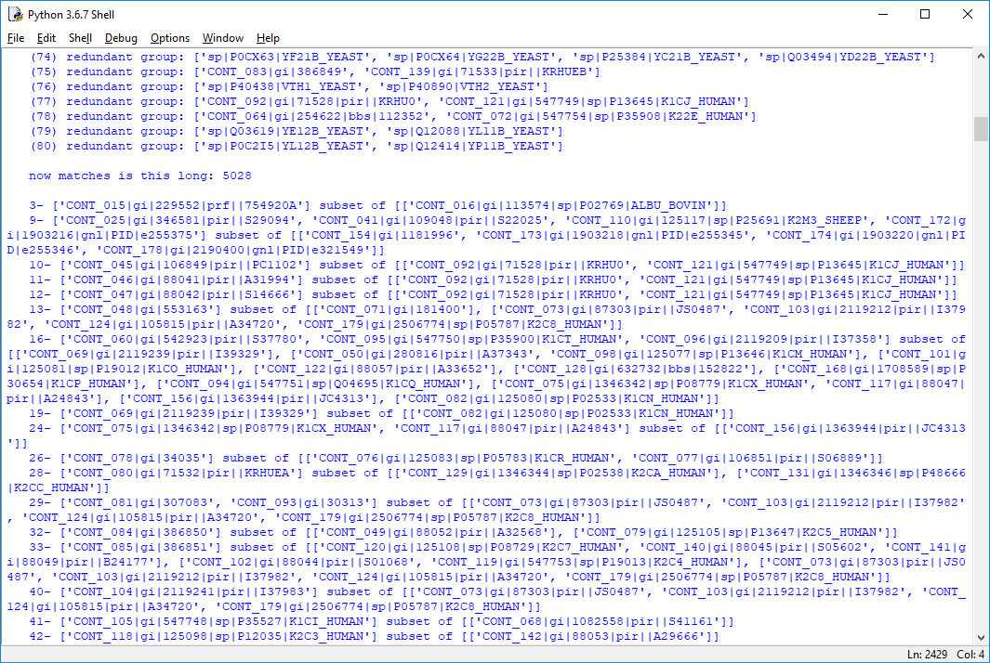
Peptide subset removal next
Notes:
Grouping redundant proteins decreased the number of proteins from 5150 to 5028. Next, we do the main parsimony step and remove proteins whose peptide sets are subsets of proteins having larger peptide sets.

Slide 17
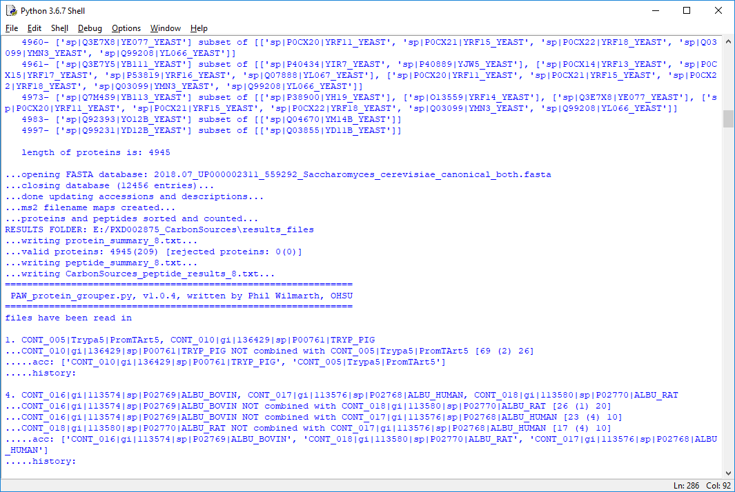
4945 protein IDs, 209 were decoys
Protein grouping runs automatically
Notes:
After subset removal, we have 4945 protein groups. Yeast has a simple genome, so protein grouping does not alter the protein numbers as much as we see for species like human and mouse. The protein grouping algorithm runs automatically.

Slide 18
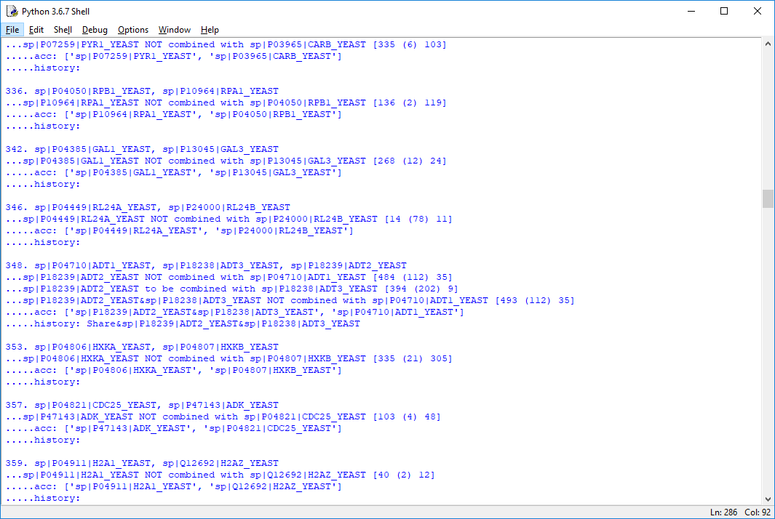
Unique spectral count of left protein
Shared spectral count of pair
Unique spectral count of right protein
9 is small compared to 596
Notes:
The protein grouping algorithm is an extension of the basic parsimony concepts. If two proteins have nearly identical peptides sets, they will be grouped. If one protein has a peptide set that is almost a subset of a protein with a larger peptide set, the subset protein will be absorbed. The test conditions are weight tests. The weights are the total spectral counts. When the “weight” of one protein’s unique and shared peptides are much larger than another protein’s unique “weight”, protein grouping will happen. The grouping is iterative and continues until the final number of groups is no longer changing. Grouped proteins get their peptide’s shared and unique status redefined after grouping. This can have some effects on quantitative results for highly homologous protein families.
Aside – since the proteins that get grouped have some unique peptides (they have to have some or they would have already been grouped), the set of peptides associated with the proteins in a grouped family will not be present in all protein sequences. Some detail is lost after grouping. That is why the grouping is done in ADDITION TO the regular protein reports.

Slide 19
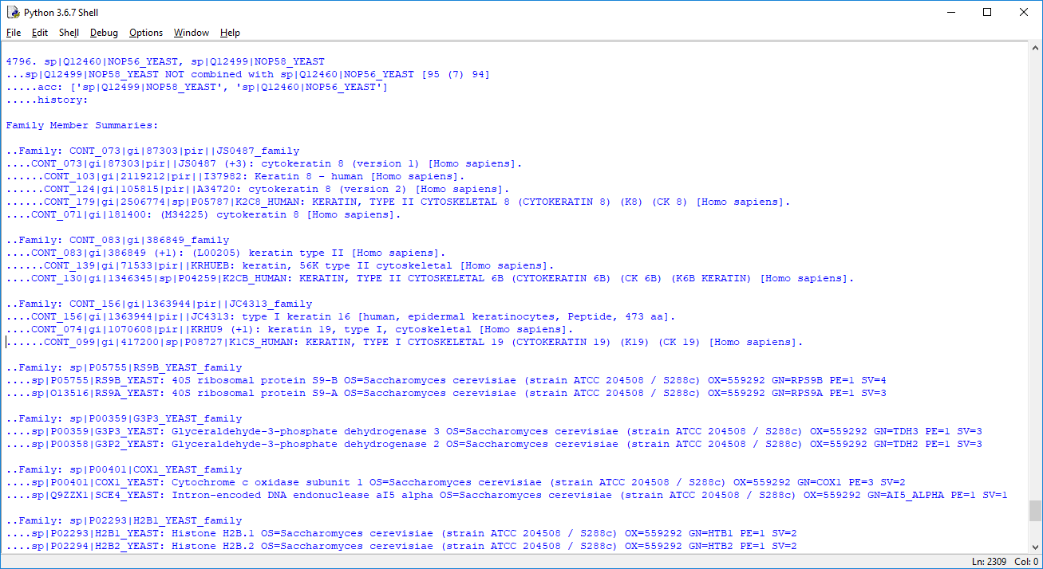
Grouped proteins are sensible
Notes:
The protein grouping console output is usually really interesting to read through. All details during the iterative steps are logged. After the final set of protein families has been determined, the family memberships are logged. The protein descriptions for the grouped proteins indicated similar proteins. Housekeeping genes are frequently grouped.

Slide 20
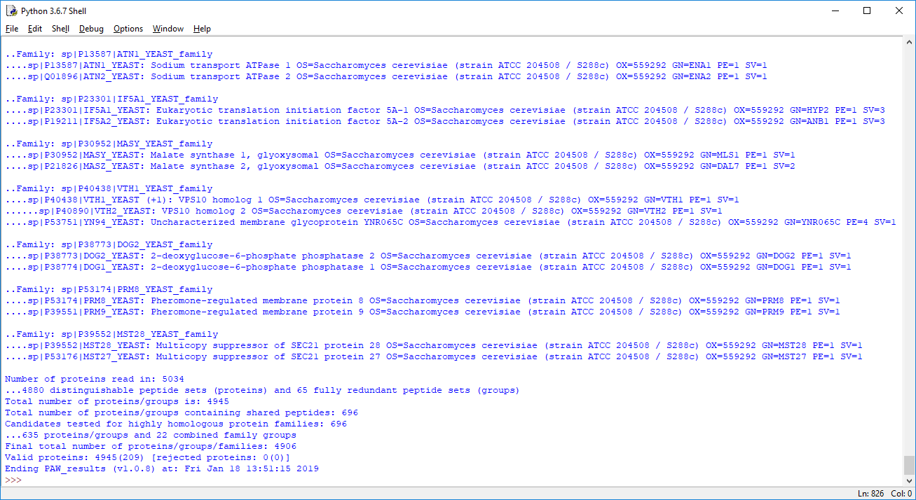
Summary statistics
Notes:
Summary statistics are logged at the end.

Slide 21
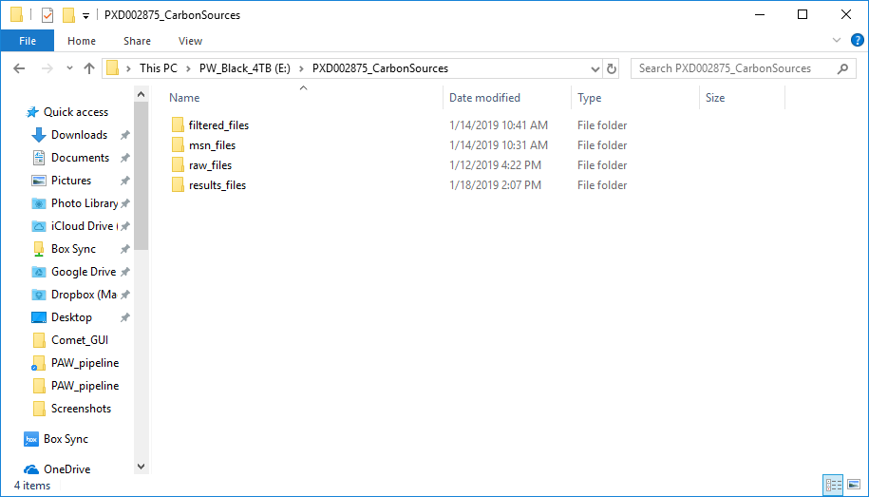
Notes:
We have a new “results_files” folder added to our project folder.

Slide 22
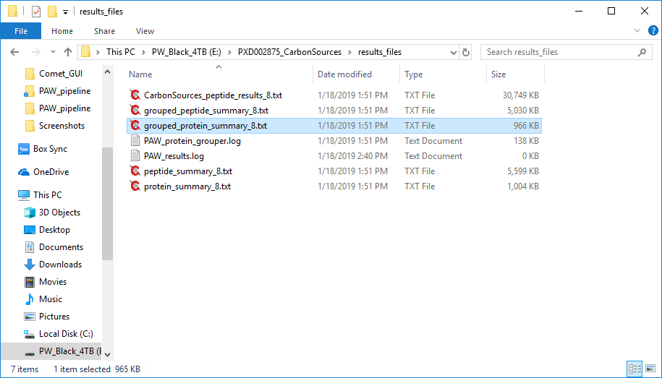
Detailed peptide report
Grouped, non-redundant protein and peptide reports
Log files
Redundant protein and peptide reports
Notes:
That folder has our tab-delimited text summary files. There will be a detailed peptide file for each biological sample (we have only one here: CarbonSource_peptide_resuls_8.txt). We have the redundant protein and peptide reports generated before protein grouping. We have the non-redundant reports produced by the protein grouping step, and we have log files that duplicate most of the console output.

