Slide 1
histo_GUI.py guide
Phil Wilmarth Jan. 14, 2019

Slide 2
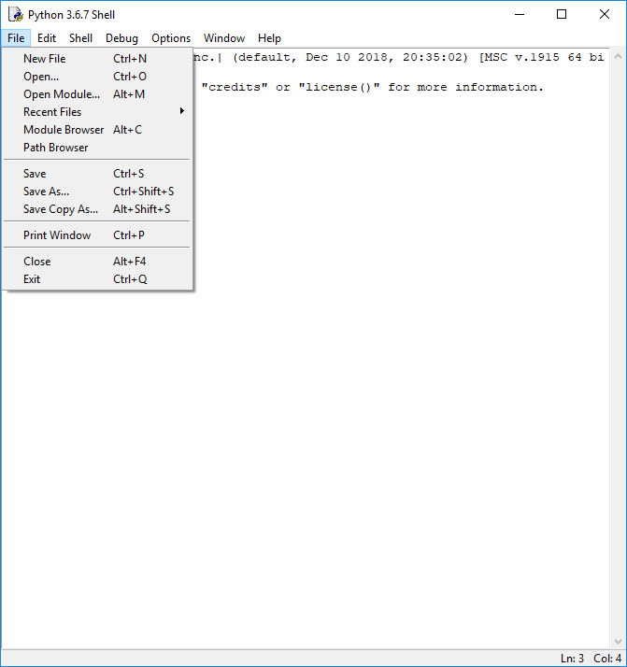
Notes:
Open the histo_GUI.py script from IDLE (“File” menu, “Open…” command, from the console “Shell” window).

Slide 3
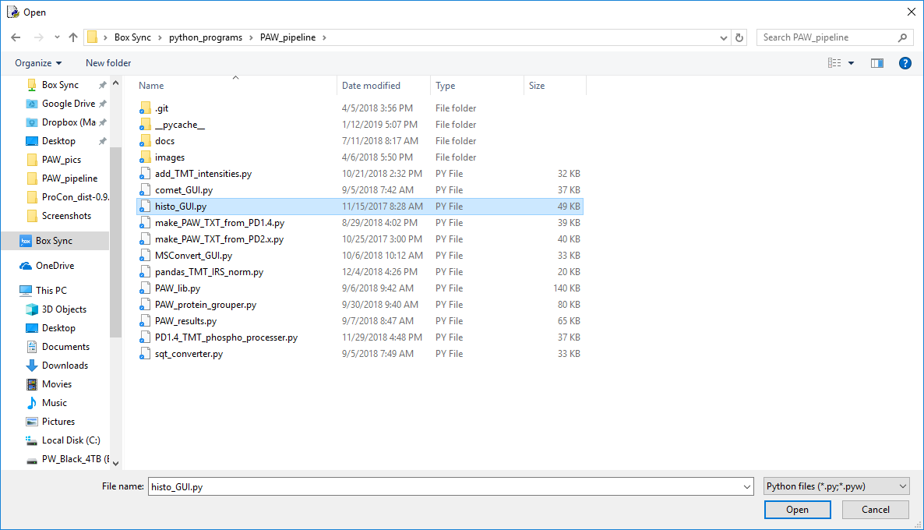
1
2
Notes:
Select the “histo_GUI.py” script in the file dialog box and click “Open”. You may need to browse to the location where the scripts are saved on your system.

Slide 4
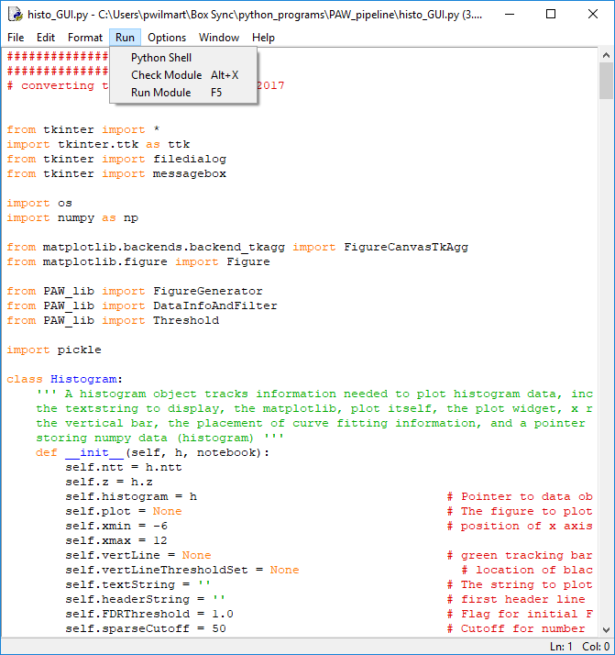
Notes:
From the code editor window, select the “Run Module” command from the “Run” menu (or press the F5 key).

Slide 5
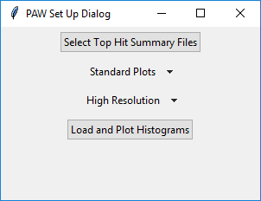
Notes:
A Tkinter GUI application will launch. The first window is a setup dialog box. Click on the first button (“Select Top Hit Summary Files”).

Slide 6
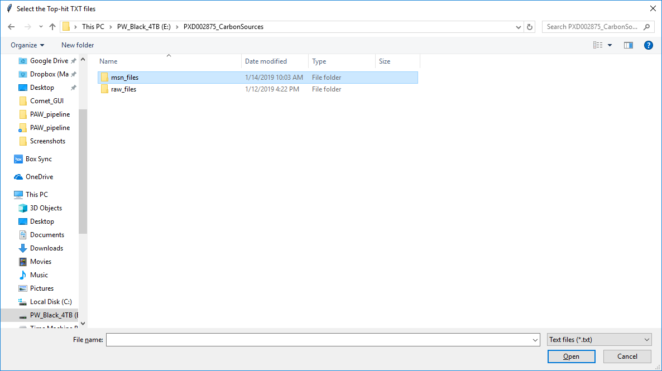
Notes:
This brings up a file browser dialog box. Browse to the location of the Comet search results. This is where the MS2 format files were located. After Comet runs, there will be SQT files that have the Comet results. The “sqt_converter.py” script converts the SQT files (with several matches per spectrum) into a “top hit” summary file. These TXT files have the top hit sequences and scoring information. They may also have reporter ion intensities. Double click the “msn_files” folder (or select then press the Open button).

Slide 7
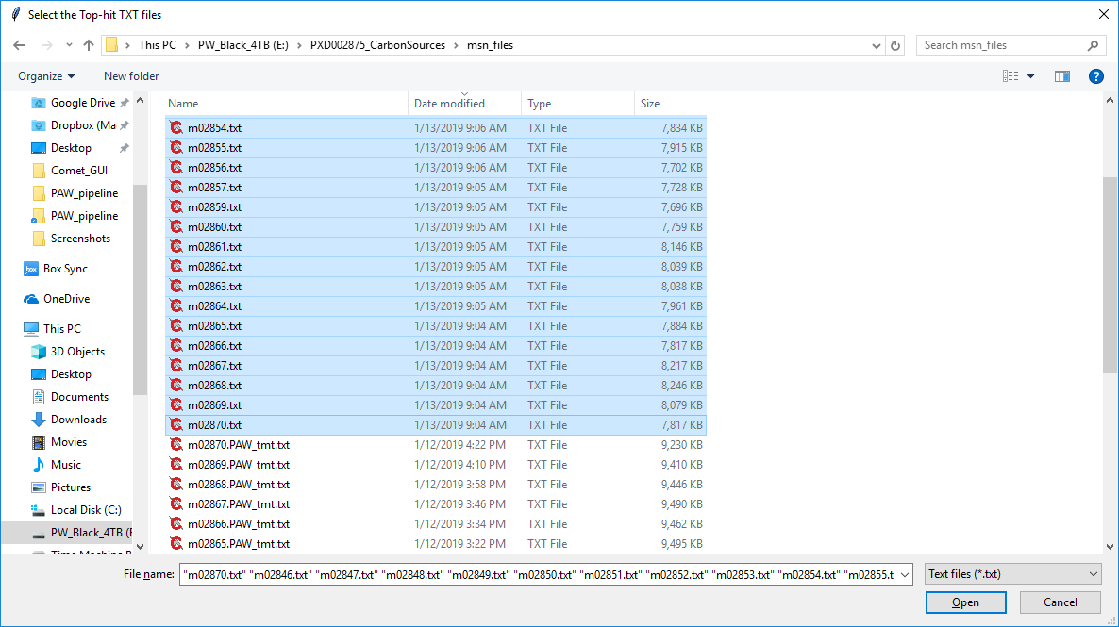
Select all of the TXT files
Then click
Notes:
Select all of the top hit summary text files (“txt” extension). This is a basic multiple file selection operation for your operating system. Then click the “Open” button. NOTE: the “PAW_tmt.txt” extension files are NOT top hit summary files. They are the files with reporter ion intensities.

Slide 8
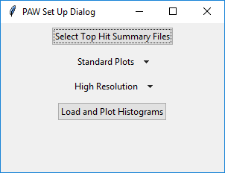
Standard or smoothed histogram plots
High resolution/accurate mass or low resolution ion traps
Notes:
The defaults are “Standard” histogram plots (or smoothed) and “High Resolution” (Orbitrap) instrument (or “Low Resolution” for ion traps). Change the defaults if need be, then press the bottom “Load and Plot Histograms” button.

Slide 9
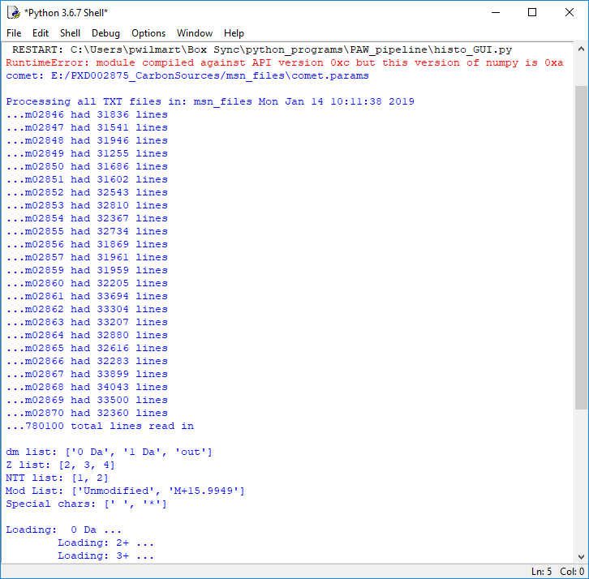
File reading progress
Selected search parameters
Notes:
In poor GUI design, the GUI application is not self-contained. Useful output still gets printed to the standard console Shell window. Here we see that the 24 selected TXT files were read in. We see some of the search parameters that affect what histograms will be created. After the top hit files are read and the score histograms have been constructed, the GUI window will have the delta mass histograms. When using high mass accuracy instruments, correct matches will have accurate masses and most incorrect masses with not have an accurate mass provided we do not use 10 or 20 ppm precursor mass tolerances. We need a wider tolerance so that incorrect matches will not be coerced into having an accurate mass (essentially invalidating accurate mass as a discriminant).

Slide 10
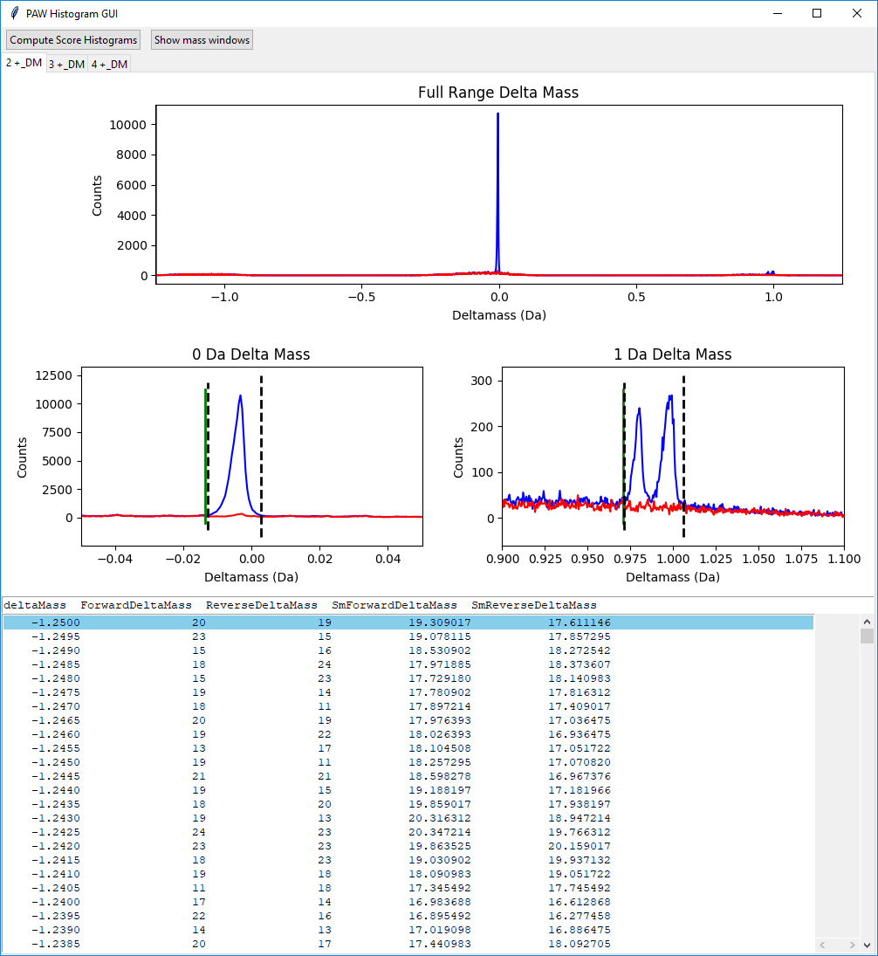
Full range plot
0-Da
region
1-Da
region
Target and decoy count by delta mass table
Notes:
There is no support for PPM units. Delta mass histograms are in Da units. Mass values for matches to the target half of the protein database are in blue color. Matches to the decoy half are in red. The top plot is the full precursor tolerance window (I recommend 1.25 Da in Comet searches). The bottom two plots are expanded scale plots for the 0-Da region (left) and the 1-Da region (right). We should have a strong peak at 0-Da for most of the correct matches. It should be pretty symmetric and be narrow. There are dotted lines automatically set for the left and right bounds of the peak. The right plot typically has two peaks. The left one is from deamidation of asparagine residues (+0.984 Da) and the right one is the first isotopic peak when the precursor was not triggered on the monoisotopic peak (+1.003 Da). The dotted lines encompass both peaks. Below the plots is a table of delta mass information.
The next couple of slides show how to change the locations of the dotted lines when they are not quite right. There are some control button (“Compute Score Histograms” and “Show mass windows”) at the top of the window. Below those are three tabs, one for each of the supported charge states (2+, 3+, and 4+). This slide is for the 2+ peptides.

Slide 11
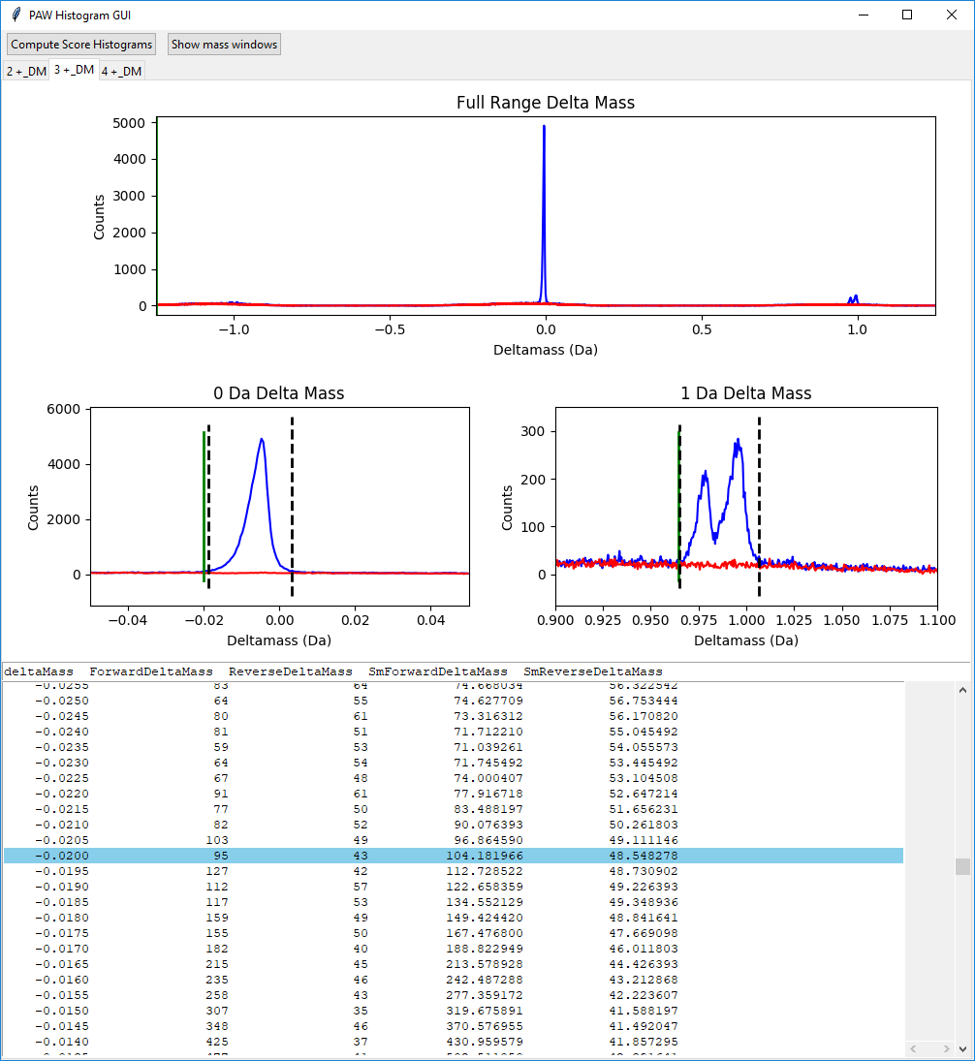
Click the plot first
Click the table second
Press left or right arrow key third
Change the table row up or down fourth
Press return key to update dotted line fifth
Notes:
Here we are on the 3+ delta mass tab. The 0-Da dotted lines can be widened a little. The interface needs to know what you want to change. It needs to know which set of dotted lines you want to change (0-Da or 1-Da), and whether you want to change the left or the right dotted line. You specify the 0-Da or 1-Da by clicking inside of the respective expanded scale plot. When you do that you may notice the text in the table will change. Then you have to CLICK INSIDE THE TABLE. The dotted lines do not move in response to clicks inside the plots. The dotted lines show what row is highlighted in the table. You will change the dotted line location by changing the highlighted row in the table. You have to specify what dotted line you are working with first. That is done by the left or right arrow keys. Once you have selected the plot, selected the table, and pressed the left or right arrow key, you can move the highlighted row up or down with the up and down arrow keys or by clicking on a table row. A green line in the plot shows where the highlighted table row is on the plot. When you have the green line where you want the new cutoff to be, press the return key. That will move the dotted line to the location of the green line.
NOTE: the y-scale can be expanded by double clicking in the y-axis label regions of the plots.

Slide 12
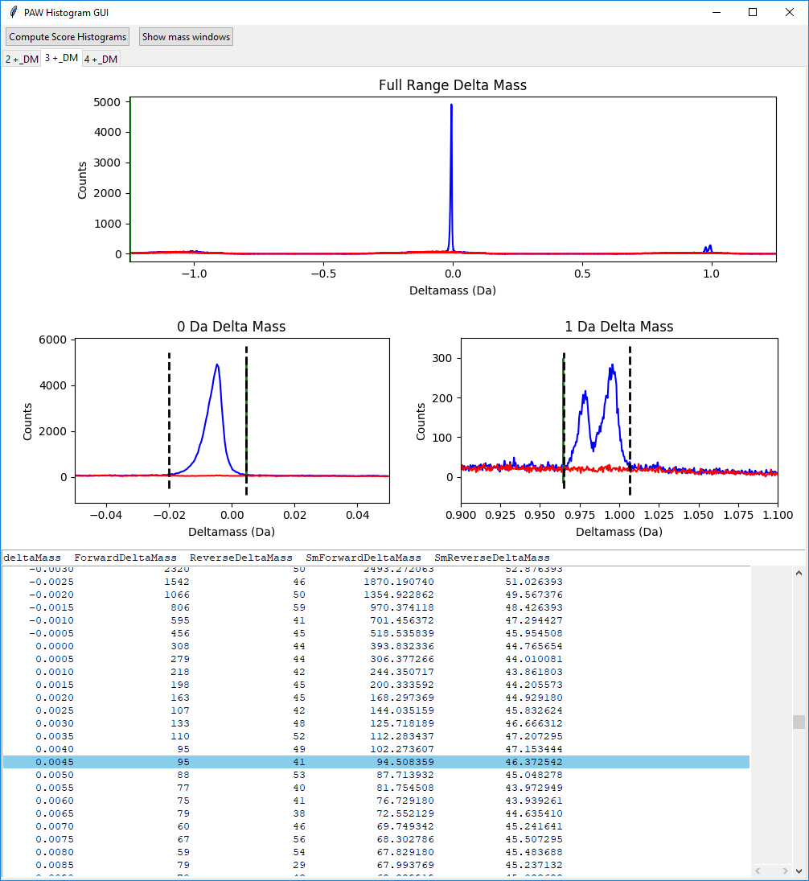
Window is wider
Notes:
Both left and right cutoffs for the 3+ 0-Da peak have been changed to capture more of the peak. The dotted lines are used to make conditional score histograms. Peptides that have delta masses that are within the two dotted lines at 0-Da will have a separate score histogram. This will reduce the noise and let us set lower score cutoffs and improve sensitivity. We will also make histograms for the 1-Da region, and even make histograms for all other delta masses.

Slide 13
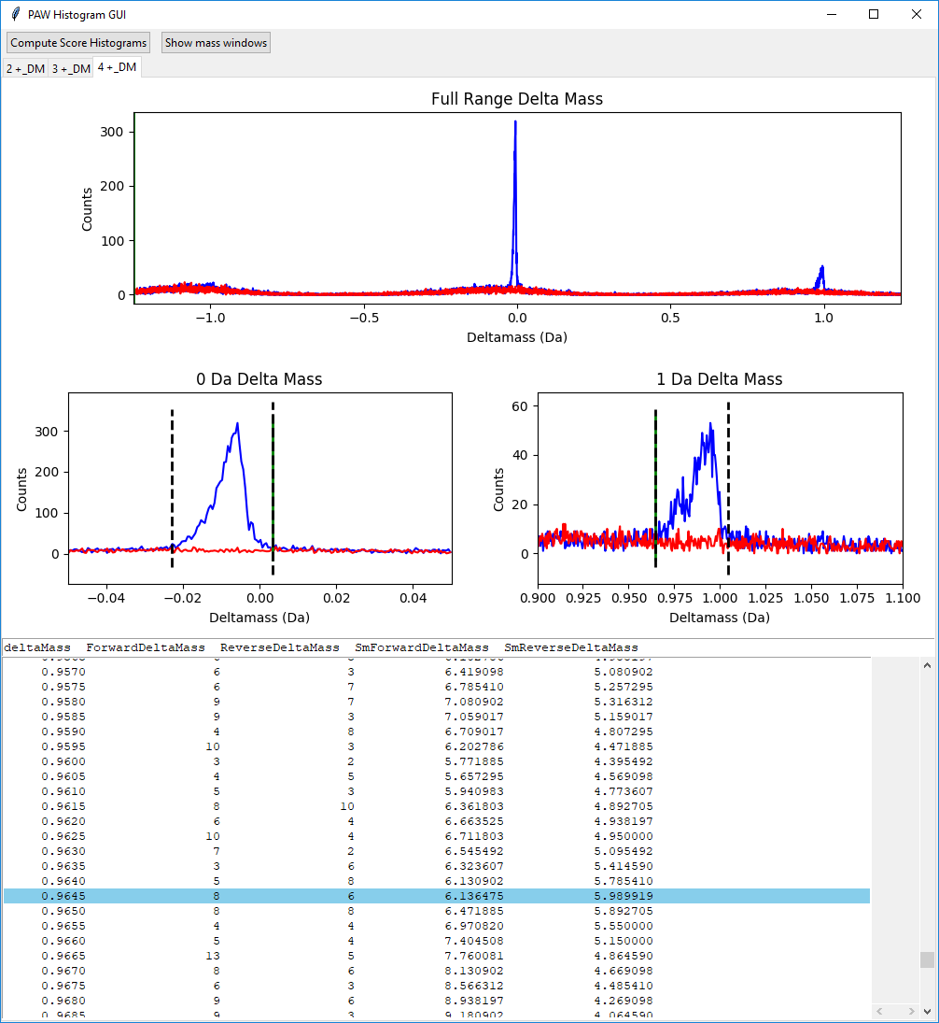
Want line where blue peak just ends
Notes:
This is the 4+ tab. I usually work across the tab left-to-right. The windows (doted lines) were widened here a little (as in the 3+). The 2+ line locations were good. When all of the windows in all of the tabs have bene inspected/adjusted, the click the “Compute Score Histograms” button.

Slide 14
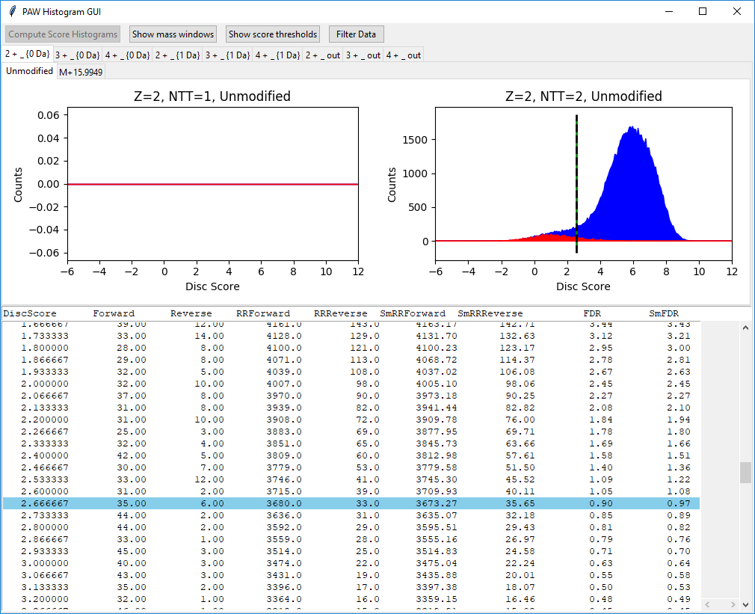
Defaults are at 1% FDR
Good
Bad
Notes:
The three conditional score histograms (0-Da window, 1-Da window, not in either window) will be created for each charge state (2+, 3+, and 4+). Those combinations make the 9 tabs in the top tab row below the command buttons (two new commands have been added). There is also a secondary tab row where peptide scores are sub-classed by modification state (unmodified and oxidized Met). There are two plot windows depending on number of enzymatic termini. Depending on Comet settings, only fully tryptic peptides may be reported (if so, the NTT=1 histogram will be empty). The historical reason for the NTT=1 plot is because SE QUEST and some versions of Comet only show a small number of proteins that contain the peptide. Peptides typically have to be checked against all proteins in the database. The enzymatic status of the N-terminus is inferred from the protein sequence. The reported peptide may match some proteins where it is fully tryptic and may match others where it is semi-tryptic. It is more likely that fully tryptic matches are the correct ones. Not showing empty histograms will be fixed in a future version.
GUI function is similar to the delta mass view. You will want to work through all of the tabs (I do all the modification tabs for each of the top tabs, and work left-to-right). There is only one threshold to move so we do not have to worry about the left and right arrow keys. Getting the correct focus set is similar: first click on the tab you want, then clock on the plot that you want, then click in the table, then change the highlighted row, then press return. There will be default thresholds set at 1% FDR locations. These may not need any adjustments.

Slide 15
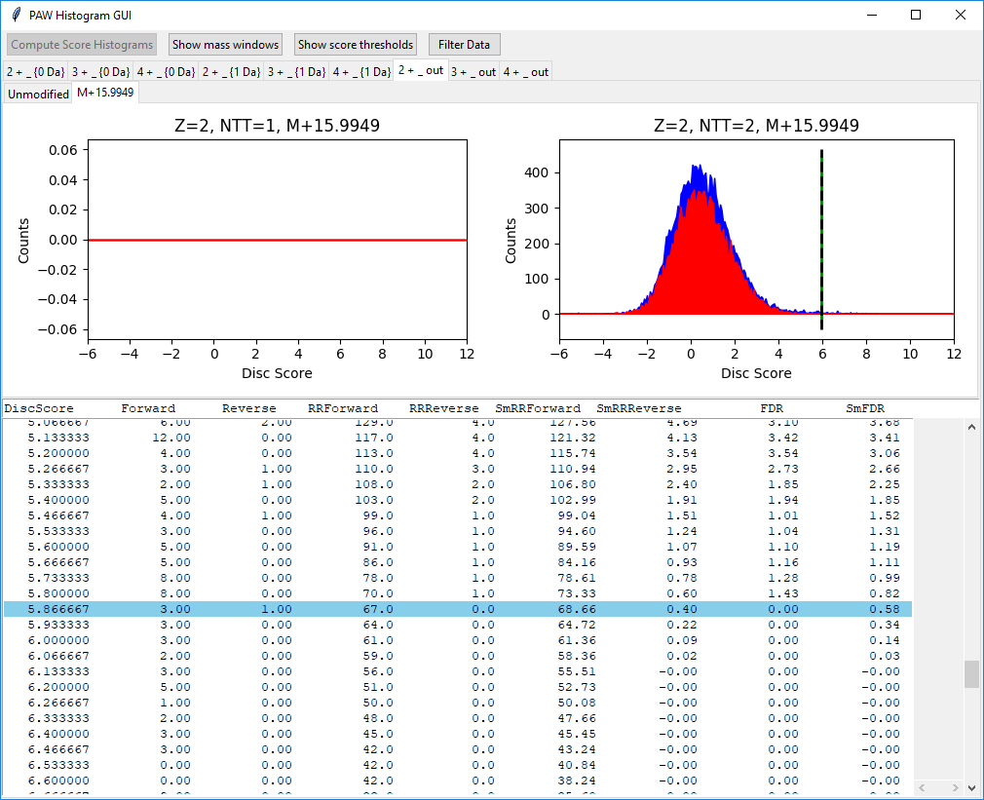
Starting threshold
Notes:
You have control over threshold locations. Sometimes adjustments from the 1% default make sense. From the table, we see that a cutoff of 5.466667 would only add one decoy match, but add 32 correct matches. We can get a few more correct matches without affecting overall accuracy much.

Slide 16
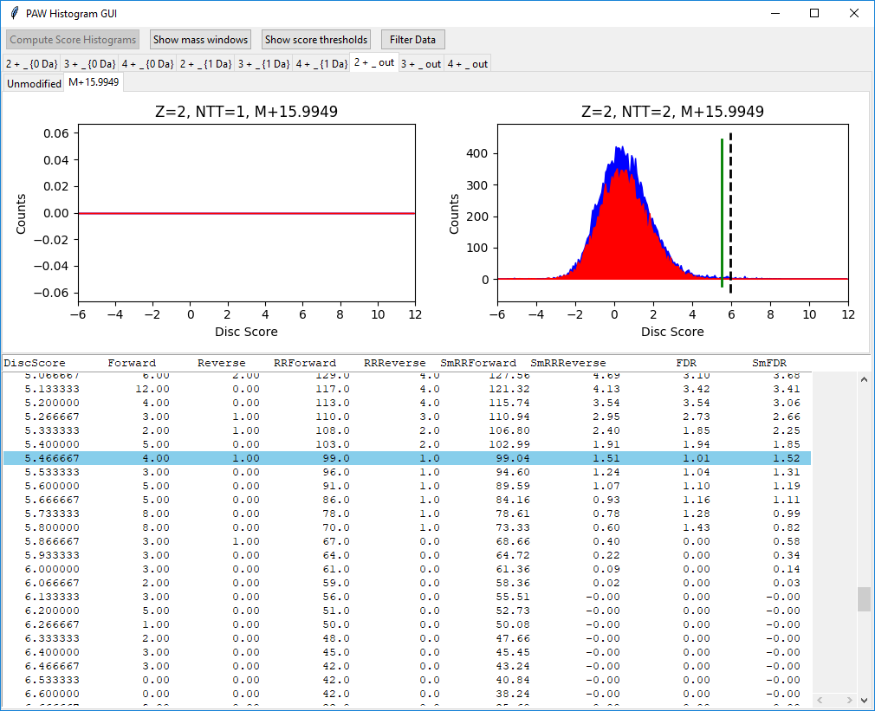
Current row value
Highlighted row has changed
Notes:
Here we are in the process of lowering the cutoff.

Slide 17

New threshold
Notes:
We have moved the threshold and updated its location by pressing the return key.

Slide 18
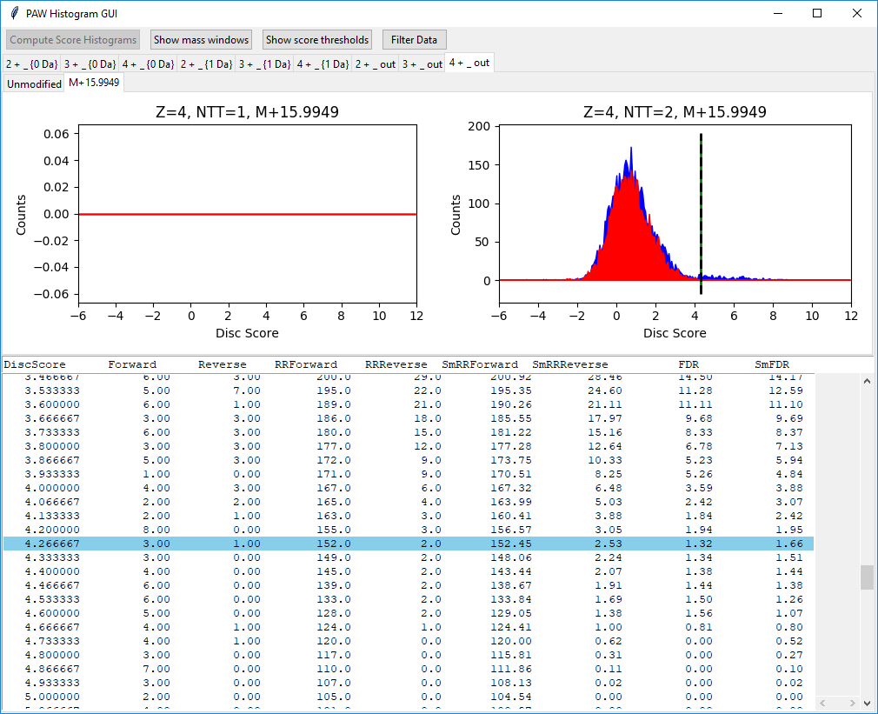
Last step
Done working from left-to-right
Notes:
When we have finished looking at (and maybe changing) the thresholds in the 18 tabs, we can filter our identifications to remove all matches with scores below the thresholds by clicking the “Filter Data” button at the top right.

Slide 19
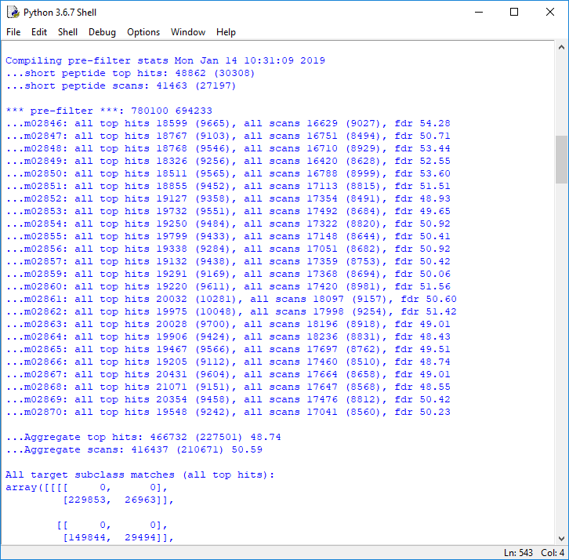
Notes:
The console (and log file) will have useful information. We see that there were 466,732 total top hits to start with (subject to a minimum peptide length). 49% of those matches were to the decoy database.

Slide 20
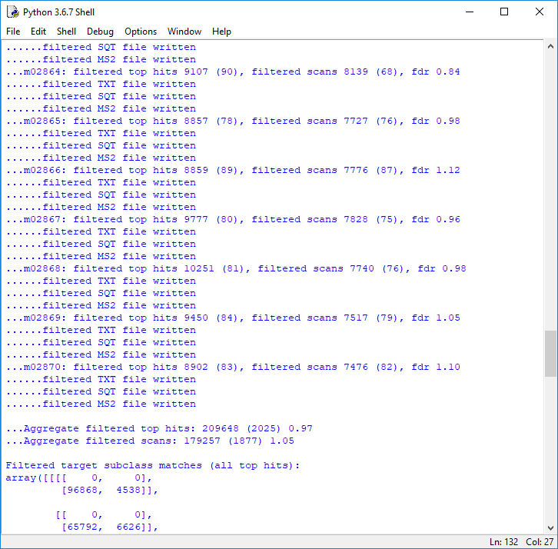
Notes:
After filtering, there were 209,648 matches passing the thresholds. There were about 2000 decoy matches for a 1% FDR.

Slide 21
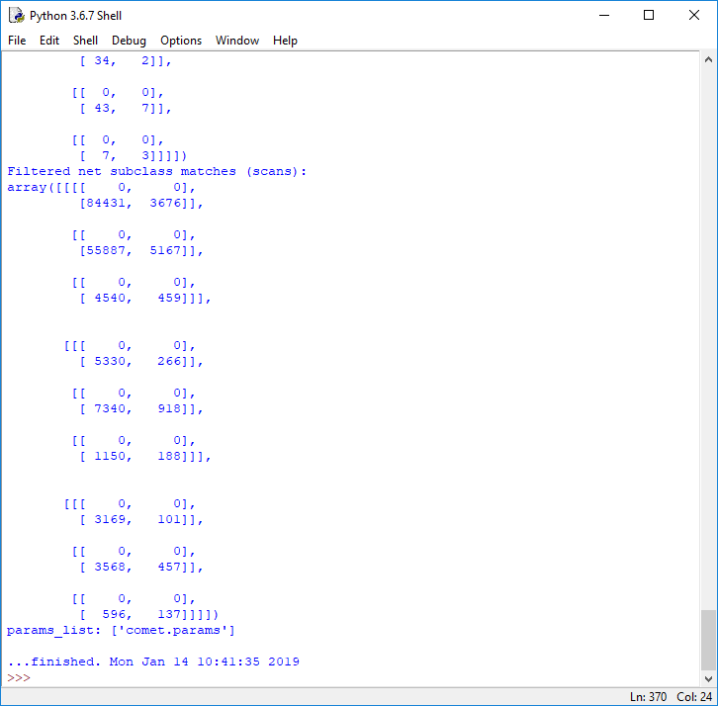
Notes:
You will get a “…finished” line when the filtering has completed. Click on the close window button on the GUI window (it does not have a quit button).

Slide 22
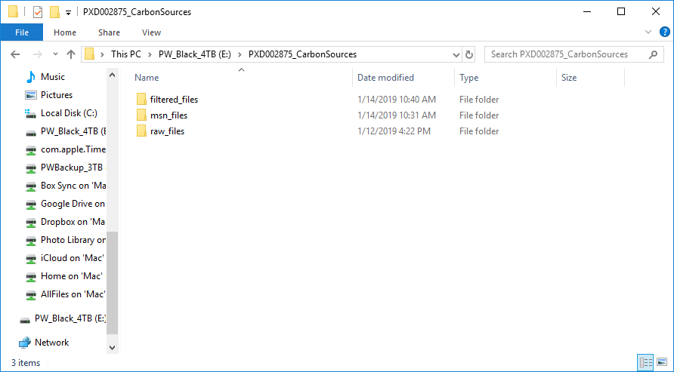
Notes:
We have a new folder called “filtered_files”.

Slide 23
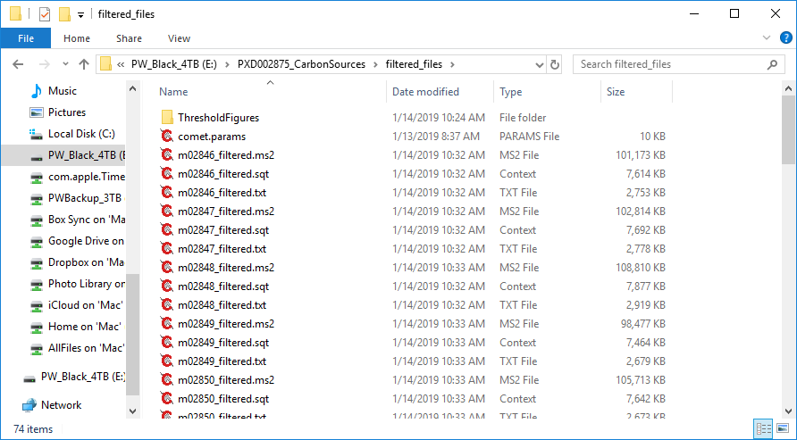
<- histograms
<- Filtered peak lists
<- Filtered Comet results
<- Filtered top hits
Notes:
There are new (smaller) MS2, SQT, and TXT files for just the PSMs that passed the thresholds. There are also PDF pictures of the score histograms and the threshold locations in the “ThresholdFigures” folder.

