Slide 1
Comet_GUI.py guide
Phil Wilmarth Jan. 14, 2019

Slide 2
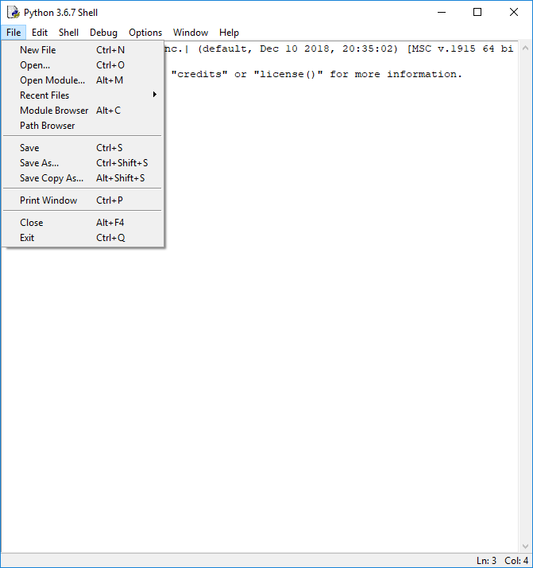
Notes:
Launch IDLE and Open the comet_GUI.py script.

Slide 3
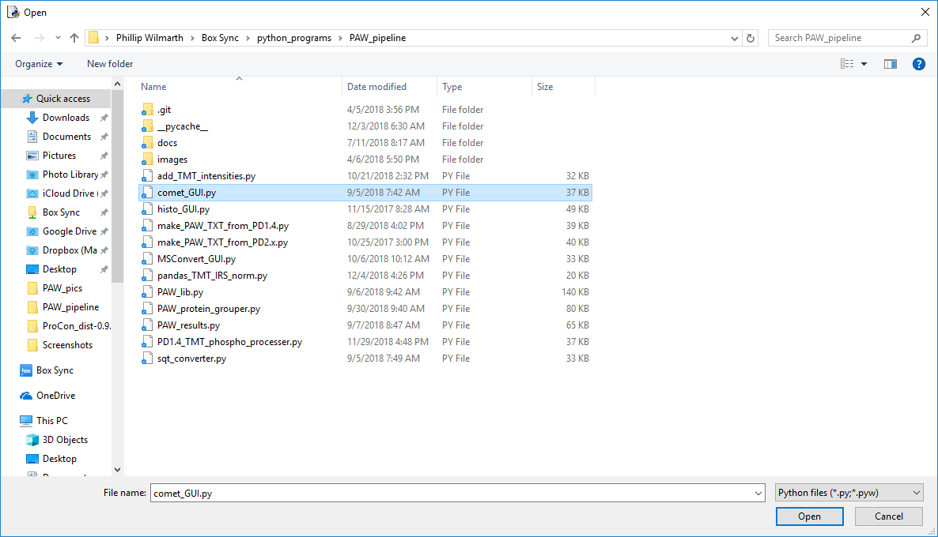
1
2
Notes:
Browse to where the PAW pipeline scripts are located and select the “comet_GUI.py” script. Click the “Open” button.

Slide 4
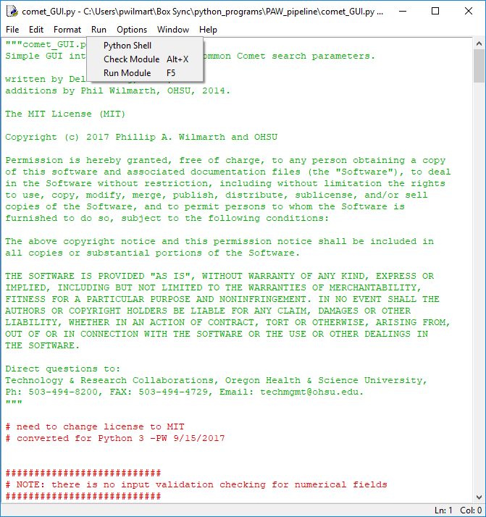
Notes:
Select the “Run Module” command from the “Run” menu of the code window.

Slide 5
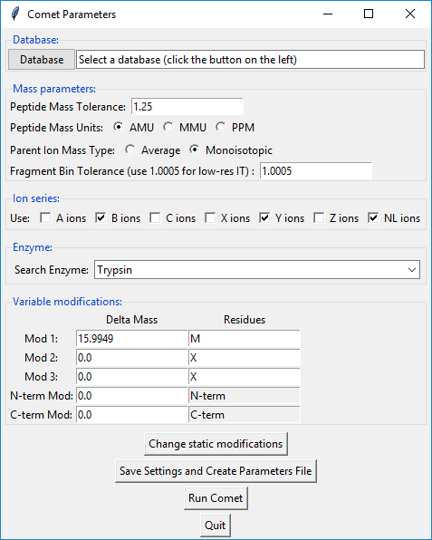
Notes:
A GUI window will launch. The GUI presents a subset of Comet parameters with some recommended defaults for many. A first ting to do is select the protein FASTA database file by clicking on the “Database” button.

Slide 6
Protein database sidebar

Slide 7
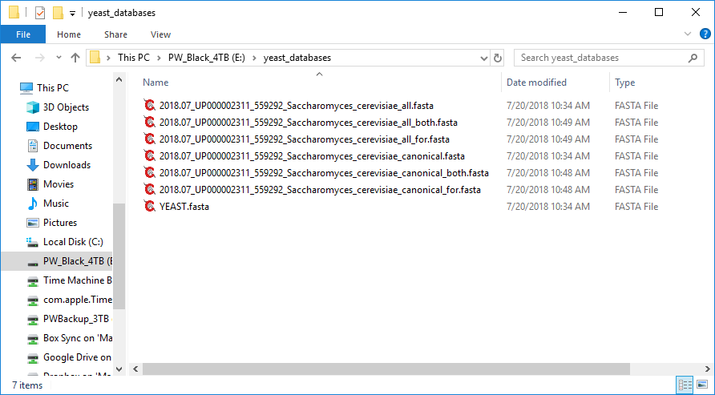
Notes:
Managing protein FASTA files is an essential part of proteomics data analysis. You can find scripts here (https://github.com/pwilmart/fasta_utilities.git) to help with that. There are various ways to approach the problem. I created a separate folder for yeast databases on the drive where I am doing analysis.

Slide 8
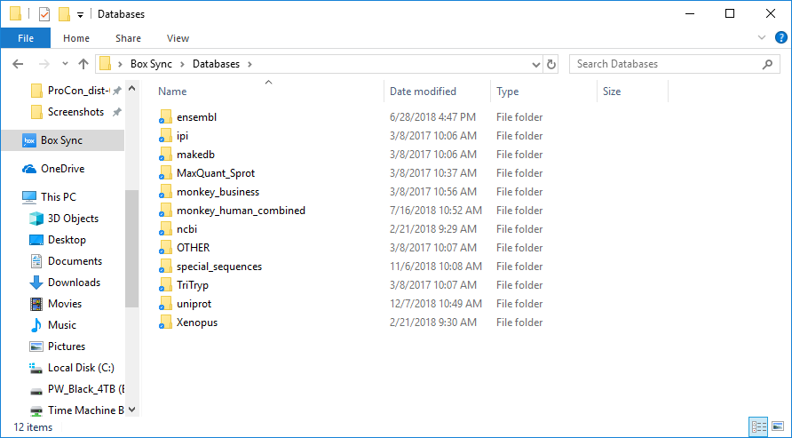
Notes:
In our core, we keep track of many databases from several sources. We have a database folder inside a sync folder so we can keep databases updated and push them out to our analysis systems.

Slide 9
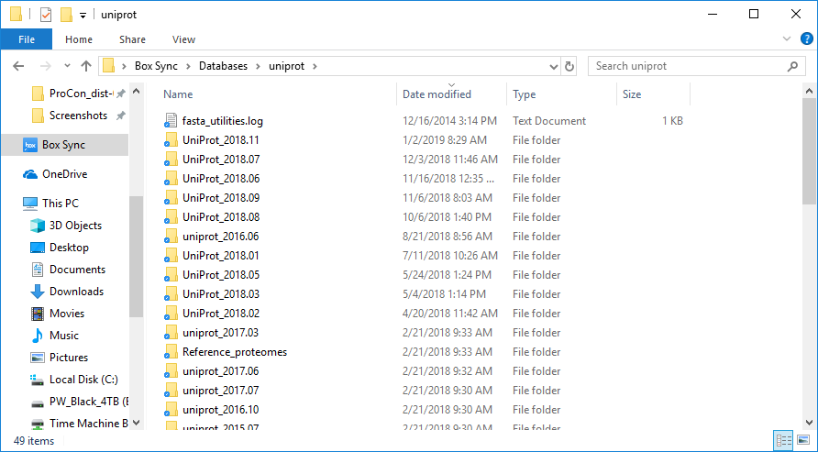
Notes:
We mostly use UniProt protein databases. They are automatically named and organized by the “UniProt_reference_proteome_manager.py” script.

Slide 10
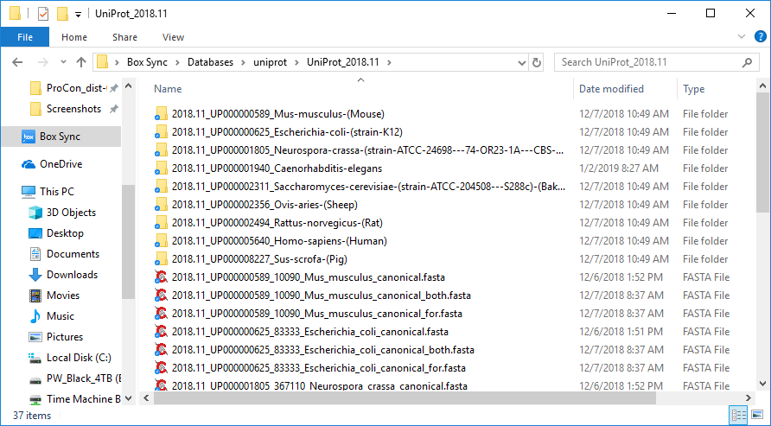
Notes:
That script will download a lift of databases of interest, name and organize them so you can keep them straight, add contaminants, and decoys.

Slide 11
Back to the guide…

Slide 12
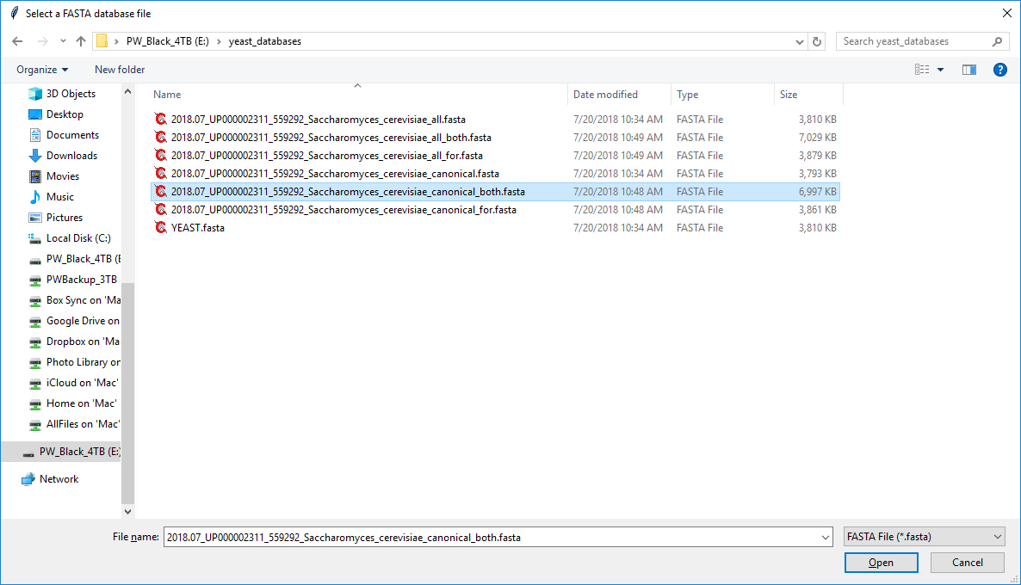
1
2
Notes:
Clicking the “database” button brings up a file dialog box. Browse to the location where you have prepared a target/decoy database with common contaminants, select the file, and click the “Open” button.

Slide 13
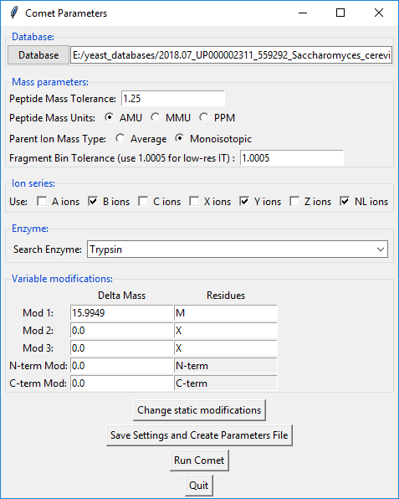
Good default value
These are good
Pick the enzyme
Keep modifications to an absolute minimum
For TMT
Notes:
After picking the protein database, most of the other parameters have good defaults. NOTE: high resolution MS2 data (Q-Exactives) needs a different fragment ion tolerance (editing the comet.params file works best). If you have TMT data, the reagent should be specified as a static modification. Click the “Change static modifications” button to do that.

Slide 14
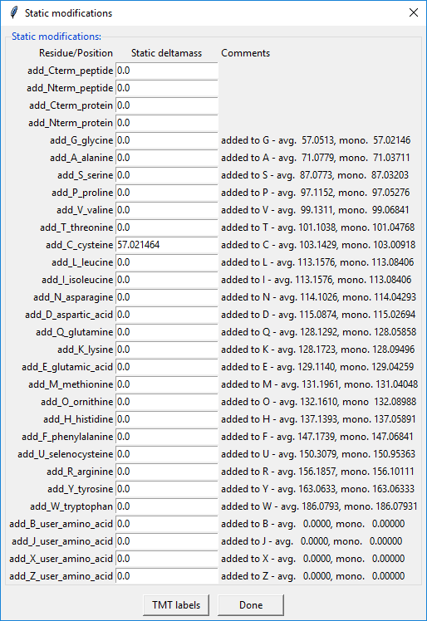
Notes:
The default static modification is alkylation of Cys. Click the “TMT labels” button to add the reagent masses to the N-term and Lys residues.

Slide 15
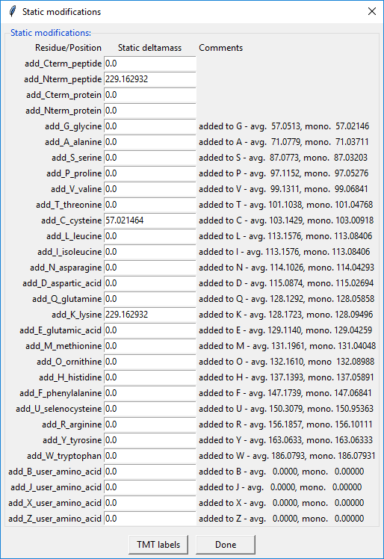
Notes:
We see that the 229 delta mass is now correctly specified. Click the “Done” button to get back to the main window.

Slide 16
Notes:
We need to create the “comet.params” file in the folder with the “.ms2” files before we can start the Comet searches. Click the “Save Setting and Create Parameters File” button.

Slide 17
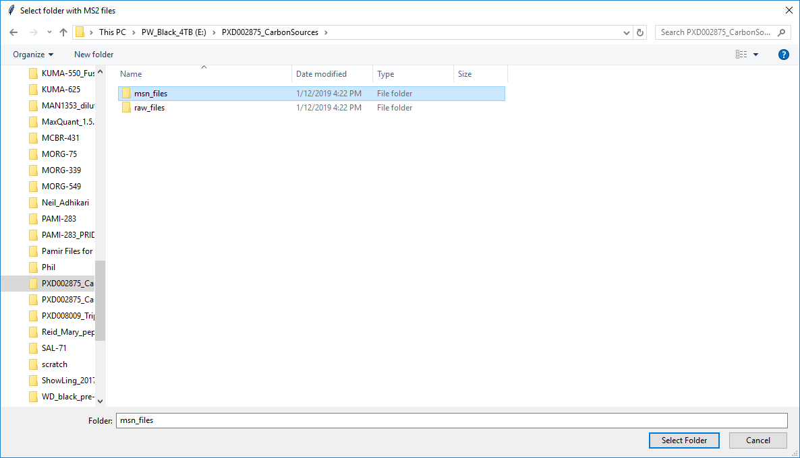
1
2
Notes:
Browse to the “msn_files” folder, select the folder, and click the “Select Folder” button.

Slide 18
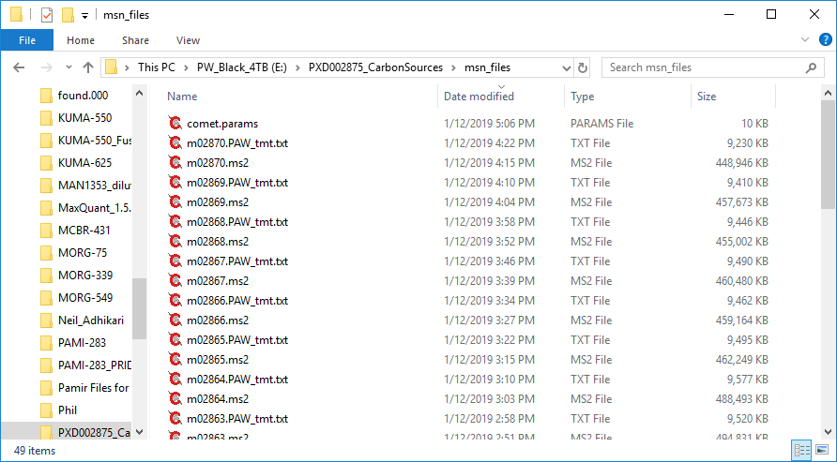
Notes:
ASIDE: after the folder has been selected, a “comet.params” file will be written. This file can be opened with any text editor and any of the other Comet parameters can be changed before starting the Comet searches. The GUI is just a helper application to cover the most basic functionality. Comet has many more parameters available.

Slide 19
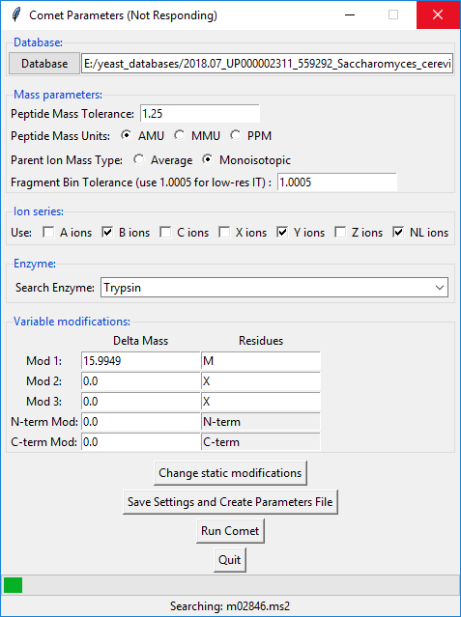
Notes:
There are some different ways to run the Comet searches. If you have set up a Windows batch file to point to Comet, and have edited the “comet_GUI.py” script to match, then the “Run Comet” button will work. The status bar will show the progress. Depending on number of files and search settings, Comet may take (many) several minutes to run (it is quite fast).

Slide 20
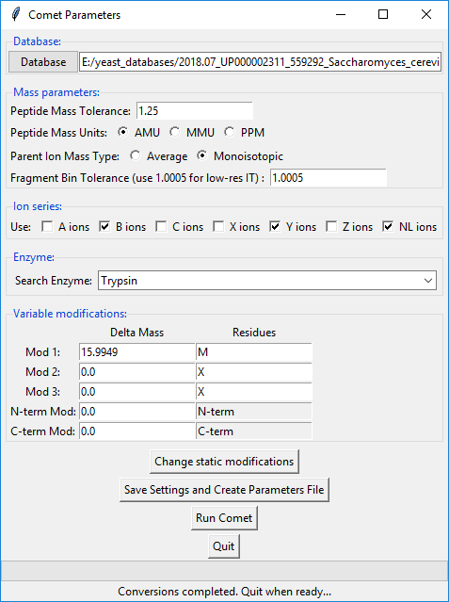
Notes:
There is a conversion process that has to happen after the Comet searches have created the SQT files. Several matches per MS2 spectrum have to be scored to get the deltaCN score. We only want to keep the top scoring match after we have the deltaCN values. There is a “sqt_converter.py” script that creates top-hit summary text files. When everything is done, the status bar will say that conversions have completed.

Slide 21
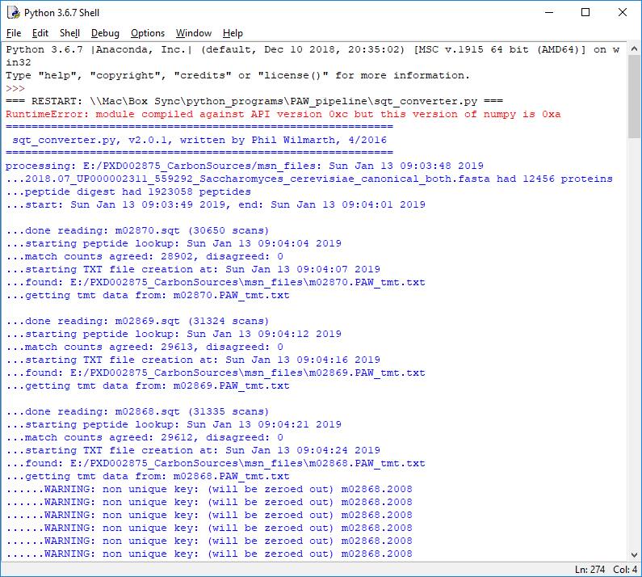
Notes:
The console Python window does not log any output from Comet during the Comet searches. Those are spawned as Windows command processes. The conversion script does log information to the console.

Slide 22
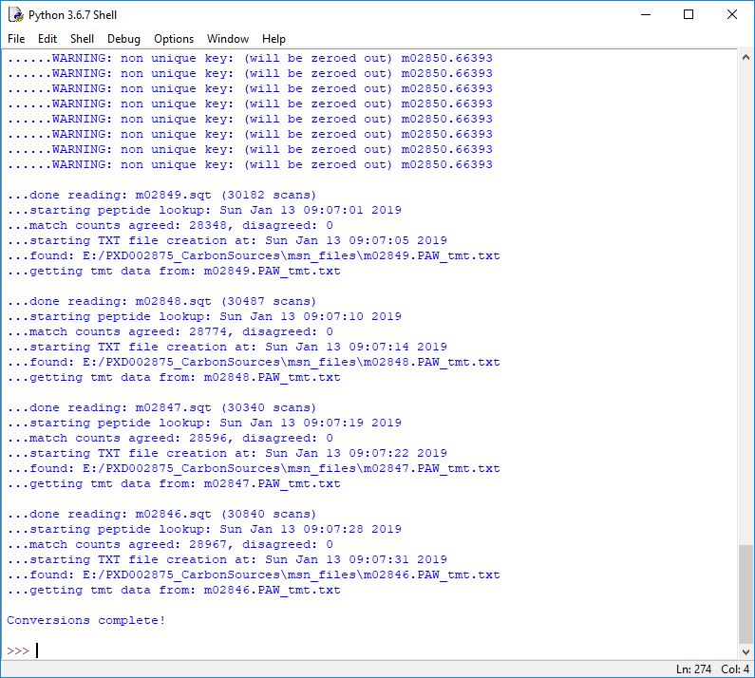
Notes:
It also tells you when it is finished.

Slide 23
Alternative way to run Comet searches

Slide 24
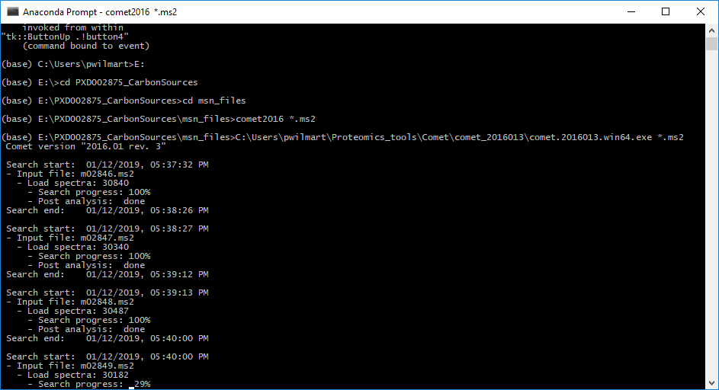
Notes:
We can also run Comet searches via standard command lines. We need to move to the folder with the “.ms2” files (top oval). Then we have to launch the older 2016 version of Comet. I have a batch file named “comet2016” in a location that is on my main search path (the PATH environment variable). We pass it a wild card for all ms2 files (“*.ms2”). There will be console output as the search progresses.

Slide 25
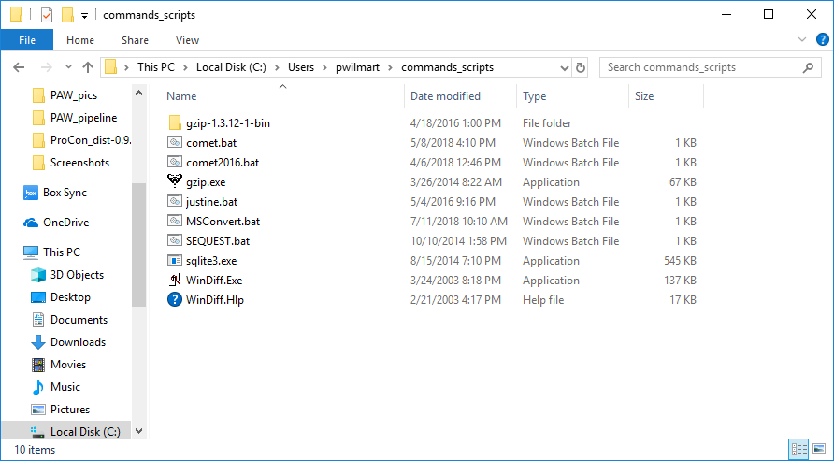
Notes:
Here is a folder I have for Windows batch files. The folder in in the search path (PATH variable).

Slide 26
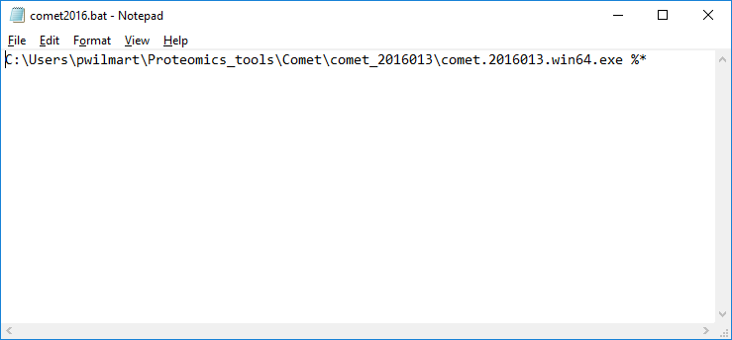
Notes:
This is the batch file for launching the 2016 version of Comet.

Slide 27
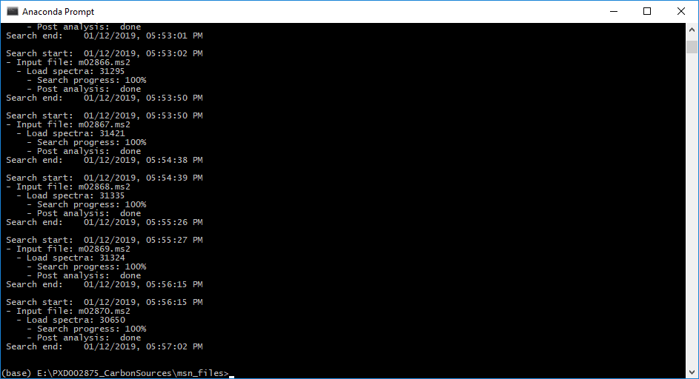
Notes:
We get the main prompt back after the searches have finished.

Slide 28
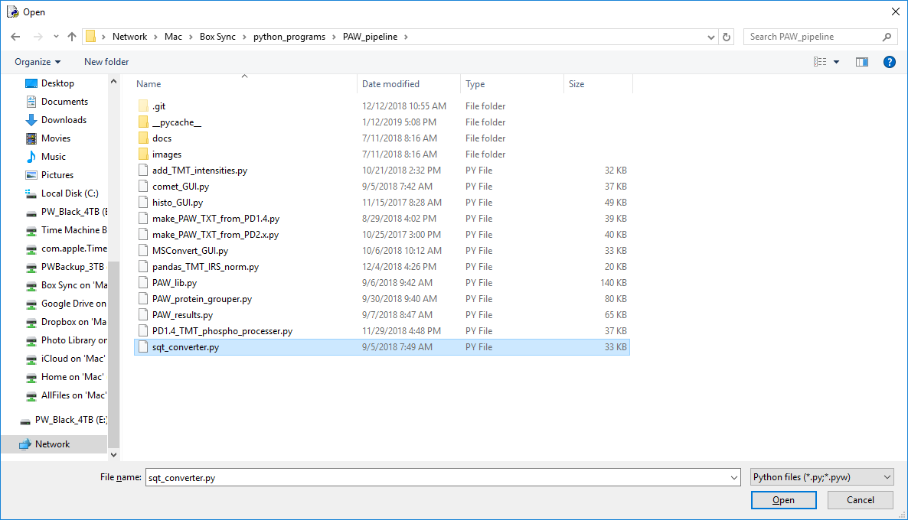
1
2
Notes:
We need to run the “sqt_converter.py” script. Open in IDLE the usual way (select script then Open).

Slide 29
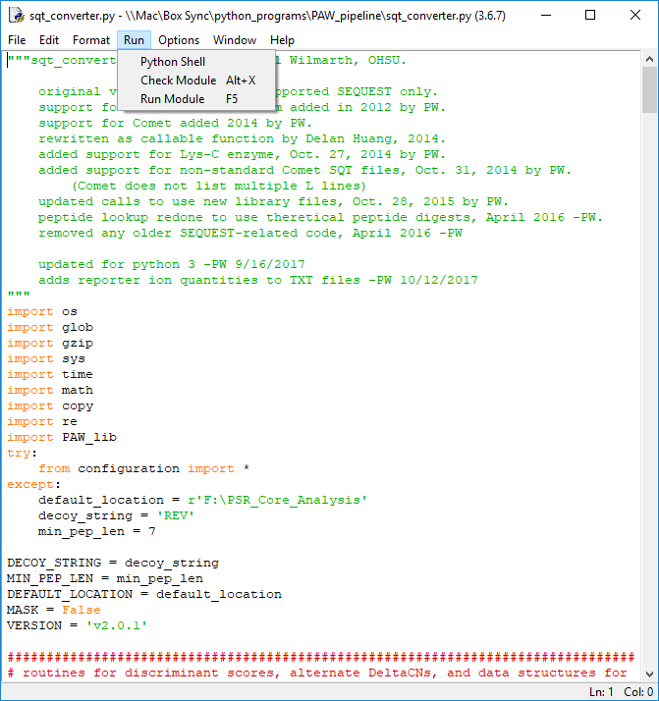
Notes:
Run the script (Run menu or F5 key).

Slide 30
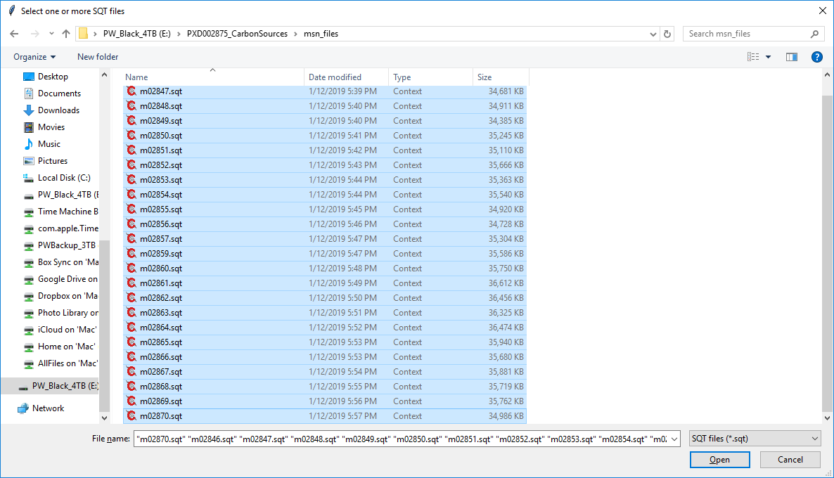
Select all of the SQT files
Notes:
Select all of the 24 SQT files and then click the “Open” button.

Slide 31

Notes:
The converter script will log progress to the console (and log file).

Slide 32
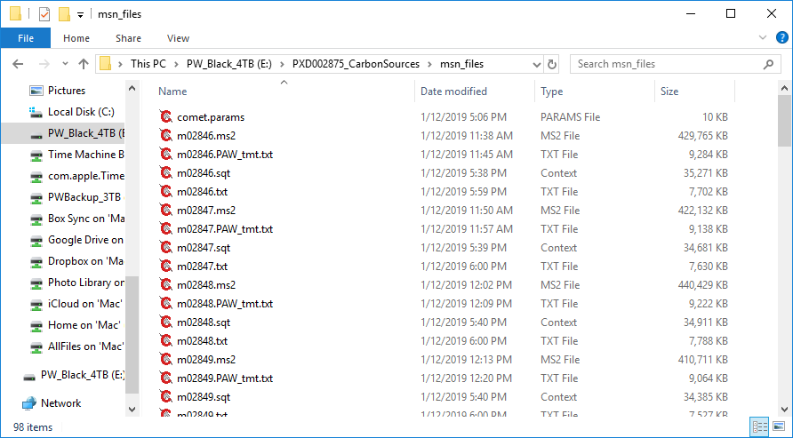
Notes:
When we have done all of the steps, either from the main GUI application or more manually, we will have more files in the “msn_files” folder. The SQT files are created by Comet. The “.txt” files (not the ”.PAW_tmt.txt” files) are created by the converter script.

