Slide 1
MSConvert_GUI.py guide
Phil Wilmarth Jan. 14, 2019

Slide 2
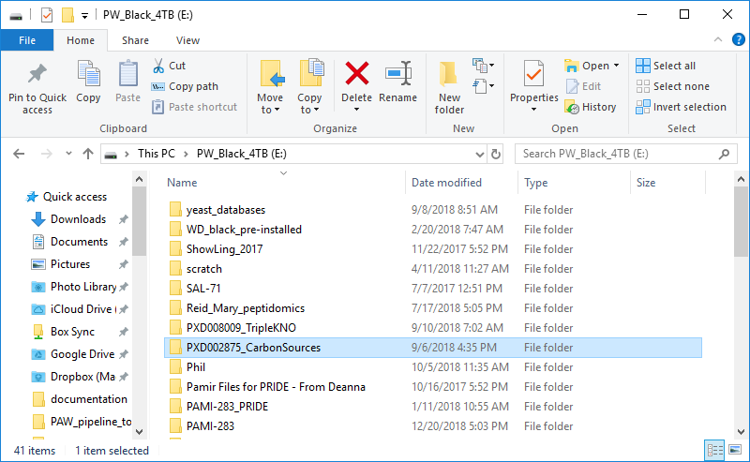
Notes:
This analysis of public data (PRIDE: PXD002875) from this publication – {Paulo, J.A., O’Connell, J.D., Gaun, A. and Gygi, S.P., 2015. Proteome-wide quantitative multiplexed profiling of protein expression: carbon-source dependency in Saccharomyces cerevisiae. Molecular biology of the cell, 26(22), pp.4063-4074.}. It is a 9-plex TMT experiment with yeast on three different carbon sources, each done in triplicate. The files were downloaded from PRIDE, a project folder created (PXD002875_CarbonSources), a “raw_files” sub-folder created to hold the 24 Thermo RAW files.

Slide 3
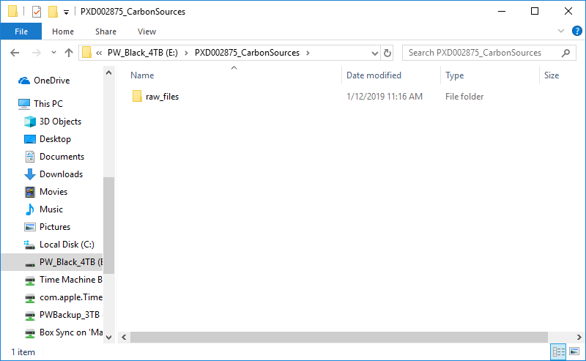
Notes:
Here is the sub folder. The PAW pipeline creates folders at different pipeline stages and keeps them inside of the main project folder. The starting point should be a raw_files folder within the project folder.

Slide 4
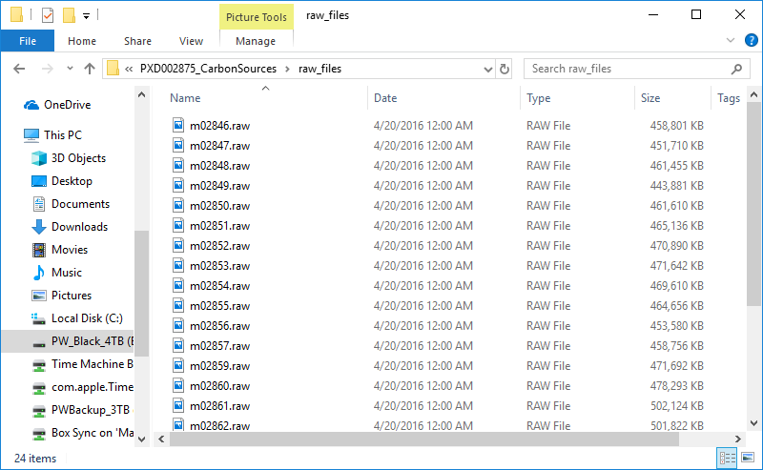
24 files
Notes:
Here are the RAW files.

Slide 5
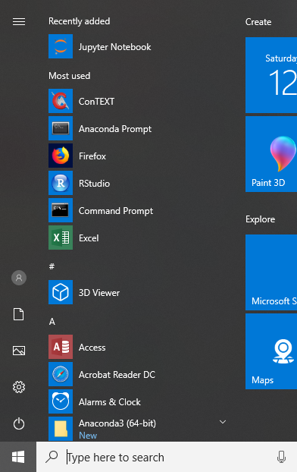
Notes:
We need to run Python scripts that use numpy and pandas. These are not part of the Python standard library. An easy way to manage all of these dependencies is to use Anaconda’s scientific Python 3 distribution. We have installed that here on a Windows 10 system. We need Windows 7 or 10 to run the MSConvert program that is part of the Proteowizard toolkit. We need to launch the Anaconda Prompt command window. It has some environmental variable defined that will make life easier.

Slide 6
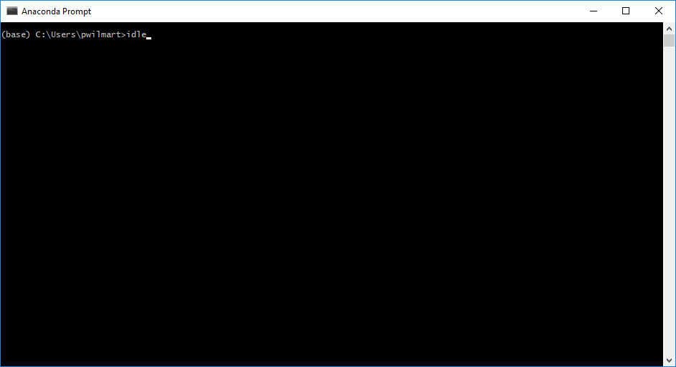
Notes:
When we have the command window open, we will type just one command: idle (on Windows; idle3 on OSX). This will launch the integrated development environment that is part of the Python standard library. It has a console shell window, supports multiple code editing windows, and has an integrated debugger.

Slide 7
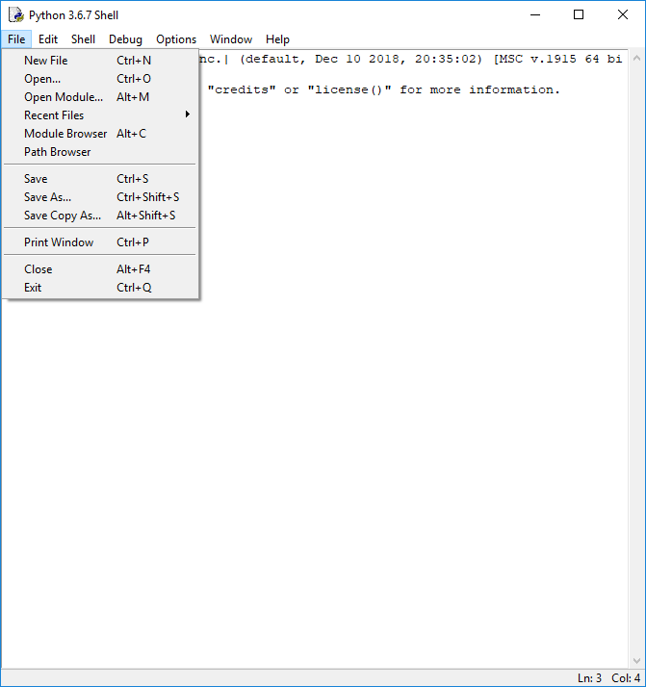
Notes:
Idle will launch with a console “Shell” window. This is like any basic command window, but a little more flexible. It is resizable and saves lines. You can easily copy output to the clipboard. We need to open the “MSConvert_GUI.py” script from the PAW pipeline (https://github.com/pwilmart/PAW_pipeline.git).

Slide 8
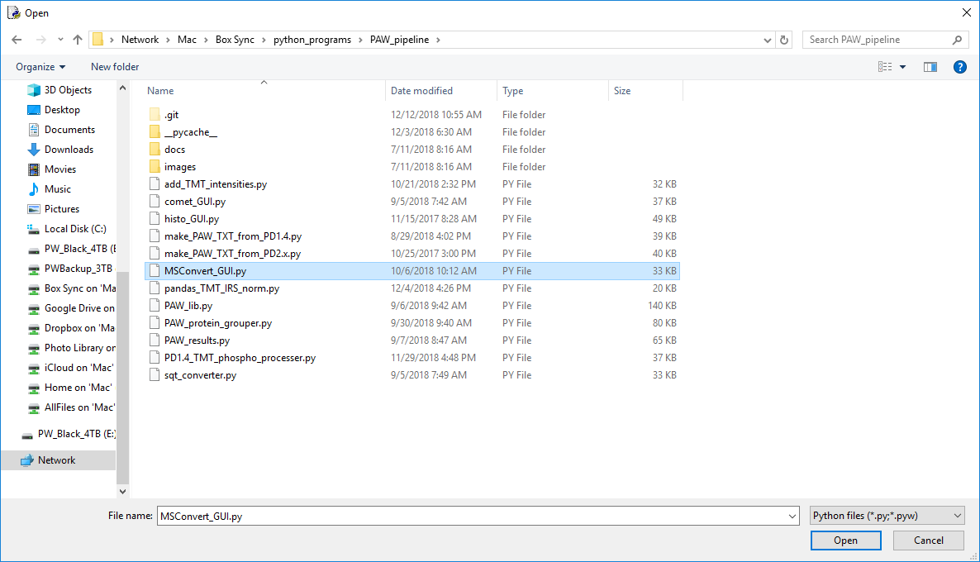
1
2
Notes:
Browse to the location where your PAW pipeline scripts are located. Select “MSConvert_GUI.py” and click the “Open” button.

Slide 9
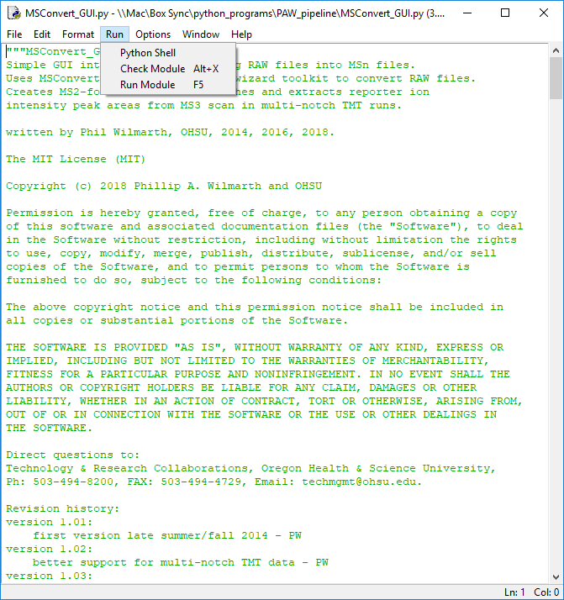
Notes:
This will open a code window. From that window, select the “Run Module” command from the “Run” menu (or the F5 key).

Slide 10
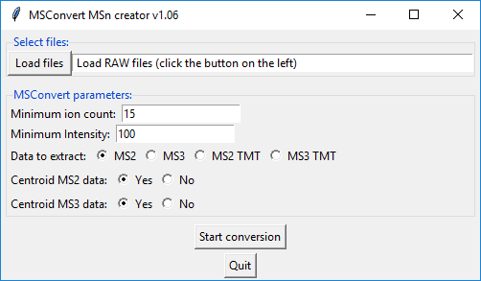
Notes:
This will launch a small GUI window. Click the “Load Files” button (top left).

Slide 11
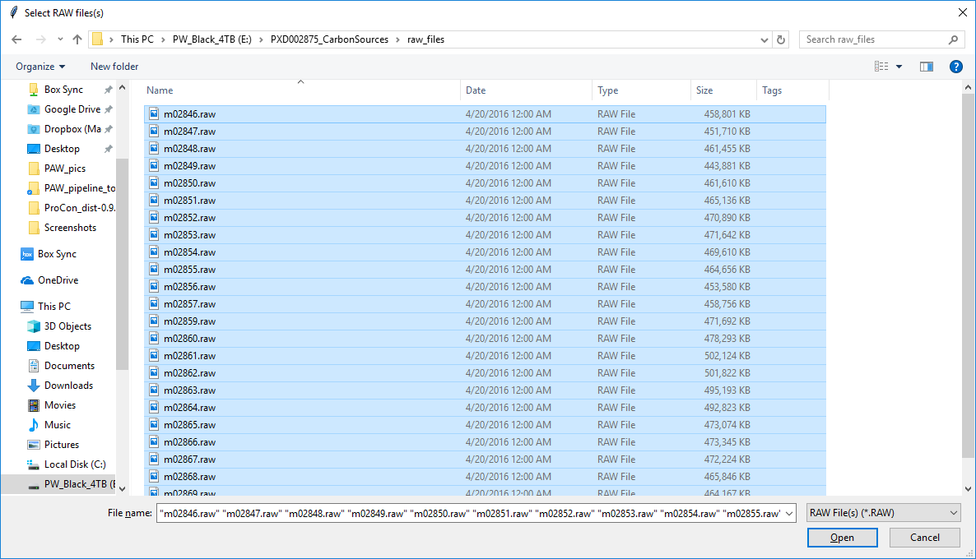
Select all of the 24 RAW files
Notes:
Browse to the location of the RAW files and select all of the RAW files that you want to process. This is a standard multiple file selection operation. Once the files are highlighted, click the “Open” button.

Slide 12
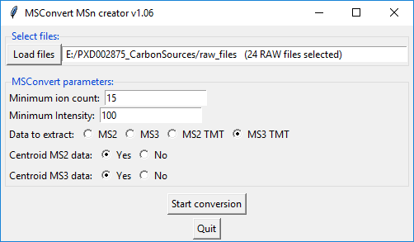
Notes:
The text field will indicate your selection. The defaults for “Minimum ion count” and “Minimum Intensity” are very minimal and probably do not need to be changed. The “Data to extract” radio buttons are very important. This data is TMT done with the SPS MS3 method, so we want the last button (MS3 TMT). Thermo instruments often collect data in profile mode. They always log cetroided data to the RAW files. For current Orbitrap instruments, centroided data works fine, so the “Yes” radio buttons for centroid data can be left in their default settings for both MS2 and MS3 scans. After the RAW files have been selected and the parameters set, then the RAW files can be converted to text files using MSConvert by clicking the “Start Conversion” button. The text files will be compressed to save disc space.

Slide 13
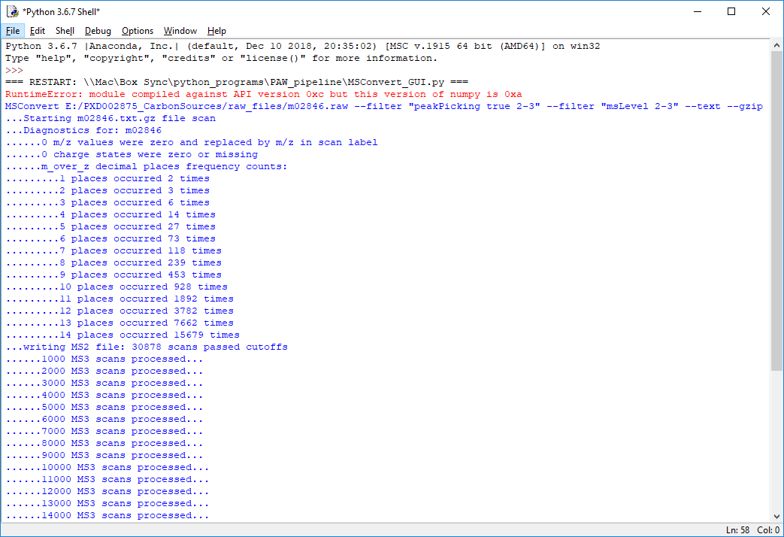
MSConvert command
Different numbers of decimal places is good
Number of MS2 scans
Getting the reporter ion intensities
Notes:
A few things happen during the conversion. MSConvert will create the compressed text files. Those files will be scanned twice, once to get the MS2 scans for the Comet searches (saved in a new “msn_files” folder in MS2 format), and once to get the reporter ion intensities. The reporter ions are saved in tab-delimited text files (one for each RAW file) and added to the msn_files folder. The console window shows the conversion progress.

Slide 14
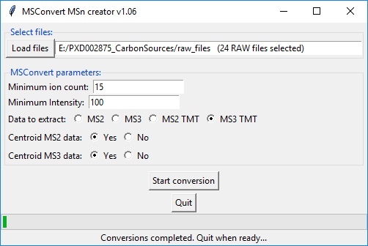
Notes:
The status bar tells you when the conversions are finished.

Slide 15
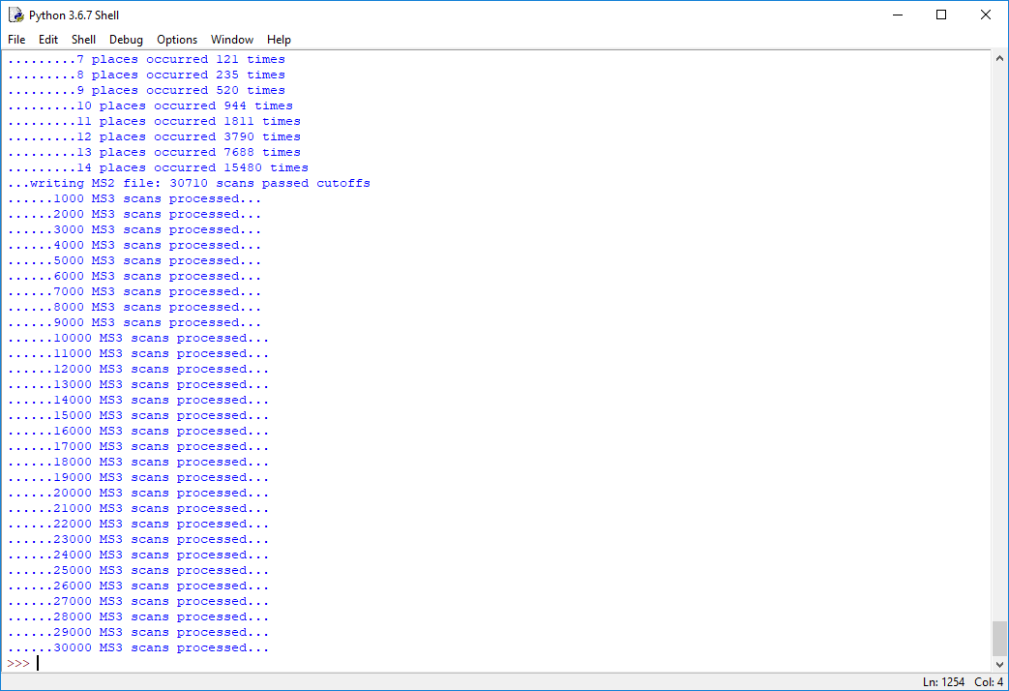
Prompt indicates we are finished
Notes:
After clicking the “Quit” button (or closing the GUI window), you will get the “>>>” prompt back in the console window.

Slide 16
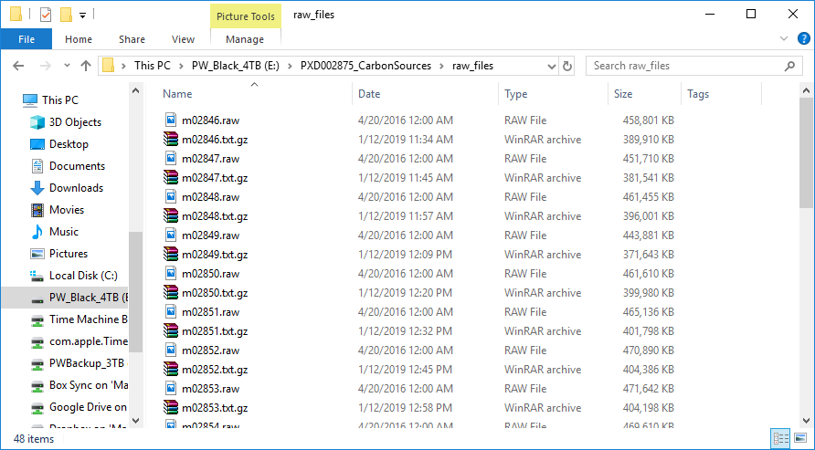
Notes:
After MSConvert has run, there will be a “.txt.gz” file for each “.raw” file. These files can be uncompressed and examined with any text editor that can handle large file sizes.

Slide 17
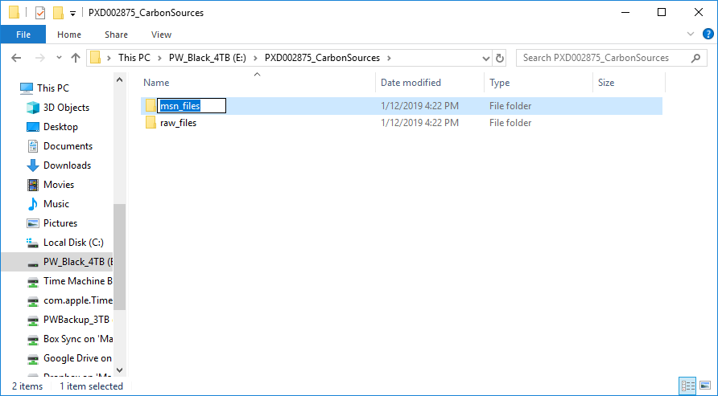
Notes:
A new “msn_files” folder has been created in the project folder.

Slide 18
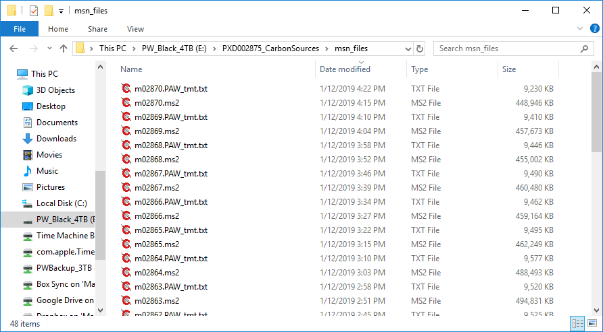
Reporter ion data files
ms2 format files for Comet
Notes:
Inside of that folder are two sets of files: the “.ms2” files with the peak lists for Comet searches, and “.PAW_tmt.txt” files containing the reporter ion intensities. The intensities are peak heights (maximum intensity value inside narrow windows centered around each reporter ion’s theoretical m/z value).

