Slide 1
Add_TMT_intensities Guide
Phil Wilmarth January 17, 2019
Notes:
This script adds reporter ions to the PAW results files. It does peptide and protein level aggregations.

Slide 2
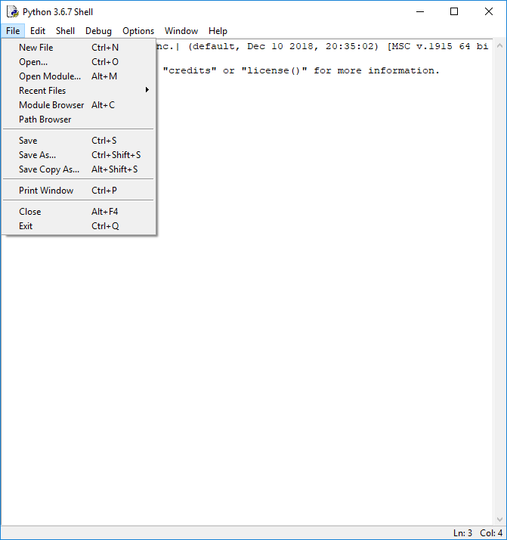
Notes:
Open the script from IDLE in the usual way.

Slide 3
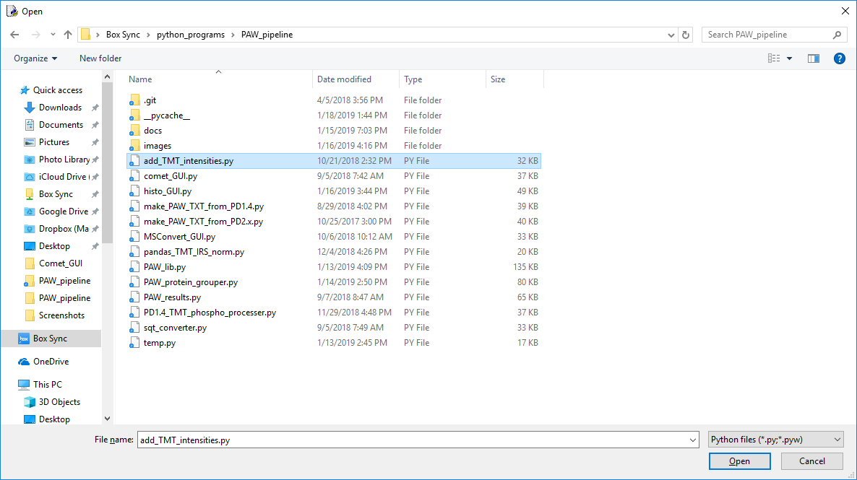
1
2
Notes:
Select the script file and Open.

Slide 4
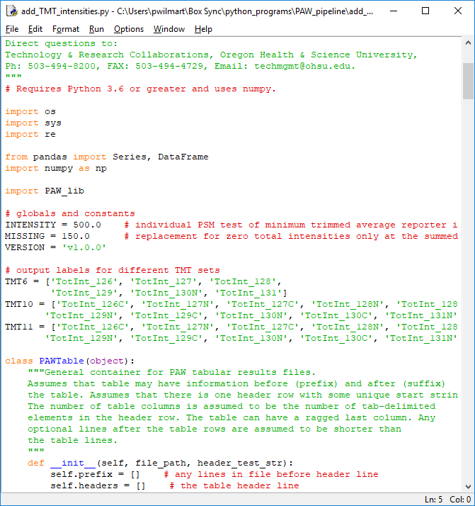
Notes:
There are two parameters that can be changed. In SPS MS3 data from Fusion instruments, the smallest non-zero intensities (reporter ion peak heights) are about 330. We have a trimmed average intensity test against the “INTENSITY” threshold. The trim removes the most intense and the least intense reporter ion, averages the rest and tests against INTENSITY. The “MISSING” value is what is used to replace zeros after the data have been aggregated to the final protein values.

Slide 5
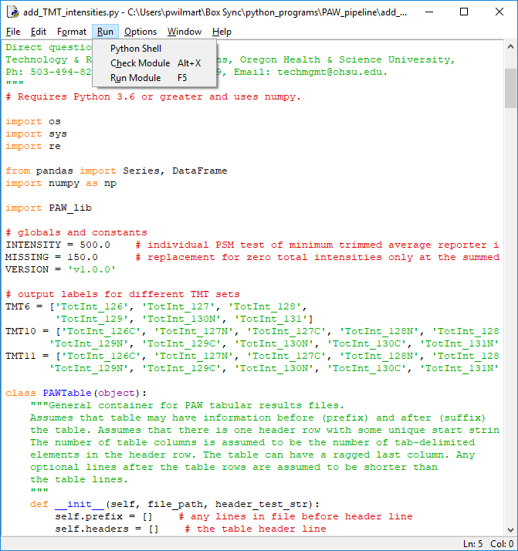
Notes:
Run the script in the usual IDLE way.

Slide 6
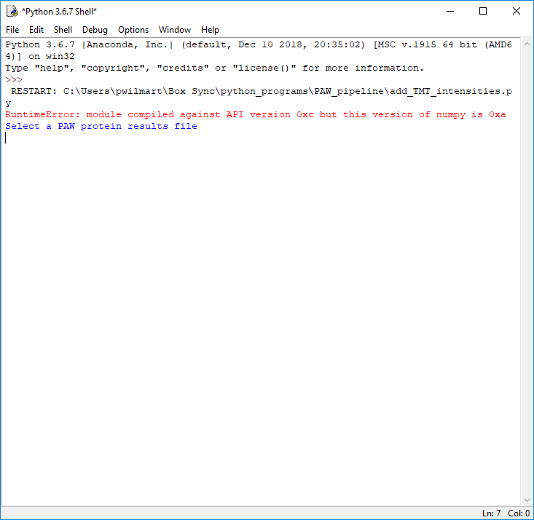
Notes:
A dialog box will appear to allow selection of the protein results file.

Slide 7
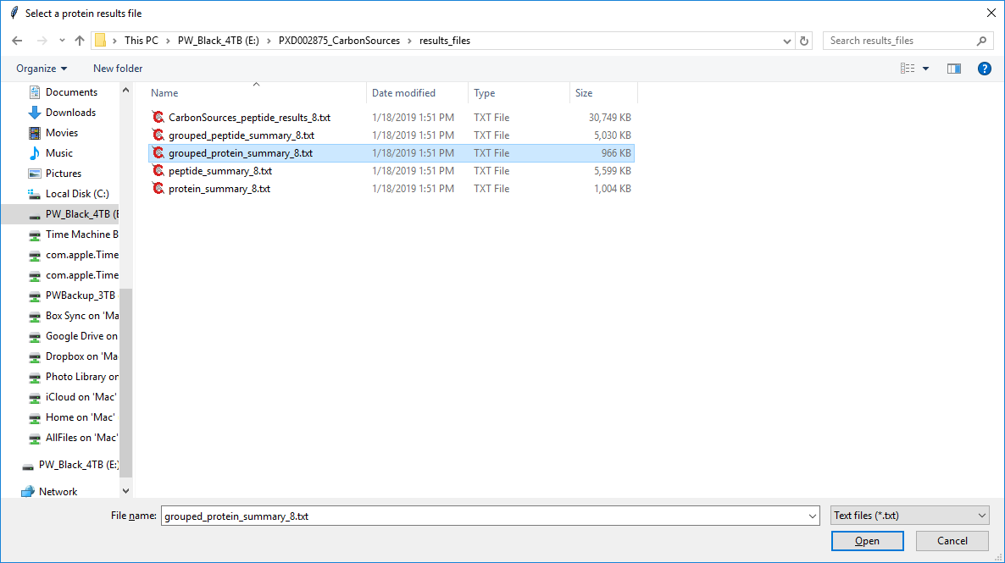
1
2
Notes:
Select the appropriate protein results file from “results_files” folder. The grouped file is recommended for most applications; however, the script can use the regular report files, too. Then click “Open”.

Slide 8
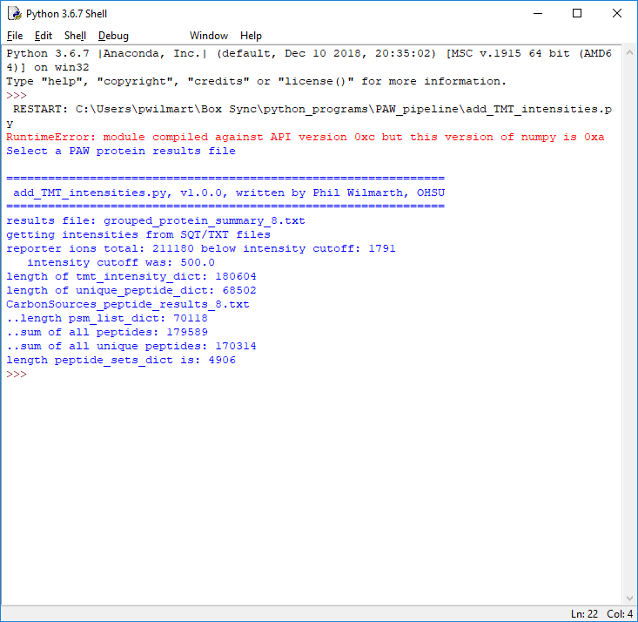
<- intensity test
<- peptide count
<- usable PSM count
protein count
Some statistics
Notes:
The script will read the protein and peptide files, determine the usable peptides, and aggregate the PSM data up to the peptide and protein levels. The reporter ions are added to the results files.

Slide 9
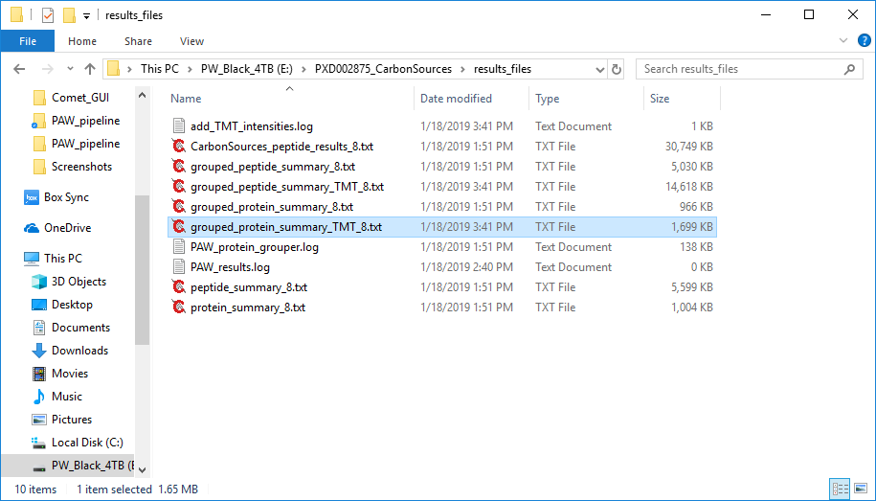
Results files with TMT intensities
Notes:
New results files with additional TMT reporter ion intensity columns are created.

