Slide 1
Encryption Project
Levi Smith
Chris Ingram
CS4235A
Professor Nelson-Palmer
April 4, 2002

Slide 2

Purpose
Familiarize users with encryption algorithms
Become familiar with implementing encryption algorithms
Make others aware of the variety of encryption algorithms

Slide 3

Methodology
Classic Software Engineering Waterfall Model
Requirements Elicitation
Design System
Implementation
Unit Testing
System Testing

Slide 4
Required Algorithms
Implemented:
Future Additions:
Polyalphabetic Substitution
Vernam Cipher
Caesar Cipher
Columnar Transposition
Data Encryption Standard (DES)
Rivest-Shamir-Adelman (RSA)
El Gamal
Merkle-Hellman

Slide 5
Design and Implementation
Java: Applet or Application
Abstract EncryptionMethod class with subclasses for each cryptogram
Proper user input and output components
Implementation methods to be selected from list
Unique Options for each algorithm
Console to display messages
ASCII, Decimal, Hexadecimal and Binary Displays

Slide 6
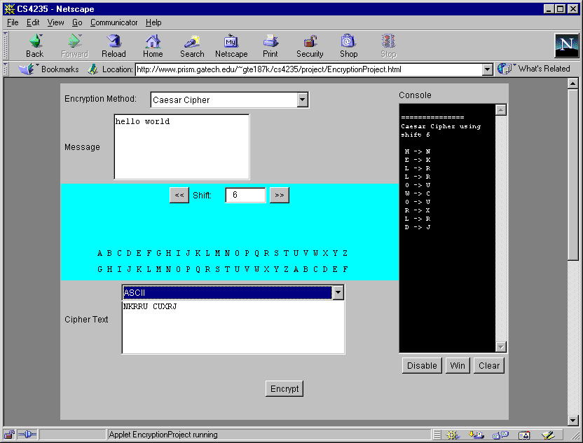
User Interface
Select Algorithm
Enter Message
Enter Options
Encrypted Message
Console Messages

Slide 7

Documents Produced
Software Requirements Specification
Software Design Document
Code
Test Cases

Slide 8

Development Obstacles
Limited Time (4 weeks)
Browser / OS Compatibility (minimal)
Console buffer too large
Finding encryption algorithm explanations and examples
Java security library calls unavailable

Slide 9

What Have We Learned?
Large variety of ways to encrypt messages
Implementing text algorithms are easy
Implementing binary algorithms are more difficult
Complex encryption algorithms are still quite fast in Java

Slide 10
Future Directions
Choose a better name for project
Implement other encryption methods
Convert code to Java 2 when standard on browsers
Decryption function

Slide 11

Questions?

