Slide 1
Java for Game Development
Knoxville Game Design
February 2020
Levi D. Smith

Slide 2
Background
Designed by James Gosling at Sun Microsystems
1995 - First version
Object oriented
Now owned by Oracle
OpenJDK – open source implementation of Java
Java is not Javascript!
Javascript is loosely typed, scripting language primarily used for client side web browsers; ECMAScript specification; developed by Netscape
Java is strongly typed, compiles code into platform independent byte code; Runs from command line using the Java Runtime Environment (also previously web “applets”)

Slide 3
Pros
Bytecode runs on multiple platforms (Windows, Mac, Linux, etc)
Old bytecode still works with latest JRE (Java Runtime Environment)
Graphics API (AWT/Swing) built directly into the language
No libraries required
Cons
Need to install or distribute JRE
Loading assets (graphics, sounds, etc) is not straight forward
“Slower” than platform specific executables (such as Windows EXEs)

Slide 4
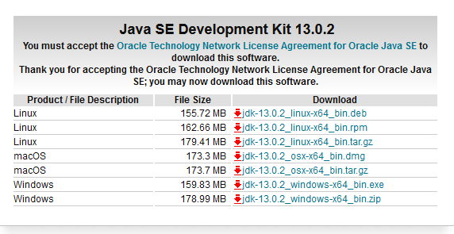
Download and Install
JRE – Java Runtime Environment
only for running Java programs
JDK – Java Development Kit
for compiling Java programs
https://www.oracle.com/technetwork/java/javase/downloads/index.html
Current version is JDK 13.0.2
LTS – Long Term Service

Slide 5

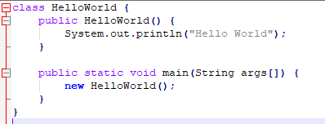

Hello World
Open command prompt (Run > cmd on Windows)
javac -version
Older versions you have to add Java path to your PATH environment variable
Class name must match file name
javac HelloWorld.java
Compiles the HelloWorld.java class file
Will create HelloWorld.class file
.class files are platform independent (bytecode)
java HelloWorld
Runs the HelloWorld class (must have main method)

Slide 6
Basics
Entry point is public static void main(String args[])
Constructor name must match the class name
New objects (class instances) are created with the new keyword
No need to delete/free objects, Garbage collection
Methods and Variable scoping (public, private, protected)
API / Javadocs
https://docs.oracle.com/javase/7/docs/api/index.html

Slide 7
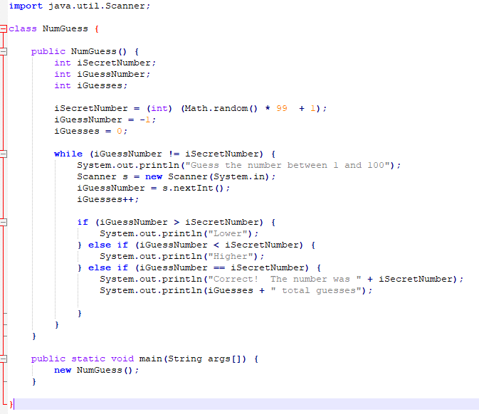
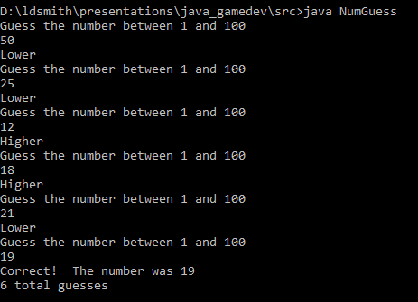
A Simple Number Guessing Game

Slide 8
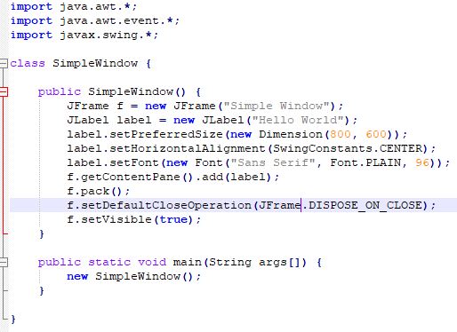
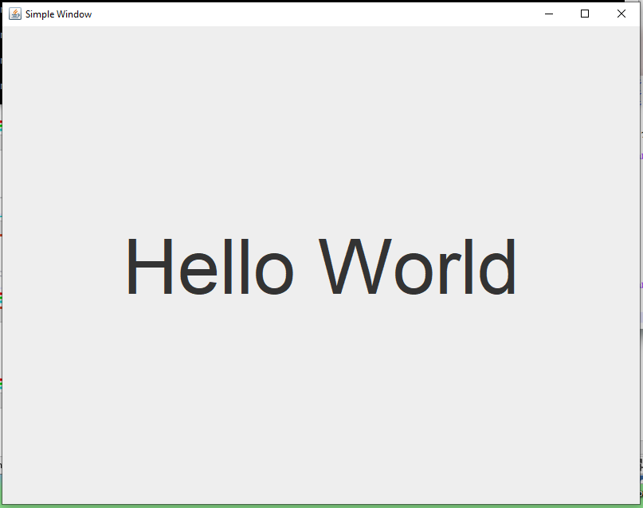
Making a Window
AWT - Abstract Window Toolkit
Java’s GUI components
Swing – Java’s attempt at making platform independent GUI components

Slide 9
Drawing to the screen
Make a new JComponent subclass for drawing
Previously Canvas
Override paintComponent(Graphics g) to draw
Coordinates are relative to the JComponent
More complex drawing methods by casting to Graphics2D
rotate, scale, etc
Rectangles / Squares
g.drawRect(x, y , width, height)
g.fillRect(x, y , width, height)
Ovals / Circles
g.drawOval(x, y, width, height)
g.fillOval(x, y, width, height)
Lines
g.drawLine(x1, y1, x2, y2)
Text
g.drawString(string, x, y)
Arcs
g.drawArc(x, y, width, height, start angle, stop angle)
g.fillArc(x, y, width, height, start angle, stop angle)
Set color - g.setColor(Color.green)

Slide 10
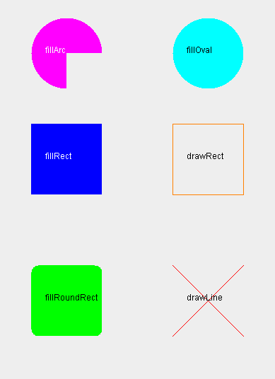
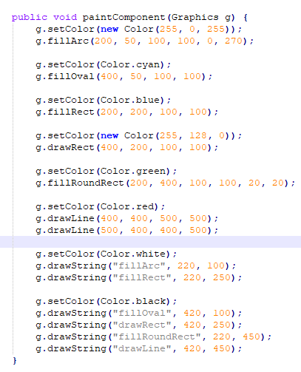
Drawing Examples

Slide 11
Types of Input
Event driven
Mouse click
Key press, release
Button pressed, released
Polling
Joystick position
Mouse pointer position
Button is pressed

Slide 12
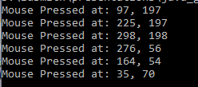
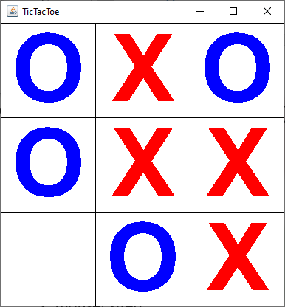
Mouse Input (event driven)
Implement MouseListener
Define callback methods
mousePressed
mouseReleased
mouseClicked
mouseEntered
mouseExited
Add MouseListener to component
Call repaint() after handling mouse input
Get mouse click position with e.getX() and e.getY() from MouseEvent e
Convert coordinates to cell row and column
Implement MouseMotionListener to detect mouse movement

Slide 13
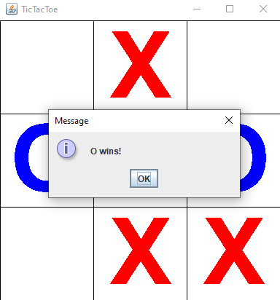
Dialog Box
Use JOptionPane.showMessageDialog
Can pass null as the JFrame
Second parameter is the message

Slide 14
Check Win State / Game Over
Win State
A row or column has all of same player mark
A diagonal has all of same player mark
Game Over
All cells are filled with player marks

Slide 15
Other GUI Components
JButton to add a button
Implement ActionListener and actionPerformed method to detect button presses
Use constant (String final) for button label
e.getActionCommand() in actionPerformed to check button press
string1.equals(string2) to compare Strings
JPanel container to add multiple components
Layouts of containers – BorderLayout, GridLayout, BoxLayout

Slide 16
Differences from C#
 | Java | C#
boolean (true/false) variable | boolean | bool
define subclass | extends | :
refer to super class | super | base
import libraries | import | using
get a random number | Math.random() | Random.Range()
constant | final | const
print debug text | System.out.println(“text”); | Debug.Log(“text”); //Unity

Slide 17
Packaging Your Game
Multiple class files can be bundled into a JAR file (Java Archive)
Must include Manifest file with default class property
If JRE is installed on system, then double clicking the JAR will run the program

