Slide 1

Introduction to Python
Emily Wolin
Northwestern University

Slide 2
Acknowledgements
This presentation was developed by Emily Wolin of Northwestern University, and adapted for online use by Danielle Sumy of the IRIS Consortium.
Any mistake is purely the fault of D. Sumy.

Slide 3
Important Information Before You Begin
You will need:
To install python:
Python is a freely available software
Download: www.python.org
Open up a terminal window
Make sure you have a text editor, ‘vi’ is usually standard
You also need to have a very basic understanding of SAC (Seismic Analysis Code): SAC info here

Slide 4
What is Python?
According to the ‘What is Python? Executive Summary (www.python.org/doc/essays/blurb):
‘Python is an interpreted, object-oriented, high-level programming language with dynamic semantics’
In the next slide, we’ll go through the meaning of these words, and what they mean for Python

Slide 5
What is Python?
Interpreted: executes a program directly, without the need to compile
Pro: platform independent
Con: can result in slower speed
Object-oriented: modular software system, where each ‘object’ has data fields
For example:
Object:
Contact Information
Name
Address
Phone
Email

Slide 6
What is Python?
High-level: uses natural language elements, and automates or even hides significant areas of the computing system
Pro: simple and easy to understand!
Dynamic Semantics: the variable type (integer, character, float, etc.) is based on use, and does not need specified. The variable can be reused in the program and the type changes based on the current need.
Pro: eliminates data type mismatches
Con: may cause unexpected behavior when reusing a variable, like squaring text (e.g. Bob^2)

Slide 7
Why do I use Python?
“How good are current tomographic models of North America?”

Slide 8
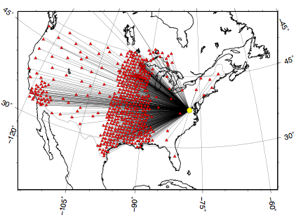
Why do I use Python?
“How good are current tomographic models of North America?”
“We can use current tomographic models to predict S and Rayleigh wavefronts
from earthquakes within North America. Do these synthetic seismograms agree with
Observations at SPREE and the TA?”
Notes:
For more information on the Transportable Array (TA): http://www.usarray.org/researchers/obs/transportable
For more information on SPREE (Superior Rifting EarthScope Experiment): http://www.earth.northwestern.edu/spree/Welcome.html

Slide 9
Why do I use Python?
Things I need to know to compare two waveforms:
Time series of ground motion (of course)
Station, network, component, location
Latitude, longitude, depth of station
Start and end time of traces
Sampling rate
Event hypocenter and origin time
Phase picks
All of this information could be stored in an object called ‘mytrace’, for example

Slide 10
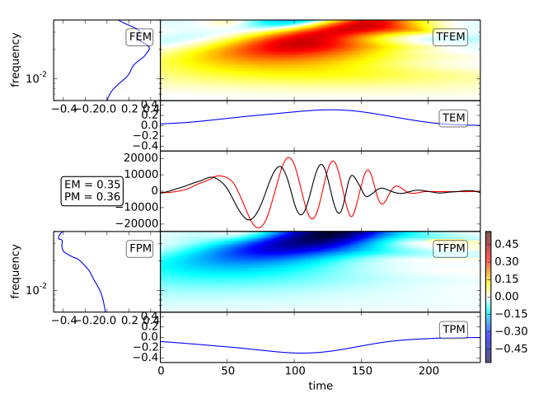
Why do I use Python?
Goal: Measure misfit between observed and synthetic seismograms

Slide 11
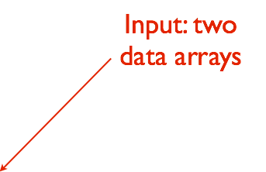
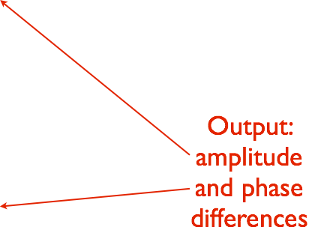
Why do I use Python?
Method: Calculate time-frequency misfit

Slide 12
Why do I use Python?
Method: Calculate time-frequency misfit
How can I get my SAC files into Python and preserve necessary metadata?

Slide 13

Why do I use Python?
I could build an object in Python that contains:
header information:
mytrace.header.stnm
mytrace.header.stla
time series:
mytrace.data
Note: this is all pseudocode to serve as an example

Slide 14

Why do I use Python?
Then, I could define functions that modify these attributes:
mytrace.trim(starttime=t1, endtime=t2)
mytrace.filter(“highpass”, freq=0.02)
mytrace.remove_response(output=“DISP”)
Note: this is all pseudocode to serve as an example

Slide 15
Why do I use Python?
Good News!
Seismology-friendly data structures already exist
in the ObsPy package (www.obspy.org)
Even better news!!
Powerful numerical and scientific libraries exist
to process and visualize data

Slide 16
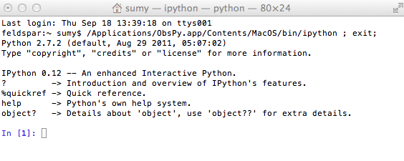
Getting started
After Python is installed, type in terminal window:
ipython - -pylab
(Note: make sure to have the double hyphen)
Now type on the command line: print ‘Hello, World!’

Slide 17
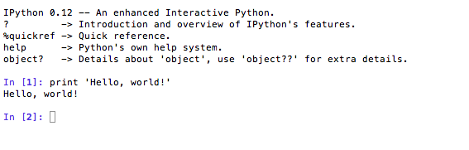
Does your screen look something like this?

Slide 18
Getting Started: Variables
a = ‘1’ string
a = 1 integer
a = 1.1 float
a = 1+2j complex

Slide 19
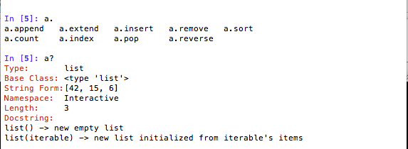
Getting Started: Lists
a = [42,17,6] a list of integers
a[1] answer? 15
Note: a list starts from zero
a.<tab>
a?
In IPython, use <tab> and ? to explore attributes/methods of an object

Slide 20
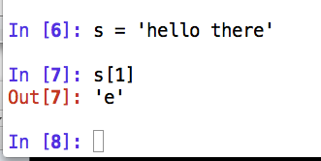
Getting Started: Strings
s = ‘hello there’ s is a string
s[1] What’s the answer here?
Answer:
Did you think that it would be ‘there’?
In this case, the list took the second character ‘e’

Slide 21

Getting Started: Spaces
if answer != 42: need a colon at the end
print ‘that is not correct’
for i in range(5):
print ‘Hello, world!’
Reminder: User a colon at the end of ‘if’ and ‘for’ statements
Four spaces are needed when in if/for statement

Slide 22
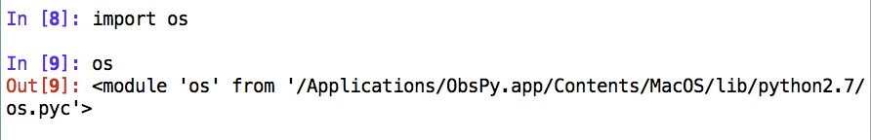
Getting Started: Modules
Python doesn’t load modules unless you ask for them
import os

Slide 23
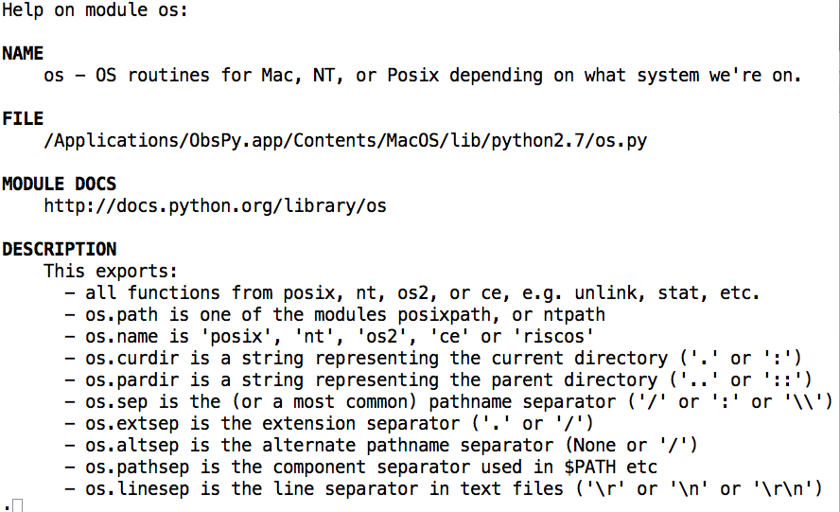
Getting Started: Modules
Once loaded, can type ‘help(os)’ which produces…

Slide 24
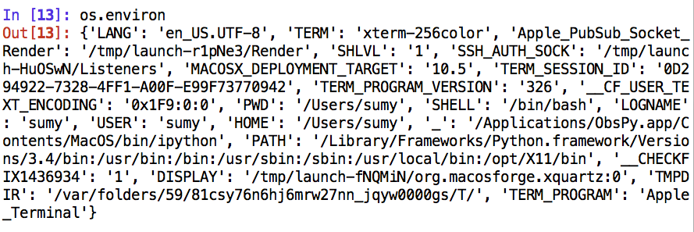
Getting Started: Modules
Once loaded, can type ‘os.environ’ which produces…
A dictionary
Dictionaries are stored with keys, and the values of those keys
(https://docs.python.org/2/library/stdtypes.html#typesmapping)

Slide 25
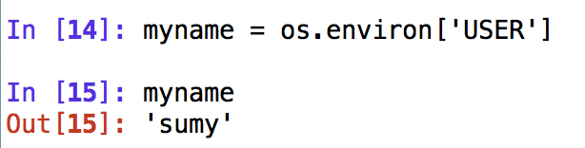
Getting Started: Modules
Within the os.environ dictionary, find value for ‘USER’:

Slide 26
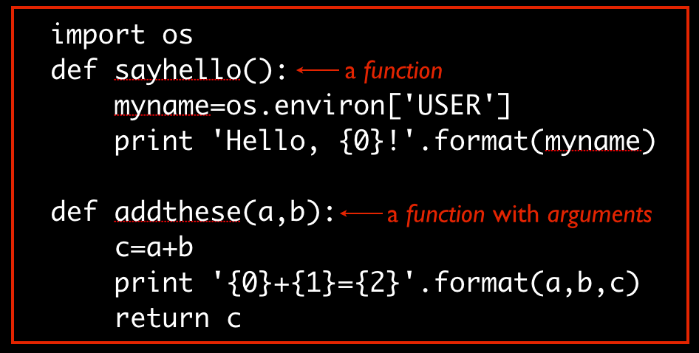
Exercise: Write Your Own Module
Create a file called mymodule.py using your preferred text editor (like ‘vi’), and type in the following:

Slide 27
Exercise: Use Your Own Module
In the Python shell:
import mymodule
mymodule.sayhello()
a=mymodule.addthese(3.1,2.7)
Or if your fingers are getting tired:
import mymodule as mm
mm.sayhello()
a=mm.addthese(3.1,2.7)

Slide 28
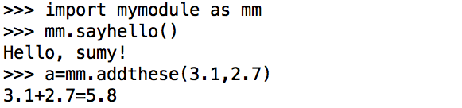
Is this what you see (or something like this)?

Slide 29
Before moving on…
Make sure that you have the file ‘birdclasses.py’ available with this material before moving on.

Slide 30


Using Classes
We can define a class (an object) that has its own attributes and methods.
from birdclasses import Swallow
bird=Swallow(species=‘African’, loadstatus=‘unladen’) bird.loadstatus
bird.velocity

Slide 31


Now try…
Try giving the bird a coconut:
bird.giveCoconut()
bird.loadstatus
What has changed?
What is the airspeed velocity of an unladen swallow?
http://style.org/unladenswallow/

Slide 32
Useful modules
NumPy: “the fundamental package for scientific computing with Python. It contains among other things:
a powerful N-dimensional array object
sophisticated (broadcasting) functions
tools for integrating C/C++ and Fortran code
useful linear algebra, Fourier transform, and random number capabilities”
http://www.numpy.org/

Slide 33
Useful modules
SciPy:
“a collection of numerical algorithms and domain-specific toolboxes, including signal processing, optimization, statistics and much more”
http://www.scipy.org/about.html

Slide 34
Useful modules
Matplotlib:
“matplotlib is a python 2D plotting library which produces publication quality figures in a variety of hardcopy formats and interactive environments across platforms”
http://matplotlib.org/
PyLab indepedently or with Matplotlib
helps give MATLAB-like syntax
http://wiki.scipy.org/PyLab

Slide 35
Useful modules
Matplotlib:
“matplotlib is a python 2D plotting library which produces publication quality figures in a variety of hardcopy formats and interactive environments across platforms”
http://matplotlib.org/
PyLab indepedently or with Matplotlib
helps give MATLAB-like syntax
http://wiki.scipy.org/PyLab

Slide 36
Useful modules
ObsPy:
“an open-source project dedicated to provide a Python framework for processing seismological data. It provides parsers for common file formats and seismological signal processing routines which allow the manipulation of seismological time series”
http://docs.obspy.org/

Slide 37
Python Basics
Now you know a little about:
Data Types
Object-oriented: attributes and methods
Flow control statements (if/while/for):
Mandatory colons and indentations
Importing modules and writing simple functions

Slide 38
Now for something different…

Slide 39
Scripting with Python
You will need the sample code: mylinefit.py
With the code, you can:
Generates a linearly-spaced array of x values
Calculate a function y(x) at each point
Add random noise to y(x)
Fit a line through the noisy data
Plot the noisy data, original function,
and best-fit line

Slide 40
Scripting with Python
Run script from iPython: run mylinefit.py
Run in Terminal:
chmod +x mylinefit.py
./mylinefit.py
Make sure that the first line of mylinefit.py is:
#!/usr/bin/env python

Slide 41
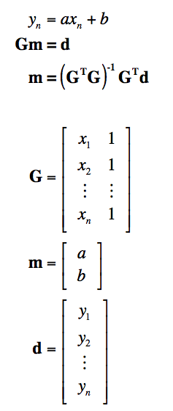
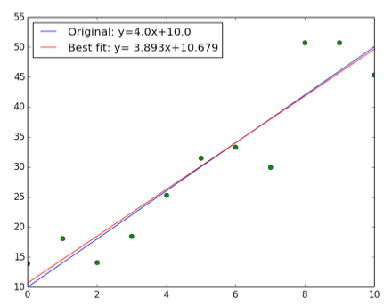
Scripting with Python
Fit a line in two ways:
SciPy: stats.linregress module
“By hand” with NumPy matrices
and some inverse theory

Slide 42
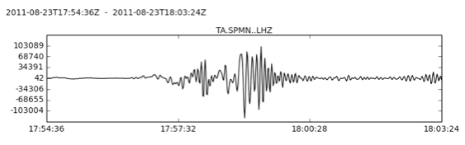
Read and Plot a Waveform
from obspy.core import read
st = read(‘TA.SPMN..LHZ.disp’)
st.plot()
OR:
print st
len(st)
tr = st[0]
print tr
print tr.stats
print tr.stats[‘station’]
tr.data

Slide 43

Plot a focal mechanism
from obspy.imaging.beachball import Beachball
mt = [180, 80, 90]
Beachball(mt, size=500)
mt2 = [-0.463, 4.61, -4.15, -0.0633, -0.171, -1.49]
Beachball(mt2, size=500)

Slide 44
Scripting with Python
Plot any two-column ASCII file from Terminal:
chmod +x plotanything.py
./plotanything.py vs.ak135
./plotanything.py vs.*
Note again that you need: #!/usr/bin/env python
as the first line of your script

Slide 45
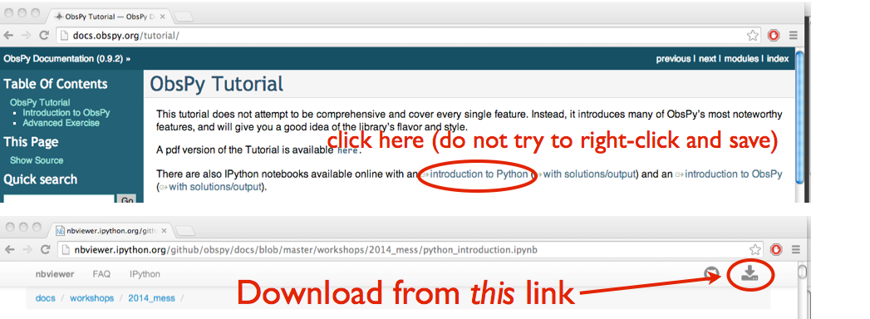
iPython notebooks
http://docs.obspy.org/tutorial
Then run the notebook (will open in a browser):
ipython notebook python_introduction.ipynb --pylab inline

Slide 46
Want to learn more?
A Byte of Python:
http://swaroopch.com/notes/python/
ObsPy tutorials: http://docs.obspy.org/tutorial/
Python Scripting for Computational Science
http://folk.uio.no/hpl/scripting/index.html
Python Scientific Lecture Notes

Slide 47
Thank you!

