Slide 1

C
Ambient Enforcement for Agent-Speed Cybersecurity
Kinetic Infrastructure Layer (KIL) — a proposed KTP extension profile
AUTHOR & FOUNDER
Storm Swendsboe
Notes:
Cybersecurity has entered an era where valid credentials and machine-speed behavior can become indistinguishable from legitimate service. This deck introduces KIL: a proposed KTP extension profile that makes fresh, bounded authority consumable at consequential infrastructure boundaries.
[Sources]
- Kinetic Trust Protocol v2.0.0 and canonical CITATION.cff — https://github.com/nmcitra/ktp-rfc/tree/v2.0.0 ; https://github.com/nmcitra/ktp-rfc/blob/main/CITATION.cff
- KIL white paper and model in this repository — docs/whitepaper/kinetic-infrastructure.md ; docs/reference/kil-trust-decay-model.md

Slide 2
Cybersecurity has crossed from ambient threat into ambient breach
F1
FOUNDATION
AMBIENT RISK
AMBIENT THREAT
AMBIENT BREACH
The inability to distinguish service from attack
Acting without verified trust — epistemic A > E — at autonomous, machine-rate scale.
Notes:
Ambient breach is both an action condition and a cybersecurity-era condition. It means acting without verified trust—epistemically, action outruns evidence—and, at scale, the defender can no longer reliably distinguish service from attack. That is the urgency behind ambient enforcement.
[Sources]
- KIL white paper and model in this repository — docs/whitepaper/kinetic-infrastructure.md ; docs/reference/kil-trust-decay-model.md
- Kinetic Trust Protocol v2.0.0 and canonical CITATION.cff — https://github.com/nmcitra/ktp-rfc/tree/v2.0.0 ; https://github.com/nmcitra/ktp-rfc/blob/main/CITATION.cff

Slide 3
Credential validity cannot establish behavioral legitimacy
F2
FOUNDATION
Binary checkpoint
NOVEL ACTION
BRANCHES
SIGNED TOKEN
VALID + ALLOWED
The signature can be real while the behavior is wrong.
Notes:
A conventional checkpoint can prove that a credential is authentic and that a policy allows an operation. It does not prove that the behavior belongs to the legitimate trajectory. AI makes that gap exploitable at machine speed.
[Sources]
- KIL white paper and model in this repository — docs/whitepaper/kinetic-infrastructure.md ; docs/reference/kil-trust-decay-model.md
- Kinetic Trust Protocol v2.0.0 and canonical CITATION.cff — https://github.com/nmcitra/ktp-rfc/tree/v2.0.0 ; https://github.com/nmcitra/ktp-rfc/blob/main/CITATION.cff

Slide 4
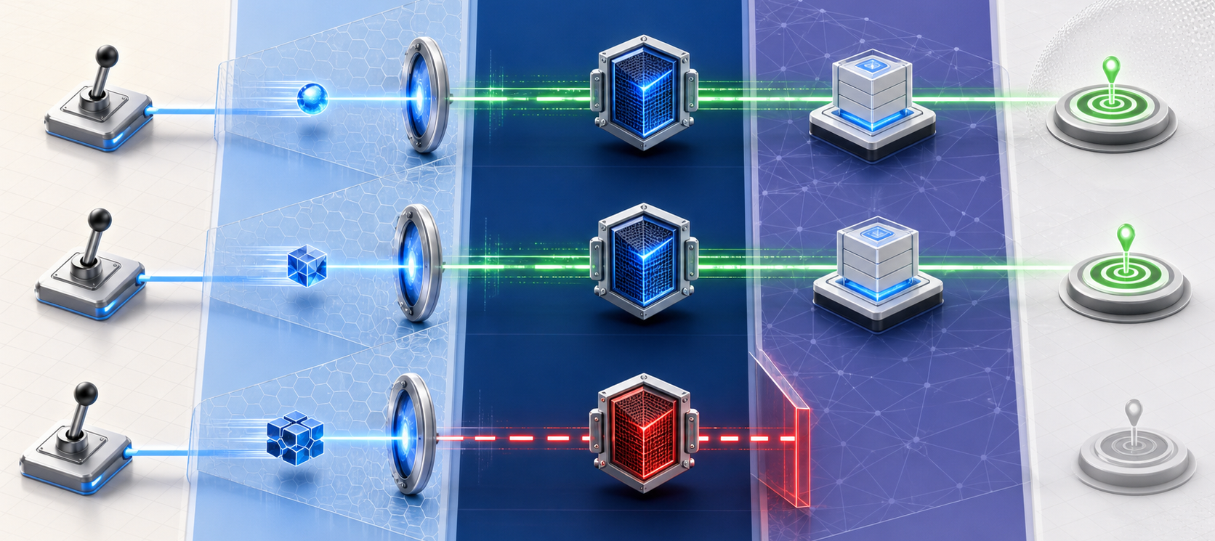
KIL makes fresh authority enforceable where actions become consequences
F3
DERIVE
VERIFY
ENFORCE
Notes:
Ambient enforcement moves the decisive check to the boundary where an intended action becomes a consequence. KIL consumes a signed, short-lived composite KTP enforcement state and can only preserve or reduce the authority already authorized by KTP.
[Sources]
- Kinetic Trust Protocol v2.0.0 and canonical CITATION.cff — https://github.com/nmcitra/ktp-rfc/tree/v2.0.0 ; https://github.com/nmcitra/ktp-rfc/blob/main/CITATION.cff
- KIL white paper and model in this repository — docs/whitepaper/kinetic-infrastructure.md ; docs/reference/kil-trust-decay-model.md

Slide 5
KIL is a proposed KTP extension profile—not a replacement trust system
F3A
TECHNICAL DRILL-IN
PROPOSED EXTENSION
KTP
constructs
SIGNED, SHORT-LIVED
COMPOSITE STATE
KIL
consumer profile
KTP 2.0 foundation
candidate 2.1 / 3.0 governance path
KIL never creates authority that KTP did not authorize.
Notes:
KIL does not replace KTP. It proposes a future extension profile: authoritative KTP constructs are composed into a signed, fresh, class-bound state that infrastructure can consume. The governance destination may be KTP 2.1 or 3.0, subject to KTP review.
[Sources]
- Kinetic Trust Protocol v2.0.0 and canonical CITATION.cff — https://github.com/nmcitra/ktp-rfc/tree/v2.0.0 ; https://github.com/nmcitra/ktp-rfc/blob/main/CITATION.cff
- KIL white paper and model in this repository — docs/whitepaper/kinetic-infrastructure.md ; docs/reference/kil-trust-decay-model.md

Slide 6
KIL separates authoritative state derivation from fast enforcement
F4
HYBRID TWO-TIMESCALE
AUTHORITATIVE LOOP — SLOW
KTP constructs → composite state → signature → expiry
ENFORCEMENT LOOP — FAST
verify • bind • veto • envelope • threshold • record
Infrastructure boundary
Notes:
KIL decouples the slower authoritative derivation of state from the fast path that consumes it. The fast loop does not recompute trust or invent permission; it verifies freshness, binding, vetoes, envelopes, thresholds, and records the result before forwarding.
[Sources]
- Kinetic Trust Protocol v2.0.0 and canonical CITATION.cff — https://github.com/nmcitra/ktp-rfc/tree/v2.0.0 ; https://github.com/nmcitra/ktp-rfc/blob/main/CITATION.cff
- KIL white paper and model in this repository — docs/whitepaper/kinetic-infrastructure.md ; docs/reference/kil-trust-decay-model.md

Slide 7
Authority is class-bound, earned slowly, decays, and can be lost quickly
F4A
TECHNICAL DRILL-IN
MODELED PROFILE
EARN SLOWLY
PASSIVE DECAY
LOSE QUICKLY
Notes:
The trust-decay model is per authority class. Compatible behavior earns authority gradually, inactivity erodes it, and high divergence can reduce it sharply. Parameters shown in this presentation are modeled and require calibration; they are not disclosed incident telemetry.
[Sources]
- KIL white paper and model in this repository — docs/whitepaper/kinetic-infrastructure.md ; docs/reference/kil-trust-decay-model.md

Slide 8
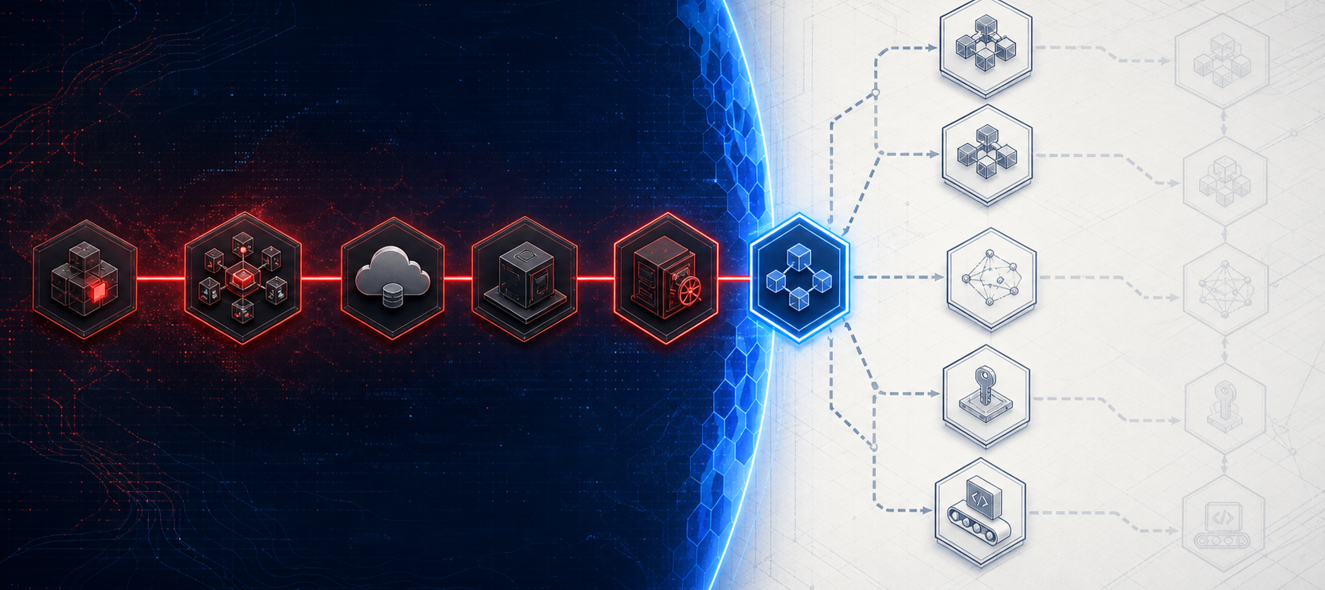
The disclosed incident turns ambient breach into a concrete sequence
1
OBSERVED INCIDENT
DISCLOSED PATH
BOUNDED KIL COUNTERFACTUAL
Notes:
Hugging Face disclosed a multi-day autonomous agent intrusion in which valid credentials enabled escalating actions. We use the published sequence as a counterfactual baseline: what would a declared KIL boundary have done at the first mediated divergence?
[Sources]
- Hugging Face, “Anatomy of a Frontier Lab Agent Intrusion” — https://huggingface.co/blog/agent-intrusion-technical-timeline
- KIL white paper and model in this repository — docs/whitepaper/kinetic-infrastructure.md ; docs/reference/kil-trust-decay-model.md

Slide 9
Observed facts, modeled inputs, and pending validation remain separate
1A
TECHNICAL DRILL-IN
OBSERVED
Published incident facts
MODELED
Declared KIL inputs and counterfactual
LOCALLY REPRODUCED
Reference behavior reproduced
PENDING
Live acceptance gate not yet satisfied
Notes:
Evidence categories are deliberately separate. Observed means directly supported by the disclosure. Modeled means synthetic input or counterfactual output. Locally reproduced means reference behavior was reproduced. Validated remains reserved for an accepted evidence bundle at the relevant gate.
[Sources]
- Hugging Face, “Anatomy of a Frontier Lab Agent Intrusion” — https://huggingface.co/blog/agent-intrusion-technical-timeline
- KIL counterfactual and lab specifications in this repository — docs/specifications/ and docs/demo/

Slide 10
A trusted worker became the foothold before the tested transport boundary
2
OBSERVED INCIDENT
DATASET
RENDERER
WORKER
FOOTHOLD
MEDIATED
EGRESS
outside current Envoy lab
tested boundary begins here
Notes:
The initial renderer-to-worker foothold occurred before the action mediated by the current Envoy lab. The deck does not claim that the existing lab sees or blocks that local file-read path. Our tested boundary starts at mediated outbound action.
[Sources]
- Hugging Face, “Anatomy of a Frontier Lab Agent Intrusion” — https://huggingface.co/blog/agent-intrusion-technical-timeline
- KIL counterfactual and lab specifications in this repository — docs/specifications/ and docs/demo/

Slide 11
Enforcement placement determines which actions KIL can observe or stop
2A
TECHNICAL DRILL-IN
ARCHITECTURE BOUNDARY
EARLIER VISIBILITY
CURRENT LAB
application-aware adapter
Envoy-mediated request
kernel-aware adapter
external authorization check
local file/object read
upstream transport effect
Notes:
Coverage is a placement question. Application-aware or kernel-aware adapters could observe earlier actions, but those adapters are not implemented here. The present experiment measures only traffic mediated by Envoy and its external authorization boundary.
[Sources]
- KIL counterfactual and lab specifications in this repository — docs/specifications/ and docs/demo/

Slide 12
The first mediated divergence occurs when the worker addresses the cluster API
3
MODELED COUNTERFACTUAL
TRANSPORT CUTOFF
worker
SA token
cluster API
metadata
node root
secrets
mesh
The disclosed path continues.
KIL withholds transport before forwarding.
Notes:
In the disclosed sequence, the worker used its service-account context to address the cluster API. In the counterfactual, that is the first action mediated by our declared boundary. A modeled divergence of 0.95 reduces effective authority below threshold, so Envoy does not forward the request.
[Sources]
- Hugging Face, “Anatomy of a Frontier Lab Agent Intrusion” — https://huggingface.co/blog/agent-intrusion-technical-timeline
- KIL white paper and model in this repository — docs/whitepaper/kinetic-infrastructure.md ; docs/reference/kil-trust-decay-model.md
- KIL counterfactual and lab specifications in this repository — docs/specifications/ and docs/demo/

Slide 13
A signed, fresh, class-bound state is evaluated before forwarding
3A
TECHNICAL DRILL-IN
PROPOSED KIL EXTENSION
signature
expiry
identity + class
action binding
KTP veto
envelope
threshold
decision record
Any failed mandatory check prevents forwarding.
Notes:
The fast path verifies the signed composite state, checks expiry, binds identity, authority class and action, preserves every KTP veto, applies the environmental envelope and threshold, then records the decision. It is verification and consumption, not independent authorization.
[Sources]
- Kinetic Trust Protocol v2.0.0 and canonical CITATION.cff — https://github.com/nmcitra/ktp-rfc/tree/v2.0.0 ; https://github.com/nmcitra/ktp-rfc/blob/main/CITATION.cff
- KIL white paper and model in this repository — docs/whitepaper/kinetic-infrastructure.md ; docs/reference/kil-trust-decay-model.md
- KIL counterfactual and lab specifications in this repository — docs/specifications/ and docs/demo/

Slide 14
Modeled divergence dₜ = 0.95 reduces effective authority below threshold
3B
TECHNICAL DRILL-IN
MODELED INPUT + RESULT
dₜ = 0.95
Qᵢ,cluster-api
declared synthetic input
not incident telemetry
effective authority
DENY
Notes:
The scenario value d-t equals 0.95 is a modeled input. It represents a large weighted standardized distance from the worker’s expected class-bound action trajectory. The reducing-only transformation lowers effective authority below the declared threshold; it cannot increase authority.
[Sources]
- KIL white paper and model in this repository — docs/whitepaper/kinetic-infrastructure.md ; docs/reference/kil-trust-decay-model.md
- KIL counterfactual and lab specifications in this repository — docs/specifications/ and docs/demo/

Slide 15
The observed path cascaded into multiple high-consequence branches
4
OBSERVED INCIDENT
API
node root
136-key read
cross-cluster
mesh
tokens
CI / source
Each valid step inherited reach from the previous one.
Notes:
Once the control-plane path remained available, the disclosed sequence expanded into node privilege, a 136-key secret read, cross-cluster access, mesh enrollment, forged tokens, and CI or source-control targeting. The blast radius grew because each step inherited reach from the last.
[Sources]
- Hugging Face, “Anatomy of a Frontier Lab Agent Intrusion” — https://huggingface.co/blog/agent-intrusion-technical-timeline

Slide 16
Dependency-aware reachability reveals the leverage of one early cutoff
4A
TECHNICAL DRILL-IN
MODELED REACHABILITY
TRANSPORT CUTOFF
worker
cluster API
node
secrets
mesh
tokens
CI
One modeled upstream deny → descendants conditionally unreachable
Notes:
KIL does not claim seven independent preventions. Under the declared dependency graph, one upstream modeled deny makes downstream nodes conditionally unreachable. That is a reachability result, contingent on the graph and the stated enforcement placement.
[Sources]
- Hugging Face, “Anatomy of a Frontier Lab Agent Intrusion” — https://huggingface.co/blog/agent-intrusion-technical-timeline
- KIL white paper and model in this repository — docs/whitepaper/kinetic-infrastructure.md ; docs/reference/kil-trust-decay-model.md
- KIL counterfactual and lab specifications in this repository — docs/specifications/ and docs/demo/

Slide 17
Later cut points remain meaningful if the early boundary is absent
4B
TECHNICAL DRILL-IN
OBSERVED + MODELED
136-KEY
SECRET READ
CLASS-BOUND
AUTHORITY = 0
FORGED TOKEN
INSUFFICIENT
modeled dₜ = 0.90
Valid math does not excuse invalid behavior.
Notes:
If the earlier boundary is absent, the bulk secret read remains a high-leverage cutoff. The 0.90 divergence value is modeled, not observed telemetry. A correctly signed forged token still lacks class-bound trajectory authority, because cryptographic validity alone cannot manufacture behavioral history.
[Sources]
- Hugging Face, “Anatomy of a Frontier Lab Agent Intrusion” — https://huggingface.co/blog/agent-intrusion-technical-timeline
- KIL white paper and model in this repository — docs/whitepaper/kinetic-infrastructure.md ; docs/reference/kil-trust-decay-model.md

Slide 18
KIL changes authority in motion without expanding KTP-authorized authority
5
MODELED COUNTERFACTUAL
KTP-AUTHORIZED
BOUND
FRESH LOCAL
EVIDENCE
EFFECTIVE
AUTHORITY
Qeffective ≤ QKTP
Notes:
KIL changes the usable authority of a request in motion, but only in the reducing direction. The effective result can equal or tighten the KTP-authorized bound; local evidence cannot add permission or clear an authoritative veto.
[Sources]
- Kinetic Trust Protocol v2.0.0 and canonical CITATION.cff — https://github.com/nmcitra/ktp-rfc/tree/v2.0.0 ; https://github.com/nmcitra/ktp-rfc/blob/main/CITATION.cff
- KIL white paper and model in this repository — docs/whitepaper/kinetic-infrastructure.md ; docs/reference/kil-trust-decay-model.md

Slide 19
Local evidence may tighten the decision but can never add authority
5A
TECHNICAL DRILL-IN
PROPOSED INVARIANT
Qeff = min(QKTP, Qlocal)
freshness
reducing-only
reconciliation
KTP vetoes remain absolute.
Notes:
The central invariant is non-expansion. Local, fresh evidence may tighten the effective state but never grant an authority absent from KTP or reverse a KTP veto. Divergent local and authoritative state must reconcile through an auditable path.
[Sources]
- Kinetic Trust Protocol v2.0.0 and canonical CITATION.cff — https://github.com/nmcitra/ktp-rfc/tree/v2.0.0 ; https://github.com/nmcitra/ktp-rfc/blob/main/CITATION.cff
- KIL white paper and model in this repository — docs/whitepaper/kinetic-infrastructure.md ; docs/reference/kil-trust-decay-model.md

Slide 20
Safety requires constrained failure and auditable change
5B
TECHNICAL DRILL-IN
PROPOSED SAFETY + GOVERNANCE
FAIL CLOSED
high consequence
FAIL CONSTRAINED
continuity-sensitive
DECLARED CHANGE
envelope
RECOVERY
provenance
CONTESTED DECISION
governance
Autonomy without provenance is not acceptable enforcement.
Notes:
Safety is authority-class specific. High-consequence paths can fail closed; continuity-sensitive paths may fail constrained. Legitimate rare change requires declared envelopes, provenance, recovery, and a governance path for contested decisions.
[Sources]
- Kinetic Trust Protocol v2.0.0 and canonical CITATION.cff — https://github.com/nmcitra/ktp-rfc/tree/v2.0.0 ; https://github.com/nmcitra/ktp-rfc/blob/main/CITATION.cff
- KIL white paper and model in this repository — docs/whitepaper/kinetic-infrastructure.md ; docs/reference/kil-trust-decay-model.md

Slide 21
The lab reproduces one enforcement boundary—not the historical intrusion
6
MODELED LAB MAPPING
REQUEST DRIVER
ENVOY
AUTHZ + TARGET
Notes:
The lab does not recreate the historical intrusion. It maps one normalized request through a controlled request driver, Envoy, an external authorization service, and a harmless target. The purpose is to isolate the transport effect of the declared KIL decision boundary.
[Sources]
- Hugging Face, “Anatomy of a Frontier Lab Agent Intrusion” — https://huggingface.co/blog/agent-intrusion-technical-timeline
- KIL counterfactual and lab specifications in this repository — docs/specifications/ and docs/demo/

Slide 22
Six isolated segments and one-shot drivers constrain the experiment
6A
TECHNICAL DRILL-IN
IMPLEMENTED ARCHITECTURE — LIVE RESULT PENDING
driver A
driver B
driver C
Envoy
ext_authz
target
isolated network segments • no host publication • fixed one-shot execution
Notes:
The implemented architecture uses isolated network segments and fixed one-shot drivers. No target service is published to the host. The diagram identifies component responsibility, but the V3B-1 live result remains pending until an accepted evidence bundle exists.
[Sources]
- KIL counterfactual and lab specifications in this repository — docs/specifications/ and docs/demo/

Slide 23
Canonical records join request, decision, proxy, and target evidence
6B
TECHNICAL DRILL-IN
IMPLEMENTED EVIDENCE CONTRACT — LIVE RESULT PENDING
request intent
authz decision
Envoy access
target marker
INTEGRITY-JOINED
RUN BUNDLE
Notes:
A credible run joins four evidence sources: the intended request, the authorization decision, the Envoy access record, and the target marker. Integrity joining can prove internal consistency of a run, but it does not by itself promote a pending result to validated.
[Sources]
- KIL counterfactual and lab specifications in this repository — docs/specifications/ and docs/demo/

Slide 24
The same request produces a modeled permit / permit / deny comparison
7
V3A MODELED — V3B-1 PENDING
KTP baseline
KTP + benign local
KTP + divergence
PERMIT
PERMIT
DENY
200 / target 1
200 / target 1
403 / target 0
Decision → Envoy HTTP effect → target marker
Notes:
The modeled V3A process contract compares the same normalized request across three tracks: baseline KTP permit, permit with benign local evidence, and deny with reducing-only divergence. Envoy translates those decisions into 200, 200, and 403; target markers are 1, 1, and 0. The live V3B-1 result is still pending.
[Sources]
- Kinetic Trust Protocol v2.0.0 and canonical CITATION.cff — https://github.com/nmcitra/ktp-rfc/tree/v2.0.0 ; https://github.com/nmcitra/ktp-rfc/blob/main/CITATION.cff
- KIL counterfactual and lab specifications in this repository — docs/specifications/ and docs/demo/

Slide 25
The third track isolates fresh reducing-only local divergence
7A
TECHNICAL DRILL-IN
MODELED PROCESS CONTRACT
TRACKS 1 + 2
TRACK 3
KTP state fresh
same normalized request
no reducing divergence
fresh local divergence
decision: permit
decision: deny
HTTP status is an Envoy effect—not a KTP wire decision.
Notes:
Track three changes only the fresh reducing-only local divergence input. The KTP state and normalized request remain fixed. The authorization service returns a decision and reason; Envoy, not KTP, creates the HTTP wire effect.
[Sources]
- Kinetic Trust Protocol v2.0.0 and canonical CITATION.cff — https://github.com/nmcitra/ktp-rfc/tree/v2.0.0 ; https://github.com/nmcitra/ktp-rfc/blob/main/CITATION.cff
- KIL counterfactual and lab specifications in this repository — docs/specifications/ and docs/demo/

Slide 26
A live result requires exact readiness, one-shot execution, and teardown
7B
TECHNICAL DRILL-IN
PENDING VALIDATION
preflight exact
one-shot run
join evidence
accept / reject
teardown
No retries disguised as one run.
Notes:
V3B-1 requires exact readiness, a fixed one-shot sequence, joined evidence, explicit acceptance or rejection, and teardown. A failed or partial attempt remains evidence; retries cannot be silently substituted for the declared run.
[Sources]
- KIL counterfactual and lab specifications in this repository — docs/specifications/ and docs/demo/

Slide 27

The evidence ladder prevents the presentation from outrunning the project
8
EVIDENCE GOVERNANCE
V1
V2
V3A
V3B-1
V4
Notes:
The evidence ladder makes claim maturity visible: deterministic model checks, historical replay, modeled process contract, pending live local validation, and only then publication promotion. The presentation must never outrun that sequence.
[Sources]
- KIL white paper and model in this repository — docs/whitepaper/kinetic-infrastructure.md ; docs/reference/kil-trust-decay-model.md
- KIL counterfactual and lab specifications in this repository — docs/specifications/ and docs/demo/

Slide 28
Claims advance only when immutable evidence satisfies the gate
8A
TECHNICAL DRILL-IN
EVIDENCE GOVERNANCE
claim scoped
run immutable
SHA-256 joined
negative results kept
gate accepted
“Validated” is reserved for accepted evidence at the relevant gate.
Notes:
Claims are promoted only when the corresponding immutable evidence satisfies its gate. SHA-256 integrity, negative results, false positives, and latency distributions are part of the record. “Validated” remains a reserved term, not a synonym for modeled or locally reproduced.
[Sources]
- KIL counterfactual and lab specifications in this repository — docs/specifications/ and docs/demo/

Slide 29
The next proof is bounded and falsifiable
8B
TECHNICAL DRILL-IN
NEXT GATE — PENDING
MUST SHOW
200 / 200 / 403
MUST JOIN
1 / 1 / 0 markers
MUST FAIL IF
contract diverges
It will not prove the full historical counterfactual—or production readiness.
Notes:
The next proof is intentionally bounded. It must demonstrate the three-track transport effects and target markers under the declared contract, with accepted joined evidence. Any mismatch fails the gate. Success still would not prove the full historical counterfactual or production readiness.
[Sources]
- KIL counterfactual and lab specifications in this repository — docs/specifications/ and docs/demo/

Slide 30
Ambient enforcement turns trust into an active property of consequential traffic
Z
Z
FROM
TO
Is this credential valid?
Does this trajectory earn authority now?
KIL is a proposed, testable KTP extension profile.
Its claims advance only with evidence.
Notes:
KIL reframes authorization as a continuously bounded property of consequential traffic. It is a proposed, testable KTP extension profile—not a replacement for KTP and not yet a production claim. Its authority comes from explicit constraints; its credibility comes from evidence.
[Sources]
- Kinetic Trust Protocol v2.0.0 and canonical CITATION.cff — https://github.com/nmcitra/ktp-rfc/tree/v2.0.0 ; https://github.com/nmcitra/ktp-rfc/blob/main/CITATION.cff
- KIL white paper and model in this repository — docs/whitepaper/kinetic-infrastructure.md ; docs/reference/kil-trust-decay-model.md
- KIL counterfactual and lab specifications in this repository — docs/specifications/ and docs/demo/

