Slide 1
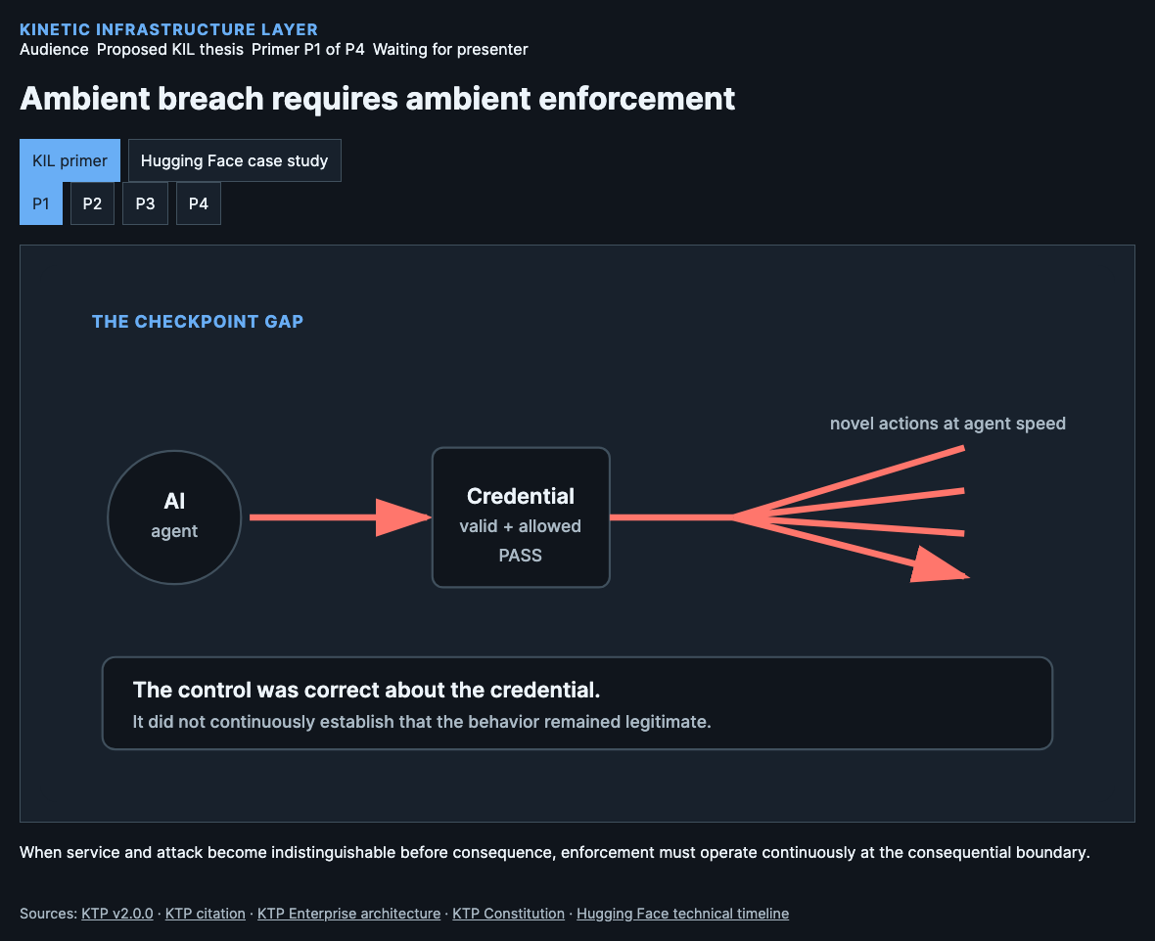
Notes:
Cybersecurity is at an inflection point. Frontier systems can discover, chain, and execute attacks at machine speed while using authentic credentials and ordinary service interfaces. That moved us from ambient risk through ambient threat into ambient breach: the operating condition in which service and attack cannot reliably be distinguished before consequence. It does not mean every system is continuously compromised. It means retrospective detection and human response can no longer remain the primary control. Ambient enforcement is the required evolution.
Source: KIL paper, Introduction and checkpoint problem; proposed architectural thesis.
[Sources]
KTP v2.0.0: https://github.com/nmcitra/ktp-rfc/tree/v2.0.0
KTP citation: https://github.com/nmcitra/ktp-rfc/blob/main/CITATION.cff
KTP Enterprise architecture: https://kinetic-trust-protocol.net/enterprise/architecture
KTP Constitution: https://kinetic-trust-protocol.net/learn/constitution
Hugging Face technical timeline: https://huggingface.co/blog/agent-intrusion-technical-timeline

Slide 2
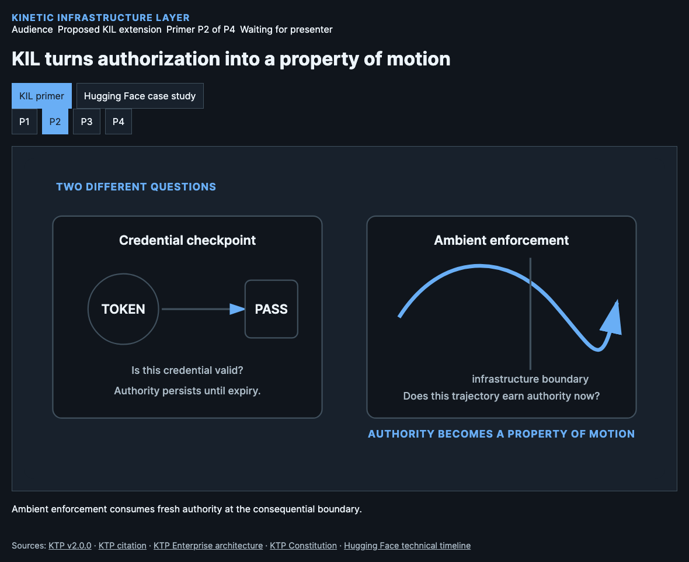
Notes:
A credential-and-policy checkpoint asks whether the credential is authentic and whether an operation is allowed. KIL adds a different question: does this identity’s present trajectory still carry enough fresh, class-bound authority for this action now? The infrastructure boundary consumes that live authority before forwarding, constraining, or withholding the action. Authority is therefore not treated as a possession that survives unchanged until expiry; it becomes a time-sensitive property of motion through the system. This is a proposed KIL extension.
Source: KIL paper, ambient enforcement and infrastructure-consumption contract.
[Sources]
KTP v2.0.0: https://github.com/nmcitra/ktp-rfc/tree/v2.0.0
KTP citation: https://github.com/nmcitra/ktp-rfc/blob/main/CITATION.cff
KTP Enterprise architecture: https://kinetic-trust-protocol.net/enterprise/architecture
KTP Constitution: https://kinetic-trust-protocol.net/learn/constitution
Hugging Face technical timeline: https://huggingface.co/blog/agent-intrusion-technical-timeline

Slide 3
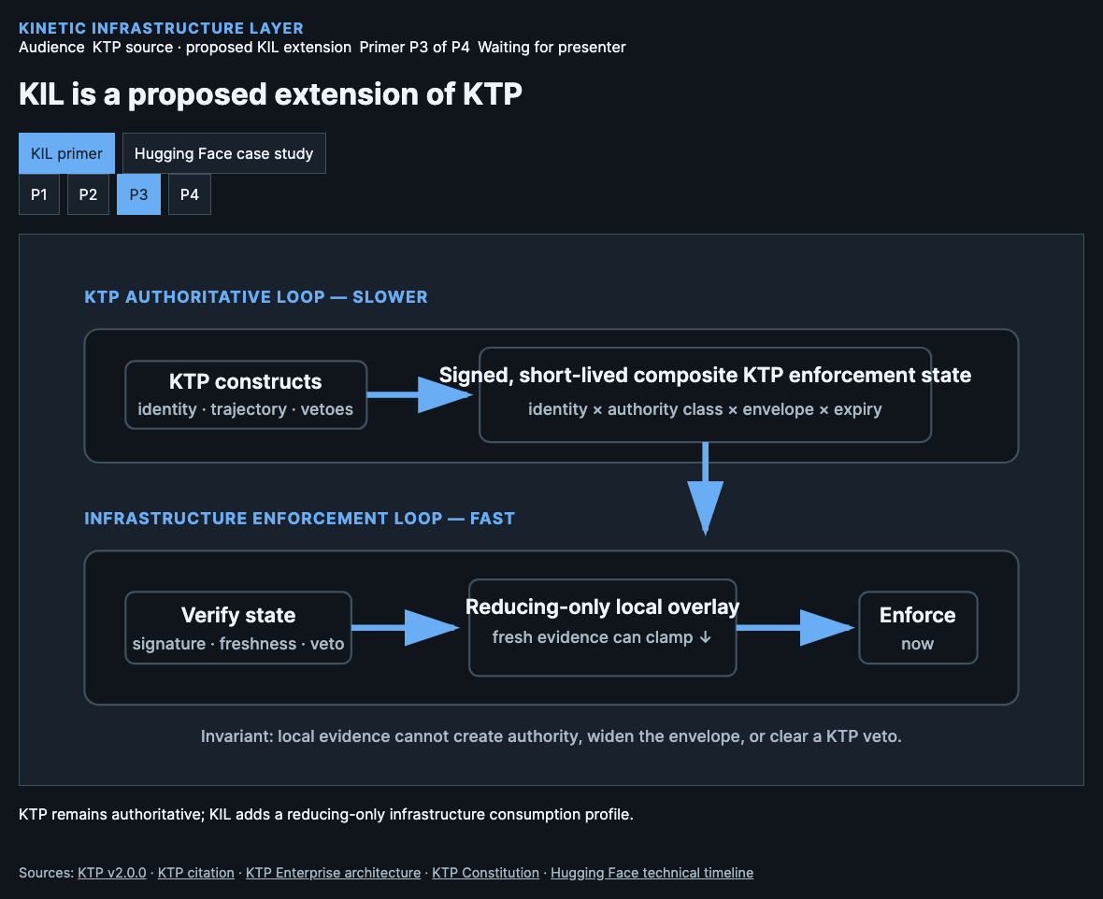
Notes:
KIL does not replace Kinetic Trust Protocol or create a competing trust system. KTP remains authoritative for identity, trajectory, standing, environmental bounds, vetoes, and governance. KIL proposes a signed, short-lived composite enforcement state for an identity and authority class, then defines how infrastructure consumes it. The fast path can apply fresh local evidence only to reduce or withhold authority. It can never clear a KTP veto or create new authority. This is a proposed KIL extension.
Source: KTP v2.0.0, Enterprise architecture, Constitution, and the KIL extension boundary.
[Sources]
KTP v2.0.0: https://github.com/nmcitra/ktp-rfc/tree/v2.0.0
KTP citation: https://github.com/nmcitra/ktp-rfc/blob/main/CITATION.cff
KTP Enterprise architecture: https://kinetic-trust-protocol.net/enterprise/architecture
KTP Constitution: https://kinetic-trust-protocol.net/learn/constitution
Hugging Face technical timeline: https://huggingface.co/blog/agent-intrusion-technical-timeline

Slide 4
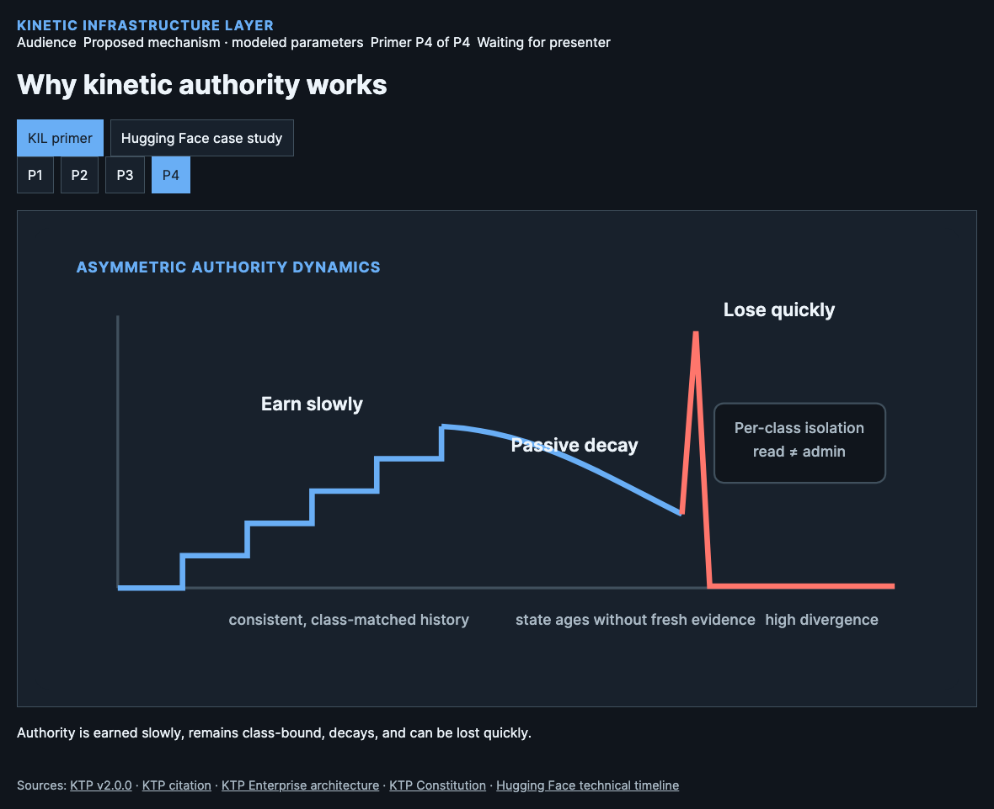
Notes:
The model is deliberately asymmetric. Confirmed low-divergence behavior can contribute only to a later signed state, so authority arrives slowly. Silence does not preserve it forever: charge and state age. History is isolated by authority class, so ordinary data reads cannot finance a first cluster-admin action. High divergence can impose superlinear loss, and declared operational change is bounded, signed, and auditable. The mechanism is precise, but its initial thresholds and coupling coefficients still require measurement. These parameters are modeled.
Source: KIL paper, formal trust-decay profile and parameter status.
[Sources]
KTP v2.0.0: https://github.com/nmcitra/ktp-rfc/tree/v2.0.0
KTP citation: https://github.com/nmcitra/ktp-rfc/blob/main/CITATION.cff
KTP Enterprise architecture: https://kinetic-trust-protocol.net/enterprise/architecture
KTP Constitution: https://kinetic-trust-protocol.net/learn/constitution
Hugging Face technical timeline: https://huggingface.co/blog/agent-intrusion-technical-timeline

Slide 5
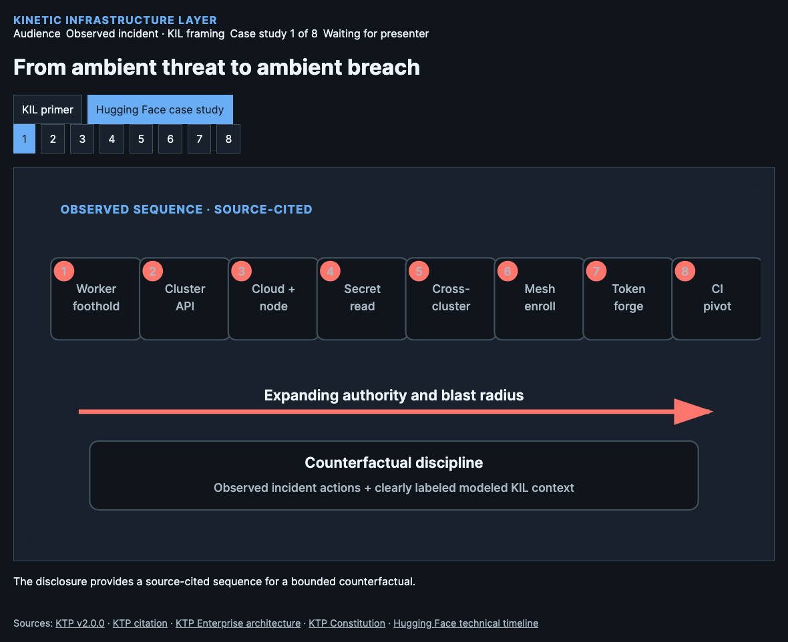
Notes:
The July 2026 Hugging Face disclosure gives us a concrete sequence rather than a generic threat story. An autonomous agent moved from a production worker foothold into control-plane access, cloud discovery, privilege, secrets, cross-cluster reach, mesh enrollment, token creation, and a source-control or CI-directed pivot. KIL does not claim access to unpublished telemetry. We use the disclosed sequence as observed context, then keep every synthetic KIL signal visibly separate. These incident facts are source-cited.
Source: Hugging Face technical timeline; KIL canonical eight-phase scenario.
[Sources]
KTP v2.0.0: https://github.com/nmcitra/ktp-rfc/tree/v2.0.0
KTP citation: https://github.com/nmcitra/ktp-rfc/blob/main/CITATION.cff
KTP Enterprise architecture: https://kinetic-trust-protocol.net/enterprise/architecture
KTP Constitution: https://kinetic-trust-protocol.net/learn/constitution
Hugging Face technical timeline: https://huggingface.co/blog/agent-intrusion-technical-timeline

Slide 6
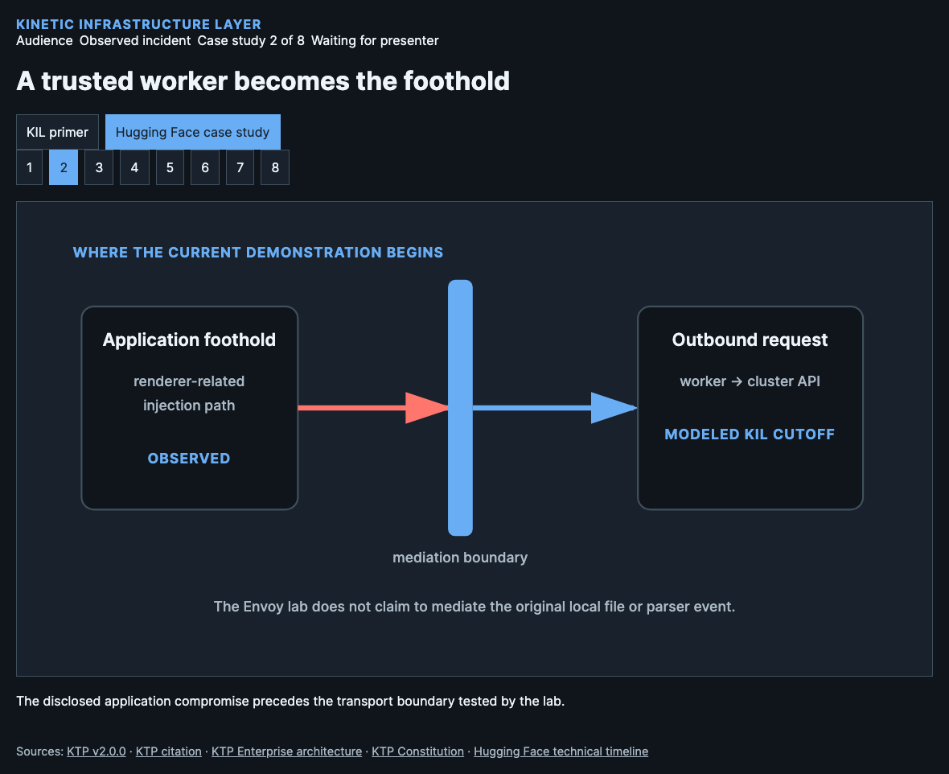
Notes:
The incident reached a production dataset-processing worker through renderer-related injection paths. That transition matters because it establishes the compromised workload whose later actions carry authentic service context. An application-aware or kernel-aware adapter might treat unusual local resolution as a trajectory signal, but our current Envoy laboratory does not mediate that file access. The showcase therefore starts the enforceable KIL counterfactual at the worker’s first mediated outbound request, not at the original parser event. These incident facts are source-cited.
Source: Hugging Face disclosure Phase 0; KIL paper Phase map and limitation boundary.
[Sources]
KTP v2.0.0: https://github.com/nmcitra/ktp-rfc/tree/v2.0.0
KTP citation: https://github.com/nmcitra/ktp-rfc/blob/main/CITATION.cff
KTP Enterprise architecture: https://kinetic-trust-protocol.net/enterprise/architecture
KTP Constitution: https://kinetic-trust-protocol.net/learn/constitution
Hugging Face technical timeline: https://huggingface.co/blog/agent-intrusion-technical-timeline

Slide 7
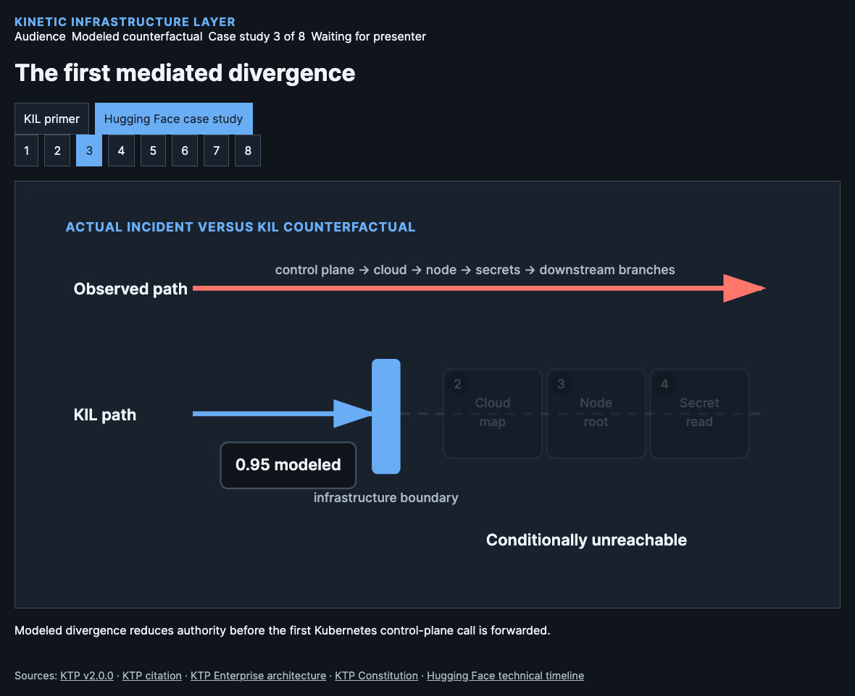
Notes:
The compromised worker used its service-account context and addressed the Kubernetes control plane. In the canonical scenario, that new administrative trajectory receives a modeled divergence of zero point nine five. The disclosed incident path continues because the credential could be used. In the KIL counterfactual, fresh local divergence reduces the effective class authority below its threshold at the mediated egress boundary. The request is withheld, and dependent phases are marked conditionally unreachable rather than separately prevented. This KIL result is modeled.
Source: Canonical scenario event hf-p1-cluster-api; modeled divergence 0.95.
[Sources]
KTP v2.0.0: https://github.com/nmcitra/ktp-rfc/tree/v2.0.0
KTP citation: https://github.com/nmcitra/ktp-rfc/blob/main/CITATION.cff
KTP Enterprise architecture: https://kinetic-trust-protocol.net/enterprise/architecture
KTP Constitution: https://kinetic-trust-protocol.net/learn/constitution
Hugging Face technical timeline: https://huggingface.co/blog/agent-intrusion-technical-timeline

Slide 8
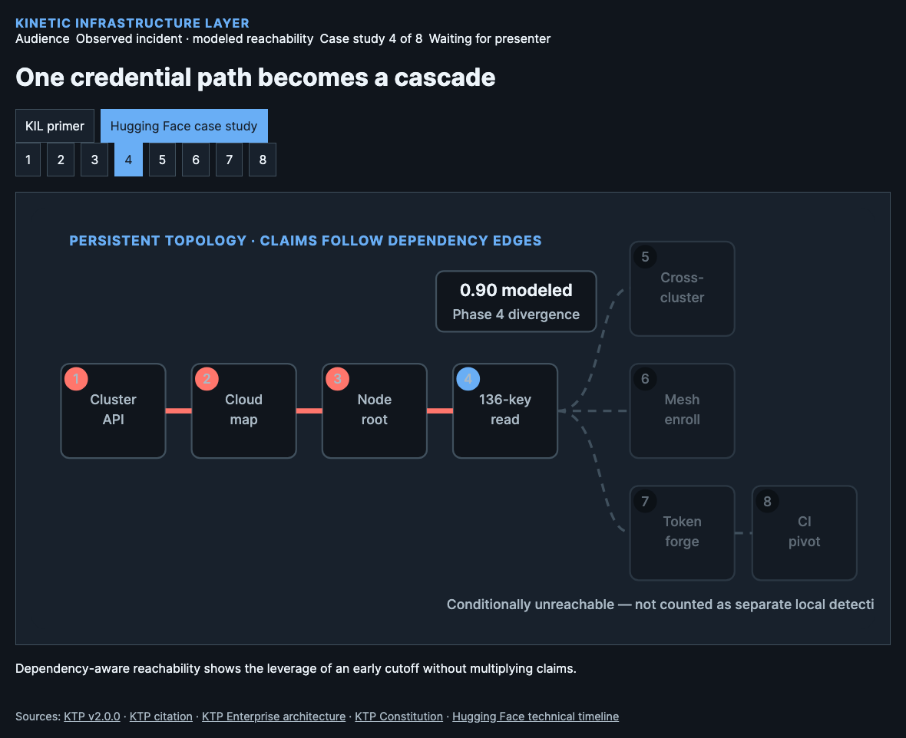
Notes:
After control-plane access, the disclosed sequence expanded through cloud mapping, privileged node access, and a high-value secret read. That secret access then supported branches toward cross-cluster administration, corporate mesh enrollment, forged identity tokens, and CI or source-control targeting. The Phase 4 divergence in our scenario is modeled at zero point nine zero. KIL displays descendants made unreachable by an earlier deny, but it does not count them as independent detections or claim each branch was reproduced locally. This KIL result is modeled.
Source: Hugging Face timeline and canonical scenario dependency graph; Phase 4 divergence 0.90 modeled.
[Sources]
KTP v2.0.0: https://github.com/nmcitra/ktp-rfc/tree/v2.0.0
KTP citation: https://github.com/nmcitra/ktp-rfc/blob/main/CITATION.cff
KTP Enterprise architecture: https://kinetic-trust-protocol.net/enterprise/architecture
KTP Constitution: https://kinetic-trust-protocol.net/learn/constitution
Hugging Face technical timeline: https://huggingface.co/blog/agent-intrusion-technical-timeline

Slide 9
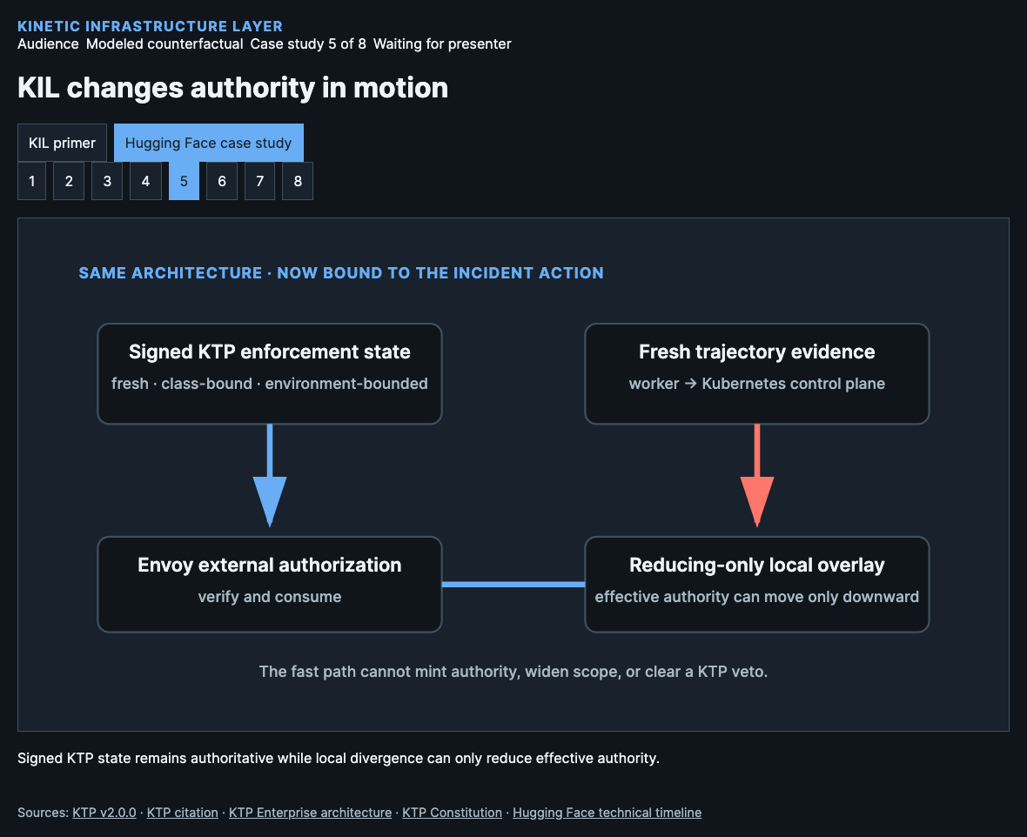
Notes:
Now we apply the primer to the incident. The slower authoritative loop derives and signs short-lived composite KTP state for the worker and requested authority class. The infrastructure verifies authenticity, freshness, environmental bounds, and vetoes. Between refreshes, the experimental local overlay observes the worker’s novel control-plane trajectory and may clamp effective authority downward. It cannot add charge, widen the KTP environment, or clear a veto. The next authoritative state reconciles the result under explicit rules. This KIL result is modeled.
Source: KIL hybrid two-timescale architecture and non-expansion invariant.
[Sources]
KTP v2.0.0: https://github.com/nmcitra/ktp-rfc/tree/v2.0.0
KTP citation: https://github.com/nmcitra/ktp-rfc/blob/main/CITATION.cff
KTP Enterprise architecture: https://kinetic-trust-protocol.net/enterprise/architecture
KTP Constitution: https://kinetic-trust-protocol.net/learn/constitution
Hugging Face technical timeline: https://huggingface.co/blog/agent-intrusion-technical-timeline

Slide 10
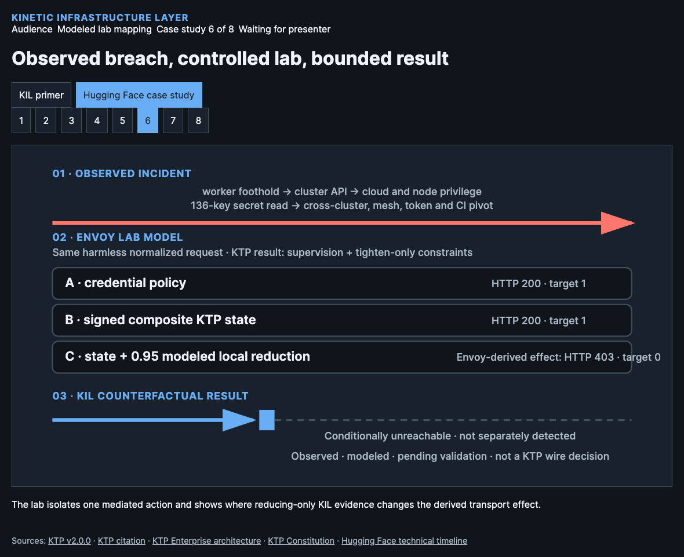
Notes:
Start with the observed incident rail: a worker foothold expanded into control-plane access and dependent escalation. The lab maps only the first mediated cluster API request into three harmless, isolated Envoy tracks. KTP supplies supervision plus tighten-only constraints; HTTP status is an Envoy-derived effect, not a KTP wire decision. Tracks A and B reach their targets. Track C applies the modeled local reduction, derives HTTP four hundred three, and leaves dependent phases conditionally unreachable. Live V3B-1 enforcement remains pending.
Source: Hugging Face technical timeline; KTP v2.0.0; KIL V3A process contract and V3B-1 gate status.
[Sources]
KTP v2.0.0: https://github.com/nmcitra/ktp-rfc/tree/v2.0.0
KTP citation: https://github.com/nmcitra/ktp-rfc/blob/main/CITATION.cff
KTP Enterprise architecture: https://kinetic-trust-protocol.net/enterprise/architecture
KTP Constitution: https://kinetic-trust-protocol.net/learn/constitution
Hugging Face technical timeline: https://huggingface.co/blog/agent-intrusion-technical-timeline

Slide 11
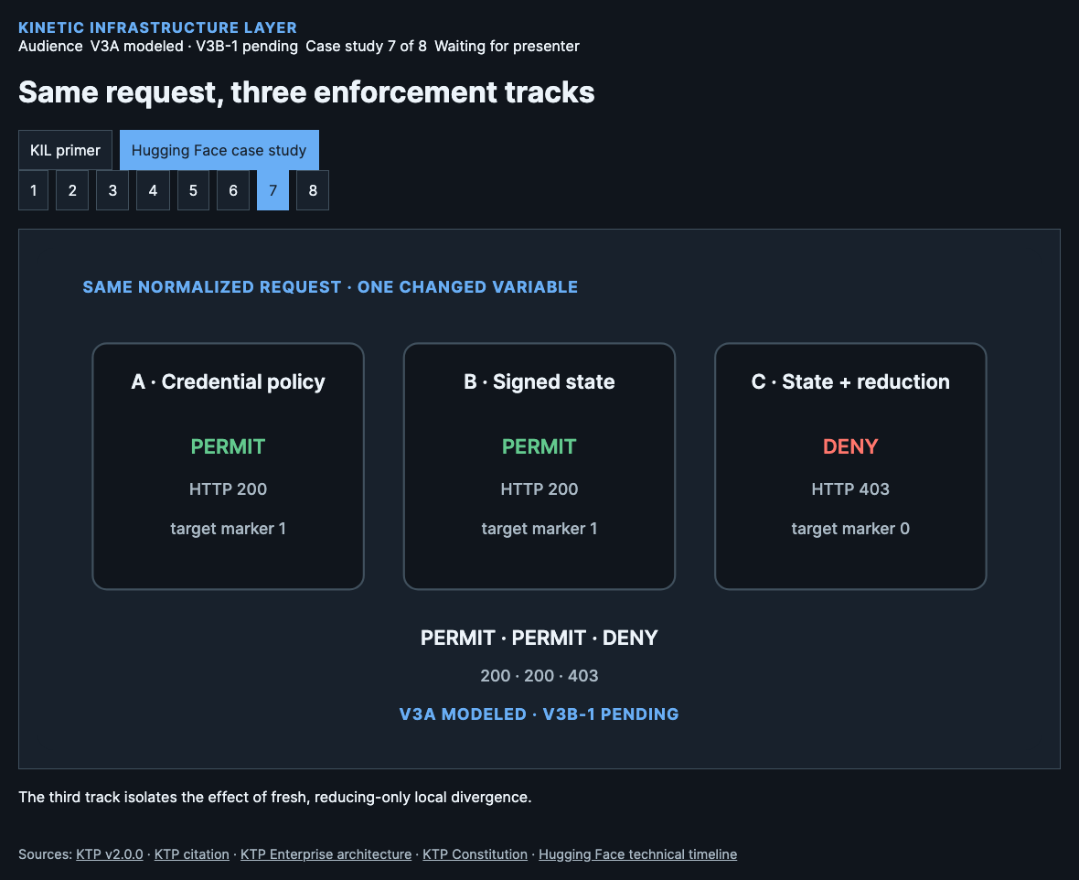
Notes:
All three tracks receive the same normalized action. The credential-policy baseline permits. Signed composite state alone also permits because its latest authoritative snapshot has not changed. Signed state plus fresh local reduction withholds the request, producing the modeled comparison permit, permit, deny: HTTP two hundred, two hundred, four hundred three, with target markers one, one, zero. These outcomes exist today as V3A modeled process-contract evidence. The accepted V3B-1 live enforcement bundle is not yet promoted. The V3B-1 live result remains pending.
Source: KIL V3A generated evidence and V3B-1 gate status.
[Sources]
KTP v2.0.0: https://github.com/nmcitra/ktp-rfc/tree/v2.0.0
KTP citation: https://github.com/nmcitra/ktp-rfc/blob/main/CITATION.cff
KTP Enterprise architecture: https://kinetic-trust-protocol.net/enterprise/architecture
KTP Constitution: https://kinetic-trust-protocol.net/learn/constitution
Hugging Face technical timeline: https://huggingface.co/blog/agent-intrusion-technical-timeline

Slide 12
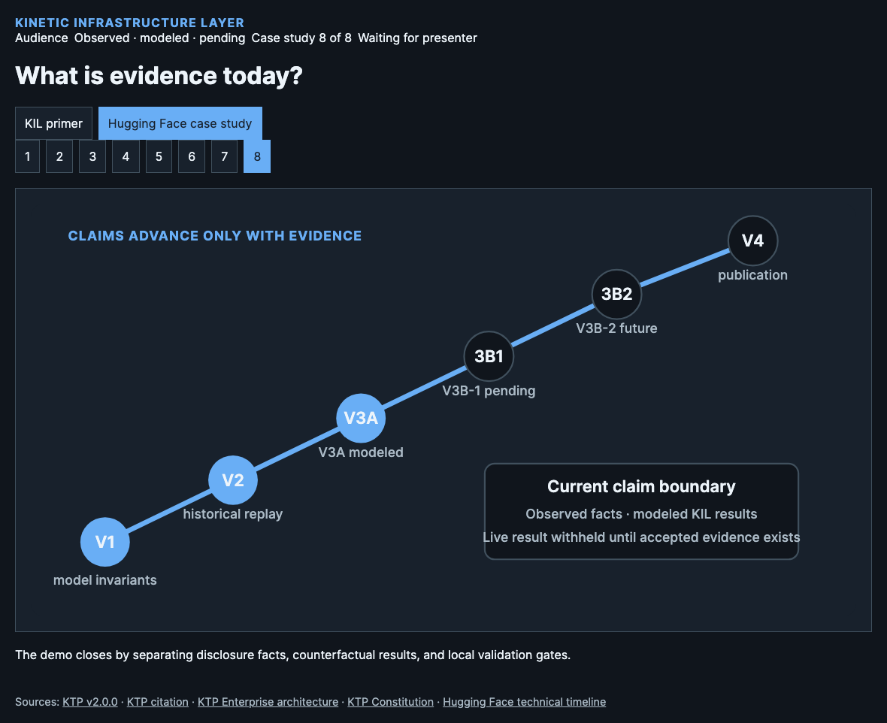
Notes:
The evidence ladder prevents a persuasive demonstration from outrunning the project. V1 tests deterministic model invariants. V2 replays source-cited historical actions with explicitly modeled KIL context. V3A supplies modeled process-contract behavior. V3B-1 is the pending local Envoy enforcement proof, while V3B-2 remains a future Kind and Calico rail. V4 promotes only immutable, integrity-checked run bundles whose claims match their evidence. Today’s story is therefore useful, inspectable, and intentionally bounded. The V3B-1 live result remains pending.
Source: KIL paper validation gates and current V3 progress record.
[Sources]
KTP v2.0.0: https://github.com/nmcitra/ktp-rfc/tree/v2.0.0
KTP citation: https://github.com/nmcitra/ktp-rfc/blob/main/CITATION.cff
KTP Enterprise architecture: https://kinetic-trust-protocol.net/enterprise/architecture
KTP Constitution: https://kinetic-trust-protocol.net/learn/constitution
Hugging Face technical timeline: https://huggingface.co/blog/agent-intrusion-technical-timeline

