Slide 2
Read and write data in Azure Databricks
Speaker Name
Title
Speaker Name
Title
Notes:
Link to published module on Learn: https://docs.microsoft.com/en-us/learn/modules/learn-pr/wwl-data-ai/read-write-data-azure-databricks/

Slide 3
Learning objectives
Use Azure Databricks to read multiple file types, both with and without a Schema.
Combine inputs from files and data stores, such as Azure SQL Database.
Transform and store that data for advanced analytics.

Slide 4
Unit Prerequisites
Microsoft Azure Account: You will need a valid and active Azure account for the Azure labs.
If you are a Visual Studio Active Subscriber, you are entitled to Azure credits per month. You can refer to this link to find out more including how to activate and start using your monthly Azure credit.
If you are not a Visual Studio Subscriber, you can sign up for the FREE Visual Studio Dev Essentials program to create Azure free account.
Notes:
Microsoft Azure Account: You will need a valid and active Azure account for the Azure labs. If you do not have one, you can sign up for a free trial
If you are a Visual Studio Active Subscriber, you are entitled to Azure credits per month. You can refer to this link to find out more including how to activate and start using your monthly Azure credit.
If you are not a Visual Studio Subscriber, you can sign up for the FREE Visual Studio Dev Essentials program to create Azure free account.

Slide 5
Create the required resources
To complete this lab, you will need to deploy an Azure Databricks workspace in your Azure subscription.
Notes:
To complete this lab, you will need to deploy an Azure Databricks workspace in your Azure subscription.

Slide 6
Agenda
Introduction
Read data in CSV format
Read data in JSON format
Read data in Parquet format
Read data stored in tables and views

Slide 7
Agenda continued
Write data
Exercises: Read and write data
Knowledge check
Summary

Slide 8
Introduction

Slide 9
Introduction
Suppose you're working for a data analytics startup that's now expanding along with its increasing customer base.
Notes:
Suppose you're working for a data analytics startup that's now expanding along with its increasing customer base. You receive customer data from multiple sources in different raw formats. To efficiently handle huge amounts of customer data, your company has decided to invest in Azure Databricks. Your team is responsible for analyzing how Databricks supports day-to-day data-handling functions, such as reads, writes, and queries. Your team performs these tasks to prepare the data for advanced analytics and machine learning operations.

Slide 10
Creating your Databricks workspace

Slide 11
Deploy an Azure Databricks workspace
Click the following button to open the Azure Resource Manager Template (ARM) template in the Azure portal.
Click the following button to open the Azure Resource Manager Template (ARM) template in the Azure portal. Deploy Databricks from the ARM Template
Provide the required values to create your Azure Databricks workspace:
Subscription: Choose the Azure Subscription in which to deploy the workspace.
Resource Group: Leave at Create new and provide a name for the new resource group.
Location: Select a location near you for deployment. For the list of regions supported by Azure Databricks, see Azure services available by region.
Workspace Name: Provide a name for your workspace.
Pricing Tier: Ensure premium is selected.
Accept the terms and conditions.
Select Purchase.
The workspace creation takes a few minutes. During workspace creation, the portal displays the Submitting deployment for Azure Databricks tile on the right side. You may need to scroll right on your dashboard to see the tile. There is also a progress bar displayed near the top of the screen. You can watch either area for progress.
Notes:
Click the following button to open the Azure Resource Manager Template (ARM) template in the Azure portal. Deploy Databricks from the ARM Template
Provide the required values to create your Azure Databricks workspace:
Subscription: Choose the Azure Subscription in which to deploy the workspace.
Resource Group: Leave at Create new and provide a name for the new resource group.
Location: Select a location near you for deployment. For the list of regions supported by Azure Databricks, see Azure services available by region.
Workspace Name: Provide a name for your workspace.
Pricing Tier: Ensure premium is selected.
Accept the terms and conditions.
Select Purchase.
The workspace creation takes a few minutes. During workspace creation, the portal displays the Submitting deployment for Azure Databricks tile on the right side. You may need to scroll right on your dashboard to see the tile. There is also a progress bar displayed near the top of the screen. You can watch either area for progress.

Slide 12
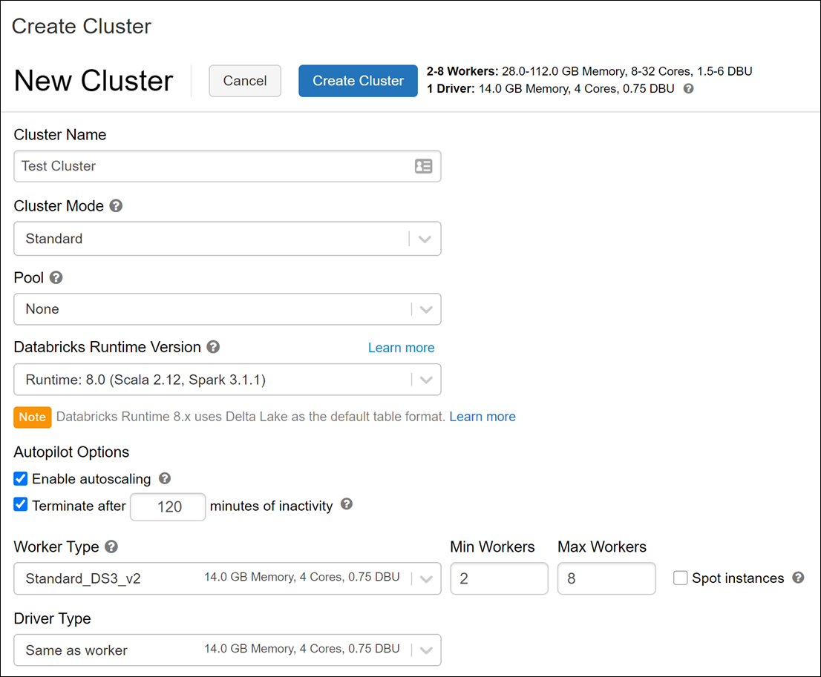
Create a cluster
When your Azure Databricks workspace creation is complete, select the link to go to the resource.
Notes:
When your Azure Databricks workspace creation is complete, select the link to go to the resource.
Select Launch Workspace to open your Databricks workspace in a new tab.
In the left-hand menu of your Databricks workspace, select Clusters.
Select Create Cluster to add a new cluster.
Enter a name for your cluster. Use your name or initials to easily differentiate your cluster from your coworkers.
Select the Cluster Mode: Single Node.
Select the Databricks RuntimeVersion: Runtime: 7.3 LTS (Scala 2.12, Spark 3.0.1).
Under Autopilot Options, leave the box checked and in the text box enter 45.
Select the Node Type: Standard_DS3_v2.
Select Create Cluster.

Slide 13
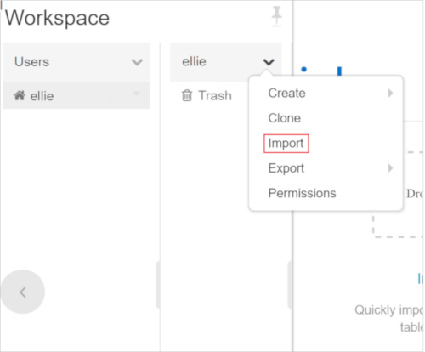
Clone the Databricks archive
If you do not currently have your Azure Databricks workspace open: in the Azure portal, navigate to your deployed Azure Databricks workspace and select Launch Workspace.
Select Import.
Select the 03-Reading-and-writing-data-in-Azure-Databricks folder that appears.
Notes:
If you do not currently have your Azure Databricks workspace open: in the Azure portal, navigate to your deployed Azure Databricks workspace and select Launch Workspace.
In the left pane, select Workspace > Users, and select your username (the entry with the house icon).
In the pane that appears, select the arrow next to your name, and select Import.
In the Import Notebooks dialog box, select the URL and paste in the following URL:
https://github.com/solliancenet/microsoft-learning-paths-databricks-notebooks/blob/master/data-engineering/DBC/03-Reading-and-writing-data-in-Azure-Databricks.dbc?raw=true
Select Import.
Select the 03-Reading-and-writing-data-in-Azure-Databricks folder that appears.

Slide 14
Read data in CSV format

Slide 15
Read data in CSV format
In this unit, you need to complete the exercises within a Databricks Notebook.
Notes:
In this unit, you need to complete the exercises within a Databricks Notebook. To begin, you need to have access to an Azure Databricks workspace. If you do not have a workspace available, follow the instructions below. Otherwise, you can skip to the bottom of the page to Clone the Databricks archive.

Slide 16
Complete the following notebook
Open the 1.Reading Data - CSV notebook.
Start working with the API documentation
Introduce the class SparkSession and other entry points
Introduce the class DataFrameReader
Read data from:
CSV without a Schema
CSV with a Schema
Notes:
Open the 1.Reading Data - CSV notebook. Make sure you attach your cluster to the notebook before following the instructions and running the cells within.
Within the notebook, you will:
Start working with the API documentation
Introduce the class SparkSession and other entry points
Introduce the class DataFrameReader
Read data from:
CSV without a Schema
CSV with a Schema
After you've completed the notebook, return to this screen, and continue to the next step.

Slide 17
Read data in JSON format

Slide 18
Read data in JSON format
In your Azure Databricks workspace, open the 03-Reading-and-writing-data-in-Azure-Databricks folder that you imported within your user folder.
Read data from:
JSON without a Schema
JSON with a Schema
Notes:
In your Azure Databricks workspace, open the 03-Reading-and-writing-data-in-Azure-Databricks folder that you imported within your user folder.
Open the 2.Reading Data - JSON notebook. Make sure you attach your cluster to the notebook before following the instructions and running the cells within.
Within the notebook, you will:
Read data from:
JSON without a Schema
JSON with a Schema
After you've completed the notebook, return to this screen, and continue to the next step.

Slide 19
Read data in Parquet format

Slide 20
Read data in Parquet format
In your Azure Databricks workspace, open the 03-Reading-and-writing-data-in-Azure-Databricks folder that you imported within your user folder.
Introduce the Parquet file format
Read data from:
Parquet files without a schema
Parquet files with a schema
Notes:
In your Azure Databricks workspace, open the 03-Reading-and-writing-data-in-Azure-Databricks folder that you imported within your user folder.
Open the 3.Reading Data - Parquet notebook. Make sure you attach your cluster to the notebook before following the instructions and running the cells within.
Within the notebook, you will:
Introduce the Parquet file format
Read data from:
Parquet files without a schema
Parquet files with a schema
After you've completed the notebook, return to this screen, and continue to the next step.

Slide 21
Read data stored in tables and views

Slide 22
Read data stored in tables and views
In your Azure Databricks workspace, open the 03-Reading-and-writing-data-in-Azure-Databricks folder that you imported within your user folder.
Demonstrate how to pre-register data sources in Azure Databricks
Introduce temporary views over files
Read data from tables/views
Notes:
In your Azure Databricks workspace, open the 03-Reading-and-writing-data-in-Azure-Databricks folder that you imported within your user folder.
Open the 4.Reading Data - Tables and Views notebook. Make sure you attach your cluster to the notebook before following the instructions and running the cells within.
Within the notebook, you will:
Demonstrate how to pre-register data sources in Azure Databricks
Introduce temporary views over files
Read data from tables/views
After you've completed the notebook, return to this screen, and continue to the next step.

Slide 23
Write data

Slide 24
Write data
In your Azure Databricks workspace, open the 03-Reading-and-writing-data-in-Azure-Databricks folder that you imported within your user folder.
Write data to a Parquet file
Read the Parquet file back and display the results
Notes:
In your Azure Databricks workspace, open the 03-Reading-and-writing-data-in-Azure-Databricks folder that you imported within your user folder.
Open the 5.Writing Data notebook. Make sure you attach your cluster to the notebook before following the instructions and running the cells within.
Within the notebook, you will:
Write data to a Parquet file
Read the Parquet file back and display the results
After you've completed the notebook, return to this screen, and continue to the next step.

Slide 25
Exercise
Exercises: Read and write data
Notes:
Link to published module on Learn: https://docs.microsoft.com/en-us/learn/modules/learn-pr/wwl-data-ai/read-write-data-azure-databricks/7-exercises

Slide 26
Exercises: Read and write data
In your Azure Databricks workspace, open the 03-Reading-and-writing-data-in-Azure-Databricks folder that you imported within your user folder.
Notes:
https://docs.microsoft.com/en-us/learn/modules/learn-pr/wwl-data-ai/read-write-data-azure-databricks/7-exercises

Slide 27
Knowledge check

Slide 28
Question 1
How do you list files in DBFS within a notebook?
ls /my-file-path
%fs dir /my-file-path
%fs ls /my-file-path
Notes:
Explanation: Correct. You added the file system magic to the cell before executing the ls command.

Slide 29
Question 1
How do you list files in DBFS within a notebook?
ls /my-file-path
%fs dir /my-file-path
%fs ls /my-file-path
Notes:
Explanation: Correct. You added the file system magic to the cell before executing the ls command.

Slide 30
Question 2
How do you infer the data types and column names when you read a JSON file?
spark.read.option("inferSchema", "true").json(jsonFile)
spark.read.inferSchema("true").json(jsonFile)
spark.read.option("inferData", "true").json(jsonFile)
Notes:
Explanation: Correct. This approach is the correct way to infer the file's schema.

Slide 31
Question 2
How do you infer the data types and column names when you read a JSON file?
spark.read.option("inferSchema", "true").json(jsonFile)
spark.read.inferSchema("true").json(jsonFile)
spark.read.option("inferData", "true").json(jsonFile)
Notes:
Explanation: Correct. This approach is the correct way to infer the file's schema.

Slide 32
Summary

Slide 33
Summary
In this module, you learned the basics about reading and writing data in Azure Databricks.
Read data from CSV files into a Spark Dataframe
Provide a Schema when reading Data into a Spark Dataframe
Read data from JSON files into a Spark Dataframe
Read Data from parquet files into a Spark Dataframe
Create Tables and Views
Write data from a Spark Dataframe
Notes:
In this module, you learned the basics about reading and writing data in Azure Databricks. You now know how to read CSV, JSON, and Parquet file formats, and how to write Parquet files to the Databricks file system (DBFS) with compression options. Though you only wrote the files in Parquet format, you can use the same DataFrame.write method to output to other formats. Finally, you put your knowledge to the test by completing an exercise that required you to read a random file that you had not yet seen.
Now that you have concluded this module, you should know:
Read data from CSV files into a Spark Dataframe
Provide a Schema when reading Data into a Spark Dataframe
Read data from JSON files into a Spark Dataframe
Read Data from parquet files into a Spark Dataframe
Create Tables and Views
Write data from a Spark Dataframe

Slide 34
Clean up
If you plan on completing other Azure Databricks modules, don't delete your Azure Databricks instance yet.
Notes:
If you plan on completing other Azure Databricks modules, don't delete your Azure Databricks instance yet. You can use the same environment for the other modules.

Slide 35
Delete the Azure Databricks instance
Navigate to the Azure portal.
Navigate to the resource group that contains your Azure Databricks instance.
Select Delete resource group.
Type the name of the resource group in the confirmation text box.
Select Delete.
Notes:
Navigate to the Azure portal.
Navigate to the resource group that contains your Azure Databricks instance.
Select Delete resource group.
Type the name of the resource group in the confirmation text box.
Select Delete.

Slide 36
Next Steps
Please tell us how you liked this workshop by filling out this survey:
https://aka.ms/workshopomatic-feedback
Practice your knowledge by trying these Learn modules:
There is a slightly more advanced and involved learning path that covers Data Engineering with Azure Databricks.

