Slide 2
¿Cómo crear una aplicación de lienzo?
Únete a la conversación en: https://aka.ms/LearnLiveTV

Slide 3
Prerequisitos
Ninguno

Slide 4
Objetivos de Aprendizaje
Aprende elementos básicos de Power Apps
Construye una aplicación de lienzo
Personaliza tu aplicación
Administra la configuración de tu aplicación

Slide 5
Temario
Introducción
Aprende los elementos básicos
Construye una aplicación de Lienzo
Aprende las funciones en Power Apps
Comparte una aplicación

Slide 6
Temario
Pon a prueba tus conocimientos
Resumen y recursos

Slide 7
Introducción

Slide 8
Introducción
Power Apps permite a cualquiera implementar soluciones de negocio poderosas y personalizables.
Aprende los elementos básicos de Power Apps
Construye una aplicación de lienzo
Personaliza tu aplicación
Administra la configuración de tu aplicación
Notes:
Power Apps allows everyone to implement custom and powerful business solutions. This module walks you through everything you need to know to build your first app. By the end of this module, you will be prepared to start building your own business apps.
In this module, you will:
Learn basic elements of Power Apps
Build a canvas app
Customize elements of your app
Configure and manage app settings

Slide 9
Elementos básicos de Power Apps

Slide 10
Aprende sobre los elementos básicos
Power Apps tiene distintos componentes para desarrollar soluciones, incluyendo pantallas, entradas, galerías, formularios y más.
Notes:
Power Apps has many different components to build solutions including screens, inputs, galleries, forms and more. Let's review some of the most common elements you will need to get started.

Slide 11
Power Apps Studio
Power Apps Studio es el nombre de la interfaz web que te permite construir tu aplicación.
Notes:
Power Apps Studio is the name of the web interface you use to build your app. With Power Apps, there is no client to download or install for building apps. Everything is done from the browser by logging into https://make.PowerApps.com.

Slide 12
Formato de la aplicación
El primer paso para crear tu aplicación es elegir el formato de la misma: Móvil o Tablet.
Notes:
The first step in creating your app is to choose the format of your app: Mobile or Tablet. While both formats can be used interchangeably on a mobile device, a tablet, or a computer, each has different defaults around sizing of the screens and controls. Once you choose the format for an app, you cannot change it.

Slide 13
Galerías
El control de Galería se usa para mostrar las filas de una tabla de datos.
Notes:
The Gallery control is used to display rows from a table of data. The display of a row is then defined by a template, which you can customize to meet your needs. This allows you to control which columns are shown and how they are formatted. Power Apps will then apply this template automatically to every row in your data.

Slide 14
Formularios
Los formularios se enfocan en trabajar con un registro específico, usualmente basado en la selección desde la galería.
Notes:
Forms are focused on working with a specific record, often based on a selection from a gallery. In this experience, a user browses a gallery to find and select the desired row to view the details on the form. Forms enable a user to not only view detailed information, but to save new records and edit existing ones. The various actions performed with forms are controlled by form modes allowing the form to serve many purposes.

Slide 15
Control de entradas
Para permitir la máxima flexibilidad al personalizar tus aplicaciones, Power Apps tiene una gran selección de controles de entrada.
Notes:
To allow you maximum flexibility in customizing your apps, Power Apps has a large selection of Input controls. Text inputs, buttons, dropdowns, toggles, date pickers, and sliders are a few examples. You can add these controls to galleries, forms, and screens to build a functional and aesthetic experience for your app. All inputs have a multitude of settings for default data, formatting, and actions which allow you to build an app that has the right user experience for your business process.

Slide 16
Controles inteligentes
Además de las entradas convencionales mencionadas anteriormente, Power Apps provee un vasto conjunto de controles para operaciones más avanzadas.
Notes:
In addition to common inputs as covered above, Power Apps also provides a rich set of controls for more advanced operations. There are hardware-based controls which allow access to the camera, bar code scanner, GPS, and more hardware features. There are also service backed controls like the business card reader or object detector which allow you to add artificial intelligence to your app without writing code.

Slide 17
Funciones
Las funciones son el pegamento que une todos estos controles, entradas y las fuentes de datos.
Notes:
Functions are the glue that binds all these controls, inputs, and data sources together. You can use one or more functions to create formulas in your apps. These formulas are similar to the language you use in Excel and can be used for actions such as sending data to a data source, formatting information, creating animations, and more. No complicated code is necessary, simply powerful functions with straightforward inputs to enhance your app.
Now that you have an overview of some of the rich functionality you can achieve with Power Apps, the next section will walk you down the path of building your first app.

Slide 18
Construye una aplicación de lienzo

Slide 19
Construye una aplicación de lienzo
En esta unidad, generarás una aplicación de lienzo en donde la fuente de datos es un archivo de Microsoft Excel, que se encuentra almacenado en OneDrive para empresas.
Identifica una necesidad de negocio que puede solucionarse por medio de Power Apps
Conéctate a cualquier dato necesario en tu Power App
Diseña la aplicación usando controles, botones y una interfaz fácil de utilizar para que tu usuario final interactúe con los datos, satisfaciendo la necesidad del negocio.
Guarda y publica tu aplicación y testea su funcionalidad.
Una vez realizado esto, comparte la aplicación con los usuarios finales para brindarles un mejor proceso de negocio
Notes:
In this unit, you will generate a canvas app where the data source is a Microsoft Excel workbook that is stored in Microsoft OneDrive for Business. This Excel workbook has a table of different buildings owned by Contoso Manufacturing. Today, they must email the shared workbook between people as they travel to different locations to make updates. With a Power Apps canvas app, they will be able to view the buildings directly from their phones. In addition, they will also be able to edit the information and even add new buildings.
This example uses Excel, but keep in mind that you can use data from many other sources, including Microsoft Dataverse, Microsoft SharePoint, cloud services like Salesforce, and on-premises sources like Microsoft SQL Server. This gives you the flexibility to build your app from your data no matter where it lives. You can also combine data sources within Power Apps to easily create associations between different data sources.
If you do not have a Power Apps account available, you can sign up for a free Power Apps Community Plan. This will allow you to learn and explore Power Apps in your own environment. For more information and to sign up, go to https://powerapps.microsoft.com/communityplan/
The basic Power Apps creator journey will look something like this:
Identify a business need that could be filled by Power Apps
Connect to any necessary data in your Power Apps
Design the app using controls, buttons, and an easy to use interface for your end user to interact with the data to accomplish the business need
Save and publish the app and test functionality
Once satisfied, share the app with end users to give them a better business process

Slide 20
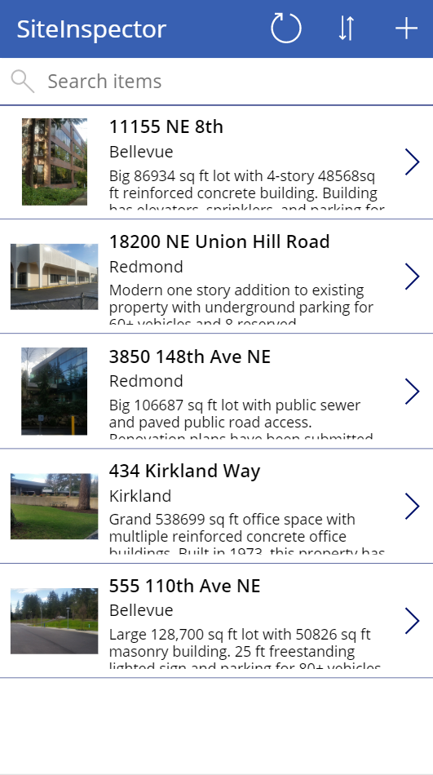
Conectar a una fuente de datos
Para conectar una fuente de datos, utiliza el siguiente proceso:
Notes:
To connect to a data source, use the following procedure:
Download the Contoso-Site-Tracking.zip file, extract all of the files, and save them to your OneDrive for Business.
Go to https://make.powerapps.com and sign in with your organizational account.
In the left pane, select Create.
In the Start from data section, select Other data sources.
Under Connections, choose OneDrive for Business. If you don't have the connection available, click New connection to create one.
For Choose an Excel file on the right select the Contoso Site Tracking.xlsx file.
For Choose a table click SiteInspector and click Connect.
[!div class="mx-imgBorder"] App published view
[!div class="mx-imgBorder"] App published view
Power Apps generates the app by inspecting your data and matching it with Power Apps capabilities so that you get a working app as a starting point. Generated apps are always based on a single list or table, but you can add more data to the app later.

Slide 21
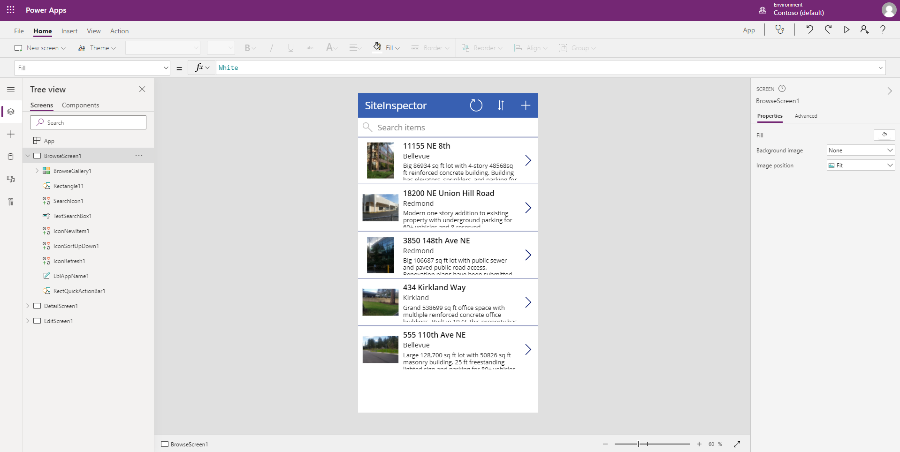
Explorar la aplicación generada
Tu nueva aplicación de tres pantallas ahora se visualiza en Power Apps Studio
Notes:
Your new three-screen app now opens in Power Apps Studio.
The following figure shows the main development window for Power Apps Studio, which you'll learn more about in later units.
[!div class="mx-imgBorder"] App editor view
Select Play Start app preview arrow in the upper-right corner to practice using the app. Notice that it includes all the data from the table and provides a good default experience.
All apps that are generated from data have the same set of screens that you can view from the Screens pane:
Browse screen - This screen appears by default. In it, you can browse, sort, search, and refresh the data from the data source. In the browse screen, you can add items to the data source by selecting the plus sign (+).
Details screen - The details screen shows all information about a single item. In this screen, you can open an item to edit or delete it.
Edit/create screen - In this screen, you can edit an existing item or create a new one.
Close out of preview mode by selecting the "X" in the upper-right corner. To make your app visible on the phone, it needs to be saved. Select File, Save as. Replace the current title "App" with Contoso Site Tracking app, and then select Save. You will see a green check mark when all changes are successfully saved. You can now open the app on your phone.

Slide 22
Instala la aplicación en tu dispositivo
Para ver como corre tu aplicación en móvil, instala la aplicación de Power Apps Mobile en tu teléfono.
Descarga Power Apps Movil de la tienda de aplicaciones que utilices.
Inicia sesión utilizando tus credenciales.
En tu teléfono o tablet, corre la aplicación Contoso Site Tracking, en Power Apps Movil. Si no deseas instalar la aplicación, puedes correrla en un navegador.
Notes:
To see how the app runs on mobile, install the Power Apps Mobile app on your phone. When building an app, you should test it in the same form factor as your users.
Download Power Apps Mobile from the app store for the platform that you want to use.
Sign in by using your username and password.
On your phone or tablet, run the Contoso Site Tracking app in Power Apps Mobile. If you do not want to install the app, you can run it in a browser.
If the app you are creating will be used on a mobile device, then it is a good idea to check how the Power App looks and runs on mobile so you can give your users the best experience.

Slide 23
Explora la aplicación
Ahora que has generado la aplicación Contoso Site Tracking, debería tomar unos minutos para entrar a la aplicación y explorar su diseño.
Notes:
Now that you have generated the Contoso Site Tracking app you should take a few minutes to click through the app and explore its design. Take note of how you use a Gallery to browse the records from the Excel file. When you click on a record, you are taken to a different screen where a Form control displays the additional details. The app also includes the ability to edit those rows or even make a new row. This is a very functional app to build upon.

Slide 24
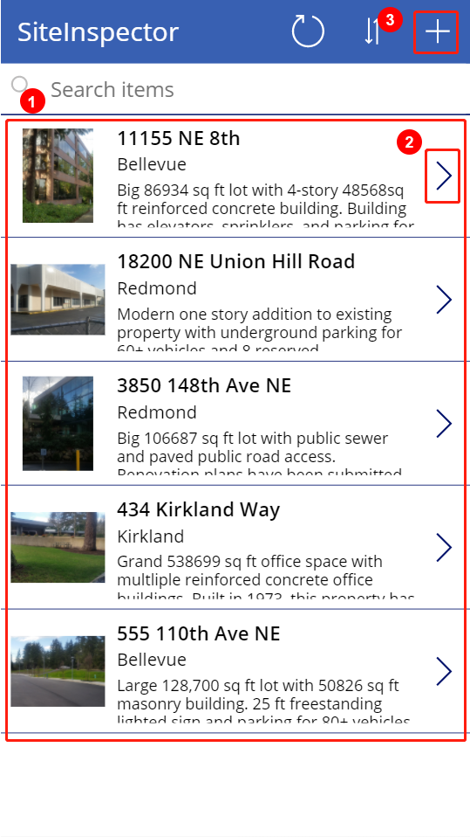
Explora la pantalla de navegación
Cada pantalla tiene múltiples controles, pero un control ocupa la mayor parte de la pantalla
Notes:
Each screen in the app has multiple controls, but one control takes up most of the screen space. The first screen in the app is the browse screen, which is named BrowseScreen1 by default.
Controls in the browse screen that you'll want to become familiar with include:
BrowseGallery1 - This control takes up most of the screen and shows data from your data source.
NextArrow1 - When this control is selected, it opens the details screen.
IconNewItem1 - When this control is selected, it opens the edit/create screen.
[!div class="mx-imgBorder"] Published view highlighted controls
[!div class="mx-imgBorder"] Published view highlighted controls

Slide 25
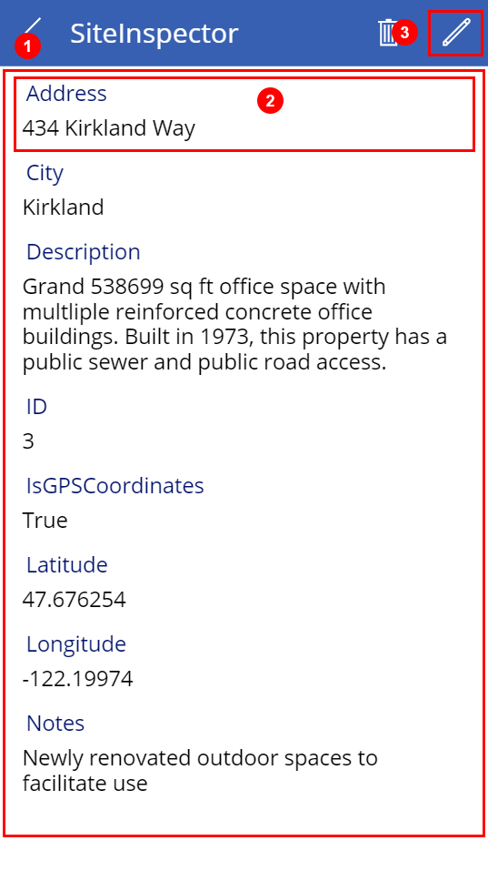
Explora la pantalla de detalles
La pantalla de detalles es nombrada DetailScreen1 por defecto.
Notes:
The details screen is named DetailScreen1 by default. Some of its controls are as follows:
DetailForm1 - This control contains other controls and contains a data card for each column of the row that is being displayed.
Address_DataCard1 - This is a card control. Each card represents a single column of the row. In this case, it shows the Address from the Site Inspector table, as shown in the previous unit.
IconEdit1 - When this control is selected, it opens the edit/create screen so that the user can edit the current item.
[!div class="mx-imgBorder"] Details screen with highlighted controls
[!div class="mx-imgBorder"] Details screen with highlighted controls

Slide 26
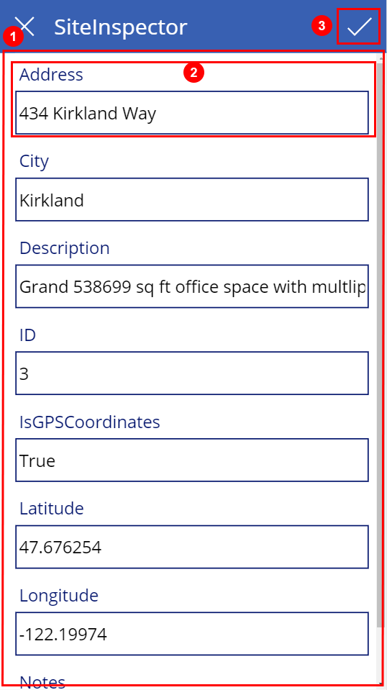
Explora la pantalla de editar/crear
La tercera pantalla de la aplicación es EditScreen1.
Notes:
The third screen in the app is EditScreen1. Some of its controls include:
EditForm1 - This control contains other controls and contains a data card for each column of the row that is being edited.
Address_DataCard2 - This is a card control that shows the address from the Site Inspector table, as shown in the previous unit.
IconAccept1 - When this control is selected, it saves the user's changes.
[!div class="mx-imgBorder"] Edit screen with highlighted controls
[!div class="mx-imgBorder"] Edit screen with highlighted controls

Slide 27
Personaliza la aplicación
Las pantallas predeterminadas hacen que una aplicación sea rápida de configurar y/o implementar, que podrás personalizar con base en tus necesidades.
Notes:
While the default screens make a useful app out of the box, you'll often want to customize a generated app to suit your needs.
The following sections cover basic changes for each screen in the app. You can do a lot more to customize an app, but the best way to start learning is to take a generated app and make common customizations. This will allow you to become familiar with the controls, layouts, and functions.

Slide 28
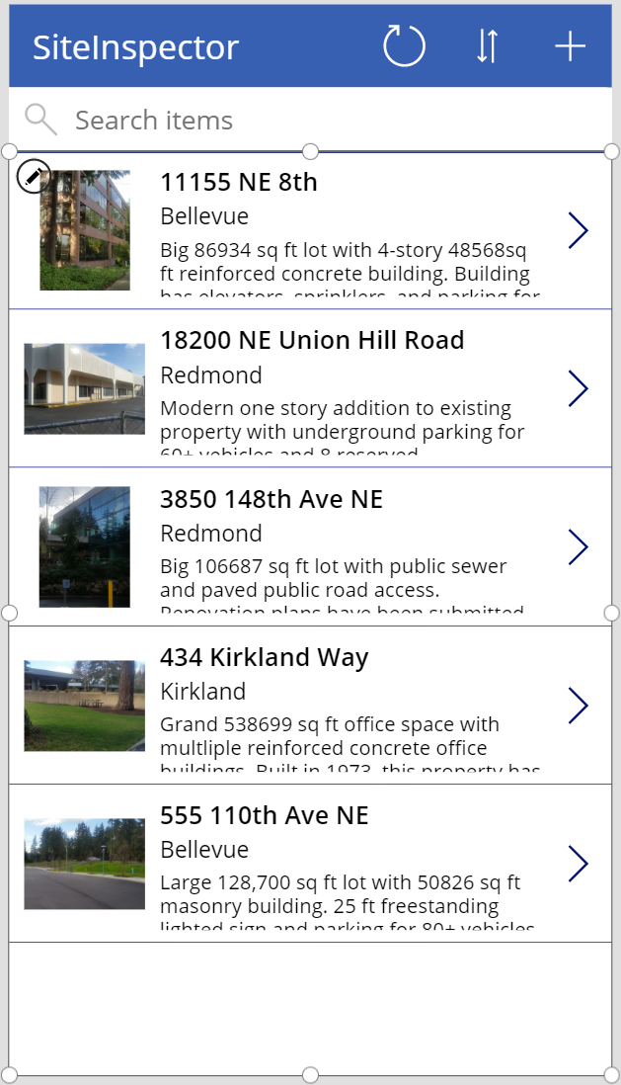
Navegación de las pantallas
La aplicación de Contoso Site Tracking ya muestra una imagen y algo de texto para cada producto, pero el diseño podría ser mejor.
Notes:
The Contoso Site Tracking app already shows an image and some text for each product, but the layout could be better. To improve the layout, use the following procedure:
On the Screens pane on the left, select BrowseGallery1. The selection box around the gallery confirms your choice.
[!div class="mx-imgBorder"] Browse screen
On the right pane, open the Data pane by selecting the drop-down menu next to Layout.
[!div class="mx-imgBorder"] Layout templates
Select the layout Image, title, and subtitle for a cleaner look.
Select the Address of the item at the top of the gallery.
[!div class="mx-imgBorder"] Text edit view
Change ThisItem.Address to ThisItem.Title in the formula bar.
Repeat the previous two steps, but change the other Label control to show the description of each item by setting it to ThisItem.Description.
[!div class="mx-imgBorder"] Text edit confirmed preview
[!div class="mx-imgBorder"] Browse screen
[!div class="mx-imgBorder"] Layout templates
[!div class="mx-imgBorder"] Text edit view
[!div class="mx-imgBorder"] Text edit confirmed preview
Changing the layout of a gallery and the types of data that it shows is that simple, and you might find that it's fun, too.

Slide 29
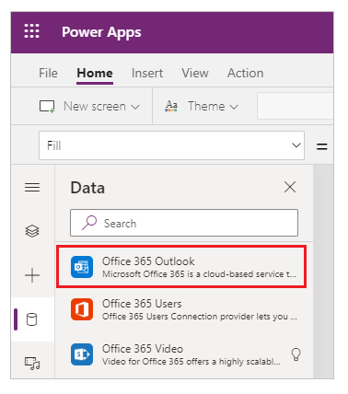
Agrega una fuente de datos adicional
En ocasiones, al crear una aplicación de lienzo, necesitarás combinar de datos de múltiples fuentes.
Notes:
Sometimes when creating a canvas app, you need to combine data from multiple data sources. This will all be determined by your needs and what you hope to accomplish with your canvas app.
Follow these steps to add Office 365 Outlook as an additional data source. This is just one of the many sources you can use to expand your canvas app's data.
Select View > Data sources to open the Data pane.
Select Add Data.
In the search bar, type or paste the first few letters of Office 365 Outlook:
Select Connect, and if prompted to sign in, enter your work account.
The Office 365 Outlook connection has been created and added to your app. Now, it is ready to be used.
See this documentation for the types of commands you can do with the Office 365 Outlook connector: https://docs.microsoft.com/connectors/office365/

Slide 30
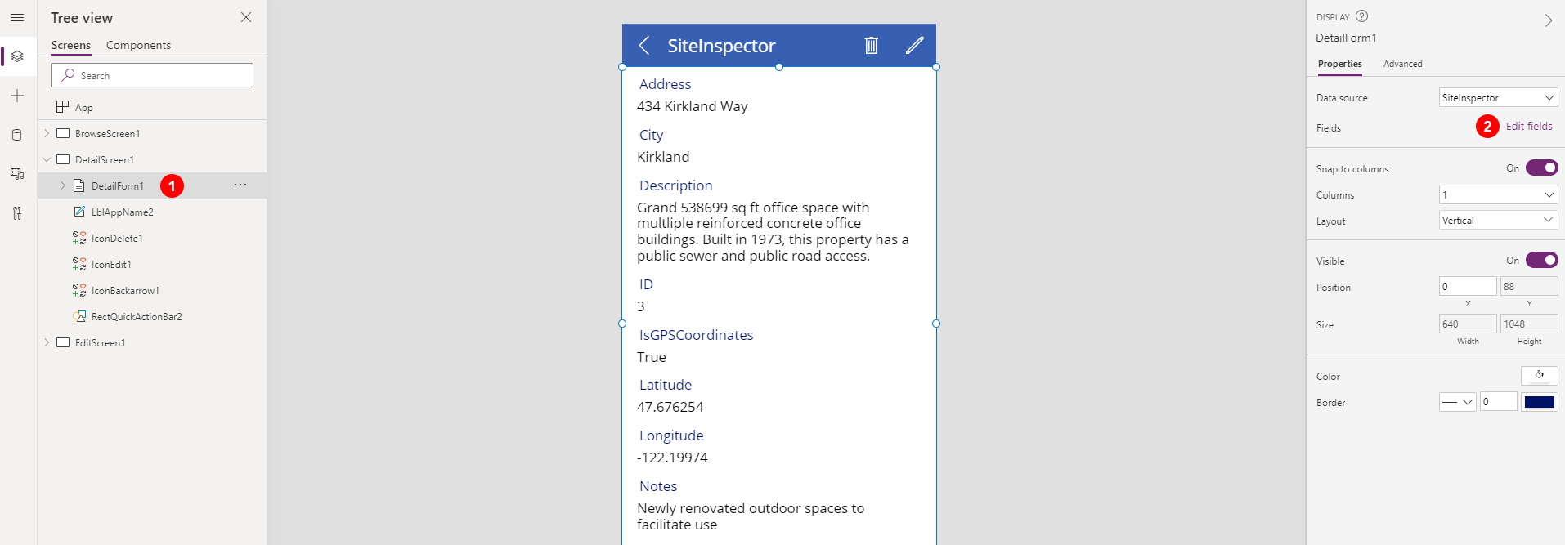
Pantalla de detalles
En la pantalla de detalles, podrás cambiar el orden de cada campo.
Notes:
On the details screen, you want to change the order of the fields. The controls on this screen differ from the controls on the browse screen, so the process for changing them is also slightly different.
On the Tree view on the left, select DetailScreen1 > DetailForm1. This will change the screen shown in the studio.
On the right pane, select Edit fields.
[!div class="mx-imgBorder"] Detail edit form
Click the + Add field button at the top of the Fields section.
Here you can add any of the data source fields that were not added by default. Check the box next to Title and SubTitle and click Add.
Now you can rearrange the order by clicking and holding on Title and then dragging it to the top of the screen.
You can also remove fields that you don't want to display to the users like the ID column. From the list of Fields click ID to expand it, click the ?, and choose X Remove.
[!div class="mx-imgBorder"] field edit form view
[!div class="mx-imgBorder"] Detail edit form
[!div class="mx-imgBorder"] field edit form view

Slide 31
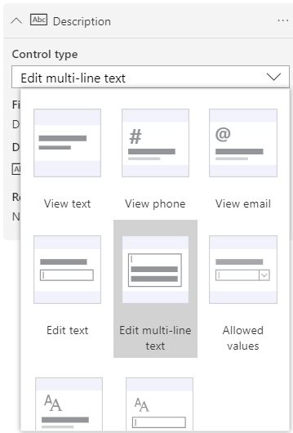
Pantalla editar/crear
En la pantalla en donde los usuarios editan y crean entradas, podrás facilitarles el ingresar información en una caja de texto.
Notes:
On the screen where your users edit and create entries, you want to make it easier for them to enter information in a text box.
On the Tree view on the left, select EditScreen1 > EditForm1.
On the right pane, select Edit fields.
Expand Description. Select the drop-down arrow for the Control type and then select Edit multi-line text.
[!div class="mx-imgBorder"] Control text edit options
A multi-line edit control will simplify your user's ability to add more than a few words in this field. You could also reorder the fields to match the order from the Details screen to give the user a more consistent experience.
[!div class="mx-imgBorder"] Control text edit options
A few basic steps can greatly improve the appearance and experience of using an app, and Power Apps Studio provides many options for customizing those apps.

Slide 32
Controles en Power Apps
Un control es un elemento de interfaz de usuario que produce una acción o muestra información.
Galerías – Estos controles son contenedores de diseño que sostienen un conjunto de controles que muestran filas de una fuente de datos.
Formularios – Estos controles muestran detalles sobre tus datos y te permiten crear y editar registros.
Medios – Estos controles te permiten agregar imágenes de fondo, incluyendo un botón de cámara (así los usuarios podrán tomar fotos desde la aplicación), un lector de código de barras para capturar rápidamente información y mucho más.
Gráficos – Estos controles te permiten agregar tablas, así los usuarios pueden implementar análisis instantáneos mientras van en camino.
Notes:
A control is a UI element that produces an action or shows information. Many controls in Power Apps are similar to controls that you've used in other apps: labels, text-input boxes, drop-down lists, navigation elements, and so on.
In addition to these typical controls, Power Apps has more specialized controls, which you can find on the Insert tab.
[!div class="mx-imgBorder"] Control type list
A few controls that can add interest and impact to your apps include:
Galleries - These controls are layout containers that hold a set of controls that show rows from a data source.
Forms - These controls show details about your data and let you create and edit records.
Media - These controls let you add background images, include a camera button (so that users can take pictures from the app), a barcode reader for quickly capturing identification information, and more.
Charts - These controls let you add charts so that users can perform instant analysis while they're on the road.
To see what controls are available, select the Insert tab, and then select each option in turn.

Slide 33
Conoce las funciones en Power Apps

Slide 34
Funciones en Power Apps
Al usar Microsoft Power Apps, no necesitas escribir código complejo como tradicionalmente lo hace un desarrollador.
Filtro – Esta función se usa normalmente con galerías o tablas de datos para reducir las filas retornadas de tu fuente de datos. Esto lo logras especificando una o más columnas en tu set de datos para implementar una evaluación lógica, la cual te permitirá regresar datos que caen en un cierto rango de fechas, tienen un valor establecido o fueron creados por el usuario, por ejemplo.
Coincidir – Esta función te permite evaluar un valor para ver si sigue un patrón dado. Puedes usar esto para evaluar si el usuario ingresó un formato adecuado de cuentas de correo y, en caso de no hacerlo, mostrarle una advertencia de que se requiere un formato de email válido. Esta función es adecuada para el formato condicional.
Distinguir – Esta función te permite retornar los valores únicos de una lista de datos, facilitando construir listas desplegables que muestren a los usuarios únicamente los valores válidos de una columna dada.
Funciones matemáticas - Power Apps incluye un rango de funciones matemáticas para trabajar con tus datos desde algo tan sencillo como una Suma o Promedio a algo más complejo como el ArcoTangente o Seno para trabajar con radianes.
Notes:
When using Microsoft Power Apps, you don't have to write complicated application code the way that a traditional developer does. However, you must express logic in an app and control its navigation, filtering, sorting, and other functionality. This is where formulas come in.
If you've used Microsoft Excel functions, you'll be comfortable building apps in Power Apps. To create a formula, you will combine one or more formulas with the required and optional parameters. Here are some common functions and an explanation of what they do:
Filter - This function is often used with galleries or tables of data to narrow down the rows returned from your data source. You do this by specifying one or more columns in your data set to perform a logic test on, which will allow you to return data that falls in a certain date range, has a set value, or was created by the user for example.
Match - This function allows you to check a value to see if it follows a given pattern. You can use this to check if the user entered a properly formatted email address and, if they did not, show them a warning that a valid email is required. This function serves well for conditional formatting.
Distinct - This function allows you to return the unique values from a list of data, making it easier to build dynamic dropdowns that show users only the valid values for the given column.
Math functions - Power Apps includes a range of math formulas for working with your data from the simple such as Sum or Average to the complex such as Atan and Sin to work with radians.
This is a small sampling of the large library of Power Apps functions that are available. Also, remember you can combine functions into one formula to solve complex problems. This is the power of the platform. You start with simple formulas and then as your comfort grows you learn to combine them.
For a complete list of all of the functions available in Power Apps, check out the documentation here. To learn more about using formulas, check out the Microsoft Learning Path - [Use basic formulas to make better Power Apps canvas apps.

Slide 35
Comparte una aplicación

Slide 36
Comparte una aplicación
Ahora que has creado tu aplicación, puedes compartirla con usuarios o grupos específicos o la organización entera.
Notes:
Now that you've created an app, you can share it with specific users, groups, or your whole organization. When you share an app with other people, they can run it in a browser, or in the players for Apple iOS and Google Android.
Even better, you can give someone permission to update the app.
Sharing your app is your final step as an app creator. You will want to share the app to test the full functionality with some stakeholders. This will give them a chance to provide feedback and help you become a better app creator.

Slide 37
Preparate para compartir la aplicación
Para completar los siguientes pasos, abre la aplicación que deseas compartir en modo Edición.
En Power Apps Studio, selecciona el menú Archivo y selecciona Guardar como, luego selecciona La nube.
Clic en Guardar en la esquina superior derecha.
Una vez guardada exitosamente la aplicación, clic en Compartir.
En la sección de Compartir, especifica los usuarios o grupos con quienes deseas compartir la aplicación. Para agregar a todos en tu organización, escribe Todos y selecciona Todos en Nombre de la Compañía. Si necesitas compartir con un grupo mayor de usuarios, una buena práctica es hacerlo desde Azure Active Directory Grupo de Seguridad.
Por defecto, los usuarios reciben el permiso de Usuario. Si deseas que el usuario sea capaz de editar la aplicación, selecciona la casilla de co-propietario. Lo siguiente es una descripción de ambos permisos:
Co-propietario – Los usuarios pueden usar, editar, y compartir la aplicación, pero no pueden eliminar o cambiar al propietario.
Usuario – Los Usuarios pueden ver y usar la aplicación, pero no pueden cambiarla.
Notes:
To complete the following steps, open the app that you want to share in Edit mode.
In Power Apps Studio, select the File menu and then select Save as and then select The cloud.
Click Save in the bottom right corner.
After the app is successfully saved click Share.
On the Share tab, specify the users or groups with whom you want to share the app. To add everyone in your organization, type Everyone and select Everyone in Company Name. If you need to share with a large group of users, a best practice is to share through an Azure Active Directory Security Group.
By default, the user receives the User permission. If you want the user to also be able to edit the app, then select the co-owner check box. The following is a description of both permissions:
Co-owner - Users can use, edit, and share the app, but can't delete or change the owner.
User - Users can view and use the app, but they can't change it.
Consider security groups.
If you share an app with a security group, existing members of that group and anyone who joins it will have the permission that you specify for that group. Anyone who leaves the group loses that permission unless they belong to a different group that has access or if you give them permission as an individual.
Every member of a security group has the same permission for an app as the overall group does. However, you can specify greater permissions for one or more members of that group to allow them greater access. For example, you can give Security Group A permission to run an app, but you can also give User B, who belongs to that group, Co-owner permission. Every member of the security group can run the app, but only User B can edit it. If you give Security Group A Co-owner permission and User B permission to run the app, User B can still edit the app.
To notify users by email, leave the Send an email invitation to new users check box selected.
If you select to notify the users by email, everyone you shared the app with will receive an email message that has a link to the app. People whom you granted Co-owner permission for the app will also receive a link to Edit App in Power Apps Studio.
Click Share.
If you make and save changes to a shared app, the people whom you shared it with will see your changes as soon as you publish them. This can be useful if you improve the app, but it can also negatively affect users if you remove or significantly change features. Remember to create a notification plan for alerting your users of major updates.

Slide 38
Preparate para compartir la aplicación
Considera los grupos de seguridad.
Si compartes una aplicación con un grupo de seguridad, los miembros existentes de ese grupo y cualquiera que sea una, tendrán el permiso que especifiques para ese grupo. Aquél que deje el grupo, perderá ese permiso a menos que pertenezca a un grupo diferente que tenga acceso si tú has dado permiso como individual.
Cada miembro de un grupo de seguridad tiene el mismo permiso para la aplicación, así como el grupo entero lo tiene. Sin embargo, puedes especificar mayores permisos para uno o más miembros de un grupo para permitirles mayor acceso. Para notificar a los miembros por email, deja la casilla Enviar una invitación por email a nuevos usuarios seleccionada.
Si seleccionas notificar a los usuarios por email, todos con quienes compartiste la aplicación recibirán un correo que contiene un enlace a la aplicación. Las personas a quienes concedas permiso de Co-propietario para la aplicación, también recibirán un enlace para editarla en Power Apps Studio.
Clic en Compartir.
Si haces cambios a una aplicación compartida y los guardas, las personas con quienes la compartiste verán reflejados los cambios de inmediato. Esto puede ser útil si mejoras la aplicación, pero puede afectar negativamente si se remueven o se cambian significativamente algunas características. Recuerda crear un plan de notificación para alertar a tus usuarios respecto a actualizaciones.
Notes:
To complete the following steps, open the app that you want to share in Edit mode.
In Power Apps Studio, select the File menu and then select Save as and then select The cloud.
Click Save in the bottom right corner.
After the app is successfully saved click Share.
On the Share tab, specify the users or groups with whom you want to share the app. To add everyone in your organization, type Everyone and select Everyone in Company Name. If you need to share with a large group of users, a best practice is to share through an Azure Active Directory Security Group.
By default, the user receives the User permission. If you want the user to also be able to edit the app, then select the co-owner check box. The following is a description of both permissions:
Co-owner - Users can use, edit, and share the app, but can't delete or change the owner.
User - Users can view and use the app, but they can't change it.
Consider security groups.
If you share an app with a security group, existing members of that group and anyone who joins it will have the permission that you specify for that group. Anyone who leaves the group loses that permission unless they belong to a different group that has access or if you give them permission as an individual.
Every member of a security group has the same permission for an app as the overall group does. However, you can specify greater permissions for one or more members of that group to allow them greater access. For example, you can give Security Group A permission to run an app, but you can also give User B, who belongs to that group, Co-owner permission. Every member of the security group can run the app, but only User B can edit it. If you give Security Group A Co-owner permission and User B permission to run the app, User B can still edit the app.
To notify users by email, leave the Send an email invitation to new users check box selected.
If you select to notify the users by email, everyone you shared the app with will receive an email message that has a link to the app. People whom you granted Co-owner permission for the app will also receive a link to Edit App in Power Apps Studio.
Click Share.
If you make and save changes to a shared app, the people whom you shared it with will see your changes as soon as you publish them. This can be useful if you improve the app, but it can also negatively affect users if you remove or significantly change features. Remember to create a notification plan for alerting your users of major updates.

Slide 39
Permisos y licenciamiento
Hay algo de información básica respecto a los permisos y licenciamiento a considerar:
Usuarios y contribuidores necesitan permisos para cualquier conexión a datos y puertas de enlace que una aplicación compartida utiliza.
Algunos permisos vienen implícitos con la aplicación, pero deberás explícitamente otorgar otros.
Si creas una aplicación basada en Microsoft Dataverse, deberás asegurarte de que los usuarios con quienes compartiste la aplicación tengan los permisos apropiados para la tabla o tablas en las que se basa la aplicación. Específicamente, aquellos usuarios que pertenezcan a un rol de seguridad pueden implementar tareas como crear, leer, escribir y eliminar filas relevantes.
En muchos casos, crearás uno o más roles de seguridad personalizados con los permisos necesarios para que los usuarios corran la aplicación. Así podrás asignar un rol para cada usuario que sea apropiado.
Notes:
There is some basic information about permissions and licensing of which you should be aware:
Users and contributors need permissions to any data connections and gateways that a shared app uses.
Some permissions come implicitly with the app, but you must explicitly grant others.
If you create an app based on Microsoft Dataverse, you must also ensure that the users with whom you share the app have the appropriate permissions for the table or tables on which the app relies. Specifically, those users must belong to a security role that can perform tasks such as creating, reading, writing, and deleting relevant rows.
In many cases, you'll want to create one or more custom security roles with the exact permissions that users need to run the app. You can then assign a role to each user as appropriate.
Sharing an app is simple, and it's a great way to make an app that you find useful available to people across your organization.

Slide 40
Comprobación de conocimientos

Slide 41
Pregunta 1
Tu equipo de ventas necesita urgentemente una aplicación móvil que muestre las filas de una lista en SharePoint. Cuando se muestran los registros, múltiples piezas de información de cada registro necesitan ser visibles para el usuario. ¿Cuál de las siguientes herramientas de Power Apps usarías al diseñar tu aplicación para lograr esta funcionalidad?
Crear una galería que muestre las filas de las ventas.
Crear un formulario que muestre las filas de las ventas.
Crear un control de entrada que muestre las filas de las ventas.
Notes:
Explanation: Correct. Galleries are used to display tables of data from your data source. They are highly customizable, so you can show whatever information about a particular row that is necessary. You could then use a Form to edit individual records, if desired.

Slide 42
Pregunta 1
Tu equipo de ventas necesita urgentemente una aplicación móvil que muestre las filas de una lista en SharePoint. Cuando se muestran los registros, múltiples piezas de información de cada registro necesitan ser visibles para el usuario. ¿Cuál de las siguientes herramientas de Power Apps usarías al diseñar tu aplicación para lograr esta funcionalidad?
Crear una galería que muestre las filas de las ventas.
Crear un formulario que muestre las filas de las ventas.
Crear un control de entrada que muestre las filas de las ventas.
Notes:
Explanation: Correct. Galleries are used to display tables of data from your data source. They are highly customizable, so you can show whatever information about a particular row that is necessary. You could then use a Form to edit individual records, if desired.

Slide 43
Pregunta 2
Se te ha asignado la tarea de crear una Power App que pueda escanear códigos de barra que mostrarán en pantalla la información de los artículos escaneados. ¿De las siguientes opciones de control cuál de ellas podría incluir un escáner de código de barras?
Galerías
Medios
Formularios
Notes:
Explanation: Correct. The barcode scanner control is a part of the Media category of controls. This control can be used to scan barcodes of various types and pass information about the barcode to the Power App. Then, additional Functions can use that barcode information to perform additional tasks.

Slide 44
Pregunta 2
Se te ha asignado la tarea de crear una Power App que pueda escanear códigos de barra que mostrarán en pantalla la información de los artículos escaneados. ¿De las siguientes opciones de control cuál de ellas podría incluir un escáner de código de barras?
Galerías
Medios
Formularios
Notes:
Explanation: Correct. The barcode scanner control is a part of the Media category of controls. This control can be used to scan barcodes of various types and pass information about the barcode to the Power App. Then, additional Functions can use that barcode information to perform additional tasks.

Slide 45
Pregunta 3
Tienes un control de galería en tu aplicación para mostrar todas las órdenes de los clientes. Tu gerente dice que a ella también le gustaría ver las órdenes de los últimos 90 días. ¿Cómo podrías reducir la cantidad de datos que ella ve?
Modificarías la fuente de datos para filtrar todas las órdenes anteriores a 90 días
Usarías el asistente de filtrado de datos.
Crearias una fórmula para tu galería que use la función Filtrar.
Notes:
Explanation: Correct. The Filter function allows you to apply logic tests to one or more columns in your data source. For this scenario you could filter out data where the Order Date is less than 90 days ago.

Slide 46
Pregunta 3
Tienes un control de galería en tu aplicación para mostrar todas las órdenes de los clientes. Tu gerente dice que a ella también le gustaría ver las órdenes de los últimos 90 días. ¿Cómo podrías reducir la cantidad de datos que ella ve?
Modificarías la fuente de datos para filtrar todas las órdenes anteriores a 90 días
Usarías el asistente de filtrado de datos.
Crearías una fórmula para tu galería que use la función Filtrar.
Notes:
Explanation: Correct. The Filter function allows you to apply logic tests to one or more columns in your data source. For this scenario you could filter out data where the Order Date is less than 90 days ago.

Slide 47
Resumen y recursos

Slide 48
Resumen y recursos
Power Apps te permite construir aplicaciones personalizables para crear poderosas soluciones que tengan el potencial para incrementar la eficiencia en los procesos en las áreas de comunicación y datos.
Entender los elementos básicos de Power Apps
Construir una aplicación de lienzo
Personalizar los elementos de tu aplicación
Compartir la aplicación que has creado
Notes:
Power Apps allows you to build custom business apps to make powerful new solutions with the potential to increase process efficiency in the areas of communication and data. Now that you have built your first app, consider areas that could benefit from custom solutions at your business. Start by thinking of processes that frustrate you and consider how you can leverage Power Apps to improve them for everyone.
Now that you have reviewed this module, you should be able to:
Understand basic elements of Power Apps
Build a canvas app
Customize elements of your app
Share the app you have created

Slide 49
Elementos clave
Aquí tienes 3 elementos clave:
1. Power Apps puede referenciar elementos dentro de la aplicación para crear soluciones dinámicas y una interfaz amigable.
2. Con las interminables opciones de configuración, Power Apps puede usarse para mejorar cualquier proceso de negocio.
3. Crear y administrar aplicaciones es sencillo de aprender, incluso para quienes no tienen ninguna base de programación de computadoras.
Notes:
[Table was here]

Slide 50
Power Apps
Power Apps
Power Apps
Recursos de Power Apps
Notes:
Power Apps
Power Apps Resources

Slide 51
Aprendizaje Adicional
Navegación en una aplicación de lienzo en Power Apps
Personalización de una aplicación de lienzo en Power Apps
Administración de aplicaciones en Power Apps
Por favor, compártenos si te gustó este taller completando la siguiente encuesta:
https://aka.ms/workshopomatic-feedback
Notes:
Navigation in a canvas app in Power Apps
Customize a canvas app in Power Apps
Manage apps in Power Apps

