Slide 2
Create serverless logic with Azure Functions
Speaker Name
Title
Speaker Name
Title
Notes:
Link to published module on Learn: https://docs.microsoft.com/en-us/learn/modules/learn-pr/azure/create-serverless-logic-with-azure-functions/

Slide 3
Prerequisites
A Microsoft account
Notes:
You’ll need a Microsoft account to activate the Azure sandbox environments inside of Microsoft Learn

Slide 4
Learning objectives
Decide if serverless computing is right for your project
Create an Azure Function app in the Azure portal
Execute a function using triggers
Monitor and test your Azure Function from the Azure portal

Slide 5
Agenda
Introduction
Decide if serverless computing is right for your business needs
Exercise - Create a function app in the Azure portal
Run your code on-demand with Azure Functions
Exercise - Add logic to the function app
Summary & knowledge check

Slide 6
Introduction

Slide 7
Introduction
Imagine you’re working on an IoT project where you want to figure out how many people sit at each table in your school's cafeteria.
Notes:
You want to use infrared sensors at each table that provide you with data from all of the locations, and you want to develop a reusable service that can process the data from all of the different sources. With *serverless computing*, you can use a cloud provider, like Azure, to manage the infrastructure of your project.
Azure Functions is a key component of the serverless computing offering from Azure that enables you to run pieces of code, or *functions*, written in the programming language of your choice, in the cloud.

Slide 8
Decide if serverless computing is right for your project

Slide 9
What is serverless compute?
Serverless compute can be thought of as a function as a service (FaaS), or a microservice that is hosted on a cloud platform.
Notes:
Serverless compute can be thought of as a function as a service (FaaS), or a microservice that is hosted on a cloud platform. Your business logic runs as functions and you don't have to manually create or scale infrastructure. The cloud provider manages infrastructure. Your app is automatically scaled out or down depending on load. Azure has several ways to build this sort of architecture. The two most common approaches are Azure Logic Apps and Azure Functions, which we'll focus on in this module.

Slide 10
What is Azure Functions?
Azure Functions is a serverless application platform.
Notes:
Azure Functions is a serverless application platform. It enables developers to host business logic that can be executed without provisioning infrastructure. Functions provides intrinsic scalability and you are charged only for the resources used. You can write your function code in the language of your choice, including C#, F#, JavaScript, Python, and PowerShell Core. Support for package managers like NuGet and NPM is also included, so you can use popular libraries in your business logic.

Slide 11
Benefits of a serverless compute solution
Serverless compute is a great option for hosting business logic code in the cloud.
Notes:
Serverless compute is a great option for hosting business logic code in the cloud. With serverless offerings such as Azure Functions, you can write your business logic in the language of your choice. You get automatic scaling, you have no servers to manage, and you are charged based on what is used - not on reserved time. Let’s walk through some of the advantages, and the drawbacks.

Slide 12
Avoids over-allocation of infrastructure
Suppose you've provisioned virtual machine (VM) servers and configured them with enough resources to handle your peak load times.
Notes:
Suppose you've provisioned virtual machine (VM) servers and configured them with enough resources to handle your peak load times. When the load is light, you are potentially paying for infrastructure you're not using. Serverless computing helps solve the allocation problem by scaling up or down automatically, and you're only billed when your function is processing work.

Slide 13
Stateless logic
Stateless functions are great candidates for serverless compute; function instances are created and destroyed on demand.
Notes:
Stateless functions are great candidates for serverless compute; function instances are created and destroyed on demand. If state is required, it can be stored in an associated storage service.

Slide 14
Event driven
Functions are event driven.
Notes:
Functions are event driven. This means they run only in response to an event (called a "trigger"), such as receiving an HTTP request, or a message being added to a queue. You configure a trigger as part of the function definition. This approach simplifies your code by allowing you to declare where the data comes from (trigger/input binding) and where it goes (output binding). You don't need to write code to watch queues, blobs, hubs, and so on. You can focus purely on the business logic.

Slide 15
Functions can be used in traditional compute environments
Functions are a key component of serverless computing, but they are also a general compute platform for executing any type of code.
Notes:
Functions are a key component of serverless computing, but they are also a general compute platform for executing any type of code. Should the needs of your app change, you can take your project and deploy it in a non-serverless environment, which gives you the flexibility to manage scaling, run on virtual networks, and even completely isolate your functions.

Slide 16
Drawbacks of a serverless compute solution
Serverless compute will not always be the appropriate solution to hosting your business logic.
Notes:
Serverless compute will not always be the appropriate solution to hosting your business logic. Here are a few characteristics of functions that may affect your decision to host your services in serverless compute.

Slide 17
Execution time
By default, functions have a timeout of five (5) minutes.
Notes:
By default, functions have a timeout of five (5) minutes. This timeout is configurable to a maximum of 10 minutes. If your function requires more than 10 minutes to execute, you can host it on a VM. Additionally, if your service is initiated through an HTTP request and you expect that value as an HTTP response, the timeout is further restricted to 2.5 minutes. Finally, there's also an option called Durable Functions that enables you to orchestrate the executions of multiple functions without any timeout.

Slide 18
Execution frequency
The second characteristic is execution frequency.
Notes:
The second characteristic is execution frequency. If you expect your function to be executed continuously by multiple clients, it would be prudent to estimate the usage and calculate the cost of using functions accordingly. It might be cheaper to host your service on a VM.
While scaling, only one function app instance can be created every 10 seconds, for up to 200 total instances. Keep in mind, each instance can service multiple concurrent executions, so there is no set limit about how much traffic a single instance can handle. Different types of triggers have different scaling requirements, so research your choice of trigger and investigate its limits.

Slide 19
Exercise
Create a function app in the Azure portal
Notes:
Link to published module on Learn: https://docs.microsoft.com/en-us/learn/modules/learn-pr/azure/create-serverless-logic-with-azure-functions/3-create-an-azure-functions-app-in-the-azure-portal

Slide 20
Create a function app in the Azure portal
You are now ready to start implementing the temperature service.
What is a function app?
Choose a service plan
Storage account requirements
Create a function app
Verify your Azure function app
Notes:
https://docs.microsoft.com/en-us/learn/modules/learn-pr/azure/create-serverless-logic-with-azure-functions/3-create-an-azure-functions-app-in-the-azure-portal
For the purposes of this workshop, we will work with an example that checks for safe temperature levels.

Slide 21
Run your code on-demand with Azure Functions

Slide 22
Run your code on-demand with Azure Functions
Now that we have created a function app, let's look at how to build, configure, and execute a function.
JSON
{ "bindings": [ { "name": "order", "type": "queueTrigger", "direction": "in", "queueName": "myqueue-items", "connection": "MY_STORAGE_ACCT_APP_SETTING" }, { "name": "$return", "type": "table", "direction": "out", "tableName": "outTable", "connection": "MY_TABLE_STORAGE_ACCT_APP_SETTING" } ] }
Service | Trigger description
Blob Storage | Starts a function when a new or updated blob is detected.
Azure Cosmos DB | Start a function when inserts and updates are detected.
Event Grid | Starts a function when an event is received from Event Grid.
HTTP | Starts a function with an HTTP request.
Microsoft Graph Events | Starts a function in response to an incoming webhook from the Microsoft Graph. Each instance of this trigger can react to one Microsoft Graph resource type.
Queue Storage | Starts a function when a new item is received on a queue. The queue message is provided as input to the function.
Service Bus | Starts a function in response to messages from a Service Bus queue.
Timer | Starts a function on a schedule.
Notes:
Now that we have created a function app, let's look at how to build, configure, and execute a function.
Functions are event driven, which means they run in response to an event. The type of event that starts a function is called a trigger. Each function must be configured with exactly one trigger.
Azure supports triggers for the following services.
[Table was here]
A binding is a declarative way to connect data and services to your function. Bindings know how to interact with different services, which means you don't have to write code in your function to connect to data sources and manage connections. The platform takes care of that complexity for you as part of the binding code. Each binding has a direction - your code reads data from input bindings, and writes data to output bindings. Each function can have zero or more bindings to manage the input and output data processed by the function.
A trigger is a special type of input binding that has the additional capability of initiating execution.
Azure provides a large number of bindings to connect to different storage and messaging services.
Let's look at an example of configuring a function with an input binding (trigger) and an output binding. Let's say we want to write a new row to Azure Table storage whenever a new message appears in Azure Queue Storage. This scenario can be implemented using an Azure Queue Storage trigger and an Azure Table storage output binding.
The following snippet is the function.json file for this scenario.
{ "bindings": [ { "name": "order", "type": "queueTrigger", "direction": "in", "queueName": "myqueue-items", "connection": "MY_STORAGE_ACCT_APP_SETTING" }, { "name": "$return", "type": "table", "direction": "out", "tableName": "outTable", "connection": "MY_TABLE_STORAGE_ACCT_APP_SETTING" } ] }
Our JSON configuration specifies that our function will be triggered when a message is added to a queue named myqueue-items. The return value of our function is then written to outTable in Azure Table storage. For PowerShell functions, output bindings are explicitly written to with the Push-OutputBinding cmdlet.
This example is a simple illustration of how we configure bindings for a function. We could change the output to be an email using a SendGrid binding, or put an event onto a Service Bus to notify some other component in our architecture, or even have multiple output bindings to push data to various services.
[!TIP] To view and edit the contents of function.json in the Azure portal, from the Home page, select your function app, and in the right pane, select JSON View. The Resource JSON view displays the Resource ID and the editable JSON code. To close the JSON view, select the X in the top right corner of the pane.

Slide 23
Create a function in the Azure portal
Azure provides several predefined function templates for common scenarios:
Quickstart
Custom functions
Notes:
Azure provides several predefined function templates for common scenarios:
Quickstart
Custom functions

Slide 24
Add function templates
When adding your first function, you are presented with the Add function pane in which you can select the trigger for your function.
Notes:
When adding your first function, you are presented with the Add function pane in which you can select the trigger for your function. Based on your selections, Azure will generate the function code and configuration with sample code provided to display the input data received in the log.

Slide 25
Custom function templates
Selecting a template from the Add function pane provides easy access to the most common templates.
Notes:
Selecting a template from the Add function pane provides easy access to the most common templates. Azure provides over 30 additional templates you can start with. These can be selected from the template list when creating subsequent functions.

Slide 26
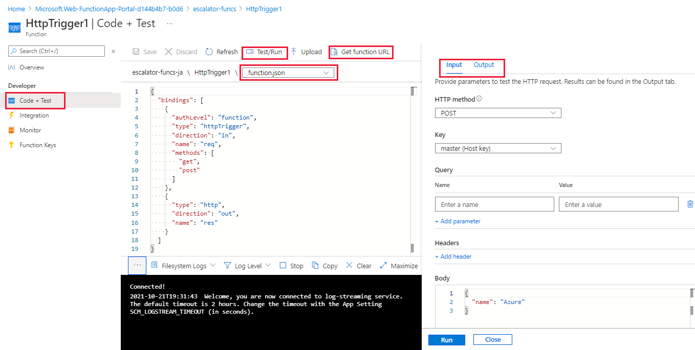
Navigate to your function and files
When you create a function from a template, several files are created.
Notes:
When you create a function from a template, several files are created. For example, if you opted to use the Webhook + API Quickstart using JavaScript, the files generated would be a configuration file, function.json, and a source code file, index.js.
The functions you create in a function app appear by selecting Functions under the Functions category in the left menu pane of your function app.
When you select a function in your function app, your function pane appears. To display and edit your code for your function, in the left menu pane, under Developer, select Code + Test. In the function's path above the code box, select function.json from the dropdown list, and then select Test/Run from the top menu bar for the Input/Output pane to appear. See the following screenshot.
As you can see, the pane on the right has tabs for Input and Output. Selecting the Input tab provides parameters to test the HTTP request for your function.

Slide 27
Test your Azure function
After you've created a function, you'll want to test it.
Running it manually
Testing it from within the Azure portal itself
Notes:
After you've created a function, you'll want to test it. There are two approaches:
Running it manually
Testing it from within the Azure portal itself

Slide 28
Run function manually
You can start a function by manually triggering the configured trigger.
Notes:
You can start a function by manually triggering the configured trigger. For instance, if you are using an HTTP trigger, you can use a tool, such as Postman or cURL, to initiate an HTTP request to your function endpoint URL, which is available from the function definition (Get function URL).

Slide 29
Test in the Azure portal
The portal also provides a convenient way to test your functions.
Notes:
The portal also provides a convenient way to test your functions. As previously described, after selecting Test/Run from the top menu bar, on the right side of the code box, a tabbed Test pane appears. Here, you can provide parameters to test the HTTP request. When you select Run in this pane, the results appear in the Output tab, along with a status code in the Logs pane.

Slide 30
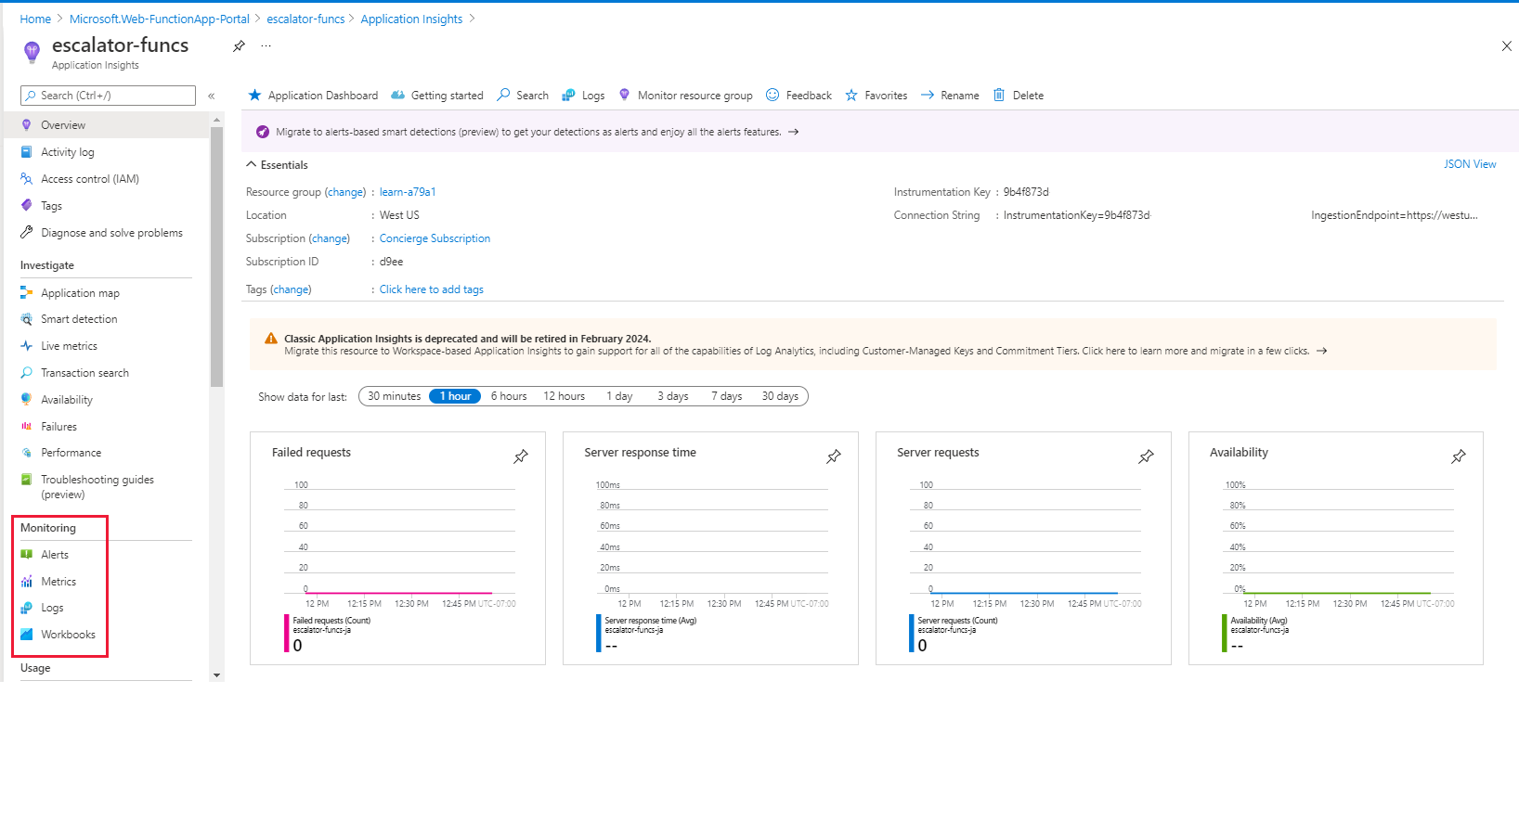
Monitoring and Application Insights dashboard
The ability to monitor your functions is critical during development and in production.
Notes:
The ability to monitor your functions is critical during development and in production. The Azure portal provides a monitoring dashboard, which you turn on by enabling Application Insights integration. In the menu of your function app, under Settings, select Application Insights, select Turn on Application Insights, and then select Apply. In the dialog box, select Yes. The Application Insights dashboard provides a quick way to view the history of function operations by displaying the timestamp, result code, duration, and operation ID populated by Application Insights.

Slide 31
Streaming logs pane
After you've enabled Application Insights in the Azure portal, you're also able to add logging statements to your function for debugging.
JavaScript
C#
context.log('Enter your logging statement here');
log.LogInformation("Enter your logging statement here");
Notes:
After you've enabled Application Insights in the Azure portal, you're also able to add logging statements to your function for debugging. The called methods for each language are passed a "logging" object, which may be used to log information to the Logs pane located at the bottom of the code window in the Code + Test pane after running a test.
The following JavaScript code snippet shows how to log a message using the context.log method (the context object is passed to the handler).
context.log('Enter your logging statement here');
We could do the same thing in C# using the log.LogInformation method. In this case, the log object is passed to the C# method processing the function.
log.LogInformation("Enter your logging statement here");
In PowerShell, use Write-Host to write to the log:
Write-Host "Enter your logging statement here"

Slide 32
Errors and warnings in the logs pane
You can locate the errors and warnings tab in the same menu as the log tab.
Notes:
You can locate the errors and warnings tab in the same menu as the log tab. This tab shows compilation errors and warnings within your code.

Slide 33
Exercise
Add logic to the function app
Notes:
Link to published module on Learn: https://docs.microsoft.com/en-us/learn/modules/learn-pr/azure/create-serverless-logic-with-azure-functions/5-add-logic-to-the-function-app

Slide 34
Add logic to the function app
Let's continue with our gear drive example, and add the logic for the temperature service.
Function requirements
Add a function to our function app
Test the function
Secure HTTP triggers
Add business logic to the function
Test our business logic
Notes:
https://docs.microsoft.com/en-us/learn/modules/learn-pr/azure/create-serverless-logic-with-azure-functions/5-add-logic-to-the-function-app

Slide 35
Summary

Slide 36
Summary
You've learned how to use Azure Functions to host business logic services in the cloud.
Notes:
You've learned how to use Azure Functions to host business logic services in the cloud. It's a great way to add hosted services to your solution that can scale and grow with your business. You focus on the code using the language of your choice, and Azure manages the infrastructure. Functions can integrate with other services, like Event Grid, GitHub, Twilio, Microsoft Graph, and Logic Apps to create complex and robust serverless workflows quickly and easily.

Slide 37
Knowledge check

Slide 38
Question 1
Which of the following best defines serverless logic?
Code you write that doesn't run on servers.
Code you write that runs on servers you manage.
Code you write that runs on servers a cloud provider manages.
Notes:
Explanation: Serverless doesn't mean there are no servers - it just means the developer doesn't have to worry about servers. Instead, a cloud provider such as Azure, manages servers.

Slide 39
Question 1
Which of the following best defines serverless logic?
Code you write that doesn't run on servers.
Code you write that runs on servers you manage.
Code you write that runs on servers a cloud provider manages.
Notes:
Explanation: Serverless doesn't mean there are no servers - it just means the developer doesn't have to worry about servers. Instead, a cloud provider such as Azure, manages servers.

Slide 40
Question 2
The container that groups functions into a logical unit for easier management, deployment, and sharing of resources is called?
Resource group
Function app
Function collection
Notes:
Explanation: A function app is a way to organize and collectively manage your functions. A function app is comprised of one or more individual functions that are managed together by Azure App Service. All the functions in a function app share the same pricing plan, continuous deployment, and runtime version.

Slide 41
Question 2
The container that groups functions into a logical unit for easier management, deployment, and sharing of resources is called?
Resource group
Function app
Function collection
Notes:
Explanation: A function app is a way to organize and collectively manage your functions. A function app is comprised of one or more individual functions that are managed together by Azure App Service. All the functions in a function app share the same pricing plan, continuous deployment, and runtime version.

Slide 42
Question 3
We secured our function against unknown HTTP callers by requiring a function-specific API key be passed with each call. Which of the following fields is the name header in the HTTP requests that needs to contain this key?
x-functions-key
x-requested-with
x-csrf-token
Notes:
Explanation: The API can be included in a query string variable named "code", or it can be included in an x-functions-key HTTP header.

Slide 43
Question 3
We secured our function against unknown HTTP callers by requiring a function-specific API key be passed with each call. Which of the following fields is the name header in the HTTP requests that needs to contain this key?
x-functions-key
x-requested-with
x-csrf-token
Notes:
Explanation: The API can be included in a query string variable named "code", or it can be included in an x-functions-key HTTP header.

Slide 44
Next Steps
Practice your knowledge by trying these Learn modules:
Execute an Azure Function with triggers
Chain Azure Functions together using input and output bindings
Develop, test, and publish Azure Functions by using Azure Functions Core Tools
Please tell us how you liked this workshop by filling out this survey:
https://aka.ms/workshopomatic-feedback

Slide 45
Thank you!

