Slide 2
Introduction to classification models by using R and Tidymodels
Speaker Name
Title
Follow along with this module at https://aka.ms/learn-classification-with-R
Speaker Name
Title
Notes:
Link to published module on Learn: Explore and analyze data with R - Learn | Microsoft Docs

Slide 3
Learning objectives
What is classification
Train and evaluate a binary classification model
Create multiclass classification models

Slide 4
Introduction

Slide 5
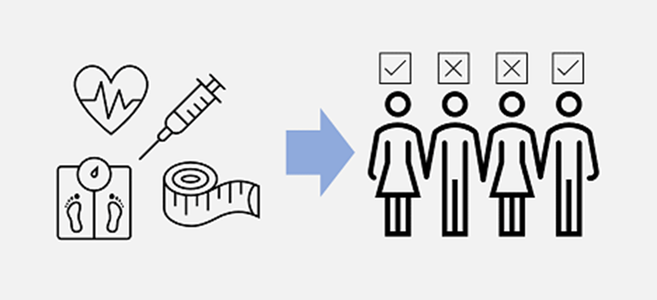
What is classification
Classification is a form of supervised machine learning in which you train a model to predict which category an item belongs to and with which probability, from the features values.
Notes:
Classification is a form of machine learning in which you train a model to predict which category an item belongs to. For example, a health clinic might use diagnostic data such as a patient's height, weight, blood pressure, or blood-glucose level to predict whether the patient is diabetic.
Classification is an example of a supervised machine learning technique, which means that it relies on data that includes known feature values (for example, diagnostic measurements for patients) as well as known label values (for example, a classification of non-diabetic or diabetic). You use a classification algorithm to fit a subset of the data to a function that can calculate the probability for each class label from the feature values. You use the remaining data to evaluate the model by comparing the predictions that it generates from the features to the known class labels.
Categorical data has distinct classes, rather than numeric values. Some kinds of data can be either numeric or categorical. For example, race completion times could be measured in seconds or minutes, or the times could be separated into classes called fast, medium, and slow. Other kinds of data can only be categorical. For example, a shape can be categorized only as, say, circle, triangle, or square.

Slide 6
Train and evaluate a binary classification model

Slide 7
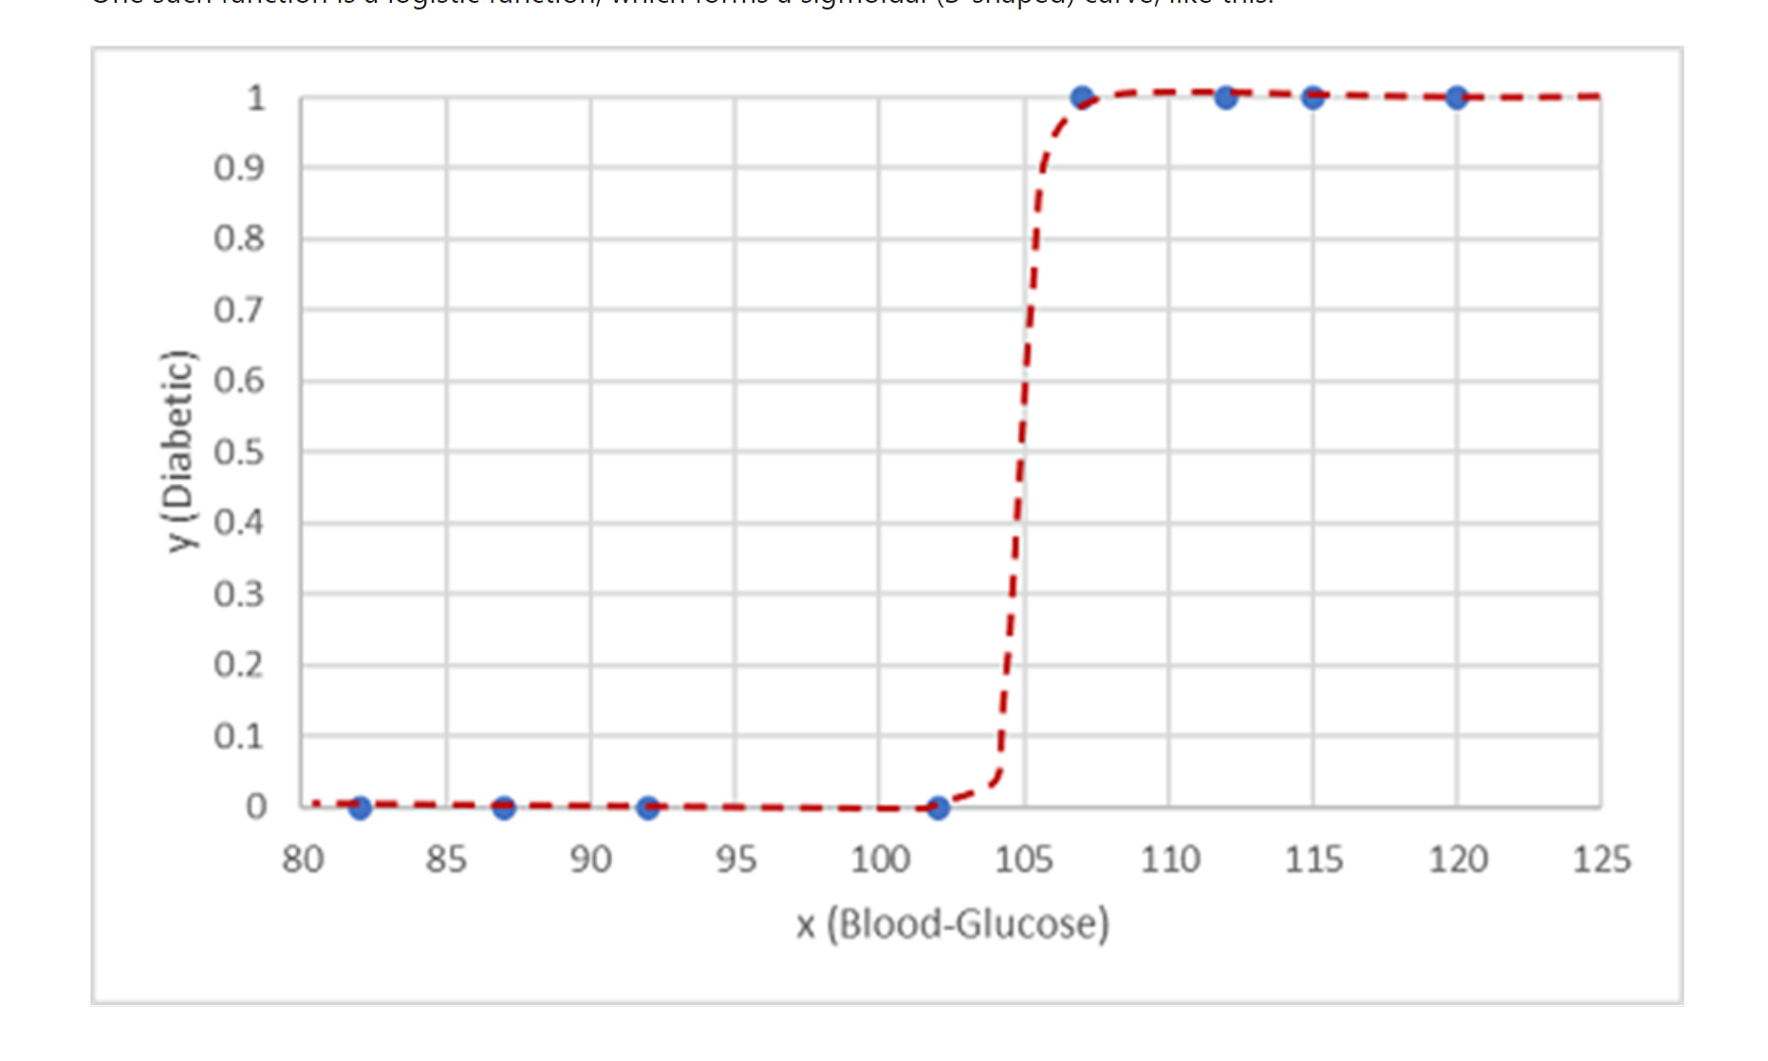
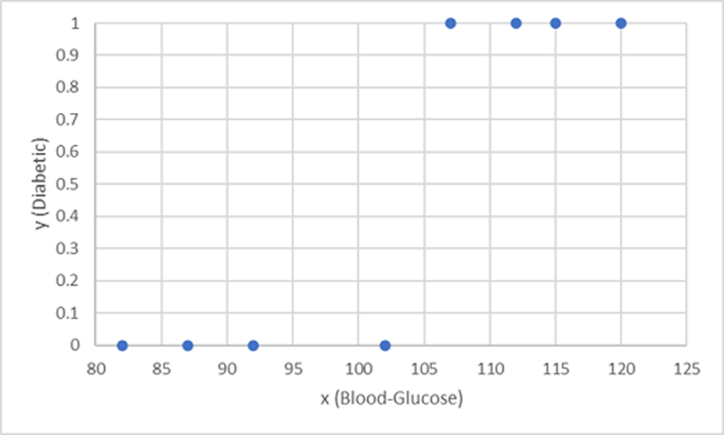
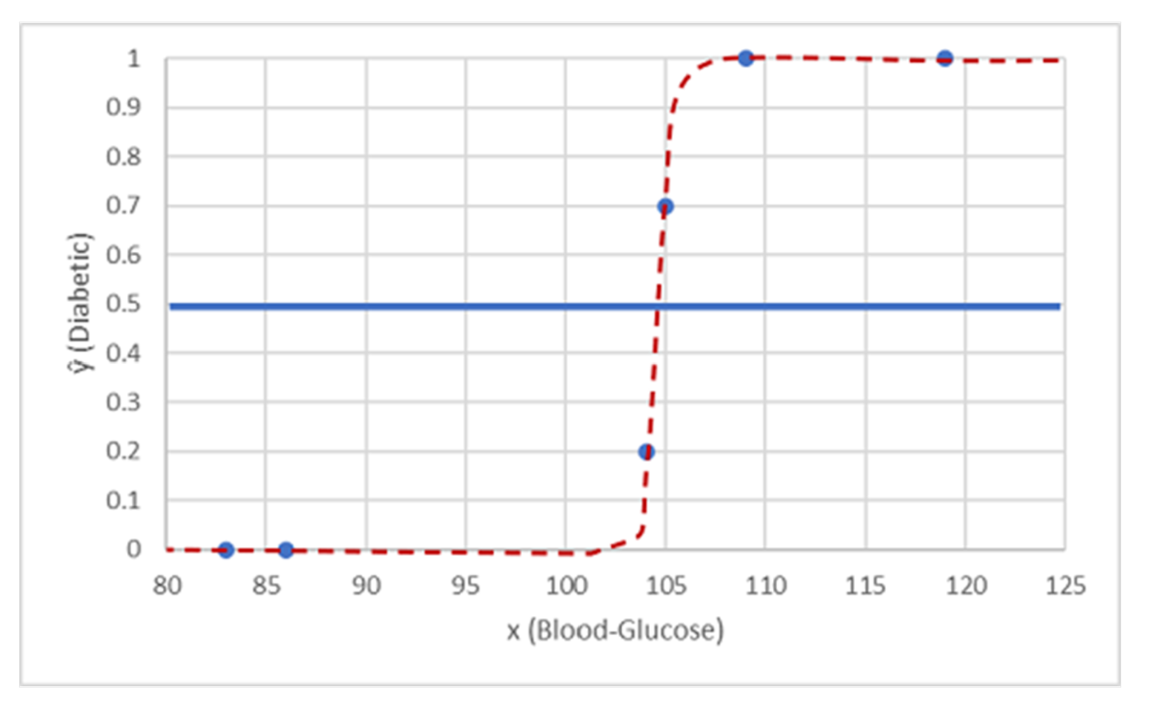
A simple example
Starting with some data that includes known values for the patient’s blood-glucose level feature (x) and the class label (y) (0 for non-diabetic, 1 for diabetic), let’s define a predictive function able to predict the diabetic label (ŷ) given the blood-glucose feature.
Blood-glucose | Diabetic/non-diabetic
82 | 0
92 | 0
112 | 1
102 | 0
115 | 1
107 | 1
87 | 0
120 | 1
83 | 0
119 | 1
104 | 1
105 | 0
86 | 0
109 | 1
Training
0
1
0
1
0
1
Test
ŷ
Notes:
Let's explore a simple example to help explain the key principles. Suppose you have the following patient data, which consists of a single feature (blood-glucose level) and a class label (0 for non-diabetic, 1 for diabetic).
Let's use the first eight observations to train a classification model. Start by plotting the blood-glucose feature (x-axis) and the predicted diabetic label (y-axis).
What you need is a function that calculates a probability value for y based on x. That is, you need the function f(x) = y. You can see from the chart that patients with a low blood-glucose level are all non-diabetic, and patients with a higher blood-glucose level are diabetic.
It seems that the higher the blood-glucose level, the more probable it is that a patient is diabetic, with the inflection point being somewhere between 100 and 110. You need to fit a function that calculates a value between 0 and 1 for y to these values.
One such function is a logistic function, which forms a sigmoidal (S-shaped) curve, like this:
Now you can use the function to calculate a probability value that y is positive, meaning that the patient is diabetic, from any value of x by finding the point on the function line for x. You can set a threshold value of 0.5 as the cutoff point for the class label prediction.
Let's test it with the data values we've held back:
Points plotted below the threshold line yield a predicted class of 0 (non-diabetic), and points above the line are predicted as 1 (diabetic).
Now you can compare the label predictions based on the logistic function encapsulated in the model (which we'll call ŷ, or "y-hat") to the actual class labels (y).

Slide 8
Evaluate classification models
After we've trained a classification model, we should evaluate how well it performs on a set of new, unseen data. We can tabulate the results in a structure called a confusion matrix.
Predicted
x | y | ŷ
83 | 0 | 0
119 | 1 | 1
104 | 1 | 0
105 | 0 | 1
86 | 0 | 0
109 | 1 | 1
TN
0
1
0
2 | 1
1 | 2
FP
Actual
1
FN
TP
Accuracy: (TP+TN)/(TP+TN+FP+FN)
Recall: TP/(TP+FN)
Precision: TP/(TP+FP)
Notes:
The training accuracy of a classification model is much less important than how well that model works when it's given new, unseen data. After all, you train models so that they can be used on new data that you find in the real world. So, after you've trained a classification model, you should evaluate how well it performs on a set of new, unseen data.
Earlier, you created a model that predicts whether a patient has diabetes based on their blood glucose level. Now, if you apply this model to some data that wasn't part of the training set, you get the following predictions:
[Table was here]
Recall that x refers to blood glucose level, y refers to whether the patient is actually diabetic, and ŷ refers to the model's prediction as to whether the patient is diabetic.
Simply calculating the number of correct predictions is sometimes misleading or too simplistic to help you understand the kinds of errors it will make in the real world. To get more detailed information, you can tabulate the results in a structure called a confusion matrix, as shown here:
The confusion matrix shows the total number of cases where:
The model predicted 0 and the actual label is 0 (true negatives [TN], top left)
The model predicted 1 and the actual label is 1 (true positives [TP], bottom right)
The model predicted 0 and the actual label is 1 (false negatives [FN], bottom left)
The model predicted 1 and the actual label is 0 (false positives [FP], top right)
The cells in the confusion matrix are often shaded so that higher values have a deeper shade. This makes it easier to see a strong diagonal trend from top-left to bottom-right, highlighting the cells where the predicted value and actual value are the same.
From these core values, you can calculate a range of other metrics that can help you evaluate the performance of the model. For example:
Accuracy: (TP+TN)/(TP+TN+FP+FN); of all the predictions, how many were correct?
Recall: TP/(TP+FN); of all the cases that are positive, how many did the model identify?
Precision: TP/(TP+FP); of all the cases that the model predicted to be positive, how many actually are positive?

Slide 9
Create multiclass classification models

Slide 10
Create multiclass classification models
It's also possible to create multiclass classification models, in which there are more than two possible classes.
To which class does this shape belong to?
One-vs-Rest
or not
or not
or not
One-vs-One
or
or
or
Notes:
It's also possible to create multiclass classification models, in which there are more than two possible classes.
Multiclass classification can be thought of as a combination of multiple binary classifiers. There are two ways in which you can approach the problem:
One-vs-Rest (OVR), in which a classifier is created for each possible class value, with a positive outcome for cases where the prediction is a certain class, and a negative outcome for cases where the prediction is any other class. For example, a classification problem with 3 possible shape classes (square, circle, triangle, hexagon) would require four classifiers that predict:
Square or not
Circle or not
Triangle or not
One-vs-One (OVO), in which a classifier for each possible pair of classes is created. The classification problem with 3 shape classes would require the following binary classifiers:
Square or circle
Square or triangle
Circle or triangle
In both approaches, the overall model must take into account all these predictions to determine which single category the item belongs to.
Fortunately, in most machine-learning frameworks, including tidymodels, implementing a multiclass classification model is not significantly more complex than implementing a binary classification.

Slide 11

Challenge: Train a classification model to classify wine data
Let's say we are data scientists in a wine making company. We are tasked with working with the company's wine records and wine expert to produce the best wine.
In this challenge, we will train a classification model to analyze the chemical and visual features of wine samples and classify them based on their grape variety.

Slide 12

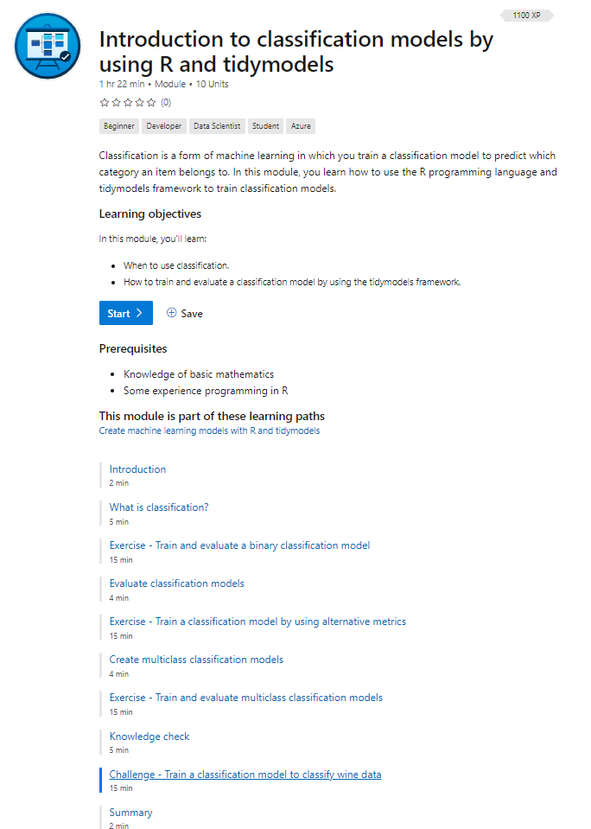




Code with us
Browse https://aka.ms/learn-classification-with-R
Click on Unit 9: Challenge - Train a classification model to classify wine data
Sign in with your Microsoft or GitHub account to activate the sandbox

Slide 13
Knowledge check

Slide 14
Question 1
You plan to use the tidymodels framework to train a model that predicts credit default risk. The model must predict a value of 0 for loan applications that should be automatically approved, and 1 for applications where there is a risk of default that requires human consideration. What kind of model is required?
A binary classification model.
A multiclass classification model.
A linear regression model.
Notes:
Explanation: Correct. A binary classification model predicts probability for two classes.

Slide 15
Question 1
You plan to use the tidymodels framework to train a model that predicts credit default risk. The model must predict a value of 0 for loan applications that should be automatically approved, and 1 for applications where there is a risk of default that requires human consideration. What kind of model is required?
A binary classification model.
A multiclass classification model.
A linear regression model.
Notes:
Explanation: Correct. A binary classification model predicts probability for two classes.

Slide 16
Question 2
You've trained a classification model specification in tidymodels. You want to use the model, logreg_cls_fit, to return labels for a new dataset called new_data. Which code should you use?
predict(logreg_cls_fit, new_data)
fit(logreg_cls_fit, new_data)
fit_resamples(logreg_cls_fit, new_data)
Notes:
Explanation: Correct. Use the parsnip::predict.model_fit() method for inferencing labels for new data.

Slide 17
Question 2
You've trained a classification model specification in tidymodels. You want to use the model, logreg_cls_fit, to return labels for a new dataset called new_data. Which code should you use?
predict(logreg_cls_fit, new_data)
fit(logreg_cls_fit, new_data)
fit_resamples(logreg_cls_fit, new_data)
Notes:
Explanation: Correct. Use the parsnip::predict.model_fit() method for inferencing labels for new data.

Slide 18
Question 3
You're training a binary classification model by using the tidymodels framework. When you evaluate it with test data, you determine that the model achieves an overall recall metric of 0.81. What does this metric indicate?
The model correctly predicted 81 percent of the test cases.
81 percent of the cases predicted as positive by the model were actually positive.
The model correctly identified 81 percent of positive cases as positive.
Notes:
Explanation: Correct. The recall metric indicates the percentage of actual positive cases that the classifier correctly identified.

Slide 19
Question 3
You're training a binary classification model by using the tidymodels framework. When you evaluate it with test data, you determine that the model achieves an overall recall metric of 0.81. What does this metric indicate?
The model correctly predicted 81 percent of the test cases.
81 percent of the cases predicted as positive by the model were actually positive.
The model correctly identified 81 percent of positive cases as positive.
Notes:
Explanation: Correct. The recall metric indicates the percentage of actual positive cases that the classifier correctly identified.

Slide 20
Summary

Slide 21
Summary
What is classification
Train and evaluate a binary classification model
Create multiclass classification models

