Slide 2
Create a Regression Model with Azure Machine Learning designer
Speaker Name
Title
Speaker Name
Title
Notes:
Link to published module on Learn: https://docs.microsoft.com/en-us/learn/modules/learn-pr/wwl-data-ai/create-regression-model-azure-machine-learning-designer/

Slide 3
Prerequisites Learning Objectives
Ability to navigate the Azure portal
Learn how to train and publish a regression model with Azure Machine Learning designer.

Slide 4
Agenda
Create an Azure Machine Learning workspace and Computer Resources
Explore data
Create, run and evaluate a training pipeline
Set up Inference pipeline and REST service endpoing
[Optional] Repeat the process with your own dataset

Slide 5
Introduction

Slide 6
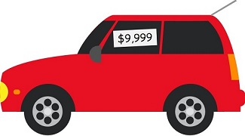
Introduction
Regression is a form of machine learning that is used to predict a numeric label based on an item's features.
x
x
Price
Label →
x
x
x
Engine Power
← Feature(s)
Notes:
Regression is a form of machine learning that is used to predict a numeric label based on an item's features. For example, an automobile sales company might use the characteristics of a car (such as engine size, number of seats, mileage, and so on) to predict its likely selling price. In this case, the characteristics of the car are the features, and the selling price is the label.
[!div class="centered"] A car priced at $9,999
Regression is an example of a supervised machine learning technique in which you train a model using data that includes both the features and known values for the label, so that the model learns to fit the feature combinations to the label. Then, after training has been completed, you can use the trained model to predict labels for new items for which the label is unknown.
You can use Microsoft Azure Machine Learning designer to create regression models by using a drag and drop visual interface, without needing to write any code.
In this module, you'll learn how to:
Use Azure Machine Learning designer to train a regression model.
Use a regression model for inferencing.
Deploy a regression model as a service.
To complete this module, you'll need a Microsoft Azure subscription. If you don't already have one, you can sign up for a free trial at https://azure.microsoft.com?azure-portal=true.

Slide 7




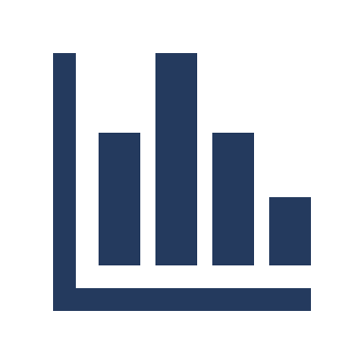


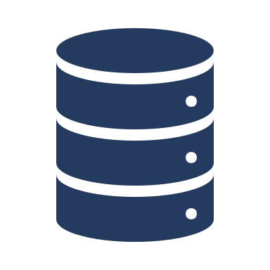
Azure Machine Learning
Workspace
AutoML
Designer
Notebooks
Experimentation
Deployment
For beginners (Low Code / No Code)
Advanced Data Science
Compute
Datasets

Slide 8
Setting things up

Slide 9
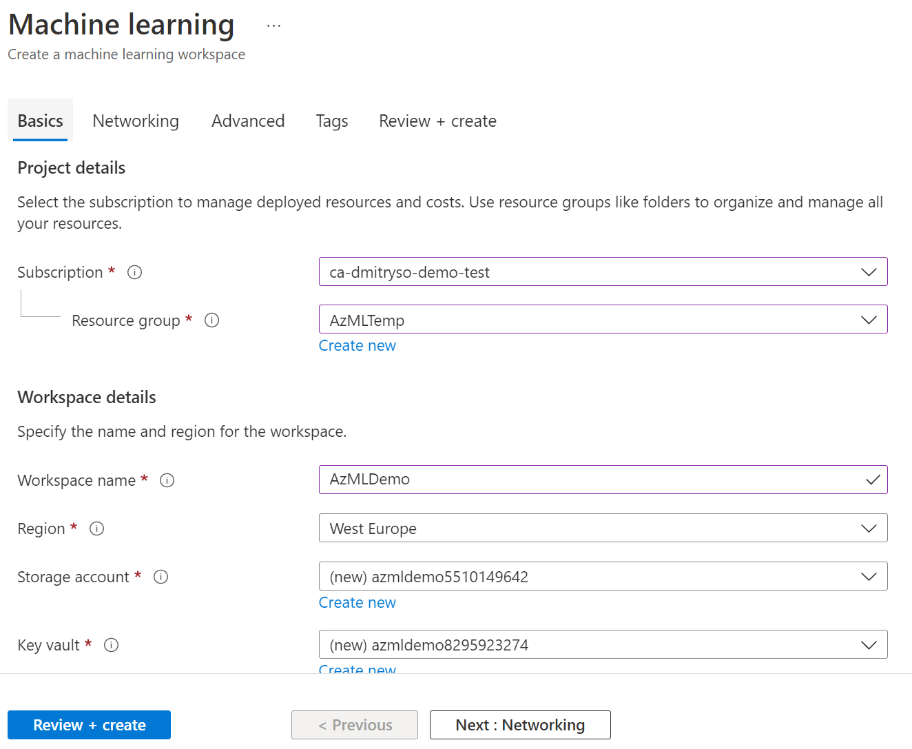
Create Workspace Create compute targets
http://portal.azure.com
Compute Instances: Development workstations that data scientists can use to work with data and models. Create Standard_DS11_v2 compute instance.
Compute Clusters: Scalable clusters of virtual machines for on-demand processing of experiment code.
Inference Clusters: Deployment targets for predictive services that use your trained models.
Attached Compute: Links to existing Azure compute resources, such as Virtual Machines or Azure Databricks clusters.
http://ml.azure.com
Notes:
Compute targets are cloud-based resources on which you can run model training and data exploration processes.
In Azure Machine Learning studio, view the Compute page (under Manage). This is where you manage the compute targets for your data science activities. There are four kinds of compute resource you can create:
Compute Instances: Development workstations that data scientists can use to work with data and models.
Compute Clusters: Scalable clusters of virtual machines for on-demand processing of experiment code.
Inference Clusters: Deployment targets for predictive services that use your trained models.
Attached Compute: Links to existing Azure compute resources, such as Virtual Machines or Azure Databricks clusters.
[!NOTE] Compute instances and clusters are based on standard Azure virtual machine images. For this module, the Standard_DS11_v2 image is recommended to achieve the optimal balance of cost and performance. If your subscription has a quota that does not include this image, choose an alternative image; but bear in mind that a larger image may incur higher cost and a smaller image may not be sufficient to complete the tasks. Alternatively, ask your Azure administrator to extend your quota.
On the Compute Instances tab, add a new compute instance with the following settings. You'll use this as a workstation from which to test your model:
Compute name: enter a unique name
Virtual Machine type: CPU
Virtual Machine size:
Choose Select from all options
Search for and select Standard_DS11_v2
While the compute instance is being created, switch to the Compute Clusters tab, and add a new compute cluster with the following settings. You'll use this to train a machine learning model:
Location: Select the same as your workspace. If that location is not listed, choose the one closest to you
Virtual Machine priority: Dedicated
Virtual Machine type: CPU
Virtual Machine size:
Choose Select from all options
Search for and select Standard_DS11_v2
Compute name: enter a unique name
Minimum number of nodes: 0
Maximum number of nodes: 2
Idle seconds before scale down: 120
Enable SSH access: Unselected
[!TIP] After completing each module, be sure to follow the Clean Up instructions at the end of the module to stop your compute resources. Stopping your compute ensures your subscription won't be charged for compute resources.
The compute targets will take some time to be created. You can move onto the next unit while you wait.

Slide 10
Clean the Data

Slide 11
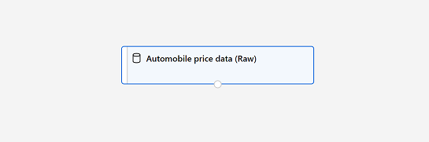
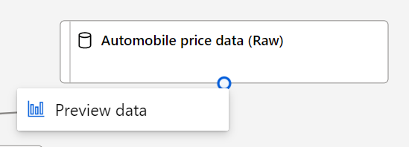
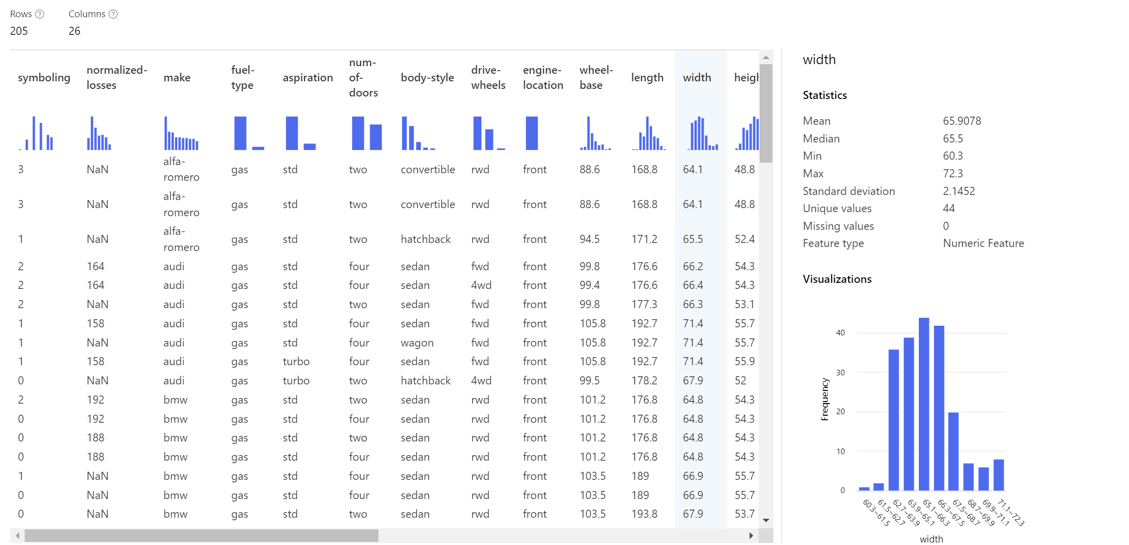
Azure ML Designer
Notes:
To train a regression model, you need a dataset that includes historical features (characteristics of the entity for which you want to make a prediction) and known label values (the numeric value that you want to train a model to predict).

Slide 12
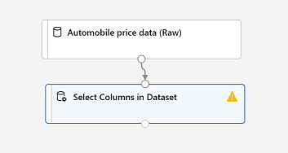
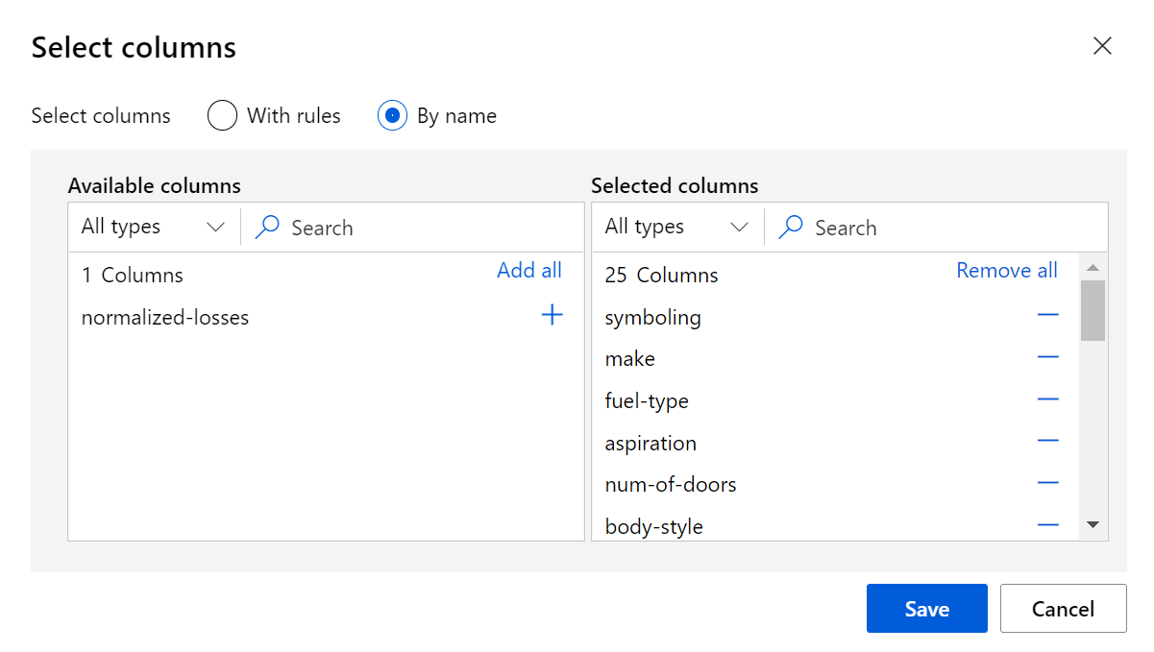
Data Transformations
You typically apply data transformations to prepare the data for modeling.
Notes:
You typically apply data transformations to prepare the data for modeling. In the case of the automobile price data, you'll add transformations to address the issues you identified when exploring the data.
In the pane on the left, expand the Data Transformation section, which contains a wide range of modules you can use to transform data before model training.
Drag a Select Columns in Dataset module to the canvas, below the Automobile price data (Raw) module. Then connect the output at the bottom of the Automobile price data (Raw) module to the input at the top of the Select Columns in Dataset module, like this:
[!div class="centered"] The Automobile price data (Raw) dataset connected to the Select Columns in Dataset module
Select the Select Columns in Dataset module, and in its Settings pane on the right, select Edit column. Then in the Select columns window, select By name and use the + links to add all columns other than normalized-losses, like this:
[!div class="centered"] all columns other than normalized_losses
In the rest of this exercise, you'll go through steps to create a pipeline that looks like this:
[!div class="centered"] Automobile price data (Raw) dataset with Select Columns in Dataset, Clean Missing Data, and Normalize Data modules
Follow the remaining steps, using the image above for reference as you add and configure the required modules.
Drag a Clean Missing Data module from the Data Transformations section, and place it under the Select Columns in Dataset module. Then connect the output from the Select Columns in Dataset module to the input of the Clean Missing Data module.
Select the Clean Missing Data module, and in the settings pane on the right, click Edit column. Then in the Select columns window, select With rules, in the Include list select Column names, in the box of column names enter bore, stroke, and horsepower (making sure you match the spelling and capitalization exactly), like this:
[!div class="centered"] bore, stroke, and horsepower columns are selected
With the Clean Missing Data module still selected, in the settings pane, set the following configuration settings:
Minimum missing value ratio: 0.0
Maximum missing value ratio: 1.0
Cleaning mode: Remove entire row
Drag a Normalize Data module to the canvas, below the Clean Missing Data module. Then connect the left-most output from the Clean Missing Data module to the input of the Normalize Data module.
Select the Normalize Data module and view its settings, noting that it requires you to specify the transformation method and the columns to be transformed. Then, set the transformation to MinMax and edit the columns by applying a rule to include the following Column names (ensuring you match the spelling, capitalization, and hyphenation exactly):
symboling
wheel-base
length
width
height
curb-weight
engine-size
bore
stroke
compression-ratio
horsepower
peak-rpm
city-mpg
highway-mpg
[!div class="centered"] all numeric columns other than price are selected

Slide 13
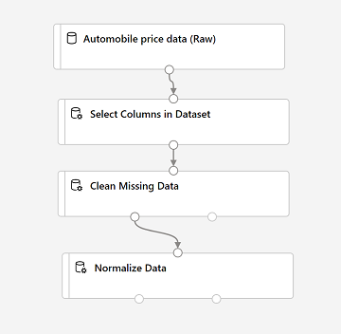
Handling Missing Values
Some of the data may be missing. We need to handle missing values before training the model
Delete column with missing data (normalized-losses)
Delete rows with missing values (bore, stroke and horsepower)
Fill missing values (with 0s, with mean values)
Notes:
To apply your data transformations, you need to run the pipeline as an experiment.
Ensure your pipeline looks similar to this:
[!div class="centered"] Automobile price data (Raw) dataset with Select Columns in Dataset, Clean Missing Data, and Normalize Data modules
Select Submit, and run the pipeline as a new experiment named mslearn-auto-training on your compute cluster.
Wait for the run to finish. This may take 5 minutes or more. When the run has completed, the modules should look like this:
[!div class="centered"] Automobile price data (Raw) dataset with Select Columns in Dataset, Clean Missing Data, and Normalize Data modules in completed state

Slide 14
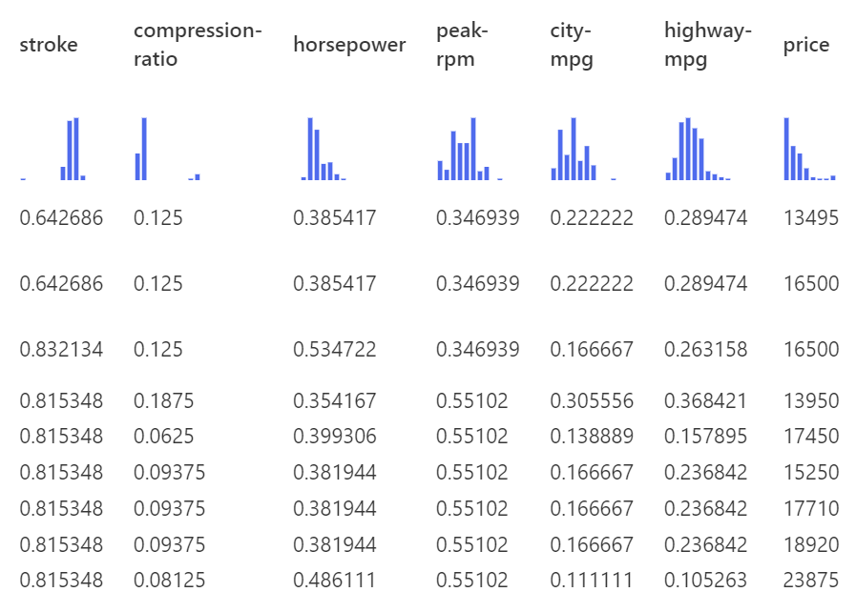
Normalize Data
Run the pipeline and observe the result

Slide 15
Train the Model

Slide 16
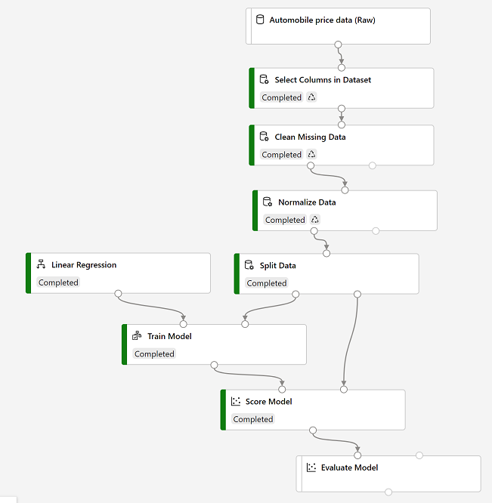
Training Experiment
After the data has been cleaned:
Split between train/test dataset
Train on training data
Score on test data
Evaluate to compute the statistics
Metrics:
Mean absolute error: $2k (15%)
Coefficient of determination: 93%
Notes:
It's common practice to train the model using a subset of the data, while holding back some data with which to test the trained model. This enables you to compare the labels that the model predicts with the actual known labels in the original dataset.
In this exercise, you're going to work through steps to extend the Auto Price Training pipeline as shown here:
[!div class="centered"] split data, then train with linear regression and score
Follow the steps below, using the image above for reference as you add and configure the required modules.
Open the Auto Price Training pipeline you created in the previous unit if it's not already open.
In the pane on the left, in the Data Transformations section, drag a Split Data module onto the canvas under the Normalize Data module. Then connect the Transformed Dataset (left) output of the Normalize Data module to the input of the Split Data module.
Select the Split Data module, and configure its settings as follows:
Splitting mode: Split Rows
Fraction of rows in the first output dataset: 0.7
Random seed: 123
Stratified split: False
Expand the Model Training section in the pane on the left, and drag a Train Model module to the canvas, under the Split Data module. Then connect the Result dataset1 (left) output of the Split Data module to the Dataset (right) input of the Train Model module.
The model we're training will predict the price value, so select the Train Model module and modify its settings to set the Label column to price (matching the case and spelling exactly!)
The price label the model will predict is a numeric value, so we need to train the model using a regression algorithm. Expand the Machine Learning Algorithms section, and under Regression, drag a Linear Regression module to the canvas, to the left of the Split Data module and above the Train Model module. Then connect its output to the Untrained model (left) input of the Train Model module.
[!NOTE] There are multiple algorithms you can use to train a regression model. For help choosing one, take a look at the Machine Learning Algorithm Cheat Sheet for Azure Machine Learning designer.
To test the trained model, we need to use it to score the validation dataset we held back when we split the original data - in other words, predict labels for the features in the validation dataset. Expand the Model Scoring & Evaluation section and drag a Score Model module to the canvas, below the Train Model module. Then connect the output of the Train Model module to the Trained model (left) input of the Score Model module; and drag the Results dataset2 (right) output of the Split Data module to the Dataset (right) input of the Score Model module.
Ensure your pipeline looks like this:
[!div class="centered"] split data, then train with linear regression and score

Slide 17
Create an inference pipeline

Slide 18
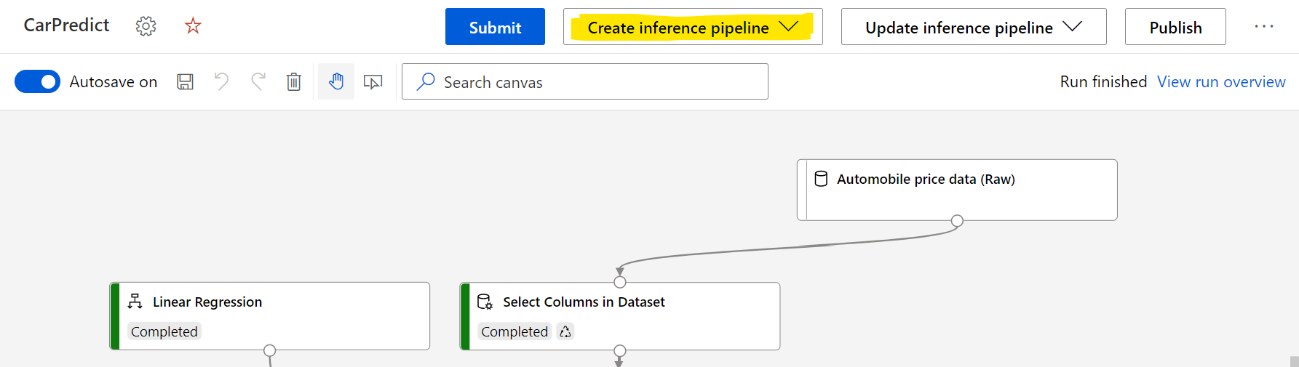
Create an inference pipeline
Inference = Using the model to predict new prices
REST Endpoint = Call through the internet from anywhere
Notes:
After creating and running a pipeline to train the model, you need a second pipeline that performs the same data transformations for new data, and then uses the trained model to infer (in other words, predict) label values based on its features. This will form the basis for a predictive service that you can publish for applications to use.

Slide 19
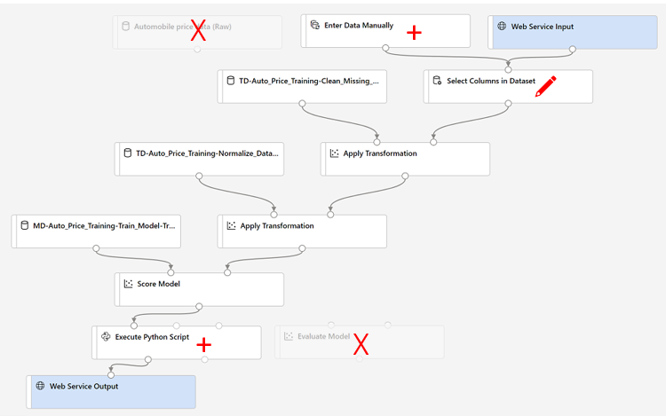
Create and run an inference pipeline
Web service input -> Web Service Output
Need to apply the same transformations (normalization, etc.)
Use sample data as schema
After scoring we can do some post-processing using custom Python script
Run the pipeline to test it and do the scoring of sample data
Notes:
In Azure Machine Learning Studio, click the Designer page to view all of the pipelines you have created. Then open the Auto Price Training pipeline you created previously.
Navigate to the the Create inference pipeline drop-down list, located on the top right hand corner of the screen. If you do not see it, you may need to expand your screen or click on the ... three dots which represent More Actions on the top right hand corner. Then click Real-time inference pipeline. After a few seconds, a new version of your pipeline named Auto Price Training-real time inference will be opened.
If the pipeline does not include Web Service Input and Web Service Output modules, go back to the Designer page and then re-open the Auto Price Training-real time inference pipeline.
Rename the new pipeline to Predict Auto Price, and then review the new pipeline. It contains a web service input for new data to be submitted, and a web service output to return results. Some of the transformations and training steps have been encapsulated in this pipeline so that the statistics from your training data will be used to normalize any new data values, and the trained model will be used to score the new data.
You are going to make the following changes to the inference pipeline in the next steps #4-8:
[!div class="centered"] An inference pipeline with changes indicated
Use the image for reference as you modify the pipeline in the next steps.
The inference pipeline assumes that new data will match the schema of the original training data, so the Automobile price data (Raw) dataset from the training pipeline is included. However, this input data includes the price label that the model predicts, which is unintuitive to include in new car data for which a price prediction has not yet been made. Delete this module and replace it with an Enter Data Manually module from the Data Input and Output section, containing the following CSV data, which includes feature values without labels for three cars (copy and paste the entire block of text):
symboling,normalized-losses,make,fuel-type,aspiration,num-of-doors,body-style,drive-wheels,engine-location,wheel-base,length,width,height,curb-weight,engine-type,num-of-cylinders,engine-size,fuel-system,bore,stroke,compression-ratio,horsepower,peak-rpm,city-mpg,highway-mpg3,NaN,alfa-romero,gas,std,two,convertible,rwd,front,88.6,168.8,64.1,48.8,2548,dohc,four,130,mpfi,3.47,2.68,9,111,5000,21,273,NaN,alfa-romero,gas,std,two,convertible,rwd,front,88.6,168.8,64.1,48.8,2548,dohc,four,130,mpfi,3.47,2.68,9,111,5000,21,271,NaN,alfa-romero,gas,std,two,hatchback,rwd,front,94.5,171.2,65.5,52.4,2823,ohcv,six,152,mpfi,2.68,3.47,9,154,5000,19,26
Connect the new Enter Data Manually module to the same dataset input of the Select Columns in Dataset module as the Web Service Input.
Now that you've changed the schema of the incoming data to exclude the price field, you need to remove any explicit uses of this field in the remaining modules. Select the Select Columns in Dataset module and then in the settings pane, edit the columns to remove the price field.
The inference pipeline includes the Evaluate Model module, which is not useful when predicting from new data, so delete this module.
The output from the Score Model module includes all of the input features as well as the predicted label. To modify the output to include only the prediction:
Delete the connection between the Score Model module and the Web Service Output.
Add an Execute Python Script module from the Python Language section, replacing all of the the default python script with the following code (which selects only the Scored Labels column and renames it to predicted_price):
import pandas as pddef azureml_main(dataframe1 = None, dataframe2 = None): scored_results = dataframe1[['Scored Labels']] scored_results.rename(columns={'Scored Labels':'predicted_price'}, inplace=True) return scored_results
Connect the output from the Score Model module to the Dataset1 (left-most) input of the Execute Python Script, and connect the output of the Execute Python Script module to the Web Service Output.
Verify that your pipeline looks similar to the following:
symboling,normalized-losses,make,fuel-type,aspiration,num-of-doors,body-style,drive-wheels,engine-location,wheel-base,length,width,height,curb-weight,engine-type,num-of-cylinders,engine-size,fuel-system,bore,stroke,compression-ratio,horsepower,peak-rpm,city-mpg,highway-mpg 3,NaN,alfa-romero,gas,std,two,convertible,rwd,front,88.6,168.8,64.1,48.8,2548,dohc,four,130,mpfi,3.47,2.68,9,111,5000,21,27 3,NaN,alfa-romero,gas,std,two,convertible,rwd,front,88.6,168.8,64.1,48.8,2548,dohc,four,130,mpfi,3.47,2.68,9,111,5000,21,27 1,NaN,alfa-romero,gas,std,two,hatchback,rwd,front,94.5,171.2,65.5,52.4,2823,ohcv,six,152,mpfi,2.68,3.47,9,154,5000,19,26 import pandas as pd def azureml_main(dataframe1 = None, dataframe2 = None): scored_results = dataframe1[['Scored Labels']] scored_results.rename(columns={'Scored Labels':'predicted_price'}, inplace=True) return scored_results
[!div class="centered"] A visual inference pipeline
Submit the pipeline as a new experiment named mslearn-auto-inference on your compute cluster. This may take a while!
When the pipeline has completed, select the Execute Python Script module, and in the settings pane, on the Output + logs tab, visualize the Result dataset to see the predicted prices for the three cars in the input data.
Close the visualization window.
Your inference pipeline predicts prices for cars based on their features. Now you're ready to publish the pipeline so that client applications can use it.

Slide 20
Deploy a predictive service

Slide 21
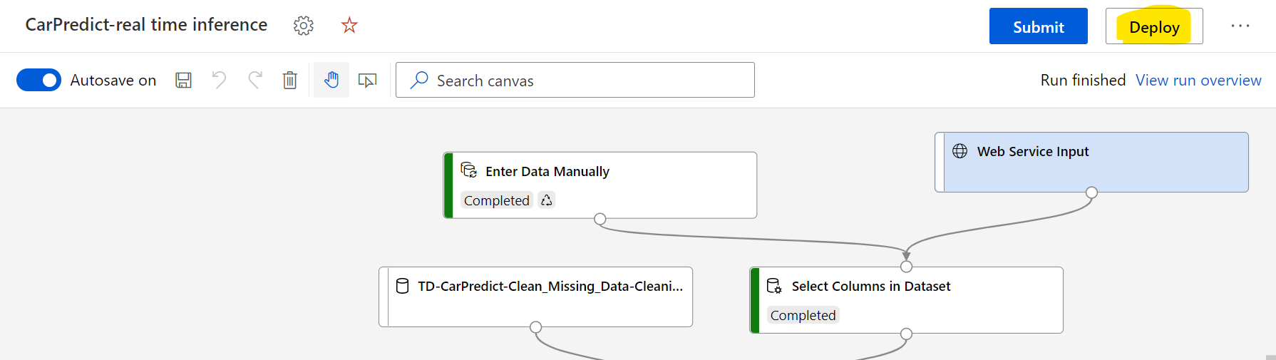
Deploy a predictive service
Deploy = Run the predictive model somewhere on some compute
ACI: Container instance, one VM for testing / low load
AKS: Kubernetes cluster, for productions / scalable load
Notes:
After you've created and tested an inference pipeline for real-time inferencing, you can publish it as a service for client applications to use.
[!NOTE] In this exercise, you'll deploy the web service to an Azure Container Instance (ACI). This type of compute is created dynamically, and is useful for development and testing. For production, you should create an inference cluster, which provides an Azure Kubernetes Service (AKS) cluster that provides better scalability and security.

Slide 22
Test the service
We will use Notebooks service to run Python code
endpoint = 'YOUR_ENDPOINT' #Replace with your endpoint
key = 'YOUR_KEY' #Replace with your key
import urllib.request, json, os
# Prepare the input data
data = {
"Inputs": { "WebServiceInput0": [
{
'symboling': 3,
'make': "alfa-romero",
….. }, ], },
"GlobalParameters": { } }
body = str.encode(json.dumps(data))
headers = {'Content-Type':'application/json', 'Authorization':('Bearer '+ key)}
req = urllib.request.Request(endpoint, body, headers)
response = urllib.request.urlopen(req)
result = response.read()
json_result = json.loads(result)
y = json_result["Results"]["WebServiceOutput0"][0]
print(y)
REST
Call
Notebooks
Deployment
Compute
Designer
Notes:
Now you can test your deployed service from a client application - in this case, you'll use the code in the cell below to simulate a client application.
On the Endpoints page, open the predict-auto-price real-time endpoint.
When the predict-auto-price endpoint opens, view the Consume tab and note the following information there. You need this to connect to your deployed service from a client application.
The REST endpoint for your service
The Primary Key for your service
Observe that you can use the ? link next to these values to copy them to the clipboard.
With the Consume page for the predict-auto-price service page open in your browser, open a new browser tab and open a second instance of Azure Machine Learning studio. Then in the new tab, view the Notebooks page (under Author).
In the Notebooks page, under My files, use the ?? button to create a new file with the following settings:
File location: Users/your user name
File name: Test-Autos
File type: Notebook
Overwrite if already exists: Selected
When the new notebook has been created, ensure that the compute instance you created previously is selected in the Compute box, and that it has a status of Running.
Use the ? button to collapse the file explorer pane and give you more room to focus on the Test-Autos.ipynb notebook tab.
In the rectangular cell that has been created in the notebook, paste the following code:
endpoint = 'YOUR_ENDPOINT' #Replace with your endpointkey = 'YOUR_KEY' #Replace with your keyimport urllib.requestimport jsonimport os# Prepare the input datadata = { "Inputs": { "WebServiceInput0": [ { 'symboling': 3, 'normalized-losses': None, 'make': "alfa-romero", 'fuel-type': "gas", 'aspiration': "std", 'num-of-doors': "two", 'body-style': "convertible", 'drive-wheels': "rwd", 'engine-location': "front", 'wheel-base': 88.6, 'length': 168.8, 'width': 64.1, 'height': 48.8, 'curb-weight': 2548, 'engine-type': "dohc", 'num-of-cylinders': "four", 'engine-size': 130, 'fuel-system': "mpfi", 'bore': 3.47, 'stroke': 2.68, 'compression-ratio': 9, 'horsepower': 111, 'peak-rpm': 5000, 'city-mpg': 21, 'highway-mpg': 27, }, ], }, "GlobalParameters": { }}body = str.encode(json.dumps(data))headers = {'Content-Type':'application/json', 'Authorization':('Bearer '+ key)}req = urllib.request.Request(endpoint, body, headers)try: response = urllib.request.urlopen(req) result = response.read() json_result = json.loads(result) y = json_result["Results"]["WebServiceOutput0"][0] print(y)except urllib.error.HTTPError as error: print("The request failed with status code: " + str(error.code)) # Print the headers to help debug the error print(error.info()) print(json.loads(error.read().decode("utf8", 'ignore')))
[!NOTE] Don't worry too much about the details of the code. It just submits details of a car and uses the predict-auto-price service you created to get a predicted price.
Switch to the browser tab containing the Consume page for the predict-auto-price service, and copy the REST endpoint for your service. Then switch back to the tab containing the notebook and paste the key into the code, replacing YOUR_ENDPOINT.
Switch to the browser tab containing the Consume page for the predict-auto-price service, and copy the Primary Key for your service. Then switch back to the tab containing the notebook and paste the key into the code, replacing YOUR_KEY.
Save the notebook. Then use the ? button next to the cell to run the code.
Verify that predicted price is returned.
endpoint = 'YOUR_ENDPOINT' #Replace with your endpoint key = 'YOUR_KEY' #Replace with your key import urllib.request import json import os # Prepare the input data data = { "Inputs": { "WebServiceInput0": [ { 'symboling': 3, 'normalized-losses': None, 'make': "alfa-romero", 'fuel-type': "gas", 'aspiration': "std", 'num-of-doors': "two", 'body-style': "convertible", 'drive-wheels': "rwd", 'engine-location': "front", 'wheel-base': 88.6, 'length': 168.8, 'width': 64.1, 'height': 48.8, 'curb-weight': 2548, 'engine-type': "dohc", 'num-of-cylinders': "four", 'engine-size': 130, 'fuel-system': "mpfi", 'bore': 3.47, 'stroke': 2.68, 'compression-ratio': 9, 'horsepower': 111, 'peak-rpm': 5000, 'city-mpg': 21, 'highway-mpg': 27, }, ], }, "GlobalParameters": { } } body = str.encode(json.dumps(data)) headers = {'Content-Type':'application/json', 'Authorization':('Bearer '+ key)} req = urllib.request.Request(endpoint, body, headers) try: response = urllib.request.urlopen(req) result = response.read() json_result = json.loads(result) y = json_result["Results"]["WebServiceOutput0"][0] print(y) except urllib.error.HTTPError as error: print("The request failed with status code: " + str(error.code)) # Print the headers to help debug the error print(error.info()) print(json.loads(error.read().decode("utf8", 'ignore')))
[!NOTE] Don't worry too much about the details of the code. It just submits details of a car and uses the predict-auto-price service you created to get a predicted price.

Slide 23
Knowledge check

Slide 24
Question 1
You are creating a training pipeline for a regression model, using a dataset that has multiple numeric columns in which the values are on different scales. You want to transform the numeric columns so that the values are all on a similar scale based relative to the minimum and maximum values in each column. Which module should you add to the pipeline?
Select Columns in a Dataset
Normalize Data
Clean Missing Data
Notes:
Explanation: That is correct. When you need to transform numeric data to be on a similar scale, use a Normalize Data module.

Slide 25
Question 1
You are creating a training pipeline for a regression model, using a dataset that has multiple numeric columns in which the values are on different scales. You want to transform the numeric columns so that the values are all on a similar scale based relative to the minimum and maximum values in each column. Which module should you add to the pipeline?
Select Columns in a Dataset
Normalize Data
Clean Missing Data
Notes:
Explanation: That is correct. When you need to transform numeric data to be on a similar scale, use a Normalize Data module.

Slide 26
Question 2
Why do we split our data into training and validation sets?
Data is split into two sets in order to create two models, one model using the training set and a different model using the validation set.
Splitting data into two sets enables you to compare the labels that the model predicts with the actual known labels in the original dataset.
We only need to split our data when we use the Azure Machine Learning Designer, not in other machine learning scenarios.
Notes:
Explanation: That is correct. We want to test the model created with training data on validation data to see how well the model performs with data it was not trained on.

Slide 27
Question 2
Why do we split our data into training and validation sets?
Data is split into two sets in order to create two models, one model using the training set and a different model using the validation set.
Splitting data into two sets enables you to compare the labels that the model predicts with the actual known labels in the original dataset.
We only need to split our data when we use the Azure Machine Learning Designer, not in other machine learning scenarios.
Notes:
Explanation: That is correct. We want to test the model created with training data on validation data to see how well the model performs with data it was not trained on.

Slide 28
Optional Train on your own data

Slide 29
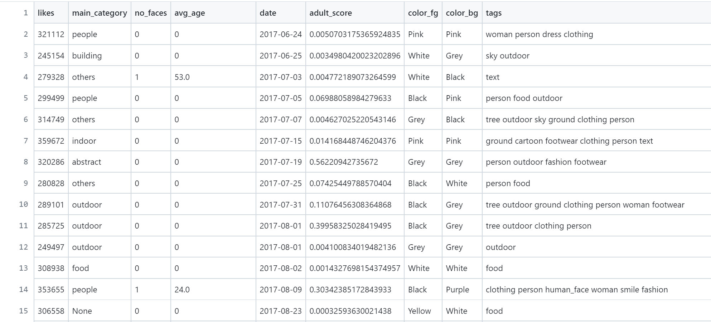
Where to get data
http://Kaggle.com Instagram Dataset
Notes:
Explanation: That is correct. We want to test the model created with training data on validation data to see how well the model performs with data it was not trained on.

Slide 30
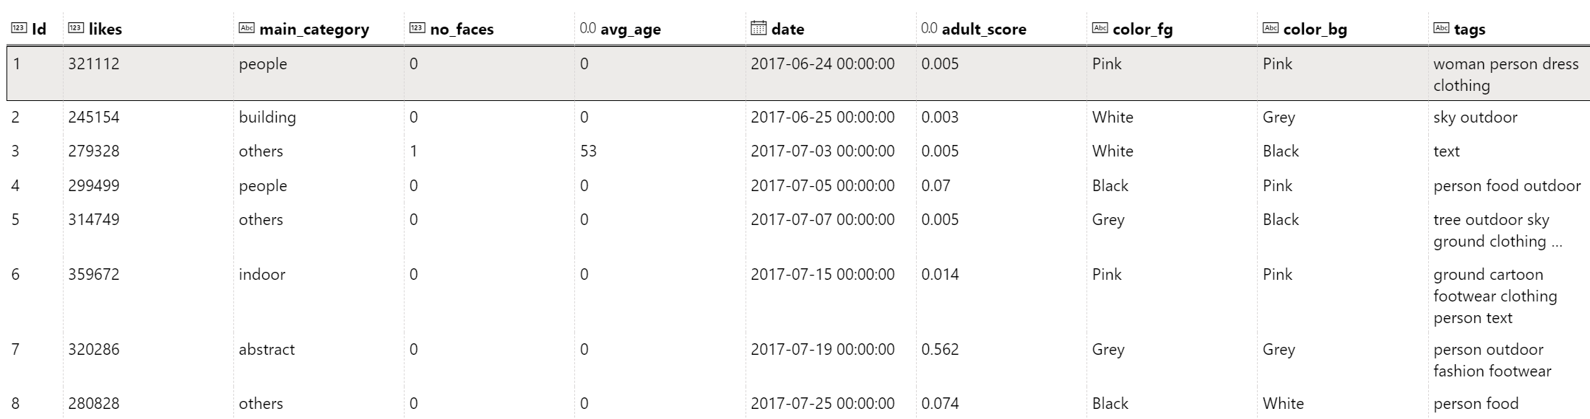
Upload the Dataset
Go to Datasets section
Create Dataset -> From Web Files
https://raw.githubusercontent.com/shwars/NeuroWorkshopData/ master/Data/instagram/instagram.csv

Slide 31
Train the model and observe the metrics
Explore the data
Think of which columns to keep, and which to get rid of
Compare different model types
(hint: decision trees should work better than linear models!)
Try computing extra columns (Compute Column)
(e.g. number of days instead of date)
Try setting some of the fields to categorical using Edit metadata
Try explainability to see which features affect likes the most

Slide 32
Summary

Slide 33
Summary
In this module, you learned how to use Azure Machine Learning designer to train and publish a regression model.
Follow-up Project: Create predictive applicaton
Select a problem domain that interests you. Get an inspiration from datasets available on Kaggle or elsewhere
Train and deploy the model the way you have done in this workshop
Build a mobile or web application that consumes the API.
Notes:
In this module, you learned how to use Azure Machine Learning designer to train and publish a regression model.

Slide 34
Clean-up
Make sure to delete all used cloud resources to avoid consuming subscription credits
Delete the prediction endpoint (Endpoints in Azure ML Portal)
Stop the compute instance (Compute in Azure ML Portal)
Delete Azure ML Workspace (Azure Portal)
Notes:
The web service you created is hosted in an Azure Container Instance. If you don't intend to experiment with it further, you should delete the endpoint to avoid accruing unnecessary Azure usage. You should also stop the compute instance until you need it again.
In Azure Machine Learning studio, on the Endpoints tab, select the predict-auto-price endpoint. Then select Delete (??) and confirm that you want to delete the endpoint.
On the Compute page, on the Compute Instances tab, select your compute instance and then select Stop.
[!NOTE] Stopping your compute ensures your subscription won't be charged for compute resources. You will however be charged a small amount for data storage as long as the Azure Machine Learning workspace exists in your subscription. If you have finished exploring Azure Machine Learning, you can delete the Azure Machine Learning workspace and associated resources. However, if you plan to complete any other labs in this series, you will need to recreate it.
To delete your workspace:
In the Azure portal, in the Resource groups page, open the resource group you specified when creating your Azure Machine Learning workspace.
Click Delete resource group, type the resource group name to confirm you want to delete it, and select Delete.
In the Azure portal, in the Resource groups page, open the resource group you specified when creating your Azure Machine Learning workspace.
Click Delete resource group, type the resource group name to confirm you want to delete it, and select Delete.

