Slide 2
Get started with Jupyter notebooks for Python
Speaker Name
Title
Speaker Name
Title
Notes:
Link to published module on Learn: https://docs.microsoft.com/en-us/learn/modules/learn-pr/

Slide 3
Prerequisites
Understand basic programming concepts.
Have Python 3 installed locally.

Slide 4
Learning objectives
Create a Jupyter notebook locally.
Run a Jupyter notebook by using Python in Visual Studio Code.
Describe some of the ways to build a notebook.

Slide 5
Agenda
Introduction
Set up your environment
Exercise - Create and run your notebook
Exercise - Use advanced commands
Knowledge check

Slide 6
Agenda continued
Summary

Slide 7
Introduction

Slide 8
Introduction
Although web developers build their websites by using tools such as Node.js, ASP.NET, or Java, and run their code locally by using tooling in code editors such as Visual Studio Code, Python developers have some other tools at their disposal.
Notes:
Although web developers build their websites by using tools such as Node.js, ASP.NET, or Java, and run their code locally by using tooling in code editors such as Visual Studio Code, Python developers have some other tools at their disposal.
One of those useful tools is called a notebook. A notebook is an interactive environment that a developer can use to run code blocks and add areas for documentation to explain the code itself. Although Python developers can also use .py files to run Python programs directly, they can use notebooks to both run and document their code, explaining its logic along the way.

Slide 9

Scenario:
Suppose you are a crew member on a spaceship. Your mission is to deliver some important equipment to the International Space Station (ISS). If you're not familiar with some of the many buttons on the spaceship's console, it's better not to learn by the trial-and-error method, mid-flight! Instead, you might consult the ship's documentation to learn what buttons to push to perform various tasks. But what if the manual is incomplete?
Your job is to improve the ship's log by creating interactive explanations of the ship's controls. By working with a notebook, you can more easily explain the uses of the various parts of the console.
Notes:
Suppose you are a crew member on a spaceship. Your mission is to deliver some important equipment to the International Space Station (ISS). If you're not familiar with some of the many buttons on the spaceship's console, it's better not to learn by the trial-and-error method, mid-flight! Instead, you might consult the ship's documentation to learn what buttons to push to perform various tasks. But what if the manual is incomplete?
Your job is to improve the ship's log by creating interactive explanations of the ship's controls. By working with a notebook, you can more easily explain the uses of the various parts of the console.

Slide 10
What will you learn?
By the end of this module, you'll be able to:
Create a Jupyter notebook locally.
Run a Jupyter notebook by using Python in Visual Studio Code.
Describe some of the ways to build a notebook.
Notes:
By the end of this module, you'll be able to:
Create a Jupyter notebook locally.
Run a Jupyter notebook by using Python in Visual Studio Code.
Describe some of the ways to build a notebook.

Slide 11
What is the main goal?
Take advantage of notebooks as a tool to create a more interactive learning experience.
Notes:
Take advantage of notebooks as a tool to create a more interactive learning experience.

Slide 12
Set up your environment

Slide 13
Set up your environment
There are many ways to run notebooks.
Python
Visual Studio Code
Visual Studio Code Jupyter extension
Notes:
There are many ways to run notebooks. You can run them right within this environment, on Microsoft Learn, and in fact in several of this path's modules you will run notebooks. In this module, however, you will learn how to get set up to run notebooks locally by using Visual Studio Code.
Before we start, take a look at this video tutorial on YouTube. The video explains how to download Python, get set up in Visual Studio Code, and run a notebook locally.
To start building your notebook, you need to have the following software available on your computer:
Python
Visual Studio Code
Visual Studio Code Jupyter extension

Slide 14
Install Python
If you don't have Python installed on your computer, you need to download it.
On a Mac, go to Python.org to install the latest version compatible with your operating system. On Windows, go to the Microsoft Store to download the most recent version.
If you already have Python installed, you might need to update your installation to the latest version. Make sure you have Python 3 by typing python3 --version in your terminal or command line. If it is installed, the version will be displayed.
Notes:
If you don't have Python installed on your computer, you need to download it. On a Mac, go to Python.org to install the latest version compatible with your operating system. On Windows, go to the Microsoft Store to download the most recent version.
If you already have Python installed, you might need to update your installation to the latest version. Make sure you have Python 3 by typing python3 --version in your terminal or command line. If it is installed, the version will be displayed.

Slide 15
Install Visual Studio Code
Next, install Visual Studio Code.
Notes:
Next, install Visual Studio Code. When the installation is complete, configure it to your liking. There are several good videos on setting things up in the Visual Studio Code documentation.

Slide 16
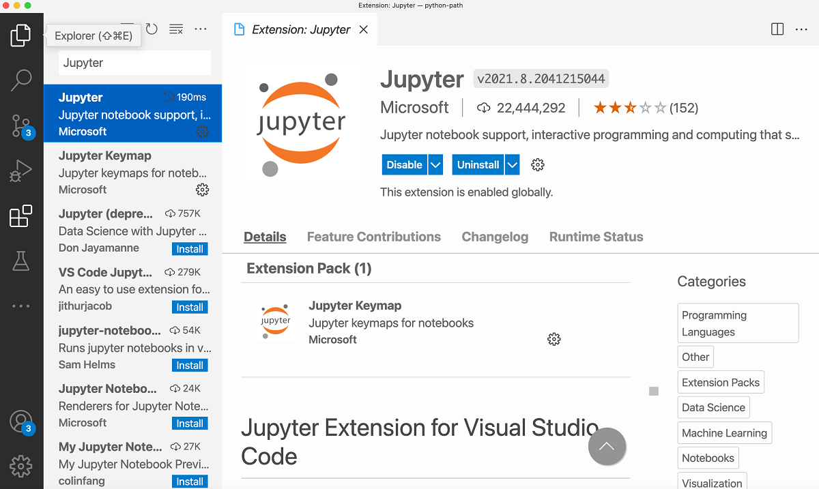
Install the Python extension
When these two installations are complete, you'll then need to install a Visual Studio Code extension.
Notes:
When these two installations are complete, you'll then need to install a Visual Studio Code extension. This extension allows you to run Jupyter notebooks from within Visual Studio Code by using a kernel. A kernel in Visual Studio Code helps you activate an Anaconda environment, so you can run your notebooks by using your Python installation.
In Visual Studio Code, from extensions panel on the left, search for Jupyter by Microsoft. To install this extension, select Install.
Now that you have the three elements of your workspace set up, you can start working with Jupyter notebooks in Visual Studio Code.

Slide 17
Exercise
Create and run your notebook
Notes:
Link to published module on Learn: https://docs.microsoft.com/en-us/learn/modules/learn-pr/3-exercise-run-notebook

Slide 18
Create and run your notebook
A notebook is an interactive environment where you can both write code and document it.
Create a notebook
Create a document element in Markdown
Run your notebook
Create runnable code
Notes:
https://docs.microsoft.com/en-us/learn/modules/learn-pr/3-exercise-run-notebook

Slide 19
Exercise
Use advanced commands
Notes:
Link to published module on Learn: https://docs.microsoft.com/en-us/learn/modules/learn-pr/4-exercise-advanced-commands

Slide 20
Use advanced commands
You have created a basic notebook with some Markdown and a widget to start your ship.
Create a visualization
Perform ship calculations
Notes:
https://docs.microsoft.com/en-us/learn/modules/learn-pr/4-exercise-advanced-commands

Slide 21
Knowledge check

Slide 22
Question 1
What file extension does a Jupyter notebook have?
.ipynb
.opynb
.epynb
Notes:
Explanation: Correct. The .ipynb file extension refers to *iPython Notebook*, now called a Jupyter notebook.

Slide 23
Question 1
What file extension does a Jupyter notebook have?
.ipynb
.opynb
.epynb
Notes:
Explanation: Correct. The .ipynb file extension refers to *iPython Notebook*, now called a Jupyter notebook.

Slide 24
Question 2
Which of the following answers include types of elements in an interactive notebook?
Equations and UI elements.
Charts and graphs.
Both of the above.
Notes:
Explanation: Correct. In addition to many other elements, equations, UI elements, charts, and graphs are types of elements in an interactive notebook.

Slide 25
Question 2
Which of the following answers include types of elements in an interactive notebook?
Equations and UI elements.
Charts and graphs.
Both of the above.
Notes:
Explanation: Correct. In addition to many other elements, equations, UI elements, charts, and graphs are types of elements in an interactive notebook.

Slide 26
Question 3
Which of the following types of content blocks are available in a Jupyter notebook?
HTML
PDF
Markdown
Notes:
Explanation: Correct. You can use a Markdown content block in a Jupyter notebook.

Slide 27
Question 3
Which of the following types of content blocks are available in a Jupyter notebook?
HTML
PDF
Markdown
Notes:
Explanation: Correct. You can use a Markdown content block in a Jupyter notebook.

Slide 28
Summary

Slide 29
Summary
As an astronaut, you need to have a ship's manual on hand to troubleshoot common problems on your spaceship.
Create a Jupyter notebook locally.
Run a Jupyter notebook by using Python in Visual Studio Code.
Describe some of the ways to build a notebook.
Notes:
As an astronaut, you need to have a ship's manual on hand to troubleshoot common problems on your spaceship. In this module, you learned how to build an interactive manual by using Jupyter notebooks.
You learned how to:
Create a Jupyter notebook locally.
Run a Jupyter notebook by using Python in Visual Studio Code.
Describe some of the ways to build a notebook.

Slide 30
References
This module introduced some core elements of the many things you can do in Jupyter notebooks.
Notes:
This module introduced some core elements of the many things you can do in Jupyter notebooks. For inspiration, you can check out an interesting gallery of Jupyter notebooks on GitHub.

Slide 31
Next Steps
Explore this learning path on Data Science with Notebooks
Please tell us how you liked this workshop by filling out this survey:
https://aka.ms/workshopomatic-feedback

