Slide 1
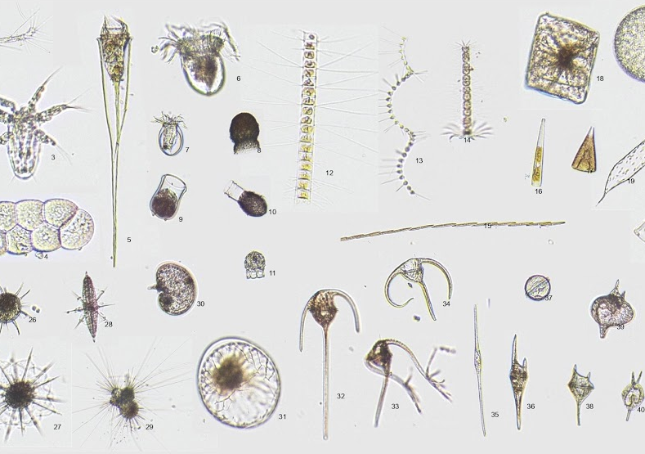
{PLANKTHON CHALLENGE}
PRESENTATION
HawaiianBobtailGreen7

Slide 2
TABLE OF CONTENTS
01
02
03
04
MODEL
DISTRIBUTION
Approaches and what we settled on
Docker and lightweight dependencies
DATA VIZ
PROPOSAL
Easily view the collected data
End-to-end solution

Slide 3
MODEL
01
MobileNetV3_Large_100_Miil_In21k

Slide 4
CHOOSING MODELS
CLASSIC ML
DEEP LEARNING
Scikit learn, support vector classification
Feature extraction via histogram of oriented gradients (HOG) and Haralick features
Reduction of dimensionality using principal component analysis (PCA)
Initial approach was to generate layers by ourselves
Ended up adopting the transfer learning method
Tried out different models, and ended up with MobileNetV3
Notes:
# Change ‘Classical’ to ‘Traditional’
# Simplify bullet points [speak into each point during presentation]:
Classical ML
Vector Classification
Feature Extraction
Principal Component Analysis
Deep Learning [Also speak into choice and finalization using MobileNetV3]
Transfer Learning
Readily Available Base Models (timm)

Slide 5
CHOOSING MODELS
TRADITIONAL ML
DEEP LEARNING
Support vector classification
Feature extraction
Principal component analysis
Custom layers
Transfer learning
Available custom models (timm)
Notes:
# Change ‘Classical’ to ‘Traditional’
# Simplify bullet points [speak into each point during presentation]:
Classical ML
Vector Classification
Feature Extraction
Principal Component Analysis
Deep Learning [Also speak into choice and finalization using MobileNetV3]
Transfer Learning
Readily Available Base Models (timm)

Slide 6
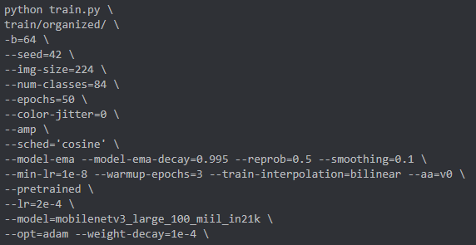
ADVANTAGES
FINE TUNING
Tuning hyperparameters to achieve higher accuracy
LIGHTWEIGHT
Built for mobile, balances accuracy with latency
TIME SAVING
Relatively less complex, train multiple epochs

Slide 7
ADVANTAGES
FINE TUNING
Tuning hyperparameters to achieve higher accuracy
LIGHTWEIGHT
Built for mobile, balances accuracy with latency
TIME SAVING
Relatively less complex, trains multiple epochs

Slide 8
DISTRIBUTION
02
Docker Image on Raspberry Pi

Slide 9




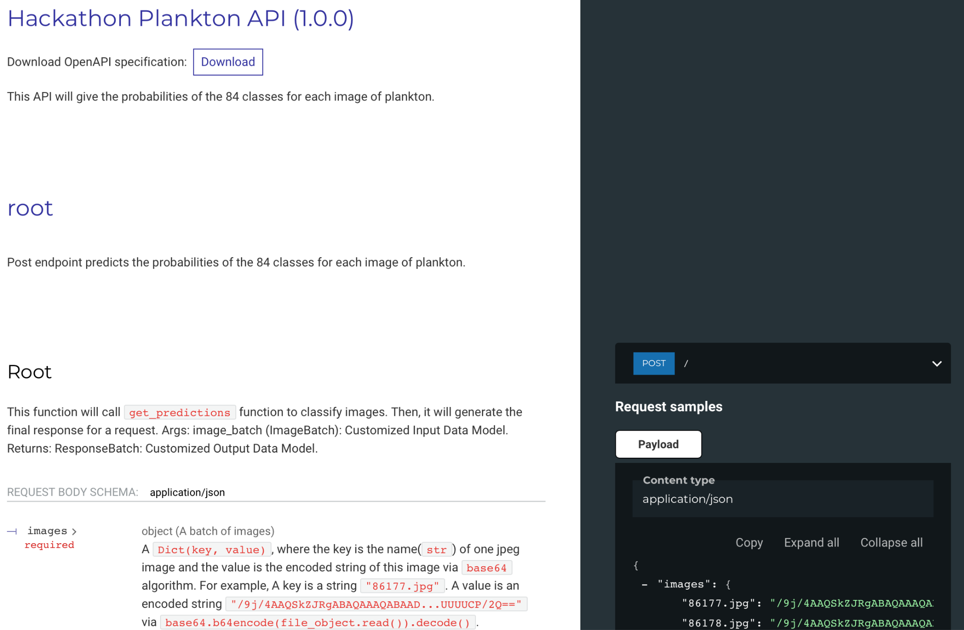


ARCHITECTURE
Notes:
Introduce self
Architecture as per Plankthon Challenge set by Veolia and the Tara Ocean Foundation
Low powered Unit: Raspberry Pi
Docker image
Minimum App functionality: local web server to upload images in base64 encoded strings
Solution to include proper trained model and app dependencies whilst maintaining low requirements. Predicted response of 84 probabilities for each image

Slide 10
ADVANTAGE
01
02
03
04
CONSISTENT
LIGHTWEIGHT
Standardised environment, portable
Shares host resources, only runs packaged app
ISOLATED
SPEEDY
No external dependencies, no remnants on delete
No boot sequence,
low resource overhead
Notes:
Advantage of our approach
Consistent environment: Python & reusable libraries
Light weight, without a need for external software, we reuse resources from within the docker container
Isolated: since there are no external dependencies, removing the app is as simple as deleting the docker container
Speedy: Without a need for boot sequence and driver loadings,

Slide 11
ADVANTAGE
01
CONSISTENT
Standardized environment
Portable
02
LIGHTWEIGHT
Shares host resources
Only runs packaged app
03
ISOLATED
No external dependencies
No remnants on delete
04
SPEEDY
No boot sequence
Low resource overhead

Slide 12

DATA VIZ.
03
Easily view collected data

Slide 13
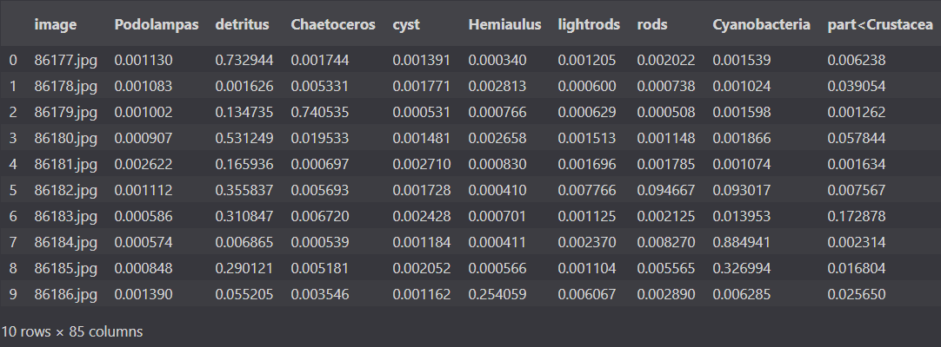
DATA VISUALISATION
INFORMATIVE
VISUALLY APPEALING
EASY TO READ
Notes:
As our machine learning model became more accurate we had a ton of information in that we wanted to process. A bunch of numbers that we got as probabilities needed to be converted into a figure.
Our main goals for the figure were
Informative
The figure had to convey the relevant information and statistics to the user.
Visually Appealing
The shown charts graphs and images needed to have a proper design and architecture that is pleasing to the human eye.
Easy to read
We wanted the reader to retrieve the information from the figure within the first few seconds of looking at it.

Slide 14
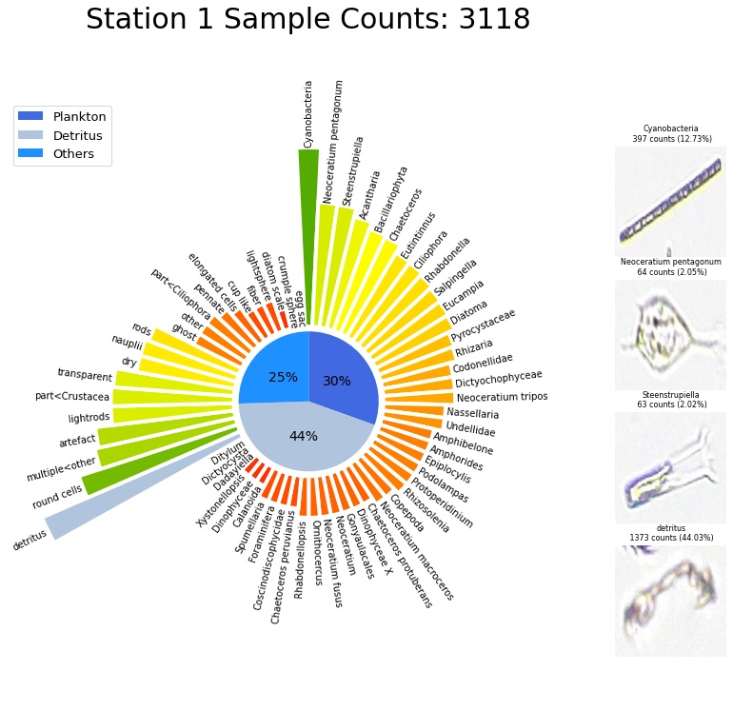
FIGURE ANATOMY
TOTAL SAMPLES
POLAR BAR CHART
IMAGES
PIE
CHART
Notes:
# Not sure about ‘FIGURE ANATOMY’ as a title although linguistically it’s acceptable # Change ‘Polar Bar Chart’ to ‘Ordered Genus’
# Change ‘Pie Chart’ to ‘*Categorical/*General Distribution’ * - either one # Change ‘Images’ to ‘Dominant Sampling’ # Redundant use of ‘Total Samples’ # List down points to speak into on why we choose these specific charts/layout and how functional it is/could be

Slide 15
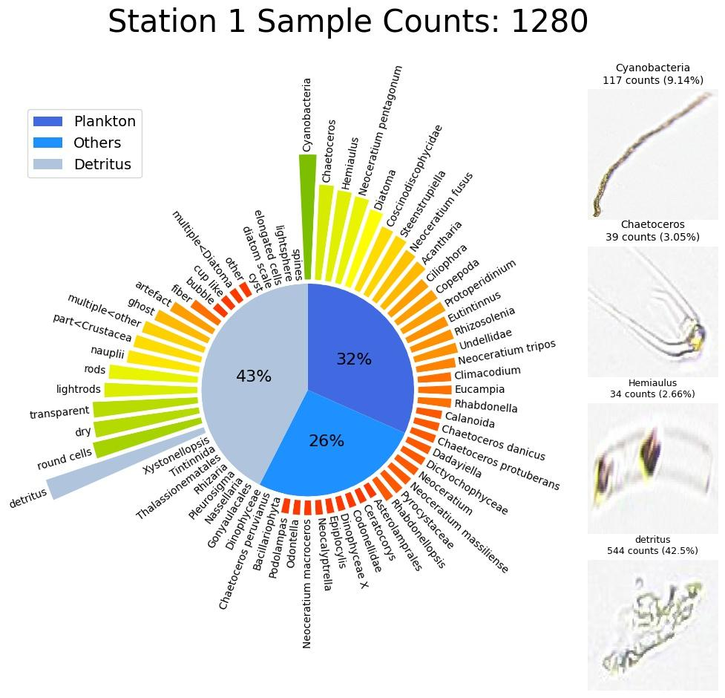
FIGURE BREAKDOWN
GENERAL DISTRIBUTION
Summary of sample content
ORDERED GENUS
Categorised as plankton | others, scaled
DOMINANT SAMPLING
MorphoCut extracted images
Notes:
The general distribution is split into a pie chart of 3 parts
It is used for differentiating between labeled planktons , unlabeled planktons and detritus.
We also have a polar bar chart to represent the amount of that certain plankton in the sample. It starts from the most to least plankton, then detritus and other unlabeled planktons.
Lastly we are showing images of the dominant genera on the left of our figure which will be directly taken from the morpho cut.

Slide 16
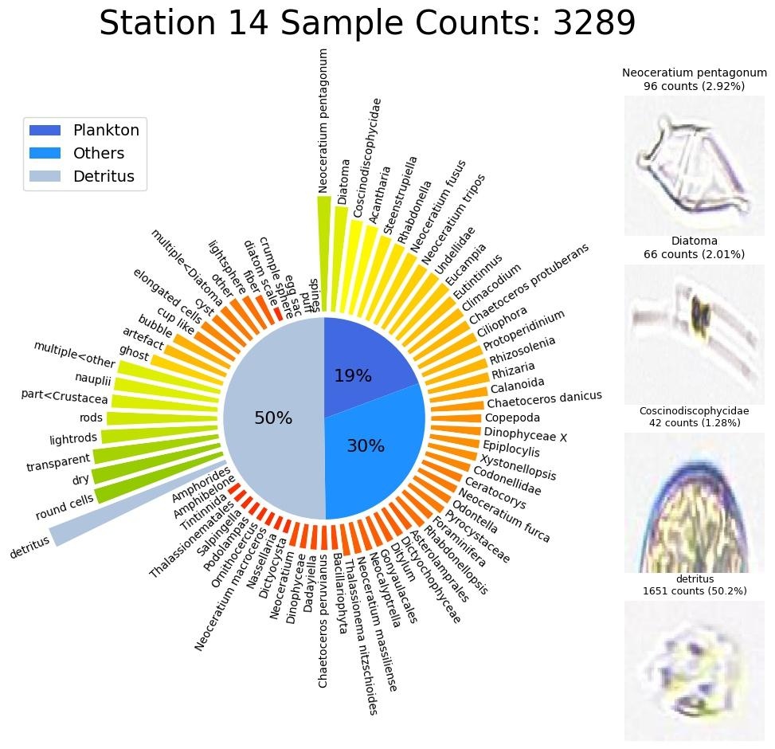
COMPARISON
Notes:
Easily distinguishable from each other
Compare two figures counts, images, proportion of plankton to detritus and other generally similar shapes
Data viz method scales

Slide 17
PROPOSAL
04
End-to-end solution

Slide 18
WHY OUR APPROACH?
01
02
03
04
LIGHTWEIGHT
INTEGRATION
Pandas & matplotlib
All the good stuff in a single Docker container image
SPEEDY
SCALABLE CODE
Generate informative charts within seconds
More than just charts?
Notes:
Lightweight - minimal dependencies - pandas to parse & manipulate data from body.json & response.json - matplotlib to simply generate the figure - all data visualised using just the packages, and body.json & response.json, nothing less nothing more
Integration - written in Python - easily integrate with Docker server - API endpoint to generate & view charts (for example) - anyone in the Planktoscope’s local network can visit URL / make HTTP requests to see the charts
Speed - generate charts in seconds, literally! - 0-3 seconds - most importantly, our charts are designed to only show important bits
Scalable Code - overtime, requirements and/or demands change over time - make changes to the code, rebuild & push (that’s it!!) - add coordinates, more descriptive titles (for example) - parse json to output csv (for example)

Slide 19
THANKS!

Slide 20
Instructions for use (free users)
In order to use this template, you must credit Slidesgo by keeping the Thanks slide.
You are allowed to:
Modify this template.
Use it for both personal and commercial purposes.
You are not allowed to:
Sublicense, sell or rent any of Slidesgo Content (or a modified version of Slidesgo Content).
Distribute this Slidesgo Template (or a modified version of this Slidesgo Template) or include it in a database or in any other product or service that offers downloadable images, icons or presentations that may be subject to distribution or resale.
Use any of the elements that are part of this Slidesgo Template in an isolated and separated way from this Template.
Delete the “Thanks” or “Credits” slide.
Register any of the elements that are part of this template as a trademark or logo, or register it as a work in an intellectual property registry or similar.
For more information about editing slides, please read our FAQs or visit Slidesgo School:
https://slidesgo.com/faqs and https://slidesgo.com/slidesgo-school

