Slide 1

🌱 ECO AFYA
Make every
choice count.
A clearer way to choose food that is good for your body and kinder to the planet.
PRODUCT PRESENTATION
Health insight × environmental insight
02 SEPTEMBER 2026

Slide 2
THE ECO AFYA APPROACH
The everyday food decision is overloaded.
Labels are everywhere. Clarity is not.
01
02
03
Nutrition is hard to scan
Impact stays invisible
Good intentions fade
People want to understand what they are eating without decoding a wall of labels.
The environmental cost of a product rarely appears beside the choice itself.
Without a simple way to save and reflect, healthy habits are difficult to sustain.
Eco Afya turns scattered information into one calm, actionable decision.

Slide 3
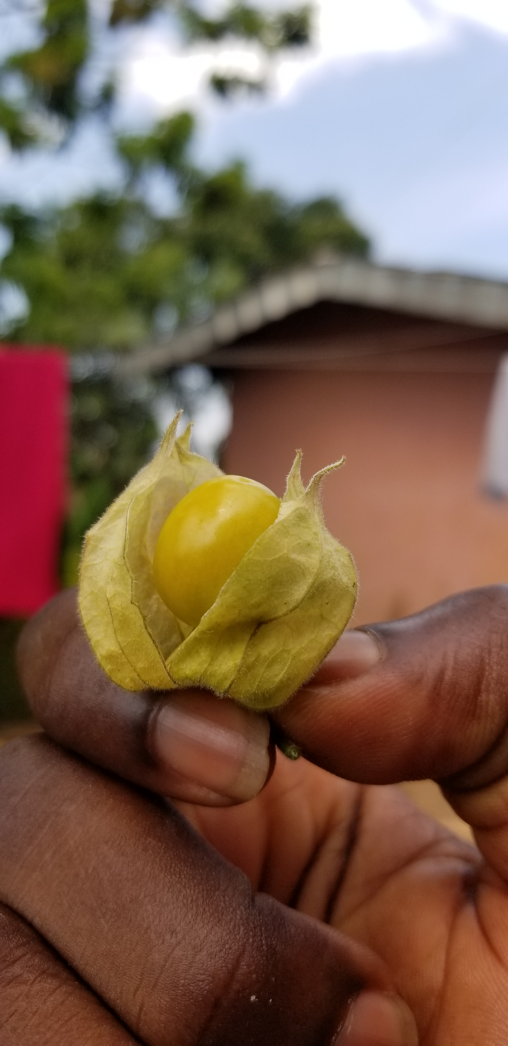
THE ECO AFYA APPROACH
One place to understand the choice.
Eco Afya connects food discovery, personal context, and better habits.
OUR PROMISE
See the food.
Read the signal.
Choose with confidence.
Built for everyday people, local food stories, and decisions that add up over time.
NUTRITION
PLANET
WELLNESS

Slide 4
THE ECO AFYA APPROACH
A three-step journey from curiosity to habit.
Every feature has one job: make the next good choice easier.
🔎
01
🥗
02
❤️
03
DISCOVER
UNDERSTAND
REMEMBER
Browse a focused catalogue or search the wider food database.
Compare Nutri-Score, Eco-Score, ingredients, and product details.
Save favourites and keep a personal food log to build awareness over time.
The result: less guesswork, more agency.

Slide 5
THE ECO AFYA APPROACH
The product card is the decision surface.
A compact view of the signals that matter most.
🥜
01
Nutri-Score
Peanut Butter
Fast nutritional orientation
Bega · food product
B
D
02
Eco-Score
Nutrition
Planet
Environmental context
View details →
03
Ingredients
A product page can go deeper when the user wants ingredients, barcode information, and a full breakdown.
Transparent product detail

Slide 6
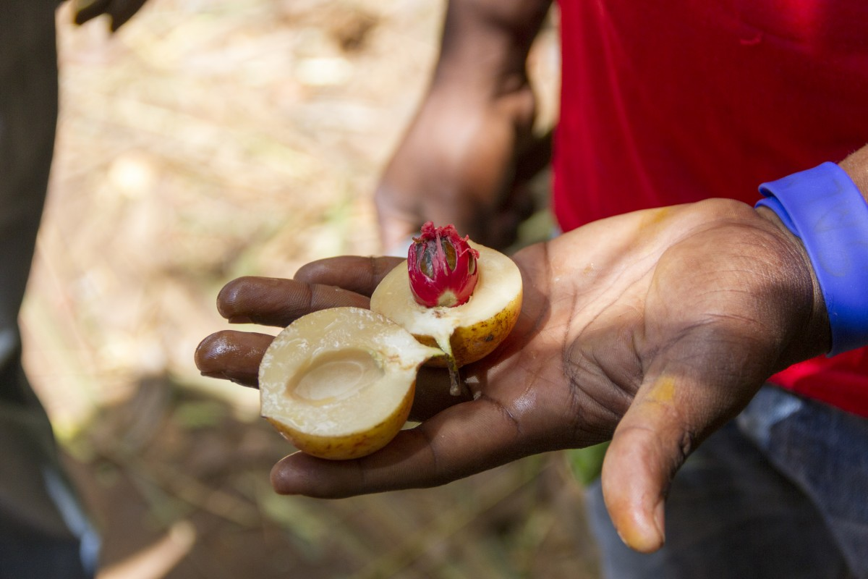
THE ECO AFYA APPROACH
The personal layer turns information into momentum.
The app remembers what matters to each user.
♥
Favourites
Keep promising products close and compare them later.
✎
Food logs
Record a choice, add a note, and reflect on patterns.
⌁
Protected account
Personal records stay attached to the authenticated user.

Slide 7
THE ECO AFYA APPROACH
A lightweight full-stack foundation.
A practical architecture for a product that can grow with its users.
React + Vite
Flask API
PostgreSQL
Responsive interface
Auth + food logs
Users + records
Open Food Facts
Product intelligence
Designed to keep the user experience calm while the data and ownership rules stay explicit underneath.

Slide 8
THE INVITATION
Better choices
start with better context.
IMAGE SOURCES
Ghana cacao2.jpg
Wikimedia Commons
Local wild fruit in Bamenda, Cameroon
Wikimedia Commons
Nutmeg, spice, Zanzibar farming
Pxhere · photo 130131
Eco Afya makes nutrition and sustainability part of the same everyday conversation.
LIVE PRODUCT DEMO
eco-afya.vercel.app
Thank you

