Slide 1
COMP 3522
Object Oriented Programming in C++
Testing and debugging

Slide 2
Agenda
COMP 3522
Introduction
Fundamentals of Testing
Kinds of Tests
Strategies

Slide 3
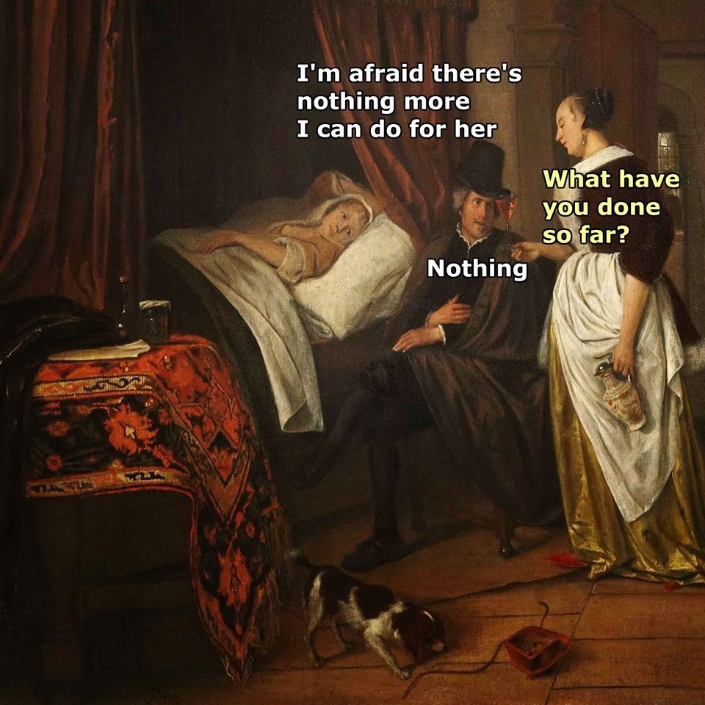

Slide 4
What’s the Output?
public void test()
{
int sum = 1;
for (int i = 0; i <= 4; i++);
{
sum = sum + 1;
}
System.out.println("The result is: " + sum);
System.out.println("Double result: " + sum + sum);
}

Slide 5
Solution
public void test()
{
int sum = 1;
for (int i = 0; i <= 4; i++);
{
sum = sum + 1;
}
System.out.println("The result is: " + sum);
System.out.println("Double result: " + sum + sum);
}
Notes:
The result is: 2
Double result: 22

Slide 6
We Must Deal with Errors!
Early errors are usually syntax errors
Our browser/IDE may spot these
We can use code quality tools with our IDE
Later errors are usually logic errors
Also known as BUGS
Our browser/IDE cannot help with these
Some logical errors have no immediately obvious manifestation

Slide 7
Typical Error Situations
Implementing a class or method incorrectly
Failing to meet the specification
Making an inappropriate object request
invalid index
Generating an inconsistent or inappropriate object state
arising through class extension

Slide 8
Not ALWAYS Programmer Error*
Errors often arise from the environment:
Incorrect URL entered
Network interruption
File processing is particular error-prone:
Missing files
Lack of appropriate permissions
* ^^but ^^it ^^usually ^^is

Slide 9
Prevention vs Detection
We can lessen the likelihood of errors:
Use software engineering techniques, like encapsulation.
We can improve the chances of detection:
Use software engineering practices, like modularization and documentation.
We can test and debug our code

Slide 10
Testing != Debugging
Testing reveals the EXISTENCE
of a problem
vs
Debugging pinpoints the SOURCE of a problem
The manifestation may occur some distance from its ‘source’
These are crucial skills!

Slide 11
Debugging Review
Print statements
Walkthroughs
Debuggers

Slide 12
Print Statements
The most popular technique
Ensure you use them in the correct places in the correct methods
Output may be voluminous!
Turning off and on requires forethought

Slide 13
Walkthroughs (often Manual!)
Tabulate the values of key variables
Document state changes after each function call
Verbal Walkthrough is when you describe your code to a peer
They might spot the error
The process of explaining might help you to spot it for yourself
Formal group-based processes exist for conducting formal walkthroughs /inspections

Slide 14
Debuggers
Debuggers are both language- and environment-specific
Set breakpoints
Execute line by line using Step and Step-into controlled execution
Track the call sequence (stack)
Monitor variable value and object state

Slide 15
IN CLASS ACTIVITY
Write a simple program that loops through range of integers and aggregates the sum.
Use the CLion debugger to set a breakpoint and watch the value of the aggregator value increase with each loop.
Neat.

Slide 16
Testing = Verification + Validation
Verification: “Did we build the app correctly?”
Discover situations in which the behavior of the software is incorrect or undesirable
Validation: “Did we build the correct app?”
Demonstrate to the developer and the customer that the software meets its requirements

Slide 17
Testing Axioms
Testing can’t show that bugs don’t exist
A bug is a bug only if it’s observed. Bugs that haven’t been found yet are simply undiscovered bugs.
We cannot fix all the bugs in a software application
It is virtually impossible to find subtle bugs in a program while it still contains major bugs
Specifications and requirements are a moving target; features will be added, removed, or changed during development.

Slide 18
Testing Fundamentals
Start with the basics:
Format and organize your code
Document your code
Apply what you’ve learned in 1510, 1536, 2510, 2526, … for variable and function names, constant usage, etc.
Use the code analysis tools in CLion:
Quickfix suggestions (the lightbulb)
Analysis suggestions in the right-hand margin
Wiggly underlines that signify unused variables or errors.

Slide 19
Static and Dynamic Testing
Dynamic testing: testing the app by providing an input, receiving an output and comparing the output to the expected behavior.
Static testing: reviewing the
Source code
Documentation
Project plan.

Slide 20
Testing Fundamentals
Understand what the test subject should do – its contract – and look for violations
Use positive tests and negative tests
+ testing the subject using valid data
- testing the subject using invalid data
Notes:
A positive test checks if behaves as expected with its EXPECTED input.
A negative test checks if behaves as expected with BAD input.

Slide 21
Testing Fundamentals
Test boundaries:
Zero, One, Full.
Max/Min
Just inside/just outside boundaries
Typical values
Error values
Create DISJOINTED EQUIVALENCE PARTITIONS
Notes:
A positive test checks if behaves as expected with its EXPECTED input.
A negative test checks if behaves as expected with BAD input.

Slide 22
Disjointed Equivalence Partitions
Coverage: Identify what types of inputs are going to be processed in a similar way (equivalent behaviour)
Disjointedness: Each group of inputs is a partition
Representation: Each test should exercise one and only one equivalence partition
Math lovers: it’s like the Cartesian product

Slide 23
Equivalency Partition Example
Suppose we create a function that will correctly process a number between 100 and 999
Equivalence partitions:
Less than 100
100 to 999
Greater than 999
Choose 5 tests:
50 (waaay off)
100 and 999 (the boundaries)
500 (some arbitrary value inside)
1500 (waaay off)

Slide 24
Testing Tactics
Functional (black box)
Tests based on specifications
Treat system as atomic
Covers as much specified behaviour as possible
Structural (white box)
Tests based on code
Examines system internals
Covers as much implemented behaviour as possible

Slide 25
Kinds of Testing we’ll use in COMP 3522
Assertions
Unit Tests
Regression Testing

Slide 26
Assertions
Assertions let us document and check:
Preconditions (what must the user promise when using the code)
Postconditions (what the code promises if preconditions are met)
Invariants (what never, ever changes)

Slide 27
Assertions
The macro assert from header <cassert> is inherited from C
Evaluates an expression, immediately terminates the program if false
Easy to turn off by defining NDEBUG before including <cassert>
#define NDEBUG // Turns off assertions
#include <cassert>

Slide 28
Assertion example
#include <cassert>
// Compute square root of non-negative number
double square_root(double x)
{
check_somehow(x >= 0);
… // Perform our calculation
assert(result >= 0.0); // Should be positive
return result;
}

Slide 29
Unit Tests
WHAT: a piece of code that exercises a very small, specific area of functionality applied to one of the functions being tested.
HOW: A unit test invokes a particular function or method in a particular context.
EXAMPLE: add a large value to a sorted list, then confirm that this value appears at the end of the list.
GOAL: isolate important parts of program and show they are free of certain faults early in the development life cycle.

Slide 30
Unit Tests
A unit is the smallest testable part of an application
Each unit of an application is tested in isolation:
Function
Method
Behaviour
Composite components with defined interfaces used to access their functionality

Slide 31
Each unit test should:
Assemble
Act
Assert

Slide 32
For each unit test, consider:
Starting state
Inputs to which the unit responds
Expected results or end state

Slide 33
I ❤ Java! Let’s Review JUnit
We all know Java and Eclipse really well
JUnit is a Java unit test framework
Test methods are methods that contain tests
Test cases are classes that contain test methods
Assertions are used to assert expected method results at the end of each test case
Fixtures are set up and used in multiple tests

Slide 34
What about C++?
Lots of Unit Testing Frameworks
We will learn how to use:
Catch.

Slide 35
Test Automation
Good testing is a creative process, but ...
... thorough testing is time consuming and repetitive
Test frameworks exist to support automation
Regression testing involves re-running tests
We build a test suite of all our tests

Slide 36
Regression Testing
Whenever you find and fix a bug
Add a test for it
Rerun all your tests
Why?
We can reintroduce old bugs when fixing new bugs
We populate a test suite with thorough tests
Run regression tests as frequently as possible

Slide 37
Strategy: Test Driven Development
Write test cases first to cover new functionality or improvement
Implement the required function
Code is “complete” when tests pass
Refactor and pass tests again if design could be better
Test Driven Development: Developer can write hundreds or thousands of unit tests before writing a single line of code!

Slide 38
Strategy: Simplify (part 1 of 2)
Find the simplest “test input” that provokes a bug
This is often not the input that revealed the existence of the bug
Start with data that revealed the bug
Keep narrowing (binary search, anyone?)
When not dealing with simple function calls, think of “test input” as the set of steps needed to reliably trigger the bug

Slide 39
Strategy: Simplify (part 2 of 2)
Take advantage of:
Modularity
Start with everything, take away pieces until bug disappears
Start with nothing, add pieces until bug appears
Modular Reasoning
Trace through program and view intermediate results
Use binary search to speed things up!
Bug happens between 1st and last statements
Perform a binary search on that ordered set of statements

Slide 40
Remember
Errors are a fact of life in software development
Good software development techniques can reduce their occurrence
Employ a range of debugging and testing approaches
Testing and debugging skills are essential
Make testing a habit
Automate testing where possible
Continually repeat tests
FIN

