Slide 1
What is Cooperative Housing?
La Reunion Cooperative – 2016

Slide 2
Well, what is cooperation?
Dictionaries lend some insight:
Working with others toward the same end
Assisting others
A common effort

Slide 3
Working with others toward the same end
<Picture of a meeting for which we have permission>

Slide 4
Assisting others
<Picture for which I have a waiver>

Slide 5
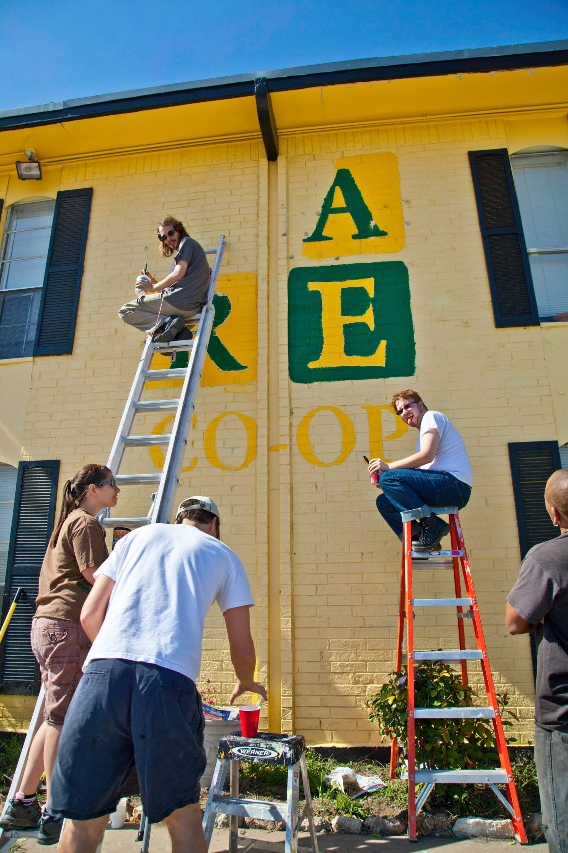
A Common Effort

Slide 6
Cooperation is that, as an economy
We all have some shared basic needs
  Food
  Shelter
  Wifi
Some of us have unique needs
  Physical
  Financial
  Emotional
And yet all too often these needs are not met.

Slide 7
How do solvable problems not get solved?
Governance
  Many people have little or no voice
Economic Participation
  A rented life is not one you have stake in
Division
  Organizing is difficult on top of other responsibilities
  How do you even know others will join you?

Slide 8
Cooperation is Collective Empowerment
Skip the “if you can’t beat ‘em” part and just join them!
Democratic member control
Member economic participation
Voluntary and open membership

Slide 9
Cooperative Housing puts the “you” in “US”
Members meet and vote
Members pay dues and volunteer
  Collective ownership of profits
  Lowered costs: don’t pay someone else to sweep!
  Encourages a sense of community
The community is inclusive and welcomes all.
Sorry for the pun.

Slide 10
A little history
Rochdale Society of Equitable Pioneers, 1844
  College cooperatives
  ICC Ann Arbor, 1937
  NASCO, 1968
Meanwhile, in Texas ...
  ICC Austin, 1930s
  College Houses, 1960s
  CHEA -- that's us!

Slide 11
Rochdale Principles
Voluntary and Open Membership
Democratic Member Control
Member Economic Participation
Autonomy and Independence
Education, Training, and Information
  Hey, that's what I'm doing here!
Cooperation Among Cooperatives
Concern for Community

Slide 12
Okay but how does it work?
Case study: La Reunion Cooperative
Founded in 2013 by volunteers
  Most lived in coops previously
  Part of larger organization, CHEA
Purchased with help from NASCO Properties
  Arm of NASCO which develops and helps coops
  CHEA itself elects a member to the NP board
Residents meet once a week
  Decide policy
  Approve expenses
  Review membership when necessary
  Eat dinner and talk together!

Slide 13
La Reunion is just one house …
Community Housing Expansion of Austin (CHEA)
Founded in 2002 by former college coop residents
First house, Sasona, bought in south Austin
Joined NP after meeting difficulties
Each house selects two members to the CHEA board
  A fifth community representative is elected by the general membership
  CHEA also elects a representative to the NP board
Board monitors and ensures the legal and financial stability of the houses and delegates much responsibility to the houses

Slide 14
And it DOES work!
Rent is very competitive compared to surrounding market
Both houses are independently financially solvent
Houses are empowered to take care of themselves, and they do.
  No assembly of more than 1 person will ever be free of conflict
  Cooperation is how we face problems
Coops exist around the country
Every year hundreds meet in Ann Arbor, MI to discuss housing, social issues, and other topics of interest to communities.
“No [person] is an island.” - John Donne

Slide 15
Stats are worth 1000 words
 | Coop rent / room | Neighborhood rent / room
La Reunion (Wooten) | $360 | $427.50 | 84.2 %
ICC (West Campus) | $565 | $904.35 | 62%
Sasona (Zilker) | $660 | $1,238 | 53%
Sunflower (Bouldin Creek) | $375 | $1,376 | 27%

Slide 16
Questions?
CHEA website: http://chea.coop
La Reunion: http://lareunioncoop.org
  info@lareunioncoop.org
Sasona: http://sasona.org
NASCO: http://nasco.coop

