Slide 1
PLINK / Haploview
Whole genome association software tutorial

Slide 2
Overview of the PLINK software package
A simulated WGAS dataset
Summary statistics and quality control
Assessment of population stratification
Whole genome association screen
Further exploration of ‘hits’
Visualization and follow-up using Haploview
PLINK tutorial, October 2006; Shaun Purcell, shaun@pngu.mgh.harvard.edu

Slide 3
Overview of the PLINK software package
A simulated WGAS dataset
Summary statistics and quality control
Assessment of population stratification
Whole genome association screen
Further exploration of ‘hits’
Visualization and follow-up using Haploview

Slide 4
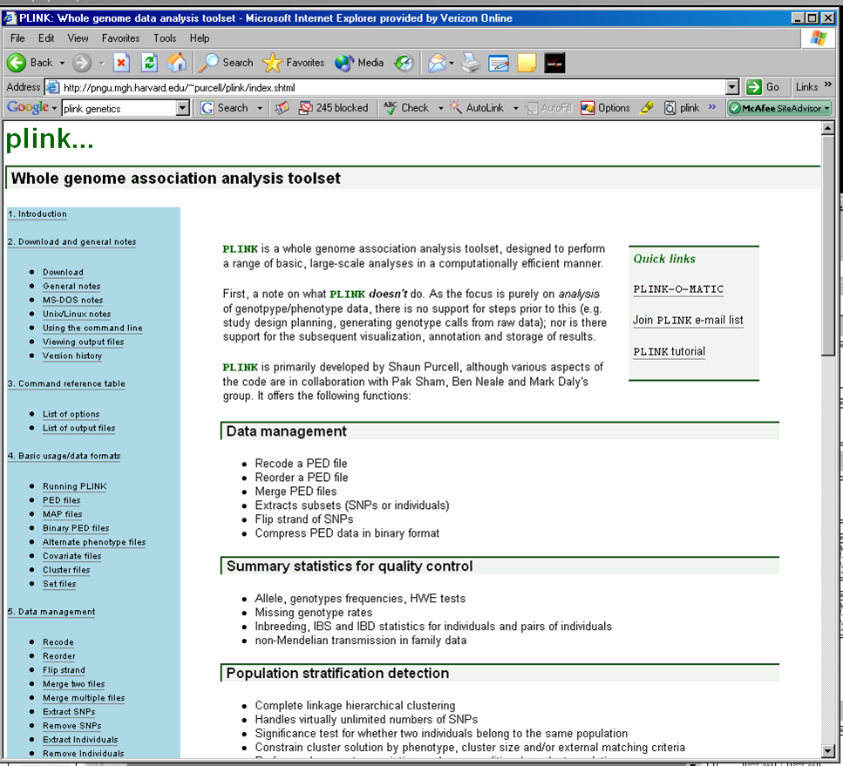
http://pngu.mgh.harvard.edu/purcell/plink/
Data management
Summary statistics
Population stratification
Association analysis
IBD estimation

Slide 5
Cardinal rules
Always consult the log file, console output
Also consult the web documentation
  regularly
PLINK has no memory
  each run loads data anew, previous filters lost
Exact syntax and spelling is important
  “minus minus” …

Slide 6
Overview of the PLINK software package
A simulated WGAS dataset
Summary statistics and quality control
Assessment of population stratification
Whole genome association screen
Further exploration of ‘hits’
Visualization and follow-up using Haploview
PLINK tutorial, October 2006; Shaun Purcell, shaun@pngu.mgh.harvard.edu

Slide 7
Simulated WGAS dataset
Real genotypes, but a simulated “disease”
90 Asian HapMap individuals
  ~228.7K autosomal SNPs
Simulated quantitative phenotype; median split to create a disease phenotype
Illustrative, not realistic!

Slide 8
Questions asked in this demonstration
1) What is the genotyping rate?
2) How many monomorphic SNPs are there in this sample?
3) Is there evidence of non-random genotyping failure?
4) Is there evidence for stratification in the sample? Does our knowledge about the different populations correct for this bias?
5) What is the single most associated SNP not controlling for stratification? Does it reach genome-wide significance?
6) Is there evidence for stratification conditional on the two-cluster solution?
7) What is the best SNP controlling for stratification. Is it genome-wide significant?
For the most highly associated SNP:
8) Does this SNP pass the Hardy-Weinberg equilibrium test?
9) Does this SNP differ in frequency between the two populations?
10) Is there evidence that this SNP has a different association between the two populations?
11) What are the allele frequencies in cases and controls? Genotype frequencies? What is the odds ratio?
12) Is the rate of missing data equal between cases and controls for this SNP?
13) Does an additive model well characterize the association? What about genotypic, dominant models, etc?

Slide 9
Data used in this demonstration
Available at http://pngu.mgh.harvard.edu/~purcell/plink/hapmap1.zip/
wgas1.ped Text format genotype information
wgas1.map Map file (6 fields: each row is a SNP: chromosome, RS #, genetic position, physical position, allele 1, allele 2)
chinese.set FID and IID for all Chinese individuals
pop.cov Chinese/Japanese population indicator (FID, IID, population code)

Slide 10
Making a binary PED fileset
If no --out {filename} option is specified, then all new files have the form:
plink.{extension}
plink --file wgas1 --make-bed --out example
Three files will be created:
example.bed (genotypes)
example.bim (map file)
example.fam (family/phenotype)
--file {filename}
loads in two files
wgas1.ped
and wgas1.map
By default, no filtering occurs at this stage
  all individuals and SNPs are included in the binary fileset
PLINK tutorial, October 2006; Shaun Purcell, shaun@pngu.mgh.harvard.edu

Slide 11
Overview of the PLINK software package
A simulated WGAS dataset
Summary statistics and quality control
Assessment of population stratification
Whole genome association screen
Further exploration of ‘hits’
Visualization and follow-up using Haploview
PLINK tutorial, October 2006; Shaun Purcell, shaun@pngu.mgh.harvard.edu

Slide 12
Data management
Recode dataset (A,C,G,T → 1,2)
Reorder dataset
Flip DNA strand
Extract subsets (individuals, SNPs)
Remove subsets (individuals, SNPs)
Merge 2 or more filesets
Compact binary file format

Slide 13
Extracting the Chinese subset
Three files will be created:
Chinese.bed (binary ped)
Chinese.fam (family file)
Chinese.map (map file)
plink --bfile example -–keep chinese.set --out Chinese --make-bed
Extracts out the individuals listed in the chinese.set file
Log file will display the overall genotyping rate
All SNPs and individuals are included for making ped files
PLINK tutorial, October 2006; Shaun Purcell, shaun@pngu.mgh.harvard.edu

Slide 14
Summarizing the data
Hardy-Weinberg
Mendel errors
Missing genotypes
Allele frequencies
Tests of non-random missingness
  by phenotype and by (unobserved) genotype
Individual homozygosity estimates
Stretches of homozygosity
Pairwise IBD estimates

Slide 15
What is the genotyping rate?
Two files will be created:
plink.imiss (individual)
plink.lmiss (SNP)
plink --bfile example --missing
--bfile {filename}
loads in the binary format fileset (genotype, map and pedigree files)
Log file will display the overall genotyping rate
By default, low genotyping individuals are first excluded
PLINK tutorial, October 2006; Shaun Purcell, shaun@pngu.mgh.harvard.edu

Slide 16
How many monomorhpic SNPs?
Using filters to include all individuals and SNPs
--mind (individual missing rate)
--geno (genotype missing rate)
--maf (SNP allele frequency)
plink --bfile example --mind 1 --geno 1 --maf 0
--max-maf 0
Filter --max-maf sets the maximum minor allele frequency
Command must still be entered all on a single line
PLINK tutorial, October 2006; Shaun Purcell, shaun@pngu.mgh.harvard.edu

Slide 17
Evidence for non-random genotyping failure?
Association between failure and phenotype (per SNP)?
plink --bfile example –-test-missing
plink --bfile example –-test-mishap
Association between failure and genotype (per SNP)?
These two commands generate output files plink.missing and plink.missing.hap respectively.
PLINK tutorial, October 2006; Shaun Purcell, shaun@pngu.mgh.harvard.edu

Slide 18
An example of non-random genotyping failure
--test-mishap (plink.missing.hap)
LOCUS HAPLOTYPE F_0 F_1 M_H1 M_H2 CHISQ P
rs1631460 33 0.5 0.0183 7/3 7/161 56.4 5.77e-14 rs1631460 22 0.5 0.9820 7/161 7/3 56.4 5.77e-14 rs1631460 HETERO 1.0 0.0366 7/3 0/79 60.0 9.39e-15
CHR SNP F_MISS_A F_MISS_U CHISQ_MISS P_MISS
4 rs1631460 0.0625 0.09756 0.3751 0.5402
For this particular SNP, genotyping failure consistently
occurs on a particular haplotypic background …
--test-missing (plink.missing)
…but is still random with respect to phenoype

Slide 19
Overview of the PLINK software package
A simulated WGAS dataset
Summary statistics and quality control
Assessment of population stratification
Whole genome association screen
Further exploration of ‘hits’
Visualization and follow-up using Haploview
PLINK tutorial, October 2006; Shaun Purcell, shaun@pngu.mgh.harvard.edu

Slide 20
Population stratification: confounding
Artificially inflates test statistic distribution
Detectable using genome-wide data
  I’ll be speaking Thursday modeling stratification
We’ll run association and correct for it
PLINK tutorial, October 2006; Shaun Purcell, shaun@pngu.mgh.harvard.edu

Slide 21
Overview of the PLINK software package
A simulated WGAS dataset
Summary statistics and quality control
Assessment of population stratification
Whole genome association screen
Further exploration of ‘hits’
Visualization and follow-up using Haploview
PLINK tutorial, October 2006; Shaun Purcell, shaun@pngu.mgh.harvard.edu

Slide 22
Association analysis
Case/control
  allelic, trend, genotypic
  general Cochran-Mantel-Haenszel
Family-based TDT
Quantitative traits
Haplotype analysis
  focus on “multimarker predictors”
Multilocus tests, epistasis, etc

Slide 23
Most highly associated SNP?
Standard case/control association
plink --bfile example –-assoc --adjust
Generate extra output file of rank-ordered p-values, including p-values adjusted for multiple testing
Two output files: plink.assoc (sorted by physical position) and plink.assoc.adjusted (sorted by p-value)
Log file/console also displays genomic control inflation factor in log file / console
PLINK tutorial, October 2006; Shaun Purcell, shaun@pngu.mgh.harvard.edu

Slide 24
Stratified analysis
Cochran-Mantel-Haenszel test
Stratified 2×2×K tables
A | B
C | D
A | B
C | D
A | B
C | D
A | B
C | D
A | B
C | D

Slide 25
Single SNP genome screen, conditional on cluster solution
Cochran-Mantel-Haenszel
test of association
plink --bfile example --mh --adjust
--within pop.cov
Use --within to specify a categorical clustering (i.e. to condition on). The file
pop.cov distinguishes Chinese from Japanese
Will generate plink.cmh and plink.cmh.adjusted, mirroring the two files generated by the standard --assoc command
PLINK tutorial, October 2006; Shaun Purcell, shaun@pngu.mgh.harvard.edu

Slide 26
Overview of the PLINK software package
A simulated WGAS dataset
Summary statistics and quality control
Assessment of population stratification
Whole genome association screen
Further exploration of ‘hits’
Visualization and follow-up using Haploview
PLINK tutorial, October 2006; Shaun Purcell, shaun@pngu.mgh.harvard.edu

Slide 27
The Truth…
 | Chinese | Japanese
Case | 34 | 7
Control | 11 | 38
 | “11” | “12” | “22”
Case | 4 | 24 | 21
Control | 17 | 20 | 4
Group difference
Single common variant
rs11204005 chr8

Slide 28
Does rs11204005 pass the HWE test?
For a single SNP, create standard PED fileset
plink --bfile example --snp rs11204005 --recode
--out hit
Will name files hit.ped and hit.map
plink --file hit --hardy
Loading a standard text-based PED file now so use --file, not --bfile
Creates file plink.hwe containing single SNP HWE results
PLINK tutorial, October 2006; Shaun Purcell, shaun@pngu.mgh.harvard.edu

Slide 29
Does rs11204005 differ in frequency between the two populations?
plink --file hit --assoc --pheno pop.cov
Use an alternate phenotype – instead of disease status, the outcome variable for the case/control analysis is now Chinese versus Japanese subpopulation membership
The file pop.cov is the same file that we used for the purposes of splitting the sample into the two groups for stratified anaylsis
PLINK tutorial, October 2006; Shaun Purcell, shaun@pngu.mgh.harvard.edu

Slide 30
Does rs2513514 (the most-associated SNP before controlling for subpopulation) differ in frequency between the two populations?
Selecting out a different single SNP from the original WGAS binary fileset
plink --bfile example --snp rs2513514
--assoc --pheno pop.cov
PLINK tutorial, October 2006; Shaun Purcell, shaun@pngu.mgh.harvard.edu

Slide 31
Does rs11204005 show different effects between the two populations?
Specify the Breslow-Day test for homogeneity of odds ratio as well as the Cochran-Mantel-Haenszel procedure
plink --file hit --mh --bd
--within pop.cov
PLINK tutorial, October 2006; Shaun Purcell, shaun@pngu.mgh.harvard.edu

Slide 32
Estimates of the allele, genotype frequencies and odds ratio for rs11204005 ?
Generates simple association
statistics for the single SNP, in plink.assoc
plink --file hit --assoc
Allele frequencies in plink.assoc
Genotypes counts are in plink.hwe (previously calculated)
Odds ratio in plink.cmh (previously calculated)
PLINK tutorial, October 2006; Shaun Purcell, shaun@pngu.mgh.harvard.edu

Slide 33
Similar case/control genotyping rates for rs11204005?
plink --file hit –-test-missing
Test of phenotype / genotype failure association, in plink.missing
PLINK tutorial, October 2006; Shaun Purcell, shaun@pngu.mgh.harvard.edu

Slide 34
Additive, genotypic models for rs11204005?
Force genotype tests, irrespecitve of genotype counts
plink --file hit --model --cell 0
Genotypic tests, reported in plink.model
Also includes the Cochran-Armitage trend test in plink.model
PLINK tutorial, October 2006; Shaun Purcell, shaun@pngu.mgh.harvard.edu

Slide 35
In summary
We performed whole genome
  summary statistics and QC
  stratification analysis
  conditional and unconditional association analysis
We found a single SNP rs11204005 that…
  is genome-wide significant
  has similar frequencies and effects in Japanese and Chinese subpopulations
  shows no missing or HW biases
  is consistent with an allelic, dosage effect
  has common T allele with strong protective effect ( ~0.05 odds ratio)

Slide 36
Overview of the PLINK software package
A simulated WGAS dataset
Summary statistics and quality control
Assessment of population stratification
Whole genome association screen
Further exploration of ‘hits’
Visualization and follow-up using Haploview
PLINK tutorial, October 2006; Shaun Purcell, shaun@pngu.mgh.harvard.edu

