Slide 1
Determination of Power for Mendelian and Complex Traits
John Rice
September 27, 2016

Slide 2
Hypothesis Testing
Type I and Type II error
Type I error – significance level
Type II error – 1-power
You need to understand this!

Slide 3
Significance and Power
H₀ = Null hypothesis
α = Type I error = significance level
= Probability of rejecting the null hypothesis assuming it is true
Use a test statistic – we know its distribution under the null hypothesis.
α/2 α/2
T X T
Reject if│x│> T (Two sided test)
α
X T
Reject if x> T (One sided test)

Slide 4
Two outcomes – Heads or tails; a “fair” coin has probability of 50% for each
Mendel’s Law – transmission of alleles from a parent is like a fair coin toss
If a parent has genotype Aa, half the gametes will have “A”, and half have “a”
Mendel’s Law can fail – eg, aa a lethal genotype – segregation distortion
Another example (TDT): The parents of an affected offspring will over-transmit if an allele is associated with the disease
Suppose 10 heterozygous parents (genotypes Aa) transmit allele A to affected offspring.
Under the null hypothesis, expect 5/10 (Mendel’s Law) to have allele A.
P(10/10) = (1/2)¹⁰ = .001; P(0/10) = (1/2)¹⁰ = .001
Reject null hypothesis (One sided test, p=.001; two sided test, p=.002)
Example: Flipping a coin

Slide 5
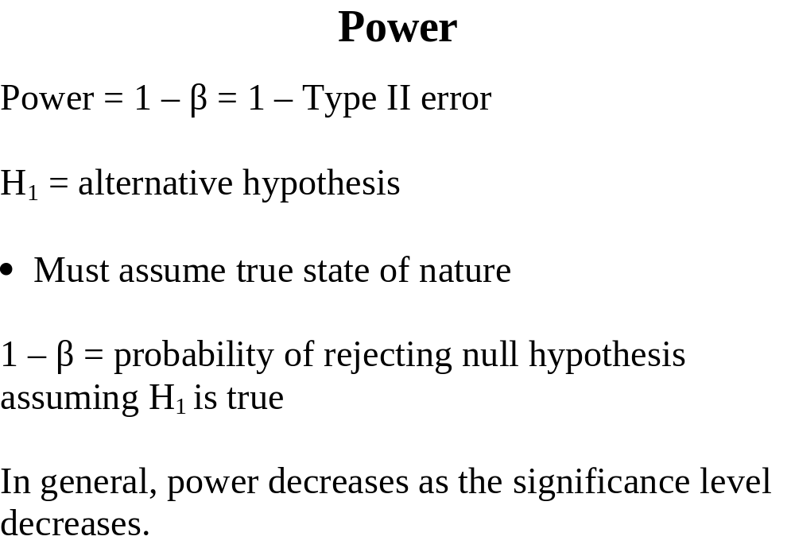

Slide 6
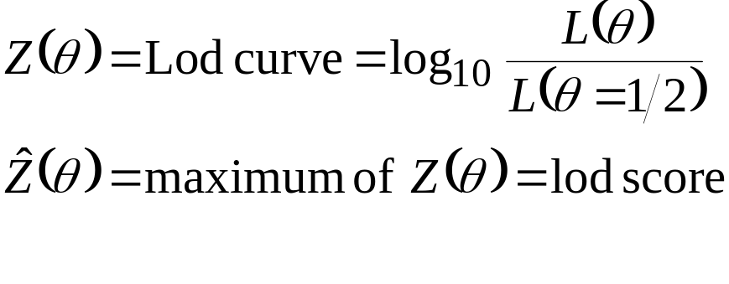
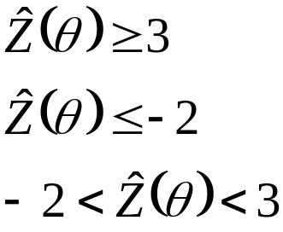
LOD Score
Nulll Hypothesis: θ = ½
Traditional cut-offs: Morton (1955)
LINKAGE
NO-LINKAGE
NEED MORE DATA
What is the p-value corresponding to a LOD of 3?
Where did these cut-offs come from?

Slide 7
Interpretation
A lod score of 3 means log₁₀ of the odds of linkage = 3. (lod= log of odds)
Often use log_{a}b to specify base a
Not really odds in statistical definition
Thus linkage is 1000 times more likely
What is the p-value for this test?

Slide 8
Change of base for logs
Statistics – use base e=2.71828…, not base 10
Ln means log to base e; log means log to base 10
We have to convert from base 10 to base e
If Log_{a}x=y
Then a^{y} = x (by definition)
Log_{b} (a^{y}) = log_{b}x
y Log_{b} (a) = log_{b}x
Therefore, Log_{a}x = log_{b}x/log_{b}(a)

Slide 9
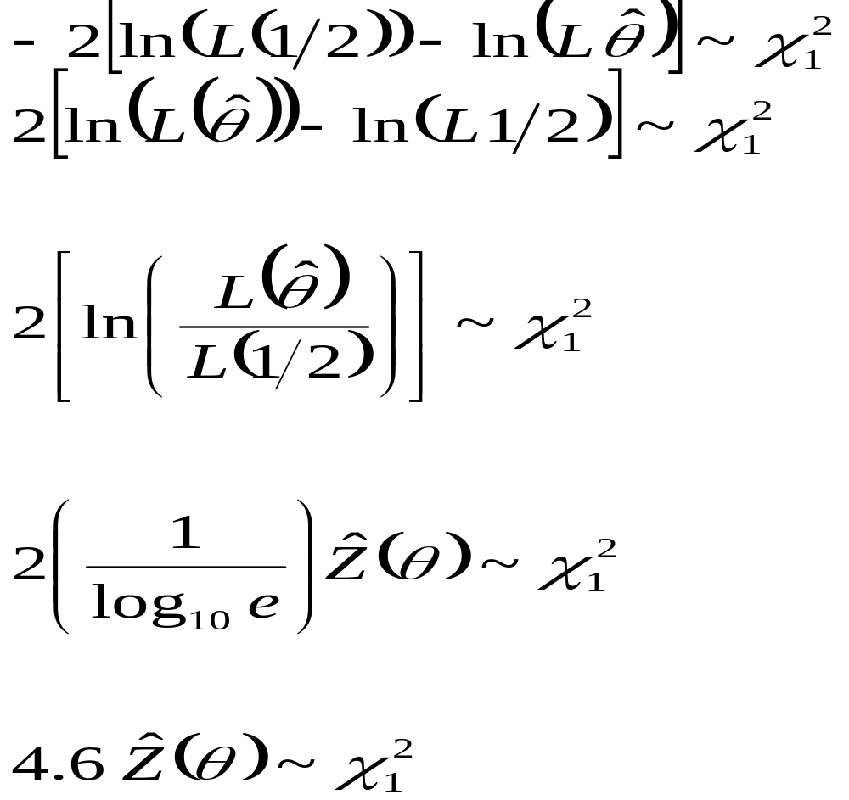
P-value for a Lod of 3
Lod score of 3 gives chi-square of 13.8, α = 0.0001 (one-sided)

Slide 10
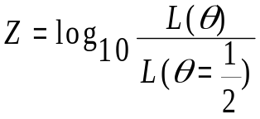

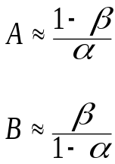
LOD Score of 3? (P118 of Neale)
Let Z = Lod score
For a Lod score of 3, α ≈ .0001, why so conservative?
Morton (1955) developed cut offs of –2 and +3 under Wald (1947) sequential sampling:
α = significance level
1 – β = power
α = .001, 1 – β = .99
gives log(A) = 3, log (β) = -2

Slide 11
Sequential (Wald) Test
Compute lod score on first family, conclude linkage, no linkage, or if -2 < lod < 3, compute lod score on first 2 families …
Sequential tests not really done:
  DNA is plated in 96 well plates, same work to do 96 subjects as 5 subjects
  Easier to genotype entire sample – reagents can go bad, etc.
  Makes grant budget a random variable

Slide 12
Why a conservative p-value?
Morton argues that the prior probability of linkage for testing a single marker is small
1/23 probability of being on the correct chromosome, 1/46 of being on the correct arm of where the disease gene is.
Don’t want false positive linkages
When genetic maps were constructed, they used a lod of 4 in map construction

Slide 13
Prior Probability of Linkage
+ = true linkage
- = non-linkage
L = conclusion of linkage
P(L| +) = power = “sensitivity” = 1-β
P(No L| -) = 1-α = “specificity”
Let P(+) = .001
P(L) = P(L| +) P(+) + P(L| -) P(-)
= (1-β) (.001) + α (.999)
For β = 0 and α = .01, P(L) = .001 + .00999 = .002
But ½ of the positive linkages are false positive

Slide 14
Problem of Multiple Tests
Significant level = α
We perform N (independent) tests
We expect to reject Nα tests if null hypothesis is true for each test.
Example:
N = 100, α = .05, x = # of rejections
P(x > 1) = 1 – P(x = 0)
= 1 –( 1 – α)¹⁰⁰
= .99408
Note: 1 –( 1 – α)^{N} ≈ Nα for α small
Choose α′ = α/N = .0005
The 1 – (1 - α′)¹⁰⁰ = .0488
  Bonferroni Correction
Problem: Power goes down as α decreases

Slide 15
Use of multiple markers in linkage analysis
Low α (I.e., lod score of 3 cut-off) helps eliminate false positive conclusions of linkage due to low prior probability.
If many regions of the genome are assessed using many markers, some argued no need to correct for multiple tests since prior probability of linkage is increased.
Multiple tests in a genome scan are not independent

Slide 16
Effective Number of Tests
For genome-wide p=.05
Marker Spacing | LOD | P-value | N_{effective}
10 cM | 2.88 | .000135 | 370
5 cM | 3.06 | .000088 | 568
2 cM | 3.24 | .000057 | 877
1 cM | 3.35 | .000044 | 1,136
0.1 cM | 3.63 | .000022 | 2,273

Slide 17
Multiple Testing for Association Analysis
Later, we will consider association analysis where 1M SNPs are tested
Standard cut-off for association is:
p=.05/1M = 5 x 10⁻⁸
Multiple testing is major issue in association analysis, and also for sequencing data

Slide 18
Genome-Wide Significance Level for Linkage
• Early 1990’s – Prior probability of linkage is low (< .05), therefore α = .0001 is good.
With multiple markers, prior probability increases, so don’t correct for multiple tests.
• Lander and Kruglyak (1995)
P (L | -) = .05 for a LOD score cut-off of 3.6 for a genome screen using an infinitely dense map.
i.e. “genome-wide significance of 0.05”
This is the criteria often cited today

Slide 19
Significant and Suggestive Linkage
Significant – Occurs once in twenty genome screens
Suggestive – Occurs once in a genome screen

Slide 20
Example -- Linkage Analysis
Bipolar Disorder
Many positive linkage reports that hit most chromosomes – small samples with no power
Gave linkage analysis a bad name in psychiatry
Two groups reported linkage on Chr 18, on different arms, but called it a replication

Slide 21
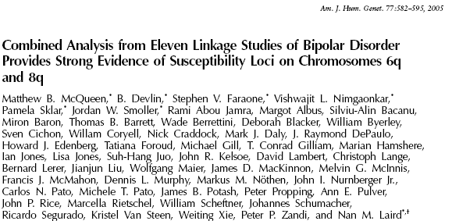

Slide 22

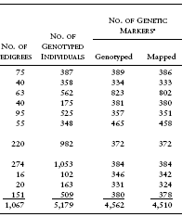

Slide 23
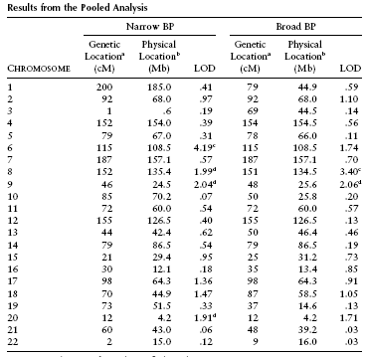

Slide 24
Significant and Suggestive Linkage
Given density of markers, significant linkage is LOD > 3.03
Suggestive linkage is LOD > 1.75
These take into account that 2 genome screens were analyzed (narrow and broad)
Significant – Occurs once in twenty genome screens
Suggestive – Occurs once in a genome screen

Slide 25
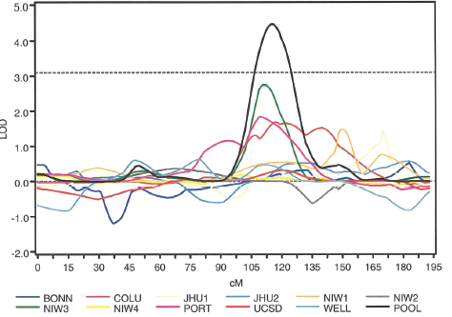
Chromosome 6

Slide 26
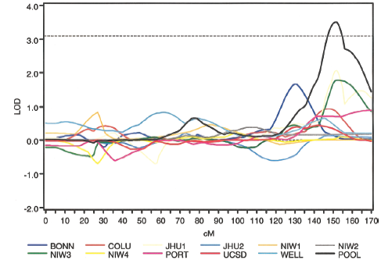
Chromosome 8

Slide 27
Map density and LOD cut-off
In most studies, start with a 10cM microsattelite map, and then add dense markers near best signals (LOD > 1?) – thus should use 3.6 cut-off in most studies.
History: 6K Illumina SNP set for linkage, Affymetrix 10K chip also widely used – More info than 400 microsatellites.
Now use SNPs designed for GWAS
LD between SNPs can cause a problem in linkage analysis

Slide 28
Power Computations for a Mendelian Trait
Assume true model – Trait gene frequency and three penetrances and theta
Usually consider theta=0 and theta=0.05 (0 is the best situation, .05 is worst for 10cM scan)
Use slink (code your pedigrees in linkage format) and simulate the marker data and compute the average lod score (ELOD)
Can count the number of times the simulated data has a lod score above your cut-off to get power.
This will be our (lab) homework next time

Slide 29
ELOD vs. EMLOD
ELOD average lod score for a given theta
In general, lod score is the maximum over theta, and max can be at a theta other than the “true” theta.
Can look at the average maximum lod score and compute EMLOD
Note that ELOD ≤ EMLOD

Slide 30
Mendelian Traits
• Can compute power (in an honest way)
• Analysis under correct model
• Can do exclusion mapping
• LOD score method has performed well
Example: MEN
Complex Traits
• Power unknown
• Model unknown

Slide 31
Affected Sib Pairs -- IBD
Probability of IBD at the Marker
0 1 2
Z₀ Z₁ Z₂
Under the null hypothesis:
α₀ = ¼ α₁ = ½ α₂ = ¼
Since Z₀ + Z₁ + Z₂ = 1,
can parameterize in terms of two parameters— multipoint marker data allows to also estimate θ

Slide 32
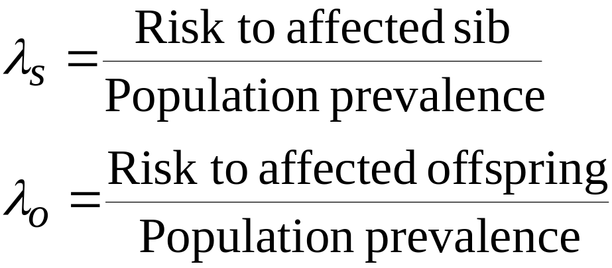
Risk Ratios
Can use λ_{s}, λ_{o} where
(λ’s of Risch; also K-ratio’s of Penrose.)

Slide 33
With Multipoint Linkage Data
Can estimate λ_{s} λ₀ and x from sib pair data
(x = location of disease gene)
Parameterized in terms of IBD at trait locus (rather than marker locus)
GENEHUNTER, MAPMAKER/SIBS, ASPEX, MERLIN do this (Use MERLIN today)
For affected sib pairs this is a maximized lod score

Slide 34
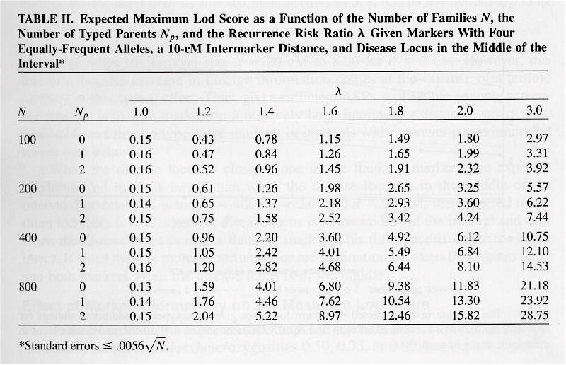
Power for specific λ
Hauser et al. (1996) Genetic Epidemiology, 13:117-137

Slide 35
Number of affected sib pairs?
Generate 1, 2,4,6,8,10 additive trait loci
Allow for either 100% heritability, or only 25% heritability
Compute sharing (will be over 50%) in affected sib pairs
Determine number of affected sib pairs to achieve 80% power at α=0.0001
Rice JP, Saccone NL, Suarez BK: The design of studies for investigating linkage and association. In: Analysis of Multifunctional Diseases, (eds. T. Bishop and P. Sham), 2000; pp. 37-62.)

Slide 36
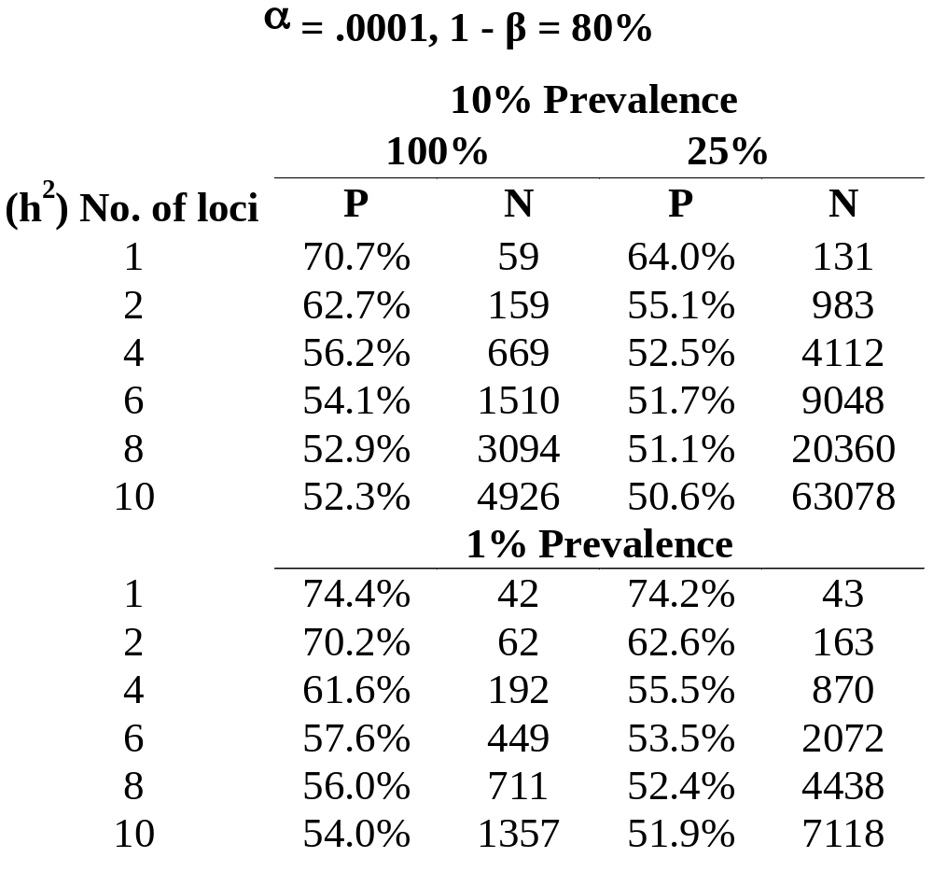

Slide 37
Studies of complex traits
So far, linkage studies of complex traits have been disappointing
Linkage signals not over 3, wide peaks (on the order of 30-50 cM; 1cM=1 megabase of dna)
Low power and multiple testing may be the problems.

Slide 38
LD between SNPs
Many linkage programs assume markers are in equilibrium
LD inflates the lod score if parents are not genotyped
Note: Similar to wrong marker allele frequencies inflating the lod score when parents are not genotyped

Slide 39
Genome-wide Association Studies
Later, we will study case/control analyses using up to1M SNPs to test for differences.
Multiple testing a major issue
Balance of type I error (false positives) vs. Type II error (missing true signals)

Slide 40
Multiple tests for association
Intuition: LD extents over smaller regions than linkage
More “independent” tests for LD -- There must be at the equivalent of at least 200,000 independent tests in one experiment (linkage about 2,000 independent tests)
Multiple testing for whole genome association studies will be problematic
Practical question – How to correct for multiple tests

Slide 41
Significance in GWAS
Many investigators want a significance level of 10⁻⁰⁷ in a GWAS. Welcome Trust study recommended 5 x 10⁻⁰⁷ based on a Bayesian argument (2007)
Currently, many people want significance of .05/1M = 5 x 10⁻⁸ (you can try to argue not all tests are independent, … ;but this doesn’t seem to fly in good journals.

Slide 42
Power computation for GWAS
Power calculator available from NCI:
dceg.cancer.gov/bb/tools/pga
Plots marker allele frequency vs. relative risk for a case-control design
We won’t cover this in class, but here is a sample plot

Slide 43
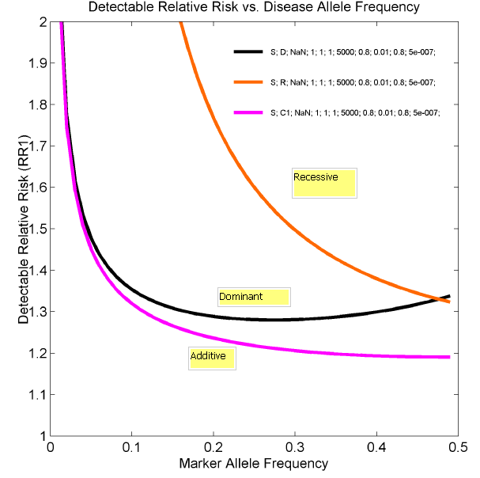

Slide 44
Is Bonferroni too harsh?
Correct so that there is at most one false positive in 20 studies
Another concept – suppose we identify 10 SNPs, and we expect 8 of the 10 to be “real” – different than above

Slide 45
False Discovery Rate (FDR)
V= # true null hypotheses called significant
S= # non-true hypotheses called significant
Q=V/(V + S) (false positives/all positives)
FDR = E(Q)
Benjamini & Hochberg (1995)
When testing m hypotheses H₁,…,H_{m}, order p-values
p₁, … p_{m} , let k be largest i for which p_{i} ≤ (i/m) q*
Then reject H₁, … H_{m}
Theorem: Above controls FDR at q*
Computer program: QVALUE

Slide 46
Interpretation of FDR
If q-value is 0.1, 1/10 is false positive.
If we identify 10 SNPs and 9 are real and 1 is false positive – major success.
Usual experiment-wise error (Bonferroni correction) only one false positive at the chosen p-value.

Slide 47
Multiple Testing
FDR helps and is commonly used
Question: Should all markers be tested using same p-value?
Roeder et al (2006) Am J Hum Genet, 78:243
Use a set of weights in the FDR computations.
If a small proportion are over-weighted, does not reduce the power to detect the others very much, but helps the detection of the ones to “bet” on.
Use of prior linkage evidence may be a way to increase power.

Slide 48
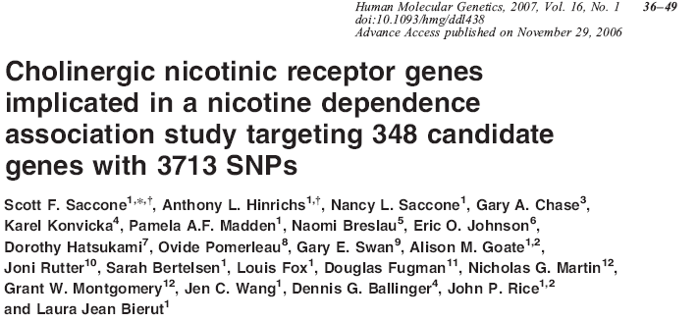

Slide 49
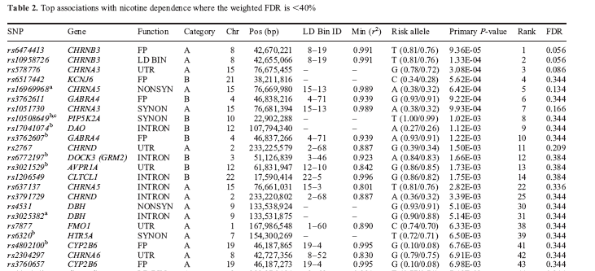
Note: CHRNB3 and CHRNA5 turned out to be “real”

Slide 50
Conventional Wisdom
Currently, many want a p-value of 5x10⁻⁸ before we accept significance in a GWAS study
Most GWAS studies with 1,000 cases and 1,000 controls for a complex trait don’t get a SNP with this p-value

Slide 51
Next Lab:
Use of simulation to estimate power
We will use the program SLINK to study the effects of marker information and reduced penetrance on power
p = trait gene frequency
f_{AA}, f_{Aa}, f_{aa} = prob of being affected (penetrances)
Marker will have ∞, 6, 4 or 2 alleles

Slide 52
∞ Alleles ?
At least one parent must be a double heterozygote for a sibship to be informative for linkage. With 2 alleles (p=.5), 50% of individuals will be homozygotes, i.e. the heterozygosity is 50%
For ∞ alleles, all matings will be informative. For this one, we fix parents as genotypes 12 x 34

Slide 53
We simulate the trait as a rare dominant
We will have one affected parent. By making the disease gene “rare”, the parent will be Dd and not DD.
In this setting, if θ = 0.0, then an affected sib pair from an informative mating who share the same allele IBD will contribute 0.3 to the LOD score

Slide 54
Next lab
Next time, we will simulate a rare dominant trait, and examine the impact of reduced penetrance, marker informativeness, and the distance between the marker and trait locus

Slide 55
Conclusions – (my opinions)
Linkage analysis was great for Mendelian diseases: CF, Brac1, Alzheimer's dominant forms, Huntington’s disease, …
Parametric linkage analysis did not work for complex diseases
Nonparametric analysis had promise, but didn’t work
Revival for the use of families, but
Use of Affected sib pairs is passé

Slide 56
My opinions (continued)
For type 2 diabetes, Nancy Cox (at ASHG) presented on 10,000 affected sib pairs – no hint of linkage. Association studies have found dozens of “real” loci
Is linkage dead?
Case/control GWAS studies using common SNPs have been in vogue
Now, return to families, where linkage can be useful in context of association

