Slide 1
Allelic Association I
Case-Control Designs
John Rice
Oct 11, 2016

Slide 2
Association analysis using case-control
Case/control design
Subjects must be from the same population
Compare marker allele frequencies / genotype frequencies
Use standard odds ratios and relative risks with modifications for genotypes

Slide 3
Collect Data
Random population sample will be inefficient (too few affecteds)
Sample cases and controls from the same population
For a marker with n alleles, obtain two sets of n(n+1)/2 genotype counts; (or, n allele counts).

Slide 4
Simple test of unequal allele frequencies
For n alleles, n x 2 contingency table
χ² test with n – 1 d.f.
Each subject contributes two alleles
Simple test of unequal genotypic frequencies
For n(n + 1)/2 genotypes n(n + 1)/2 x 2 contingency table
χ² test with [n(n +1)/2] – 1 d.f.
Only appropriate for a small number of alleles

Slide 5
Highly polymorphic loci
Markers may have 20 or more alleles
Sparse contingency tables (especially for n(n + 1)/2 genotypes) may not conform to asymptotic distribution
SNPs make life easier
One solution: group rare alleles
Require expected count for each cell to be at least 5
May reduce power if positively and negatively associated alleles are grouped together

Slide 6
Table 15.2 (p330) Neal Book
 | Genotypes
 | A1A1 | A1A2 | A2A2 | Total
Cases | 46 | 34 | 20 | 100
Controls | 60 | 30 | 10 | 100
Chi-sq=5.43, 2df, p=.066
 | Alleles
 | A1 | A2 | Total
Cases | 126 | 74 | 200
Controls | 150 | 50 | 200
Chi-sq=6.73, 1df, p=.009

Slide 7
Which to do?
Statistical price for 2 df test
With a few markers, some people report both genotypic and allelic tests
Problem in a GWAS, don’t do 2M tests when you have 1M markers
Current practice – do a trend test on genotypes with 1 df; we will see this later

Slide 8
Algebraic Example
Back to chapter 4 of Sham book
Nice derivation for the single locus model
Algebra is a good thing – gives insight into underlying assumptions
An algebraic solution can be used to compute power, etc, when underlying parameters (unknown variables) are examined

Slide 9
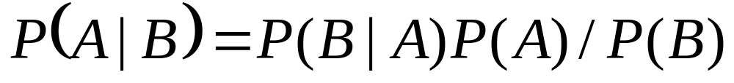
Bayes Theorem
For events A and B

Slide 10
Definitions
At disease locus D, let D₁ and D₂ denote the low and high risk alleles
Let p₁ and p₂ denote the population frequencies for D₁ and D₂
Let {f₁₁, f₁₂, f₂₂} denote the conditional probabilities of disease (penetrances) given the genotypes {D₁D₁, D₁D₂, D₂D₂}, i.e.
P(A|D_{i}D_{j})=f_{ij}

Slide 11
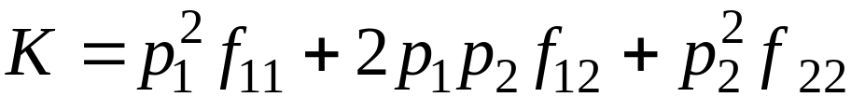
Definitions (continued)
Let K denote the population prevalence of the disease. Under Hardy-Weinberg equilibrium:
NOTE: For a recessive disease, with complete penetrance
ie, penetrances are (0,0,1), then
p₂ =Square root (K)

Slide 12
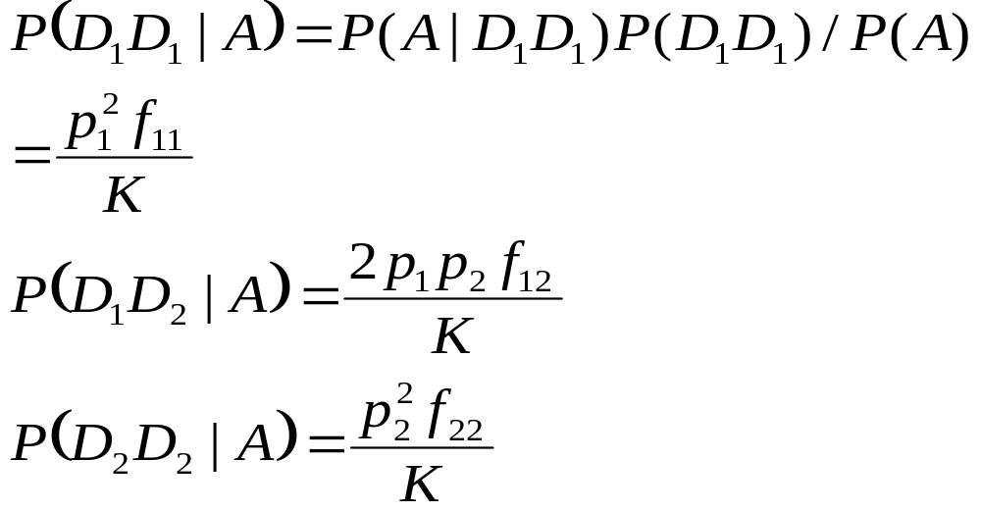
Compute disease locus genotype frequencies among affecteds:

Slide 13
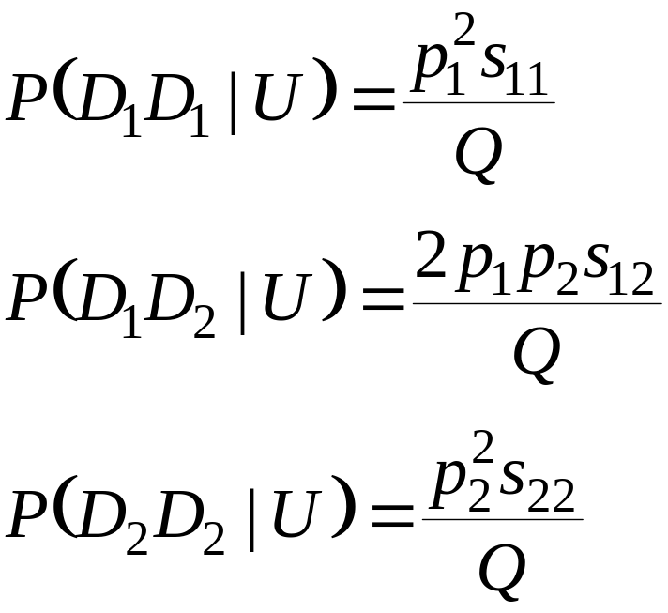
Let s_{ij} = 1 - f_{ij} and Q = 1 - K. Compute disease locus genotype frequencies among unaffecteds:

Slide 14
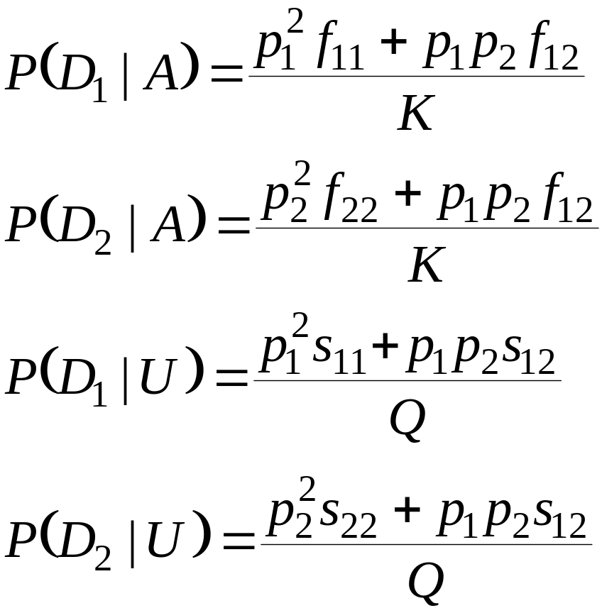
Disease locus allele frequencies among affecteds and unaffecteds:

Slide 15
We do not usually know p₁, p₂, f₁₁, f₁₂, f₂₂
Probably will not have genotypes at disease locus

Slide 16
More Definitions
At a marker locus B, let B₁, B₂, …, B_{n} be the alleles with frequencies q₁, q₂, …, q_{n}.
Let the haplotype frequencies of loci D and B be h₁₁, h₁₂, …, h_{1n}, h₂₁, h₂₂, …, h_{2n}, so that
P(D₁B_{j}) = h_{ij}

Slide 17
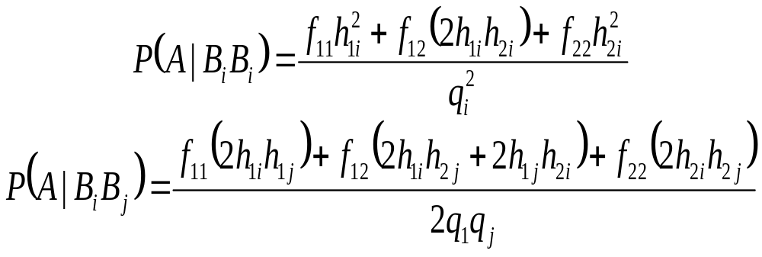
More Definitions (continued)
Compute the “apparent penetrances’ of the genotypes:

Slide 18
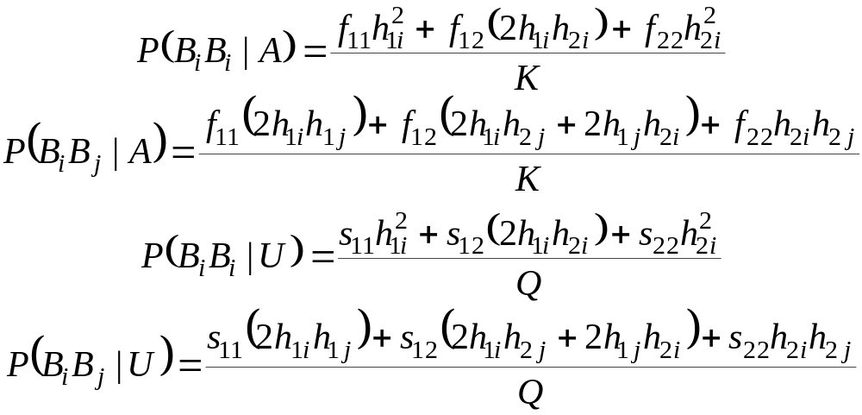
Given random mating, marker genotype frequencies are:

Slide 19
In the case of no linkage disequilibrium, h_{ij} = p_{i}q_{j}.
Then,
P(B_{i}B_{i}|A) = P(B_{i}B_{i}|U)
and
P(B_{i}B_{j}|A) = P(B_{i}B_{j}|U)

Slide 20
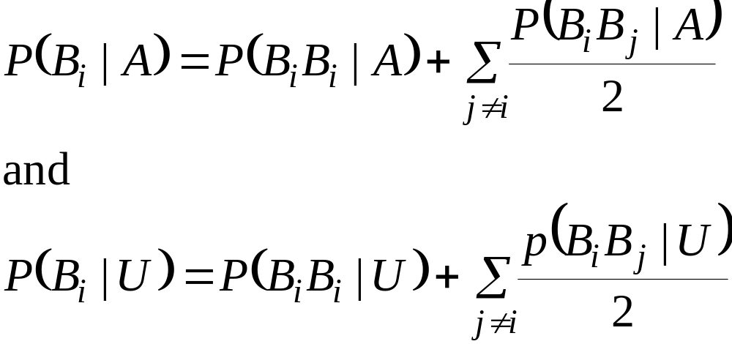

For individual allele frequencies, we compute a weighted average from the genotype frequencies:
And again, in the case of no linkage disequilibrium,

Slide 21
Logistic Regression
Most studies use logistic regression in analysis
Can use covariates
Can estimate odds ratios

Slide 22
Logistic Regression
Case/control status as outcome variable
Each genotype as a separate parameter uses up degrees of freedom
Each allele as a separate parameter requires assumptions about disease model
Can include other covariates (age, sex) and interactions
Evaluating multiple models creates a multiple testing problem

Slide 23
Logit
Usual regression wants a dependent variable that can take on any value, [-∞,∞]
A probability is in [0,1], not a good dependent variable
Odds = p/(1-p) is in [0,∞]
Logit = log(odds) is in [-∞,∞]

Slide 24
Dummy Variables
For a categorical variable with K categories, can create K-1 variables to use that categorical variable as a predictor in a regression equation eg

Slide 25
Logistic Regression
For a dichotomous outcome Y, p=P(Y=1)
Assume Ω = logit (p) = log (p/(1-p)), with
Ω = α+ β₁ X₁+…+ β _{N} X_{N}, for covariates X₁… X_{N}
p/(1-p)=e ^{Ω} , p= e ^{Ω} - p e ^{Ω} , so
p = e ^{Ω} /(1 + e ^{Ω} )

Slide 26
Odds ratio
Note: e (=2.7…) is base of natural logarithms
e⁰ = 1
e^{β} is the odds ratio; if β=0 then odds are 1

Slide 27
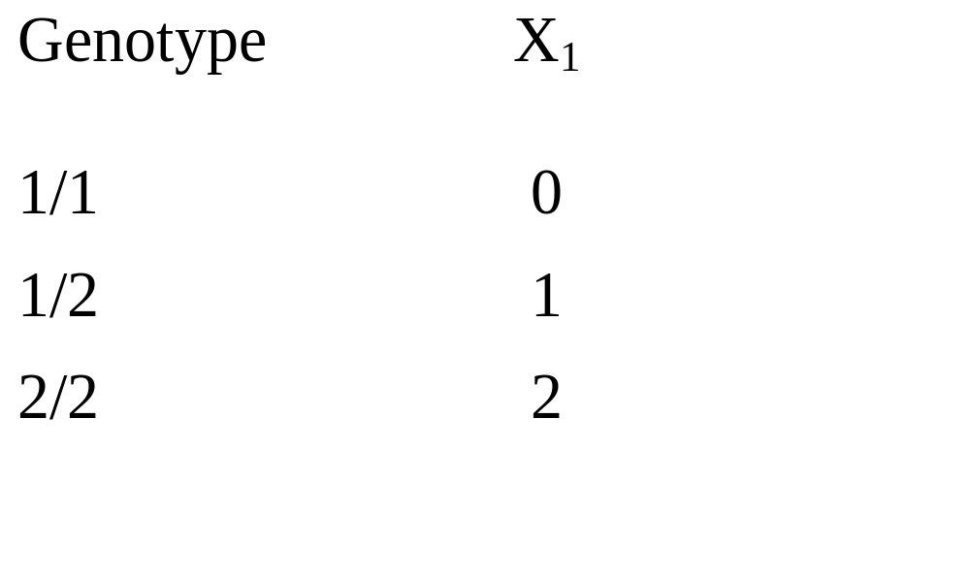
SNP Marker Coding:
This is the 1 df trend test
Code number of “1” alleles

Slide 28
Testing Marker Effects
    log (odds) = α + β₁X₁
    odds = e^{α}e ^{β1 X1}
Genotype Odds
11 e^{α}
12 e^{α}e^{β1}
22 e^{α}e^{2β1 }
Test β₁ = 0, all odds = e^{α}
Note: No dominance effect

Slide 29
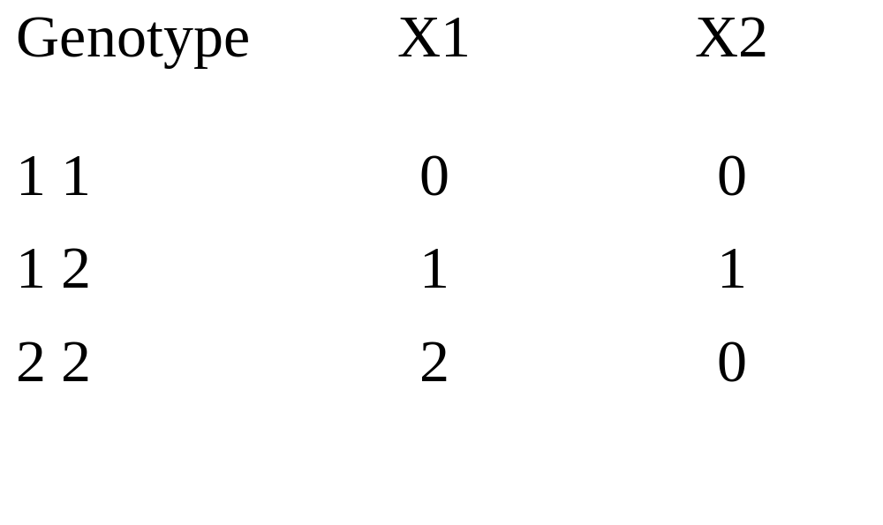
SNP Marker Coding:

Slide 30
Testing Marker Effects
    log (odds) = α + β₁ X₁ + β₂ X₂
    odds = e^{α}e ^{β1 X1} e ^{β2 X2}
Genotype Odds
1 1 e^{α}
1 2 e^{α} e^{β1}e^{β2}
2 2 e^{α}e^{2β1}
Test β₁= β₂ = 0, all odds = e^{α}
If β₂ = 0, then have additive model

Slide 31
Other covariates
Sex, 2 categories, 1 dummy variable
Study eg 4 studies – 3 dummy variables
Can test for effect of study with 3 df
Study | X1 | X2 | X3
1 | 1 | 0 | 0
2 | 0 | 1 | 0
3 | 0 | 0 | 1
4 | 0 | 0 | 0

Slide 32
Allelic vs Genotypic differences
For a SNP, can test allelic difference between cases and controls (1 df) or test genotypic differences (2 df)
Test of allelic differences assumes HW equilibrium
Can use trend test (1 df) coding additive effect of the alleles

Slide 33
Extreme example
Controls |  |  | Cases
AA | Aa | aa | AA | Aa | aa
25 | 50 | 25 | 0 | 100 | 0
P(A)=.5 |  |  | P(A)=.5
Massive genotypic differences; no allelic difference
Would miss above marker as significant with allelic test

Slide 34
“Fancy” Allelic Test
Mantel-Haenszel Test
 | A₁ | A₂
Cases | a | b | n₁
Controls | c | d | n₂
 | m₁ | m₂ | n
P_{i} = P (A₁ |Pop i), want to test P₁= P₂

Slide 35
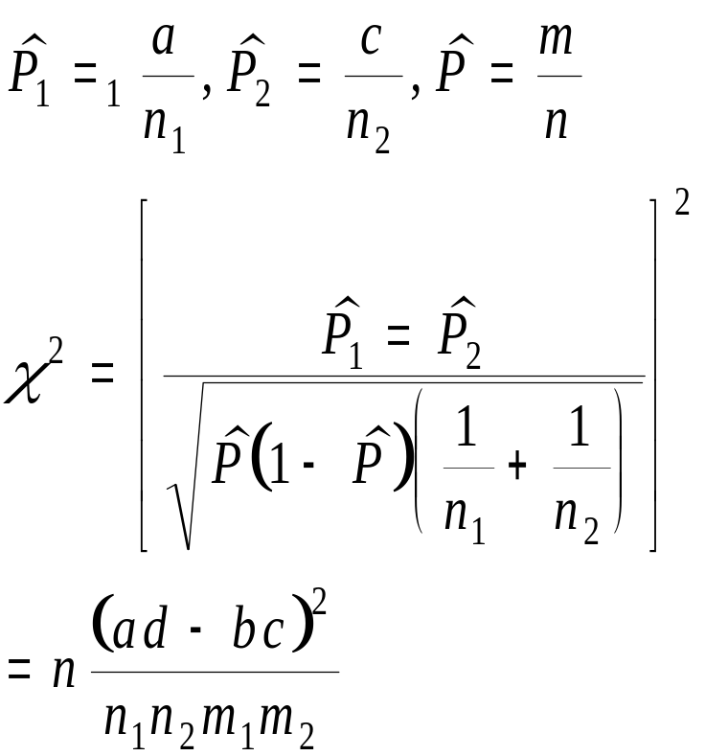
Usual Chi-square test

Slide 36
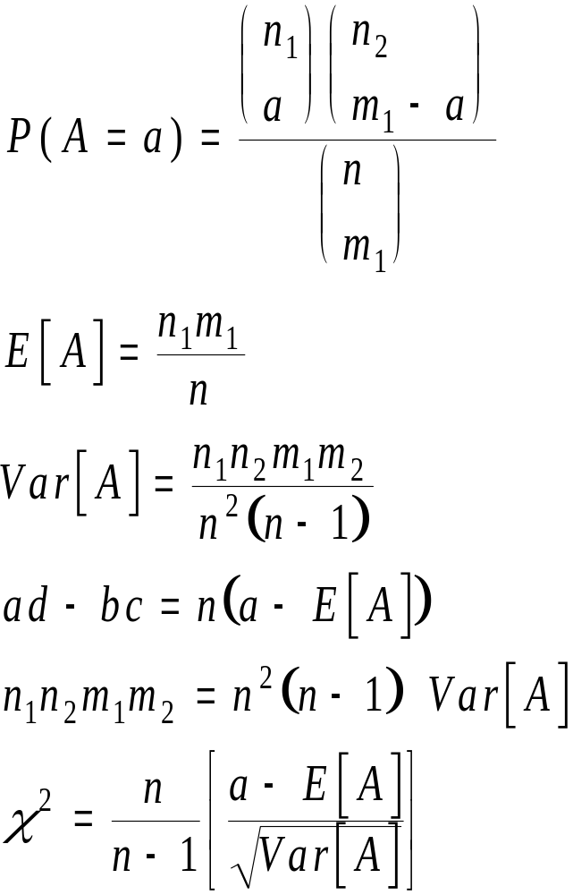
For fixed marginal, (i.e. n₁, n₂, m₁, m₂ fixed).
Let A = entry in (1, 1) cell
A has a hypergeometric distribution

Slide 37
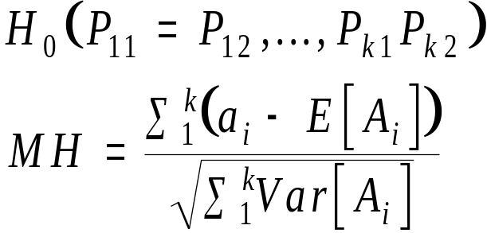
B. Sequence of 2x2’s
Suppose we have k groups
 | Group 1
 | A1 | A2 | n₁₁
Cases | a₁ |  | n₁₂
Controls
 | m₁₁ | m₁₂ | n₁
 | Group 2
 | A1 | A2 | n_{k1}
Cases | a_{k} |  | n_{k2}
Controls
 | m_{k11} | m_{k12} | n_{k}
Suppose we don’t want to pool across groups
If tables are independent
MH~N(0, 1)

Slide 38
Note:
As above, MH~N(0, 1). Therefore MH² ~χ². In fact, MH²=(n-1)/n x usual χ² for a 2x2 table, and (n-1)/n is approx. 1
Can add chi-squares for K tables, but this has K df, whereas MH has 1. Adding chi-squares is a bad idea

Slide 39
Haplotype Trend Analysis
Zaykin et al (2002) Hum Hered 53:79-91
Use haplotypes in logistic regression
For a pair of SNPs, there are 4 haplotypes, so there will be 3 “dummy” variables
Assume pair of haplotypes in an individual are “additive”, so only need 3 regression coefficients
If haplotypes are known with certainty, then:

Slide 40
Haplotype | X1 | X2 | X3
h₁/ h₁ | 2 | 0 | 0
h₁/ h₂ | 1 | 1 | 0
h₁/ h₃ | 1 | 0 | 1
h₁/ h₄ | 1 | 0 | 0
h₂/ h₂ | 0 | 2 | 0
h₂/ h₃ | 0 | 1 | 1
h₂/ h₄ | 0 | 1 | 0
h₃/ h₃ | 0 | 0 | 2
h₃/ h₄ | 0 | 0 | 1
h₄/ h₄ | 0 | 0 | 0

Slide 41
Estimated Haplotypes
One can use a program like PHASE to get estimates of the haplotype probabilities for each individual (LD between SNPs OK)
Put the estimated probabilities into the above coding (rather than 1s and 0s).
SAS/Genetics has this as an example – use proc haplotype to get haplotypes

Slide 42
Other Issues in a GWAS
Manhattan Plot – way to display all p-values
Looks like the Manhattan skyline
For p=.05/1M = 5E-8
-Log(p) = 7.3

Slide 43
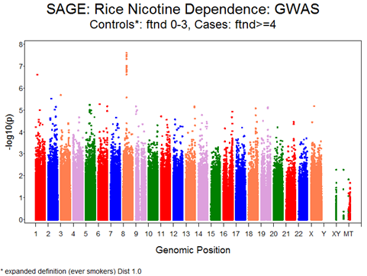
Manhattan Plot

Slide 44
Genomic control
When we test 1 million SNPs, most are not truly associated.
Genomic inflation factor – If using a chi-square test with 1 df, median value should be 0.445. λ=observed median / .445. Usually correct chi-sq by dividing by λ
Always best to control for pop admixture, eliminate CNVs, etc first to reduce λ
λ for Bierut data is 1.045

Slide 45
QQ Plot
QQ plot shows observed p-values versus expected p-values assuming nothing significant
QQ plot assumes independent tests
Better than λ that only looks at median

Slide 46
Uniform Distribution
0
p
1
If we perform N independent statistical tests for which all null
Hypotheses are true, we expect a uniform distribution.

Slide 47
QQ - plot
Plot expected chi-sq (or –log(p)) assuming no difference vs. observed statistic.
We expect most SNPs to be not related, so observations should be along the diagonal with (we hope) a few above the diagonal on the high end

Slide 48
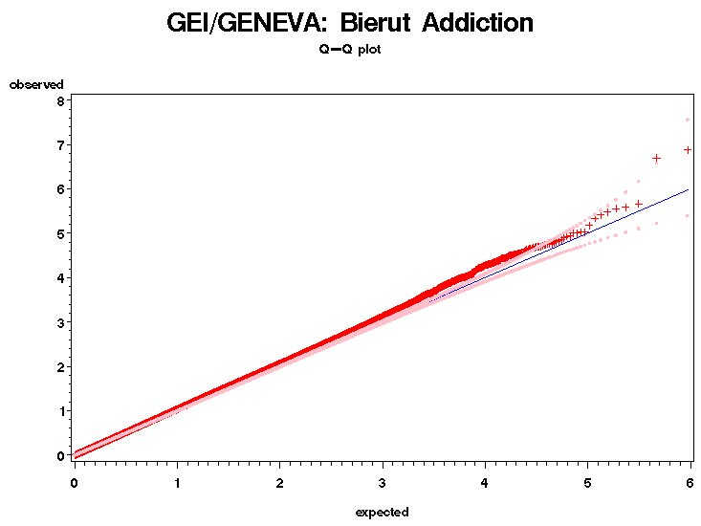
λ = 1.045

Slide 49
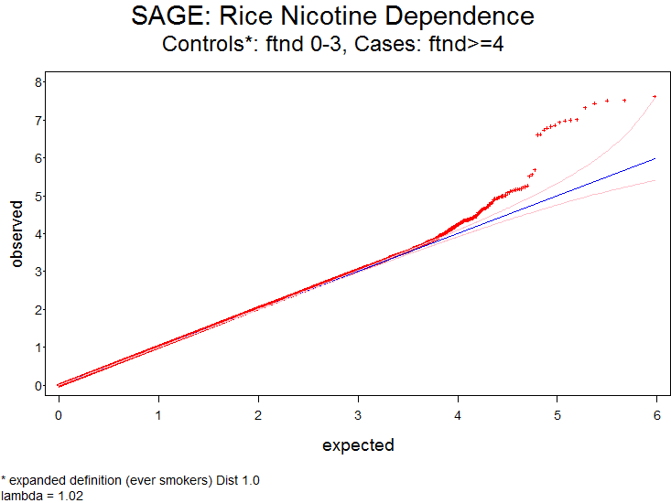

Slide 50
CATIE Schizophrenia Data
CATIE has offered early release of data
Whole genome screen on 741 cases and 751 of the Gejman controls (done by Perlegen)
These are now available
Available as a PLINK binary file

Slide 51
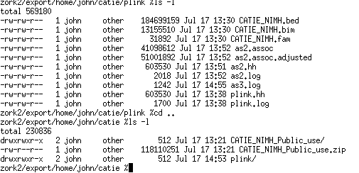
Compressed file is 118MB
Unzipped bed file is 185MB
Text file would be huge

Slide 52
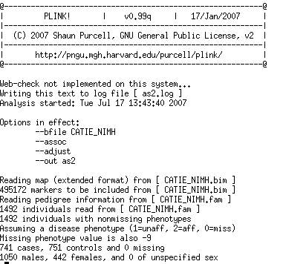

Slide 53
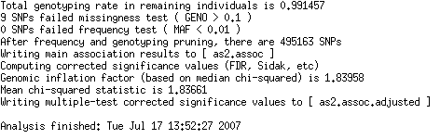
495,163 SNPs Analyzed
Total Time: 9 min!
Note: Mixture of EU and AAs

Slide 54
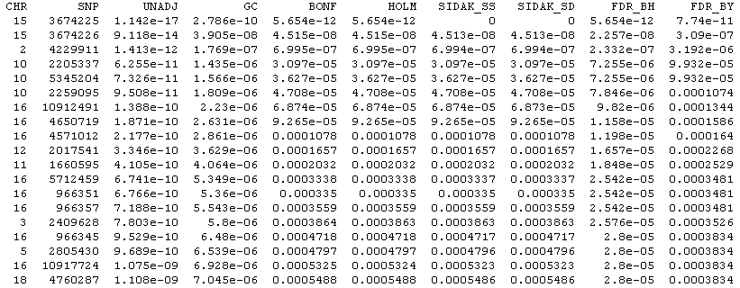
Plink Output

Slide 55
Results
Sample is mixture of EAs and AAs
This is a run with unclean data ignoring population admixture
Results are not real

Slide 56
Quantitative traits
Same approach as above, but use standard regression
This is also available in PLINK

Slide 57
Summary
Case-control GWAS studies are everywhere
Worry: Population stratification. Studies type up to 1M markers across the genome so we can use these as control markers. Idea: Stratification would lead to spurious association everywhere on the genome. QQ-Plot checks this
Analysis programs (we use PLINK) are freely available and very efficient.
“Easy” to analyze once you know how.

