Slide 1
Allelic Association II
Family Based Studies
John Rice
Oct 20 2016
+ WGA Viewer

Slide 2
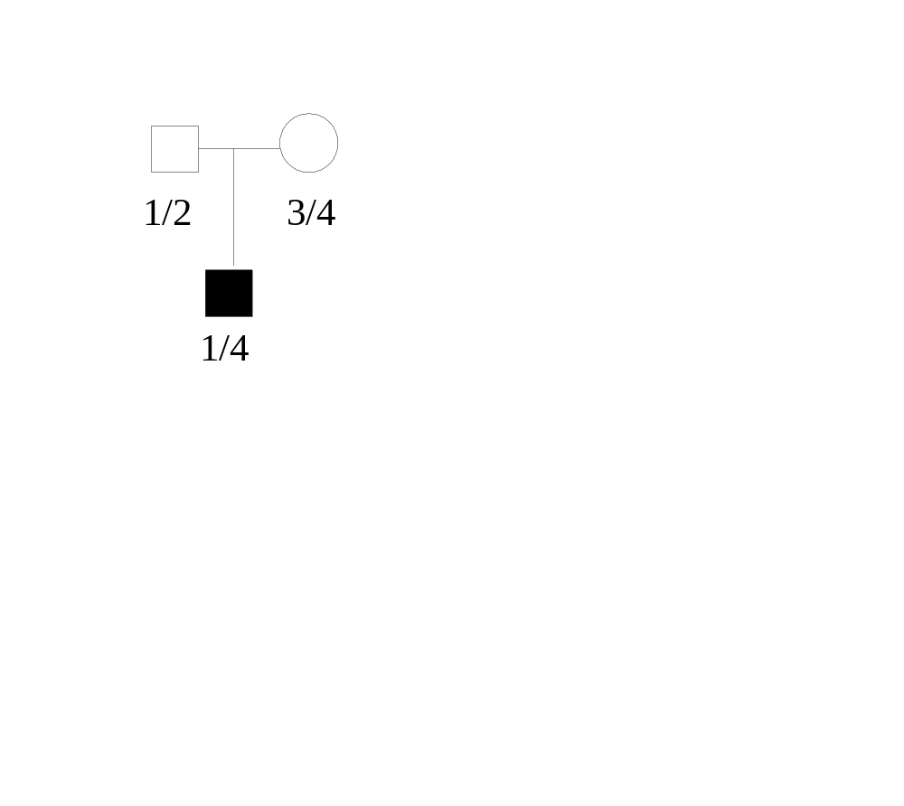
Transmission Disequilibrium Test
TDT– Sample case and parents
Alleles 1 and 4 are transmitted -- CASE
Alleles 2 and 3 are non-transmitted –CONTROL
NOTE: Genotype 3 people to get 1 case and 1 control
NOT sensitive to population stratification

Slide 3
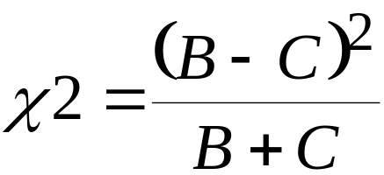
TDT (Transmission/Disequilibrium Test)
 | Non-transmitted
 |  | 1 |  | 2
Transmitted | 1 |  | A | B
 | 2 |  | C | D

Slide 4
TDT Notes
TDT only uses heterozygous parents
Power is determined by number of off-diagonal observations – not N of trios
A SNP has maximal heterozygosity of 50% for p=.5, p² =.25, 2pq=.5, q² =.25
TDT is McNemar’s test for matched dichotomous data
Same as testing for a fair coin on the off-diagonal cells

Slide 5
Use of multiple affecteds (confusing issue)
TDT is a valid test of association if trios are sampled.
TDT is not a valid test of association if multiple affected sibs are used.
TDT is a valid test of linkage even if multiple affected sibs are used.
** Valid = testing at the correct p-value

Slide 6
Example
TDT is not a valid test of association if multiple affected sibs are used
Rare dominant, parents 12 x 34, father aff
Have 10 affected children, all 10 inherit allele 1 due to complete linkage
Affected father transmitted allele 1 for 10/10 times, but because of linkage.
Only 1 observation for association
All 10 transmission support linkage

Slide 7
Use of Multiple Affected Sibs
For a complex trait, some argue OK to detect either linkage or association
Then break up families. Eg, for 3 affected kids and parents, create 3 trios for analysis
One should know this is a test of linkage and/or association.

Slide 8
TDT with multiple alleles
Approach 1: With n alleles, do n TDT tests– allele 1 vs not 1, …allele n vs. not n. This leads to n non-independent tests. Some people multiply p-values by n; some people don’t correct.
Approach 2: Perform a chi-sq test with n-1 degrees of freedom

Slide 9
Example
10 trios with father genotype 12, mother genotype 13, and all offspring receive 11 from the parents.

Slide 10
Unphased Package
(no lab on this one)
Set of programs that includes TDT
Input is in linkage format
We won’t cover them this year
Can do family association
Can have mixture of case control and family data

Slide 11
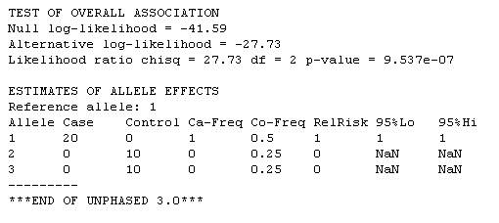

Slide 12
Allele | H₀ | H₁ | N
1 | .5 | 1 | 20
2 | .25 | 0 | 10
3 | .25 | 0 | 10
ln L₀=20ln(.5)+2x10ln(.25)=-41.59
Ln L₁=40 x ln(.5)=-27.726
LRS= 2 x 13.8629 = 27.73 (2 df)

Slide 13
PLINK
Example parents 12 x 13 …
Can this be analyzed using PLINK?
NO – PLINK only does SNPs

Slide 14
P-value for TDT
Same as flipping a coin 20 times and geting 20 heads – p=(.5)²⁰ = 0.000000954
# of alleles = 3, so p= 3 times the above one sided value = 0.000002862
Note this is an “exact” test

Slide 15
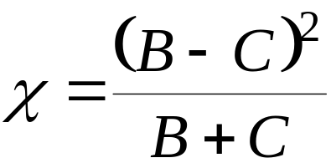
TDT (Transmission/Disequilibrium Test)
If we were testing allele 1 from prior knowledge
 | Non-transmitted
 |  | 1 |  | Not 1
Transmitted | 1 |  | 0 | 20
 | Not 1 |  | 0 | 0
Chi-sq=20x20/20=20

Slide 16
HHRR
Haplotype-based Haplotype Relative Risk
In case/control sample, can compare genotypes in cases and controls with chi-sq test since these are independent samples
In trans/non-trans situation, cases and controls are matched since they come from the same parent.
The original HHRR does usual chi-sq in this matched design – is this valid?
See discussion of HHRR in Sham Book

Slide 17
HHHR
Transmitted and untransmitted alleles are not statistically independent unless there is complete linkge (θ=0)
Observations in a contingency table need to be independent for chi-sq to be valid test
The dependence contains terms with Dθ, so when θ=0, they are independent.
This is HHRR test in Sham book

Slide 18
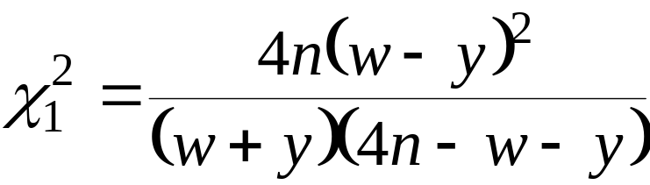
HHRR vs TDT
Sample n trios (affected case and parents)
Table I
 | M₁ | M₂
Trans | w | 2n-w | 2n
Not-Trans | y | 2n-y | 2n
 | w+y | 4n-w-y | 4n
N trios => 2n parents => 4n alleles
Valid only for θ=0

Slide 19
Summary
HHRR tests δ = 0 if θ ≈0
TDT is valid test for association
TDT is useful test of linkage if δ ≠ 0

Slide 20
Case/Control vs. TDT
Possible stratification effects – use genome control from other markers typed
Less efficient – genotype 3 individuals to get one case and 1 control
Must have parents available (ADHD, Autism, … use trios)
Trios help detect genotyping errors

Slide 21
Irony:
In case/control design, genotyping errors don’t give false positive results as long as same error rate in cases and controls
Genotyping error can inflate Type I error for TDT! Eg monomorphic SNP with allele 2 always an error

Slide 22
Error in TDT
Parents are 11 x 11, see 2 in a kid – error remove
Parents are 12 x 11, see 11 in kid, conclude allele 1 is transmitted (even if “2” is an error)
In general, genotyping error leads to over transmission of common allele

Slide 23
The Pedigree Disequilibrium Test (PDT) - Martin et al, AJHG 2000
Similar to TDT but designed for families with multiple children
Will make use of both affected and unaffected children
Families with missing parental genotypes are still applicable
Notes:
Introduced by Eden (pr?) Martin (what’s the E?)
Will not go into great detail

Slide 24
The PDT Statistic
“Score” genotypes: 1/1 = 1, 1/2 = 0, 2/2 = −1
b = mean score of parents = expected score in children
If parents aren’t genotyped, take b = mean score of all children (include unaffecteds)
For affected child with score s
deviation = s − b (Observed − Expected)
Overall family score=mean deviation in affected children
Add family scores, get PDT statistic and p-value
Notes:
TOO COMPLICATED, MOVE TO END

Slide 25
NAG - Family 3660
Heavy Smoking/DSM-IV
SNP rs1909884-Chr 15/CHRNA7
PDT Score = 0.50
1/1
1/2
Score=1
Score=0
1/1
Score=1
Expected score = (1+0)/2 = 0.5
Mean deviation = 1-0.5 = 0.5
Notes:
Include previous slide showing QTDT results for the CHRNA7 markes
Might want to skip showing the overall p-value unitl later
This is the score for allele 1
How does this relate to the TDT for a trio? Is it the same? Pretty much the same although the TDT large under the alternative hypothesis of disequilibrium. The TDT treats transmissions for het parents as independent, while the PDT does not.
I have my own program to do PDT - which is why I did these slides

Slide 26
NAG - Family 2054
Heavy Smoking/DSM-IV
SNP rs1909884-Chr 15/CHRNA7
PDT Score = 0.13
?
0/0
1/1
1/1
1/1
1/1
1/1
1/2
1/2
Mother’s phenotype must be 1/2
However, phenotypes are not inferred
Expected score = mean score in children: 4/6 = 0.66
Mean deviation: (4×.33 + ( - 0.66)) / 5 = 0.13
Notes:
4/5 = (1+1+1+1+0+0)/6
The expected score would have been ½ if the mother got genotyped as 1/2 , the overall score
Would have been 0.3 = 0.5 - 1/5 (due to the heterozygote)
Also, the lack of the mother’s genotype creates less deviation in the homozygotes (0.33 i/o 0.50)
Reason to not infer: bias from genotypic error
This family scores less than the previous one, even though there are lots of affected homozygotes
Because these transmissions aren’t independent, we effectively treat them as one affected after taking the average score.
Use case/control? Would probably select 1 affected per family

Slide 27
SIB-TDT
Often can’t get parents – Alzheimer’s, Schizophrenia
Spielman and Ewens (1998) AJHG 52:506-516
Use families with at least one affected sib and one unaffected sib (and not all sibs have the same genotype)
S-TDT valid test of linkage; valid test of association if only one affected, one unaffected sib

Slide 28
S-TDT
For t sibs in a family, with a affected, u unaffected, Marker with allleles M,m
let r = # who are MM, s= # who are Mm
Compute A=(2r+s)a/t
Y= Number of M in affected sibs
Test statistic (Y-A)/sqrt(V)

Slide 29
TDT vs. S-TDT
Discordant sibs are “matched” for genotype, so case/control pairs will give more power
Practical consideration – you have a family sample with DNA available
General lack of control samples available
Given a family with discordant sibs and both parents with DNA – do TDT

Slide 30
S-TDT
PLINK uses DFAM to compute Sib-TDT
Can combine Trios and sibs

Slide 31
QTDT
There is a quantitative version of the TDT
http://www.sph.umich.edu/csg/abecasis/QTDT/index.html
We won’t go into details.

Slide 32
Parental Discordance Test
Implemented in PLINK
Use a nuclear family parental pair as a matched pair
Assumes homogeneity within families
Often, parental phenotypes are available, but not used in TDT

Slide 33
PAR Statistic
Unaffected Parent
 |  | A/A | A/B | B/B
Affected | A/A | - | p | r
Parent | A/B | x | - | q
 | B/B | z | y | -
(p+q+2r) – (x+y+2z)]²
PAR= -------------------------------
(p+q+x+y+2r+2z

Slide 34
Combined TDT and Parent Test
(B+p+q+2r) – (C+x+y+2z)]²
COM= ------------------------------- (B+C+p+q+x+y+2r+2z)

Slide 35
What test to do?
Depends on your data
More important question – what families to collect
Practical issue – Often start with sample aimed at linkage, get linkage signals, then do association in these samples.
Combine linkage with association?

Slide 36
WGA Viewer
(Used to be a lab)
New Topic

Slide 37
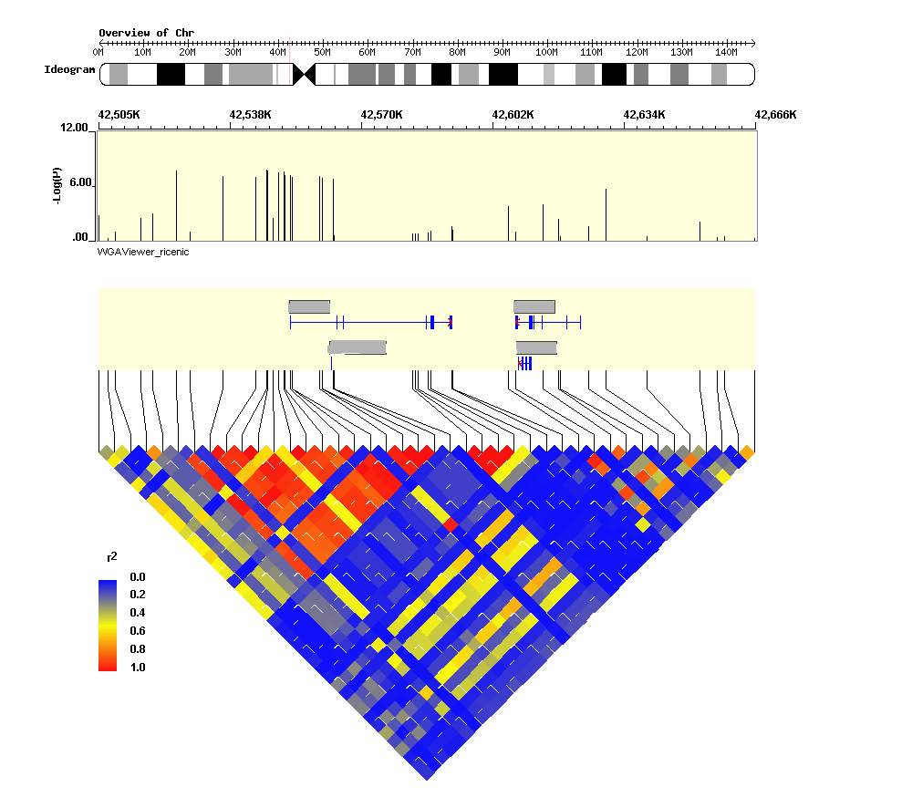
The end product of WGA Viewer: annotated LD plot
Ideogram
GWAS p-values
Genes
LD matrix
in GWAS data

Slide 38
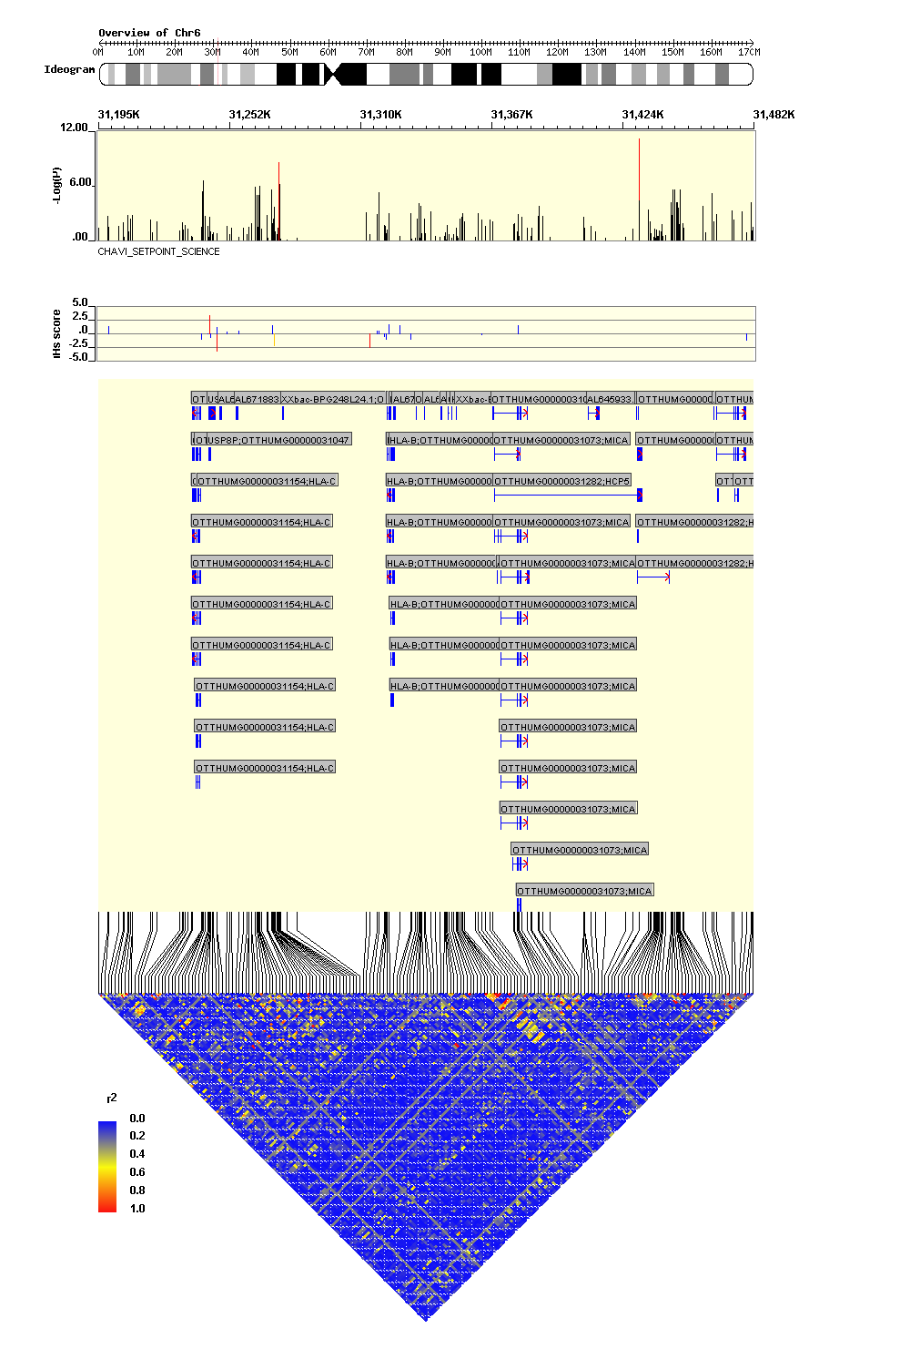
Annotated LD plot
WGA Viewer: default plot
Ideogram
GWAS p-values
Selection score
Transcripts
LD matrix
HapMap data

Slide 39
WGA Viewer Goals
“This software package allows the researcher to visualize and consider other supporting evidence, such as the genomic context of the SNP, linkage disequilibrium (LD) with ungenotyped SNPs and the evidence from other Whole Genome Association projects alongside the P value of association when determining the potential importance of an individual SNP . . .”

Slide 40
WGA Viewer Goals (2)
“. . . Most importantly, it would highlight possible mechanisms, for example by directly or indirectly implicating a polymorphism with an apparent link to gene expression, splicing, non-coding RNAs or other possibilities that would suggest specific functional follow-up.”

Slide 41
What does WGA Viewer do?
Aligns map coordinates to latest Ensembl build
Reads and displays plink output
  P-values from GWAS
  LD: R-squared or D-prime
  QC measures: Hardy-Weinberg p-values
  Effect sizes
  Allele frequency

Slide 42
What does WGA Viewer do? (2)
Gene annotation
  Simple
  Comprehensive
Displays results from multiple GWAS, eg different phenotypes: nicotine case-control status and cigarettes per day
Notes:
Key innovation: “What happens with a polymorphism that only achieves a P value of 10 -5 , but which is itself in strong LD with an ungenotyped SNP that is annotated as definitely functional?” “Are there (perhaps ungenotyped) proxies for the associated SNP that are in a more interesting genomic context?”

Slide 43
Developers
Dongliang Ge and David Goldstein
Duke Institute for Genome Sciences & Policy
Center for HIV-AIDS Vaccine Immunology (CHAVI)
“We are working on WGAViewer to make it a framework to house and service the rapidly evolving knowledge of the human genome.”

Slide 44
WGAViewer source datasets
Two main sources
  Ensembl : http://www.ensembl.org
  HapMap: http://www.hapmap.org
Other sources
  Haploview: http://www.broad.mit.edu/mpg/haploview/
  GENEVAR (GENe Expression VARiation): http://www.sanger.ac.uk/humgen/genevar/

Slide 45
Three major gene browsers/ annotation groups
Database | Housed by . . . | Abbr
Ensembl | European Bioinformatics Institute | EBI
dbSNP | National Center for Biotechnology Information | NCBI
ENCODE | University of California Santa Cruz | UCSC
Notes:
http://www.ncbi.nlm.nih.gov/Genbank/index.html
GenBank is part of the International Nucleotide Sequence Database Collaboration, which comprises the DNA DataBank of Japan (DDBJ), the European Molecular Biology Laboratory (EMBL), and GenBank at NCBI. These three organizations exchange data on a daily basis.
http://www.ncbi.nlm.nih.gov/projects/mapview/static/app_help/Browser_Genome_Release_Agreement.html
Acronyms
EMBL-Bank/EBI (European Bioinformatics Institute) and GenBank/NCBI (National Center for Biotechnology Information) on a daily basis, the three data banks share virtually the same data at any given time. The virtually unified database is called "the International Nucleotide Sequence Database (INSD)

Slide 46
Implications for gene annotation
Maps vary for current versions across the three main databases
Maps vary within databases across time (versions)
WGA Viewer solution: align all other sources to the current Ensembl map coordinates

Slide 47
Reading plink output
Plink GWAS results: WGA Viewer will subset on “ADD”, the additive genetic effect from plink –logistic
  May have to subset your GWAS results if too large, eg. Chr 1-5
Reading LD output
  Plink 1.05+ adds column of bp which WGA Viewer does not like, need to process to remove bp column

Slide 48
Schedule
Next Tues – Lab on TDT using plink

