Slide 1
Analysis of GWAS data for smoking
John Rice
October 27, 2016

Slide 2
GENEVA Addiction Project
Results for
Nicotine Dependence

Slide 3
GENEVA / SAGE
The Gene, Environment Association Studies Consortium (GENEVA) Sponsored by NHGRI
Cornelis et al (2010) Genet Epidemiol
SAGE (Study of Addiction: Genetics and Environment) one of the GENEVA Projects
SAGE sample was Genotyped by CIDR (one of the GENEVA genotyping centers) using 1M Illumina chip
SNP data cleaned by U. of Washington (Coordinating Center for GENEVA)
Laurie et al. (2010) Genet Epidemiol

Slide 4
Study Design
Case/ Control
Samples come from 3 studies
Alcohol Dependence (COGA)
Nicotine Dependence (COGEND)
Cocaine Dependence (FSCD)
Cases have a diagnosis of alcohol dependence
Controls do not have a diagnosis of alcohol or cocaine dependence; must have drunk alcohol
Mixture of EUs, AAs and Hispanics

Slide 5
Cleaning of GENEVA addiction GWAS data (SAGE)
1 million Illumina chips were done at CIDR
Data are at dbGaP

Slide 6
Relatedness
Identify unexpected relatedness, correct pedigree and identify one representative from each family
Use IBD – Identity by Descent
Two individuals can share 0, 1 or 2 alleles from a common ancestor
MZ twins (or duplicates) always share 2 alleles IBD; Parent-offspring pairs always share 1 allele IBD, etc.
PLINK can estimate these probabilities from the SNP data (which is IBS data since parents are not genotyped)

Slide 7
Prob of IBD by Relationship

Slide 8
We found “unexpected” relatedness
Duplicates:
8 subjects were both in FSCD and COGA
This is documented by dbGaP
Some full sibs were selected for SAGE and were known – Others were identified in cleaning
Other unexpected relatedness found
Data from “extra” samples will be distributed by dbGaP

Slide 9
Aneuploidy
Normal male – XY; Normal Female – XX
Phenotypically male if at least one Y chromosome
Found XXY (male who genotypes like a female), XYY, XO individuals, mosaics
Most of this is due to DNA from cell lines
Some detected by looking at intensity plots

Slide 10
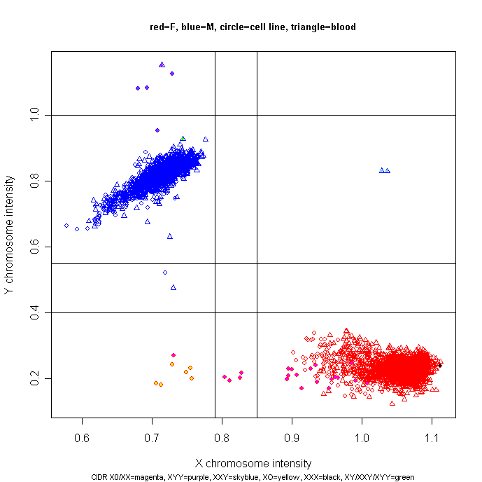
CIDR X0/XX=magenta, XYY=purple, XXY=skyblue, X0=yellow, XXX=black, XY/XXY/XYY=green
XYY
XXY
XY/X0?
X0
XX/X0

Slide 11
Population structure
Assign samples to population groups for allele frequency estimation, HW testing, etc.
Alternatively, produce quantitative covariates to control for population admixture
Use the program Eigenstrat to perform Principal Component Analysis

Slide 12
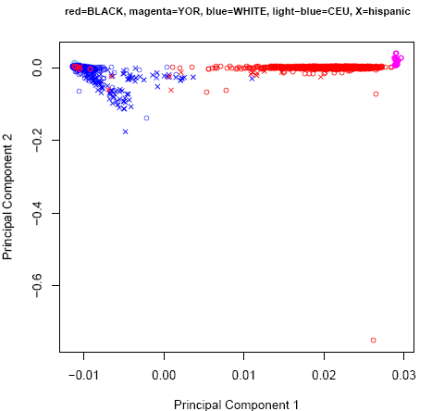
Asian

Slide 13
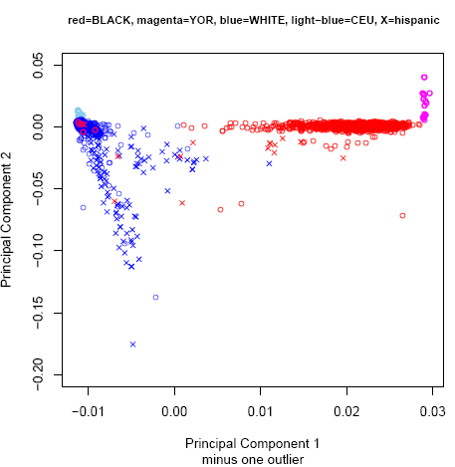

Slide 14
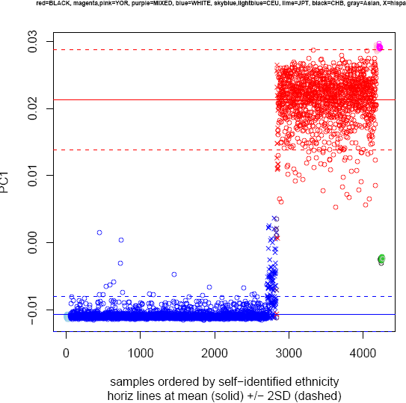

Slide 15
Admixture
First PC separates EUs and AAs
Second PC separates Hispanics
Some self reported ethnicities were in error and turned out to be data entry mistakes
One “unexpected” Asian was found

Slide 16
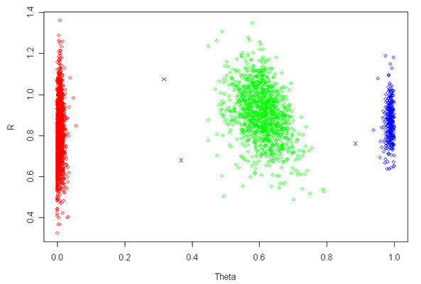
Intensity Plot – good SNP

Slide 17
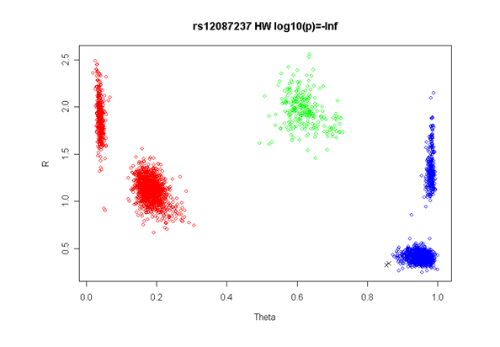

Slide 18
Primary Model
Dependent variable (s)
Case control status (diagnosis of alcohol dependence)—simple logistic model
Independent variables
Genotype --(1 df trend test)
EU vs AA vs Hispanic (Asians, Mixed, etc excluded)
Study (alc, cocaine, nicotine)
Gender
Test each SNP with 1 df

Slide 19
Definitions of Smoking
FTND* (Fagerström Test for Nicotine Dependence) -- Scale from 0 to 10
Case: FTND > 4
Control: Individual who has smoked 100 or more cigarettes and Lifetime FTND = 0; (or smoked some)
CPD (Cigarettes Per Day)
Coded 0-10, 11-20, 21-30, 31 or more
(These are ranges in the definition of FTND)
Available in many studies of other disorders
DSM-IV – Not often used by nicotine researchers
* Heatherton et al, 1991
Notes:
19

Slide 20
U.S. Population Screening and Nicotine Dependence
Screened
53,742
No
Symptoms
3,051
50.9%
19.2%
Initiated
Smoking
27,372
Smoked 100+
Cigarettes
15,881
Some
Symptoms
5,596
58.0%
35.2%
44.3%
Nicotine
Dependence
7,028
Collaborative Genetic Study of Nicotine Dependence
Notes:
20

Slide 21
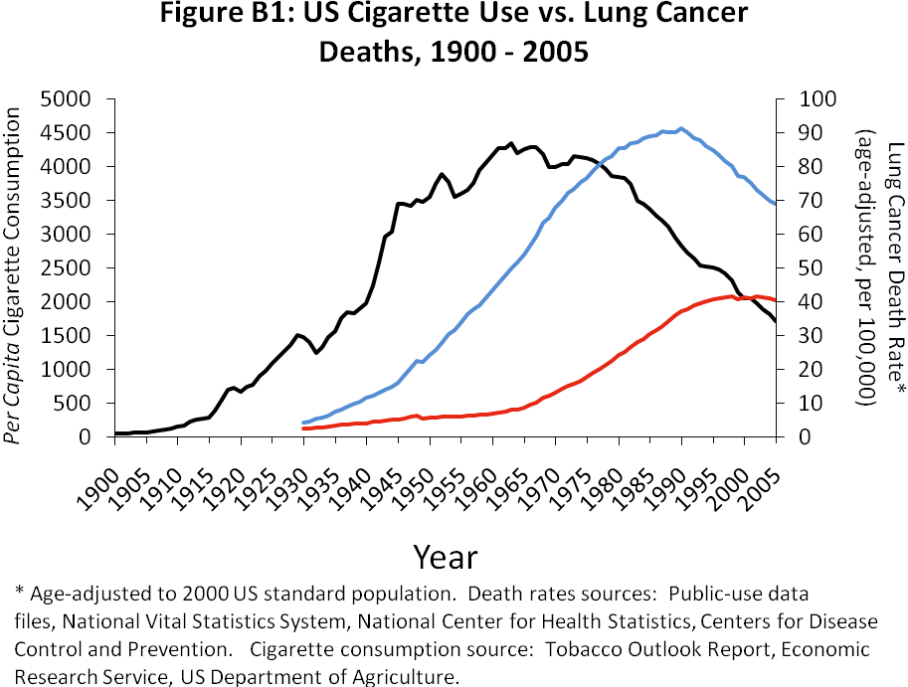

Slide 22
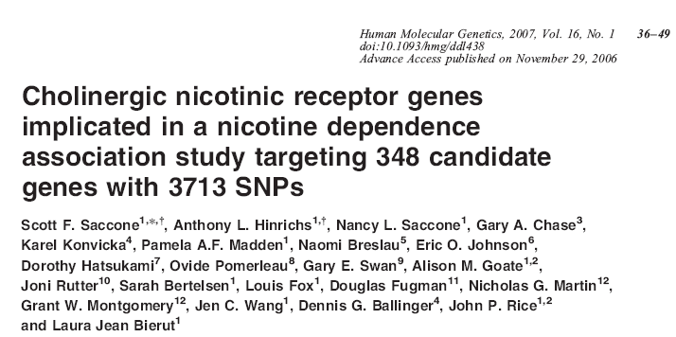

Slide 23
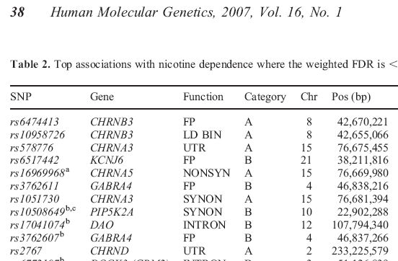

Slide 24
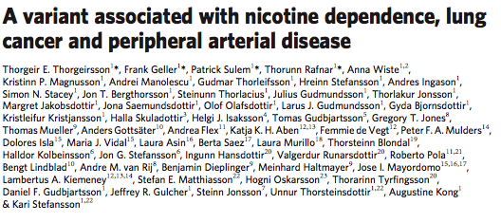
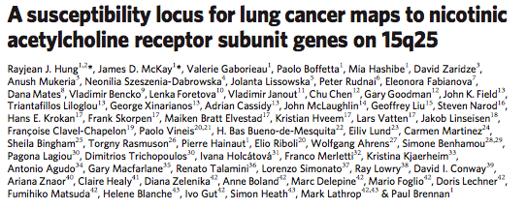
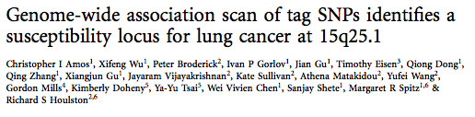

Nature, 2008
Nature, 2008
Nature Genetics, 2008

Slide 25
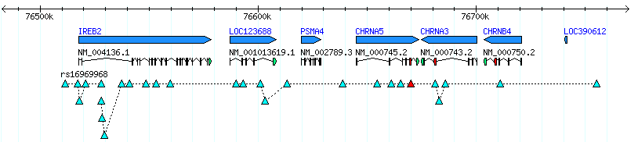
SNPs highly correlated with rs16969968 (Mr. Big)
Findings for Nicotine Dependence and Lung Cancer
rs16969968
Saccone et al., 2007
Bierut et al., 2008
Sherva et al., 2008
Weiss et al., 2008
Stevens et al., in press
rs8034191
Amos et al., 2008
Hung et al., 2008
Liu et al., 2008
rs1317286
Berrettini et al., 2008
rs1051730
Saccone et al., 2007
Thorgeirsson et al., 2008
Amos et al., 2008
Hung et al., 2008
Thorgeirsson et al., 2008
Liu et al., 2008
NOTE: TAG poster at ASHG
Had p = 10⁻⁷³ ; N=74,000
Notes:
25
25

Slide 26
Meta-analysis of CPD from Thorgeirsson et al, 2010
Genegeirsson et al. | Chr | N | p_Value
CHRNA5-CHRNA3-CHRNB4 | 15 | 76,972 | 2.4 x 10(-69)
CHRNB3-CHRNA6 | 8 | 84,956 | 1.4 x 10(-8)
CYP2A6-CYP2B6 | 19 | 83,317 | 2.2 x 10(-12)
--- | 7 | 77,012 | 5.4 x 10(-9)

Slide 27
Nicotine Dependence in SAGE
We use FTND scale, with cases FTND ≥ 4
In COGEND, controls have FTND = 0 and smoked at least 100 cigarettes lifetime
My view, don’t do GWAS multiple ways to investigate phenotype definition
How to define Controls? -- We used Mr. Big on Chromosome 15 as a sign post (Similar to APOE for Alzheimer’s Disease)

Slide 28
Results for Mr. Big and control definition
Phenotype | Amount smoked | N added | P-value | OR
FTND=0 | 100 cigs | -- | 0.15
FTND=0 | Smoked some | 563 | 0.03 | 1.22
FTND ≤ 3 | Smoked some | 443 | 0.0006 | 1.31
We use last row for control definition
There are 1,294 cases and 2,071 controls
Note that Mr. Big is not significant,
Although odds ratio is right on

Slide 29
Table 1: Characteristics of the sample
 | Nicotine Dependence | controls
 | n=1294 | n=2071
cigarettes per day
0-10 | 11% | 89%
11-20 | 44% | 10%
21-30 | 19% | 1%
≥ 31 | 25% | 0%
male | 58% | 39%
female | 42% | 61%
African American | 36% | 26%
Hispanic | 2% | 3%
European American | 62% | 71%
Age
< 35 | 25% | 31%
35-39 | 24% | 24%
40-44 | 26% | 27%
≥ 45 | 24% | 18%
no comorbid diagnosis | 8% | 71%
alcohol dependence | 41% | 19%
alcohol & cocaine dependence | 51% | 11%

Slide 30
Co-morbid diagnosis
Primary study a GWAS of alcohol dependence
Sampling from study of cocaine dependence oversampled individuals with both disorders
Only 72 EA and 27 AA subjects had nicotine dependence w/o alcohol dependence! (by design)
We use co-morbid diagnosis as a covariate

Slide 31
Analysis Model
Logistic analysis under additive model (0,1,2 copies of the minor allele).
Covariates: sex, age (defined using quartiles of ≤ 34, 35-39, 40-44, and ≥ 45 years), self-reported ethnicity, and alcohol or alcohol + cocaine dependence
Analysis using principal components from Eigenstrat gave same results as self-reported ethnicity

Slide 32
QQ-plot of association test
When we test 1 million SNPs, most are not truly associated. Plot - log(p) for observed tests against a uniform distribution as a final check
Genomic inflation factor – If using a chi-square test with 1 df, median value should be 0.445. λ=observed median / .445. Usually correct chi-sq by dividing by λ
Always best to control for pop admixture, eliminate CNVs, etc first

Slide 35
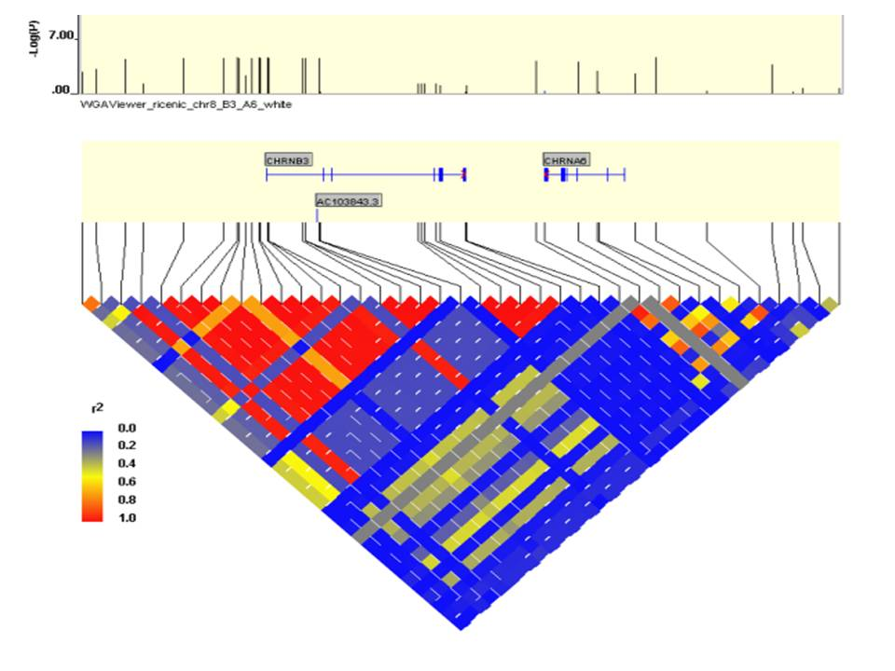
EU

Slide 36
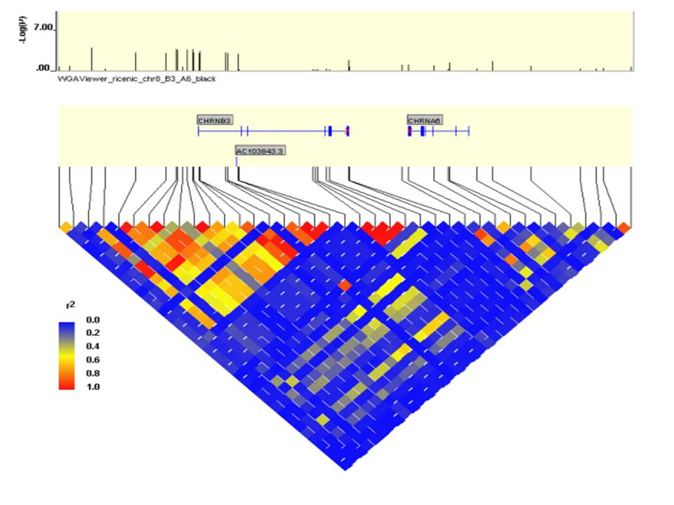
AA

Slide 37
Why Were We Successful?
CHRNB3 detected using FTND and N=3,300, whereas CPD analyses needed N=80,000
FTND invariant across age and ethnic strata, CPD is not
There are complex secular trends for CPD
CPD heterogeneous across co-morbid diagnoses; FTND is not
Our sample is enriched for co-morbidity

Slide 38
Final Words
Current GWAS – Chi-Square on steroids
Only pick low fruit – genome-wide significant; test one SNP at a time
How to identify true signals mixed in with noise due to chance?
How to identify gene-gene interactions and G x E interactions?
Where is the heritability of 50%?

Slide 39
Conclusions
Phenotype definition is important – FTND appears to capture dependence better than CPD
Sampling is important – We were enriched for co-morbid alcohol and cocaine dependence
Having an AA sample may help localize the signal
CPD has complex sex and age-period-cohort effects – FTND is more invariant
Paper of these analyses on Blackboard

Slide 40
GEVEVA Acknowledgement
U. Washington
Bruce Weir, Thomas Lumley, Ken Rice, Tushar Bhangale, Xiuwen Zheng, Ian Painter, Fred Boehm, CathyLaurie
CIDR
Kim Doheny, Elizabeth Pugh, Kurt Hetrick.
NCBI
Justin Pashall, Mike Feolo, Stephanie Pretel
Washington U.
Laura Bierut, John Rice, Nancy Saccone, Sherri Fisher
NHGRI
Emily Harris, Teri Manolio

