Slide 1
Human Linkage and Association Analysis
Fall 2016
Tuesday 8/30/16 (Week 1), N.L. Saccone

Slide 2
Human Linkage and Association Analysis
Coursemaster: John Rice
TA: Lei Chen (leichen@wustl.edu)
Nancy L. Saccone
Offices: Room 308 Biotech Building, 4559 Scott Avenue (3rd floor, behind elevators); also Room 6311, 4444 Forest Park Parkway
Email: nlims@genetics.wustl.edu
Office hours: Tuesday after class, and by appointment
Textbook: Statistical Genetics: Gene Mapping through Linkage and Association; edited by Ben Neale et al.
Other suggested books:
Statistics in Human Genetics by Pak Sham (textbook in 2008)
Genetic Data Analysis II, Bruce Weir
Analysis of Human Genetic Linkage, Jurg Ott
Also, web-available text: by Almgren et al.
http://www.maths.lth.se/matstat/kurser/statgen/book/StatisticsInGenetics-20031125.pdf

Slide 3
Human Linkage and Association Analysis
Grading: There will be 4 quizzes (10 percent each), one after each "unit." Homework will count 35% and the final exam will count 25%.
Final exam: December 20, 2016 (Tuesday)
Quiz for Linkage unit: 9/13/2016 (Tuesday), prior to computer lab.

Slide 4
The study of genetic diseases/traits in humans
Determine whether the disease has a possible genetic etiology.
Segregation analysis - determine whether the pattern of disease in families is consistent with the presence of one or more underlying genes.
“Map” the disease/trait
Linkage analysis
Association
(Replicate)
Clone the gene and determine causative mutation(s)
Biological/functional followup

Slide 5
Case study (Mendelian disease)
Cystic Fibrosis (CF)
1/2000 births
abnormally thick, sticky mucus affecting lungs (also pancreas, sometimes liver)
Data indicated autosomal recessive inheritance pattern
Linkage analysis localized the gene to chr 7q, between 7q22 and 7q31.1
CFTR gene identified (1989).
Disease alleles cause defect(s) in a protein involved in transport of chloride ions across the cell membrane.
most common mutation: Deletion of phenylalanine at reside 508 (CFTRΔF508), seen in 70% of mutant chromosomes
>1000 distinct mutations
Notes:
(deletion of phenylalanine at residue 508)

Slide 6
Case study (Complex disease)
Age-related Macular Degeneration (AMD)
Macula: circular area at the center of the retina. In AMD, progressive damage to the macula ultimately leads to patients becoming legally blind.
onset usually >50 years
Mendelian forms of MD occur (e.g. Stargardt disease, early onset, recessive, caused by mutations in ABCA4 gene on chr1, 1p22.1-p21 )
Linkage mapping of AMD implicated chr 1q31 (2003, 2004)
2005: 3 different research groups used SNP association methods to identify Complement Factor H (CFH). Common variant (rs1061170) Tyr402His increases risk of AMD (2 to 4-fold for heterozygotes, 5 to 7-fold for homozygotes)
NOTE: 96 cases, 50 controls. 116,000 SNPs. P = 10⁻⁷
But, much larger studies needed for other diseases.

Slide 7
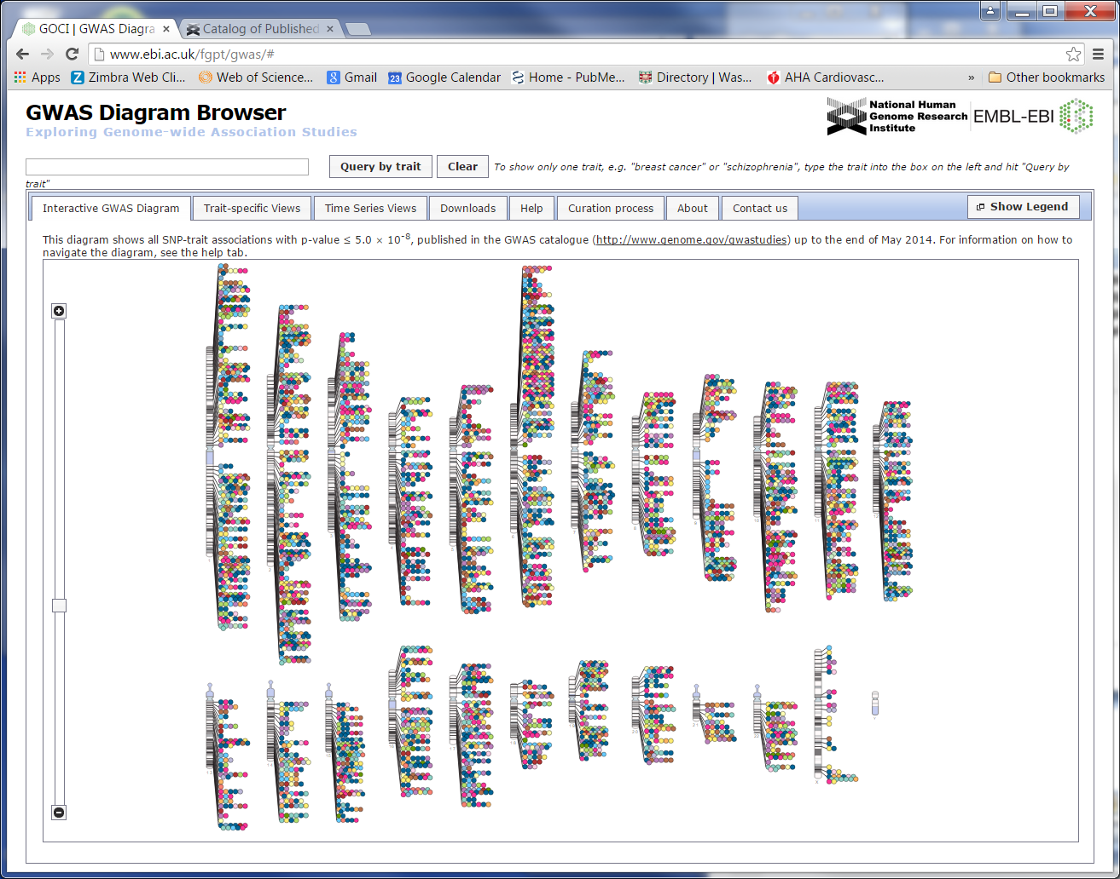

GWAS Catalog NHGRI/EMBL-EBI
http://www.ebi.ac.uk/fgpt/gwas/
Published Genome-Wide Associations (p < 5 x 10-8) through 05/2014

Slide 8
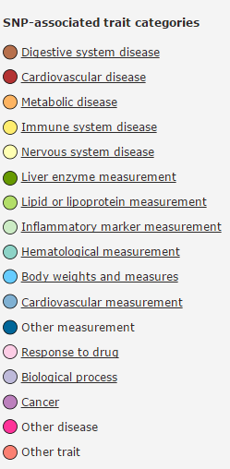
GWAS Catalog NHGRI/EMBL-EBI
http://www.ebi.ac.uk/fgpt/gwas/
Published Genome-Wide Associations (p < 5 x 10-8) through 05/2014

Slide 9
Some genetics background
"Gene":
Mendel demonstrated the existence of discrete units that are inherited according to Mendelian laws (particulate inheritance).
Now usually refers to the parts of chromosomes containing DNA that code for proteins (only ~2% of the human genome!).
"locus": a specific position (location) in the genome.
"allele": a particular form of the sequence occurring at a locus
"DNA markers": discrete inherited units that indicate differences in DNA sequence, but do not necessarily correspond to (protein-coding) genes. Examples:
RFLPs (restriction fragment length polymorphisms)
VNTRs (variable nucleotide tandem repeat polymorphisms)
microsatellites (e.g. trinucleotide repeats)
SNPs (single nucleotide polymorphisms)
(history: blood cell antigens, e.g. ABO blood group)
Notes:
Example of SNP on whiteboard

Slide 10
Some genetics background
Humans:
diploid organisms, meaning we have chromosomes in pairs
Thus, at a given locus, an individual’s “genotype” consists of 2 alleles to indicate the genetic status at that locus
23 pairs of chromosomes (22 autosomal pairs, 1 pair sex chromosomes (XX or XY))
The two members of a chromosome pair are called homologous chromosomes
~3 billion base pairs per haploid genome (e.g. gamete)
number of (protein coding) genes estimated at around 30,000 (or fewer), revised down from the 100,000 expected previous to the Human Genome Project
Notes:
Add to example on whiteboard: show 2nd chromosome

Slide 11
DNA markers
RFLPs (restriction fragment length polymorphisms):
Presence or absence of a restriction site for a bacterial restriction enzyme which cuts DNA at a specific recognition site.
Resulting DNA fragments are of varying lengths which are distinguished by differential migration in electrophoresis.
Can correspond to single nucleotide changes
VNTRs (variable nucleotide tandem repeat polymorphisms)
Motif (short oligonucleotide sequence) is repeated in tandem.
Microsatellites (e.g. di- tri- or tetra- nucleotide repeats)
Very polymorphic
SNPs (single nucleotide polymorphisms)
Difference at a single nucleotide position.
Biallelic (almost always)
Very common in genome.
Genotyping error rates tend to be low

Slide 12
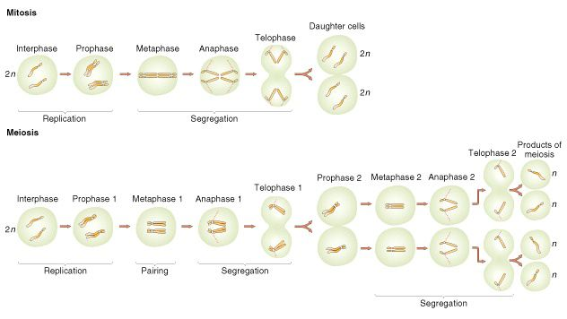
Mitosis, Meiosis
from Griffiths et al.
Notes:
See also SNP example on board

Slide 13
Linkage analysis concepts
Example of meiosis resulting in some recombinant gametes
Parent
meiosis
A₁
B₁
A₂
B₂
A₁
B₁
A₁
B₁
A₂
B₂
A₂
B₂
From one
grandparent
sister
chromatids

Slide 14
Linkage analysis concepts
Example of meiosis resulting in some recombinant gametes
Parent
meiosis
A₁
B₁
A₂
B₂
A₁
B₁
A₁
B₁
A₂
B₂
A₂
B₂
A₁
B₁
A₁
B₂
A₂
B₁
A₂
B₂
Non-sister chromatids may
cross over between the loci
From one
grandparent
sister
chromatids

Slide 15
Linkage analysis concepts
Example of meiosis resulting in some recombinant gametes
Parent
meiosis
A₁
B₁
A₂
B₂
A₁
B₁
A₁
B₁
A₂
B₂
A₂
B₂
A₁
B₁
A₁
B₂
A₂
B₁
A₂
B₂
Non-sister chromatids may
cross over between the loci
From one
grandparent
sister
chromatids
A₁
B₁
A₁
B₂
A₂
B₁
A₂
B₂
gametes

Slide 16
Genetic models of disease
Suppose a disease is caused by a single major gene (SML model) with two alleles: wild type (+) and mutant (d). Let T denote the presence of the trait or disease.
One way to specify a disease model: use parameters for penetrances, gene frequencies, population prevalence.

Slide 17
Genetic models of disease
Penetrances for each of the possible genotypes at the gene are denoted by
f₊₊= Pr(T | ++)
f_{+d}= Pr(T | +d)
f_{dd}= Pr(T | dd)
Terminology:
homozygous genotype: both alleles are the same
heterozygous genotype: the two alleles are different

Slide 18
Classic models of disease
Classical autosomal dominant inheritance (no phenocopies, fully penetrant).
Penetrance table:
f₊₊ f_{+d} f_{dd}
0 1 1
Often the dominant allele is rare, so that probability of homozygous dd individuals occurring is negligible.

Slide 19
Classic models of disease
Classical autosomal dominant inheritance (no phenocopies, fully penetrant).
Penetrance table:
f₊₊ f_{+d} f_{dd}
0 1 1
Often the dominant allele is rare, so that probability of homozygous dd individuals occurring is negligible.
Some hallmarks:
All affected have at least one affected parent, so the disease occurs in all generations (above the latest observed case – see example on board)
The disease does not appear in descendants of two unaffecteds.
Possible molecular explanation: disease allele codes for a functioning protein that causes some kind of dysfunction.

Slide 20
Classic models of disease
Classical autosomal recessive inheritance (no phenocopies, fully penetrant).
Penetrance table:
f₊₊ f_{+d} f_{dd}
0 0 1

Slide 21
Classic models of disease
Classical autosomal recessive inheritance (no phenocopies, fully penetrant).
Penetrance table:
f₊₊ f_{+d} f_{dd}
0 0 1
Some hallmarks:
Most affected individuals have two normal parents, so the disease appears to skip generations.
On average, 1/4 of (carrier x carrier) offspring are affected.
(Affected x normal) offspring are normal (but carriers)
(Affected x affected) offspring are all affected.
Possible molecular explanation: disease allele codes for a nonfunctional protein or lack of a protein, and one copy of the wild-type allele produces enough protein for normal function.

Slide 22
Genetic models of disease
Other examples of penetrance tables (locus-specific):
f₊₊ f_{+d} f_{dd}
0 1 1
0 0 1
0 0 0.9
0.1 1 1
Reduced penetrance (e.g. due to environmental interaction, modifier genes)
Phenocopies (e.g. due to heterogeneity, environmental effects)

Slide 23
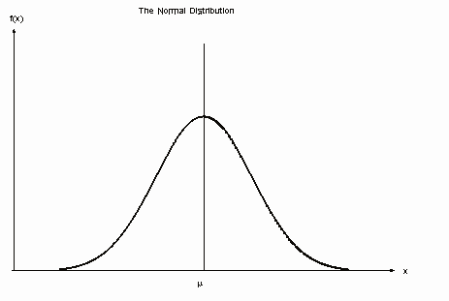
Polygenic model for inheritance of quantitative traits
How to explain inheritance of normally distributed traits (e.g. height)?
Many loci (polygenes) are involved in determining the QT

Slide 24
Liability threshold model of disease
Based on an underlying quantitative trait
unaffected
affected
The underlying risk of disease is a polygenic trait

Slide 25
Disease Prevalence
Denote gene (allele) frequencies: p=Pr(+), q=Pr(d)=1-p
Recall penetrances for each of the possible genotypes at the gene are denoted by
f₊₊= Pr(T | ++)
f_{+d}= Pr(T | +d)
f_{dd}= Pr(T | dd)
Assuming that the two alleles are distributed randomly in the population, then the genotype frequencies are
Pr(++) = p²
Pr(+d) = 2pq (we don't distinguish between +d and d+)
Pr(dd) = q²
Then the prevalence of the disease is
K = f₊₊p² + 2f_{+d}pq + f_{dd}q²

Slide 26
Genetic models of disease
"Assuming that the two alleles are distributed randomly in the population..." Is our assumption here valid?
Let p = Pr(A₁), q = Pr(A₂) = 1-p

Slide 27
Hardy-Weinberg equilibrium (2 allele locus)
Under certain assumptions, Hardy-Weinberg equilibrium holds: that is, the probabilities of the three genotypes (A₁A₁, A₁A₂, A₂A₂) are p², 2pq, and q², respectively.
HW law (under the assumptions below):
1) HWE is established after 1 generation of random mating.
2) HWE, once established, is maintained over the generations
Assumptions:
a. (infinitely) large population
discrete generations
random mating
no selection, no migration, no mutation
equal initial genotype frequencies in the two sexes
Note also we take genotypes to be unordered.

Slide 28
Hardy-Weinberg equilibrium
To see 2): Suppose HWE holds. Then
 |  | Maternal
 |  | A₁ (p) | A₂ (q)
Paternal | A₁ (p) | A₁A₁ (p²) | A₁A₂ (pq)
 | A₂ (q) | A₂A₁ (qp) | A₂A₂ (q²)
Why is p the prob of a parent transmitting A₁ ?
Parental Prob of having Prob of Joint
genotype this genotype transmitting ‘A₁' probability
A₁A₁ p² 1 p²
A₁A₂ 2pq 1/2 pq
A₂A₂ q² 0 0
Total: p²+pq = p(p+q)=p
Because HWE holds in current pop

Slide 29
Hardy-Weinberg Equilibrium
To see 1):HWE is established after 1 generation of random mating.
Notation:
Let p = Pr(A₁) = allele freq of A₁ in parental generation,
q = Pr(A₂) = allele freq of A₂ in parental generation
Pr(A₁A₁) = frequency of genotype A₁A₁ in initial (parental) generation
Pr(A₁A₂) = frequency of genotype A₁A₂ in initial (parental) generation
Pr(A₂A₂) = frequency of genotype A₂A₂ in initial (parental) generation
(we don't assume these equal p², 2pq, q²)
Pr₁ is notation for probability (frequency) in the next (offspring) generation

Slide 30
To see 1):
Given genotype frequencies in a (parental) population, Mendelian principles of segregation dictate the probability distribution for the genotypes in the offspring population
Father | Mother | Prob that Offspr is A₁A₁ | Prob that Offspr is A₁A₂ | Prob that Offspr is A₂A₂
A₁A₁ | A₁A₁ | 1 | 0 | 0
A₁A₁ | A₁A₂ | 0.5 | 0.5 | 0
A₁A₁ | A₂A₂ | 0 | 1 | 0
A₁A₂ | A₁A₁ | 0.5 | 0.5 | 0
A₁A₂ | A₁A₂ | 0.25 | 0.5 | 0.25
A₁A₂ | A₂A₂ | 0 | 0.5 | 0.5
A₂A₂ | A₁A₁ | 0 | 1 | 0
A₂A₂ | A₁A₂ | 0 | 0.5 | 0.5
A₂A₂ | A₂A₂ | 0 | 0 | 1
Notes:
[Pr(++)]² + Pr(++)Pr(+d) + [0.5Pr(+d)]²

Slide 31
To see 1):
Father | Mother | Prob that Offspr is A₁A₁ | Prob that Offspr is A₁A₂ | Prob that Offspr is A₂A₂ | Freq of this mating type
A₁A₁ | A₁A₁ | 1 | 0 | 0 | Pr(A₁A₁)Pr(A₁A₁)
A₁A₁ | A₁A₂ | 0.5 | 0.5 | 0 | Pr(A₁A₁)Pr(A₁A₂)
A₁A₁ | A₂A₂ | 0 | 1 | 0 | Pr(A₁A₁)Pr(A₂A₂)
A₁A₂ | A₁A₁ | 0.5 | 0.5 | 0 | Pr(A₁A₂)Pr(A₁A₁)
A₁A₂ | A₁A₂ | 0.25 | 0.5 | 0.25 | Pr(A₁A₂)Pr(A₁A₂)
A₁A₂ | A₂A₂ | 0 | 0.5 | 0.5 | Pr(A₁A₂)Pr(A₂A₂)
A₂A₂ | A₁A₁ | 0 | 1 | 0 | Pr(A₂A₂)Pr(A₁A₁)
A₂A₂ | A₁A₂ | 0 | 0.5 | 0.5 | Pr(A₂A₂)Pr(A₁A₂)
A₂A₂ | A₂A₂ | 0 | 0 | 1 | Pr(A₂A₂)Pr(A₂A₂)
In offspring, genotype probabilities are:
Pr₁(A₁A₁) = 1*Pr(A₁A₁)Pr(A₁A₁) + 0.5Pr(A₁A₁)Pr(A₁A₂) + 0.5 Pr(A₁A₂)Pr(A₁A₁) + 0.25 Pr(A₁A₂)Pr(A₁A₂)
= [Pr(A₁A₁) + 0.5Pr(A₁A₂)]²
Pr₁(A₂A₂) = ... = [Pr(A₂A₂) + 0.5Pr(A₁A₂)]²
Pr₁(A₁A₂) = ... = 2[Pr(A₁A₁) + 0.5Pr(A₁A₂)][Pr(A₂A₂) + 0.5Pr(A₁A₂)]
Notes:
KEY is that 1st column "prob that offspring is A1A1" together with last column, freq of mating type, gives Pr_1(A1A1).

Slide 32
HWE. To see 1):
In offspring,
Pr₁(A₁A₁) = [Pr(A₁A₁) + 0.5Pr(A₁A₂)]²
Pr₁(A₂A₂) = ... = [Pr(A₂A₂) + 0.5Pr(A₁A₂)]²
Pr₁(A₁A₂) = ... = 2[Pr(A₁A₁) + 0.5Pr(A₁A₂)][Pr(A₂A₂) + 0.5Pr(A₁A₂)]
Note also that in the parents' generation,
p=Pr(A₁) = Pr(A₁A₁) + 0.5Pr(A₁A₂)
q=Pr(A₂) = Pr(A₂A₂) + 0.5Pr(A₁A₂)
Thus,
Pr₁(A₁A₁) = [Pr(A₁)]² = p²
Pr₁(A₂A₂) = [Pr(A₂)]² = q²
Pr₁(A₁A₂) = 2Pr(A₁)Pr(A₂) = 2pq
And, again, in the offspring generation
p₁=Pr₁(A₁) = Pr₁(A₁A₁) + 0.5Pr₁(A₁A₂)= p² + 0.5(2pq)=p(p+q)=p
q₁=Pr₁(A₂) = Pr₁(A₂A₂) + 0.5Pr₁(A₁A₂)=q
So the allele frequencies are unchanged in the next generation;
thus Pr₁(A₁A₁) = p₁², Pr₁(A₂A₂) = q₁², Pr₁(A₁A₂) = 2p₁q₁.

Slide 33
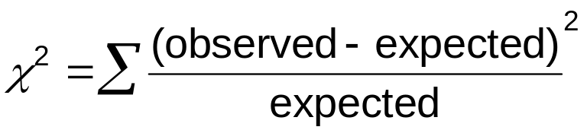
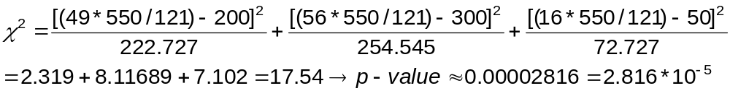
Testing for HWE
ex/ consider locus with alleles a,A. Suppose in a sample of 550 individuals, we observe 200 aa, 300 aA, 50 AA. Is this consistent with HWE?
Answer: use chi-squared test ,1 df:
N = total number of alleles observed = 2*550 = 1100
Pr(a) = (200*2 + 300)/1100 =7/11
Pr(A) = (300 + 50*2)/1100 = 4/11
Expected genotype counts Observed genotype
under HWE: counts
aa: (49/121)*550 = 222.727 200
aA: 2*(28/121)*550 = 254.545 300
AA: (16/121)*550 = 72.727 50
Notes:
so not consistent with HWE

Slide 34
Chi-squared statistic with 1 df:
3.841 is the critical value for α = 0.05.
6.635 is the critical value for α = 0.01.
Uses of HWE:
checking for genotyping errors
estimation of gene (allele) frequencies

Slide 35
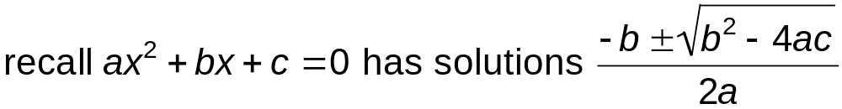
Using HWE to estimate disease allele frequencies
If random mating is a reasonable assumption, HWE provides a way to estimate allele frequencies for (pure) Mendelian dominant or recessive diseases, given the prevalence of a disease/trait.
Pure Dominant: Prevalence = f₊₊p² + 2f_{+d}pq + f_{dd}q² = 2pq + q²
Pure Recessive: Prevalence = f₊₊p² + 2f_{+d}pq + f_{dd}q² = q²
ex/ Consider a recessive disease in which a random sample of 40,000 individuals yields 4 cases. What is a good estimate of the frequency of the disease allele (“disease gene”)?
Assuming HWE, prevalence of the disease = Pr(dd) = q².
Thus q = sqrt(prevalence) = sqrt(4/40,000) = 0.01.
SEE Neale, page 93
For dominant models, can solve quadratic equation
OR....

Slide 36
Using HWE to estimate disease allele frequencies
If dominant model for a disease with prevalence K, with A the dominant allele
genotype: aa aA AA
penetrance: 0 1 1
Note this is equivalent to a the recessive allele for a recessive trait of "not having the disease":
genotype: aa aA AA
penentrance: 1 0 0
(for NOT having disease)
prevalence of NOT having the disease is 1-K.
So have a recessive trait with allele frequency p_{a}=1-p_{A}, prevalence 1-K:
use the formula: 1-K = f_{AA}p_{A}² + 2f_{aA}p_{a}p_{A} + f_{aa}p_{a}² = p_{a}²
Then p_{A} = 1 – p_{a} (see homework.)

Slide 37
Strategies for human disease gene mapping
Family-based linkage studies
Traditional parametric LOD score analysis in pedigrees
Allele-sharing methods (e.g. using sib-pairs)
Association studies
Unrelated case-control samples
Family-based methods (e.g. TDT using trios)

