Slide 1
Human Linkage and Association Analysis
Fall 2016
Thursday 9/1/16 (Week 1), N.L. Saccone
Notes:
Degrees of freedom

Slide 2
Quick announcements:
1. Final exam will be Tuesday 12/20/2016 at 9:30am
2. Lecture slides and syllabus will be posted to the WashU blackboard, under “Course Documents” (log in using your WUSTL Key)
  https://bb.wustl.edu

Slide 3
Recall: Hardy-Weinberg equilibrium (2 allele locus)
Under certain assumptions, we expect Hardy-Weinberg equilibrium to hold: that is, if p = Pr(A₁) and q = Pr(A₂) = 1-p, then
Pr(A₁A₁) = p²
Pr(A₁A₂) = 2pq
Pr(A₂A₂) = q²
HW law (under the assumptions below):
1) HWE is established after 1 generation of random mating.
2) HWE, once established, is maintained over the generations
Assumptions:
a. (infinitely) large population
discrete generations
random mating
no selection, no migration, no mutation
equal initial genotype frequencies in the two sexes
Note also we take genotypes to be unordered.
Notes:
NOTE typo correction compared to paper handout

Slide 4
Hardy-Weinberg equilibrium (2 allele locus)
Under certain assumptions, Hardy-Weinberg equilibrium holds: that is, the probabilities of the three genotypes (A₁A₁, A₁A₂, A₂A₂) are p², 2pq, and q², respectively.
HW law (under the assumptions below):
1) HWE is established after 1 generation of random mating.
2) HWE, once established, is maintained over the generations
Assumptions:
a. (infinitely) large population
discrete generations
random mating
no selection, no migration, no mutation
equal initial genotype frequencies in the two sexes
Note also we take genotypes to be unordered.

Slide 5
Hardy-Weinberg Equilibrium
To see 1):HWE is established after 1 generation of random mating.
Notation:
Let p = Pr(A₁) = allele freq of A₁ in parental generation,
q = Pr(A₂) = allele freq of A₂ in parental generation
Pr(A₁A₁) = frequency of genotype A₁A₁ in initial (parental) generation
Pr(A₁A₂) = frequency of genotype A₁A₂ in initial (parental) generation
Pr(A₂A₂) = frequency of genotype A₂A₂ in initial (parental) generation
(we don't assume these equal p², 2pq, q²)
Pr₁ is notation for probability (frequency) in the next (offspring) generation

Slide 6
To see 1):
Given genotype frequencies in a (parental) population, Mendelian principles of segregation dictate the probability distribution for the genotypes in the offspring population
Father | Mother | Prob that Offspr is A₁A₁ | Prob that Offspr is A₁A₂ | Prob that Offspr is A₂A₂
A₁A₁ | A₁A₁ | 1 | 0 | 0
A₁A₁ | A₁A₂ | 0.5 | 0.5 | 0
A₁A₁ | A₂A₂ | 0 | 1 | 0
A₁A₂ | A₁A₁ | 0.5 | 0.5 | 0
A₁A₂ | A₁A₂ | 0.25 | 0.5 | 0.25
A₁A₂ | A₂A₂ | 0 | 0.5 | 0.5
A₂A₂ | A₁A₁ | 0 | 1 | 0
A₂A₂ | A₁A₂ | 0 | 0.5 | 0.5
A₂A₂ | A₂A₂ | 0 | 0 | 1
Notes:
[Pr(++)]² + Pr(++)Pr(+d) + [0.5Pr(+d)]²

Slide 7
To see 1):
Father | Mother | Prob that Offspr is A₁A₁ | Prob that Offspr is A₁A₂ | Prob that Offspr is A₂A₂ | Freq of this mating type
A₁A₁ | A₁A₁ | 1 | 0 | 0 | Pr(A₁A₁)Pr(A₁A₁)
A₁A₁ | A₁A₂ | 0.5 | 0.5 | 0 | Pr(A₁A₁)Pr(A₁A₂)
A₁A₁ | A₂A₂ | 0 | 1 | 0 | Pr(A₁A₁)Pr(A₂A₂)
A₁A₂ | A₁A₁ | 0.5 | 0.5 | 0 | Pr(A₁A₂)Pr(A₁A₁)
A₁A₂ | A₁A₂ | 0.25 | 0.5 | 0.25 | Pr(A₁A₂)Pr(A₁A₂)
A₁A₂ | A₂A₂ | 0 | 0.5 | 0.5 | Pr(A₁A₂)Pr(A₂A₂)
A₂A₂ | A₁A₁ | 0 | 1 | 0 | Pr(A₂A₂)Pr(A₁A₁)
A₂A₂ | A₁A₂ | 0 | 0.5 | 0.5 | Pr(A₂A₂)Pr(A₁A₂)
A₂A₂ | A₂A₂ | 0 | 0 | 1 | Pr(A₂A₂)Pr(A₂A₂)
In offspring, genotype probabilities are:
Pr₁(A₁A₁) = 1*Pr(A₁A₁)Pr(A₁A₁) + 0.5Pr(A₁A₁)Pr(A₁A₂) + 0.5 Pr(A₁A₂)Pr(A₁A₁) + 0.25 Pr(A₁A₂)Pr(A₁A₂)
= [Pr(A₁A₁) + 0.5Pr(A₁A₂)]²
Pr₁(A₂A₂) = ... = [Pr(A₂A₂) + 0.5Pr(A₁A₂)]²
Pr₁(A₁A₂) = ... = 2[Pr(A₁A₁) + 0.5Pr(A₁A₂)][Pr(A₂A₂) + 0.5Pr(A₁A₂)]
Notes:
KEY is that 1st column "prob that offspring is A1A1" together with last column, freq of mating type, gives Pr_1(A1A1).

Slide 8
HWE. To see 1):
In offspring,
Pr₁(A₁A₁) = [Pr(A₁A₁) + 0.5Pr(A₁A₂)]²
Pr₁(A₂A₂) = ... = [Pr(A₂A₂) + 0.5Pr(A₁A₂)]²
Pr₁(A₁A₂) = ... = 2[Pr(A₁A₁) + 0.5Pr(A₁A₂)][Pr(A₂A₂) + 0.5Pr(A₁A₂)]
Note also that in the parents' generation,
p=Pr(A₁) = Pr(A₁A₁) + 0.5Pr(A₁A₂)
q=Pr(A₂) = Pr(A₂A₂) + 0.5Pr(A₁A₂)
Thus,
Pr₁(A₁A₁) = [Pr(A₁)]² = p²
Pr₁(A₂A₂) = [Pr(A₂)]² = q²
Pr₁(A₁A₂) = 2Pr(A₁)Pr(A₂) = 2pq
And, again, in the offspring generation
p₁=Pr₁(A₁) = Pr₁(A₁A₁) + 0.5Pr₁(A₁A₂)= p² + 0.5(2pq)=p(p+q)=p
q₁=Pr₁(A₂) = Pr₁(A₂A₂) + 0.5Pr₁(A₁A₂)=q
So the allele frequencies are unchanged in the next generation;
thus Pr₁(A₁A₁) = p₁², Pr₁(A₂A₂) = q₁², Pr₁(A₁A₂) = 2p₁q₁.

Slide 9
Strategies for human disease gene mapping
Family-based linkage studies
Traditional parametric LOD score analysis in pedigrees
Allele-sharing methods (e.g. using sib-pairs)
Association studies
Unrelated case-control samples
Family-based methods (e.g. TDT using trios)

Slide 10
Strategies for human disease gene mapping
Family-based linkage studies
Traditional parametric LOD score analysis in pedigrees
Allele-sharing methods (e.g. using sib-pairs)
Association studies
Case-control samples
Family-based methods (e.g. TDT using trios)
Notes:
Sign-in sheet
office hours directly after class, or by appointment
From this slide, go to notes on whiteboard for example of LOD score in coin-tossing context

Slide 11
Linkage analysis concepts
General approach for a genome screen:
Genotype individuals at marker loci along the genome.
If a marker locus is "near" the trait-influencing locus, the parental alleles from the same grandparent at these two loci "tend to be inherited together" (recombination between the two loci is rare)
This phenomenon is called "genetic linkage" between the two loci: the two loci are "genetically linked"
"Genetic linkage analysis" is the study of ordering loci and estimating genetic distances between them.

Slide 12
Linkage analysis concepts
Recombination between (with respect to) 2 loci has occurred when the in a haplotype of an individual, the alleles at the 2 loci come from 2 different grandparents.
Nonrecombination: when the alleles at the 2 loci come from the same grandparent
= the probability of recombination between 2 given loci
example:
Parent
Locus 1:
A₁
B₁
A₁
B₁
A₂
B₂
A₂
B₂
gametes
Locus 2:
meiosis
If recombination between the 2 loci is rare, tend to get overrepresentation of A₁B₁ and A₂B₂ gametes (nonrecombinants)

Slide 13
Linkage analysis concepts
Example of meiosis resulting in some recombinant gametes
Parent
meiosis
A₁
B₁
A₂
B₂
A₁
B₁
A₁
B₁
A₂
B₂
A₂
B₂
A₁
B₁
A₁
B₂
A₂
B₁
A₂
B₂
Non-sister chromatids may
cross over between the loci
From one
grandparent
sister
chromatids
A₁
B₁
A₁
B₂
A₂
B₁
A₂
B₂
gametes

Slide 14
Linkage analysis concepts
Example of meiosis resulting in some recombinant gametes
Parent
meiosis
A₁
B₁
A₂
B₂
A₁
B₁
A₁
B₁
A₂
B₂
A₂
B₂
A₁
B₁
A₁
B₂
A₂
B₁
A₂
B₂
Non-sister chromatids may
cross over between the loci
From one
grandparent
sister
chromatids
A₁
B₁
A₁
B₂
A₂
B₁
A₂
B₂
Recombination with respect to 2 loci: has occurred when in the individual's haplotype (ie. in a gamete inherited from the parent), the alleles at the 2 loci come from the 2 different grandparents.
gametes

Slide 15
Linkage analysis concepts
If locus A and locus B are on different chromosomes (or "very far" apart), θ = 1/2 (independent assortment at the 2 loci), ie. the loci are unlinked
Expected frequencies in gametes:
A₁B₁ 1/4
A₁B₂ 1/4
A₂B₁ 1/4
A₂B₂ 1/4
A₁
B₁
A₁
B₁
A₂
B₂
A₂
B₂
Usually θ is considered to range between 0 and 1/2.
Note:
if a gamete experiences an odd # of crossovers btwn 2 loci, then have a recombinant.
if even # of crossovers, then have a non-recombinant.

Slide 16
Linkage analysis concepts
Genotypes do not necessarily determine haplotypes: the alleles received from the same parent (same chromosome strand)
Consider an individual with 2-locus genotype
A₁ A₂ B₁ B₂ (heterozygous at both loci)
There are two possible phases:
A₁
B₁
A₂
B₂
A₁
B₂
A₂
B₁
haplotypes: haplotypes:
A₁ B₁/A₂ B₂ A₁ B₂/A₂ B₁

Slide 17
Linkage analysis in pedigrees
Representation of pedigrees:
Female: circle
Male: square
Affected: shaded
Unaffected:unshaded
1 2
1
2
3 3
1 3
3
4
2 3
"LINKAGE" format pedigree files:
Fam_id ind_id fath_id moth_id gender disease_status genotypes
1 0 0 1 2 1 2
1 2 0 0 2 1 3 3
1 3 1 2 2 1 1 3
1 4 1 2 2 2 2 3

Slide 18
Linkage analysis in pedigrees
Representation of pedigrees:
Female: circle
Male: square
Affected: shaded
Unaffected:unshaded
Vertical bar indicates haplotype phase is known
1 2
2 3
1
2
3 3
4 1
1 3
2 4
2 3
1 3
3
4
"LINKAGE" format pedigree files:
Fam_id ind_id fath_id moth_id gender disease_status genotype(s)
1 0 0 1 2 1 2 2 3
1 2 0 0 2 1 3 3 1 4
1 3 1 2 2 1 1 3 2 4
1 4 1 2 2 2 2 3 1 2

Slide 19
Linkage analysis in pedigrees
Question: how do we determine if there is evidence that two loci are linked (i.e., that θ < 1/2)?
1 2
1 2
3 4
3 4
Write out the "likelihood function" for the pedigree, determine the "maximum likelihood estimate" for theta.
1 3
1 4
2 3
2 3
Notes:
GO TO COIN TOSS EXAMPLE

Slide 20
Linkage analysis in pedigrees
Coin toss example on board
Notes:
GO TO COIN TOSS EXAMPLE

Slide 21
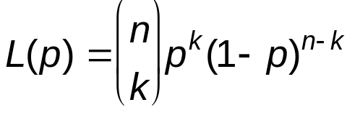


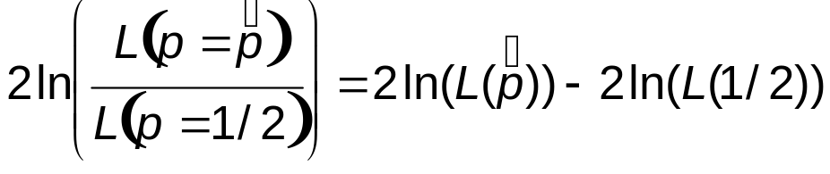
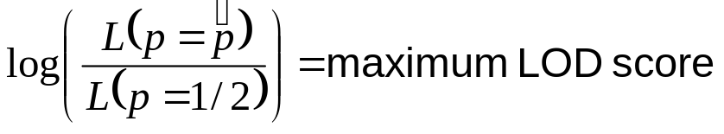
Method for coin tosses (or linkage analysis)
P = probability of a Head, n = number of coin tosses, k = number of heads observed
Write down the likelihood of the data as a function of p:
Idea: compare the maximum likelihood estimate to p=1/2.
For two proposed values of p (say, p₀ = 0.5 and p₁ = ), the likelihood ratio (LR)
indicates the relative support provided by the data.
In fact, the likelihood ratio statistic
asymptotically follows a chi-squared distribution with one degree of freedom.
Notes:
8/27/15: added line at top to define notation.

Slide 22
Linkage analysis in pedigrees
First, discuss detecting linkage between two marker loci.
Example: phase known, fully heterozygous parents
1 2
1 2
3 4
3 4
Can explicitly count recombs (k=1) and nonrecombs (n-k=3).
L(θ) = C θ¹ (1-θ)³
As in coin-toss example,
∧
θ = (# recombs) / (# trials) = 1/4,
and max LOD = 0.227
1 3
1 4
2 3
2 3

Slide 23
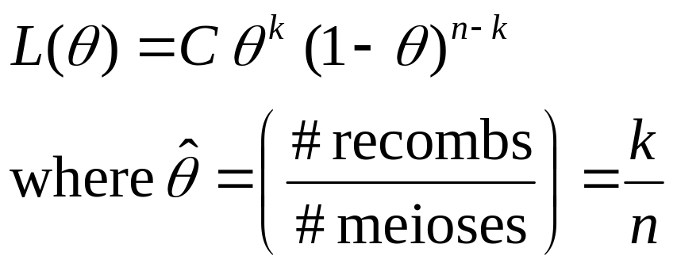
Linkage analysis in pedigrees
For cases where all recombinants and non-recombinants can be explicitly counted:
Say we have k recombinants in a total of n meioses

Slide 24
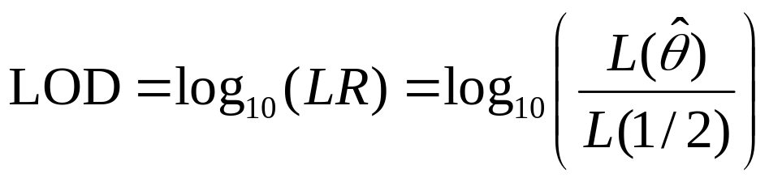
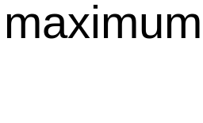
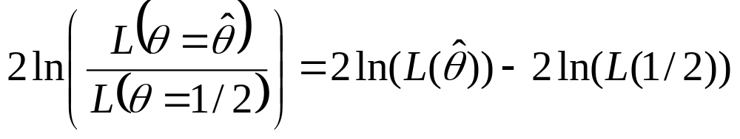
Linkage analysis in pedigrees
Testing for linkage:
Null hypothesis: θ = 1/2
Alternative hypoth: θ = max likelihood estimate
Another way to test the alt vs. null hypotheses:
Use the likelihood-ratio based chi-squared stat.
Under the null hypothesis, this asymptotically follows a chi-squared distribution with 1 df.

Slide 25
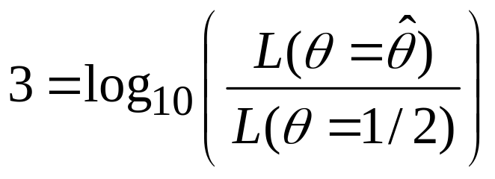
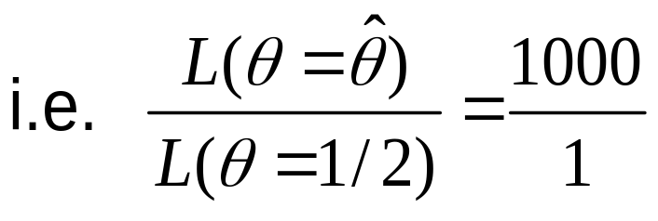
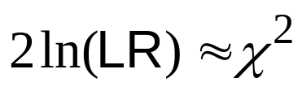
Linkage analysis in pedigrees
Notes:
The "traditional" LOD score threshold for significance is 3.
  This corresponds to
The pointwise p-value corresponding to LOD=3 is 0.0001.
  To see this: convert the LOD score to a χ²
  Note
  Then 4.6*3=13.8, which in a 1-sided test gives p = 0.0001.

Slide 26
Linkage analysis in pedigrees
Next, what if phase is not known? Example:
4 4
4 4
3 3
3 3
1 2
1 2
3 4
3 4
1 3
1 4
2 3
2 3

Slide 27
Linkage analysis in pedigrees
Next, what if phase is not known? Example:
4 4
4 4
3 3
3 3
Possible phases for father:
I: 1 1 / 2 2 II: 1 2 / 2 1
ie. ie.
1 2
1 2
1 2
2 1
1 2
1 2
3 4
3 4
So two cases:
I: 1 recomb, 3 non-recomb
L(θ) = θ¹ (1- θ)³
II: 3 recomb, 1 non-recomb
L(θ) = θ³ (1- θ)¹
1 3
1 4
2 3
2 3
F m
F m
F m
F m
Presumably the 2 cases are equally likely, so overall L is:
L(θ) = (1/2) θ (1- θ)³ + (1/2) θ³ (1- θ)¹

Slide 28
Linkage analysis in pedigrees
PHASE II now:
4 4
4 4
3 3
3 3
Possible phases for father:
I: 1 1 / 2 2 II: 1 2 / 2 1
ie. ie.
1 2
1 2
1 2
2 1
1 2
2 1
3 4
3 4
So two cases:
I: 1 recomb, 3 non-recomb
L(θ) = θ¹ (1- θ)³
II: 3 recomb, 1 non-recomb
L(θ) = θ³ (1- θ)¹
1 3
1 4
2 3
2 3
F m
F m
F m
F m
R, R R NR
Presumably the 2 cases are equally likely, so overall L is:
L(θ) = (1/2) θ (1- θ)³ + (1/2) θ³ (1- θ)¹

Slide 29
Linkage analysis in pedigrees
Next, how do we compute the LOD score indicating linkage between a disease locus and a marker locus?
Disease locus is unknown!
Key: must assume a disease model. This allows us to assign possible genotypes at the disease locus.

