Slide 1
Human Linkage and Association Analysis
Fall 2016
Thursday 9/8/16 (Week 2), N.L. Saccone
Notes:
Degrees of freedom

Slide 2
Example files are on golding and/or fuzzle:
/nfs/golding/home/nsaccone/sdata/ex1/2015
/nfs/golding/home/nsaccone/sdata/ex2/2015
Or, if above directories not accessible: on gewiz:
/home/gems/nsaccone/ex1
/home/gems/nsaccone/ex2

Slide 3
Multipoint linkage with multiple genotyped markers
Ues map functions to relate recombination fraction θ to "map distance" x.
Want x₁₂ + x₂₃ = x₁₃
x₁₂
x₂₃
M₁
M₂
M₃
Notes:
chr 1: F: 365, M: 216
chr 22: F: 74, M: 49
comment on sex-specific maps
comment on the practice of taking theta always le 1/2.

Slide 4
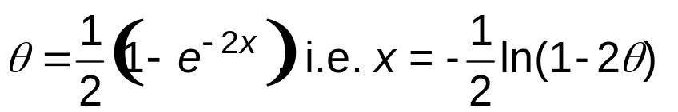
Map functions
Examples:
Morgan map function: x = θ.
Haldane map function:
ex/ if θ_{AB} = 1/4 and θ_{BC} = 1/4, what is θ_{AC} assuming the Haldane map function?
Compute:
x_{AB} = -(1/2) ln(1- 2(1/4)), x_{BC} = -(1/2) ln(1- 2(1/4))
x_{AC} = x_{AB} + x_{BC} = - ln(1- 2(1/4)) = -ln(1/2)
Then
θ_{AC} = (1/2)(1 - exp(-2x_{AC})) = (1/2)(1 - exp(2ln(1/2))
= (1/2)(1 - exp(ln((1/2)²))) = (1/2)(1-(1/4))
= (1/2)(3/4) = 3/8 .
Notes:
chr 1: F: 365, M: 216
chr 22: F: 74, M: 49
comment on sex-specific maps
comment on the practice of taking theta always le 1/2.

Slide 5
Map functions
Haldane map function:
More generally, can derive a formula (see HW):
θ_{AC} = θ_{AB} + θ_{BC} - 2 θ_{AB} θ_{BC}
Notes:
chr 1: F: 365, M: 216
chr 22: F: 74, M: 49
comment on sex-specific maps
comment on the practice of taking theta always le 1/2.

Slide 6
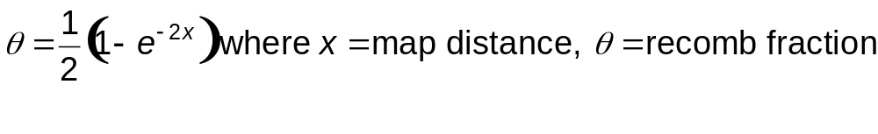
Map functions
Haldane map function:
x
Δx
Let θ = f(x)
M₁
M₂
M₃
Assumption 1: θ₁₂ independent from θ₂₃
Assumption 2: For a small enough subinterval, x ≈ θ
hence as Δx → 0, f(Δx) → Δx
(Poisson process)
Notes:
chr 1: F: 365, M: 216
chr 22: F: 74, M: 49
comment on sex-specific maps
comment on the practice of taking theta always le 1/2.

Slide 7
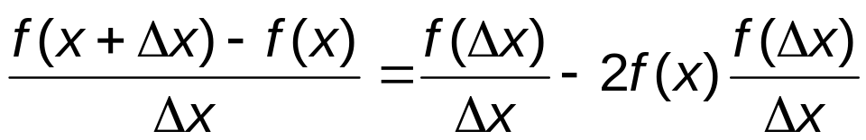
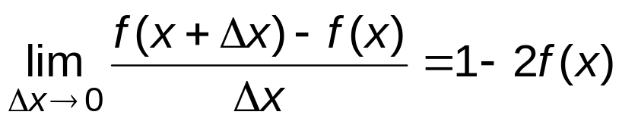
Map functions
x
Δx
M₁
M₂
M₃
Note: θ₁₃ = θ₁₂(1-θ₂₃ ) + θ₂₃(1-θ₁₂) (using independence)
= θ₁₂ - θ₁₂θ₂₃ + θ₂₃ - θ₁₂θ₂₃
= θ₁₂ + θ₂₃ - 2θ₁₂θ₂₃
So
f(x+Δx) = θ₁₃= θ₁₂ + θ₂₃ - 2θ₁₂θ₂₃ = f(x) + f(Δx) - 2f(x)f(Δx)
As Δx→ 0, f(Δx)→Δx, so

Slide 8
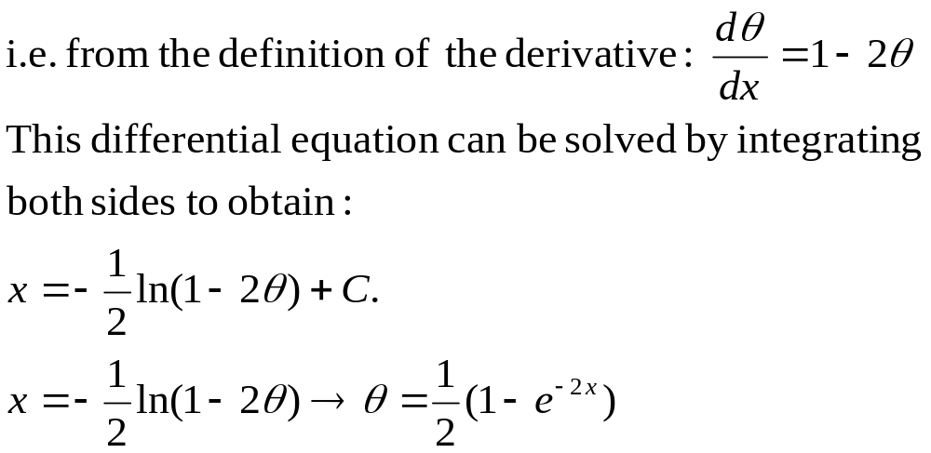
Map functions
x
Δx
M₁
M₂
M₃

Slide 9
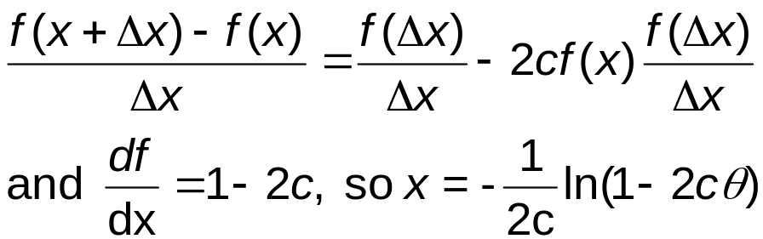
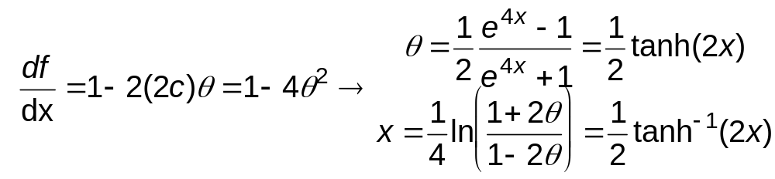
Map functions
Comments:
θ₁₃= θ₁₂ + θ₂₃ - 2θ₁₂θ₂₃ . Useful formula; can be derived another way.
Other map functions arise from generalizing this relationship:
θ₁₃= θ₁₂ + θ₂₃ - 2c θ₁₂θ₂₃
c is called the "coefficient of coincidence"
1-c is the "interference"
Then
Kosambi map function: consider function c(θ)=2θ.
The diff.eq. becomes
Notes:
Note: 2*theta =0 when theta=0 (so interference = 1), 1 when theta=1/2 (so interference = 0).

Slide 10
Multipoint linkage analysis
Three-point analysis.
Suppose have loci A, B, C , in that order, on a chromosome.
Represent haplotypes across these loci in terms of the recombination status between the loci.
Notation: for k loci, a (k-1)-long string of 0's and/or 1's,
where the ith digit represents the recombination status of
the allele at the (i+1)th locus with respect to the first locus.
e.g. for 3 loci: 00 →nonrecomb in AB, nonrecomb in AC
01→NR in AB, R in AC , etc.
Let γ_{ij}=haplotype frequency for ij haplotype
GOAL: get relationship between haplo freqs and thetas.
A
B
C

Slide 11
A
B
C
 | Recomb status in the interval
haplo ABC. Recomb in AB? AC? | AB | AC | BC (determined)
00 | 0 | 0 | 0
01 | 0 | 1 | 1
10 | 1 | 0 | 1
11 | 1 | 1 | 0
θ_{AB}= sum of frequencies of the haplos for which AB are recombinant
= γ₁₀ + γ₁₁ .
θ_{AC}= γ₀₁ + γ₁₁ .
θ_{BC}= γ₀₁ + γ₁₀ .
Also: γ₀₀ + γ₀₁ + γ₁₀ + γ₁₁ = 1.

Slide 12
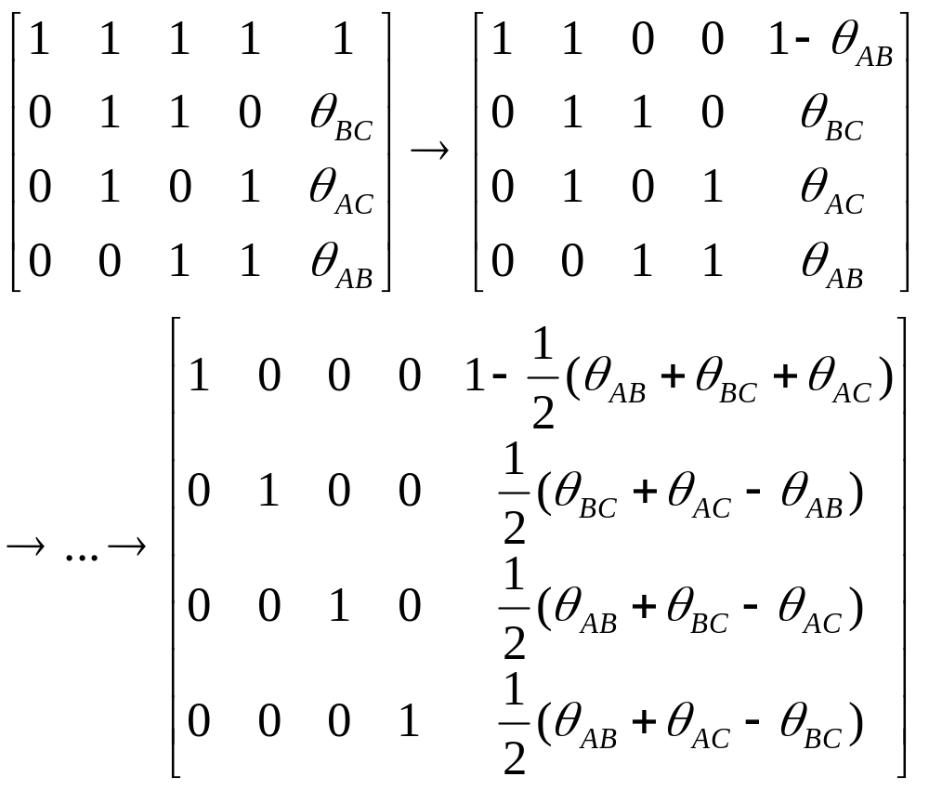
4 equations, 4 unknowns: columns corresp to subscripts 00,01,10,11

Slide 13
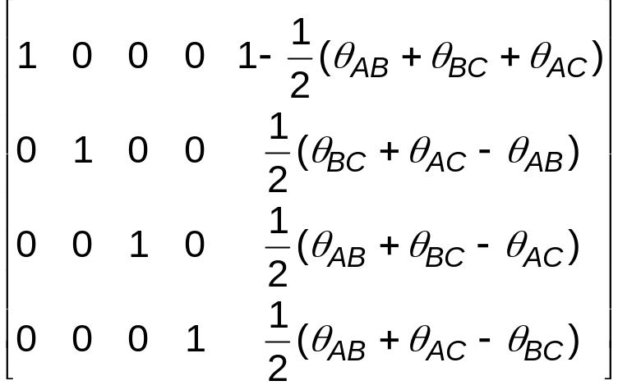
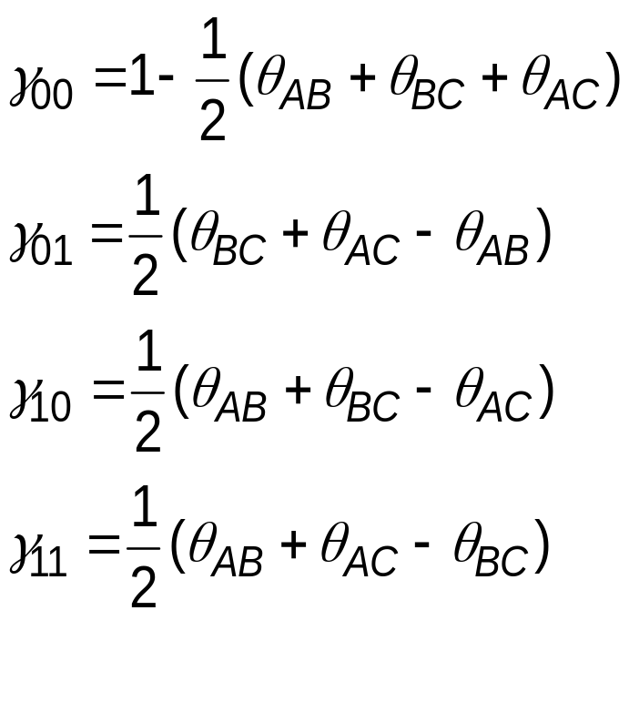
so

Slide 14
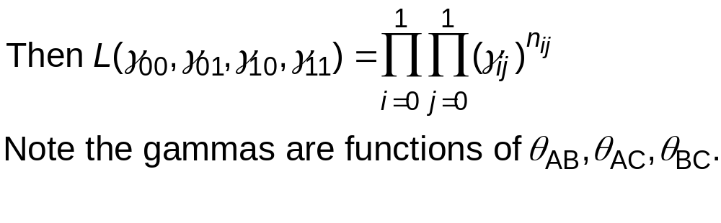
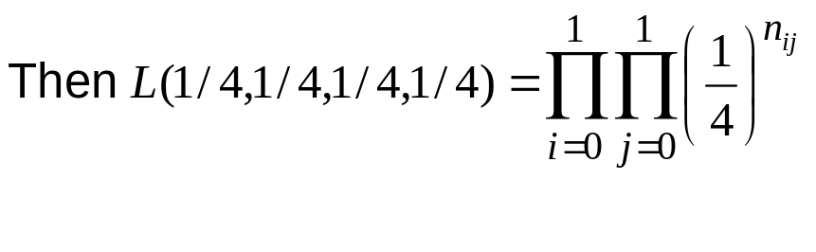
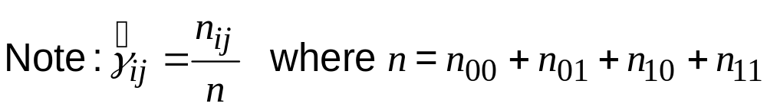
A
B
C
Q: connection to computing LOD scores?
Suppose observe n_{ij} = # of haplos of type ij .
prob of haplotype of type ij,
raised to the power of the
# of those observed
When all the θs are 1/2, the formulas for γ_{ij} give γ_{ij} = 1/4.

Slide 15
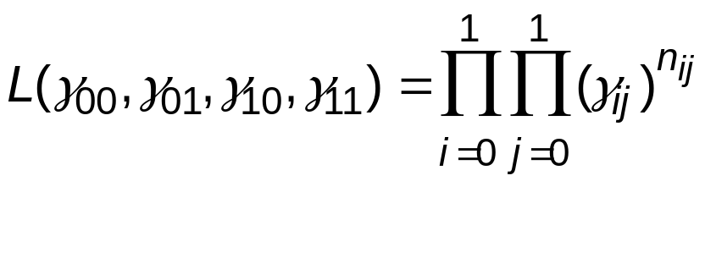
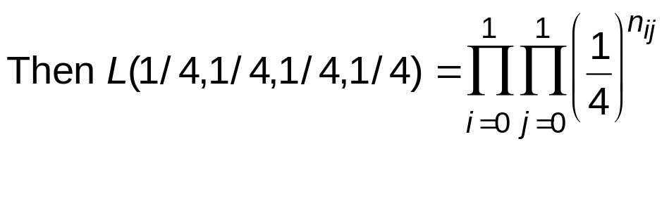
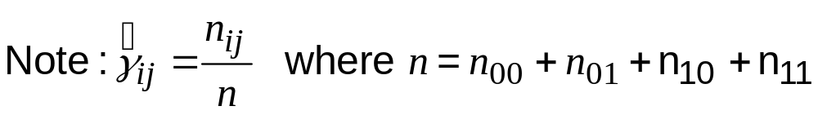
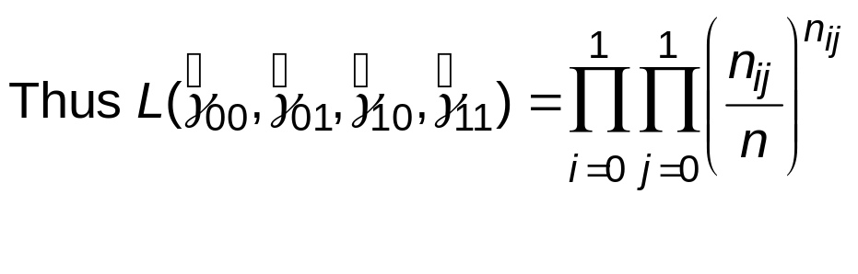
A
B
C
H₀: when all the θs are 1/2, the formulas for γ_{ij} give γ_{ij} = 1/4.
Compare to alternative hypothesis:

Slide 16
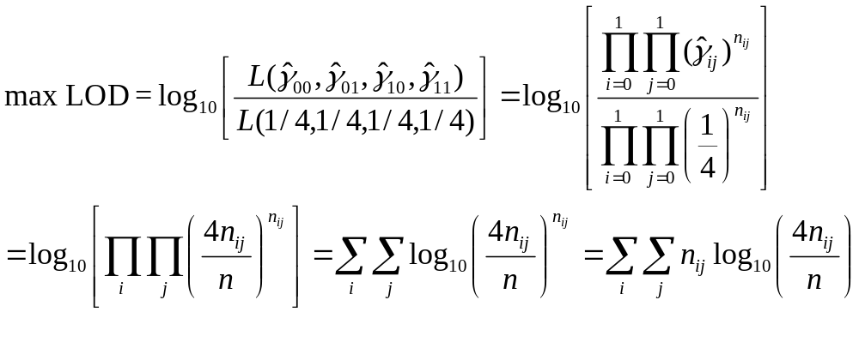
A
B
C
If some θs are known or specified, use them and compute LOD at
those θs.

Slide 17
Practical advantages of multipont LOD score analysis
Can allow us to “impute” genotype information at an originally uninformative marker, or between markers
  Results thus less sensitive to missing genotypes (or uninformative genotypes) at any one locus
Allows better resolution, for narrowing down the location of the disease locus
Caveats for multipoint LOD score analysis
Sensitive to errors in the genetic map
Can inflate evidence for linkage in inter-marker intervals.

Slide 18
Algorithms for likelihood calculations
Elston-Stewart algorithm: allows for large, complex pedigrees, but limited in number of markers that
can be considered in multipoint calculations.
Lander-Green algorithm: can handle large number of loci
but limited in the size of pedigree that can be handled
in practice.

Slide 19
Mapping disease genes
  Linkage
    quantify co-segregation of trait and genotype in families
LOD score traditionally
used to measure statistical
evidence for linkage
  Association
    Common design: unrelated case-control sample, analyzed for allele frequency differences
AC
AC
CC
AC
AC
AC
CC
CC
CC
AA
AA
AC
AA
AC
AA
AC
CC
AC
AA
cases
controls

Slide 20
Comparing Linkage and Association
Linkage mapping: | Association mapping:
Requires family data | Unrelated cases/controls OR Case/parents or family design
Disease travels with marker allele within families (close genetic distance between disease locus and marker | Disease is associated with marker allele that is either causative or is in linkage disequilibrium
Relationship between same allele and trait need not exist across the full sample (e.g. across different families) | works only if association exists at the population level
robust to allelic heterogeneity: if different mutations occur within the same gene/locus, the method works | not robust to allelic heterogeneity
signals for complex traits tend to be broad (~20 Mb) | association signals generally not as broad
Notes:
Mention pendred syndrome

Slide 21
Multipoint linkage analysis programs
Genehunter:
Demo on gewiz/golding/fuzzle
Genehunter command is
gh.linux
Merlin

