Slide 1
Association analysis with sequence data (1)
Human Linkage & Analysis
November 29, 2016
Adam Locke, PhD

Slide 2
Overview for today
Discuss data characteristics that influence the choice of test to use for analysis
Quick exploration of these in test data sets
Learn tools for running genome-wide analyses
Single variant association tests
Variant annotation
Gene-based or group-wise association analysis
Discuss visualization and interpretation of results from these analysis methods

Slide 3
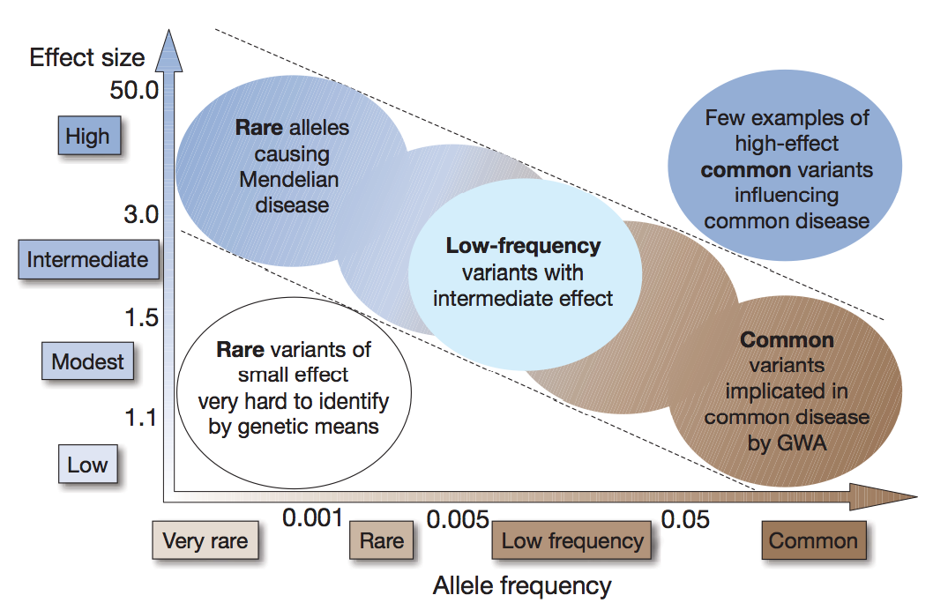
Genetic architecture of complex traits

Slide 4
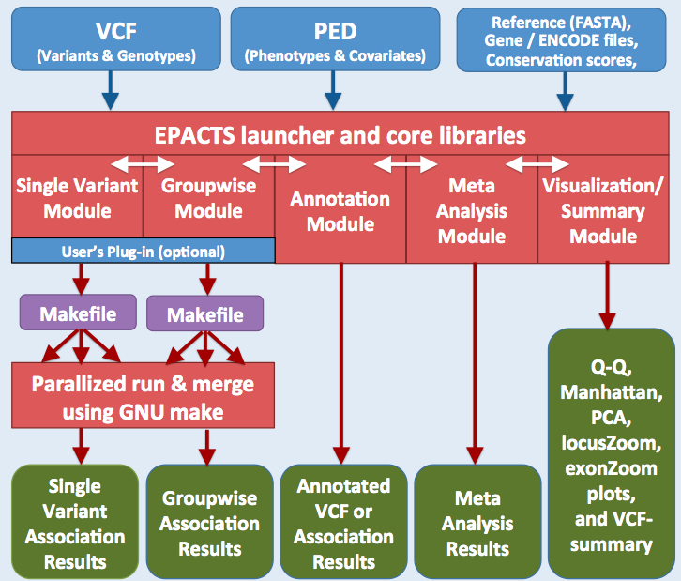
Overview of EPACTS framework
Parallelized run & merge using GNU make

Slide 5
Key Features of EPACTS
Convenient to run
Only needs a genotype VCF and phenotype (PED) file
Efficient and parallel access of VCF files
Fault-tolerant pipeline structure based on GNU make
Supports a variety of single variant and group-wise tests
Automated annotation of variants
Automated visualization of association results and QC metrics
Under active development and dynamic plug-in of user-defined statistical tests

Slide 6
Using EPACTS
Wiki page with extensive explanations of workflow, data types, available methods
http://genome.sph.umich.edu/wiki/EPACTS
Useful descriptions in help/man menus
Start with this command: epacts --help

Slide 7
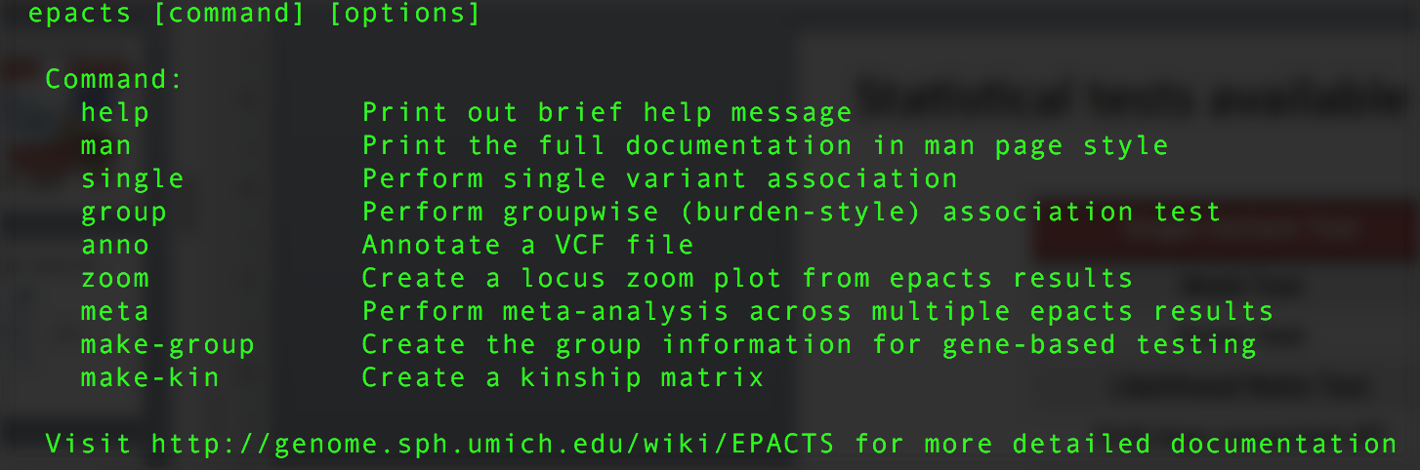
EPACTS main “menu”
Shows the major functions available in EPACTS:
Single variant association (single)
Groupwise tests (group)
Annotation (anno)
Visualizations (zoom)
Meta-analysis (meta)

Slide 8
Before we run analysis, understand our data sets
Two test data sets:
Set 1: /home/gems/m21-5483/seq_assoc/set1
Set 2: /home/gems/m21-5483/seq_assoc/set2
Each has two sets of data:
Genetic data in a .vcf file
Phenotype data in a .ped file

Slide 9
Understand the basics of each file
PED file
How many individuals?
What phenotypes are available?
For dichotomous traits, how many cases/controls?
For quantitative traits, what does the distribution look like?
What about outliers? Assumptions to worry about?
What covariates are available?
VCF file
What are all the columns?
How many individuals? (Do they overlap?)
How many variants?

Slide 10
Some useful unix commands to help answer these questions
head -n X file – gives the first X lines of a file
tail -n X file – gives the last X lines of a file
cut -f X,Y or (X-Y) file – prints only columns X and Y or X through Y (tab separated by default)
grep -e”expr” file – prints lines that contain a desired string “expr” (-v negates this, yielding lines that do NOT contain the string)
wc –(m,w,l) file – prints count of characters (-m), words (-w), and/or lines (-l) in a file

Slide 11
Exercise #1:
Run single variant association analysis
Test data are located here:
Set 1: /home/gems/m21-5483/seq_assoc/set1
Set 2: /home/gems/m21-5483/seq_assoc/set2
What is required to do this?
What are the required parameters?
What optional parameters might be useful?
What are the considerations we need to take into account before we start?
What type of trait? Test?
Covariates to include?
Notes:
Outcome of interest
-- quantitative or binary
-- covariates, potential confounders (PCs, etc), no?
-- for QTs: trait distribution, transformations, comparability to other studies
2) Sample size
-- feasible to achieve desired significance?
-- for binary: case/control balance
-- type of sample: case/control cohort, population-based, family-based, etc.
3) Data quality/QC
-- type of input data (GT, GL, PL, DS)
-- variants to include/exclude? (PASS)
-- missingness, HWE, MAC/MAF thresholds
4) Test of choice, evaluating significance
-- what output is given
-- speed, computational resources
-- # of variants tested (tests performed)

Slide 12
Phenotypes: binary trait
Y
1
0
1
1
0
…
0
Cases = 1
Controls = 0
n individuals

Slide 13
Phenotypes: quantitative trait (QT)
Y
0.08
0.84
0.17
0.19
0.35
…
1.39
Transf.(Y)
-2.5
-0.2
-1.8
-1.7
-1.0
…
0.3
n individuals
Transformation:
Logarithm
Inverse normal
Freq.
Freq.
Y
Transf.(Y)

Slide 14
Challenges for association testing of low-frequency variants
Low minor allele count (MAC)
Stringent α = 5x10⁻⁸ (multiple testing)
For binary traits:
Unbalanced numbers of cases and controls (e.g. population-based studies)

Slide 15
Single variant tests available in EPACTS
Single Variant Test
Wald Test
Score Test
Likelihood Ratio Test
Firth bias-corrected LRT
Linear Regression
Reverse Regression
Wilcoxon Rank Sum
EMMAX

Slide 16
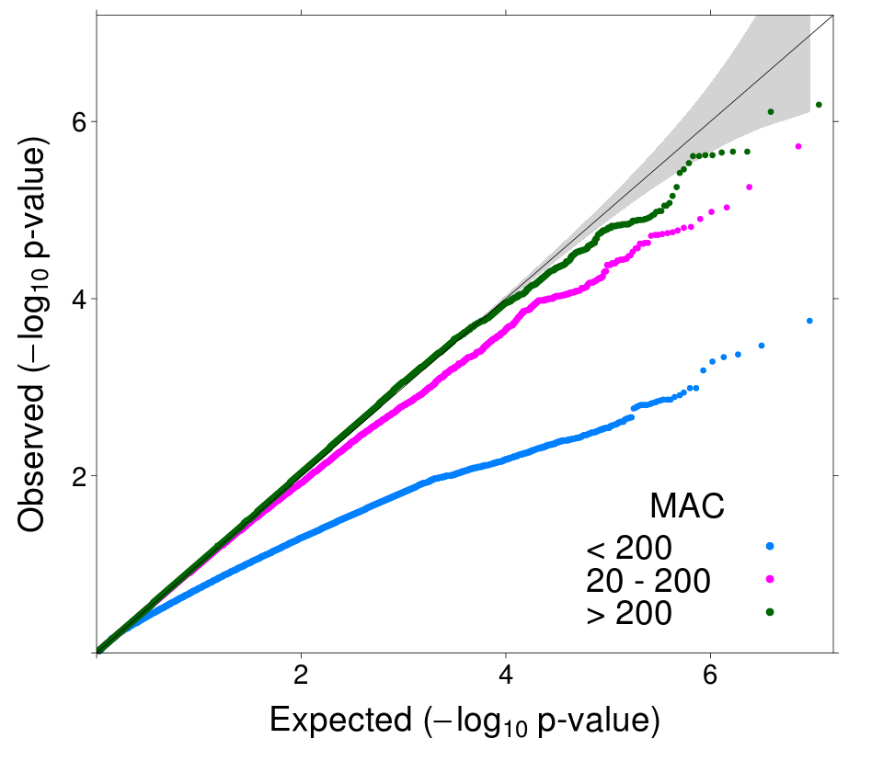
Logistic Wald test is very conservative for low-frequency and rare variants in balanced studies
QQ Plot
1,060 Cases / 1,090 Controls
MAC ≥ 200
20 ≤ MAC < 200
MAC < 20
Xing et al. (2012) Ann Hum Genet 76:168-77

Slide 17
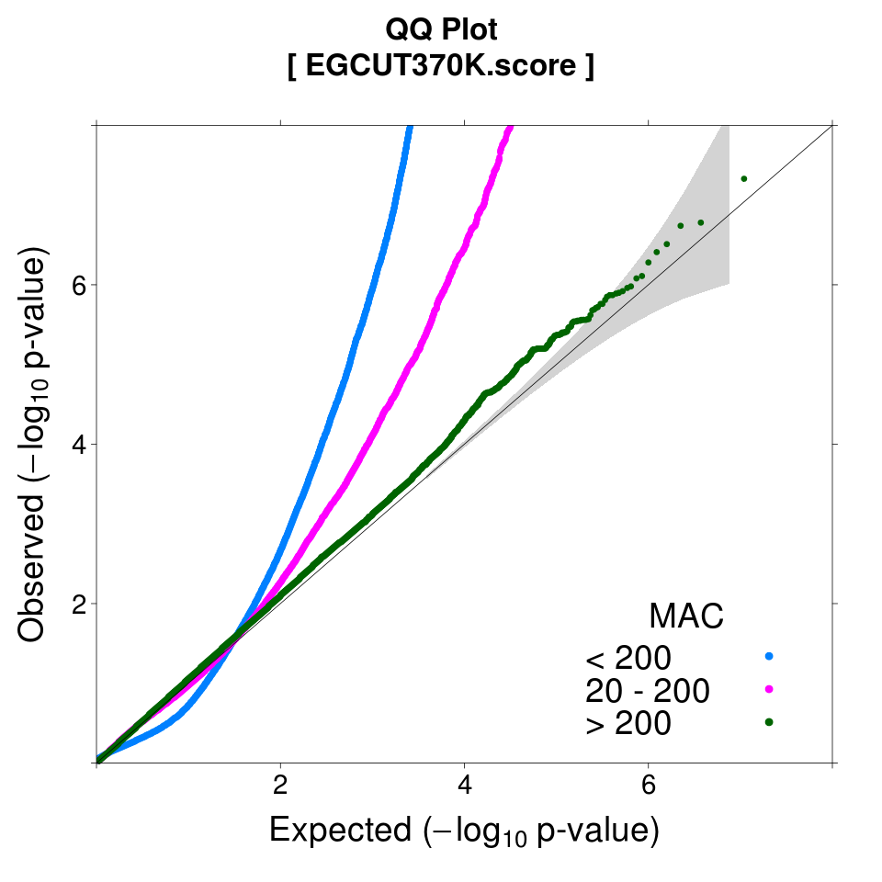
Logistic score test is anti-conservative for low-frequency and rare variants in unbalanced studies
QQ Plot
80 Cases / 1,768 Controls
20 ≤ MAC < 200
MAC < 20
See Ma et al. Genetic Epidemiology 2013

Slide 18
Recommended single marker tests for low-frequency variants
Binary Traits (unrelated)
Quantitative Traits
For balanced studies (case-control ratio < 3:2)
Use Firth bias-corrected*, or score logistic regression
Avoid Wald test (low power)
For unbalanced studies (case-control ratio > 3:2)
Use Firth, likelihood ratio logistic regression
Avoid score test (inflated false positive rate)
Given normally-distributed QTs
Use any linear regression test
(Ma et. al. Genet. Epidemiol., 2013;
Ma et. al., in preparation)
*(Firth, Biometrika, 1993)

Slide 19
What output do we get?
Runtime files: These configure and are input for the desired analysis
*.epacts.conf
*.epacts.R
*.ind
*.phe
*.Makefile
Full assocation output: *.epacts.gz (*.epacts.gz.tbi)
What information is included in the output?
Top hits: *.epacts.top5000
Visualizations:
Manhattan plot: *.epacts.mh.pdf
QQ plot: *.epacts.qq.pdf

Slide 20
Evaluating the results
What do the visualizations tell us?
Does the association test appear to be well calibrated? At all allele frequencies?
What about evidence for inflation?
Is there any signal of positive associations?

Slide 21
Variance component model for family-based association test
Population-based analysis assumes uncorrelated phenotypes between individuals under the null
Family-based analysis assumes phenotypes are correlated with relatives’ phenotypes
Similar model for population-based analysis to account for distant relationship inferred from dense SNP arrays
K_{ij} : kinship coefficient
: marker-based kinship coeff.
Kang HM et al, Nat Genet (2010) 42:348-54

Slide 22
Exercise #1B: Run single variant association with EMMAX
1st generate a kinship matrix to determine genetic relationship estimate between individuals
Then rerun association with EMMAX
Does incorporating relatedness affect association statistics?

Slide 23
Summary
EPACTS is a flexible package of tools for the analysis of GWAS and sequence data
Performs multiple types of single variant association tests
Quantitative vs dichotomous traits
Related or unrelated individuals
Test considerations for unbalanced study designs
Automated visualization of results

Slide 24
Suggested Reading
Ma et al., Genetic Epidemiology, Sept. 2013
Analysis strategies for low count data in case/control studies
Purcell et al., Nature, Feb. 2014
Rare variation in schizophrenia

Slide 25
Next time
Group-wise tests
Run annotation in EPACTS
Run group-wise tests in EPACTS
Meta-analysis
Data cleaning and QC
Running fixed effects meta-analysis in METAL

Slide 26
Contact Me
Adam Locke
4444 Forest Park, #5110
McDonnell Genome Institute
Division of Genomics & Bioinformatics
Adam.Locke@wustl.edu
314-747-2601

