Slide 1
Association analysis with sequence data (cont’d) and Meta-analysis methods
Human Linkage & Analysis
December 1, 2016
Adam Locke, PhD

Slide 2
Overview
Last time
Explored test data sets
Introduced EPACTS
Discussed aspects of data relevant to association testing
Ran single variant association tests in EPACTS
Today
Variant annotation
Group-wise (gene-based) association testing
Meta-analysis of GWAS/sequence data

Slide 3
Group-wise tests combine rare variant information to increase power
Each individual rare variant has limited power to detect association
Combines information across variants for greater power
Can perform tests of plausible genetic hypotheses

Slide 4
Exercise #2: Run gene-based association tests
What is required to do this?
What are the considerations we need to take into account before we start?
Notes:
Annotation!
Variants to be included
-- by frequency
-- by annotation
3) What is the hypothesis?
-- What categories might one use to categorize variants?
-- What are the underlying assumptions of this hypothesis? (uni-directional, bi-directional)
-- How does this hypothesis influence choices of frequency/functional assumption?

Slide 5
Types of annotation
Protein-coding gene annotations
Chromatin states (chromHMM)
Heterochromatin, (repressed
Promoters, enhancers, insulators, transcription
Transcription factor or miRNA binding sites

Slide 6
Protein-coding gene annotation
Differentiates coding vs non-coding variants
Intergenic, intronic, non-coding gene variants
Coding, splice variants
Gene altering variants vs conservative variants
Non-synonymous, frameshift, essential splice
Synonymous, other splice
Disruptive vs benign
Truncating variants, evolutionarily conserved sites
Non-conserved residues

Slide 7
Protein coding gene annotation tools
Variant Effect Predictor
http://useast.ensembl.org/info/docs/tools/vep/script/index.html
Annovar
Annovar.openbioinformatics.org
dbNSFP
http://varianttools.sourceforge.net/Annotation/DbNSFP
Algorithms to predict “deleteriousness” of variants
SIFT, PolyPhen2, Mutation Taster, LRT, CADD, etc.

Slide 8
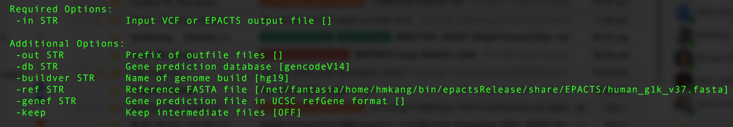
New Exercise #2: Annotation
Generate an annotated vcf file for sets 1 & 2 with EPACTS
What information is added to the VCF?
How would you classify these annotation? Generate specific hypotheses?

Slide 9
Exercise #3: Run gene-based association tests
Now that we have annotated variants, what other considerations do we need to take into account?
Notes:
Variants to be included
-- by frequency
-- by annotation
2) What is the hypothesis?
-- What categories might one use to categorize variants?
-- What are the underlying assumptions of this hypothesis? (uni-directional, bi-directional)
-- How does this hypothesis influence choices of frequency/functional assumption?
4)

Slide 10
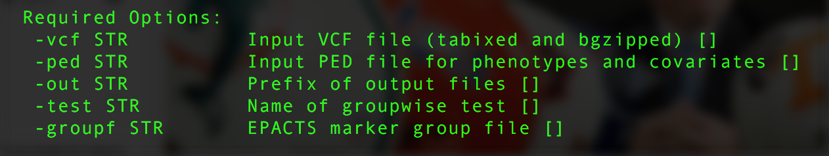
What is required to do this?
Must create a group file
What variants do we want to include?
What is our hypothesis?
How do we make the group file?
What does the group file look like?

Slide 11
Group-wise tests available in EPACTS
Groupwise Tests
Collapsing
Madsen-Browning
Reverse Regression
SKAT / SKAT-O
Variable Threshold (VT)
EMMAX-Collapsing
EMMAX-VT
EMMAX-SKAT/SKAT-O

Slide 12
Meta-analysis increases power by combining data across studies
Common variants have small effect sizes (e.g. odds ratios [OR] < 1.2)
For similar odds ratios, rare variants would need 100s of thousands of samples
To increase power to detect small genetic effects, we combine information across studies
Meta-analysis of study-level association results
Joint analysis of all individual-level data

Slide 13
Multiple studies: Data aggregation methods
Joint analysis
Study 1
Study 2
…
Study n
All Data
Combine individual-level data and analyze jointly

Slide 14
Multiple studies: Data aggregation methods
Joint analysis
Meta-analysis
Study 1
Study 2
…
Study n
Study 1
Study 2
…
Study n
All Data
Combine study-level association results using:
Inverse-variance weights
Sample-size weights

Slide 15
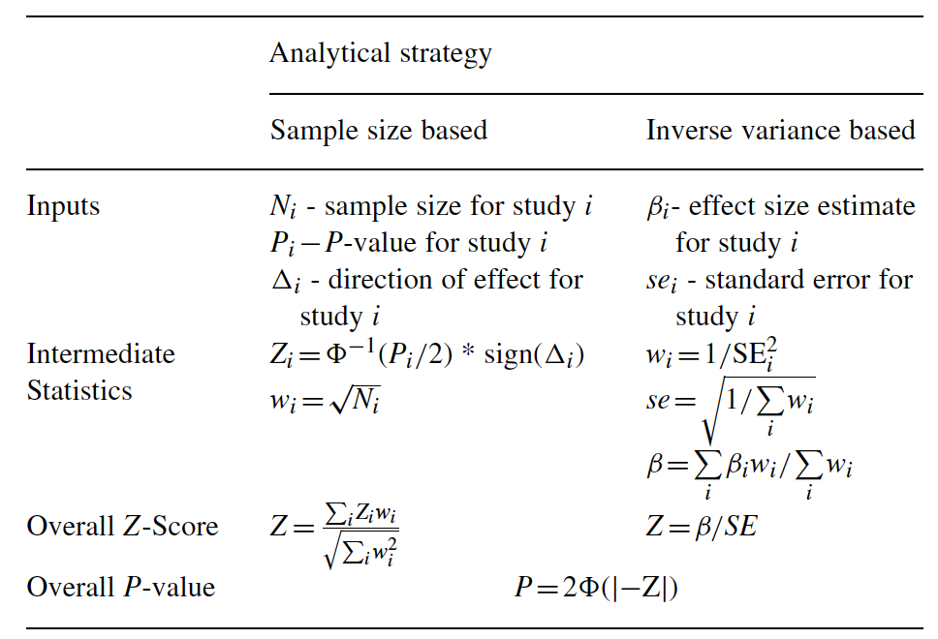
METAL only needs summary statistics to merge study results
Willer et al, Bioinformatics 2010

Slide 16
Exercise #4: Run sample meta-analysis with METAL
Data sets: /home/gems/m21-5483/seq_assoc/meta/
Use METAL for single variant meta-analysis
Documentation- http://genome.sph.umich.edu/wiki/METAL_Documentation
Or type: metal

Slide 17
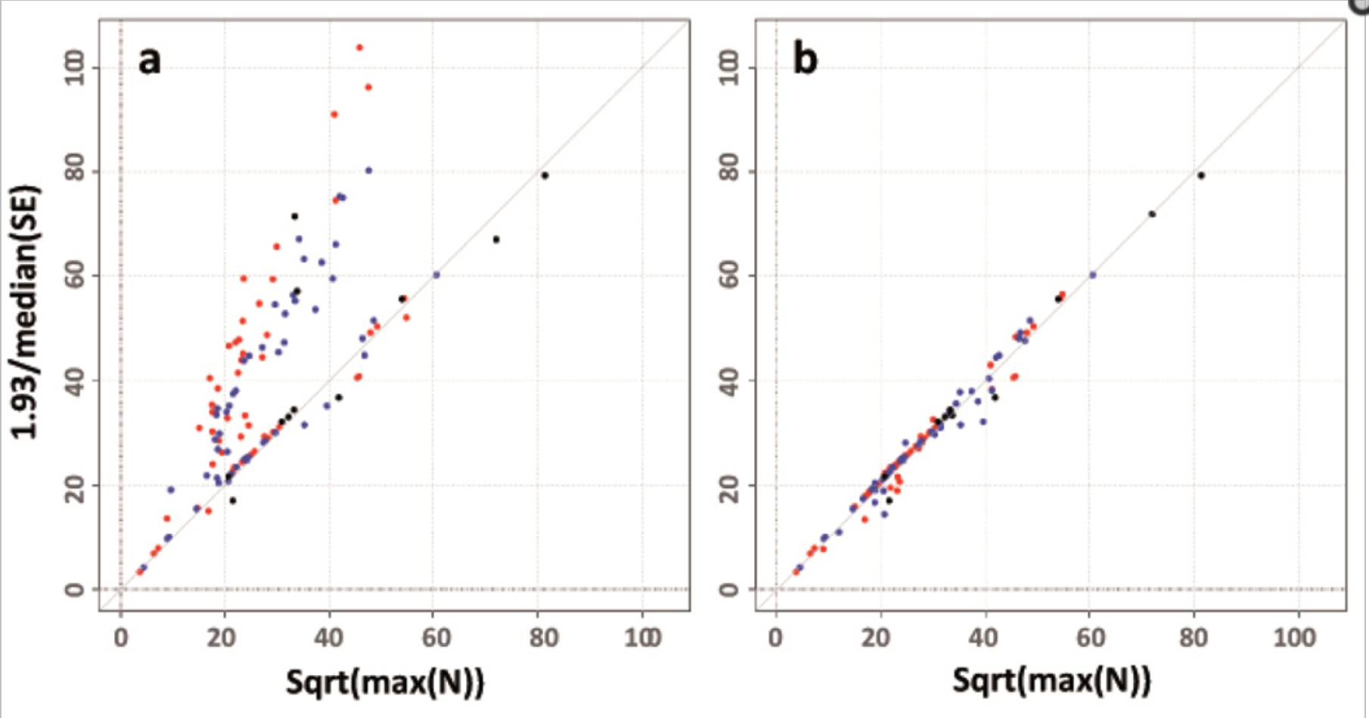
Common QC concerns for meta-analysis
Trait measured in same units and transformed in the same way

Slide 18
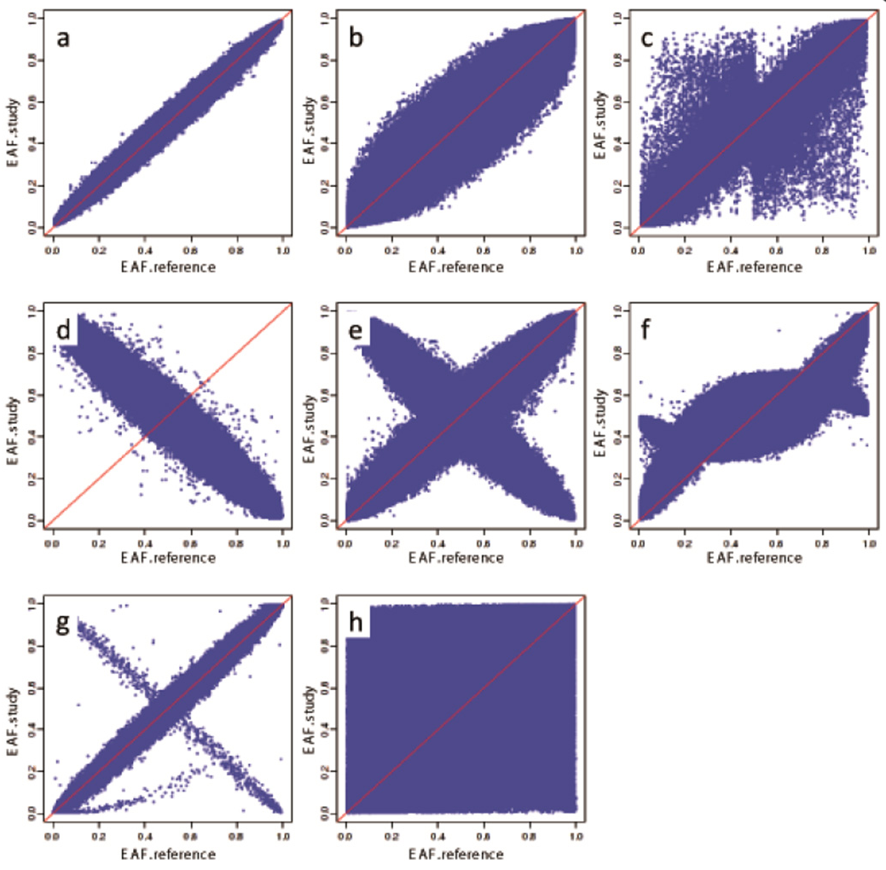
Common QC concerns for meta-analysis
Reporting of effect allele and allele frequencies

Slide 19
Common QC concerns for meta-analysis
Genome builds and SNP IDs
rs9939609, chr16:53820527 (b37), chr16:52378028 (b36), and 16_53820527 can all mean the same SNP

Slide 20
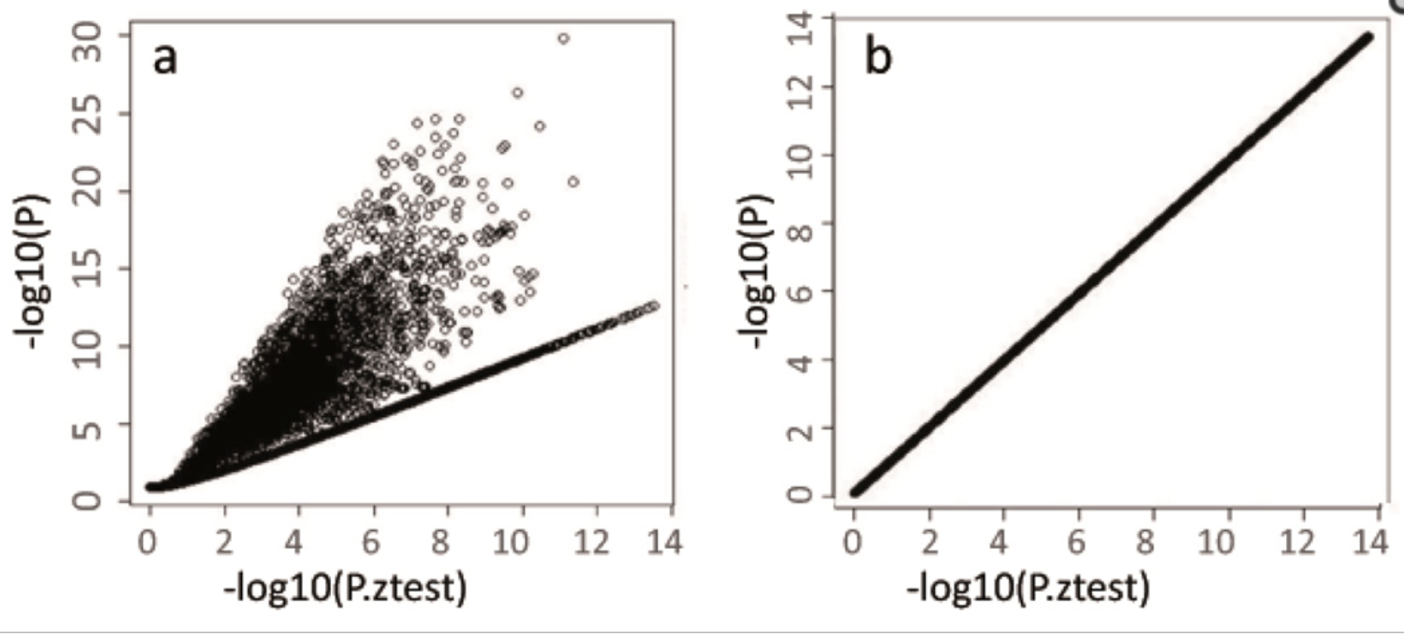
Common QC concerns for meta-analysis
P-values, betas, and standard errors are reported correctly

Slide 21
EasyQC is a good tool to check these
R script to detect many of these typical errors in GWAS results
Cleans input files before meta-analysis
Remove poorly imputed and other problem SNPs
Calculates the inflation factor (λ_{GC})
Winkler et al., Nature Protocols, May 2014
Contains step-by-step instructions

Slide 22
New methods allow more flexible meta-analysis
RareMetalWorker and RareMetal
http://genome.sph.umich.edu/wiki/RAREMETALWORKER
http://genome.sph.umich.edu/wiki/RAREMETAL_Documentation
RareMetalWorker performs primary analysis
Generates summary statistics and covariance matrix
RareMetal performs flexible meta-analyses
Single variants
Gene-based tests
Conditional analyses

Slide 23
Suggested Reading
Willer et al., Bioinformatics, Sept. 2010
METAL for running fixed effects meta-analysis of GWAS data
Liu et al., Nature Genetics, Mar. 2013
Meta-analysis of group-wise (gene-based) tests (RareMetal)
Winkler et al., Nature Protocols, May 2014
EasyQC for cleaning of GWAS data for meta-analysis

Slide 24
Summary
Can combine multiple rare variants to increase power with group-wise tests
Incorporate genomic annotation/function to predict most likely functional variants
Many pitfalls in GWAS to check prior to meta-analysis
Meta-analysis increases power through larger sample size

Slide 25
Contact Me
Adam Locke
4444 Forest Park, #5110
McDonnell Genome Institute
Division of Genomics & Bioinformatics
Adam.Locke@wustl.edu
314-747-2601

