Slide 1
Analysis of Sequence Data
John Rice
Nov 15, 2016

Slide 2
Exome vs Genome
Exome
~1.5% of genome
All exons
– Some pseudogenes missed
Deeper coverage
– Average 60-180x
Useful for Mendelian disease
Requires library construction
Genome
Almost entire genome
Much lower pass
– Currently 4-12x , now 30-40
Useful for structural variation/CNVs
Shotgun sequence
– Randomly shear and capture

Slide 3
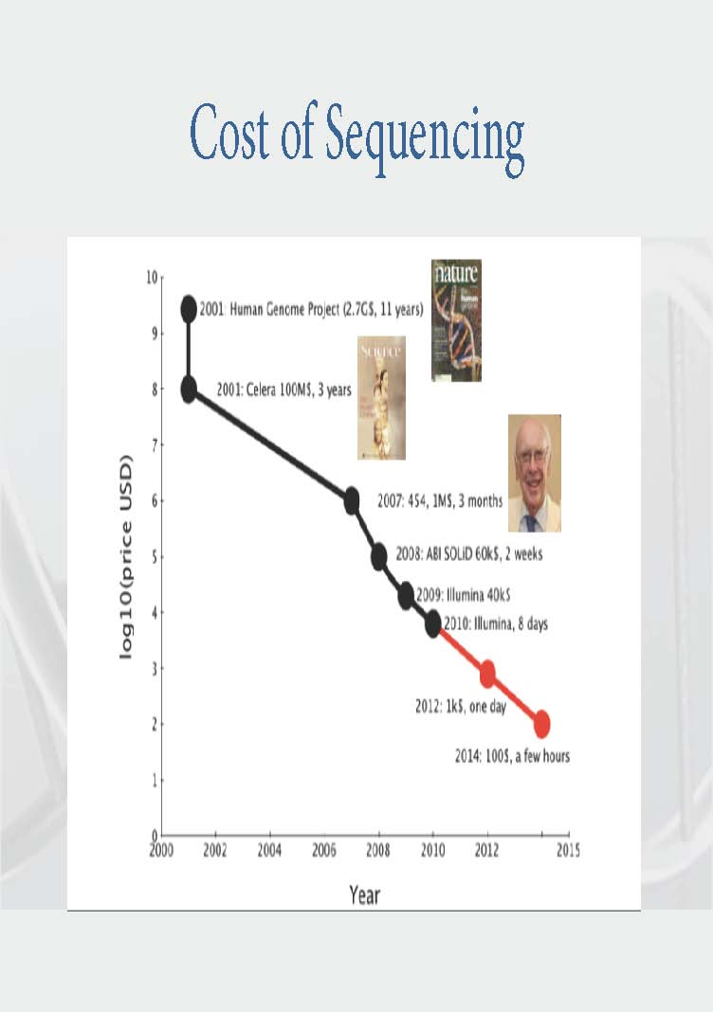

Slide 4
Direct Sequencing has Enormous Potential …
Ng, Shendure: Miller syndrome, 4 cases
– exome sequenced reveals causal mutations in DHODH
Lifton: Undiagnosed congenital chloride diarrhea (consanguinous)
– Exome seq reveals homozygous SLC23A chloride ion transporter mutation
Worthey, Dimmock: 4-year old, severe unusual IBD
- exome seq reveals XIAP mutation (at a highly conserved aa)
Jones, Marra: Secondary lung carcinoma unresponsive to erlotinib
-Genome and transcriptome sequencing reveals defects
Mardis, Wilson: acute myelocytic leukaemia but not classical translocation
– Genome sequencing (1 week + analysis) reveals PML-RARA translocation

Slide 5
…and tremendous challenges
Managing and processing vast quantities of data into variation
Interpreting millions of variants per individual
– An individual’s genome harbors
~80 point nonsense mutations
~100-200 frameshift mutations
Tens of splice mutants, CNV induced gene disruptions
QC essential

Slide 6
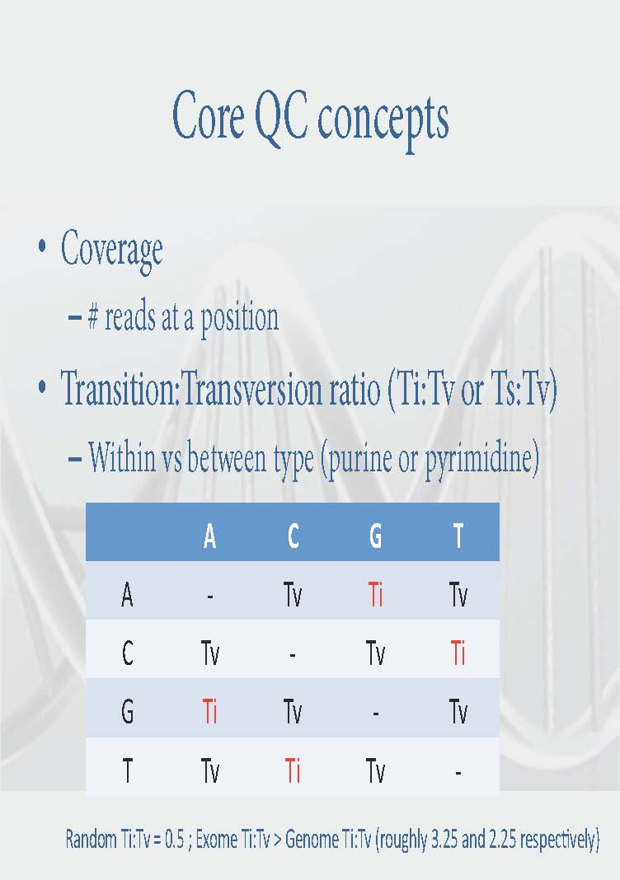

Slide 7
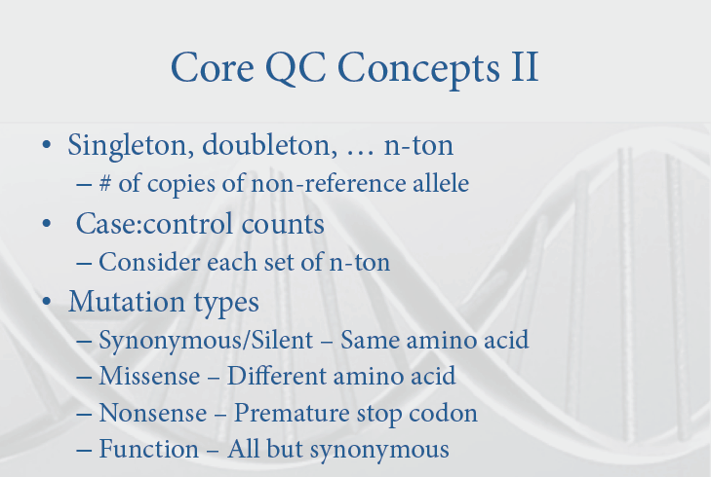

Slide 8
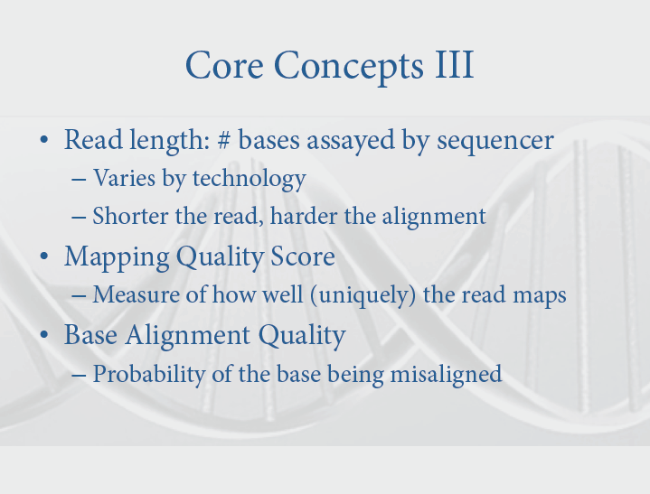

Slide 9
From Mapped Reads to Genotype
Each aligned read provides a small amount of evidence about the underlying genotype
Read may be consistent with a particular genotype …
Read may be less consistent with other genotypes …
A single read is never definitive
For read evidence for (or against) a variant to be interpreted correctly, it is important that we are very confident of the alignment
Common to apply multiple refinement steps to initial alignment

Slide 10
FASTQ
Sequences with base qualities
Sequences are stored together with associated base qualities
Base qualities are integers (typically, ranging up to 40) and stored as characters for compactness

Slide 11
SAM/BAM
Aligned sequence reads
Header describes alignment and sample information
Each row describes alignment for a single short read
Can be viewed more conveniently with samtools tview or IGV
http://samtools.sourceforge.net/

Slide 12
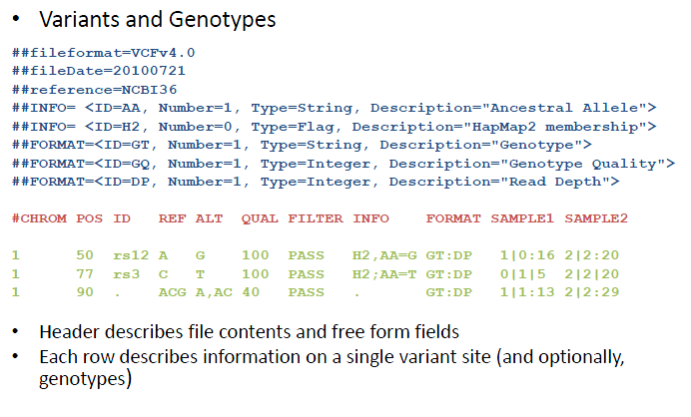
VCF

Slide 13
VCF
Documentation for a VCF file is available at the 1000genomes web site
This is the starting point for analysis

Slide 14
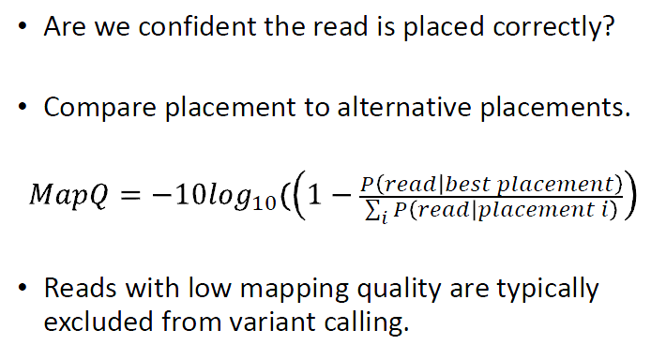
Mapping Quality Score

Slide 15
Recommended Reading
The 1000 Genomes Project (2010) A map of human genome variation from populationscale sequencing. Nature 467:1061‐73.

Slide 16
Testing for Rare Variants
Problem: We do not observe enough copies of rare variants to use traditional association testing approaches. One SNP at a time has no power.
One solution: We group variants together to increase the amount of testable variation and to improve power to detect association

Slide 17
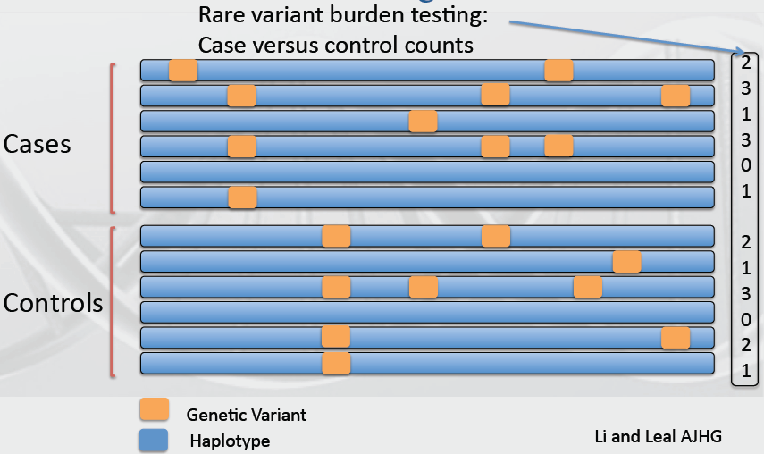
Burden Test
2008

Slide 18
Cohort Allelic Sum Test
Conduct a burden test
– # case alleles vs. # control alleles
For a gene stratify the variation
– ‘Functional’ vs. not [e.g.missense/nonsense vs. synonymous]
Test for difference in functional vs. not.

Slide 19
Example
Have a set of “causal” SNPs 1000 cases and controls, 5% in cases, 1% in controls gives chi-square=27
Throw in neutral mutations, 10% in cases and controls, so that 15% of cases and 11% of controls have mutations; then chi-square=7
Common SNPs will swamp rare variants.

Slide 20
Combined Multivariate and Collapsing
Define an allele frequency threshold
– Variation above this gets modeled in regression
– Variation below gets collapsed into a single predictor [burden test]
Improves power over collapsing everything or testing all variation separately
Test the variants you can and collapse the ones you can’t

Slide 21
Observation:
Neutral variation reduces power to detect, so restricting to functional variation or weighting variation may yield improved power

Slide 22
Additional Methods
Madsen and Browning(PLoS Genetics, 2009)
– Sum of allele count, weighted by inverse of the binomial variance (i.e. rarer alleles carry more weight)
– Functional weighting (e.g. POLYPHEN) may improve power
Variable threshold (Alkes Price, Shamil Sunyaev, 2010)
– Adaptation of burden tests to optimally select allele frequency cut-off

Slide 23
Madsen & Browning Test
In a region sum rare variation in a weighted fashion
Derive these weights from the inverse of the control allele frequency
– In practice this is v. similar to pooled allele frequency
Conduct a rank sum test
– Similar to the Wilcoxon test

Slide 24
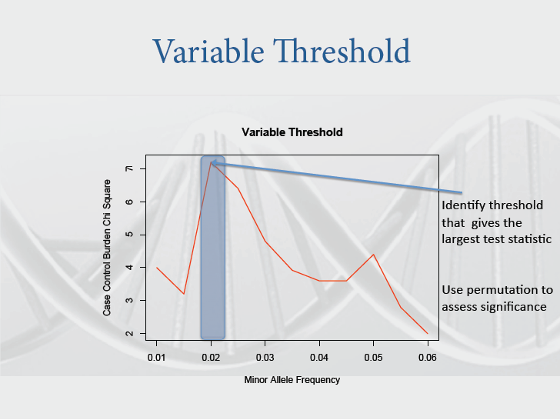

Slide 25
Observation:
Variation in a region that influences phenotype is potentially a mixture of neutral, risk, and protective variation

Slide 26
Solution: C-alpha Neale, 2011
Neyman and Scott. On the use of c(α) optimal tests of composite hypotheses. 1966
– Developed a set of functions defined for testing for mixtures
Zelterman and Chen. Homogeneity tests against central-mixture alternatives. 1988
– Applied c(α) approach for binomial mixtures in a score test fashion

Slide 27
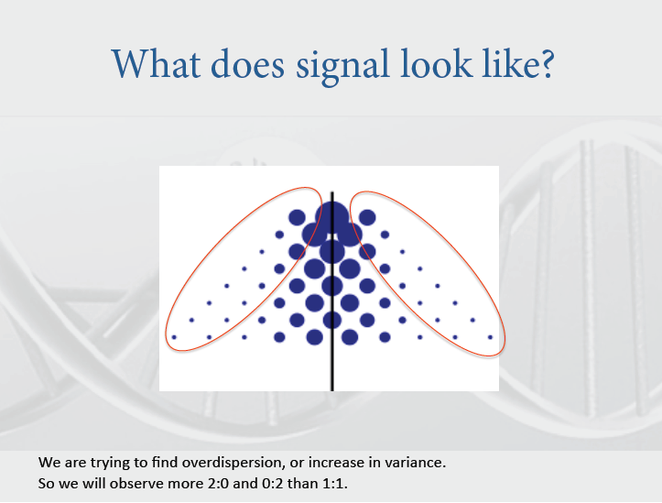

Slide 28
Issues
Need method with covariates, eg population stratification
Permutation test requires lots of computation on a genome wide scale
C alpha only works for dichotomous trait

Slide 29
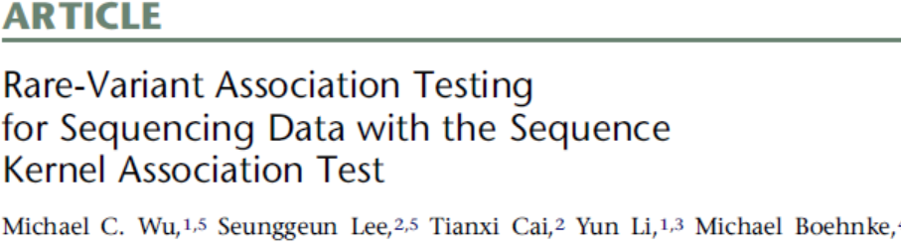
SKAT, 2011, AJHG

Slide 30
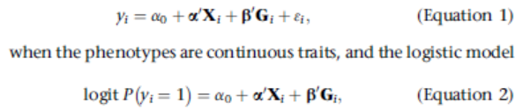
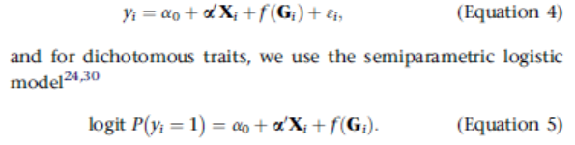
Basic Model
Assume:

Slide 31
Basic Model (Continued)
The function f is modeled by a kernel function
Test assume the genetic effects follow a distribution and the test statistic is easy to compute under the null hypothesis
Simulations showed out-performed other methods
Also generalizes the C alpha test

Slide 32
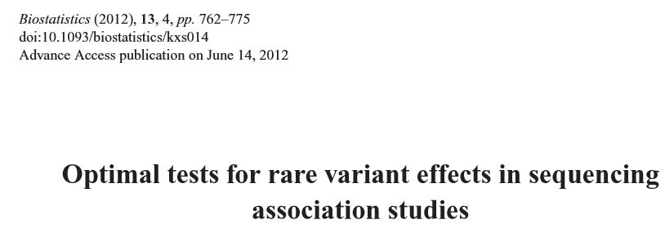
SKAT-O (Optimal)

Slide 33
SKAT-O
Proposes new set of kernel functions
Outperforms SKAT, burden tests and C-alpha
Very complicated paper
Implemented in EPACTS software -- we will have a lab later (Adam Locke)

Slide 34
SOFTWARE
We used to have a lab on PLINK/Seq – replaced by EPACTS in the course

Slide 35
Comments
GWAS worked for common variants
However, there is “missing heritability” problem
Will rare variants provide new sources of variants? – won’t know until we try
Sequencing worked for rare Mendelian diseases (Miller’s Syndrome); has been essential in cancer (can sequence germline and tumor in the same patient). Efforts under way for common disorders – will be interesting

Slide 36
Note
We will only have 3 quizzes that will count for 35% of final grade (35% homework, 30% final exam)
No quiz the last day of class!

