Slide 1
Genome-wide Association Studies (GWAS)
Linkage/Association Fall 2016
Tuesday 11/01/16 Lecture, N.L. Saccone

Slide 2
LD / Association studies in humans
Association between genetic markers (e.g. SNPs)
Empirical studies of patterns of LD, haplotypes
Association between markers and a phenotype
Case-control samples
Family-based samples (e.g. TDT using trios)

Slide 3
Comparing Linkage and Association
Linkage mapping:
requires family data
disease travels with marker allele within families, due to close genetic distance between disease locus and marker
connection between same allele and trait need not exist across the full sample (e.g. across different families)
robust to allelic heterogeneity: if different mutations occur within the same gene/locus in different families, the method works
signals for complex traits tend to be broad (~20 Mb)
Association mapping
can use case/control or case/parents (trios) design
disease is associated with marker allele that is either the causative mutation or is in linkage disequilibrium with the mutation
only works if association exists in the population
not robust to allelic heterogeneity
association signals generally not as broad
Notes:
Mention pendred syndrome

Slide 4
LD / Association studies in humans
Design options for large-scale association studies:
Genome-wide sequencing (expensive)
Genome-wide association study (GWAS)
  Fixed set of SNPs (e.g. Affymetrix or Illumina). Typically designed to “tag” common variation.
  Often “impute” additional variants using “more fully genotyped” reference panel.
Exome-wide coverage (exome array or whole-exome sequencing)
Targeted: e.g. selected SNPs in candidate genes

Slide 5
Using LD in study design
Use LD patterns to identify "tag SNPs" for genotyping
in disease association screens.
Two main approaches:
Haplotype tags
identify groups of SNPs exhibiting reduced haplotype
diversity, and represent each such group with a subset
of SNPs that uniquely identify all haplotypes (or all
common haplotypes)
2. LD tags:
identify groups of SNPs in strong LD with each other;
represent each such group with a subset of appropriate
SNPs.
Notes:
Check N vs 2N which notation clearer? Note used 2N previously. Discuss (multilocus) HWE assumption? Note it is comes in where we assume that h11 h22 gives proport of A1B1 | A2 B2 individuals. Selection - co-occurrence of alleles due to functional relationship that confers fitness advantage

Slide 6
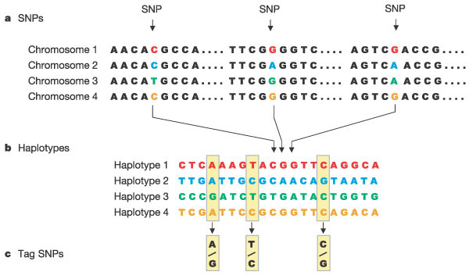
Using LD in study design
The International HapMap Project, Nature 2003
Notes:
Check N vs 2N which notation clearer? Note used 2N previously. Discuss (multilocus) HWE assumption? Note it is comes in where we assume that h11 h22 gives proport of A1B1 | A2 B2 individuals. Selection - co-occurrence of alleles due to functional relationship that confers fitness advantage

Slide 7
Using LD in study design
A popular LD tag method:
"r² bin tags" (Carlson et al., 2004): greedy algorithm that identifies bins of SNPs such that at least one member of each bin has r² > T (threshold) with all bin members.
    Note: bin members are not necessarily contiguous
Software: e.g. "Haploview" (Barrett et al., 2005); "Tagger" (de Bakker et al., 2005, Broad Institute); "Snagger" (Edlund et al., 2008); Broad Institute "SNAP" webtool
Notes:
Check N vs 2N which notation clearer? Note used 2N previously. Discuss (multilocus) HWE assumption? Note it is comes in where we assume that h11 h22 gives proport of A1B1 | A2 B2 individuals. Selection - co-occurrence of alleles due to functional relationship that confers fitness advantage

Slide 8
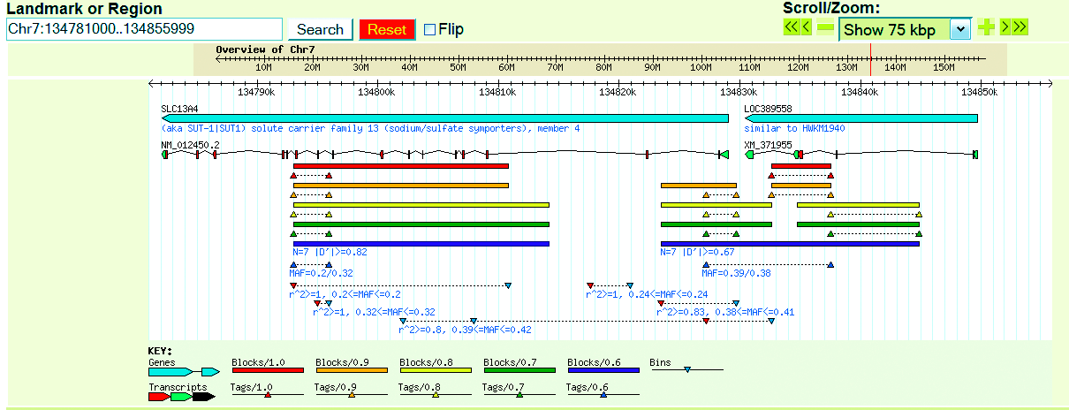
75 Kb region on Chromosome 7
inverted triangles indicate r² bins; tags = the red inverted triangles
from S. Saccone et al., 2006

Slide 9
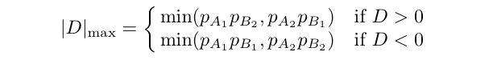
Recall: common LD measures
Disequilibrium coefficient:
D = h₁₁ - p_{A1} p_{B1}
Normalized disequilibrium coefficient:
D' = D / |D|_{max} , where
Range of D' is [-1,1]
Correlation coefficient:
r² = D² / ( p_{A1}p_{A2}p_{B1}p_{B2} )
Also: significance using the chi-squared p-value
Notes:
Mention chi-square and statistical sig - do example where one allele very rare.
Note that if we define the random variable $X_i$ on gametes to be 1 if the gamete has allele 1 at locus $i$ and 0 if it has allele 2,
then $D = {\rm cov}(X_1,X_2)$ and ${\rm var}(X_i)=p_iq_i$, so $r$ is the usual correlation coefficient of these two random variables.

Slide 10
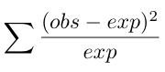
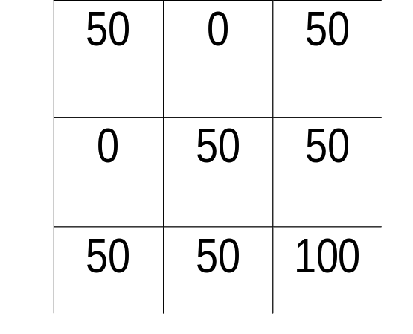
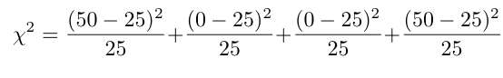
Measuring LD
To measure significance: χ² (1 df):
Example:
B₁ B₂
A₁
A₂
Notes:
Mention chi-square and statistical sig - do example where one allele very rare.

Slide 11
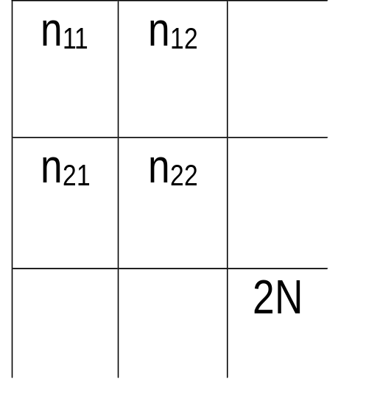
Notes:
1. D = h₁₁ - p_{A1}p_{B1} = h₂₂ - p_{A2}p_{B2}
2. Choice of allele labeling may affect sign but not absolute value of D.
3. Range of D: [max(-p_{A1}p_{B1},-p_{A2}p_{B2}), min(p_{A1}p_{B2},p_{A2}p_{B1})]
To see this:
Case 1: D < 0.
Then the ‘most negative’ D can be is the max of 0 - p_{A1}p_{B1} or 0 - p_{A2}p_{B2} .
Case 2: D > 0.
Relabel, and then use Case 1 argument.
B₁ B₂
A₁
A₂
Notes:
For 1. Can see this by using fact that n22 = 2N – n11 – n12 – n21.
For 3: note D = h11 - pA1pB1 AND D=h22 - pA1pB1, so both constraints lead to 3, case 1;

Slide 12
LD measures
|D'| is 1 when the alleles of the two markers are as correlated as they can be, given the allele frequencies of the co-occuring alleles. (at least one cell is empty)
The range of r² depends on the marker allele frequencies.
r² equals 1 if and only if 1) the MAFs at the two loci match and 2) the minor alleles co-occur (always)
D' : useful for identifying regions of reduced recombination.
r² : useful for identifying markers that are good predictors of allelic status at other markers.
Notes:
Mention chi-square and statistical sig - do example where one allele very rare.

Slide 13
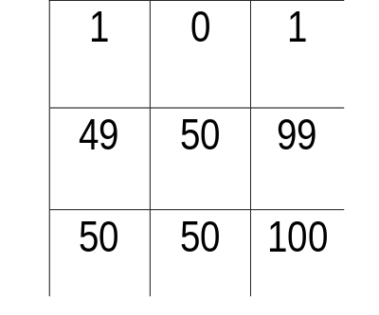
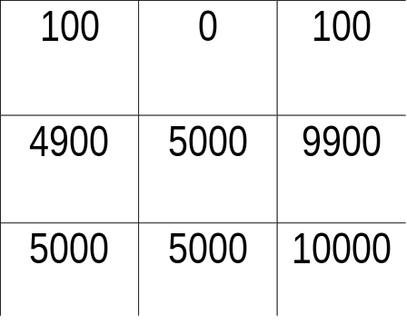
Measuring LD: D', r², chi-square significance
D' can equal 1 even though the p-value is not significant
Example 1:
B₁ B₂
D' = (.01 - (.01)(.5)) / (.005) = 1
χ² = 1.01, p-value = 0.31.
r² is small
A₁
A₂
Example 2: same haplotype freqs as before, but larger sample
B₁ B₂
D'=1
r² = same as above
χ² = 50+50+0.5050+0.5050
=101.01
p-value is significant
A₁
A₂
When calculating significance, sample size matters.
Notes:
In fact, r^2 = chi-sqr / N

Slide 14
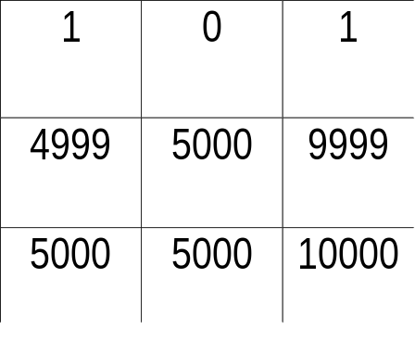
Measuring LD: D', r², chi-square significance
D' can equal 1 even though the p-value is not significant
Example 1:
(from last slide)
B₁ B₂
D' = (.01 - (.01)(.5)) / (.005) = 1
χ² = 1.01, p-value = 0.31.
r² is small
A₁
A₂
Example 3: not the same haplotype freqs as before
B₁ B₂
D'=1
r² = same as above
χ² = 1.0
p-value =0.32
A₁
A₂
Notes:
In fact, r^2 = chi-sqr / N

Slide 15
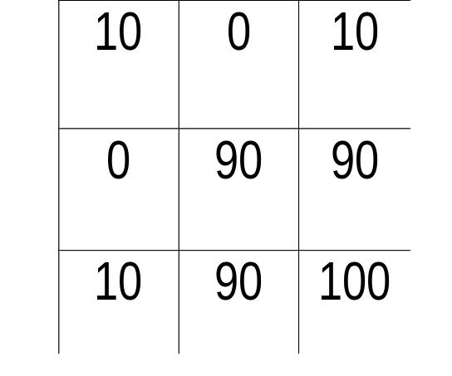
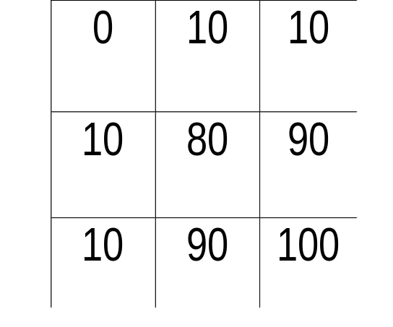
LD measures
An even more important example:
B₁ B₂
B₁ B₂
A₁
A₂
A₁
A₂
D' = (.1 - (.1)(.1)) / (.09) = 1
χ² = 100, p-value ~ 0.0
r² = 1
D' = (0 - (.1)(.1)) / (.01) = -1
χ² =1.23 , p-value = 0.27
r² = 0.012
Notes:
Mention chi-square and statistical sig - do example where one allele very rare.

Slide 16
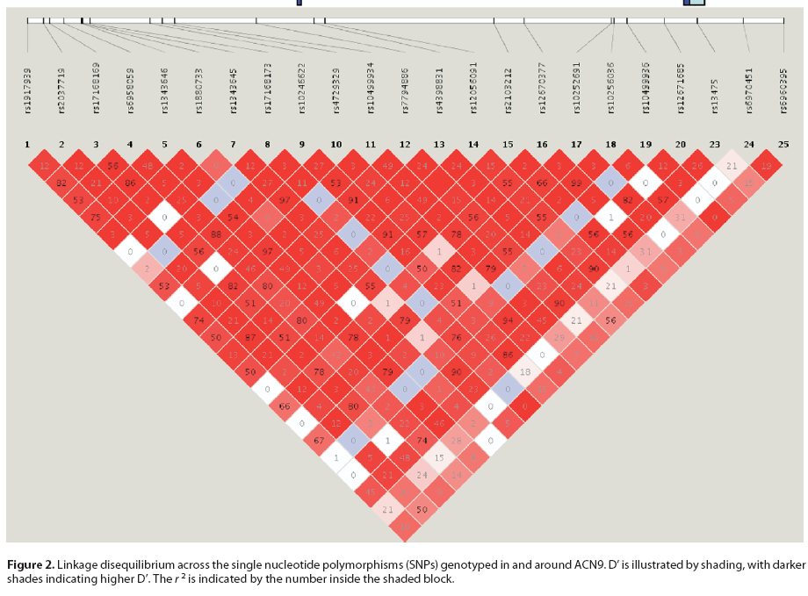
Describing empirical LD patterns
Haploview output: D’
Dick et al., Biol Psychiatry 63:1047-1053 2007

Slide 17
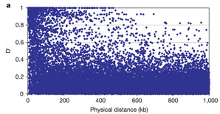
LD is not a simple monotonic function of distance
Dawson et al., Nature 2002

Slide 18
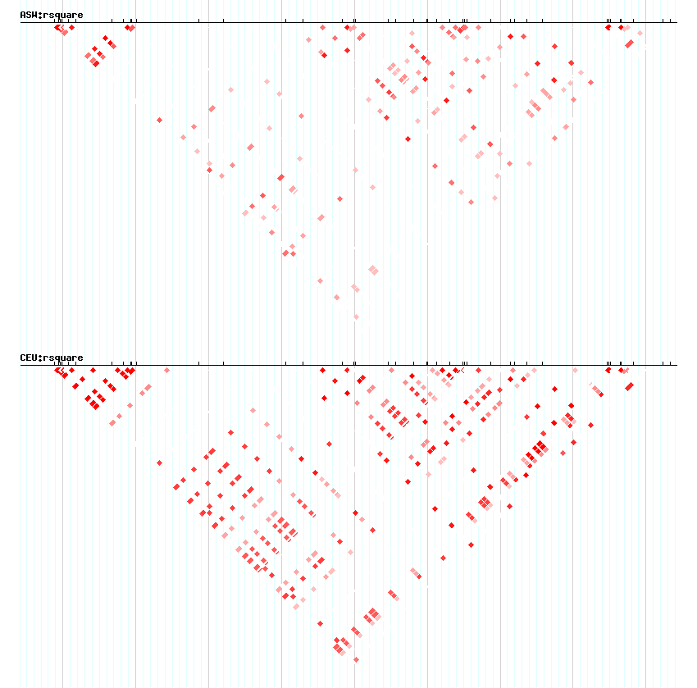
LD patterns can vary by population
ASW:
African-American
CEU:
European-American
Chromosome 15q25 region

Slide 19
LD measures
r² (between a marker and disease locus) is closely related to the statistical power to detect disease association:
Suppose, in a sample of size N, the power to detect disease association at a given significance level, when the disease locus is genotyped, is X%. Then to achieve the same power if a marker in LD with that locus is genotyped, the sample size must be increased to N/r² .
(Pritchard and Przeworski, 2001)
Notes:
later mention power can also be formulated in terms of D.
key to the derivation: derive two distributions, for the two test chi-squared statistics - means involve the sample size.
These distributions are approximately the same if N2 = N1/r^2. some assumptions are built in.

Slide 20
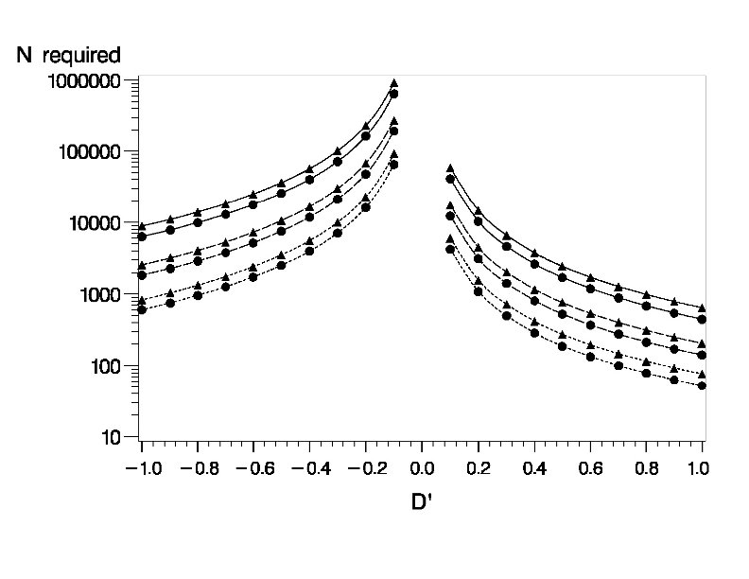
Sample sizes to detect disease association with 90% power at α = 0.001
from Saccone et al., Genetic Epidemiol 2006

Slide 21
Implications of this N/r² formula
Can quantify the degree to which genotyping only 'common' SNPs limits success: we have good power to detect only disease loci that satisfy the CDCV hypothesis (unless we ramp up the sample size)
Ex/ Suppose all genotyped SNPs satisfy MAF ≥ 0.1
What is the maximum r² that a SNP having MAF = 0.1 can have with SNPs having these MAFs:
MAF max possible r² required sample size
0.1 1 N (e.g. 1000)
0.05
0.02
Notes:
later mention power can also be formulated in terms of D.
key to the derivation: derive two distributions, for the two test chi-squared statistics - means involve the sample size.
These distributions are approximately the same if N2 = N1/r^2. some assumptions are built in.

Slide 22
Implications of this N/r² formula
MAFs max possible r²
0.1, 0.05 0.4737
B₁ B₂
0.05(2N) | 0.05(2N) | 0.1(2N)
0 | 0.9(2N) | 0.9(2N)
0.05(2N) | 0.95(2N) | 2N
A₁
A₂
D = 0.05 - 0.1*0.05 = 0.045
r² = D² / (0.1*0.9*0.05*0.95)
= 0.002025/ 0.004275 = 0.47368
Notes:
later mention power can also be formulated in terms of D.
key to the derivation: derive two distributions, for the two test chi-squared statistics - means involve the sample size.
These distributions are approximately the same if N2 = N1/r^2. some assumptions are built in.

Slide 23
Implications of this N/r² formula
Can quantify the degree to which genotyping only 'common' SNPs limits success to disease loci satisfying the CDCV hypothesis
Ex/ Suppose all genotyped SNPs satisfy MAF ≥ 0.1
What is the maximum r² that a SNP having MAF = 0.1 can have with SNPs having these MAFs:
MAF max possible r² required sample size
0.1 1 N (e.g. 1000)
0.05 0.4737 2.11*N (e.g. 2111)
0.02 0.1837 5.44*N (e.g. 5444)
Notes:
later mention power can also be formulated in terms of D.
key to the derivation: derive two distributions, for the two test chi-squared statistics - means involve the sample size.
These distributions are approximately the same if N2 = N1/r^2. some assumptions are built in.

Slide 24
The modern GWAS
Commercial fixed genotyping platforms
(Affymetrix, Illumina, Perlegen)
One important question: how good is the coverage?
Reference populations are used to design tags, impute un-typed variants
  HapMap: Phase I 2003, Phase II 2007, Phase III
  NOW: 1000 Genomes Project
  Evaluating coverage:
    Barrett and Cardon, Nat. Genetics 2006, Pe’er et al., Nat. Genetics 2006: global evaluation of coverage
    Li et al., Eur J Hum Genet 2008: local evaluation (by region and by gene)

Slide 25
Info about reporting/interpreting GWAS results
  Standard multiple-test corrected significance threshold: p-value ≤ 5 x 10⁻⁸ = 0.05/1,000,000
  i.e. Bonferroni correction for 1,000,000 tests

Slide 26
Aside on multiple testing and the Bonferroni correction
Let alpha = α
  = P(the observed result is “this extreme” | null hypothesis is true)
  = P(observed > critical value | null hypoth is true)
Typically, set α = 0.05, so require p-value <= 0.05.
BUT: if you are doing n independent tests, it’s not enough to require p < 0.05 for any of these tests.
Question: over n independent tests, what’s the probability of seeing AT LEAST ONE result where p < 0.05 (i.e. obs > critical value), under the null?

Slide 27
Aside on multiple testing and the Bonferroni correction
Notation: Two distinct alphas: α_{experiment-wide} and α_{singletest}
How do they relate to each other?
α_{experiment-wide}
= P(observe at least one result this extreme in n indep tests | null)
= 1 – P(no results are this extreme, in n indep test | null)
= 1 – [P(the result of a single test is not this extreme | null)]^{n}
because the n tests are independent
= 1 – [1 – P(the result of a single test is this extreme | null)] ^{n}
= 1 – [1- α_{singletest}] ^{n}

Slide 28
Aside on multiple testing and the Bonferroni correction
α_{experiment-wide} = 1 – [1- α_{singletest}] ^{n}
Solving for α_{singletest} gives the Šidák correction:
α_{singletest} = 1 – [1- α_{experiment-wide}] ^{1/n}
Example/
Suppose we keep α_{singletest} = 0.05, and do n=10 tests.
Then α_{experiment-wide} = 1 – [1-0.05]¹⁰ = 0.401 (!)
Optional HW (not to turn in):
If we want α_{experiment-wide} = 0.05 with n=100 tests, what should we require for α_{singletest}? Answer: ~ 0.0005128 (almost 0.05/100).

Slide 29
Aside on multiple testing and the Bonferroni correction
Sidak correction:
α_{singletest} = 1 – [1- α_{experiment-wide}] ^{1/n}
The Bonferroni correction is an approximation of Sidak (Taylor series expansion):
α_{singletest} = α_{experiment-wide} / n
So back to GWAS. The classical choice for α_{singletest} = 5 x 10⁻⁸.
This corresponds to α_{experiment-wide} =0.05, n ~ 1,000,000 .

Slide 30
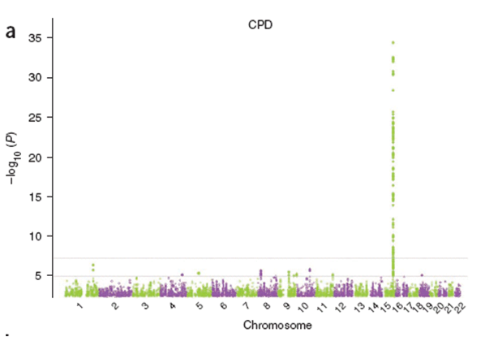
Displaying GWAS results
  “Manhattan plot”
  x-axis: chromosomal position
  y-axis: -log(p-value), so p = 10⁻⁸ is plotted at y = 8
-log₁₀(p)
y = -log(5 x 10⁻⁸)=7.3
Tobacco and Genetics Consortium, Nat Genet 2010

Slide 31
GWAS results
  “Q-Q plot”: Quantile-quantile plot
  Rank associated SNPs; at any given significance level, compare observed number of associations to expected number under the null hypothesis
  x-axis: number of expected associations at a given significance under the null
  y-axis: number of observed associations at a given significance
  Helps detect systematic bias in data

Slide 32
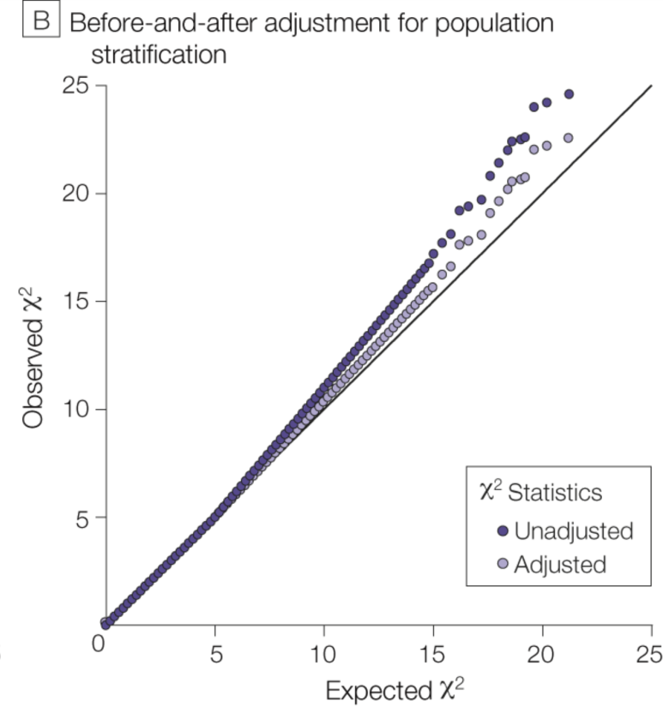
GWAS results
  “Q-Q plot”: Quantile-quantile plot
JAMA 299:1335-1344 (2008)

Slide 33
GWAS
Imputation
  Used to attempt to refine associations
  Helps with aligning or combining genetic data across different studies that have differing genotyping coverage.
Notes:
(We’ll discuss these both. Attention to LD is useful for each)

Slide 34
Imputation
  Method(s) for "in silico genotyping" or predicting/estimating genotype status at un-typed variants
  Obtain probabilities of having the 3 genotypes:
  p₁₁, p₁₂, p₂₂
  Benefits:
    Potential for improved detection of a signal at an imputed SNP
    Ease of combining data/results across studies with differing SNP coverage.

Slide 35
Green = genotyped, Red = not genotyped, Blue = imputed
Your data:
SNP 1
SNP 2
SNP 3
SNP 4
SNP 5
Reference
data:
SNP 1
SNP 2
SNP 3
SNP 4
SNP 5
Imputed
Data:
SNP 1
SNP 2
SNP 3
SNP 4
SNP 5

Slide 36
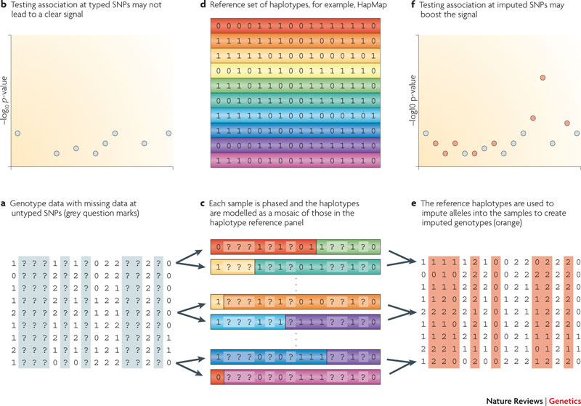
Overview
Data for samples.
? = untyped SNPs
c. Phase each sample; model haplos as mosaic of those in reference
e. Impute alleles for the samples (orange)
d. Reference haplotypes
f. Testing typed and imputed SNPs
b. Testing typed SNPs
(adapted from Marchini & Howie, Nat Rev Genet 2010)

Slide 37
Imputation
  Hidden Markov models(HMMs) used
  (e.g. IMPUTE program, Marchini et al., 2007)
  Suppose have (unobserved/hidden) process that can be observed through another process that produces sequence of observable values. Goal is to characterize that process.
  N possible states for the system (unobserved), and transition probabilities between the states.
  Tasks:
    Determine number of states (if not pre-specified - can be difficult)
    Determine state transition probabilities.

