Slide 1
Genome-wide association studies (GWAS), Part 2
Linkage/Association Fall 2016
Tuesday 11/3/16 Lecture, N.L. Saccone
Notes:
look up ftnd
look up in taillon-miller paper what we said about sample size, chi-square, LD relationship

Slide 2
References for multiple test correction for “effective number of tests”
  Cheverud JM (2001), A simple correction for multiple comparisons in interval mapping genome scans. Heredity 87:52-58
  Nyholt DR (2004), A simple correction for multiple testing for SNPs in linkage disequilibrium with each other. Am J Hum Genet 74 (4):765-769
  Software: SNPSpD
  Li and Ji (2005), Adjusting multiple testing in a multilocus analysis using the eigenvalues of a correlation matrix. Heredity 95:221-227.

Slide 3
Imputation
  Method(s) for "in silico genotyping" or predicting/estimating genotype status at un-typed variants
  Obtain probabilities of having the 3 genotypes:
  p₁₁, p₁₂, p₂₂
  Benefits:
    Potential for improved detection or refinement of a signal
    Ease of combining data/results across studies with differing SNP coverage.

Slide 4
Green = genotyped, Red = not genotyped, Blue = imputed
Your data:
SNP 1
SNP 2
SNP 3
SNP 4
SNP 5
Reference
data:
SNP 1
SNP 2
SNP 3
SNP 4
SNP 5
Imputed
Data:
SNP 1
SNP 2
SNP 3
SNP 4
SNP 5

Slide 5
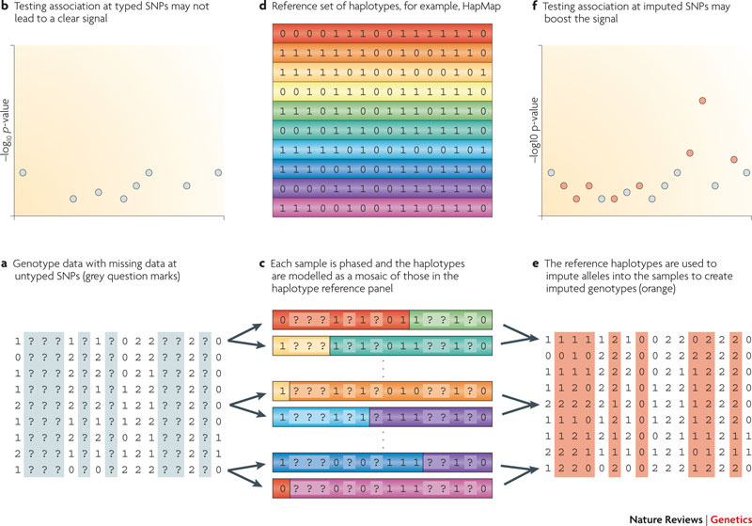
How it works
Data for samples.
? = untyped SNPs
c. Phase each sample; model haplos as mosaic of those in reference
e. Impute alleles for the samples (orange)
d. Reference haplotypes
f. Testing typed and imputed SNPs
b. Testing typed SNPs
(adapted from Marchini & Howie, Nat Rev Genet 2010)

Slide 6
Imputation
  Hidden Markov models(HMMs) used
  (e.g. IMPUTE program, Marchini et al., 2007)
  Suppose have (unobserved/hidden) process that can be observed through another process that produces sequence of observable values. Goal is to characterize that process.
  N possible states for the system (unobserved), and transition probabilities between the states.
  Tasks:
    Determine number of states (if not pre-specified - can be difficult)
    Determine state transition probabilities.

Slide 7
Imputation
  Example: suppose someone is behind a curtain, tossing coin(s). Don't know what kind of coins (fair or biased), how many coins (number of states). But you're able to observe the result of each toss: e.g.
  O₁, O₂, O₃, O₄, O₅, …, O_{N},
  H, H, T, H, H , …, T

Slide 8
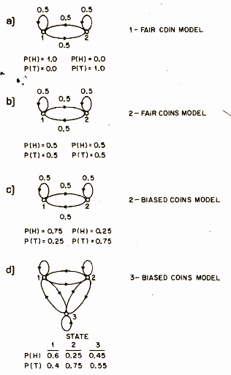
HMM example
  Some possible models:
  - 1 fair coin model: (2 states, one uniquely associated with H, one with T). NOT a hidden model (because of unique association between coin toss and H or T)

Slide 9
HMM example
  Some possible models:
  - 2 fair coins model: 2 states corresponding to 2 coins: in state 1, use coin 1; in state 2, use coin 2. (2 (unobserved) states, but each associated with .5 prob H, .5 prob T). An independent fair coin is used to decide which of the 2 coins to use at each trial. Now there is a non-unique, probabilistic association between toss and H or T outcome – Model is hidden.
Figure from Rabiner and Juang, 1986

Slide 10
HMM example
  "2 biased coins model": In state 1, use coin 1 (P(H) = 0.75, P(T) = 0.25); in state 2, use coin 2 (P(H) = 0.25, P(T) = 0.75). But an independent fair coin is used to decide which of the other 2 coins is used at each trial. (Model is hidden: don't know which state (which biased coin) led to the observed H/T.)

Slide 11
HMM example
  Tasks:
    Determine number of states (can be difficult)
    Determine state transition probabilities.

Slide 12
Imputation
  N possible states for the system (unobserved) – the possible haplotypes from reference panel. (Note – here, # of states is set by the ref panel.)
  K individuals in "your dataset"
  G = {G₁,…G_{K}}. Each G_{i} corresponds to the set of genotypes G_{ij} (some observed, some not), for ith person in your dataset. (j = 1,…M, M= # markers).
  Want to model each individual's genotype probability vector Pr(G_{i} | H).
  Hidden states are sequence of pairs of the N known haplotypes in the set H = {H₁,…H_{N}}, which are being selected to form the genotype vector G_{i}.

Slide 13
“Reference panels” for imputation
1000 Genomes project: multiple populations
  e.g. for Impute 2, 9/2013
  (http://mathgen.stats.ox.ac.uk/impute/data_download_1000G_phase1_integrated_SHAPEIT2.html)
  ~36.8M SNPs, 1,4M insertion/deletions (indels), ~14K structural variations.
  1,092 individuals (EUR, AFR, ASN, AMR)
“Cosmopolitan” reference panel (of combined populations) usually recommended: combine populations.
  Represents the widest range of haplotypes
For study sample: impute racial/ethnic groups separately

Slide 14
“Best practices” for imputation
(see https://mathgen.stats.ox.ac.uk/impute/impute_v2.html#best_practices)
Pre-imputation filtering of study genotypes (QC)
Variant position matching across input files
  Study sample map versus reference panel map, or “assembly”
STRAND ALIGNMENT (allele labeling) between study and reference data
  E.g. A/G versus the complementary “flipped” labeling T/C.
  Beware of SNPs with self-complementary alleles:
    E.g. an A/T SNP when “flipped” is still an A/T SNP.
  Many publicly available reference panels are aligned to the so-called “plus” (+) strand of the human genome reference sequence.

Slide 15
“Best practices” for imputation (continued)
(see https://mathgen.stats.ox.ac.uk/impute/impute_v2.html#best_practices)
Choice of reference panel
  With the latest imputation programs, prefer cosmopolitan rather than “matched ancestry” reference panels.
Post-imputation quality filtering

Slide 16
Assessing imputation reliability/quality
  Genotype the variant to confirm genotype and test association. How to compare?
    Concordance (but can be misleading for rare SNPs)
    Squared correlation (r²)
    Imputation Quality Score (Lin P, …, Rice JP, PLoS One, 2010): concordance adjusted for chance agreement.
  If “true genotype” not available:
    Statistics to compare genotype probabilities and the "most likely genotype"
  versus
  (BEAGLE allelic R², etc.)
 | 11 | 12 | 22
Geno probs | 0.6 | 0.2 | 0.2
Most likely | 1 | 0 | 0
 | 11 | 12 | 22
Geno probs | 0.97 | 0.01 | 0.02
Most likely | 1 | 0 | 0

Slide 17
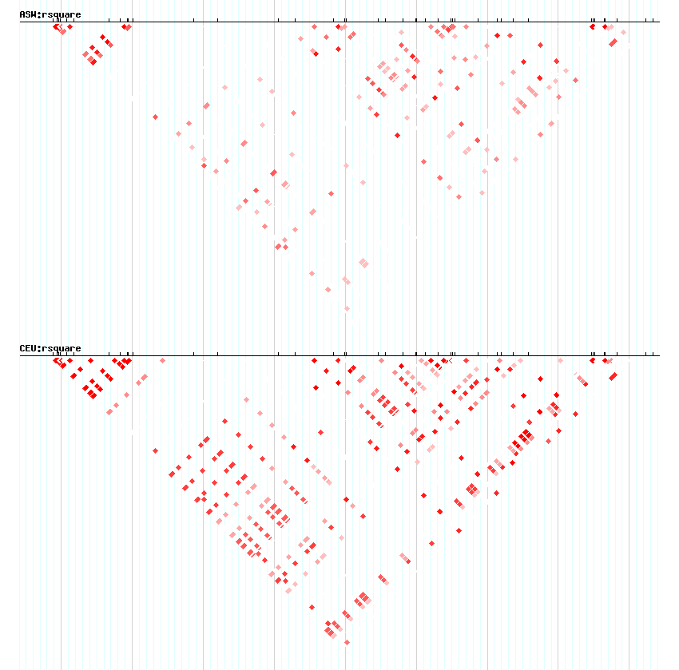
Recall: LD patterns can vary by population
ASW:
African-American
CEU:
European-American
Chromosome 15q25 region

Slide 18
Allele frequencies also vary by population
SNP | Position | Gene | Reference allele | Reference allele freq, EA | Reference allele freq, AA
rs17405217 | 76518204 | IREB2 | C | 0.662 | 0.944 †
rs2656052 | 76527987 | IREB2 | T | 0.653 | 0.565 †
rs17484235 | 76548469 | IREB2 | C | 0.662 | 0.944 †
rs7164594 | 76590112 | LOC123688 | C | 0.785 | 0.584 †
rs8034191 | 76593078 | LOC123688 | T | 0.648 | 0.840 †
rs10519203 | 76601101 | LOC123688 | A | 0.643 | 0.697 †
rs2036534 | 76614003 | LOC123688 | T | 0.789 | 0.778
rs12916483 | 76619452 | PSMA4 | G | 0.575 | 0.835 †
rs3813570 | 76619887 | PSMA4 | A | 0.789 | 0.739 †
rs11858230 | 76622607 | PSMA4 | G | 0.574 | 0.771 †
rs2036527 | 76638670 |  | C | 0.645 | 0.778 †
rs667282 | 76650527 | CHRNA5 | T | 0.779 | 0.704 †
rs588765 | 76652480 | CHRNA5 | C | 0.576 | 0.705 †
rs6495306 | 76652948 | CHRNA5 | A | 0.576 | 0.702 †
rs17486278 | 76654537 | CHRNA5 | A | 0.648 | 0.710 †
rs578776 | 76675455 | CHRNA3 | C | 0.726 | 0.451†
† indicates significantly allele frequency difference
Chromosome 15q25 region, from Saccone et al., Cancer Research 2009

Slide 19
Case-control designs
An important concern: population stratification
Spurious association between a locus and disease can occur if there are two (unknown) subpopulations (strata).
Exaggerated example: if stratum 2 has only 1 alllele, then a trait with much higher prevalence in stratum 2 could appear to be associated with this allele.
Subpop1: alleles A1, A2
Subpop2: allele A1 only
unshaded = affected
Notes:
tests are not independent
That is, α' = 1 - (1 - α)^{(1/N) ~ a'/N} .

Slide 20
Case-control designs
Or similarly: if a trait has higher prevalence in stratum 2, then any marker with higher frequency in stratum 2 could appear to be associated with this allele.
subpop1: allele A2 frequent
subpop2 allele A2 rare
unshaded = affected
Notes:
tests are not independent
That is, α' = 1 - (1 - α)^{(1/N) ~ a'/N} .

Slide 21
An example of spurious association due to admixture/stratification:
population 1 population 2
9 | 1 | 10
81 | 9 | 90
90 | 10 | 100
25 | 25 | 50
25 | 25 | 50
50 | 50 | 100
chi-square = 0 chi-square = 0
combined
34 | 26 | 60
106 | 34 | 140
140 | 60 | 200
chi-square = 7.26
p-value = 0.007

Slide 22
How to protect against population stratification?
Try to match geographic/racial background of the case and control samples. (at the very least!)
Check to make sure there is no underlying stratification
    Can use GWAS data
    If not GWAS, may need to genotype a selected set of “ancestry-informative markers (AIMs)”
If there is, account for this in the analysis
Software:
  EIGENSTRAT software (principal components) (Price et al)
  Pritchard: STRUCTURE software
  Devlin, Roeder, Bacanu "genomic control"
Notes:
tests are not independent
That is, α' = 1 - (1 - α)^{(1/N) ~ a'/N} .

Slide 23
Challenges for interpreting large-scale
disease association studies (e.g. GWAS)
Moving from an associated SNP to a “causal variant” or “underlying biology”
  Narrowing down the association
  Rare vs. common variants as potentially causal
  What kind of variants (e.g. coding, regulatory?)
Large samples needed to detect moderate effects (OR < 1.3)
    Combine studies (meta-analysis of results, or combining samples)
Notes:
(We’ll discuss these both. Attention to LD is useful for each)

Slide 24
Moving from association to “causal variant” to “biological meaning”
To date, GWAS have been successful in the sense of finding replicated SNP associations.
Often the effect sizes are low (~1.3)
The best single-SNP findings, taken together, explain only a small proportion of the phenotypic variance.
These findings do elucidate potential biological pathways
What might explain more of the "missing variance/heritability"?
  Interactions (gene-gene, gene-environment)
  Additional rare variants in the region

Slide 25
Moving from association to underlying biology
After detecting a GWAS "hit" at a common SNP
Goals / strategies:
Replicate
Identify most promising candidate SNPs for functional experiments (e.g narrow down amongst SNPs in strong LD using diverse populations with differing LD)
Sequence the region to catalog and evaluate additional variation in the region (both common and rare)
Refine signal in larger datasets via collaboration
Notes:
Rs16969968 FDR 0.134
Chrnb3 FDR 0.056

Slide 26
Combining studies/datasets through sharing/collaboration
e.g. via meta-analysis and/or combined ("mega") analysis
Benefits:
Improved power
Extends value of existing data (often costly to collect)
Challenges:
  Harmonizing phenotypes
  Harmonizing genotypes: imputation (prediction of genotypes “in silico” using LD information.)
Notes:
tests are not independent
That is, α' = 1 - (1 - α)^{(1/N) ~ a'/N} .

Slide 27
  Meta-analyses:
    Can be retrospective literature review
    Can carry out new, powerful coordinated analyses across independent datasets.

Slide 28
Targeted smoking meta-analysis
(Saccone et al., PLoS Genetics 2010)
  34 datasets, 17 sites
  rs16969968 genotyped in most but not all datasets
  Used proxy SNPs (rather than imputation):
Locus | Target SNP | position (bp) | Proxy SNP | position (bp) | r²
1 | rs16969968 | 76669980 | rs8034191 | 76593078 | 0.966
 |  |  | rs2036527 | 76638670 | 0.932
 |  |  | rs951266 | 76665596 | 0.966
 |  |  | rs1051730 | 76681394 | 0.900

Slide 29
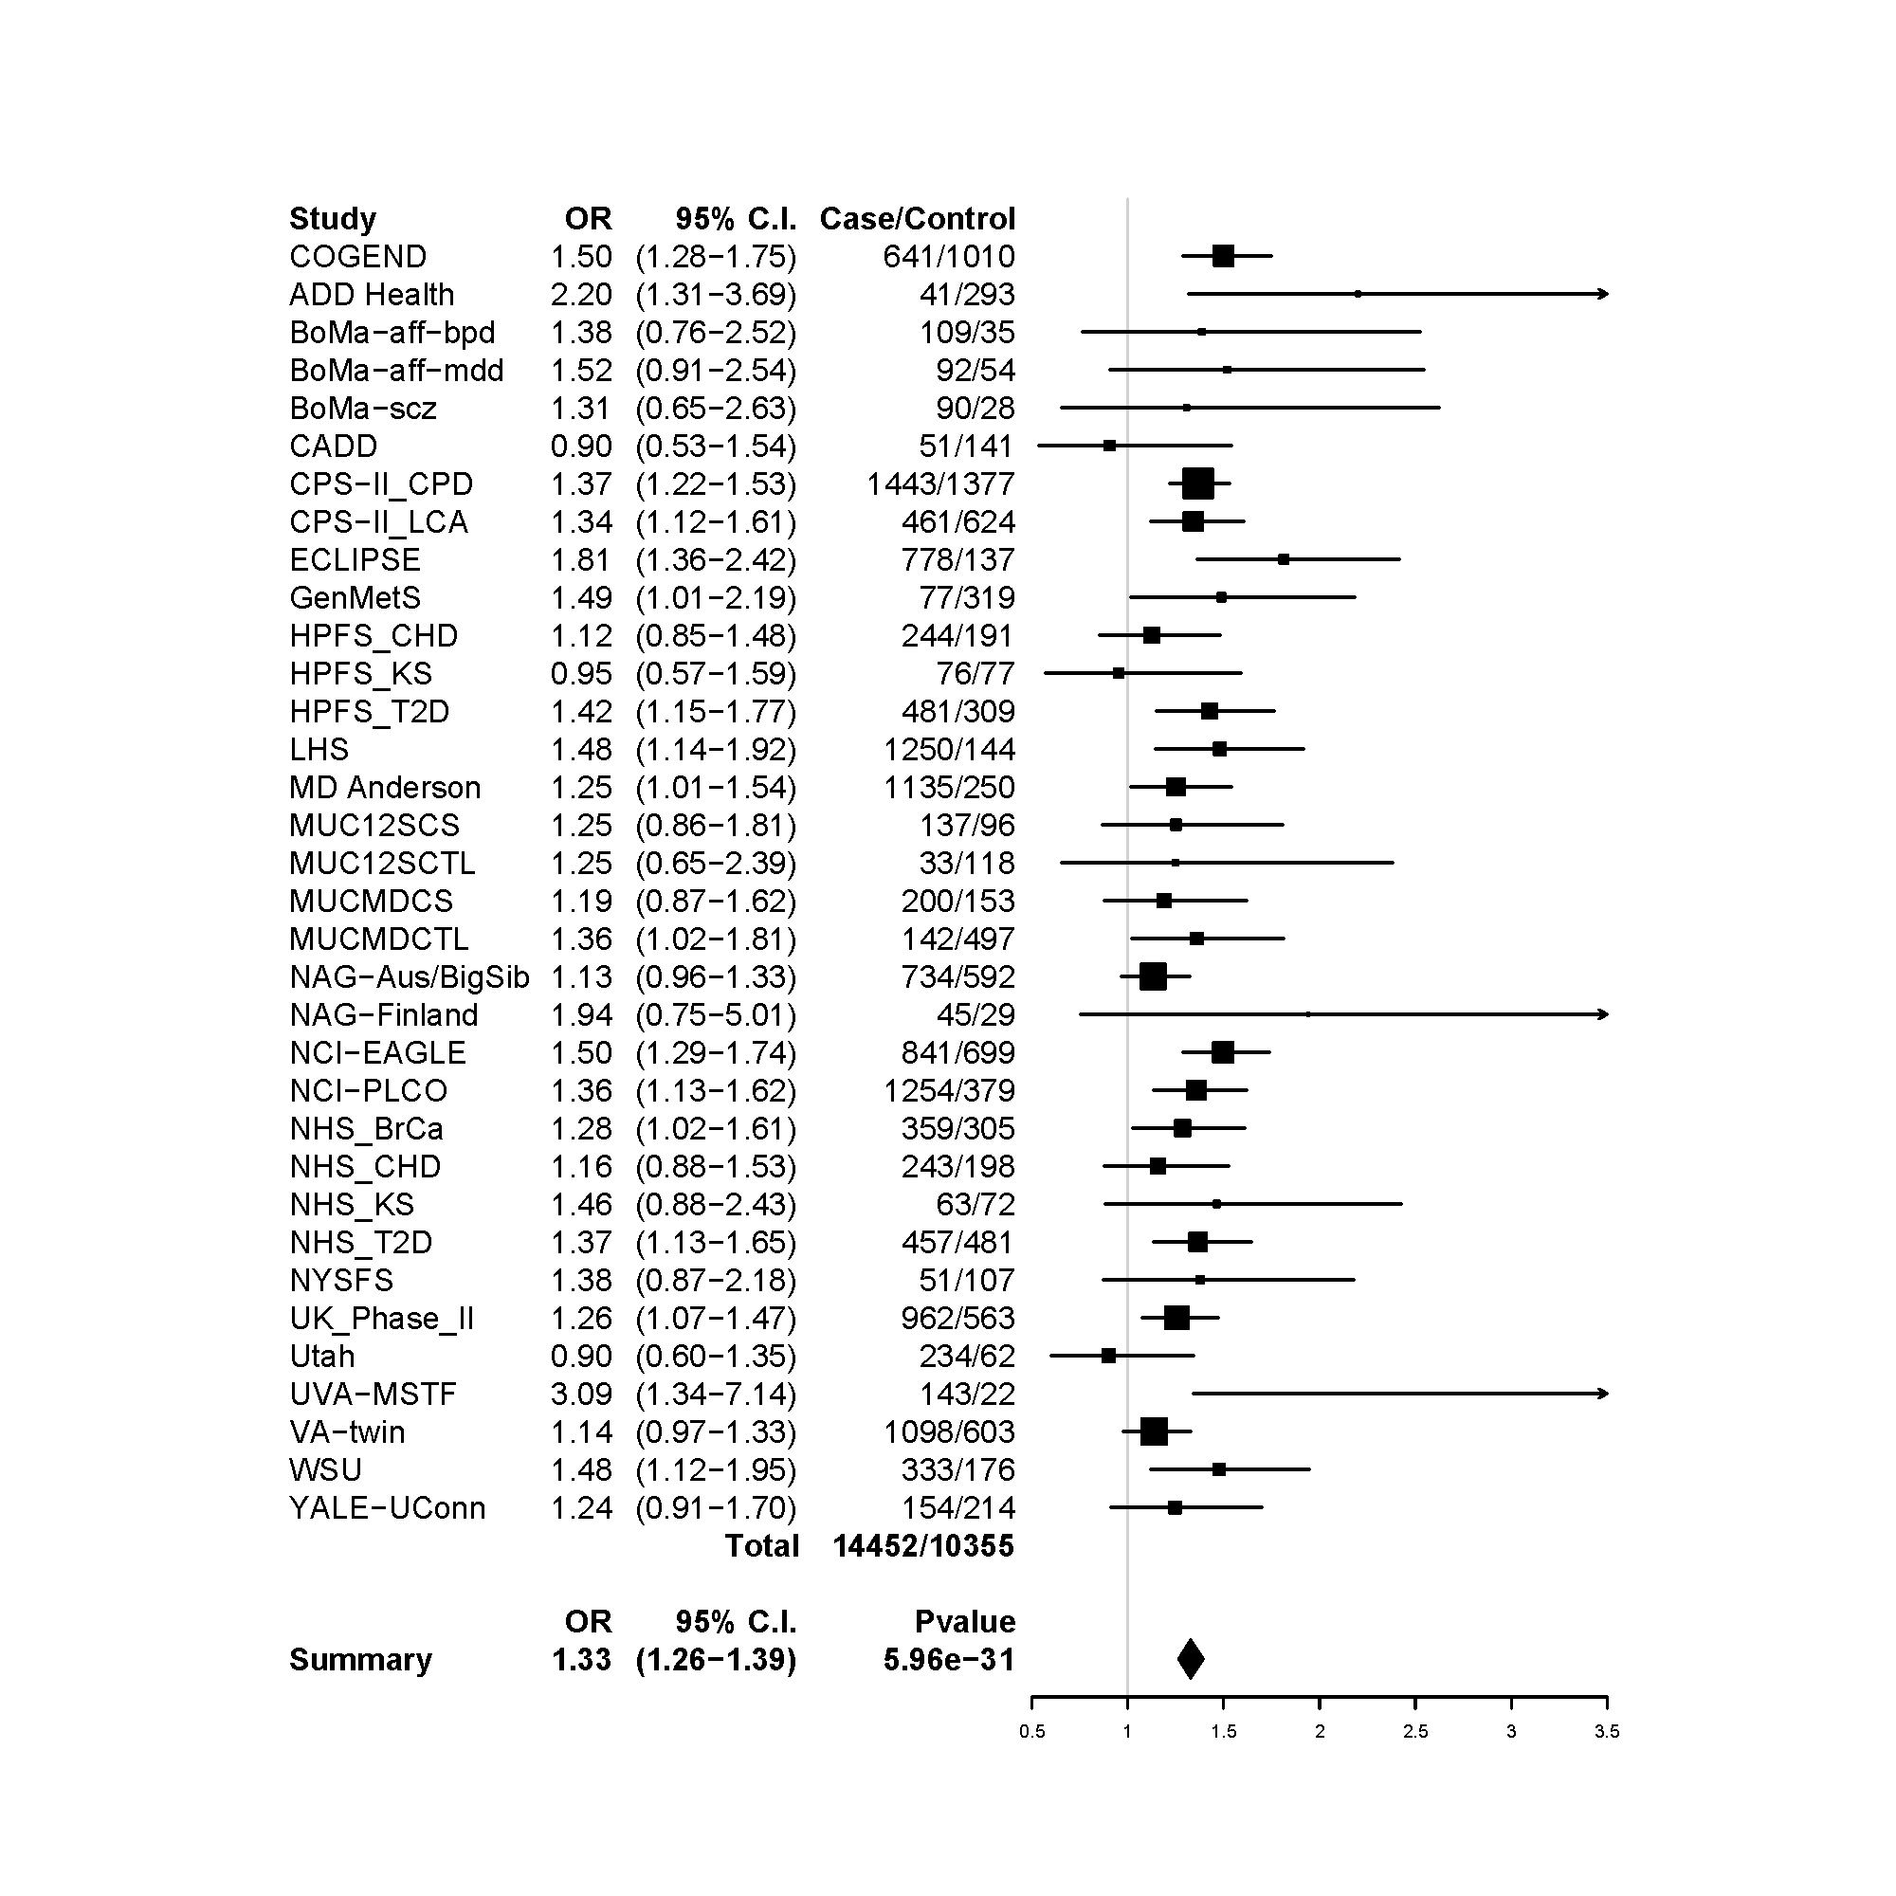
Heavy / light smoking at locus 1 (rs16969968)
OR P-value
Summary 1.33 (1.26-1.39) 5.96 x 10⁻³¹
Saccone et al., PLoS Genetics 2010

Slide 30
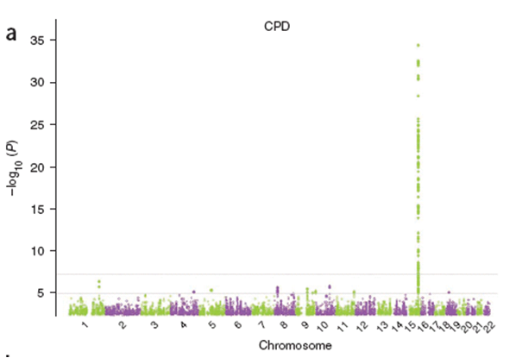
  N = 38,181 subjects
-log₁₀(p)
Tobacco and Genetics Consortium, Nat Genet 2010

Slide 31
Data available by request
All NIH funded GWAS studies are required to make their data available through the Database of Genotypes and Phenotypes (dbGaP)
Not just results – also individual-level genotype/phenotype data.
Open-access: for non-sensitive data
Controlled-access: other data are available by request; access granted by a panel (DAC: Data Access Committee)

Slide 32
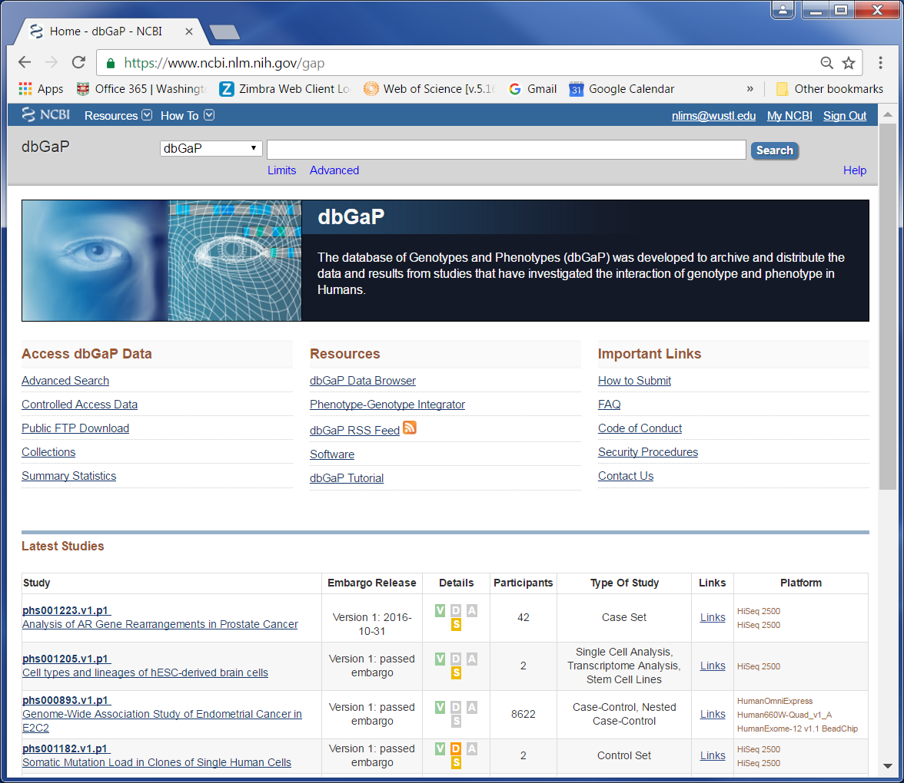
dbGaP homepage: www.ncbi.nlm.nih.gov/gap
Note the column labeled "Embargo Release"
Notes:
Screen shot of dbGaP homepage

Slide 33
Data sharing policies
dbGaP: Investigators who request the data sign an agreement that includes a pledge not to submit analyses/manuscripts for publication before the embargo date
Data Use Agreements also typically include requirements for citing original study/funding.
List of NIH Data Sharing Policies
https://www.nlm.nih.gov/NIHbmic/nih_data_sharing_policies.html
Genomic Data Sharing policy
https://gds.nih.gov/
Became effective on January 25, 2015, applies to all NIH-funded research

