Slide 1

JEDAI
Taller de Code Kata
Criteris d’acceptació

Slide 2
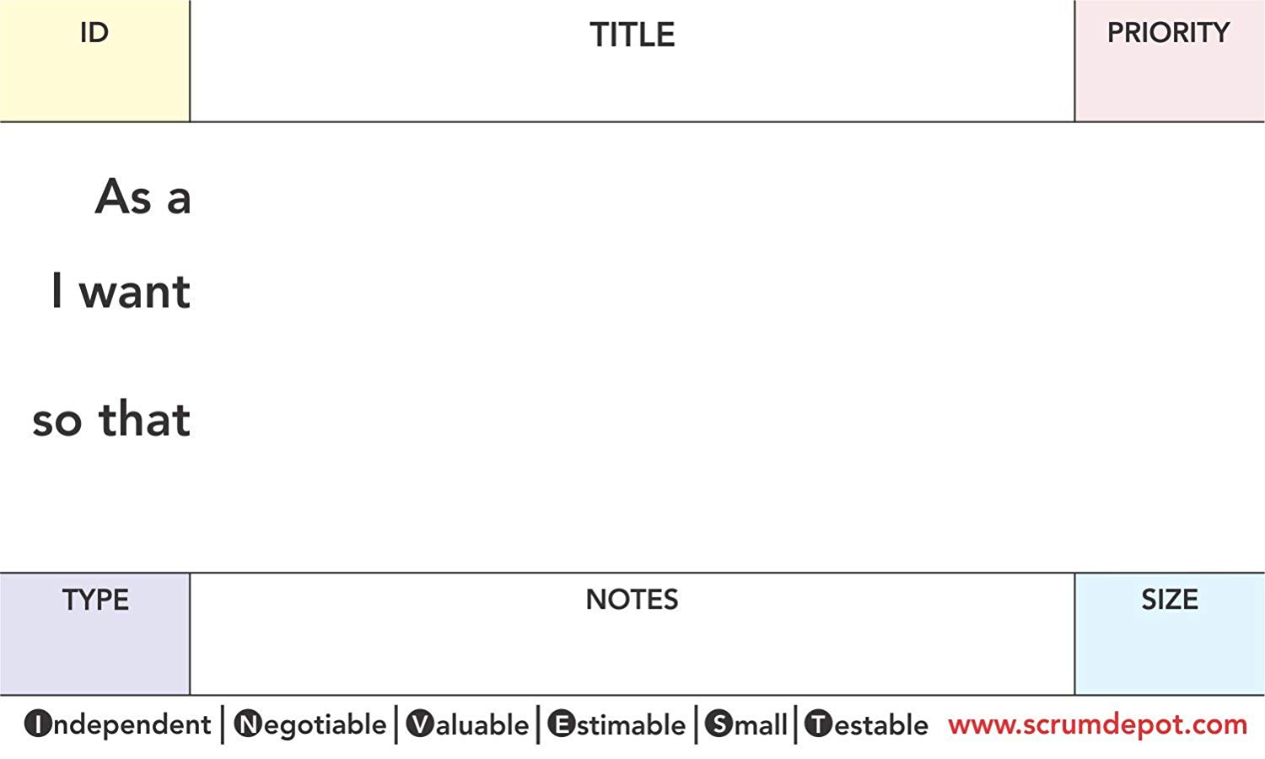
#US-001
FizzBuzz Evaluator
M
TDD newie
to evaluate a number in FuzzBuzz Evaluator
I can get quickly the associated result

Slide 3
Acceptance Criteria
Scenario: Numbers that are not multiple of 3 and/or 5
Given my FizzBuzz Evaluator
When I evaluate the number <number>
Then the result will be <number>
Examples: 1, 2, 4, 8, 11, 13, 16, 17, 19
Acceptance Criteria
Scenario: Numbers that are multiple of 3
Given my FizzBuzz Evaluator
When I evaluate the number <number>
Then the result will be Fizz
Examples: 3, 6, 9, 12
Acceptance Criteria
Scenario: Numbers that are multiple of 5
Given my FizzBuzz Evaluator
When I evaluate the number <number>
Then the result will be Buzz
Examples: 5, 10, 20, 25
Acceptance Criteria
Scenario: Numbers that are multiple of 3 and 5
Given my FizzBuzz Evaluator
When I evaluate the number <number>
Then the result will be FizzBuzz
Examples: 15, 30, 45, 60

Slide 4
#US-001
FizzBuzzBazz Evaluator
M
young student
to evaluate a number in FuzzBuzzBazz Evaluator
I can get quickly the associated result
EPIC: Common Number Utilities

Slide 5
Acceptance Criteria
Scenario: Numbers that are not multiple of 3, 5 and/or 7
Given my FizzBuzzBazz Evaluator
When I evaluate the number <number>
Then the result will be <number>
Examples: 1, 2, 4, 8, 11, 13, 16, 17, 19
Acceptance Criteria
Scenario: Numbers that are multiple of 3
Given my FizzBuzzBazz Evaluator
When I evaluate the number <number>
Then the result will be Fizz
Examples: 3, 6, 9, 12
Acceptance Criteria
Scenario: Numbers that are multiple of 5
Given my FizzBuzzBazz Evaluator
When I evaluate the number <number>
Then the result will be Buzz
Examples: 5, 10, 20, 25
Acceptance Criteria
Scenario: Numbers that are multiple of 7
Given my FizzBuzzBazz Evaluator
When I evaluate the number <number>
Then the result will be Bazz
Examples: 7, 14, 28, 49

Slide 6
Acceptance Criteria
Scenario: Numbers that are not multiple of 3 and 5
Given my FizzBuzzBazz Evaluator
When I evaluate the number <number>
Then the result will be FizzBuzz
Examples: 15, 30, 45, 60
Acceptance Criteria
Scenario: Numbers that are multiple of 3 and 7
Given my FizzBuzzBazz Evaluator
When I evaluate the number <number>
Then the result will be FizzBazz
Examples: 21, 42, 63, 84
Acceptance Criteria
Scenario: Numbers that are multiple of 5 and 7
Given my FizzBuzzBazz Evaluator
When I evaluate the number <number>
Then the result will be BuzzBazz
Examples: 35, 70, 140, 175
Acceptance Criteria
Scenario: Numbers that are multiple of 3, 5 and 7
Given my FizzBuzzBazz Evaluator
When I evaluate the number <number>
Then the result will be FizzBuzzBazz
Examples: 105, 210, 420, 630

Slide 7
#US-002
Convert from decimal to roman
M
Math enthusiast
to convert a number from decimal to roman notation
I can get quickly the associated result
EPIC: Common Number Utilities

Slide 8
Acceptance Criteria
Scenario: Convert base numbers from decimal to roman
Given my decimal to roman conversor
When I convert the decimal number <decimal> to roman
Then the roman number will be <roman>
Examples:
1 I
4 IV
5 V
9 IX
10 X
40 XL
50 L
90 XC
100 C
400 CD
500 D
900 CM
1000 M
Acceptance Criteria
Scenario: Convert complex numbers from decimal to roman
Given my decimal to roman conversor
When I convert the decimal number <decimal> to roman
Then the roman number will be <roman>
Examples:
2 II 289 CCLXXXIX
3 III 78 LXXVIII
6 VI 256 CCLVI
7 VII 395 CCCXCV
20 XX 228 CCXXVIII
21 XXI 1997 MCMXCVII
1903 MCMIII 472 CDLXXII
33 XXXIII 898 DCCCXCVIII
147 CXLVII 2010 MMX
33 XXXIII 769 DCCLXIX
147 CXLVII 3548 MMMDXLVIII
365 CCCLXV 2971 MMCMLXXI
94 XCIV

Slide 9
#US-003
Convert from roman to decimal
M
Math enthusiast
to convert a number from roman to decimal notation
I can get quickly the associated result
EPIC: Common Number Utilities

Slide 10
Acceptance Criteria
Scenario: Convert base numbers from roman to decimal
Given my roman to decimal conversor
When I convert the roman number <roman> to decimal
Then the decimal number will be <decimal>
Examples:
I 1
IV 4
V 5
IX 9
X 10
XL 40
L 50
XC 90
C 100
CD 400
D 500
CM 900
M 1000
Acceptance Criteria
Scenario: Convert complex numbers from roman to decimal
Given my roman to decoma conversor
When I convert the roman number <roman> to decimal
Then the decimal number will be <decimal>
Examples:
II 2 CCLXXXIX 289
III 3 LXXVIII 78
VI 6 CCLVI 256
VII 7 CCCXCV 395
XX 20 CCXXVIII 228
XXI 21 MCMXCVII 1997
MCMIII 1903 CDLXXII 472
XXXIII 33 DCCCXCVIII 898
CXLVII 147 MMX 2010
XXXIII 33 DCCLXIX 769
CXLVII 147 MMMDXLVIII 3548
CCCLXV 365 MMCMLXXI 2971
XCIV 94

Slide 11
#US-004
Prime Factors Generator
M
Math enthusiast
to get a list with prime factors of a given number
I can get quickly the associated result
EPIC: Common Number Utilities

Slide 12
Acceptance Criteria
Scenario: Prime factors of prime numbers
Given a Prime Factors Generator
When I evaluate the prime factors of <number>
Then the prime factors list is <result>
Examples:
2 [2]
3 [3]
5 [5]
7 [7]
11 [11]
13 [13]
17 [17]
19 [19]
23 [23]
29 [29]
31 [31]
Acceptance Criteria
Scenario: Prime factors of not prime numbers
Given a Prime Factors Generator
When I evaluate the prime factors of <number>
Then the prime factors list is <result>
Examples:
4 [2,2]
6 [2,3]
8 [2,2,2]
9 [3,3]
12 [2,2,3]
24 [2,2,2,3]
72 [2,2,2,3,3]
75 [3,5,5]
204 [2,2,3,17]
450 [2,3,3,5,5]
1092 [2,2,3,7,13]

Slide 13
#US-005
Math Expression Evaluator
M
Math enthusiast
to evaluate simple math expressions stored in string
I can get quickly the associated result
EPIC: Common Number Utilities

Slide 14
Acceptance Criteria
Scenario: Evaluate basic math expressions
Given a math expression evaluator
When I evaluate the math expression <expression>
Then the math result will be <result>
Examples:
3 + 5 8
2 - 3 -1
4 * 2 8
4 / 2 2
3 % 2 1
1+15 16
12-3 9
5-3 2
3*2 6
3/2 1.5
4%2 0
3 + 5 + 10 18
3 + 5 - 5 3
3 * 5 * 2 30
Acceptance Criteria
Scenario: Evaluate math expressions with operators precedence
Given a math expression evaluator
When I evaluate the math expression <expression>
Then the math result will be <result>
Examples:
3 + 5 * 2 13
4 + 5 * 3 19
2 + 3 * 5 - 1 16
3 * 3 + 5 + 4 - 3 * 2 – 1 11
3 * 3 + 5 + 4 + 3 / 2 - 3 * 2 - 1 12.5

Slide 15
Acceptance Criteria
Scenario: Evaluate math expressions with parenthesis
Given a math expression evaluator
When I evaluate the math expression <expression>
Then the math result will be <result>
Examples:
(3 + (-3)) 0
(3 + -3) 0
(3 + 5) 8
((3 + 5)) 8
(3*2+5) 11
(10+2*6) 22
(100 * 2) + 12 212
100 * ( 2 + 12) 1400
100 * ( 2 + 12 ) / 14 100
( ( 20 - 10 ) * ( 30 - 20 ) + 10 ) * 2 220
( (( 20 - 10 )) * ( 30 - 20 ) + 10 ) * 2 220
( ( 20 - 10 ) * ( 30 - 20 ) / 10 + 10 ) * 2 40
Acceptance Criteria
Scenario: Evaluate invalid math expressions
Given a math expression evaluator
When I evaluate the illegal math expression <expression>
Then a math invalid expression error will be thrown
Examples:
hola
2 x 1
2 * a
2 * 3 + a
(2 + 3
2 + 3)
2 + 3 +
* 3 - 5
2 + 3)
(( 2 + 3)
2 + 3))
( ( 20 - 10 ) * 30 - 20 ) + 10 ) * 2
( (( 20 - 10 ) * ( 30 - 20 ) + 10 ) * 2
( ( 20 - 10 ) * ( 30 - 20 / 10 + 10 ) * 2

Slide 16
#US-006
Conway's Game of Life
M
Agile Developer
to implements Conway's Game of Life
I can practice ATDD and TDD
See acceptance criterias to determine rules

Slide 17
Acceptance Criteria
Scenario: Center dead cell with 0 live neighbors dies
Given the following board
| 💀 | 💀 | 💀 |
| 💀 | 💀 | 💀 |
| 💀 | 💀 | 💀 |
When I evolve the universe
Then the center cell should be dead
Acceptance Criteria
Scenario: Center dead cell with 1 live neighbor dies
Given the following board
| 💀 | 😊 | 💀 |
| 💀 | 💀 | 💀 |
| 💀 | 💀 | 💀 |
When I evolve the universe
Then the center cell should be dead
Acceptance Criteria
Scenario: Center dead cell with 2 live neighbors dies
Given the following board
| 💀 | 😊 | 💀 |
| 💀 | 💀 | 😊 |
| 💀 | 💀 | 💀 |
When I evolve the universe
Then the center cell should be dead
Acceptance Criteria
Scenario: Center dead cell with 3 live neighbors lives
Given the following board
| 😊 | 😊 | 😊 |
| 💀 | 💀 | 💀 |
| 💀 | 💀 | 💀 |
When I evolve the universe
Then the center cell should be live

Slide 18
Acceptance Criteria
Scenario: Center dead cell with 4 live neighbors dies
Given the following board
| 😊 | 😊 | 😊 |
| 💀 | 💀 | 😊 |
| 💀 | 💀 | 💀 |
When I evolve the universe
Then the center cell should be dead
Acceptance Criteria
Scenario: Center dead cell with 5 live neighbor dies
Given the following board
| 😊 | 😊 | 😊 |
| 😊 | 💀 | 😊 |
| 💀 | 💀 | 💀 |
When I evolve the universe
Then the center cell should be dead
Acceptance Criteria
Scenario: Center dead cell with 6 live neighbors dies
Given the following board
| 😊 | 😊 | 😊 |
| 😊 | 💀 | 😊 |
| 😊 | 💀 | 💀 |
When I evolve the universe
Then the center cell should be dead
Acceptance Criteria
Scenario: Center dead cell with 7 live neighbors dies
Given the following board
| 😊 | 😊 | 😊 |
| 😊 | 💀 | 😊 |
| 😊 | 😊 | 💀 |
When I evolve the universe
Then the center cell should be dead

Slide 19
Acceptance Criteria
Scenario: Center dead cell with 8 live neighbors dies
Given the following board
| 😊 | 😊 | 😊 |
| 😊 | 💀 | 😊 |
| 😊 | 😊 | 😊 |
When I evolve the universe
Then the center cell should be dead
Acceptance Criteria
Scenario: Center live cell with 0 live neighbors dies
Given the following board
| 💀 | 💀 | 💀 |
| 💀 | 😊 | 💀 |
| 💀 | 💀 | 💀 |
When I evolve the universe
Then the center cell should be dead
Acceptance Criteria
Scenario: Center live cell with 1 live neighbor dies
Given the following board
| 💀 | 😊 | 💀 |
| 💀 | 😊 | 💀 |
| 💀 | 💀 | 💀 |
When I evolve the universe
Then the center cell should be dead
Acceptance Criteria
Scenario: Center live cell with 2 live neighbors lives
Given the following board
| 💀 | 😊 | 💀 |
| 💀 | 😊 | 😊 |
| 💀 | 💀 | 💀 |
When I evolve the universe
Then the center cell should be live

Slide 20
Acceptance Criteria
Scenario: Center live cell with 3 live neighbors lives
Given the following board
| 😊 | 😊 | 😊 |
| 💀 | 😊 | 💀 |
| 💀 | 💀 | 💀 |
When I evolve the universe
Then the center cell should be live
Acceptance Criteria
Scenario: Center live cell with 4 live neighbors dies
Given the following board
| 😊 | 😊 | 😊 |
| 💀 | 😊 | 😊 |
| 💀 | 💀 | 💀 |
When I evolve the universe
Then the center cell should be dead
Acceptance Criteria
Scenario: Center live cell with 5 live neighbors dies
Given the following board
| 😊 | 😊 | 😊 |
| 😊 | 😊 | 😊 |
| 💀 | 💀 | 💀 |
When I evolve the universe
Then the center cell should be dead
Acceptance Criteria
Scenario: Center live cell with 6 live neighbors dies
Given the following board
| 😊 | 😊 | 😊 |
| 😊 | 😊 | 😊 |
| 😊 | 💀 | 💀 |
When I evolve the universe
Then the center cell should be dead

Slide 21
Acceptance Criteria
Scenario: Center live cell with 7 live neighbors dies
Given the following board
| 😊 | 😊 | 😊 |
| 😊 | 😊 | 😊 |
| 😊 | 😊 | 💀 |
When I evolve the universe
Then the center cell should be dead
Acceptance Criteria
Scenario: Center live cell with 8 live neighbors dies
Given the following board
| 😊 | 😊 | 😊 |
| 😊 | 😊 | 😊 |
| 😊 | 😊 | 😊 |
When I evolve the universe
Then the center cell should be dead

Slide 22
Acceptance Criteria
Scenario: Sparse grid with nobody staying alive
Given the following board
| 💀 | 💀 | 💀 | 💀 | 💀 |
| 💀 | 😊 | 💀 | 😊 | 💀 |
| 💀 | 💀 | 💀 | 💀 | 💀 |
| 💀 | 😊 | 💀 | 😊 | 💀 |
| 💀 | 💀 | 💀 | 💀 | 💀 |
When I evolve the universe
Then I should see the following board
| 💀 | 💀 | 💀 | 💀 | 💀 |
| 💀 | 💀 | 💀 | 💀 | 💀 |
| 💀 | 💀 | 💀 | 💀 | 💀 |
| 💀 | 💀 | 💀 | 💀 | 💀 |
| 💀 | 💀 | 💀 | 💀 | 💀 |
Acceptance Criteria
Scenario: Over-crowded grid
Given the following board
| 💀 | 💀 | 💀 | 💀 | 💀 |
| 💀 | 😊 | 😊 | 😊 | 💀 |
| 💀 | 😊 | 😊 | 😊 | 💀 |
| 💀 | 😊 | 😊 | 😊 | 💀 |
| 💀 | 💀 | 💀 | 💀 | 💀 |
When I evolve the universe
Then I should see the following board
| 💀 | 💀 | 😊 | 💀 | 💀 |
| 💀 | 😊 | 💀 | 😊 | 💀 |
| 😊 | 💀 | 💀 | 💀 | 😊 |
| 💀 | 😊 | 💀 | 😊 | 💀 |
| 💀 | 💀 | 😊 | 💀 | 💀 |

Slide 23
Acceptance Criteria
Scenario: Static Structure > Block
Given the following board
| 💀 | 💀 | 💀 | 💀 | 💀 |
| 💀 | 😊 | 😊 | 💀 | 💀 |
| 💀 | 😊 | 😊 | 💀 | 💀 |
| 💀 | 💀 | 💀 | 💀 | 💀 |
| 💀 | 💀 | 💀 | 💀 | 💀 |
When I evolve the universe
Then I should see the following board
| 💀 | 💀 | 💀 | 💀 | 💀 |
| 💀 | 😊 | 😊 | 💀 | 💀 |
| 💀 | 😊 | 😊 | 💀 | 💀 |
| 💀 | 💀 | 💀 | 💀 | 💀 |
| 💀 | 💀 | 💀 | 💀 | 💀 |
Acceptance Criteria
Scenario: Static Structure > Beehive
Given the following board
| 💀 | 💀 | 💀 | 💀 | 💀 | 💀 |
| 💀 | 💀 | 😊 | 😊 | 💀 | 💀 |
| 💀 | 😊 | 💀 | 💀 | 😊 | 💀 |
| 💀 | 💀 | 😊 | 😊 | 💀 | 💀 |
| 💀 | 💀 | 💀 | 💀 | 💀 | 💀 |
| 💀 | 💀 | 💀 | 💀 | 💀 | 💀 |
When I evolve the universe
Then I should see the following board
| 💀 | 💀 | 💀 | 💀 | 💀 | 💀 |
| 💀 | 💀 | 😊 | 😊 | 💀 | 💀 |
| 💀 | 😊 | 💀 | 💀 | 😊 | 💀 |
| 💀 | 💀 | 😊 | 😊 | 💀 | 💀 |
| 💀 | 💀 | 💀 | 💀 | 💀 | 💀 |
| 💀 | 💀 | 💀 | 💀 | 💀 | 💀 |

Slide 24
Acceptance Criteria
Scenario: Static Structure > Loaf
Given the following board
| 💀 | 💀 | 💀 | 💀 | 💀 | 💀 |
| 💀 | 💀 | 😊 | 😊 | 💀 | 💀 |
| 💀 | 😊 | 💀 | 💀 | 😊 | 💀 |
| 💀 | 💀 | 😊 | 💀 | 😊 | 💀 |
| 💀 | 💀 | 💀 | 😊 | 💀 | 💀 |
| 💀 | 💀 | 💀 | 💀 | 💀 | 💀 |
When I evolve the universe
Then I should see the following board
| 💀 | 💀 | 💀 | 💀 | 💀 | 💀 |
| 💀 | 💀 | 😊 | 😊 | 💀 | 💀 |
| 💀 | 😊 | 💀 | 💀 | 😊 | 💀 |
| 💀 | 💀 | 😊 | 💀 | 😊 | 💀 |
| 💀 | 💀 | 💀 | 😊 | 💀 | 💀 |
| 💀 | 💀 | 💀 | 💀 | 💀 | 💀 |
Acceptance Criteria
Scenario: Static Structure > Boat
Given the following board
| 💀 | 💀 | 💀 | 💀 | 💀 |
| 💀 | 😊 | 😊 | 💀 | 💀 |
| 💀 | 😊 | 💀 | 😊 | 💀 |
| 💀 | 💀 | 😊 | 💀 | 💀 |
| 💀 | 💀 | 💀 | 💀 | 💀 |
When I evolve the universe
Then I should see the following board
| 💀 | 💀 | 💀 | 💀 | 💀 |
| 💀 | 😊 | 😊 | 💀 | 💀 |
| 💀 | 😊 | 💀 | 😊 | 💀 |
| 💀 | 💀 | 😊 | 💀 | 💀 |
| 💀 | 💀 | 💀 | 💀 | 💀 |

Slide 25
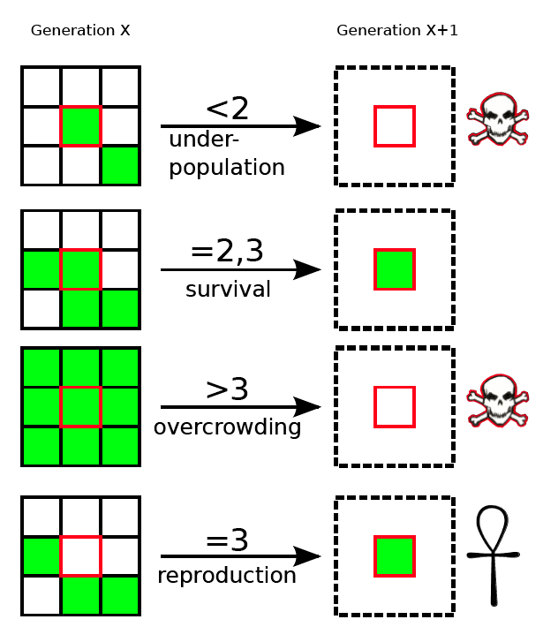
Acceptance Criteria
Scenario: Cells come alive, then die off
Given the following board
| 💀 | 💀 | 💀 | 💀 | 💀 |
| 💀 | 💀 | 💀 | 💀 | 💀 |
| 💀 | 😊 | 😊 | 😊 | 💀 |
| 💀 | 💀 | 💀 | 💀 | 💀 |
| 💀 | 💀 | 💀 | 💀 | 💀 |
When I evolve the universe
Then I should see the following board
| 💀 | 💀 | 💀 | 💀 | 💀 |
| 💀 | 💀 | 😊 | 💀 | 💀 |
| 💀 | 💀 | 😊 | 💀 | 💀 |
| 💀 | 💀 | 😊 | 💀 | 💀 |
| 💀 | 💀 | 💀 | 💀 | 💀 |
When I evolve the universe
Then I should see the following board
| 💀 | 💀 | 💀 | 💀 | 💀 |
| 💀 | 💀 | 💀 | 💀 | 💀 |
| 💀 | 😊 | 😊 | 😊 | 💀 |
| 💀 | 💀 | 💀 | 💀 | 💀 |
| 💀 | 💀 | 💀 | 💀 | 💀 |

Slide 26
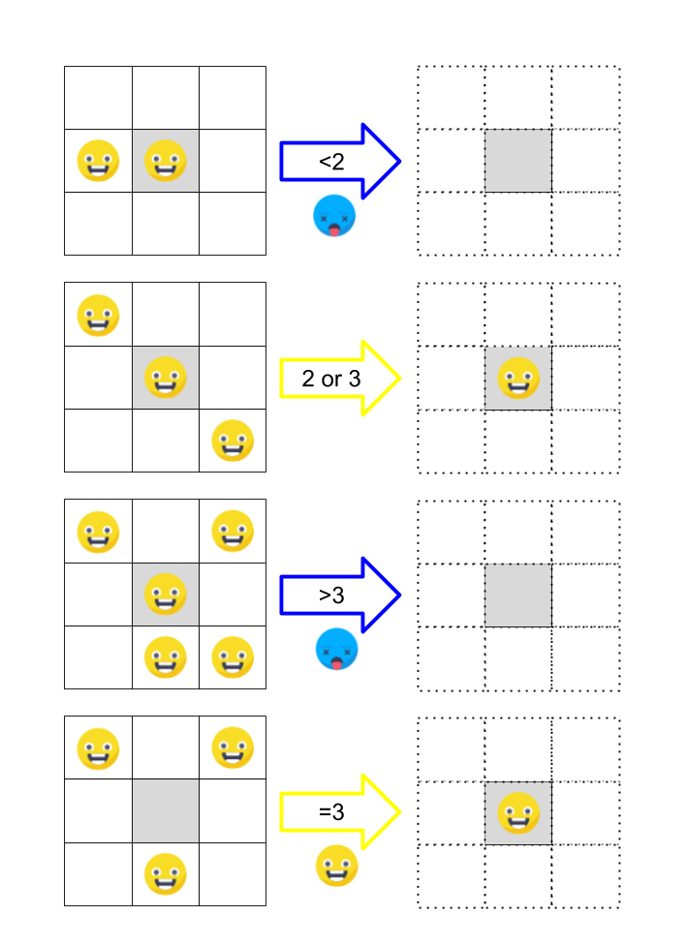
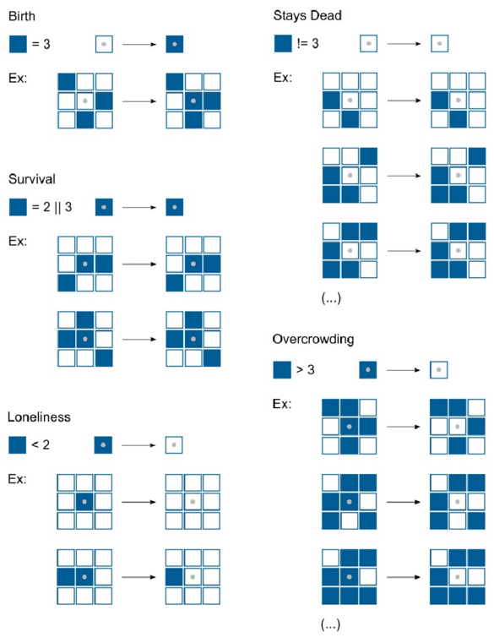

Slide 27
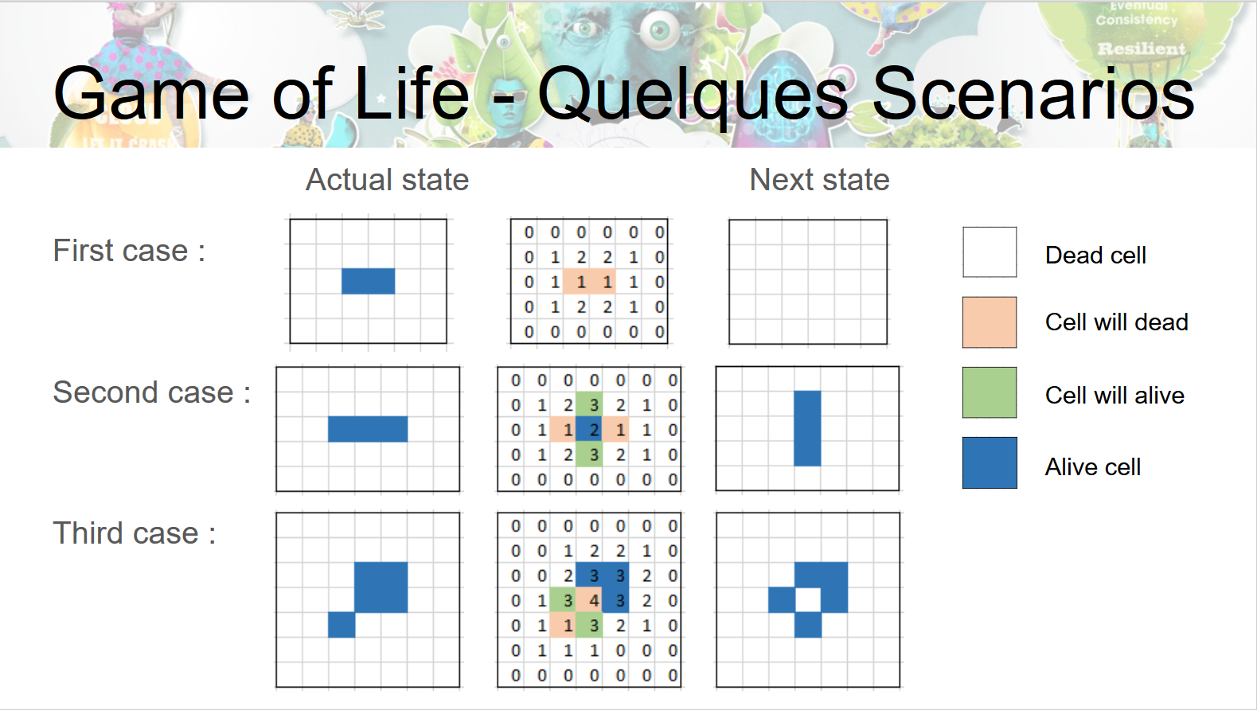

Slide 28
SPRINT BACKLOG

Slide 29
TO DO

Slide 30
BLOCKED

Slide 31
DOING

Slide 32
VALIDATION

Slide 33
DONE

Slide 34
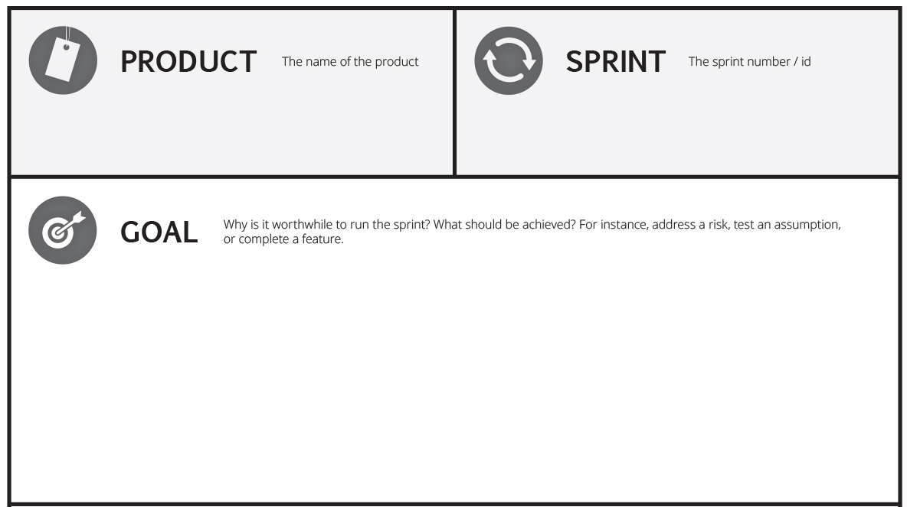

Slide 35
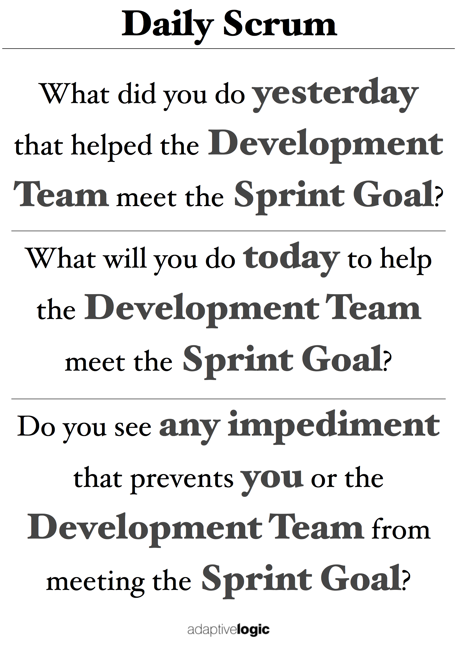
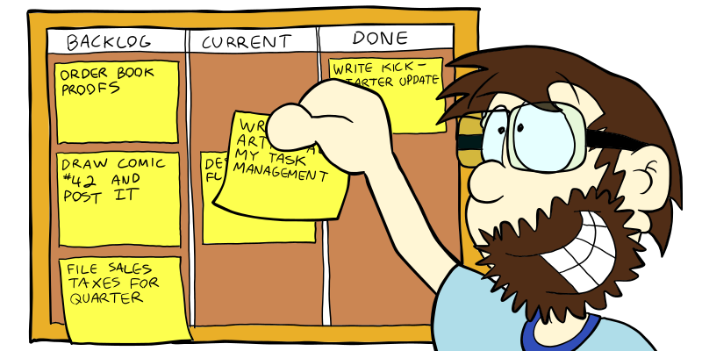
TIME
TIME
TIME
TIME

Slide 36








Team Members

Slide 37
DESIGN
BUILDING
ASSEMBLY
TEST

Slide 38
Story Points
Sprint
Team Velocity

Slide 39
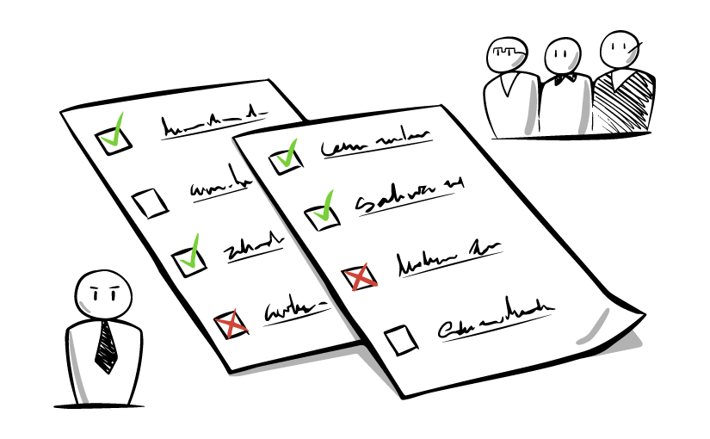

Definition of Done (DoD)

Slide 40


Slide 41

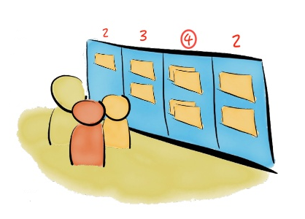
W.I.P.

Slide 42
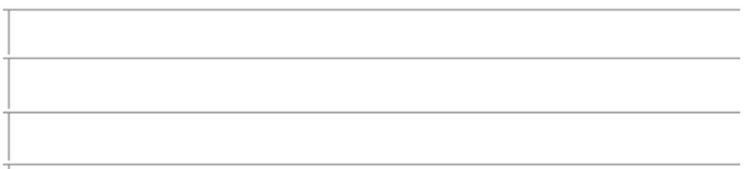
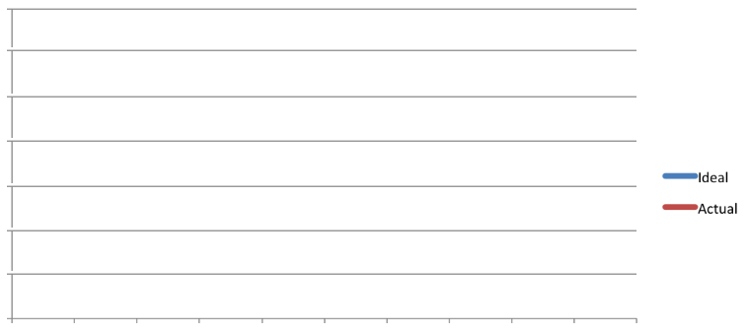


Sprint Burndown Chart

Slide 43
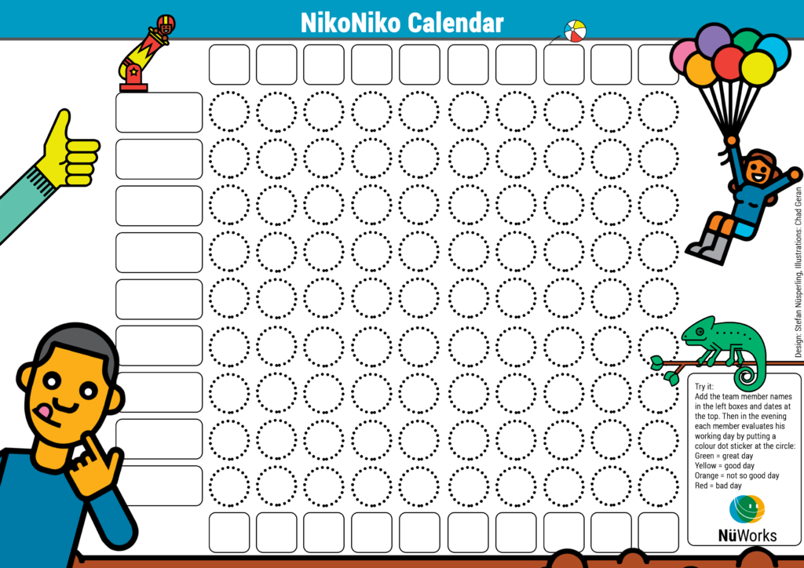

Slide 44
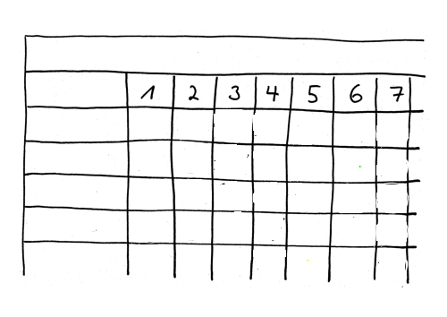
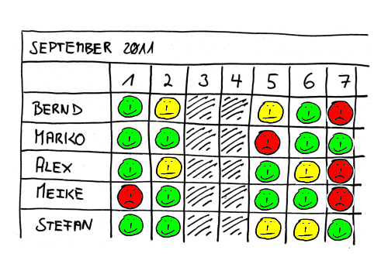

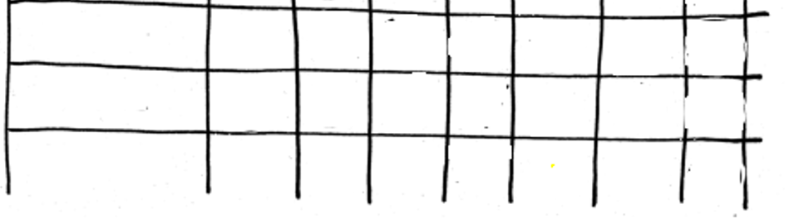
SPRINT 1

Slide 45
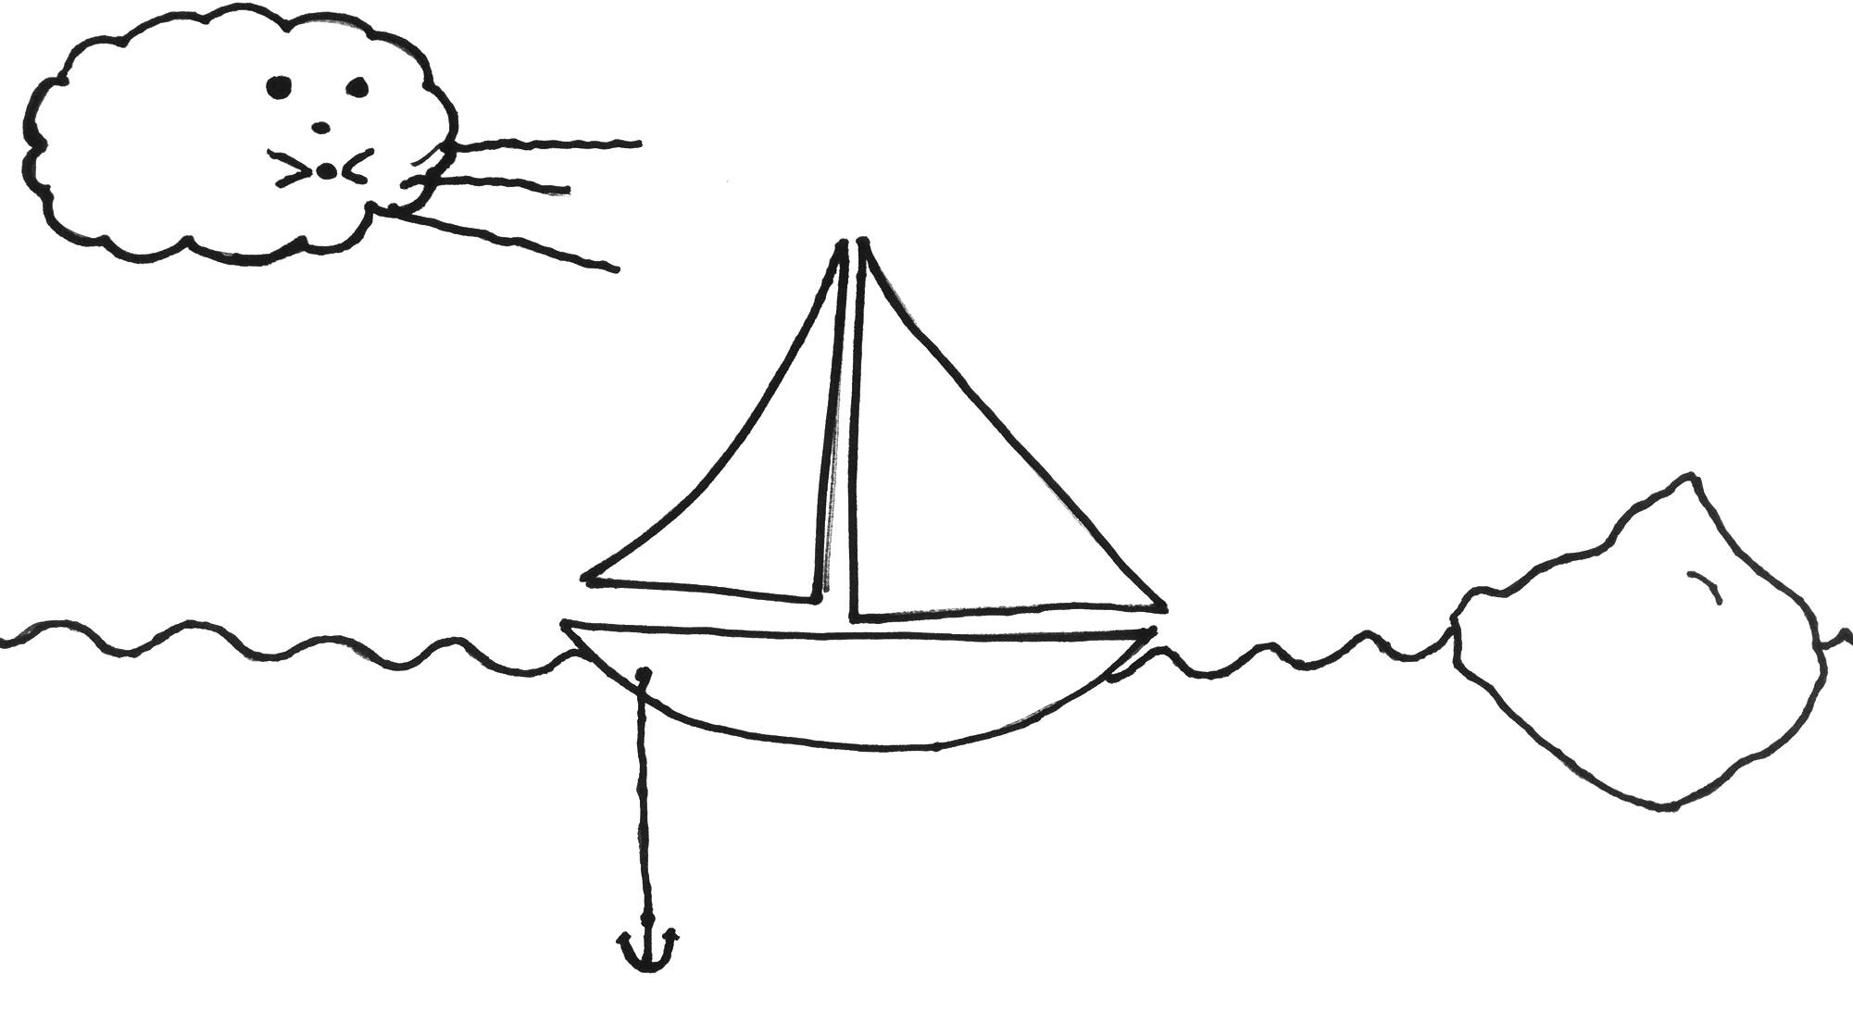

Slide 46


Slide 47
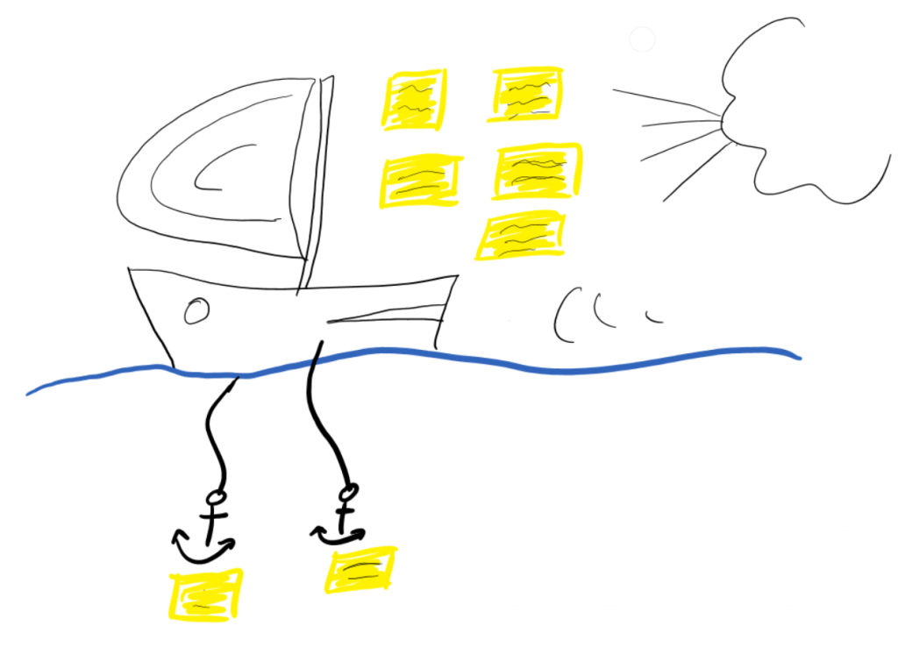

Slide 48
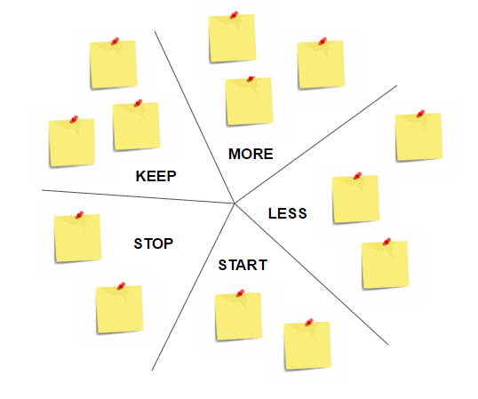

Slide 49




Slide 50
