Slide 1
Network Intrusions Detector (NID)
Project M05
Lucas Devanthery and Gary Folli
Github:

Slide 2
The dataset
KDD Cup 1999 dataset.
Used for the Third International Knowledge Discovery and Data Mining Tools Competition in 1999.
The dataset contains samples (4’898’430) representing network connections.
Each sample is made of 41 features that can be used to predict the correct label.
There are 23 different labels (normal, netptune attack, satan attack…) for 70 different type of network services (http, smtp, ftp...)
For more information: http://kdd.ics.uci.edu/databases/kddcup99/task.html

Slide 3
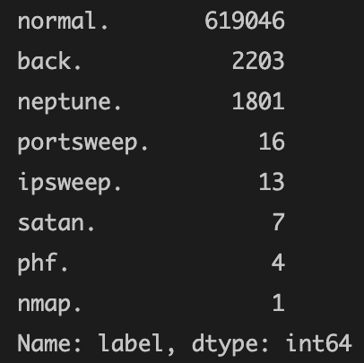
Our dataset
A subset of the original one.
Only the http service is kept. This represents 623’091 samples.
There are no more 70 different labels, but only 8 labels.
We merge all abnormal connections into a unique label.
Normal http connections
Label 0
Abnormal (intrusive) http connections
Label 1

Slide 4
The hypothesis
Statements:
There are 619’046 normal samples for 2’244 abnormal ones.
The abnormal ones represents 0.36% of the total http connections.
We believe it is possible to classify those connections using the 41 features available.
Hypothesis:
“We can achieve a good classification accuracy (> 90% on the test set) between normal (0) and abnormal (1) http connections in order to build an automatic network intrusion http detector.”

Slide 5
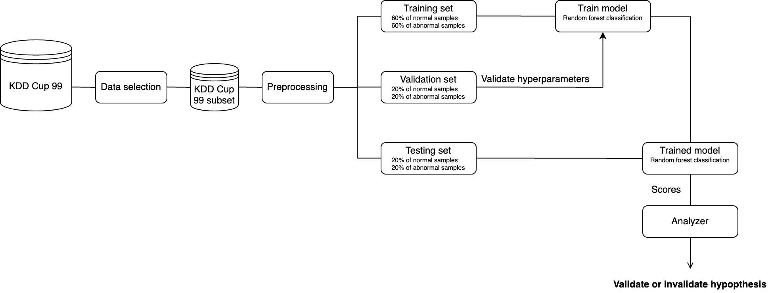
Framework organization

Slide 6
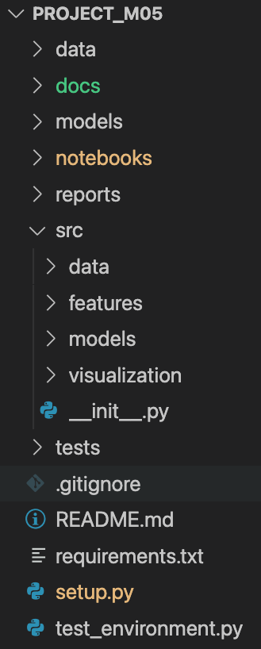
Project structure
Data files compressed
Documentation
Models in pickle format
Main pipeline of the project (preprocessing, training, evaluation…)
Reports and images of the final results
Python packages which are loaded and used in the pipeline notebook to modularize the code
Unit testing
Used to load src modules using pip install
Script to test if the environment meets the project requirements

Slide 7
Unit testing

