Slide 1
Network Intrusions Detector (NID)
Project M05
Lucas Devanthery and Gary Folli
Github:
https://github.com/gatrikh/project_m05

Slide 2
The dataset
KDD Cup 1999 dataset.
Used for the Third International Knowledge Discovery and Data Mining Tools Competition in 1999.
The dataset contains samples (4’898’430) representing network connections.
Each sample is made of 41 features that can be used to predict the correct label.
There are 23 different labels (normal, netptune attack, satan attack…).
For more information: http://kdd.ics.uci.edu/databases/kddcup99/task.html

Slide 3
The hypothesis
Statements:
In the 23 labels, 1 label is representing a normal connection and 22 a type of network attack.
The normal connections represent 20% of the samples of the whole set.
We believe it is possible to classify those connections using the 41 features available.
Hypothesis:
“We can achieve a good classification accuracy (> 95% on the test set) in classifying the network connections into the correct labels.”

Slide 4
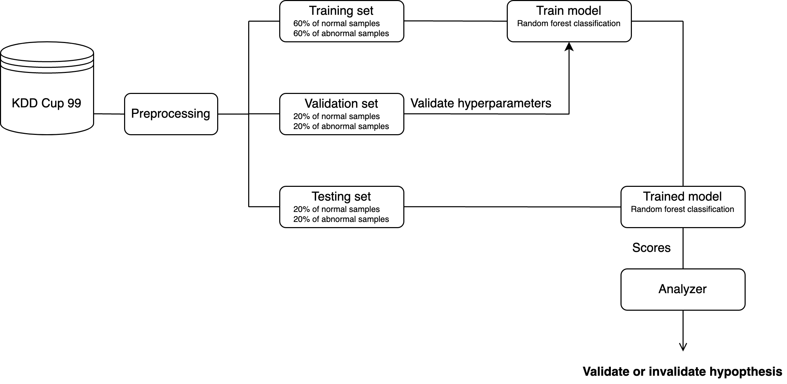
Framework organization

Slide 5
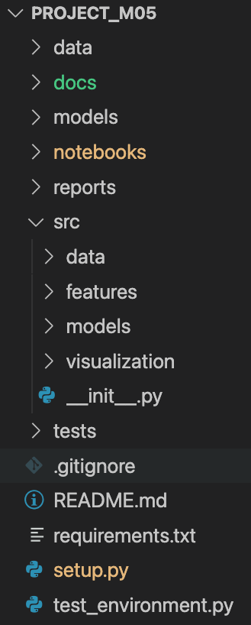
Project structure
Data files compressed
Documentation
Models in pickle format
Main pipeline of the project (preprocessing, training, evaluation…)
Reports and images of the final results
Python packages which are loaded and used in the pipeline notebook to modularize the code
Unit testing
Used to load src modules using pip install
Script to test if the environment meets the project requirements

Slide 6
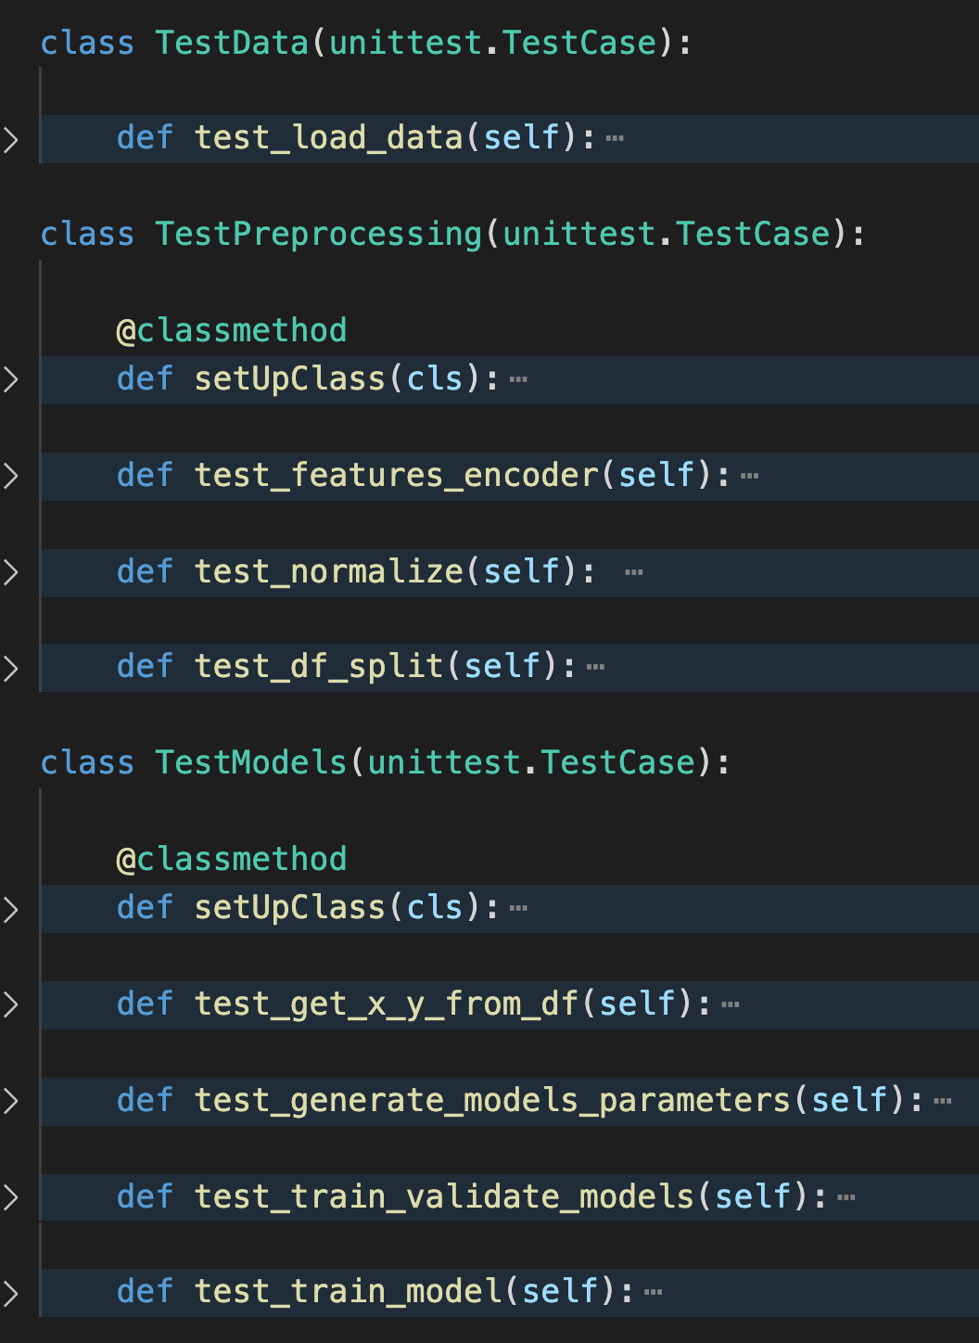
Unit testing
The Unittest runner is used but we plan to switch to Pytest.
One class of tests per module.
Each class contains many tests aiming to cover 100% of the code.

Slide 7
Plan
Current situation:
The functional part of the project (preprocessing and training) is finished.
The testing part is almost done.
Next steps:
Results analysing.
Tests improvement with Pytest.
CI/CD integration.
Documentations.

