Slide 1
Network Intrusions Detector (NID)
Project M05
Lucas Devanthery and Gary Folli
Github:
https://github.com/gatrikh/project_m05

Slide 2
The dataset
KDD Cup 1999 dataset.
Used for the Third International Knowledge Discovery and Data Mining Tools Competition in 1999.
The dataset contains approximately 5 millions of samples representing network connections.
Each sample is made of 41 features that can be used to predict the correct label.
There are 23 different labels (normal, netptune attack, satan attack…).
For more information: http://kdd.ics.uci.edu/databases/kddcup99/task.html

Slide 3
The hypothesis
Statements:
In the 23 labels, 1 label is representing a normal connection and 22 a type of network attack.
The normal connections represent 20% of the samples of the whole set.
We believe it is possible to classify those connections using the 41 features available.
Hypothesis:
“We can achieve a good classification accuracy (> 90% on the test set) in classifying the network connections into the correct labels.”

Slide 4
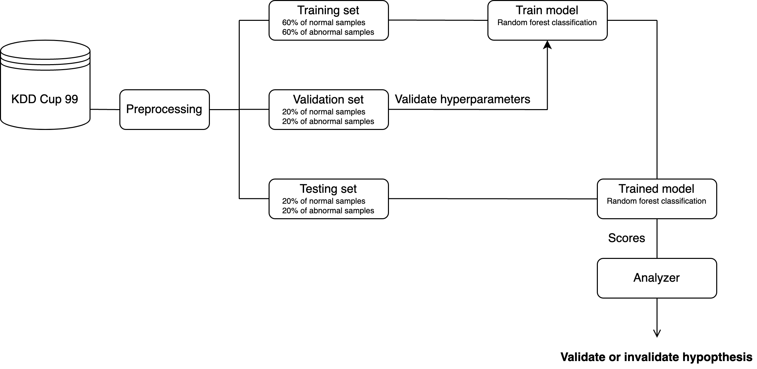
Framework organization

Slide 5
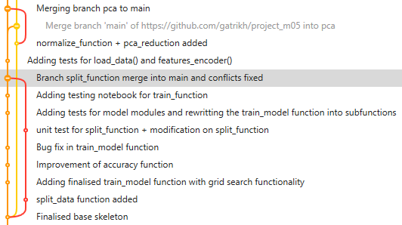
Version control
Github is used.
Branch are created for all new features.
Once ready and tested, branches are merged into the main branch and deleted.

Slide 6
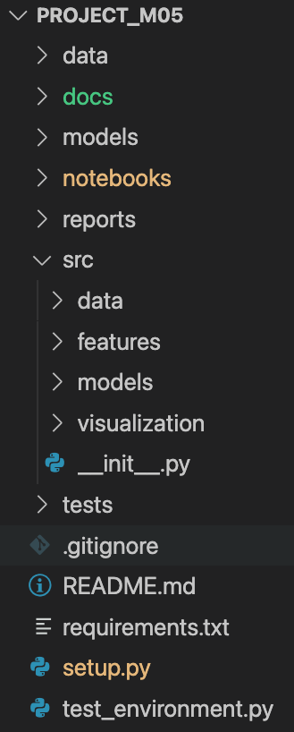
Project structure
Data files compressed
Documentation
Models in pickle format
Main pipeline of the project (preprocessing, training, evaluation…)
Reports and images of the final results
Python packages which are loaded and used in the pipeline notebook to modularize the code
Unit testing
Used to load src modules using pip install
Script to test if the environment meets the project requirements

Slide 7
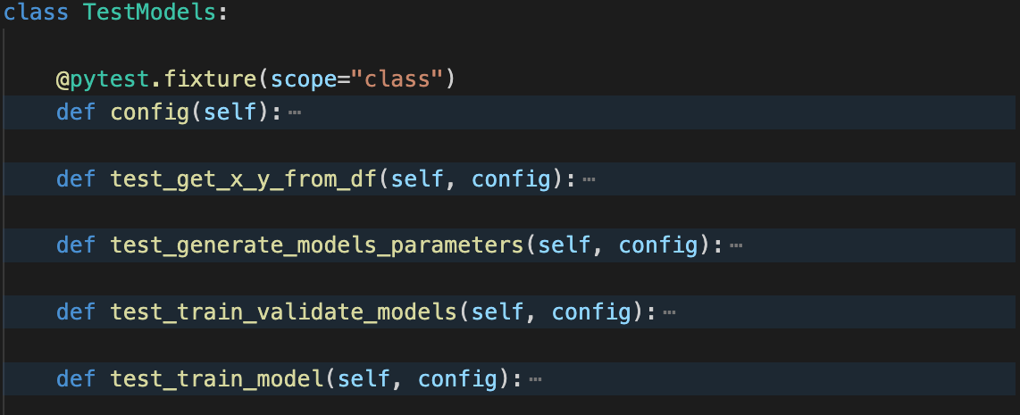
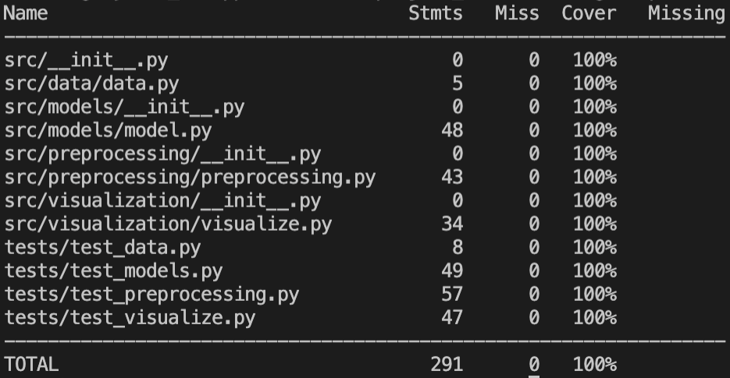
Unit testing
The Pytest runner is used.
One file per class of tests per module.
100% of code covering.

Slide 8
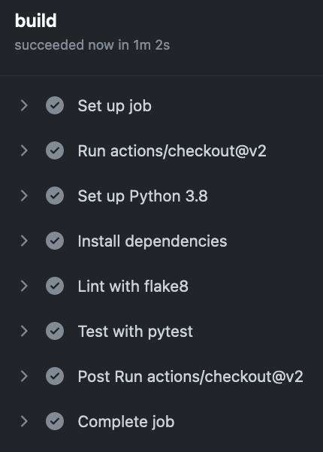
Continuous integration
Docker image created.
An ubuntu virtual machine with python 3.8 is set up with the required dependencies.
The tests are run and if one failed, an email is sent to the project authors.

Slide 9
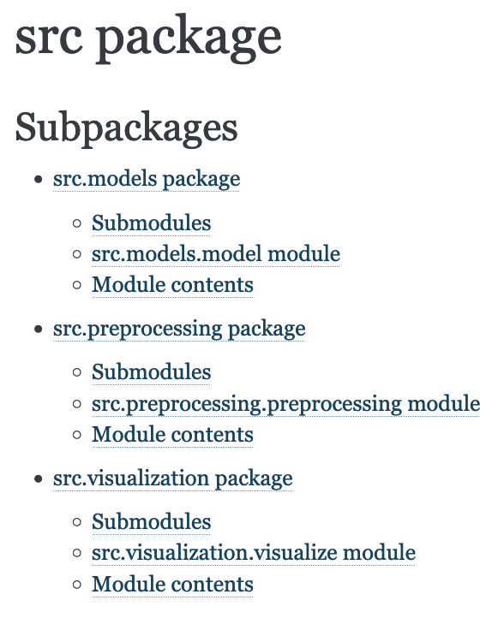
Documentation
Documentation created with Sphinx in HTML format.
README.md file created in Github repository.

Slide 10
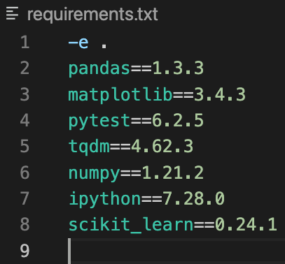
Package and deployement
A file named ”test_environment.py” is executed to check the basic python requirements.
The project and its dependencies are deployed using pip with a requirements.txt file.
The tests must be run to ensure the full project functionalities.

Slide 11
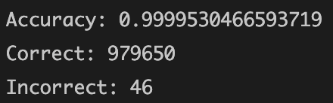
Conclusions and results
On a test set with 20% of the total samples, we achieve a final accuracy of 0.9999%.
The initial hypothesis is thus verified.

