Slide 1
SQL작성
전경환

Slide 2
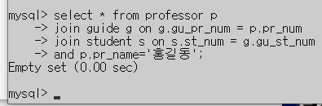
문항8 Q1
mysql> select * from professor p
-> join guide g on g.gu_pr_num = p.pr_num
-> join student s on s.st_num = g.gu_st_num
-> and p.pr_name='홍길동';
Empty set (0.00 sec)

Slide 3
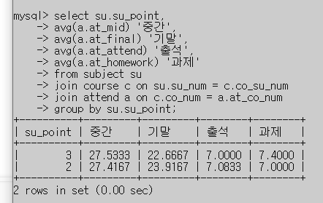
문항8 Q2
select su.su_point,
avg(a.at_mid) '중간',
avg(a.at_final) '기말',
avg(a.at_attend) '출석',
avg(a.at_homework) '과제'
from subject su
join course c on su.su_num = c.co_su_num
join attend a on c.co_num = a.at_co_num
group by su.su_point

Slide 4
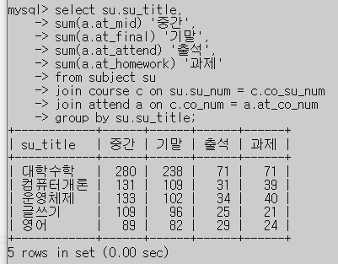
문항8 Q3
select su.su_title,
sum(a.at_mid) '중간',
sum(a.at_final) '기말',
sum(a.at_attend) '출석',
sum(a.at_homework) '과제'
from subject su
join course c on su.su_num = c.co_su_num
join attend a on c.co_num = a.at_co_num
group by su.su_title

Slide 5
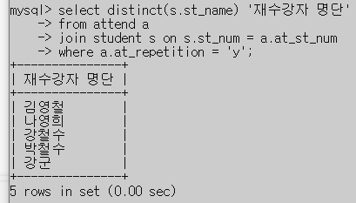
문항8 Q4
select distinct(s.st_name) '재수강자 명단'
from attend a
join student s on s.st_num = a.at_st_num
where a.at_repetition = 'y';

Slide 6
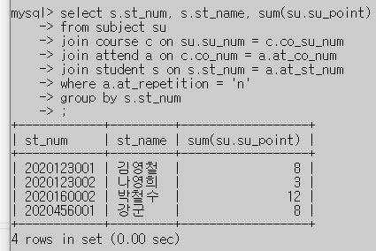
문항8 Q5
select s.st_num, s.st_name, sum(su.su_point)
from subject su
join course c on su.su_num = c.co_su_num
join attend a on c.co_num = a.at_co_num
join student s on s.st_num = a.at_st_num
where a.at_repetition = 'n'
group by s.st_num;

Slide 7
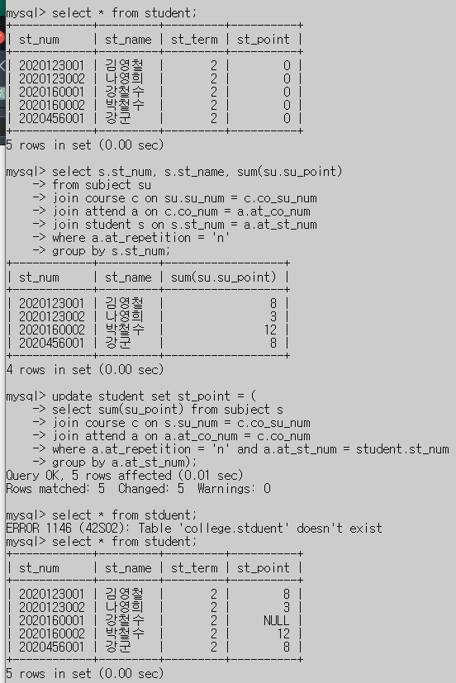
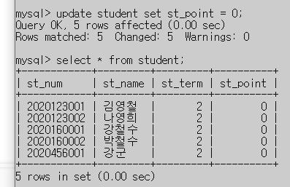
문항8 Q6
update student set st_point = (
select sum(su_point) from subject s
join course c on s.su_num = c.co_su_num
join attend a on a.at_co_num = c.co_num
where a.at_repetition = 'n' and a.at_st_num = student.st_num
group by a.at_st_num);

Slide 8
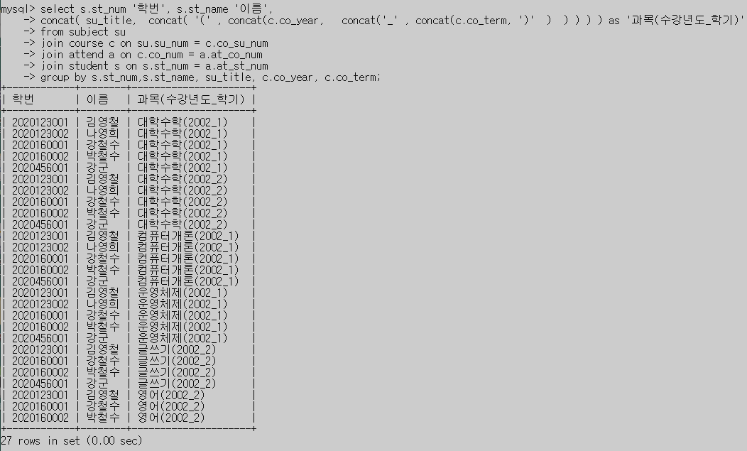
문항8 Q7
select s.st_num '학번', s.st_name '이름',
concat( su_title, concat( '(' , concat(c.co_year, concat('_' , concat(c.co_term, ')' ) ) ) ) ) as '과목(수강년도_학기)'
from subject su
join course c on su.su_num = c.co_su_num
join attend a on c.co_num = a.at_co_num
join student s on s.st_num = a.at_st_num
group by s.st_num,s.st_name, su_title, c.co_year, c.co_term;

Slide 9
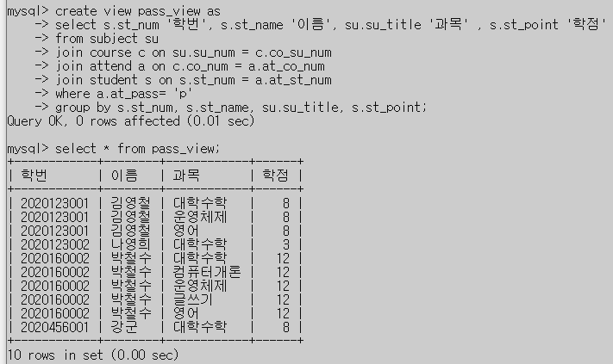
문항8 Q8
create view pass_view as
select s.st_num '학번', s.st_name '이름', su.su_title '과목' , s.st_point '학점'
from subject su
join course c on su.su_num = c.co_su_num
join attend a on c.co_num = a.at_co_num
join student s on s.st_num = a.at_st_num
where a.at_pass= 'p'
group by s.st_num, s.st_name, su.su_title, s.st_point;

Slide 10
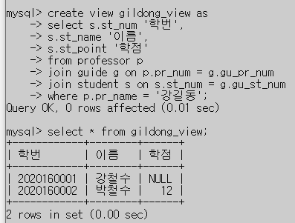
문항8 Q9
create view gildong_view as
select s.st_num '학번',
s.st_name '이름',
s.st_point '학점'
from professor p
join guide g on p.pr_num = g.gu_pr_num
join student s on s.st_num = g.gu_st_num
where p.pr_name = '강길동';

Slide 11
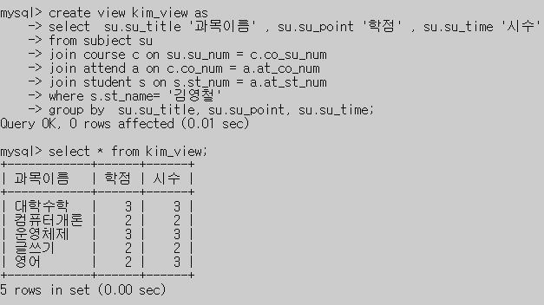
문항8 Q10
create view kim_view as
select su.su_title '과목이름' , su.su_point '학점' , su.su_time '시수'
from subject su
join course c on su.su_num = c.co_su_num
join attend a on c.co_num = a.at_co_num
join student s on s.st_num = a.at_st_num
where s.st_name= '김영철'
group by su.su_title, su.su_point, su.su_time;

